Slide 1
ERS Document Changes Associated with New SAS Implementation
DSWG – December 16, 2016

Slide 2
SAS Migration
ERCOT uses SAS as the software system for virtually all of our ERS processing
ERCOT is migrating our SAS platform from the current client/server environment to a grid computing environment
Migration to be complete prior to the October 2017/January 2018 Standard Contract Term
The migration is expected to entail minor coding changes for the most part
However, the DDE functionality we have been using to create Excel workbooks during the ERID and Award Notification processes will no longer be available
Since the returned EXCEL workbooks will have to be in a different format, ERS participants may want to consider modifying the current practice of using email/attachments as the basis for ERS submissions to ERCOT

Slide 3
ERS Data Submission Options
NAESB … is currently in use for the REP Demand Response Survey and Loads in SCED v 1
  File submissions are encrypted
  Also used for most of the Retail Market data exchange as the transport mechanism for TX Set transactions
  ERCOT expects to be changing the processing system (Paperfree) on our end, so the timing may not be ideal to add new functionality in the near term
  Does require licensing or agreement with a service provider
ERCOT has a project in the works, MP Online, targeting the Resource Asset Registration Form (RARF), to create a secure process for submitting and validating registration data
  May be able to leverage this project to include ERS data submissions
Continue submitting with email

Slide 4
Modifications of ERS File Formats
Regardless of file submission process, the files returned by ERCOT to ERS participants during the ERID and award notice will have to change (also applies to substitutions, supplementals, reinstatements)
No changes for test analysis, contract performance, settlement reports
Can continue returning EXCEL files or could be another format e.g. .csv but would change to column oriented formats
EXCEL ERID example Eliminate ‘Identification’, ‘Contract Hours’, and ‘R’ tabs
    ‘Submittal Type’ value is the only ERCOT created field, but is marginally useful
    ‘Contract Hours’ tab would remain on posted form, and does not need to be sent back
    ‘R’ tab would remain on posted form, and does not need to be sent back
  ‘Exceptions’, ‘Availability’ and ‘Baseline_Info’ tabs -- no change

Slide 5
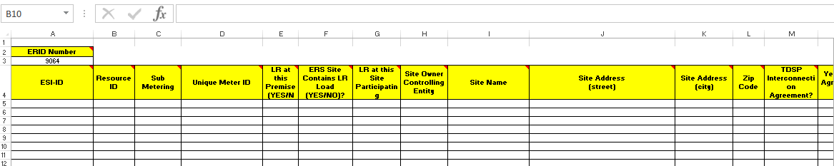
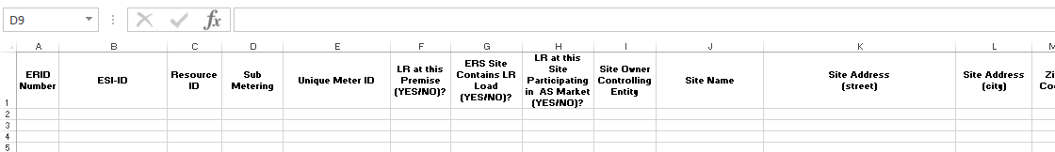
Modifications of ERS File Formats
EXCEL example ERID (continued)
  Modify the ‘ALT’ tab
    Eliminate the ‘ERID Number’ cells (A2 and A3)
    Insert a column on the left (left of the ESIID column) with title ‘ERID Number’
    Comments (red triangle) and highlighting eliminated
    All other columns remain and stay in same order
Current
Proposed

Slide 6
Modifications of ERS File Formats
EXCEL example ERID (continued)
  Split resource tab into two tabs
    Resource Information tab … tab name ‘resource name_RES’
    Site information tab … tab name ‘resource name_SITE’
    Comments (red triangle) and highlighting eliminated
    Drop-down lists eliminated
    Resource Information shifted into column orientation

Slide 7
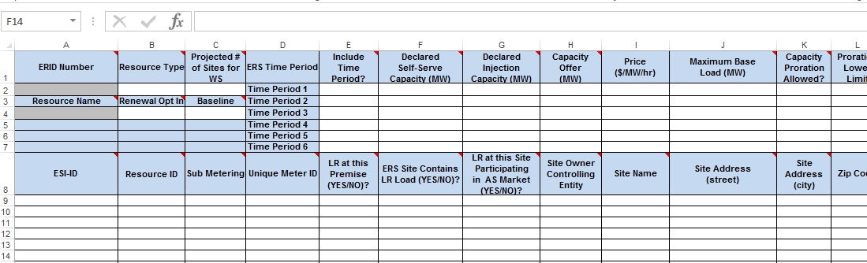
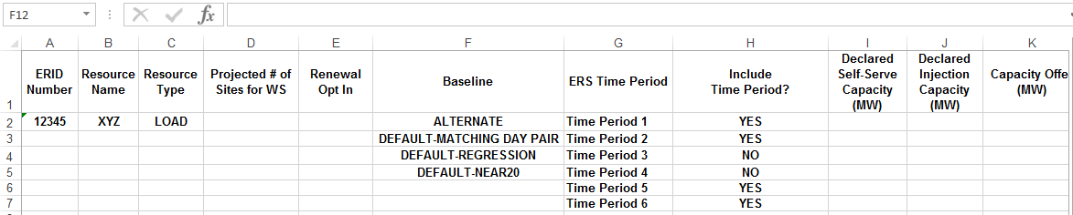
Modifications of ERS File Formats
EXCEL example ERID (continued)
Current
Proposed
Resource
Info

Slide 8
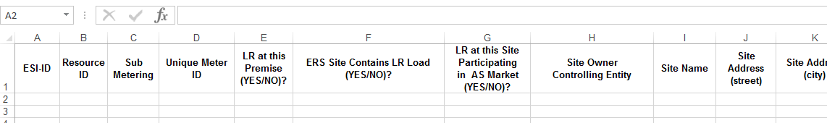
Modifications of ERS File Formats
EXCEL example ERID (continued)
Current
Proposed
Site Info

Slide 9
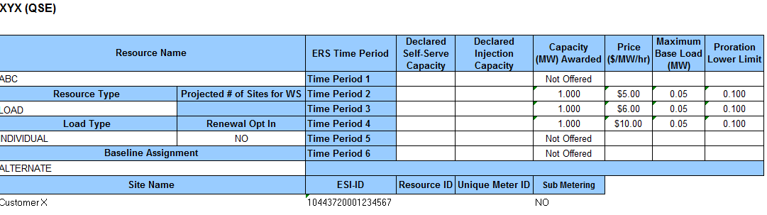
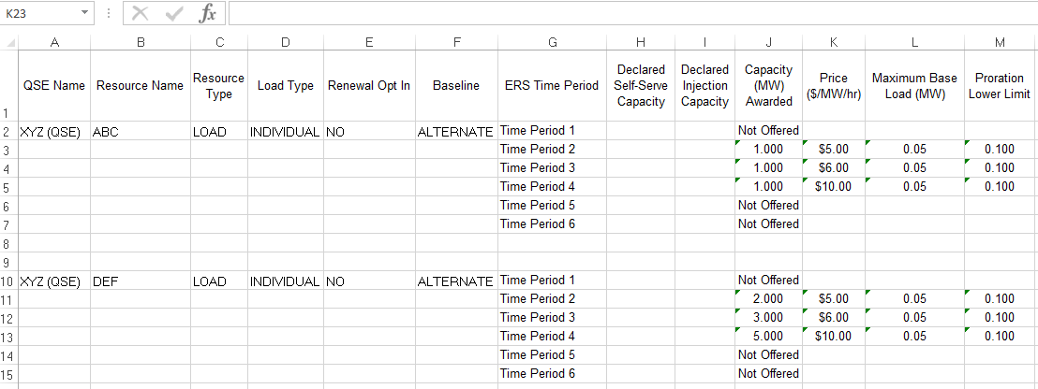
Modifications of ERS File Formats
EXCEL example Award notice
  Resource Information shifted into column orientation
  Eliminate Site information and highlighting
Current
Proposed
Site Info

Slide 10
Next Steps
ERCOT will schedule a conference call for ERS participants and DSWG to discuss options early next year
Changes will need to be identified soon thereafter to give ERCOT and participants time to make system changes
ERCOT could produce files with the new format to allow participants time to test … perhaps with June-September 2017 procurement

Slide 11
Questions?
ON
OFF

