Slide 1
Reporting of Energy Efficiency in the CDR
Pete Warnken / Calvin Opheim
December 16, 2016

Slide 2
Reporting Requirement
CDR reporting requirement:
Historical energy efficiency trend is embedded in the Long Term Load Forecast; future deviations of that historical trend are not

Slide 3
Reporting Requirement (continued)
EE is now reported separately, starting with the latest CDR report (released December 15)
EE still embedded in the forecast
Treated as a net-to-gross amount, starting with the original load forecast

Slide 4
EE Forecasting Method
EE forecast uses PUCT's most recent annual verified energy efficiency program savings estimate as the starting point.
Annual incremental growth in EE savings calculated by multiplying ERCOT's peak load forecast by an energy efficiency penetration factor.

Slide 5
EE Forecasting Method (continued)
EE penetration factor is 0.0018
Unadjusted penetration rate is 0.4% of total load for all residential and commercial consumers, per Utilities Code Section 39.905(3)(B)(i).
90% adjustment applied to represent the proportion of the total load forecast that is commercial and residential customers.
50% adjustment applied to account for actual program effectiveness and program savings that may already be accounted for in the load forecast model.

Slide 6
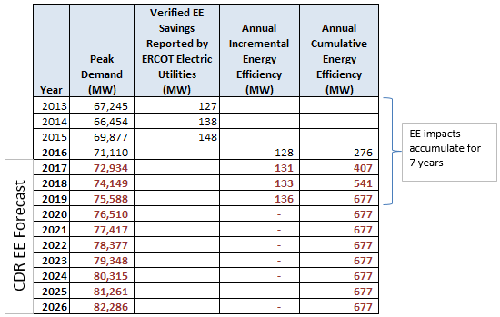
EE Forecasting Method (continued)
EE impacts from meeting Legislature's goals assumed to accumulate for seven years from the time that the annual goals must first be met (December 31, 2013).

Slide 7
Reporting Results
Excerpt of the December CDR draft report, showing load forecast and adjustments* (Summer Summary tab)
* Although the load forecast and adjustment results are “final”, the overall CDR report was in draft form at the time of slide preparation.

