Slide 1
Coordinated Operation of Electric and Natural Gas Supply Networks: Optimization Processes and Market Design (ARPA-E OPEN-15) Presented at the ERCOT Emerging Technologies Working Group (ETWG) Meeting December 6, 2016, Austin, TX
Gas-Electric Co-Optimization (GECO)

Slide 2
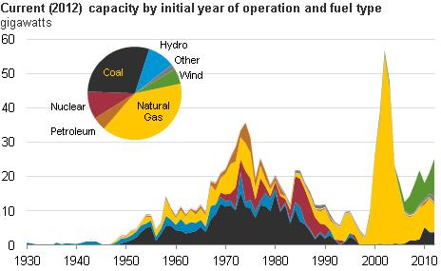
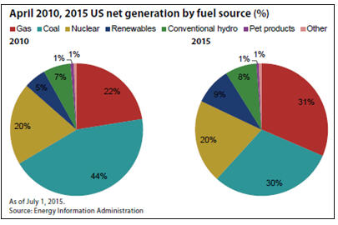
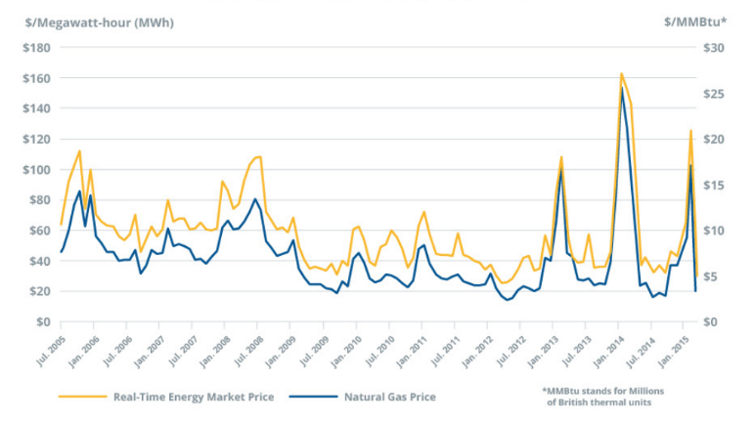
Motivation: reliable fuel supply to gas-fired power plants
Gas-fired power generation is expanding:
Fast to permit, fast to build
Economic & environmental advantages
Replacing retiring coal & nuclear
Gas pipeline loads are changing:
Increasing in volume & variation
More intermittent & uncertain
Regulatory environment is evolving:
FERC 787— need for information sharing
FERC 809— market timing and coordination
Markets converging:
Gas-fired generation sets prices for electricity
Gas use for electric generation sets prices for gas

Slide 3
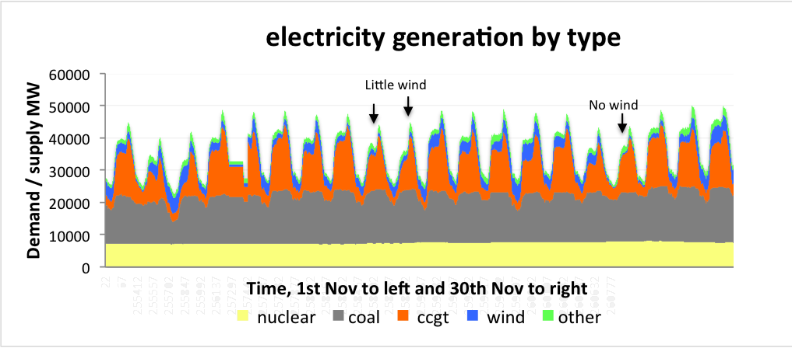
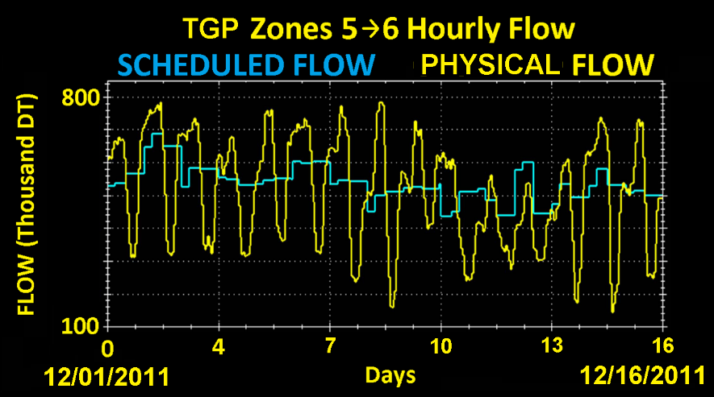
Motivation: new challenges to intra-day gas pipeline operations
Gas-fired generation fills power demand curve:
Power plants activate and shut down daily
Gas markets & flow schedules by static models cause mismatch of scheduled & observed flows
Challenges to intra-day pipeline operations:
Variability: intra-day dynamic flows that change daily with power-plant schedules
Coordination: “burn sheets” & real-time information must be shared
Uncertainty: power grid operations change quickly and unpredictably
Integration: gas markets, flow scheduling, & physical operations done separately
Economics: lack of meaningful economic signals exchanged between gas and power systems

Slide 4
The Opportunity
Recent advancements in numerical modeling and optimization methods of pipeline network transients create opportunity to:
change practical methods and algorithms of pipeline operations
Develop pricing of natural gas that is consistent with physics of the gas flow
Use novel optimization methods and pricing mechanisms to improve coordination of gas and electric systems
This will improve efficiency, reliability and economic performance of both gas and electric markets

Slide 5
GECO Team
Institution | Expertise
 | Enelytix® environment for parallel modeling and analytics of energy systems. Data structures. Optimal pricing, market design, commercialization
 | Advanced computational methods and algorithms for simulation and optimization of gas & electric networks
 | Advanced power systems simulator native to NEG cloud platform. Power systems optimization expertise
 | Market design, market coordination, algorithms
 | Modeling language, optimization
 | Pipeline operation, market expertise and information
 | Power system operation, market expertise and information

Slide 6
Objectives
The project develops new technology:
novel methods, algorithms and software for transient simulation modeling and dynamic optimization of natural gas pipeline network operation day-ahead and intra-day with sub-hourly granularity
a novel mechanism for pricing of natural gas delivered to end users and in particular to gas-fired power plants; and
Market design proposal for coordinating natural gas and electric operations both day ahead and in real-time, based on locational prices of natural gas and electricity

Slide 7
Project Objectives and Implications
Algorithmic Structures | Market Design
Co-optimization of physical systems | Coordination of gas and electric markets
 | Current Technology | GECO Technology
Pipeline operation control methods | Primarily steady state modeling with "rule-based" compressor operations. Transient analysis performed in reliability context | Fast dynamic optimization of compressor operations incorporating transient effects
Primary objectives of pipeline operation | Maintaining security at least cost of compressor operations | Maintaining security at least cost of meeting system demand
Price formation mechanisms | Daily on weekdays only. Prices formed by traders at certain pipeline delivery points. Prices do not reflect intra-day pipeline operational constraints | Hourly 24/7 at each pipeline node. Prices formed by the optimization engine and are consistent with engineering and physics of pipeline operations
Coordination
Scheduling | Daily quantity over a standard day. Intra-day profiling is opaque | Transparent intra-day scheduling
Receipt and delivery points | Rigid, based on priorities as specified in the shipping contract | Flexible, based on locational prices
Delivery guarantee | No guarantee for interruptible service customers | Economic mechanism to guarantee structured price/quantity delivery

Slide 8
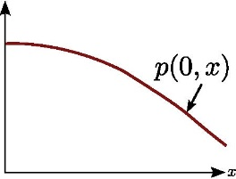
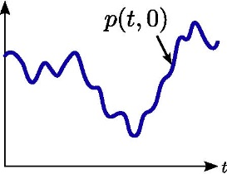
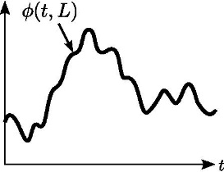
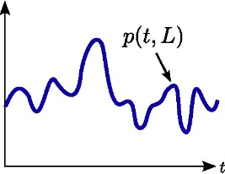
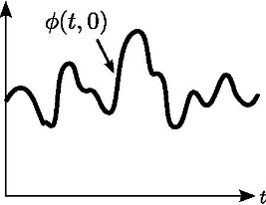
Gas Pipeline Simulation: meaning & state of the art
Gas Pipeline Simulation: meaning & state of the art
Simulation: an initial value problem (IVP)
State: instantaneous condition of system
Parameters: initial state, boundary conditions
Start with initial state and evolve forward in time
Pipeline simulation:
Given operating protocols of compressors, predict future flow & pressure based on physics
At a space point, state is time-dependent trajectory (e.g. pressure as function of time)
State of the art:
Highly developed, sophisticated physics & engineering models, e.g., precise to < 1 psi
Initial Pressure
Inlet Pressure
Outlet Flow
Pipeline Simulation
Outlet Pressure
Inlet Flow

Slide 9
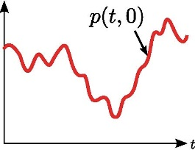
Gas Pipeline Transient Optimization: meaning & state of the art
Optimization: an optimal control problem (OCP)
State: instantaneous condition of system
Parameters: initial state, boundary conditions
Controls: parameters that can be chosen
Find controls & state as functions of time $t∈\left[0,T\right]$ that satisfy feasibility & physics constraints while minimizing a cost objective
Pipeline Optimization:
Given consumptions & pressure at a “slack” junction, compute compressor controls to minimize compressor power or maximize throughput
State of the art: long-standing and current challenge
New tractable & scalable method from LANL
Transient Optimization
Initial Pressure
Control: Inlet Pressure
Outlet Flow
Pipeline Simulation
Feasible Outlet Pressure
Feasible Inlet Flow

Slide 10
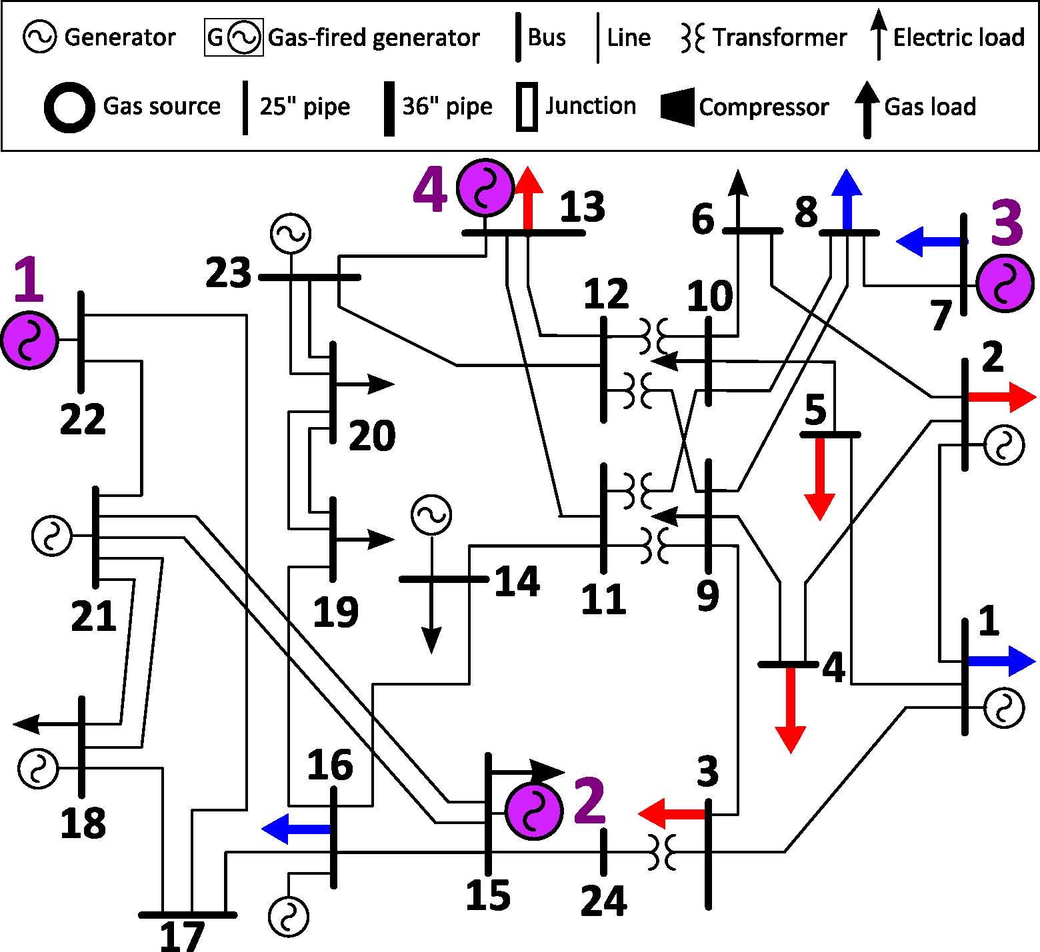
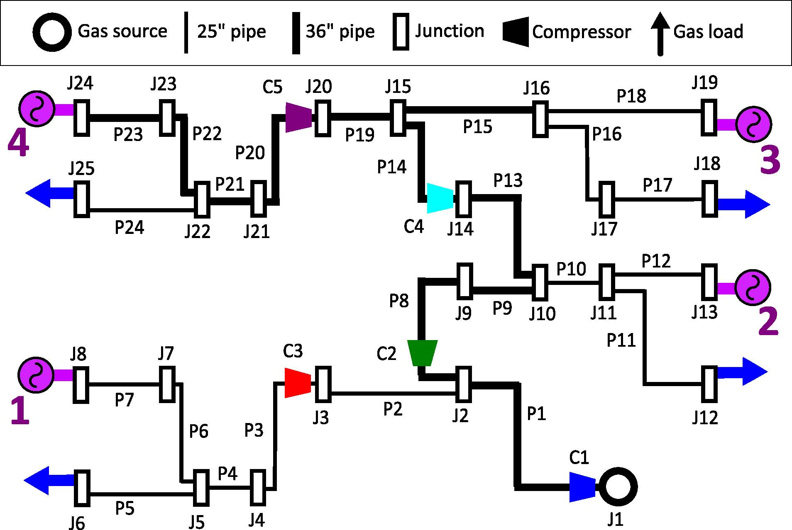
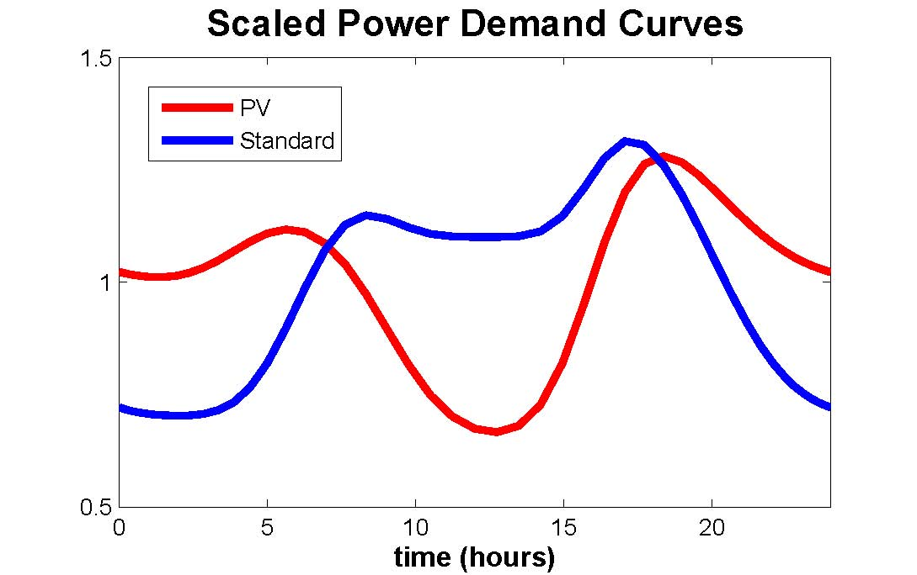
Intra-day gas-grid interdependency case study
Gas pipeline network model
Power system model
Dynamic constraints on gas availability
Simple model:
Fixed gas price $6/mmBTU,
Quadratic heat rate curves,
Quadratic generation cost curves
Interdependency Simulation &
Dynamic Gas-Grid Scheduling

Slide 11
Gas-grid coordination & co-optimization scenarios
3. Co-optimization (static)
4. Co-optimization (dynamic)
Pipeline model and data →
Grid operator
Goal for the future:
Both systems optimized together
Both systems secure and optimal
Grid operator acts based on
steady gas compressor operation
3
4
Combined
Gas feasible at high power system cost
COORDINATION
More Info & Computation
Static
Dynamic
1. Status Quo Systems and Markets
2. Dynamic Gas Flow Control
1
Separate
2
Gas-fired generator fuel schedule→ Pipeline operator
Gas-fired generator fuel schedule→ Pipeline operator
Pipeline operator uses steady state model for gas system, checks feasibility
OPERATION
(Gas System Control)
Optimal dynamic compressor operation
(new technology)
Gas pressure fluctuations, hidden costs
Improved efficiency for normal conditions

Slide 12
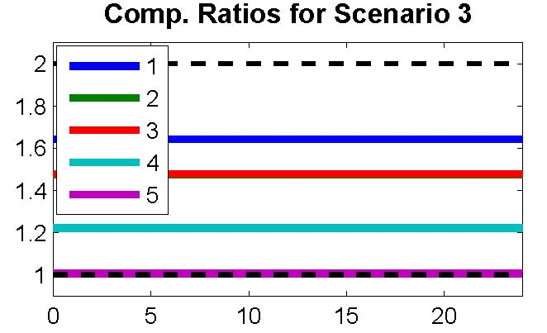
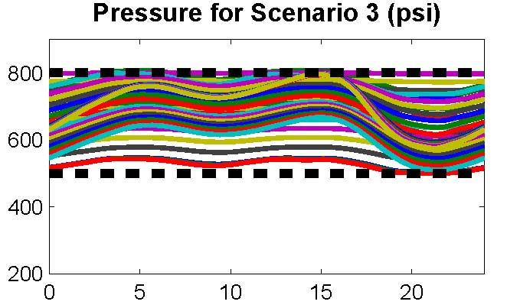
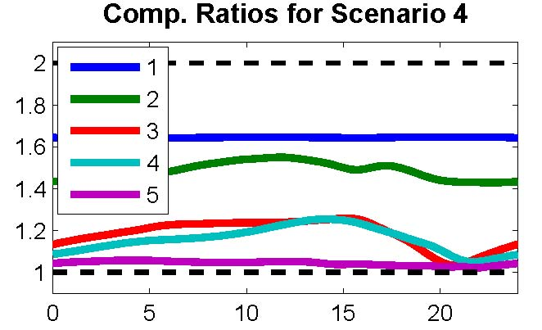
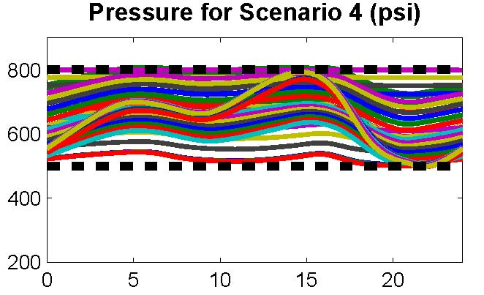
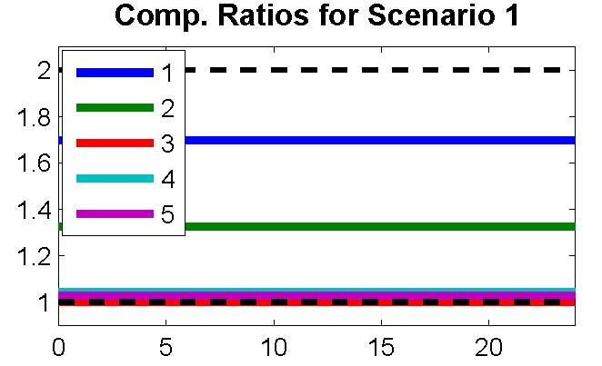
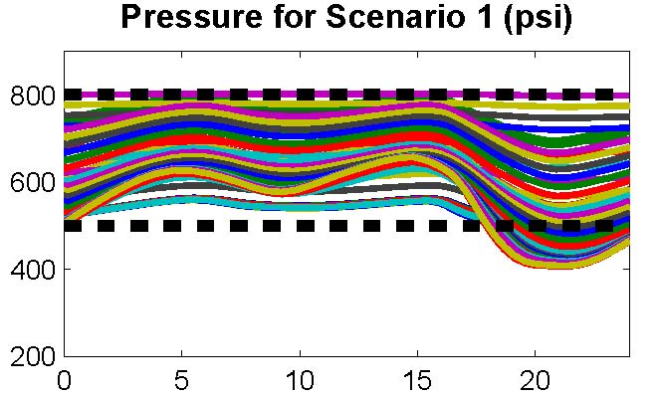
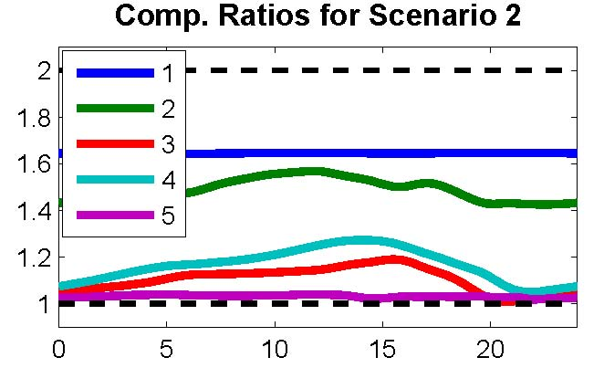
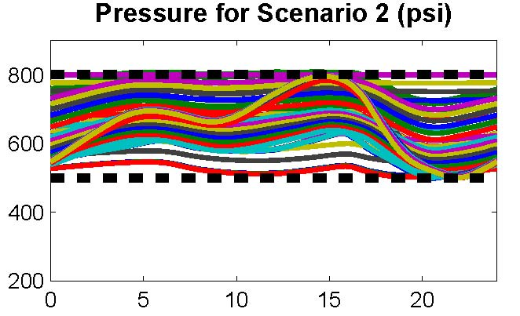
Benefits of Coordination & Information Exchange
Base Stress Case
3. Co-optimization (static)
4. Co-optimization (dynamic)
3
Combined
4
Generation Cost: $770,800; Gas Cost: $570,240
Generation Cost: $731,600;
Gas Cost: $581,200
COORDINATION
More Info & Computation
Static
Dynamic
1. Status Quo (Stressed)
2. Dynamic Gas Flow Control
1
Separate
2
OPERATION
(Gas System Control)
Generation Cost: $731,600;
Gas Cost: $581,600
Generation Cost: $731,600;
Gas Cost: $581,600

Slide 13
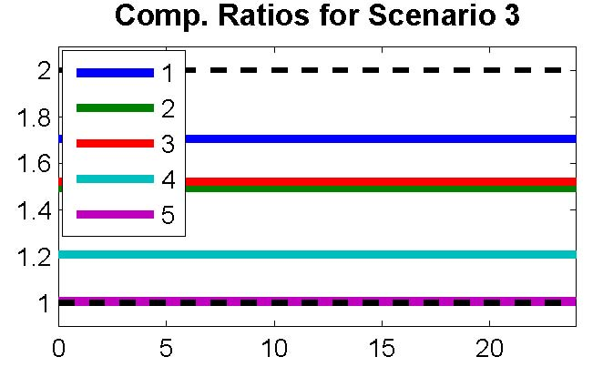
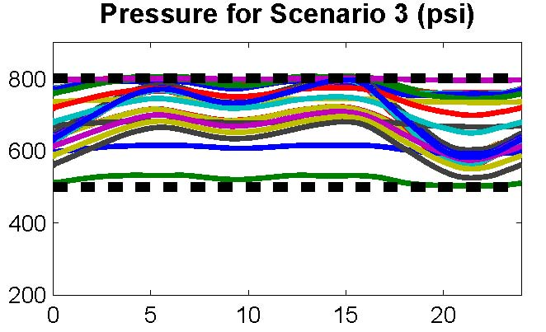
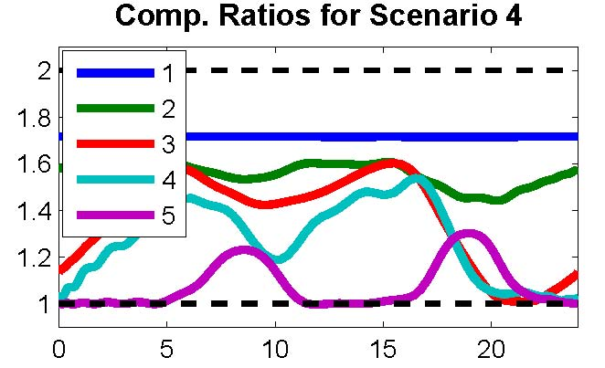
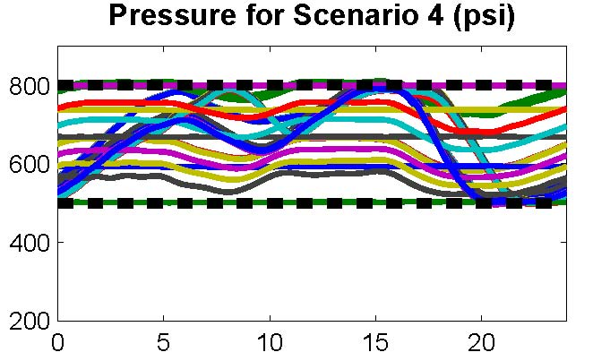
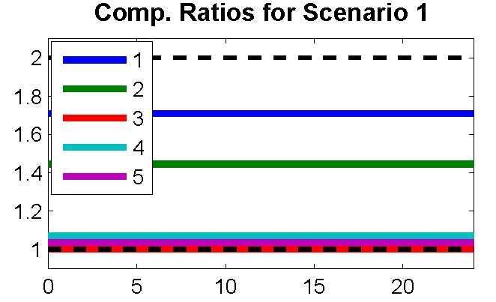
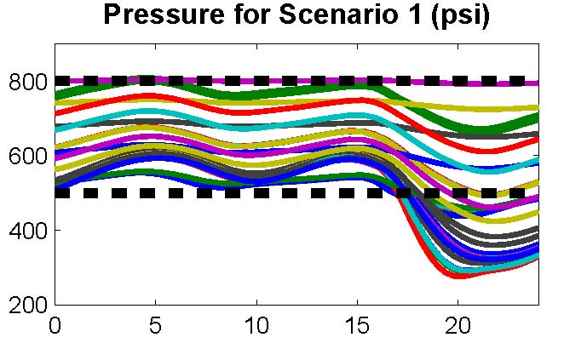
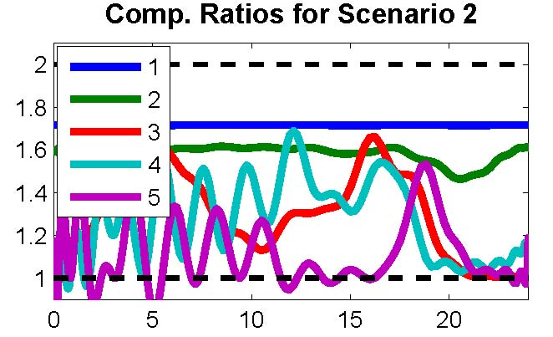
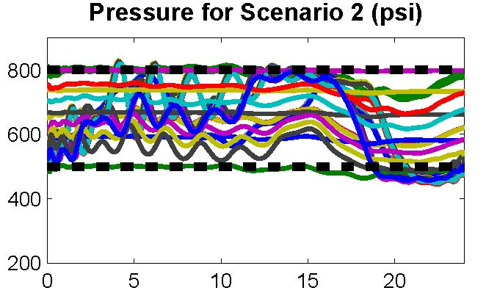
Benefits of Coordination & Information Exchange
High Stress Case
3. Co-optimization (static)
4. Co-optimization (dynamic)
3
Combined
4
Generation Cost: $1,025,000; Gas Cost: $602,300
Generation Cost: $888,300;
Gas Cost: $619,800
COORDINATION
More Info & Computation
Static
Dynamic
1. Status Quo (Stressed)
2. Dynamic Gas Flow Control
1
Separate
2
OPERATION
(Gas System Control)
Generation Cost: $825,600;
Gas Cost: $722,350
Generation Cost: $825,600;
Gas Cost: $722,350

Slide 14
Gas-Electric Coordination: current state
Exogenous processes: power demand, outages, available renewable power, etc.
Electric
Timeline (PJM)
commitment schedules
Electric Day
DAM (d+1)
DAM
RAC
Ongoing: Intermediate-Time SCED, Real-Time Markets
time
Gas
Timeline
gas schedule
power availability
0000
gas demand
power generation
0000
gas price
power offer
gas curtailments
power availability
gas nomination
power sale
Gas Day
Timely
Evening
Intra Day 1
ID2
ID3
Ongoing: Secondary Markets
confirmed schedules
Ongoing: Pipeline Operations
time
gas nominations
(non-power gas demand)
Exogenous processes: non-power gas demand, outages, etc.

Slide 15
Gas-Electric Coordination: overlay of the current state with new methods of optimization and pricing
Exogenous processes: power demand, outages, available renewable power, etc.
Electric
Timeline (PJM)
commitment schedules
Electric Day
DAM (d+1)
DAM
RAC
Ongoing: Intermediate-Time SCED, Real-Time Markets
time
Implied value of gas
Gas
Timeline
Gas LMPs and pipeline constraints
gas schedule
power availability
0000
gas demand
power generation
gas price
power offer
gas curtailments
power availability
gas nomination
power sale
Gas Day
Timely
Evening
Intra Day 1
ID2
ID3
Ongoing: Secondary Markets
confirmed schedules
Ongoing: Pipeline Operations
time
gas nominations
(non-power gas demand)
Exogenous processes: non-power gas demand, outages, etc.

Slide 16
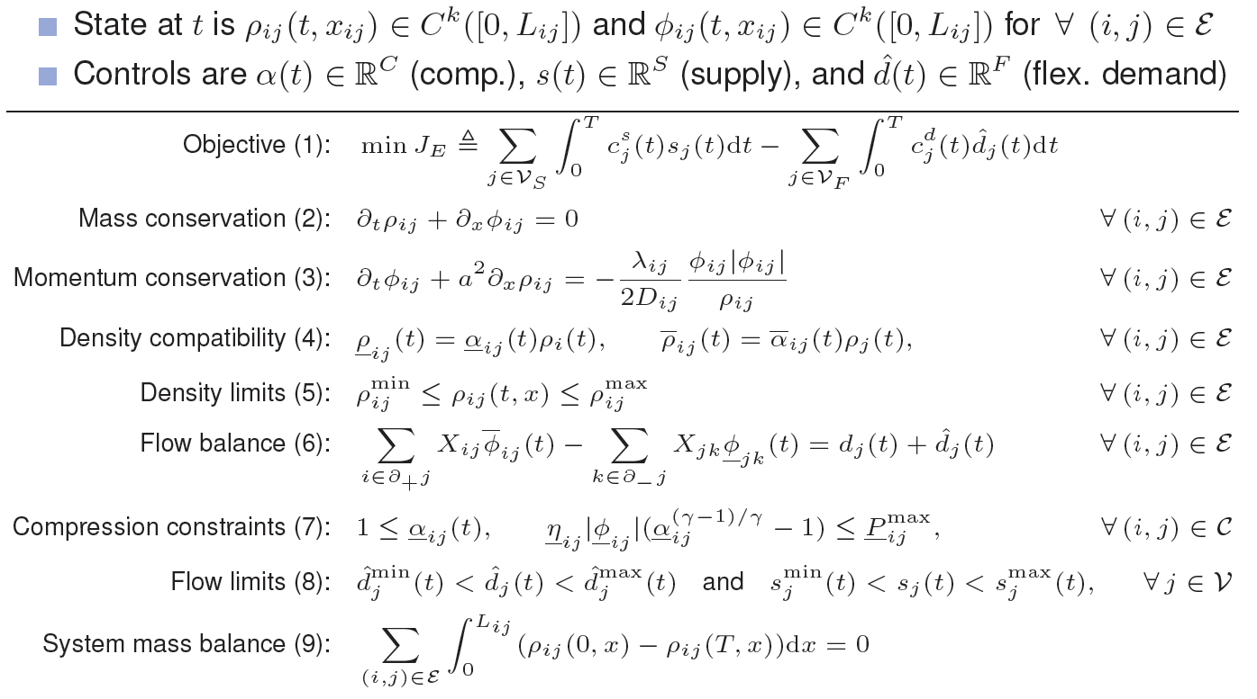
Dynamic Pipeline Optimization Formulation
A repeated auction of pipeline capacity to buyers and sellers of natural gas
Maximize market surplus subject to engineering constraints and physics of gas flow
Co-optimize compressor operations with line pack
Mathematics behind dynamic optimization and new market design

Slide 17
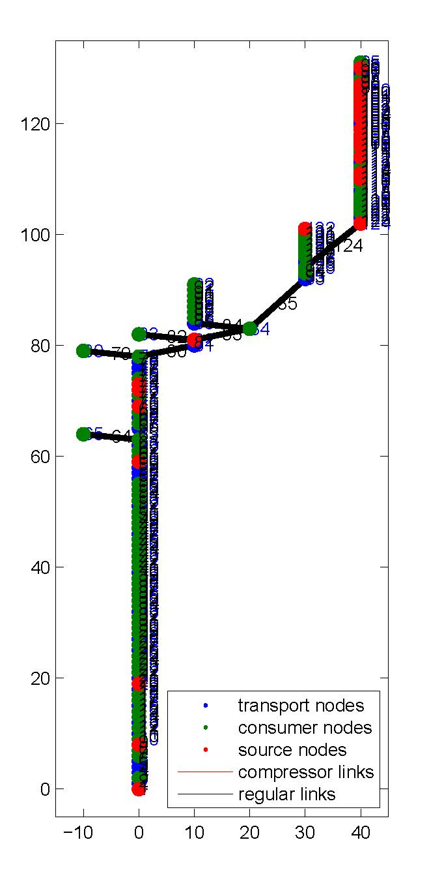
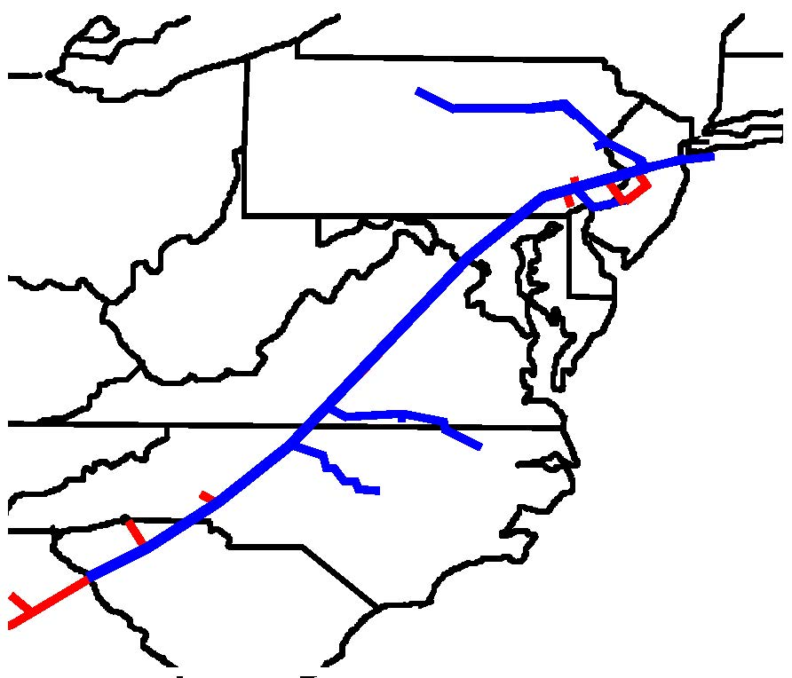
Optimization Example: 1500+ mile network
Pipeline model uses Williams-Transco topology and nomination data
Zones 5 and 6
Spans Georgia to NYC, includes PA
Stylized hourly profiles applied to daily nominations
132 nodes, 131 pipes, 31 compressors
Total pipeline length of 2678.8 km (1664.9 mi)
A numerical demonstration that the mathematics works and that results make practical sense

Slide 18
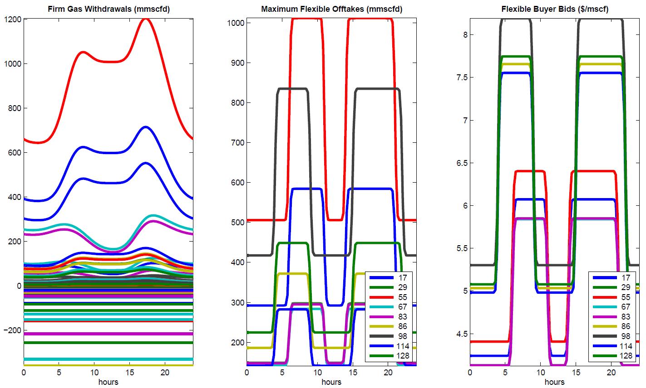
Inputs
Time-dependent inputs for dynamic optimization
Left: firm gas withdrawals (mmscfd); Center: maximum flexible withdrawals (mmscfd)
Right: Buyers’ market bids ($/mscf), supply at 1.61 $/mscf

Slide 19
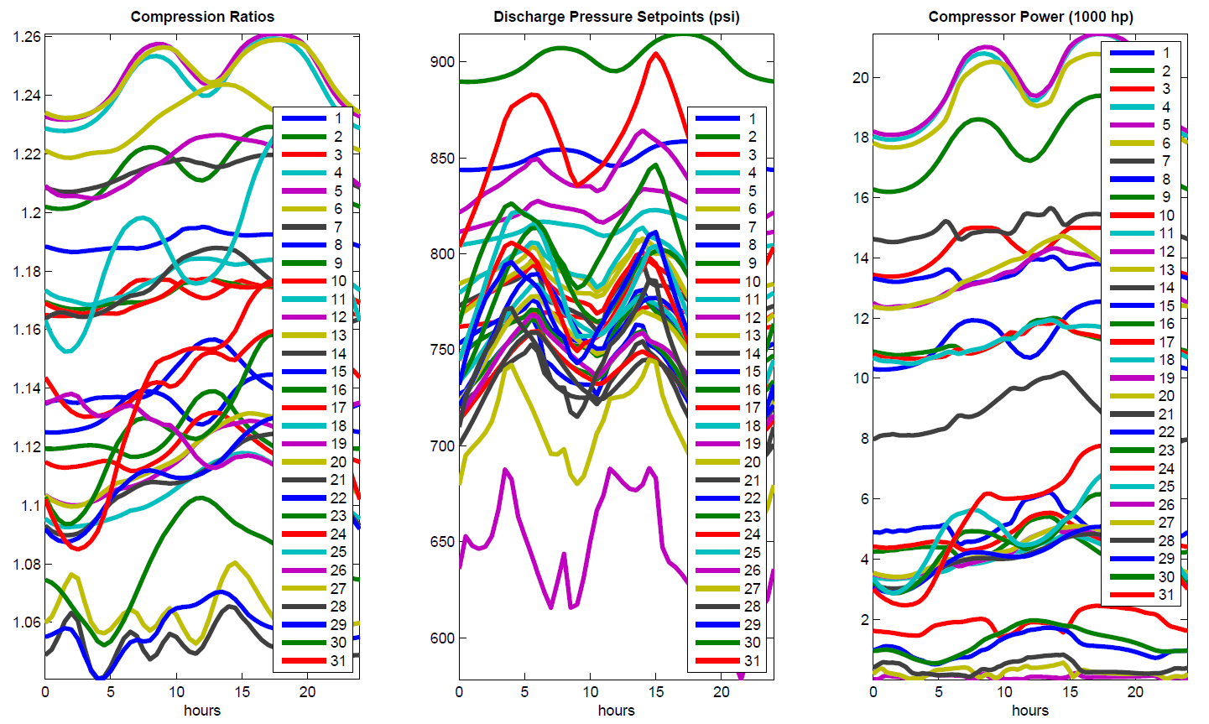
Optimal flow controls
Control variable (compressor control) solution from dynamic optimization
Left: compression ratios; Center: discharge pressures (psi)
Right: compressor power (horsepower)

Slide 20
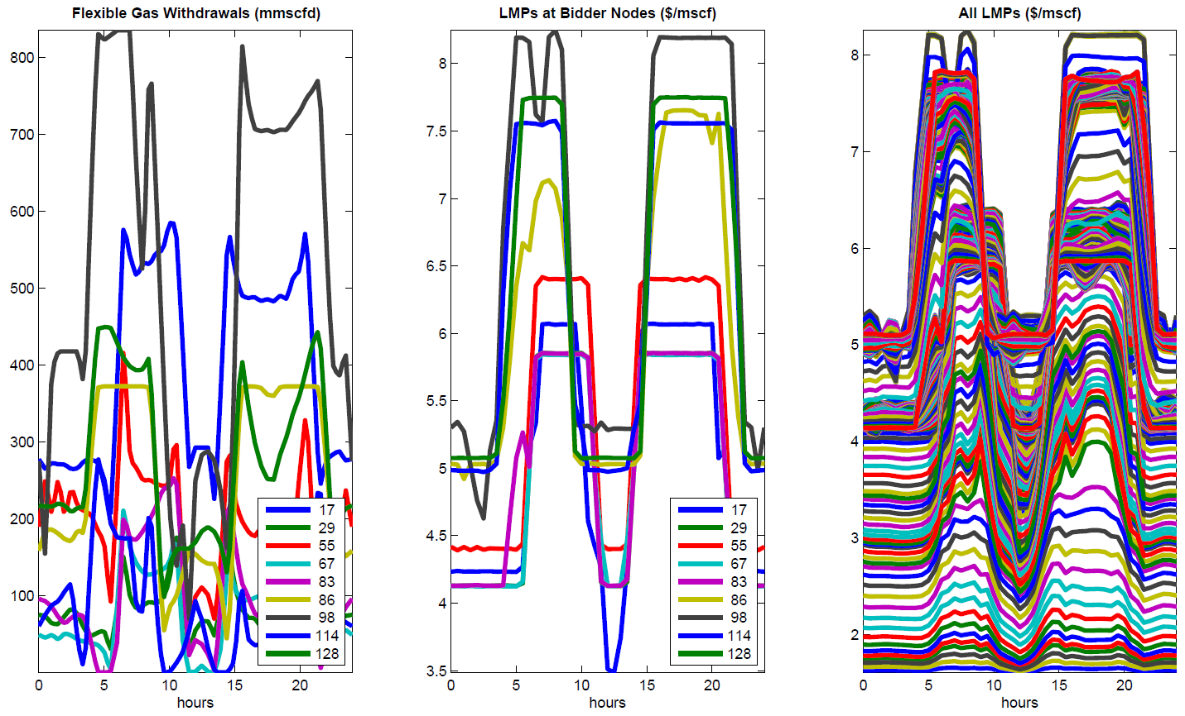
Auction Results
Purchases & Sales
Buyers Prices
Gas value over time and across networks
Economic variable (flexible demands and prices) solution from dynamic optimization
Left: offtakes at flexible demand nodes; Center: marginal price at market buyer nodes
Right: spatiotemporal marginal price at all system nodes

Slide 21
Gas LMPs
Locational marginal prices (short-run marginal costs) of natural gas are computed as dual variables for nodal flow balance constraints
Prices are consistent with the physics of gas flow in the pipeline network and engineering operation constraints
Prices reflect actual physical capacity of pipeline under current or anticipated operational conditions of the supply system
Locational prices provide critical gas-electric coordination and co-optimization of two infrastructures

Slide 22
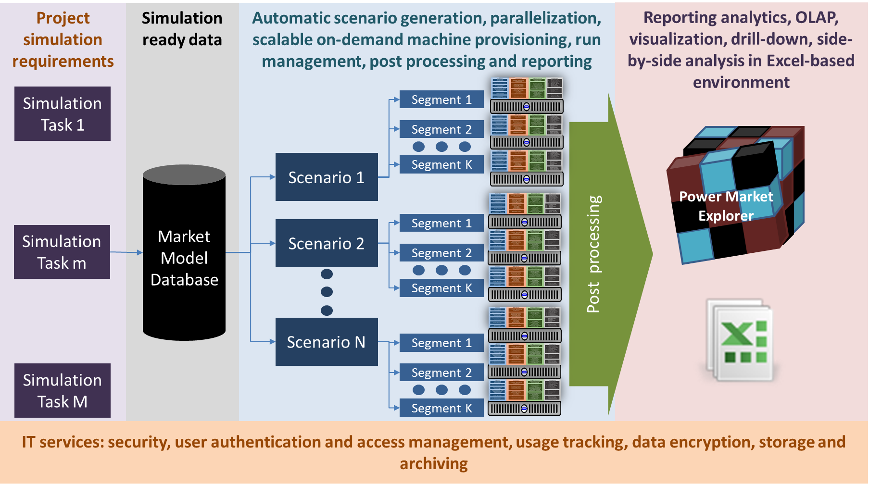
Enelytix® Simulation Environment Architecture
PSO/GSO
PSO/GSO
PSO/GSO
PSO/GSO
PSO/GSO
PSO/GSO
PSO/GSO
PSO/GSO
PSO/GSO
ENELYTIX is used as a staging environment for evaluation of market design alternatives

Slide 23
Conclusions
As we progress along with the GECO project we believe that the opportunity exists to
radically change practical methods and algorithms of pipeline operations
Develop near real time pricing of natural gas that is consistent with the near real-time operations and with physics of the gas flow
Use the dynamic optimization of pipeline operation approach and pricing mechanisms to improve coordination of gas and electric systems
Realizing this opportunity is very important for gas and electric industry

