Slide 1
Distribution System Operator (DSO) Simulation Studio
John A. Higley
ProsumerGrid, Inc.

Slide 2
ProsumerGrid, Inc.
Startup company from Georgia Tech.
Team performed ARPA-E GENI Distributed Control Architectures project (2012-2015).
Developed theoretical basis and proved massive decentralized operation of the grid (decentralized PF, OPF, UC, frequency regulation, SE, ATC).
ProsumerGrid, Inc. formed to develop and commercialize next generation software to simulate and coordinate systems with potentially billions of DERs and millions of decision-makers.

Slide 3
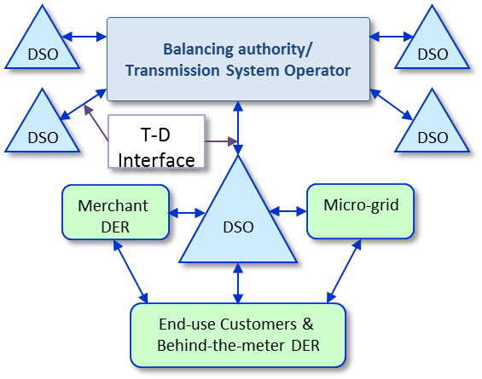
Motivation for DSO Simulation
The electricity industry has identified Distribution System Operators (DSOs) and Distributed System Platforms (DSPs) as critical to realizing an electricity grid based on distributed energy resources (DERs), energy services, and active customers.

Slide 4
Motivation for DSO Simulation
It is very important to simulate DSOs and DSPs before they are broadly implemented.
While there are many great propositions regarding DSOs, a tool that can be used to test those ideas does not exist.
High-fidelity simulations are needed to ensure robust design.
DSO/DSP operations will be very complex and simulation has the following challenges:
Underlying decentralized decision making
New physical behavior in space and time
New information, economic, and management elements
Massive number of DERs and decision makers.

Slide 5
Project Objectives
This project id developing an interactive software tool capable of simulating the operation of emerging DSOs and DSPs at the physical, informational, and market levels.
The software will extend state-of-the-art distribution grid solvers with detailed DER models, decentralized optimization, DSO pricing rules, and interactive analytics features.

Slide 6
DSO Simulation Studio
A Multi-Layer Simulator
Regulators
Market Participants
Utility Engineers
Developers
DSO Simulation Studio
Market
DSO Design and Policy Engine
DER Services Valuation
DSO Rules
DER Services
Locational-Temporal Pricing Module
System
Decentralized Energy Scheduling
Forecasting
Multi-Agent Prosumer Model
Security Modeling
Time Series DER Quasi-Steady State Solver
Devices Controllers: Intelligent Controllers
Power Electronics, Protections, Sensors
Power Grid: Wires, Transformers, Capacitors, etc.
DER: Flexible Load, Solar PV, Storage, CHP, Wind, EV, etc

Slide 7
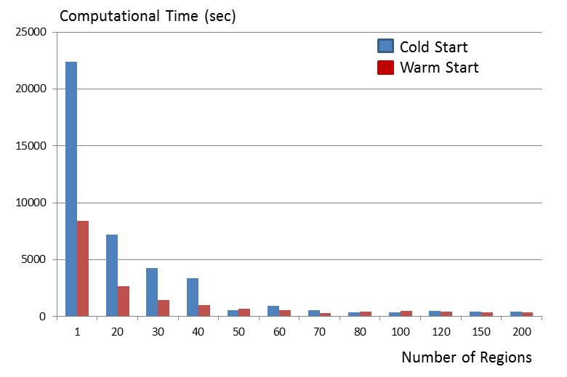
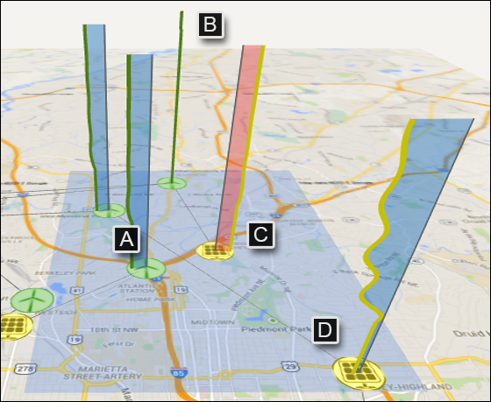
DSO Simulation Studio Unique Features
Decentralized energy scheduling of DER-rich systems of arbitrary size.
Explicit modeling of energy services transacted in the DSO.
Locational and time-vector pricing of P/Q, ancillary, and security services.
3D Interactive Visualization
Analytics and valuation of DER services, DSO rules, and business models.
Simulation of multi-scale interactions of DSO with up-stream ISO, same level DSOs, and downstream (microgrid, building, and residental) prosumer subsystems.
3D Visualization Concept

Slide 8
Team
Strategically designed team to address the complexity of DSO/DSP activities.
Major DSO/DSP efforts in NY and CA
Realistic data, use cases, rules.
NRECA’s Open Modeling Framework (OMF) allows us to leverage existing engineering models and solvers: Milsoft, CYMDIST, GridLab-D, etc.
Integrate strong expertise in decentralized architectures for control and optimization, federated co-simulation, visualization, analytics, economics, and cloud computing.

Slide 9
Project Tasks
6 Months
• System Requirements
• Multi-Agent Framework
• Realistic Datasets
12 Months
• Solver Integration
• DER Controllers
• Mid-Size Dec. Optimization
• Basic GUI
• Service Definition
18 Months
• HPC Federation
• Space-Time Pricing
• Services Def. Language
• DSO Rules
24 Months
• Realistic Simulation
• System Analytics
• DSO Optimization
• Interactive Environment
30 Months
• Large-Scale System
• Multiple DSO Scenarios
• DSO Rules Sensitivity
Seamless Simulation
of DER-rich Grids
Robust DSO Design
Integrated Simulation of DER-rich Grids
Preliminary DSO Design

Slide 10
Path to Market
After interviewing more than 100 executives, and engineers of electric utilities, the team found that the existing tools are limited, siloed, and unable to simulate DER-rich systems, many smart grid propositions, and DSO/DSP models.
This project will fill this simulation void in the industry.
ProsumerGrid will commercialize the tool.
We expect that initial target customers be utilities and energy providers, but also consultants, academia, and possibly customers.
We plan to continue using the NSF’s I-Corps Lean startup methodology to validate our value propositions.

Slide 11
What do we need?
1. Make sure that the tools meet the needs.
What are your DER simulation needs at the physical, control, information, services, economy, and policy levels?
What are the features that the simulator absolutely must have.
2. Accelerate development of an urgent tool.
We need to hire more people to accelerate development.
3. Extend development
Examples: Hosting Capacity, Optimal DER Deployment, Cyber Layer

Slide 12
Conclusions
A DSO Simulation Studio would represent a quantum leap in the industry’s ability to simulate and manage the complexity of emerging DER-based distribution grids.
It will support decisions of great criticality and impact, as various states implement DSO/DSPs in the quest to realize a highly distributed, reliable, optimized, and sustainable electricity industry.
Thanks
Please contact us at: jhigley@prosumergrid.com

