Slide 1
2017 RTP Scope Update
November, 2016
RPG Meeting

Slide 2
Agenda
2017 RTP Scope
Highlights
Next steps

Slide 3
2017 RTP Scope and Process Document
2017 RTP Scope was shared with RPG for comments and feedback on October 21, 2016
The document is also available on the November RPG meeting page :
(http://www.ercot.com/content/wcm/key_documents_lists/77750/2017_RTP_Scope_and_Process_draft_v1.docx)

Slide 4
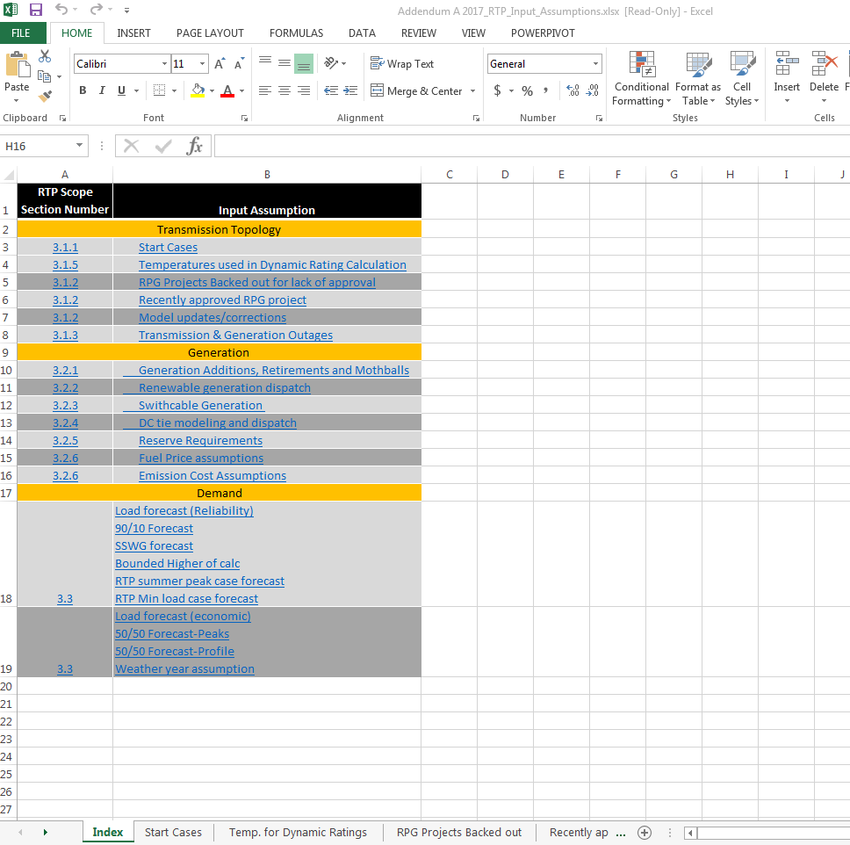
Highlight: Addendum for input assumptions
2017 RTP scope and process document will be supplemented by an Addendum
Addendum shall have specifics about the input assumptions for 2017 RTP

Slide 5
Highlights: Bounded higher-of methodology
Bounded higher-of methodology will be used to determine load levels in the RTP case
Start cases with updated RTP load levels will be shared with RPG for review and feedback
If necessary, TDSPs are encouraged to submit requests for load updates including the rationale for changes

Slide 6
Bounded higher-of methodology (Conceptual)

Slide 7
Load review process (Conceptual)
Rationale:
Historic load growth
Committed load additions
Forecast methodology
Past forecast performance
Special circumstances
Other?
Preliminary RTP start cases will be shared to allow TDSPs to review the impact of load distribution on pockets within the weather zones.

Slide 8

ERCOT SSWG (10152016)
Year | Coast | East | Far West | North | North Central | South Central | Southern | West | NCP Total
2018 | 26,920 | 2,843 | 3,670 | 1,748 | 25,287 | 13,327 | 6,353 | 2,478 | 82,625
2019 | 27,350 | 2,875 | 3,798 | 1,774 | 25,812 | 13,616 | 6,477 | 2,508 | 84,211
2020 | 27,664 | 2,905 | 3,891 | 1,815 | 26,187 | 13,830 | 6,582 | 2,537 | 85,411
2021 | 27,944 | 2,926 | 4,019 | 1,834 | 26,575 | 14,111 | 6,679 | 2,563 | 86,651
2022 | 28,254 | 2,957 | 4,173 | 1,852 | 26,958 | 14,345 | 6,786 | 2,590 | 87,914
2023 | 28,751 | 2,989 | 4,278 | 1,870 | 27,387 | 14,606 | 6,884 | 2,618 | 89,383
Higher-of (SSWG vs 90th)

Slide 9
ERCOT 90th Percentile
Year | Coast | East | Far West | North | North Central | South Central | Southern | West | NCP Total
2018 | 24,826 | 2,496 | 3,014 | 1,469 | 27,823 | 13,036 | 6,591 | 2,063 | 79,275
2019 | 25,764 | 2,510 | 3,076 | 1,471 | 28,130 | 13,255 | 6,658 | 2,090 | 80,174
2020 | 26,052 | 2,522 | 3,138 | 1,473 | 28,391 | 13,454 | 6,719 | 2,115 | 81,564
2021 | 26,329 | 2,534 | 3,206 | 1,474 | 28,638 | 13,649 | 6,744 | 2,141 | 82,276
2022 | 26,646 | 2,546 | 3,275 | 1,476 | 28,905 | 13,860 | 6,840 | 2,166 | 82,951
2023 | 27,161 | 2,559 | 3,345 | 1,477 | 29,178 | 14,077 | 6,902 | 2,191 | 83,660
Higher-of (SSWG vs 90th)

Slide 10
2017RTP Load - Using Pure Higher-Of
Year | Coast | East | Far West | North | North Central | South Central | Southern | West | NCP Total
2018 | 26,920 | 2,843 | 3,670 | 1,748 | 27,823 | 13,327 | 6,591 | 2,478 | 85,400
2019 | 27,350 | 2,875 | 3,798 | 1,774 | 28,130 | 13,616 | 6,658 | 2,508 | 86,710
2020 | 27,664 | 2,905 | 3,891 | 1,815 | 28,391 | 13,830 | 6,719 | 2,537 | 87,752
2021 | 27,944 | 2,926 | 4,019 | 1,834 | 28,638 | 14,111 | 6,744 | 2,563 | 88,779
2022 | 28,254 | 2,957 | 4,173 | 1,852 | 28,905 | 14,345 | 6,840 | 2,590 | 89,915
2023 | 28,751 | 2,989 | 4,278 | 1,870 | 29,178 | 14,606 | 6,902 | 2,618 | 91,191
SOURCE | SSWG | SSWG | SSWG | SSWG | 90th | SSWG | 90th | SSWG

Slide 11
2017RTP Load - Using 5% Bounded Threshold
Year | Coast | East | Far West | North | North Central | South Central | Southern | West | NCP Total | ∆ (2016RTP) | ∆ (2017RTP - *OLD*)
2018 | 26,068 | 2,620 | 3,164 | 1,543 | 27,823 | 13,327 | 6,591 | 2,166 | 83,303 | -1,507 | -2,097
2019 | 27,052 | 2,636 | 3,230 | 1,545 | 28,130 | 13,616 | 6,658 | 2,194 | 85,061 | -988 | -1,649
2020 | 27,355 | 2,649 | 3,295 | 1,546 | 28,391 | 13,830 | 6,719 | 2,221 | 86,006 | -1,152 | -1,747
2021 | 27,645 | 2,661 | 3,366 | 1,548 | 28,638 | 14,111 | 6,744 | 2,248 | 86,961 | -1,228 | -1,818
2022 | 27,978 | 2,674 | 3,439 | 1,550 | 28,905 | 14,345 | 6,840 | 2,274 | 88,004 | -1,251 | -1,911
2023 | 28,519 | 2,686 | 3,512 | 1,551 | 29,178 | 14,606 | 6,902 | 2,300 | 89,254 | - | -1,937
SOURCE | Bounded | Bounded | Bounded | Bounded | 90th | SSWG | 90th | Bounded

Slide 12
Next steps
 | Timeline (tentative)
Finalize a boundary threshold at RPG
Create preliminary start cases for stakeholder review | January 15, 2017
Address comments on load level | Prior to February RPG
Finalize RTP load level | No later than March 2017

Slide 13
Question
?

