Slide 1
2016 RTP Update
November, 2016
RPG Meeting

Slide 2
Agenda
Status update
Results of economic analysis
Next steps

Slide 3
Status Update
Other Reliability Studies
Case conditioning
Sensitivity analysis
Short circuit study
Long-lead time equipment study
Initial start cases, and contingency list ready
Multiple element outage and cascading analyses
2016 RTP Report
Set 1 (P1, P7),
Set 2 (P2, P4, P5) contingency analysis for the base cases
Economic case preparation and analysis
Set 3 (P3: G-1+N-1, part of P6: X-1+N-1) contingency analysis for the base cases
Green box: complete
Blue box: in progress

Slide 4
Short-circuit Study Findings
Short circuit studies for years 2019 and 2022
Evaluated 3 Phase and SLG faults for BES buses
Results communicated to TOs and GOs
22 Overdutied breakers and corresponding corrective action plans identified
Number of Overdutied breakers Identified in 2016 RTP Short
KV | 2019 | 2022* | Total
138 | 19 | 1 | 20
345 | 2 | 0 | 2
* In addition to the breakers identified in 2019

Slide 5
Sensitivity Analysis
No-Wind-No-Hydro (NWNH) conditions evaluated as a summer peak sensitivity evaluated for years 2018 and 2021
High-Wind-Low-Load (HWLL) conditions evaluated as off-peak sensitivity for 2019
Number of corrective action plans identified in 2016 RTP Sensitivity analysis
Weather Zone | NWNH | HWLL
West | 2 | -
South | 2 | 1
North Central | 1 | 2
South Central | - | 1

Slide 6
Environmental Regulation Sensitivity
The Environmental Regulation sensitivity study evaluated reliability needs for Summer peak conditions in 2021
More than 6000 MW of generation, mostly in East weather zone was replaced by generation in the Interconnect queue
Study scope presented at the May RPG meeting

Slide 7
Environmental Regulation Sensitivity
Study results shared with RPG via MIS on October 19, 2016
Study found a need to upgrade close to
178 circuit-miles of 345 kV lines
23 circuit-miles of 138 kV lines
15 circuit-miles of 69 kV lines

Slide 8
Top Congestion Constraints
Index | Projected Constraining Element | Congestion Rental ($/MW) |  | Met Economic Criteria
 |  | 2019 | 2022
1 | Panhandle Interface |  |  | Yes
2 | STP - Jones Creek 345 kV line |  |  | No
3 | Oasis - WA Parish 345 kV line |  |  | Not evaluated
4 | Cico – Comfort 138 kV line |  |  | No
5 | Long Road - North Denton 138 kV line |  |  | No
6 | Fort Stockton Plant - Airport TNP 138 kV line |  |  | No
7 | Jones Street TNP - Lakepointe TNP 138 kV line |  |  | No
8 | 16th Street TNP - Woodward 2 138 kV line |  |  | No
9 | Raymondville 2 - Las Pulgas 138 kV line |  |  | No
10 | BTU Jack Creek - Twin Oak Switch 345 kV line |  |  | Not evaluated
11 | Fayetteville 345/138-kV transformer |  |  | Not evaluated
12 | Austrop - Sandow Switch 345 kV line |  |  | Not evaluated
13 | Bruni Sub 138/69-kV transformer |  |  | No
14 | Cagnon 345/138-kV transformer |  |  | Not evaluated
15 | Fort Stockton Switch – Barrilla 69 kV line |  |  | No
16 | Reveille – Encinal 138 kV line |  |  | Not evaluated
17 | Cagnon – Kendall 345kV line |  |  | No
Low | High

Slide 9
Economic Analysis: Panhandle Interface
Addition of two 175 MVAR synchronous condensers at Windmill Substation meets economic criteria
Additional analysis is required to determine the Panhandle interface stability limit under different upgrade options
Detailed analysis will be conducted during the independent review of Sharyland’s South Plains Transmission Project

Slide 10
Question
?

Slide 11
No-Wind-No-Hydro sensitivity summary
Project/CMP index | Weather Zone | Project/CMP Description | Resolution | Notes
NWNH1 | West | Hamilton – Picacho 138 kV line overload | Reconductor (Project) | Planned project
NWNH2 | West | Hamilton – Del Rio 138 kV line overload | Reconductor (Project) | Planned project
NWNH3 | South | Low voltages and overloads in Hamilton, Maverick area | Reduce Eagle Pass DC tie export (needed in 2018) | This CMP is not needed after the completion of the Maverick County RPG Project
NWNH4 | South | Overloads and low voltages in the Valley | Reduce Railroad DC tie export and perform switching action (needed in 2018 and 2021) | This CMP is needed in addition to the Hidalgo-Starr RPG Project

Slide 12
High-Wind-Low-Load sensitivity summary
Project/CMP index | Weather Zone | Project/CMP Description | Resolution | Notes
HWLL1 | South Central | High Voltage at 345 kV Horse Hollow bus | Switching action | -
HWLL2 | South | High Voltage at 345 kV White Point bus | Switching action | -
HWLL3 | North Central | Comanche Peak – Wolf Hollow 345 kV line overload | Upgrade project | Project not recommended in RTP base plan
HWLL4 | North Central | Barton Chapel Wind Farm – Oran Sub 138 kV line overload | Upgrade project | Project not recommended in RTP base plan

Slide 13
Panhandle Modeling 2016 RTP economic analysis
Amount of generation capacity in panhandle is 5271 MW as of October 2016
Interface limit based on a WSCR threshold of 1.5 is 4013 MW (3611 MW after adjusting for 10% operating margin)
New panhandle interface limit with the recommended project is 4753 MW and (4278 MW after adjusting for 10% operating margin)

Slide 14
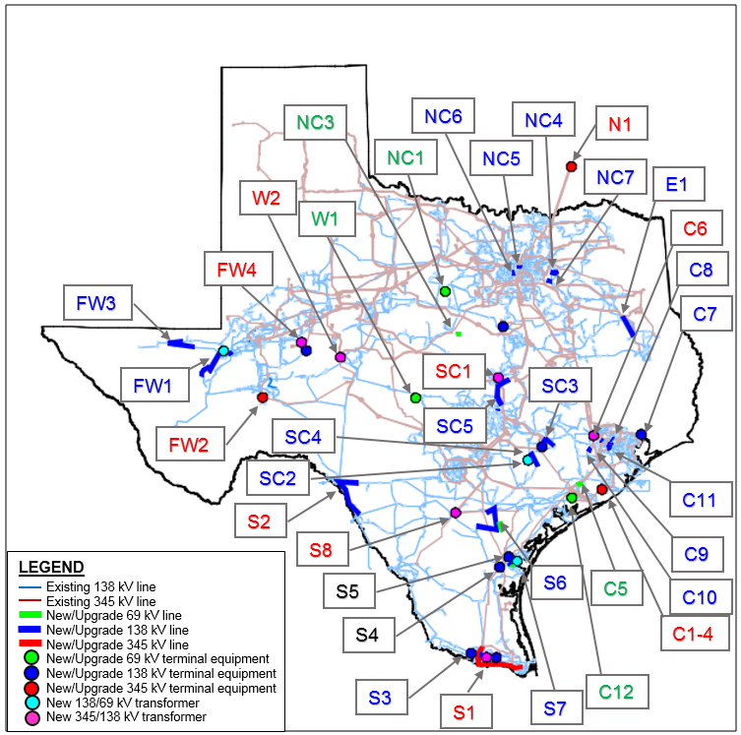
2016 RTP Reliability Project Locations

Slide 15
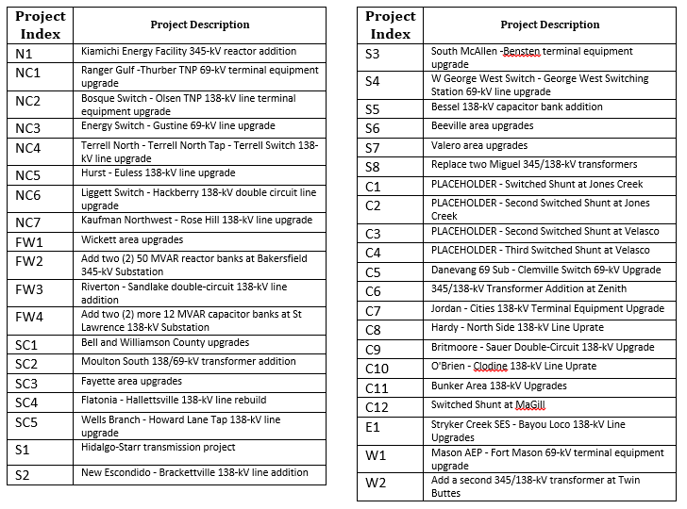
2016 RTP Project Locations

