Slide 1
2016 LTSA Update
November 2016
RPG Meeting

Slide 2
Agenda
Status of the 2016 Long-Term System Assessment (LTSA)
Preliminary transmission upgrades
Next steps

Slide 3
Status of the 2016 LTSA
Current Trends
Reliability Needs Assessment
Reliability Project Evaluation
Economic Needs Assessment
Economic Project Evaluation
Reliability Needs Assessment
Reliability Project Evaluation
Economic Needs Assessment
Economic Project Evaluation
Environmental Mandate
Reliability Needs Assessment
Reliability Project Evaluation
Economic Needs Assessment
Economic Project Evaluation
High EE/DG

Slide 4
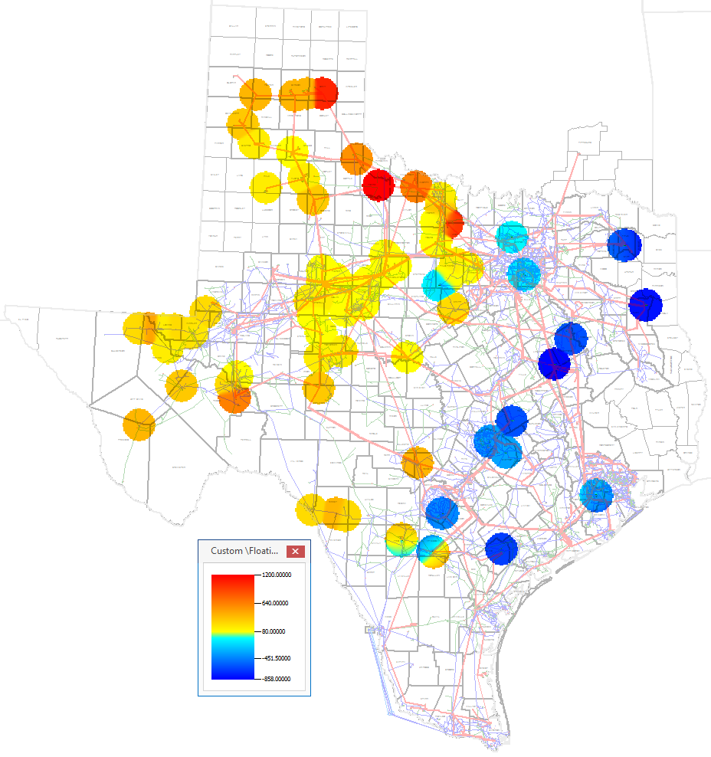
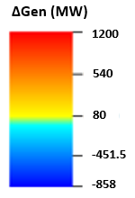
2031 Solar Addition and Generation Retirement (Current Trends)
Net Solar Additions:
16 GW by 2031
Gen Retirement:
12 GW by 2031

Slide 5
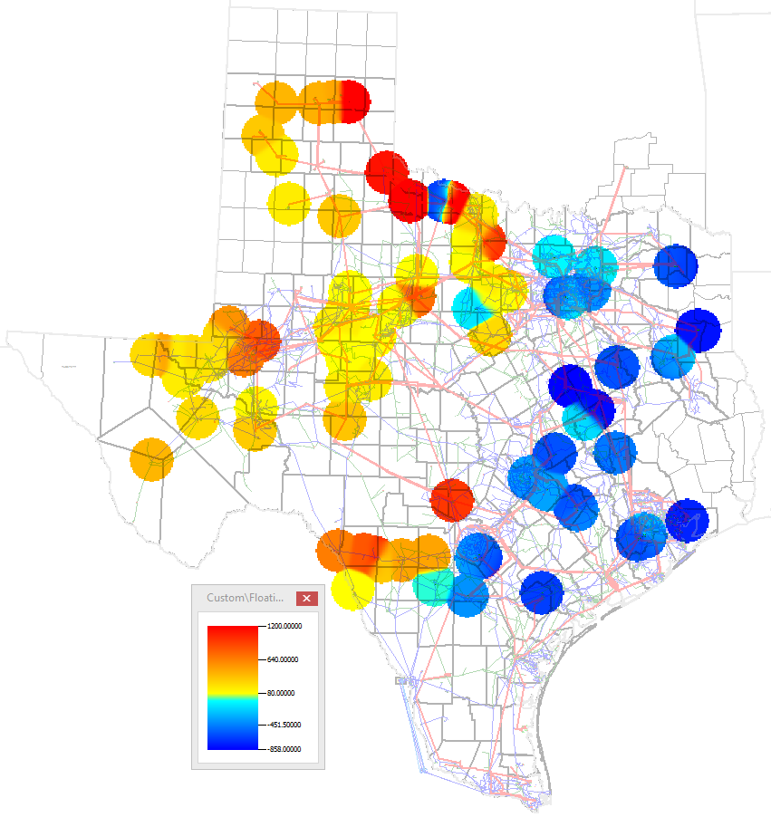
2031 Solar Addition and Generation Retirement (Environmental Mandate)
Net Solar Additions:
22 GW by 2031
Gen Retirement:
24 GW by 2031

Slide 6
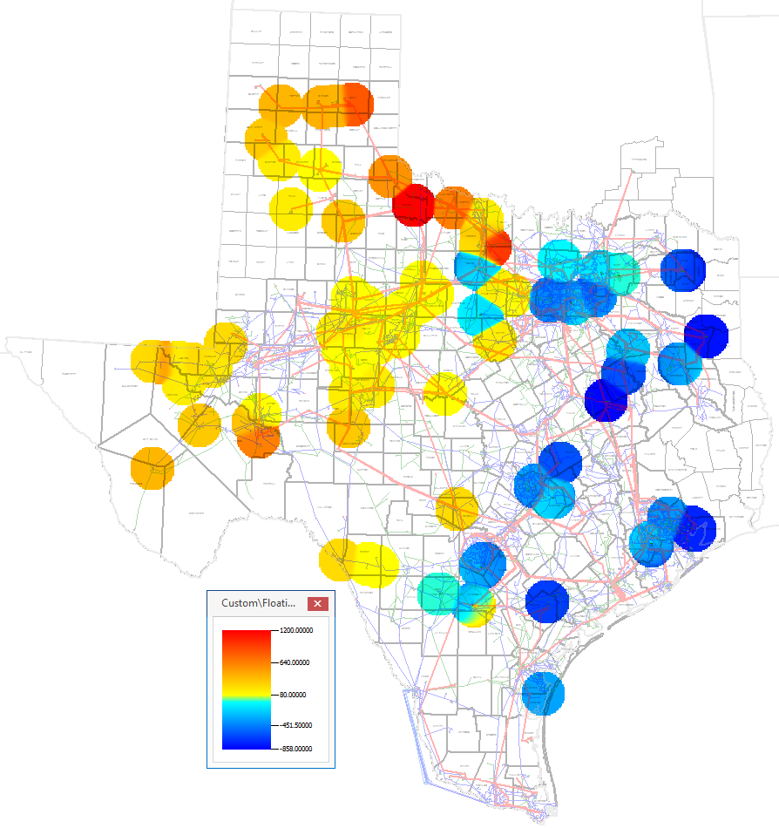
2031 Solar Addition and Generation Retirement (High EE and DG)
Net Solar Additions:
14 GW by 2031
Gen Retirement:
20 GW by 2031

Slide 7
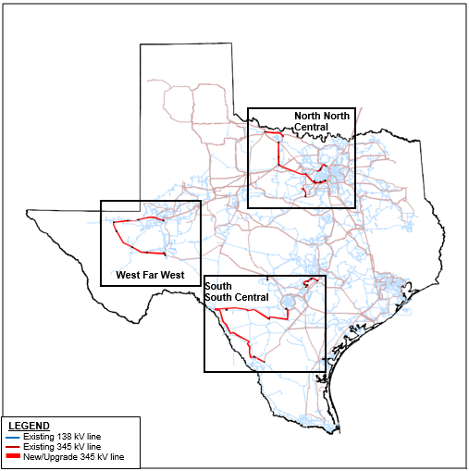
2031 Transmission Upgrades (preliminary) (Current Trends Scenario)
All Study Regions

Slide 8
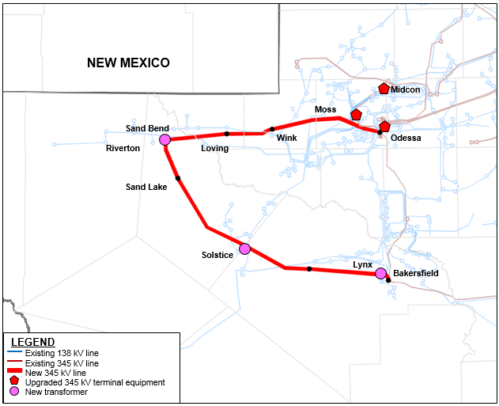
2031 Transmission Upgrades (preliminary) (Current Trends Scenario)
West/
Far West

Slide 9
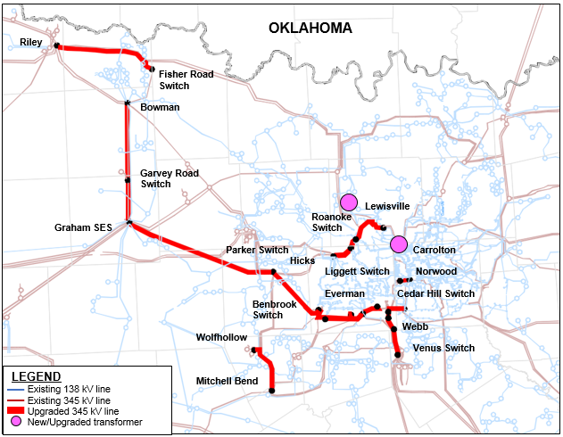
2031 Transmission Upgrades (preliminary) (Current Trends Scenario)
North/
North Central

Slide 10
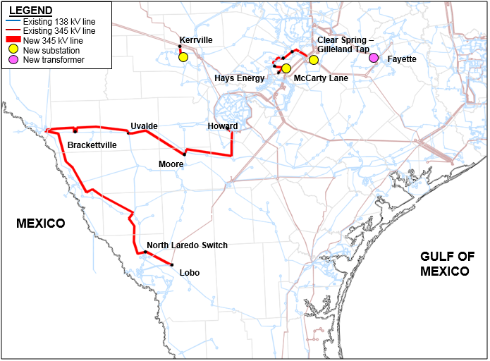
2031 Transmission Upgrades (preliminary) (Current Trends Scenario)
South/
South Central

Slide 11
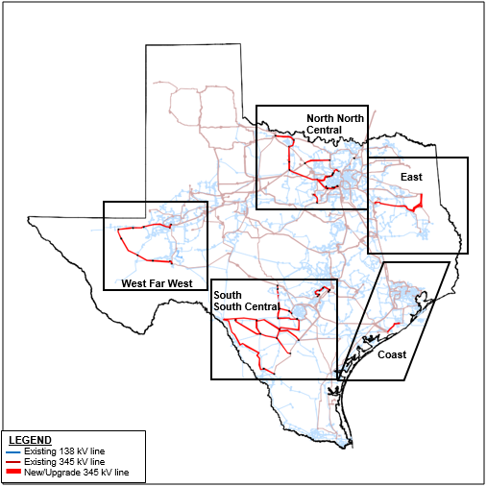
2031 Transmission Upgrades (preliminary) (Environmental Mandate Scenario)
All Study Regions

Slide 12
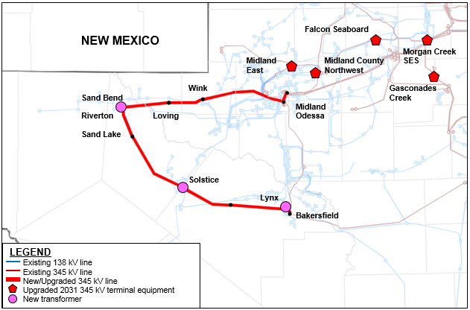
2031 Transmission Upgrades (preliminary) (Environmental Mandate Scenario)
West/
Far West

Slide 13
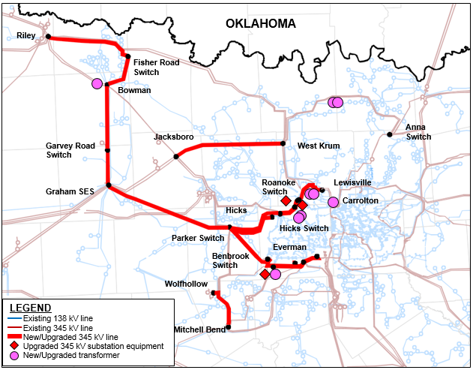
2031 Transmission Upgrades (preliminary) (Environmental Mandate Scenario)
North/
North Central

Slide 14
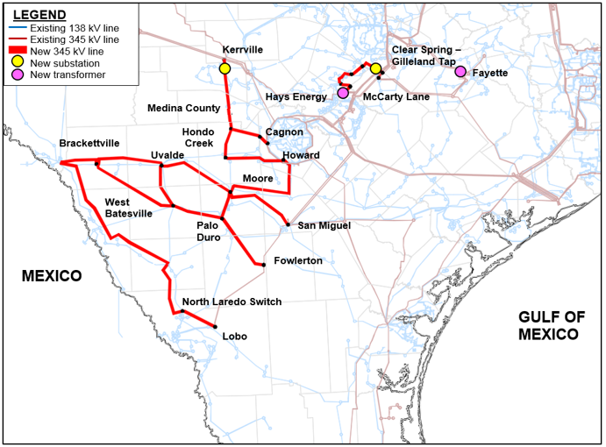
2031 Transmission Upgrades (preliminary) (Environmental Mandate Scenario)
South/
South Central

Slide 15
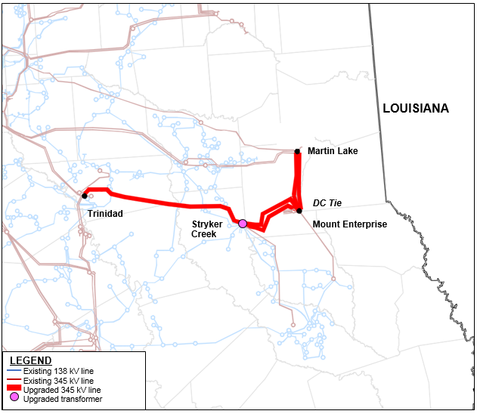
2031 Transmission Upgrades (preliminary) (Environmental Mandate Scenario)
East

Slide 16
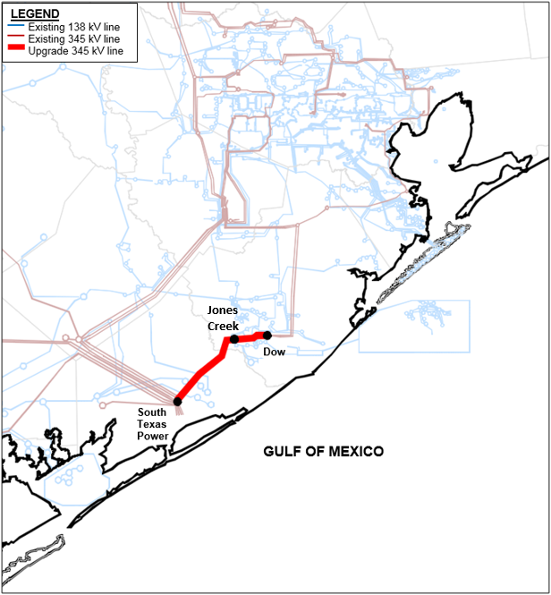
2031 Transmission Upgrades (preliminary) (Environmental Mandate Scenario)
Coast

Slide 17
Summary of Preliminary Transmission Upgrades (2031)
Current Trends
Number of Transmission Upgrades identified by kV | 345 kV | 138 kV
Line Addition (Miles) | 651 | 0
Line Upgrade (Miles) | 417 | 621
Other Upgrades (Terminal Equipment, Breaker, etc) | 3 | 0
Transformer Addition | 8 | 1
Transformer Upgrade | 3 | 0
Environmental Mandate
Number of Transmission Upgrades identified by kV | 345 kV | 138 kV
Line Addition (Miles) | 993 | 0
Line Upgrade (Miles) | 543 | 678
Other Upgrades (Terminal Equipment, Breaker, etc) | 8 | 0
Transformer Addition | 13 | 1
Transformer Upgrade | 4 | 0
-Does not include upgrades required to support the DC Tie interconnection at Mt. Enterprise in the Environmental Mandate cases.
-Additional projects are expected based on additional reliability and economic analysis.
-This summary might change if it was based on other project alternatives listed in the LTSA project spreadsheets.

Slide 18
Next Steps
Evaluate alternative transmission upgrades options based on stakeholder feedback
Complete economic needs assessment and evaluation of economic transmission project alternatives
There will be another posting of preliminary results before the final report in late December
Sandeep Borkar (sborkar@ercot.com)
Tim McGinnis (tmcginnis@ercot.com)
Load Forecast
Scenario Development
Transmission Analysis
Report
Generation Expansion
Green: complete
Blue: in progress

Slide 19
Questions
?

Slide 20
Appendix: 2016 LTSA Study Scope
The 2016 LTSA Study Scope can be found at
https://mis.ercot.com/pps/tibco/mis/Pages/Grid+Information/Long+Term+Planning >> Long-Term Planning Studies

Slide 21
Appendix: Scenario Summary (MW values)
 | Current Trends |  | Environmental Mandate |  | High EE and DG
 | 2026 | 2031 | 2026 | 2031 | 2026 | 2031
CC Adds | - | - | 1117 | 3351 | - | -
CT Adds | - | - | 190 | 1140 | - | -
Net Solar Adds [a] | 10800 | 16160 | 15440 | 22480 | 10240 | 14320
Net Wind Adds [b] | - | - | 733 | 1077 | - | -
Net Gen Additions | 10800 | 16160 | 17480 | 28048 | 10240 | 14320
Gen Retirements | 9981 | 12469 | 19388 | 24045 | 12288 | 20680
Net Generation Change | 819 | 3691 | -1908 | 4003 | -2048 | -6360
DC Tie Adds | - | - | 2000 | 2000 | - | -
SVCs Added (MVAr) | 400 | 1147 | 1965 | 4920 | 0 | 200
Load (90th Percentile) [c] | 83980 | 86055 | 83788 | 85351 | 75605 | 73805
Losses | 2.49% | 2.89% | 4.12% | 5.53% | 2.22% | 2.75%
[a] Solar is scaled to 80%
[b] Wind is scaled to CDR levels (12% for Non-Coastal; 55% for Coastal)
[c] Non-Coincident Peak, 90th Percentile load values with no losses

