Slide 1
Settlement Update
NPRR 802- Settlements Clean-up
Blake Holt
November 14, 2016

Slide 2
NPRR 802- Settlements Clean-up
The purpose of this Nodal Protocol Revision Request (NPRR) is to clarify current practices and clean up Protocol language. There are no system changes and no changes to current Settlement practices or concepts in this NPRR. This NPRR:
Clarifies how Reliability Unit Commitment (RUC) Resources that have opted out of RUC Settlement are treated in the calculation of Real-Time On-Line Reserve Capacity;
Codifies the methodology to be used when Base Point data has been corrupted due to issues with ERCOT’s Energy Management System (EMS);
Clarifies that Resources receiving Emergency Base Points are not charged for Base Point deviation during the relevant Settlement Interval(s);
Corrects descriptions of variables used in Ancillary Service imbalance Settlement to agree to the associated Settlement formulas; and
Cleans up references in Section 9, Settlement and Billing, that refer to paragraphs of Section 7.9.3.3, Shortfall Charges to CRR Owners, that have been removed from the Protocols.

Slide 3
RUC treatment in RTOLCAP- PR 6.7.5(4)
Clarifies how Reliability Unit Commitment (RUC) Resources that have opted out of RUC Settlement are treated in the calculation of Real-Time On-Line Reserve Capacity.
How this previously read:
- Do not count RUC resources in the calculation of RTOLCAP unless they were RUC’d for AS and bought the commitment back.
How this will change:
- Do not count RUC resources in the calculation of RTOLCAP unless they bought the commitment back.
Any code updates for this change?
- No.

Slide 4
Base Point Deviation -PR 6.6.5(9)
Codifies the methodology to be used when Base Point data has been corrupted due to issues with ERCOT’s Energy Management System (EMS).
How this previously read:
- Silent on method of settlement when unreliable Emergency Base Points issued.
How this will change:
- Codified method of settlement when unreliable Emergency Base Points issued.
Any code updates for this change?
- No. ERCOT will manually substitute RTMG values for proxy BP values when this situation occurs. The proxy BP values considered will be present in the MKTINPUT CODE extract for shadow settlement purposes. ERCOT will also strive to be transparent as possible, and provide a market notice in this situation.

Slide 5
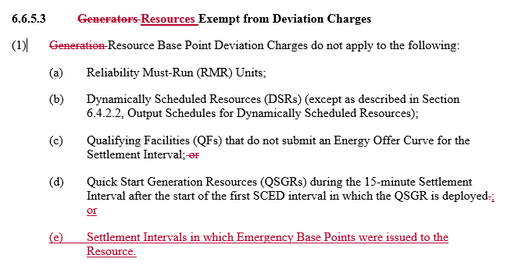
Base Point Deviation -PR 6.6.5(1)
Clarifies that Resources receiving Emergency Base Points are not charged for Base Point deviation during the relevant Settlement Interval(s).
How this previously read:
- Silent on treatment of Base-Point Deviation Charges when Emergency Base Points issued.
How this will change:
- Codified treatment of Base-Point Deviation Charges when Emergency Base Points issued.
Any code updates for this change?
- No.

Slide 6
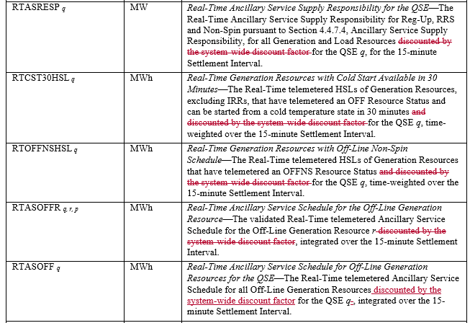
AS Imbalance - PR 6.7.5
Corrects descriptions of variables used in Ancillary Service Imbalance Settlement to agree to the associated Settlement formulas.
How this previously read:
- The variable definitions incorrectly listed the level of discount applied in the companion formulas.
How this will change:
- The variable definitions correctly list the level of discount applied in the companion formulas.
Any code updates for this change?
- No.

Slide 7
References - PR 9.2.3 ; 9.5.3 ; 9.19
Cleans up references in Section 9, Settlement and Billing, that refer to paragraphs of Section 7.9.3.3, Shortfall Charges to CRR Owners, that have been removed from the Protocols.
How this previously read:
- The Protocols referenced on a phantom section.
How this will change:
- The reference to the phantom section has been exorcised from the Protocols.
Any code updates for this change?
- No.

