Slide 1
Project Update and Summary of
Project Priority List (PPL) Activity
November 10, 2016

Slide 2
Project Update Agenda
Project Portfolio Update p. 3-10
  Recent/Upcoming Project Highlights
  2016 Release Targets
  2017 Release Targets
  2016 Project Spending Forecast
  Revision Request Funding Placeholder Status
  Aging Projects Review
  Priority/Rank Options for Revision Requests with Impacts
Appendix
  Project Portfolio Gantt Chart p. 11-20
Location of Project Priority List (PPL): http://www.ercot.com/services/projects/index

Slide 3
Recent / Upcoming Project Highlights
2016 November Release – Week of 11/1/2016 Complete
  NPRR495 – Changes to Ancillary Services Capacity Monitor
  NPRR712 – Clarification of RUC Process (2nd and final phase)
  NPRR736 – Updates to the Ancillary Service Capacity Monitor Display
  NPRR770 – Addition of Outaged Resource Capacity to the A/S Capacity Monitor
  NOGRR143 – Alignment of Nodal Operating Guides with NERC Reliability Standard, BAL-001-TRE-1 (2nd and final phase)
2016 December Release – Week of 12/6/2016 In Flight
  NPRR713 – Reactive Power Testing Requirements
  NPRR754 – Revise Load Distribution Factors Report Posting Frequency
  NOGRR147 – Reactive Power Testing Requirements
  SCR787 – Maintain NDCRC Data For Generator Transfer Between Resource Entities
  SCR788 – Addition of Integral ACE Feedback to GTBD Calculation
2016 December Retail Release – Weekend of 12/10/2016 In Flight
  RMGRR127 – Efficiencies for Acquisition Transfer
  RMGRR140 – Efficiencies for Acquisition Transfer Process
  SCR786 – Retail Market Test Environment
Note: Projected Go-Live dates are subject to change.
Please watch for market notices as the effective dates approach.

Slide 4
2016 Release Targets – Board Approved NPRRs / SCRs / xGRRs
February 2/2 – 2/4 | April 4/12 – 4/14 | June 6/21 – 6/23 | August 8/30 – 9/1 | September 9/26 – 9/30 | December 12/6 – 12/8
NPRR588 NPRR615 NPRR686(b) | NPRR419 NPRR728 COPMGRR040 | NPRR515 NPRR617 NPRR700 NPRR719 NPRR742 VMCRR008 EMS Upgrade | NPRR662 NPRR712(a) RMGRR126 RMGRR137 | NPRR219 SCR783 NOGRR050 NOGRR143(a) NPRR712(b) NOGRR143(b) NPRR495 NPRR736 NPRR770 | NPRR713 NPRR754 NOGRR147 SCR787 SCR788 RMGRR127 RMGRR140 SCR786
3 | 3 | 6 | 4 | 9 | 8
E
E
E
E
E
-
E
E
E
E
E
E
E
11/1 – 11/3
12/5 – NMMS Upgrade
5/1
6/16
7/23 – 7/24
(Retail)
12/10 – 12/11 (Retail)
EMS Upgrade “Chill”
Go-live dates can differ from Protocol effective dates – Please refer to market notices for more details
APPENDIX
Red Text: New additions and target release changes
Strike-Through Text: Previous target release changes
(a), (b), etc. indicates multiple phases
Release targets are subject to change
NPRR686(b) – Solar portion
Project Status Codes: NS = Not Started, I = Initiation, P = Planning, E = Execution, H = On Hold

Slide 5
2017 Release Targets – Board Approved NPRRs / SCRs / xGRRs
February 2/14 – 2/16 | May 5/2 – 5/4 | June 6/27 – 6/29 | September 9/12 – 9/14 | October 10/31 – 11/2 | December 12/5 – 12/7
NPRR272 NPRR649 NPRR764 RRGRR003 RRGRR006 RRGRR007 RRGRR009 | SCR790 NPRR746 NPRR785 NPRR786 RMGRR134 | NPRR714 NPRR744 NPRR758 NPRR782 NPRR789 | NPRR775 SCR777 |  | SCR789
7 | 5 | 5 | 2 | 0 | 1
E
P
P
P
P
P
P
P
I
NS
I
NS
P
I
P
NS
NS
NS
E
NS
9/16 – 9/17
(Retail)
2/13 – NMMS Upgrade
5/6 – 5/7
(Retail)
7/8 – 7/9
(Retail)
10/2 – 10/3
(Off-Cycle)
11/11 – 11/12 (Retail)
12/9 – 12/10 (Retail)
2/18 – 2/19
(Retail)
2017 TBD Items (and point at which they became “TBD”)
2014 | 2015 | 2016 (pre-October) | October 2016
NOGRR084, NPRR664 | None | SCR781 H | NPRR775, NPRR778, NPRR782, NPRR785, NPRR789, RMGRR134
Go-live dates can differ from Protocol effective dates – Please refer to market notices for more details
APPENDIX
Red Text: New additions and target release changes
Strike-Through Text: Previous target release changes
(a), (b), etc. indicates multiple phases
In-Flight Items Planned for Future Delivery
CMM bundle (Planning): NPRR519, NPRR620, NPRR683, NPRR702, NPRR741, NPRR743, NPRR755, NPRR760
Release targets are subject to change
Project Status Codes: NS = Not Started, I = Initiation, P = Planning, E = Execution, H = On Hold

Slide 6
2016 Project Spending Forecast
2016 PPL Budget = $22.5M
“Potential Demand” represents internal ERCOT projects that have not been fully approved

Slide 7
Revision Request Funding Placeholder Status
In 2016 and 2017, ERCOT forecasted $4.0M for Revision Request work
Yearly Revision Request Spending Forecast Summary
Project Status | 2016 | 2017
YTD Actuals | $2.19M | –
Approved – In-Flight / Complete | $2.91M | $1.13M
Approved – On Hold | $0.00M | $0.40M
Approved – Not Started | $0.00M | $0.39M
Remaining Funding | $1.09M | $2.08M
Total Allocation | $4.00M | $4.00M
As of 9/30/2016
Each year, an additional $400k is held in reserve in the event the $4M allocation is insufficient

Slide 8
Aging Projects Review
Definition of “Aging Item”
  PPL Source Doc = Revision Request
  PPL Project Status = “Not Started”
  PPL Priority < Current Year
3 of the 4 aging items are expected to be replaced by new Revision Requests
NPRR664 (Index Fuel Price) is the exception
  Market input needed

Slide 9
Aging Projects Review
Item | Description | Board Approval Date | Submitter | Target PPL Start Date | Comments | ERCOT Opinion
NOGRR084 | Daily Grid Operations Summary Report | 5/15/2012 | MISUG | TBD | NOGRR166 revises NOGRR084 language Language consideration at November OWG | Do not proceed on NOGRR084 at this time
NPRR439 | Updating a Counter-Party's Available Credit Limit for Current Day DAM | 5/15/2012 | ERCOT | TBD | Proposed for elimination by NPRR803 IA consideration at November PRS | Do not proceed on NPRR439 at this time
NPRR714 | Real-Time Make-Whole Payment for Exceptional Fuel Cost | 10/13/2015 | GDF Suez | TBD | Pending submission of an NPRR by ERCOT that may eliminate NPRR714 | Do not proceed on NPRR714 at this time
NPRR664 | Index Fuel Price | 12/9/2014 | RCWG | TBD | TAC asked that ERCOT not proceed until further notice | Do not start – path forward is TBD

Slide 10
Priority / Rank Options for Revision Requests with Impacts
Options for…
Revision Request | Description | Priority | Rank | Comments
NPRR792 | Changing Special Protection System (SPS) to Remedial Action Scheme (RAS) [ERCOT] | 2017 | 140 | Place in the “Regulatory” section of the PPL due to NERC requirement Recommend this item not be tracked against the Revision Request funding allocation

Slide 11
Appendix
  10/31/2016 Project Gantt
    In-flight items sorted by Project End Date
    “On Hold” projects listed separately
    “Not Started” items sorted by Project Start Date

Slide 12
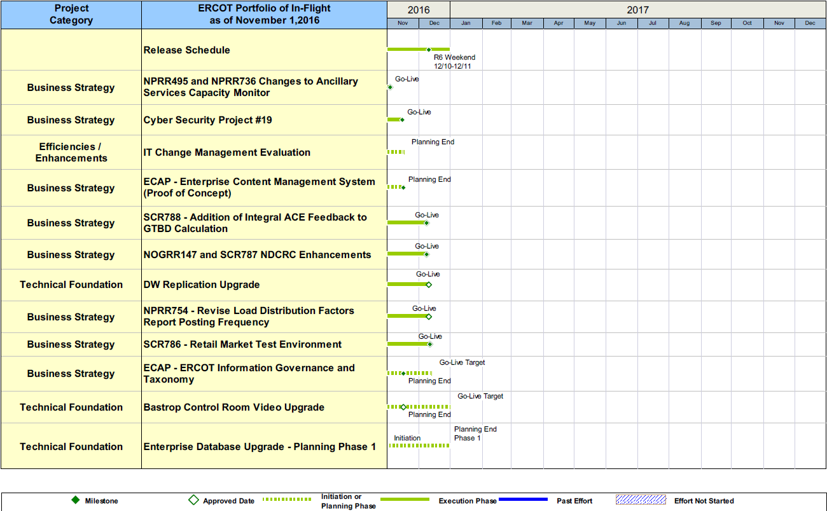
Project Portfolio Status – as of 10/31/2016

Slide 13
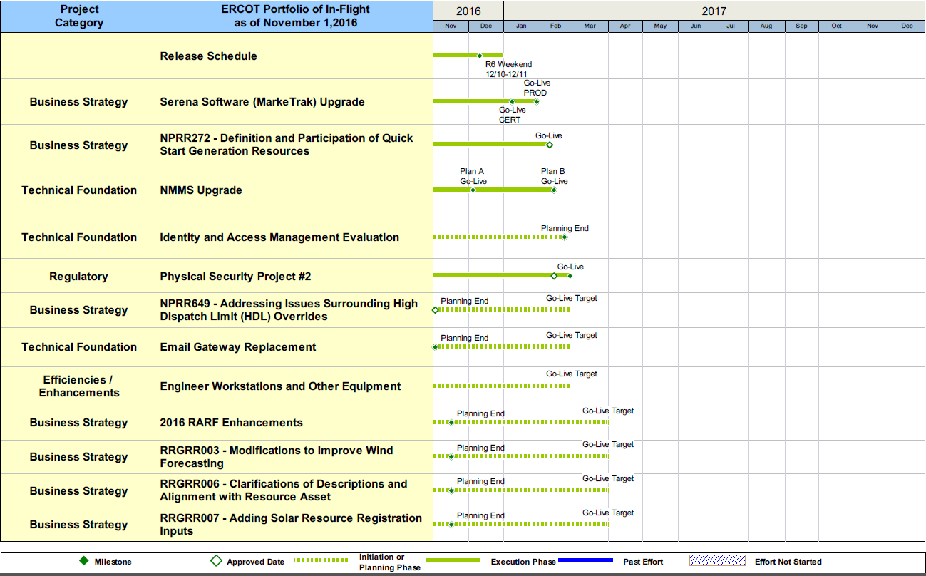
Project Portfolio Status – as of 10/31/2016

Slide 14
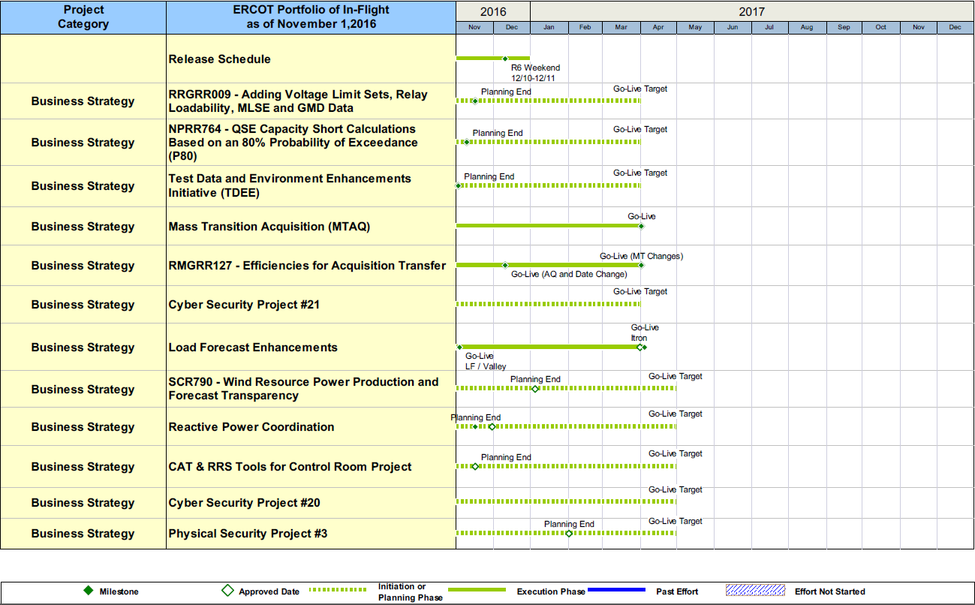
Project Portfolio Status – as of 10/31/2016

Slide 15
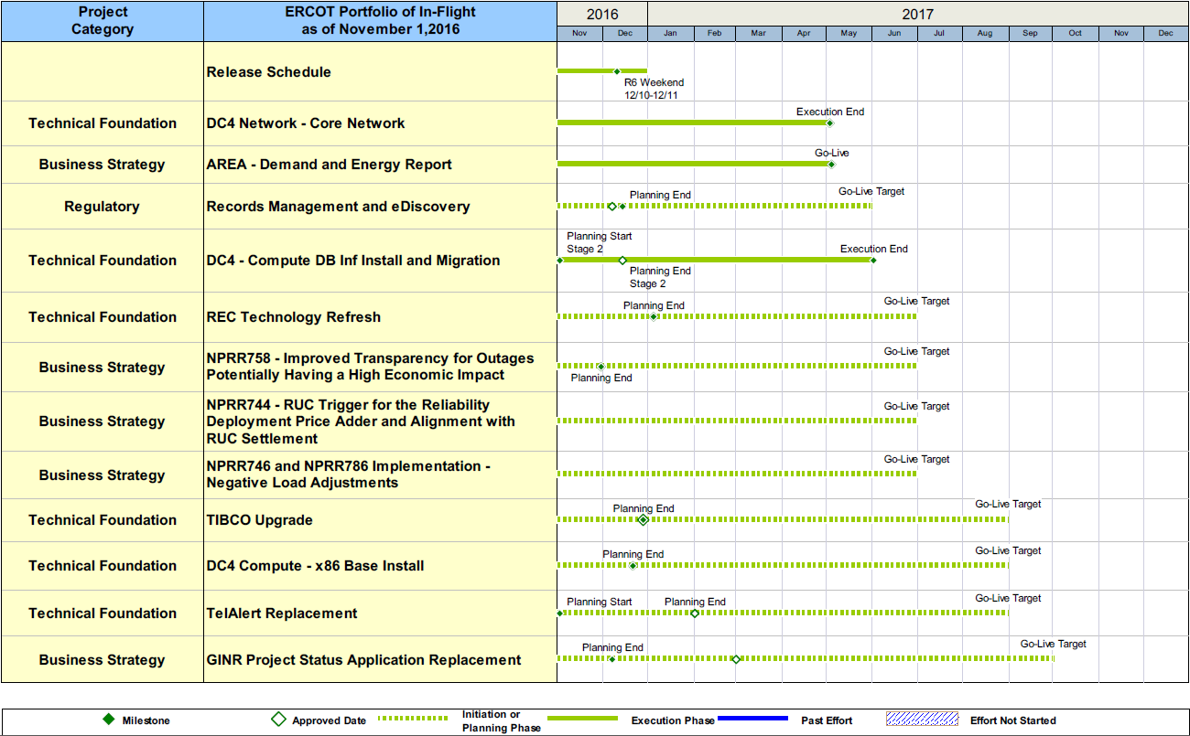
Project Portfolio Status – as of 10/31/2016

Slide 16
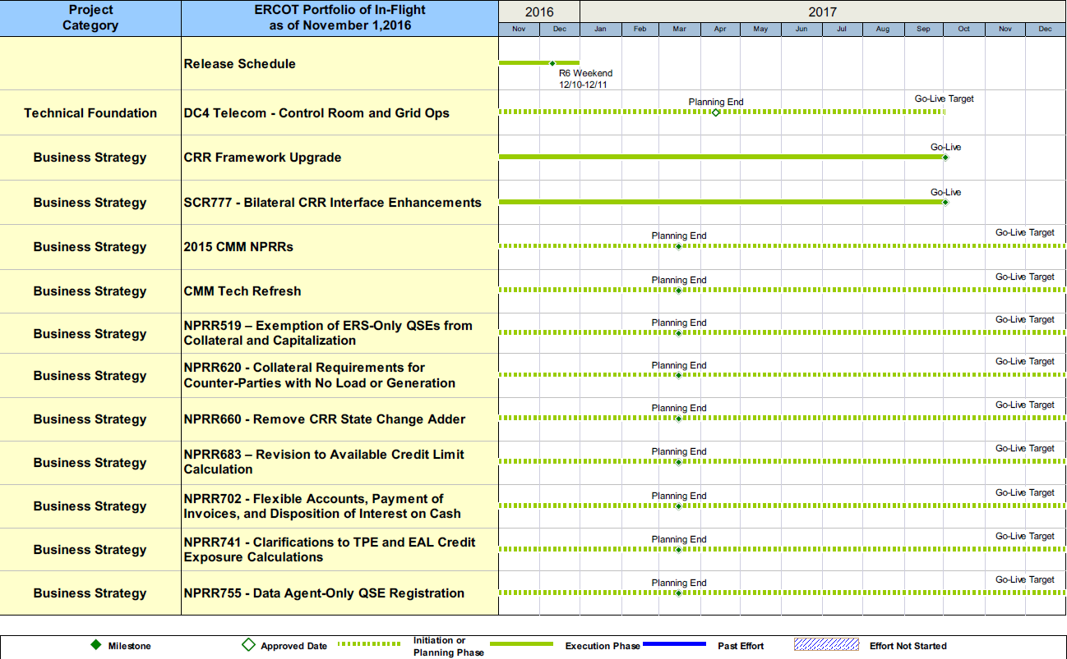
Project Portfolio Status – as of 10/31/2016

Slide 17
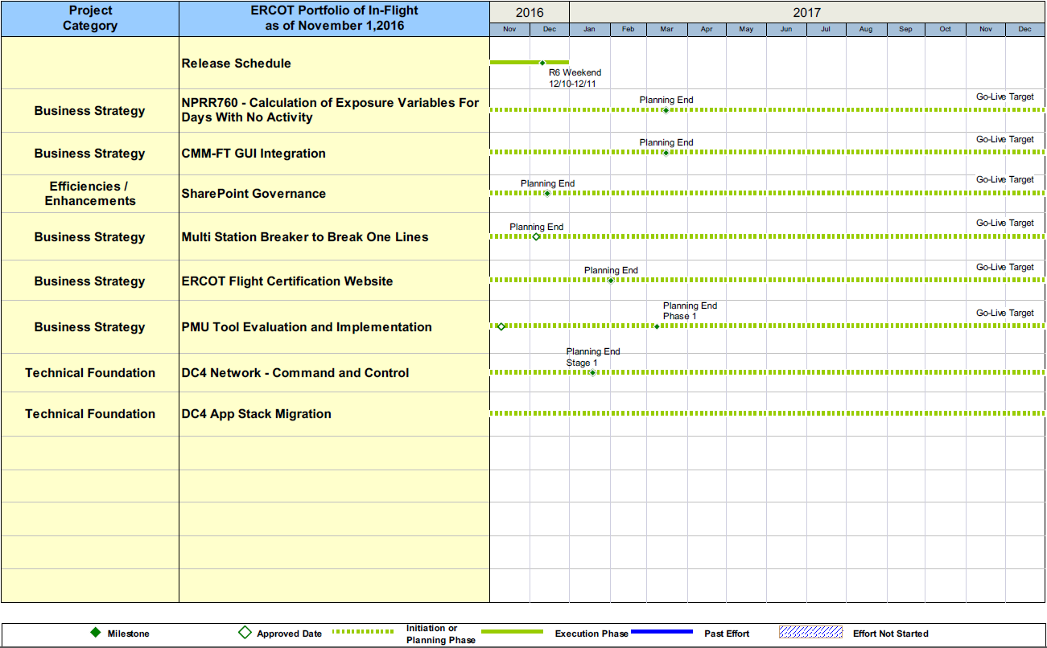
Project Portfolio Status – as of 10/31/2016

Slide 18
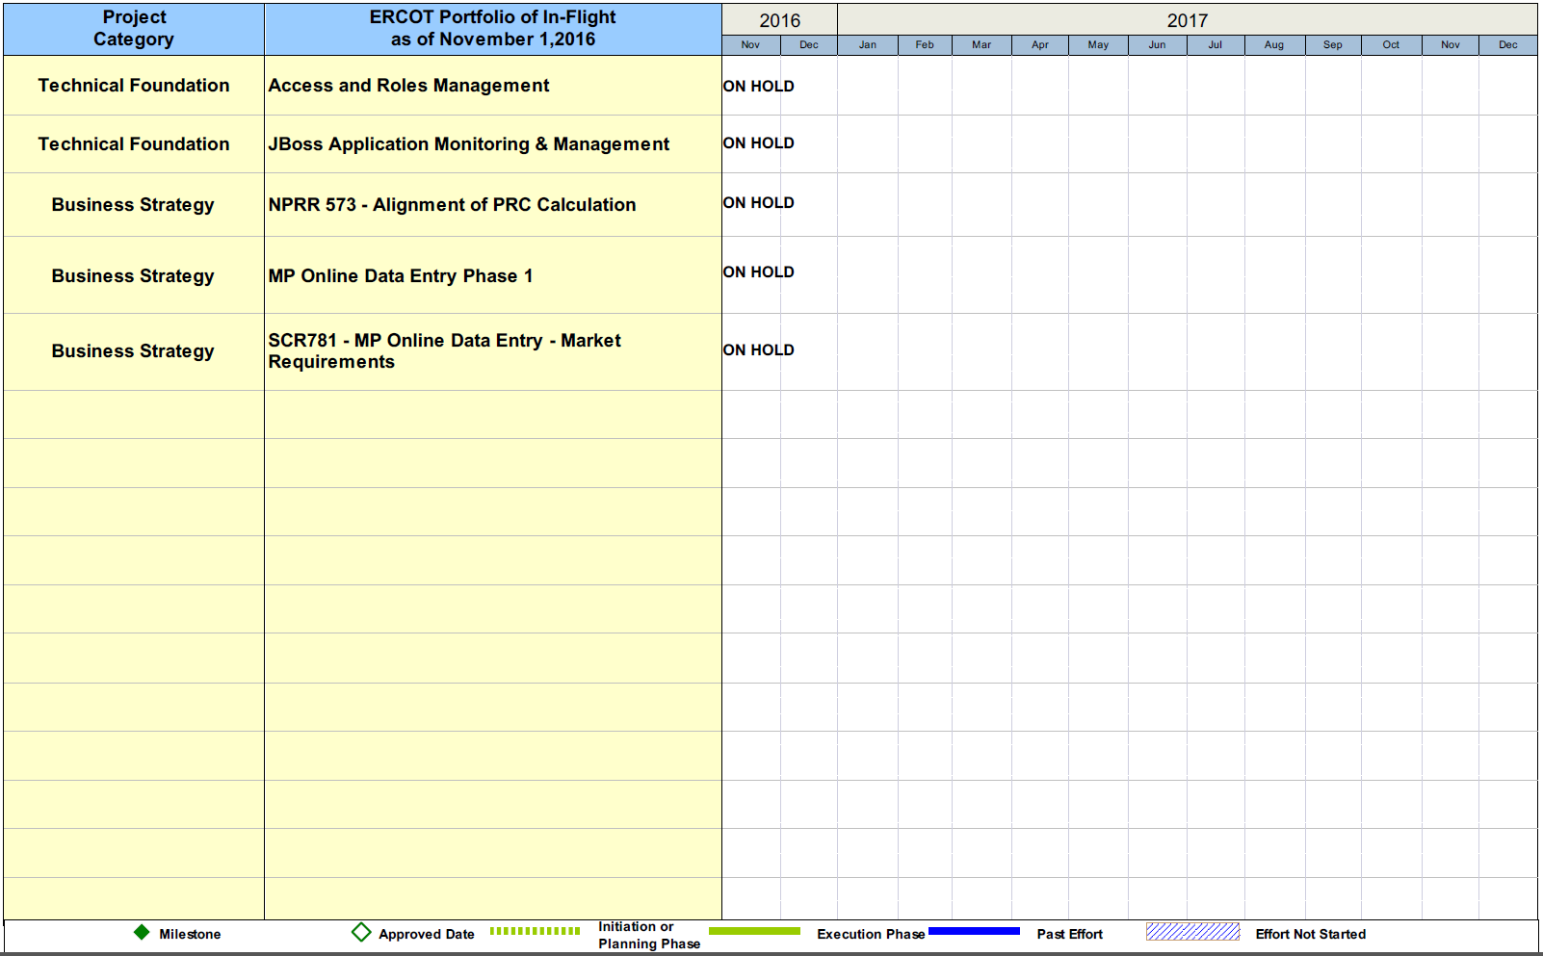
Project Portfolio Status – as of 10/31/2016

Slide 19
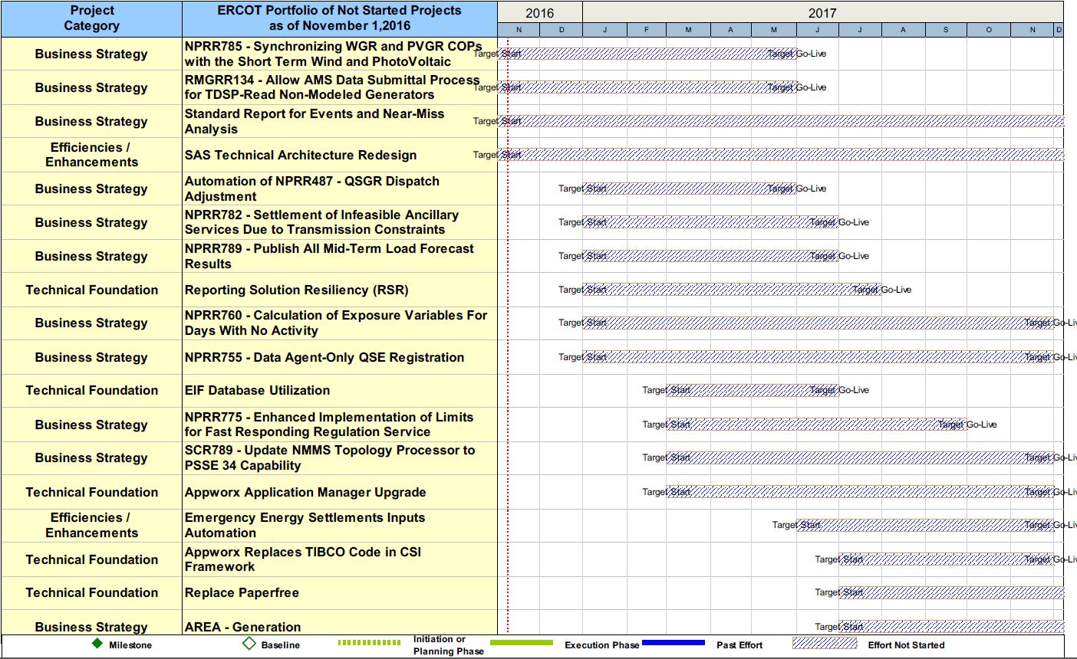
Project Portfolio Status – as of 10/31/2016

Slide 20
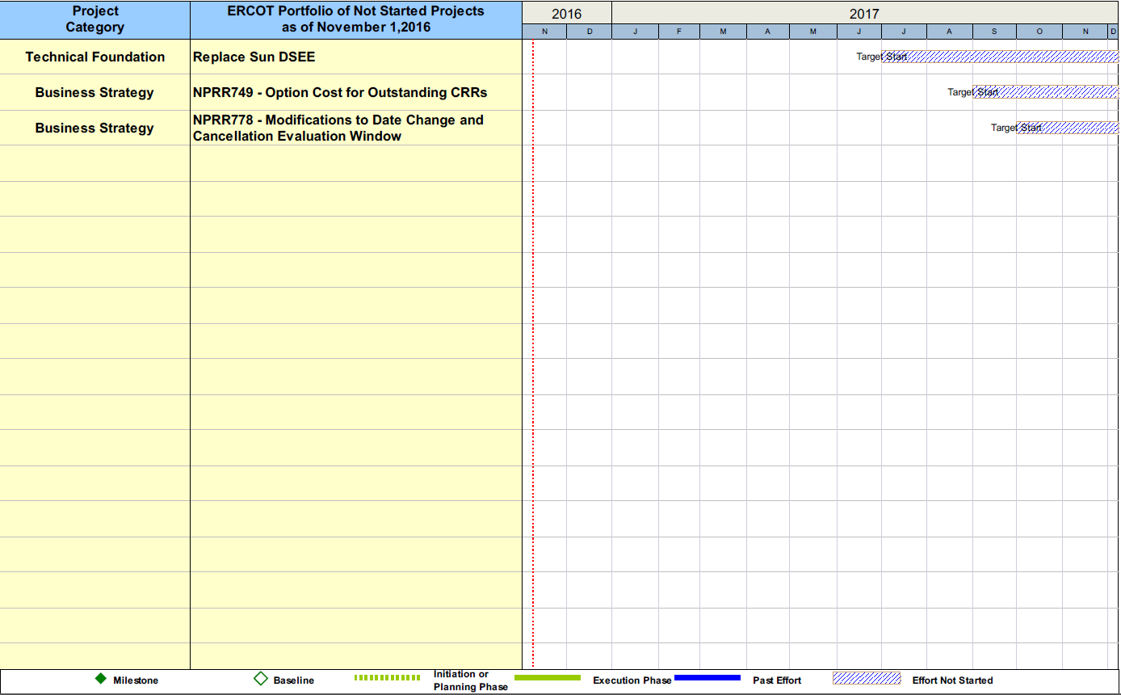
Project Portfolio Status – as of 10/31/2016

