Slide 1
PDCWG Report to ROS
Chair: Percy Galliguez, Brazos Electric Power Cooperative, Inc.
Vice Chair: Stewart Rake, Luminant
ROS
November 3rd , 2016

Slide 2
Report Overview & Notes
Report Overview
  Meeting Minutes
  BAL-001-TRE-1 FMEs & IMFR
    4 FMEs in the month of October
    BAL-001-TRE-1 Unit Performance Report now includes Solar resources.
  Frequency Control Report

Slide 3
Meeting Minutes
PDCWG Meeting 10/12/16
  Regulation & Frequency Control Reports
  GREDP Performance Analysis
  MOD-026-1 & MOD-027-1 Discussion
    NPRR Proposal/Review Status
  RRS Performance in Nodal Protocols
  Reviewed Frequency Events
    7/25/2016 16:45:54
      Loss of 733MW
      873 MW/0.1HZ Response
      2 of 41 Generation Resources providing RRS had less than 75% of their expected Initial Primary Frequency Response.
      1 of 41 Generation Resources providing RRS had less than 75% of their expected Sustained Primary Frequency Response
    8/15/2016 19:39:40
      Loss of 856MW
      940 MW/0.1HZ Response
      0 of 40 Generation Resources providing RRS had less than 75% of their expected Initial Primary Frequency Response.
      0 of 40 Generation Resources providing RRS had less than 75% of their expected Sustained Primary Frequency Response

Slide 4
Meeting Minutes (cont.)
  Reviewed Frequency Events (cont.)
    8/28/2016 14:13:33
      Loss of 534MW
      628 MW/0.1HZ Response
      1 of 38 Generation Resources providing RRS had less than 75% of their expected Initial Primary Frequency Response.
      3 of 38 Generation Resources providing RRS had less than 75% of their expected Sustained Primary Frequency Response
    8/31/2016 02:53:16
      Loss of 596MW
      864 MW/0.1HZ Response
      2 of 48 Generation Resources providing RRS had less than 75% of their expected Initial Primary Frequency Response.
      1 of 48 Generation Resources providing RRS had less than 75% of their expected Sustained Primary Frequency Response
    9/8/2016 13:22:56
      Loss of 582MW
      746 MW/0.1HZ Response
      7 of 45 Generation Resources providing RRS had less than 75% of their expected Initial Primary Frequency Response.
      7 of 45 Generation Resources providing RRS had less than 75% of their expected Sustained Primary Frequency Response

Slide 5
Frequency Measurable Events Performance
October 2016

Slide 6
Frequency Measurable Events
There was 4 FMEs in October.
  10/6/2016 15:28:00
    Loss of 571 MW
    Interconnection Frequency Response: 725 MW/0.1 Hz
    14 of 48 Evaluated Generation Resources had less than 75% of their expected Initial Primary Frequency Response.
    11 of 48 Evaluated Generation Resources had less than 75% of their expected Sustained Primary Frequency Response.
  10/13/2016 11:46:13
    Loss of 819 MW
    Interconnection Frequency Response: 1,155 MW/0.1 Hz
    3 of 41 Evaluated Generation Resources had less than 75% of their expected Initial Primary Frequency Response.
    4 of 41 Evaluated Generation Resources had less than 75% of their expected Sustained Primary Frequency Response.

Slide 7
Frequency Measurable Events
  10/23/2016 14:34:38
    Loss of 621 MW
    Interconnection Frequency Response: 1,001 MW/0.1 Hz
    6 of 54 Evaluated Generation Resources had less than 75% of their expected Initial Primary Frequency Response.
    9 of 54 Evaluated Generation Resources had less than 75% of their expected Sustained Primary Frequency Response.
  10/28/2016 12:14:36
    Loss of 599 MW
    Interconnection Frequency Response: 922 MW/0.1 Hz
    10 of 54 Evaluated Generation Resources had less than 75% of their expected Initial Primary Frequency Response.
    7 of 54 Evaluated Generation Resources had less than 75% of their expected Sustained Primary Frequency Response.

Slide 8
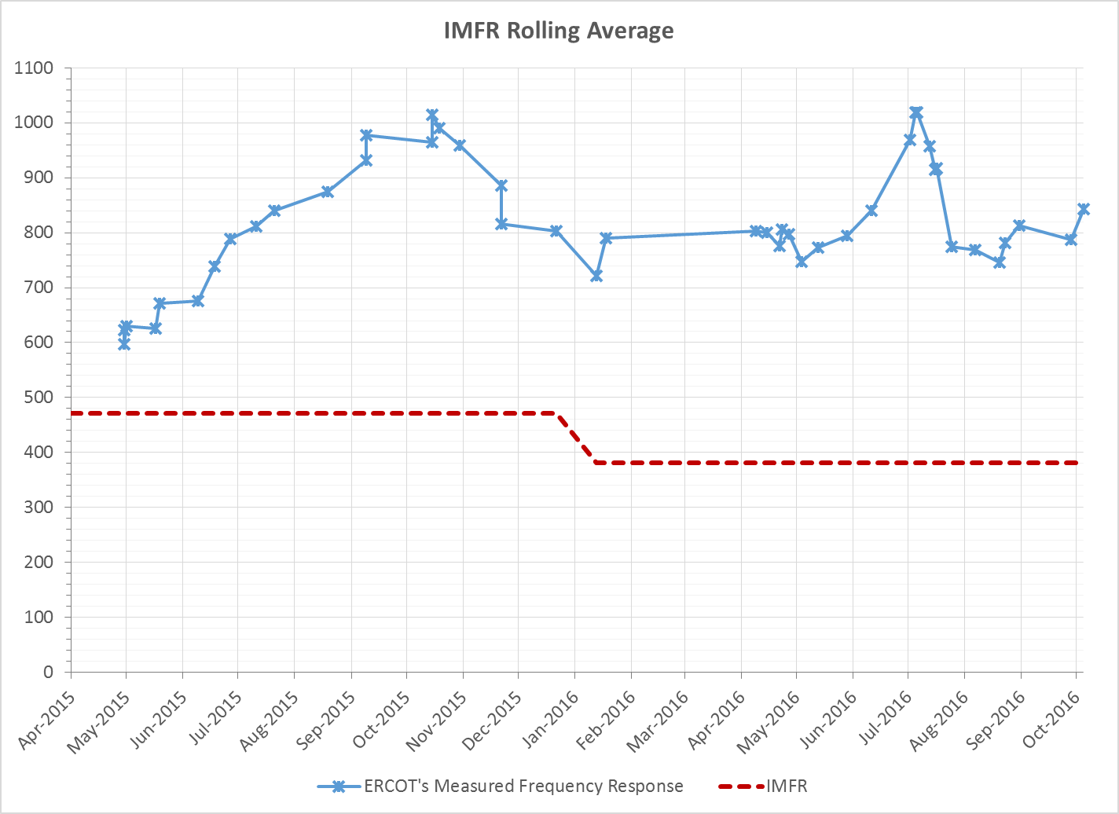
Interconnection Minimum Frequency Response (IMFR) Performance
IMFR Performance currently 843.14 MW/0.1Hz

Slide 9
Frequency Control Report
October 2016

Slide 10
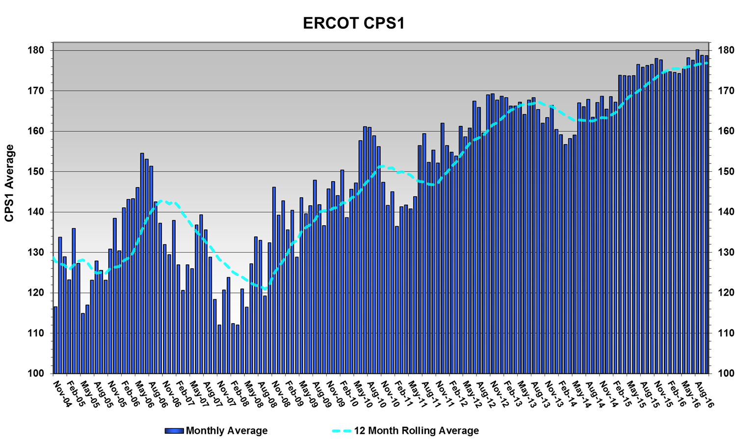
CPS1 Performance
CPS1 12 Month Rolling Average = 176.92%

Slide 11
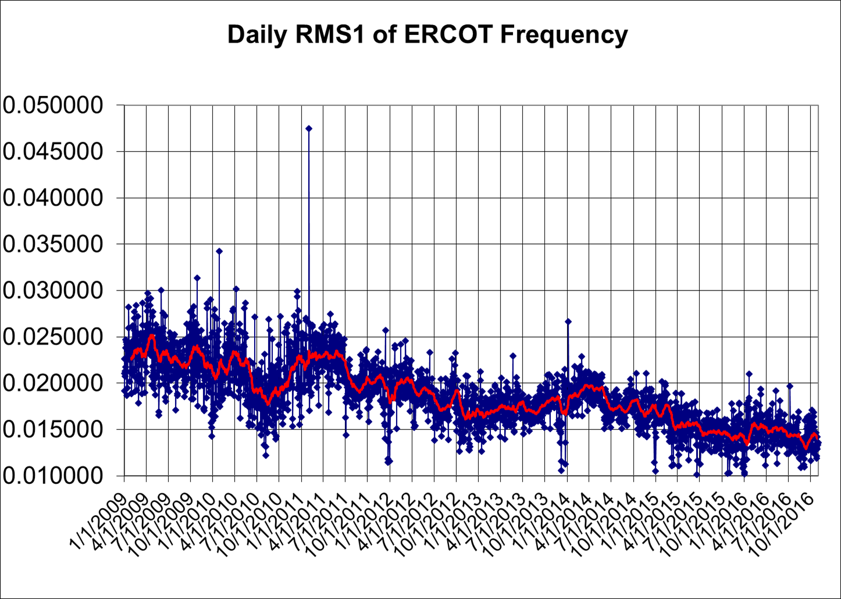
RMS1 Performance of ERCOT Frequency

Slide 12
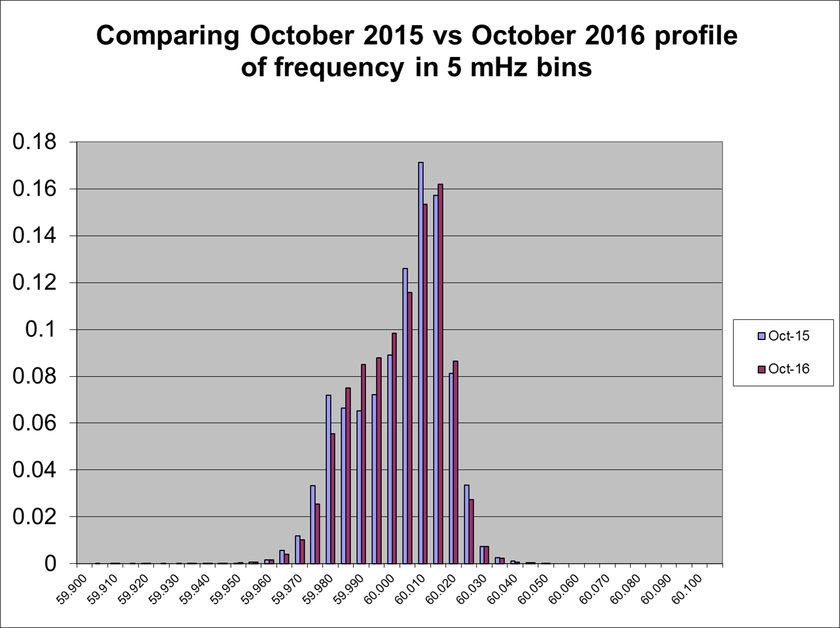
Frequency Profile Analysis
Year | Low Side (<60Hz) | High Side (>60Hz)
2015 | 174.27 | 178.27
2016 | 175.73 | 181.02
Year | Mean | Standard Deviation (from 60Hz)
2015 | 60.00007 | 0.014506
2016 | 60.00005 | 0.014026

Slide 13
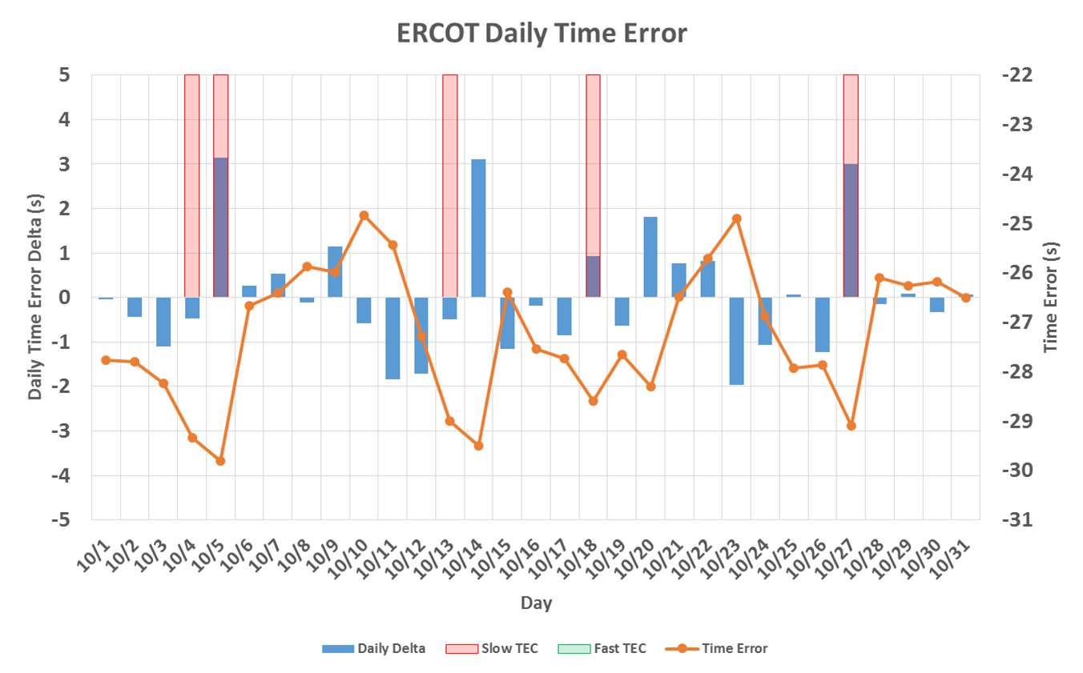
Time Error Corrections
There were 5 Time Error Corrections (TEC) in October.

Slide 14
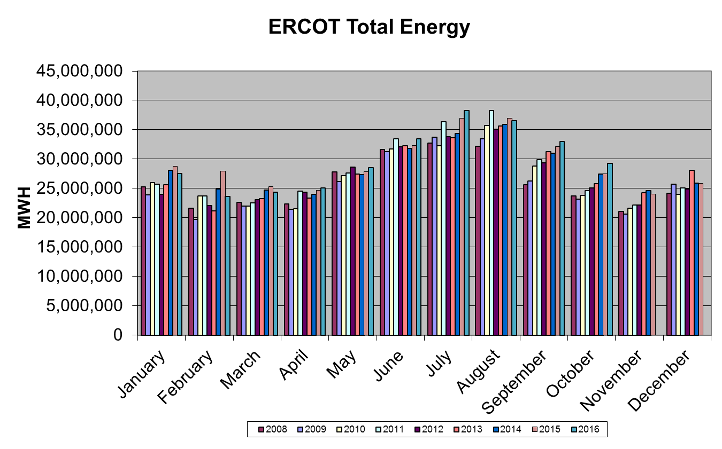
Wind Generation Performance

Slide 15
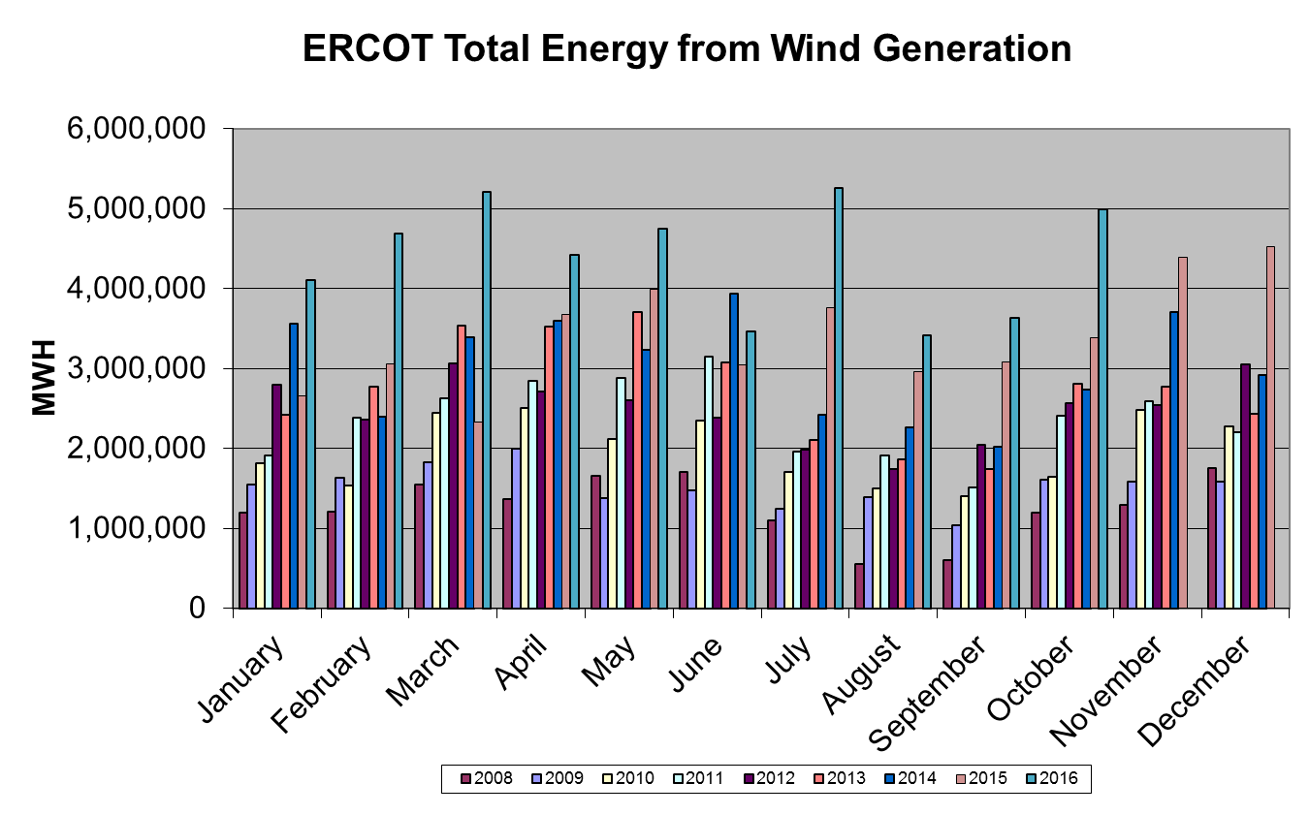
Wind Generation Performance

Slide 16
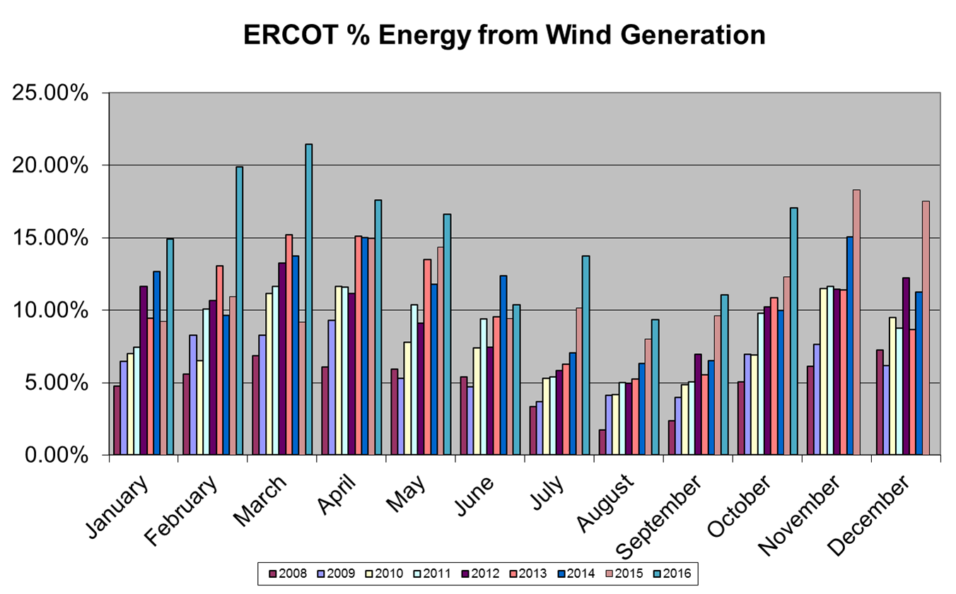
Wind Generation Performance

Slide 17
Questions?

