Slide 1
Requiem for DREAM

Slide 2
NPRR 777 Shortcomings
As identified by stakeholders
What about ancillaries?
What about nodal dispatch and settlement?
Resources must be paid nodal, 777 pays a resource load zone

Slide 3
Ancillaries
NPRR 777 was authored assuming that distributed resources that could respond as a reserve would be best suited for ERS.
Numerous providers expressed interest in providing Non-Spin and Responsive Reserve Service.
The NPRR targeted price-responsive distributed generators, and did not consider future deployment of storage providers.

Slide 4
Nodal Settlement
ERCOT, among others, expressed concern that with high DG penetration, continuing to settle DG at Zonal would be a retreat from the concept and goals of a Nodal market.
DREAM meetings focused on system limitations associated with establishing many resource nodes to accommodate distributed resources.
Mobile generators also create unique issues for efficient participation in energy and CRR markets.

Slide 5
Resources must be paid a nodal price
NPRR 777 was authored to leverage existing settlement structures, and extend them to distributed resources based upon a load-zone price and dispatch.
PUC rule requires Resources be paid a nodal price.
What is a generator but is not a Resource?

Slide 6
Updated Strategy
Create an option for price-responsive distributed resources to participate in an ERCOT dispatch.
A. Improved market transparency
B. Efficient price formation
C. Improved ERCOT awareness and control
Streamline the ERCOT interconnection process to eliminate steps unnecessary for distributed resources, such that distributed resources have a reasonably onerous process to become a “Diet Generation Resource.”
A. Enable a more efficient dispatch
B. Enable participation in all ancillaries
Notes:
(e.g. bypass ERCOT interconnection studies where minimum load on the DGR feeder is greater than Pmax on the DGR)

Slide 7
Updated Strategy
Leverage existing ERS structures*, enhance the program to allow ERS resources to telemeter an offer to deploy based upon price.
Utilize existing M&V
Allow ERS to deploy for price, potentially outside of an ERCOT deployed emergency
Enable ERS to resolve local congestion based upon price

Slide 8
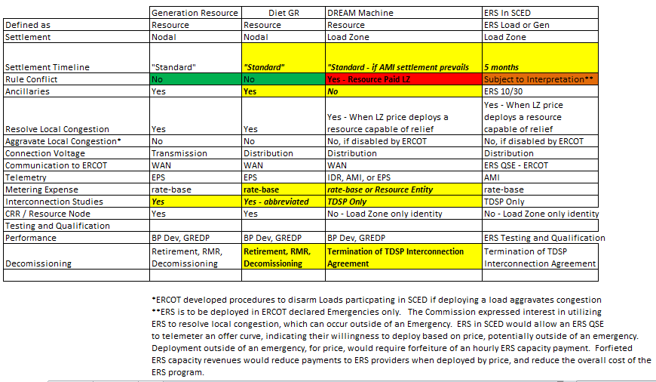
The EWG Matrix

Slide 9
Repackaging
DREAM awakens as ERS in SCED
Major change: Leverage ERS protocols and practices, rather than Resource protocols and practices.
Benefit:
Potential to reduce cost of ERS program (ERS participants forfeit capacity payments when deployed for price)
Detriment:
ERS timeline for settlement is lengthy

Slide 10
Repackaging
Right-size the ERCOT interconnection process for distributed resources
Enable a nodal dispatch
Enable participation in ancillary services
Leverage existing protocols and practices for Generation Resources
Comply with PUC rule

Slide 11
Questions?

