Slide 1
ERCOT
Retail Market Training
Task Force
Update to RMS
Tuesday, November 1st, 2016

Slide 2
Retail Training Instructor Led Classes - 2017
Tentative Training Roadshow for 2017
AUSTIN Georgetown Library
        Retail 101 – Tues, January 31st, 2017
        MarkeTrak 101 – Wed, February 1st, 2017
DALLAS Oncor
        Retail 101 – Wed, May 3rd, 2017
        Inadvertent GainTraining – Thurs, May 4th
HOUSTON CenterPoint
        Retail 101 - September
        Inadvertent GainTraining - September

Slide 3
September Instructor Led Classes – Houston
S U C C E S S !!!
Retail 101 participants – September 27th
  39 classroom
  57 WebEx
MarkeTrak 101 participants – September 28th
  45 classroom
  30 WebEx

Slide 4
MarkeTrak On-line Training Modules Update!
  Marketrak Overview
  Switch Hold Removal
  Cancel With/Without Approvals
  Inadvertent Gains/Losses & Rescissions
  Usage and Billing
  Other D2D Subtypes
  Bulk Insert
  MarkeTrak Admin Functionality
  Data Extract Variances (DEV) LSE Subtypes – Upcoming!
  Data Extract Variances (DEV) Non-LSE Subtypes - Upcoming!
  Background Reporting
  GUI Reporting
  Emails and Notifications

Slide 5
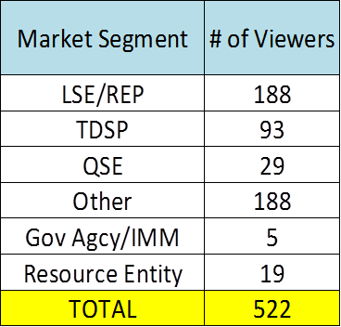
MarkeTrak On-line Module Training via
ERCOT Learning Management System
How many market participants have viewed the Online training modules*?
Which segment of the market do the viewers represent?
*Training taken via ERCOT LMS. Does not include training taken outside the LMS

Slide 6
MarkeTrak On-line Training Module Series
How do I register for Training?
Go to the ERCOT Training Website at http://www.ercot.com/services/training/
Select the course you are interested in attending
On the ‘Schedule/Registration’ tab, select the ‘enroll online’ link under ‘Registration’ to register for the course.
If you find the course is not listed under the Web-based training…
Go to ERCOT Training Website as shown above
Select the ‘ERCOT Learning Management System’ (LMS) link in the upper right hand corner under RELATED CONTENT
If necessary, set up a log on
Once in LMS, follow drop downs for ‘web-based training’ and ‘retail market’. Available modules will appear
Select ‘start course’
Note! Most modules are able to be completed in less than 30 minutes.

Slide 7
Please join us for our Next RMTTF Meeting
November 3rd, 2016
9:30 AM to 3:30 PM
ERCOT Met Center
Room 102

Slide 8
Thank you!

