Slide 1
Multi-Interval Real-Time Market (MIRTM)
Update to SAWG
ERCOT Staff
Market Design & Analysis
October 24, 2016

Slide 2
Today’s Agenda
Overview of recent activity
Refresher on study inputs and outputs
For all study days, review and compare all of the Separate Commitment and Dispatch MIRTM runs

Slide 3
MIRTM - Changes since September SAWG
Changes made after discussion with Market Participant’s at last SAWG:
GTBD in first interval altered in both Sequential SCED and MIRTM
$$GTBD\left(i\right)=\left\{\begin{aligned}SCED GTBD i=1 \\ TelemMW_{0}+\left(STLF_{i}−STLF_{0}\right)+\left(DCTie_{i}−DCTie_{0}\right) all intervals \end{aligned}\right.$$
TelemMW₀ = Sum of Telemetered Gen output at MIRTM Run time
i = 5-Minute MIRTM Intervals Within Study Window
(ex: i=6 represents 30 Min. Ahead)
Include Start Up and Minimum Energy calculation in Sequential SCED in order to be consistent with MIRTM
Update Energy Offer Curve for fast responding resources based on commitment decision in Production (suggested by IMM after the SAWG meeting):
If the Resource was self committed in production and the EOC is lower in production, then use the lower offer in MIRTM instead of the higher “bucketed average” value
If the Resource was in QS mode in production, use the “bucketed average” value in MIRTM (assumes that the production EOC would have considered some value for SU/ME)

Slide 4
MIRTM - Changes since September SAWG
Changes made after discussion with Market Participant’s at last SAWG:
For Sequential SCED, Add to production cost the estimate of Start Up and Minimum Energy cost in order to be consistent with MIRTM
Update Energy Offer Curve for fast responding resources based on commitment decision in Production (suggested by IMM after the SAWG meeting):
If the Resource was self committed in production and the EOC is lower in production, then use the lower offer in MIRTM instead of the higher “bucketed average” value
If the Resource was in QS mode in production, use the “bucketed average” value in MIRTM (assumes that the production EOC would have considered some value for SU/ME)

Slide 5
MIRTM - Changes since September SAWG cont.
Changes made after detailed analysis of results
ERCOT staff corrected the treatment of start-up cost which had been incorrectly scaled relative to Minimum Energy Cost and Energy Offer Cost
For some LR, input data error in the ramp period (notification time) error was corrected
ERCOT staff re-ran all of the study data after data changes

Slide 6
Study Runs
For all the study days we will step incrementally through the progression of studies as follows:
Production SCED (information only)
Sequential SCED
MIRTM with Separate Commitment and Dispatch:
Loads only with QSGR not committable to mimic production (LOAD)
QSGRs have three-part offer based on average Verifiable Costs (3PO)

Slide 7
Study Process
Determine the study period based on the day of interest and run a sequential SCED for the entire study period using the Energy Offers from actual Real Time SCED runs.
Sequential SCED considered the “baseline” that simulates all resources following base points while the GTBD is consistent with MIRTM.
Run MIRTM Separate Commitment and Dispatch with QSGR Production EOC replaced with 3PO as inputs
Use new STLF and Wind Persistence to “look ahead” 30 minutes to determine if commitments needed

Slide 8
Study Process
Calculate Production Costs: Four Components
Generation Costs: Integrate Step 2 EOC from LSL to BP + Power Balance Violation
Transmission Penalty Cost: Violated MW * Shadow Price
QSGR Startup/Mingen Cost: Startup and Minimum Energy Costs
Blocky Load Cost: Bid Price * Commit MW
Calculate Make Whole
QSGR Make whole across entire study period
Prod. SCED & Seq. SCED: Emergency Operations QSGR payments (Per 6.6.9 (3))
MIRTM: Max(0,QSGR Verifiable Cost - QSGR Revenue)
Blocky Load Make whole across entire study period
MIRTM: Max(0, [Bid Price * Commit MW] -[Binding LMP * Commit MW])
Notes:
QSGR revenue:
(Binding LMP + Operating Reserve Demand Curve (ORDC) Online Price Adder + Pricing Run Price Adder) * Binding Base Point of Committable QSGR Unit List
QSGR Verifiable cost:
QSGR Verifiable Cost Above LSL - Integrate Input EOC or Verifiable Cost EOC (if no QSGRs in MIRTM) from LSL to BP of Committable QSGR Unit List
plus
QSGR Startup/Mingen Cost of Committable QSGR Unit List - Startup and Minimum Generation Costs of Committable QSGR Unit List

Slide 9
Simulation Assumptions – Blocky Load Resources
Offers were received for 12 Blocky Loads from DSWG
A total of 366 MW split between the load zones (each zone has 12 resources)
Load Resource | $/MWh | MW | Ramp Period | Minimum Run Time | Maximum Run Time | Return to Service Time
1 | 200 | 40 | 10 Min. | 15 Min. | 48 hours | 24 hours
2 | 250 | 50 | 10 Min. | 15 Min. | 4 hours | 0 hours
3 | 250 | 100 | 10 Min. | 15 Min. | 0.5 hours | 0.5 hours
4 | 300 | 1 | 10 Min. | 15 Min. | 1 hour | 1.5 hours
5 | 498 | 30 | 15 Min. | 15 Min. | 1.25 hours | 2 hours
6 | 500 | 5 | 15 Min. | 15 Min. | 2 hours | 10 Min.
7 | 665 | 30 | 15 Min. | 15 Min. | 3 hours | 20 hours
8 | 800 | 30 | 15 Min. | 15 Min. | 2 hours | 5 Min.
9 | 1431 | 25 | 15 Min. | 15 Min. | 1.25 hours | 1 hour
10 | 2008 | 20 | 15 Min. | 15 Min. | 6 hours | 20 hours
11 | 2008 | 20 | 15 Min. | 15 Min. | 3 hours | 20 hours
12 | 3365 | 15 | 15 Min. | 15 Min. | 6 hours | 20 hours

Slide 10
Simulation Assumptions – Fast Generation Resource Temporal Constraints
All Resources that are Quick Start qualified are considered “fast responding resources”. If the Resource was “OUT” or “ONTEST” during the study period they are not considered as “committable”
Gas Turbines (36 units)
Minimum On Time | Minimum Off Time | Cold Start-Up Time | Intermedate Start-Up Time | Hot Start-Up Time
15 Min. | 15 Min. | 10-15 Min. | 10-15 Min. | 10-15 Min.
Reciprocating Engines (3 units)
Minimum On Time | Minimum Off Time | Cold Start-Up Time | Intermedate Start-Up Time | Hot Start-Up Time
5 Min. | 15 Min. | 10 Min. | 10 Min. | 10 Min.
Wartsilas (4 units)
Minimum On Time | Minimum Off Time | Cold Start-Up Time | Intermedate Start-Up Time | Hot Start-Up Time
5 Min. | 5 Min. | 5 Min. | 5 Min. | 5 Min.

Slide 11
Simulation Assumptions – Fast Responding Resources
Four average Verifiable Costs groups were identified.
Each Fast Responding Resources is assigned a group cost based on HRL/LSL
The Single Part offer is structured in order to recover Start Up and Minimum Energy cost over the Minimum On time and can vary due to individual units’ LSL
Minimum EOC and Min. Gen. is $75 if Resource had Non-Spin responsibility during study period

Slide 12
Simulation Assumptions – Fast Responding Resources
Sample of costs
Res Type | HRL (MW) | LRL (MW) | Seasonal LSL (MW) | Startup Cost ($) | Min-Energy Price ($/MWh) | Min EOC ($/MWh) | Max EOC ($/MWh)
SCLE90 | 54.0 | 10.0 | 13.0 | 4,322.05 | 52.39 | 30.86 | 33.91
SCLE90 | 60.0 | 0.0 | 12.0 | 3,448.99 | 48.85 | 28.47 | 31.05
SCLE90 | 95.0 | 0.0 | 41.0 | 6,058.75 | 56.12 | 40.35 | 41.88
DSL | 8.9 | 6.0 | 6.0 | 962.21 | 39.93 | 34.84 | 39.79
NOTE: Min EOC will be equal to the production EOC if the Resource was self committed in production and the EOC value is lower

Slide 13
Other Assumptions – Days Analyzed
The Capacity from all Fast Responding Resources is considered online in MIRTM study runs; this has the impact of changing the Operating Reserve Demand Curve (ORDC) calculation slightly; however, the resource capacity is only shifted from offline to online.
The Block Load Resources are considered “new” Resources for MIRTM which increases the RTOLCAP and shifts the curve to the right by 366MW.
The Reliability Deployment Price Adder in MIRTM treats the deployment by ERCOT as a “deployment event” therefore MIRTM may find a RTDP when Production and Sequential SCED did not.
MIRTM Commitment decisions are based on new short-term load forecast and DC tie schedule changes while dispatch uses production SCED GTBD based on old short-term load forecast ramp and regulation component

Slide 14
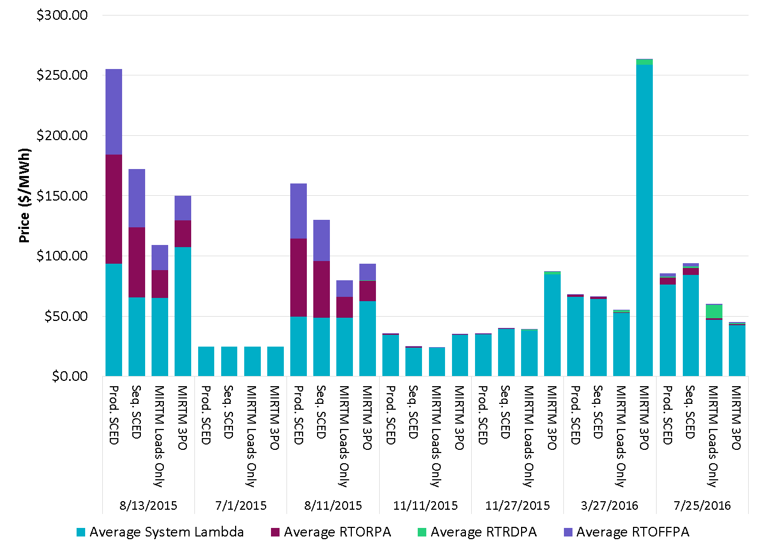
Average Price of All Study Dates

Slide 15
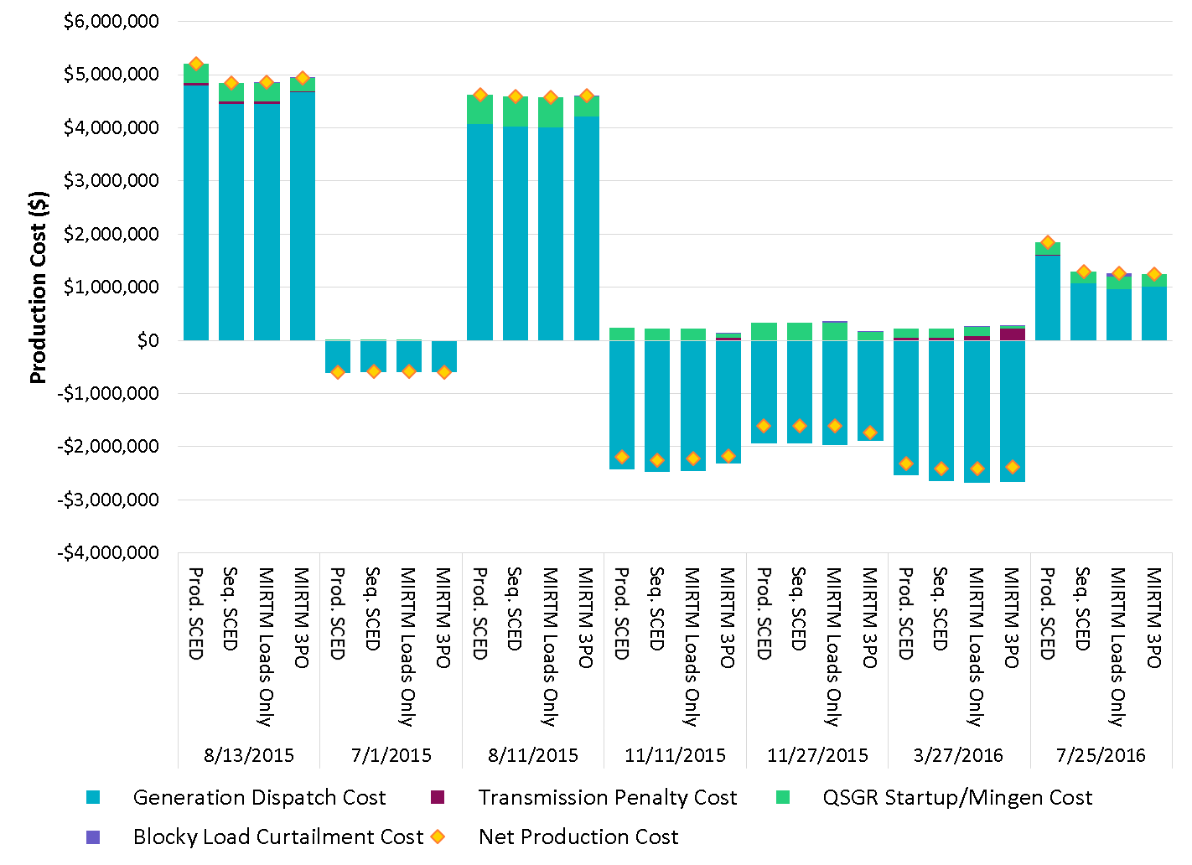
Production Cost of All Study Dates
Negative production costs are due to significant MW on output schedules. Production costs for those resources are -$250/MWh from LSL to output schedule.

Slide 16
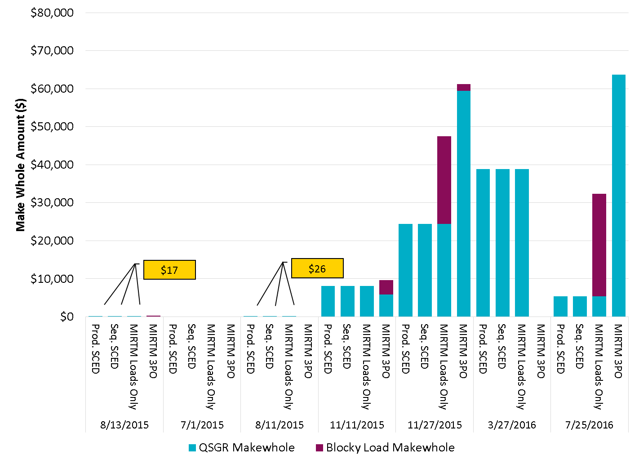
Make Whole Amounts of All Study Dates

Slide 17
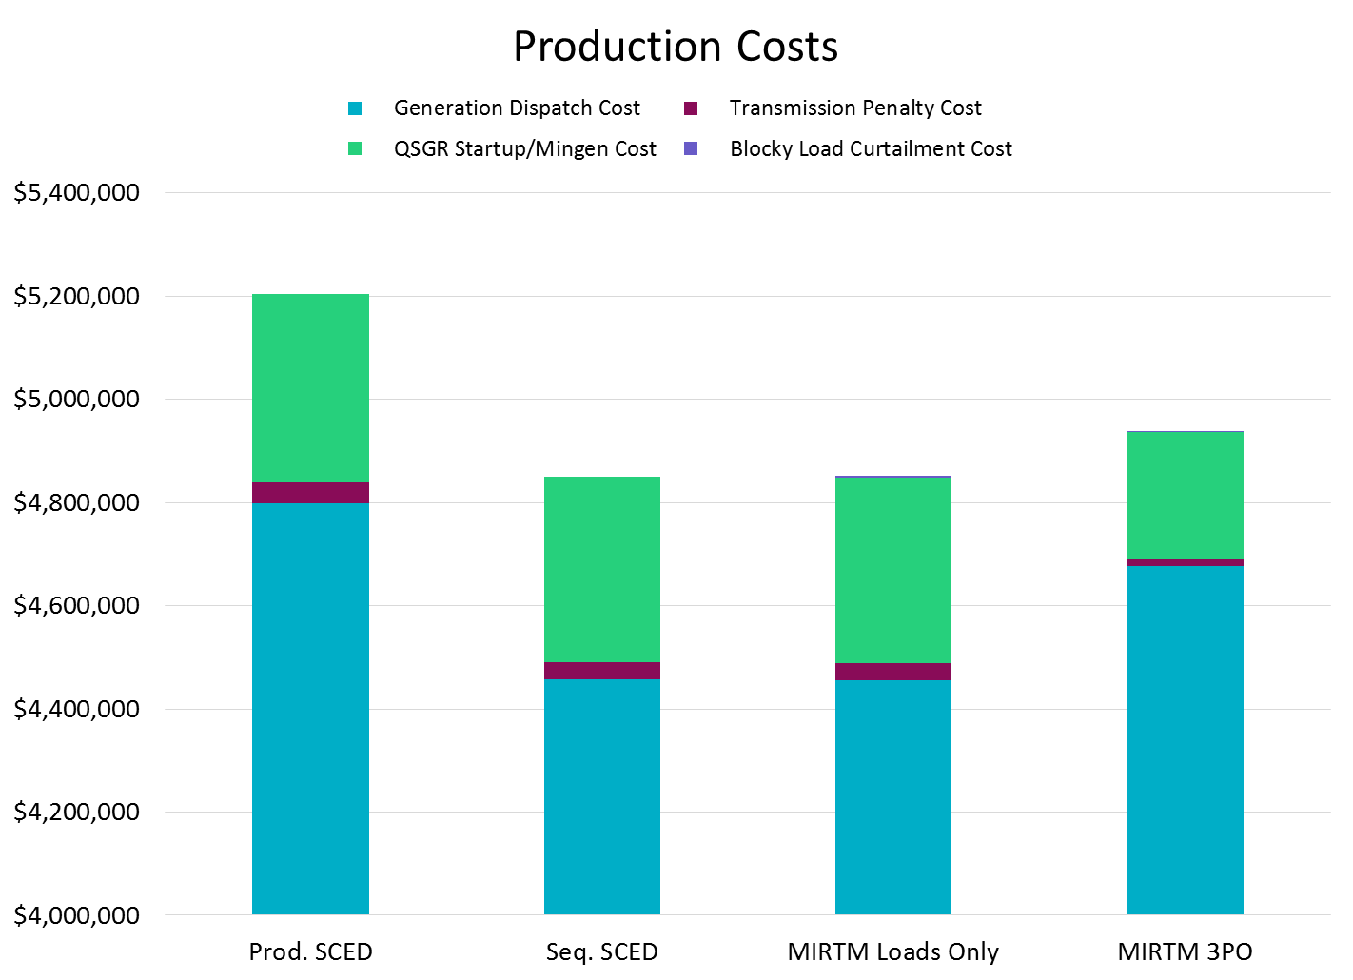
August 13, 2015

Slide 18
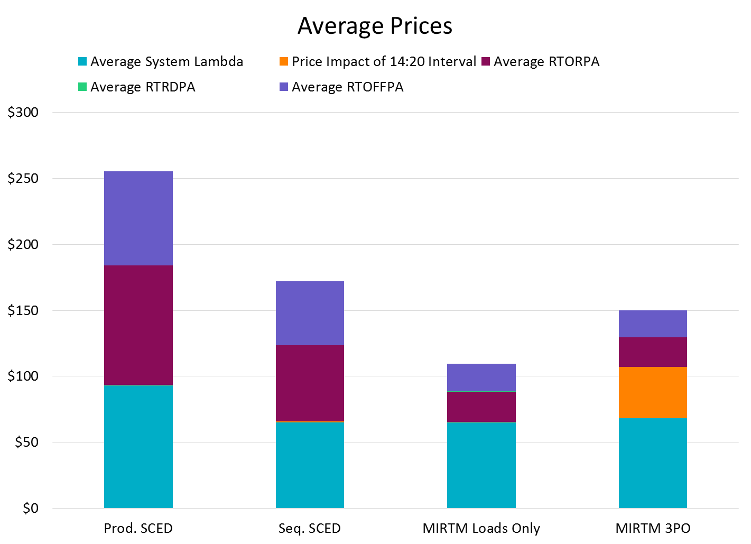
August 13, 2015
Changes in ORDC price adders due to NCLRRRS calculation change in Seq. SCED (NPC-LPC)
Changes in ORDC price adders due to 366 MW of new Blocky Load capacity in RTOLCAP
Impact of high price interval separated for all 4 scenarios

Slide 19
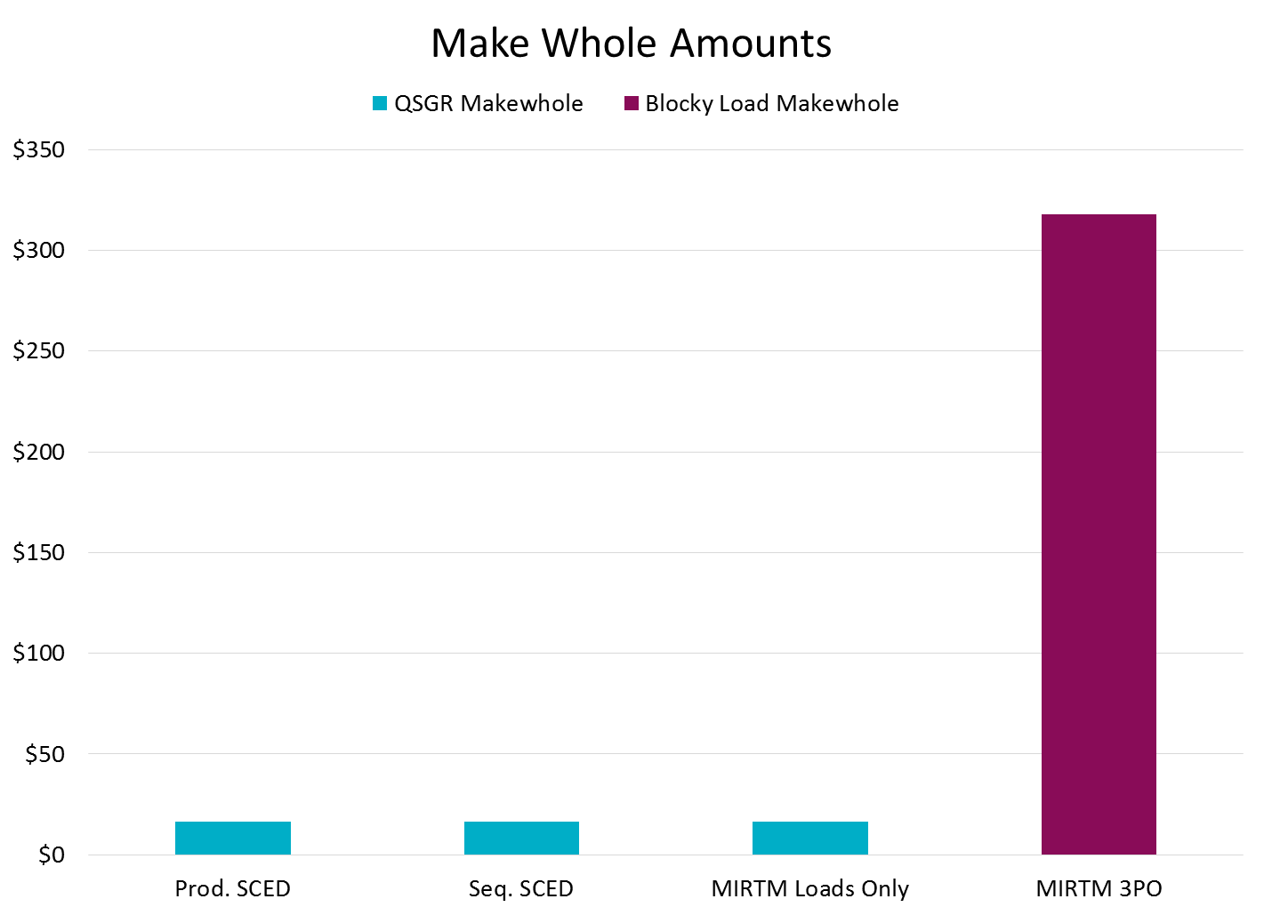
August 13, 2015

Slide 20
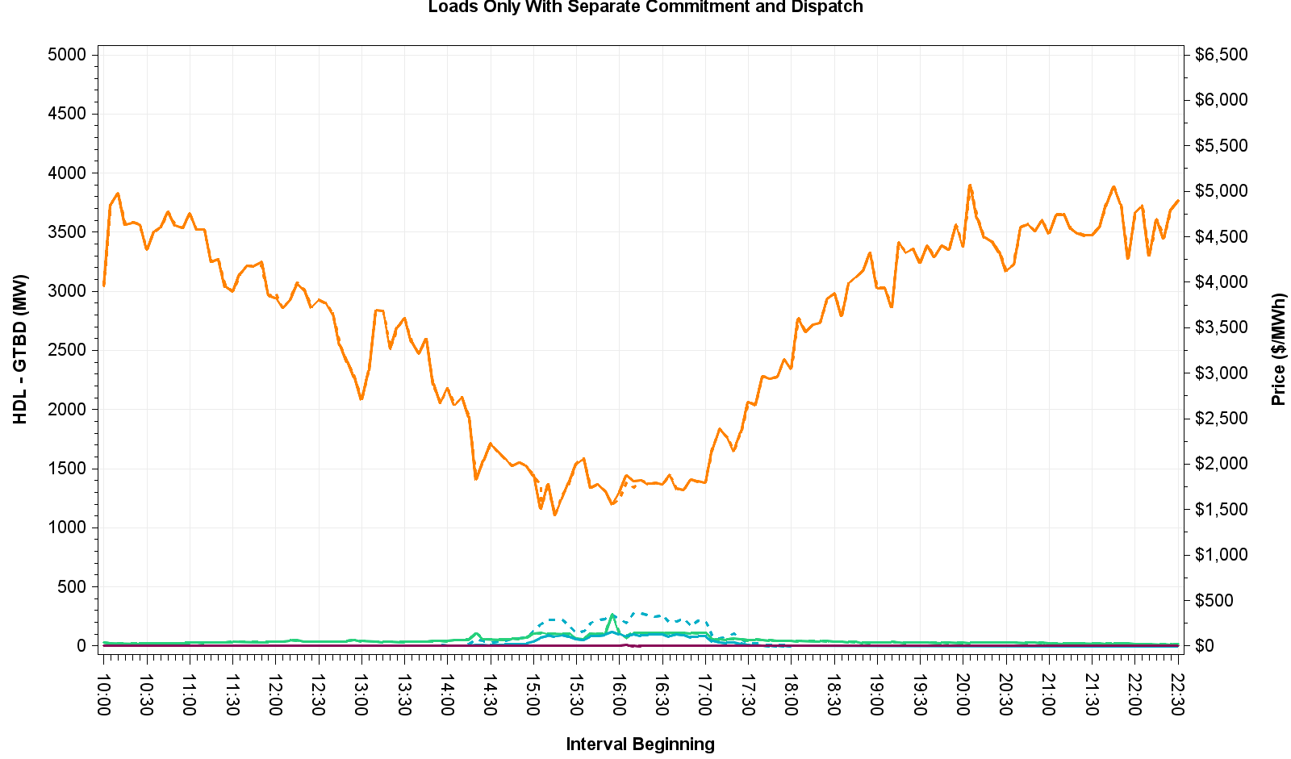
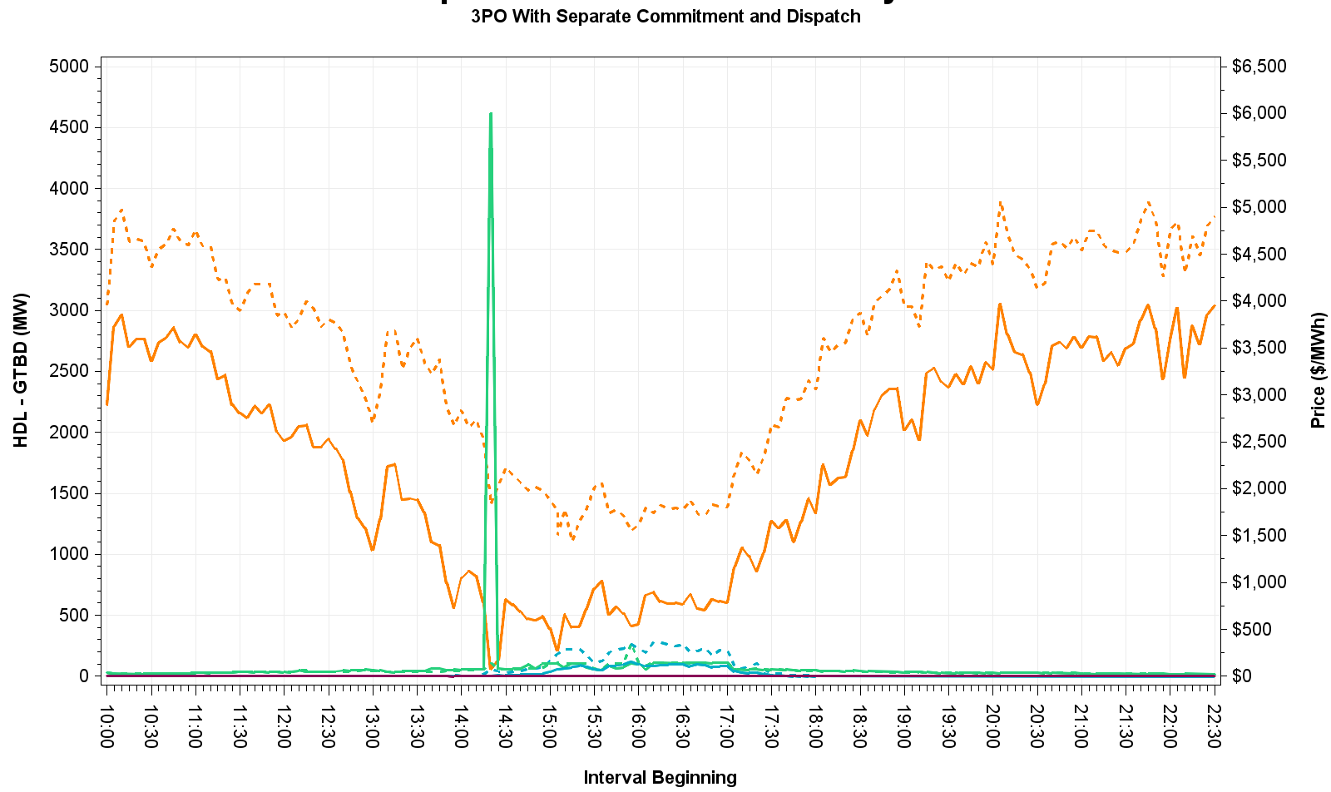
August 13, 2015 – HDL-GTBD & Price
Cause for price spike at 14:20 in MIRTM 3PO explained on next slide
HDL is reduced in MIRTM 3PO due to less QSGRs committed to be online by MIRTM

Slide 21
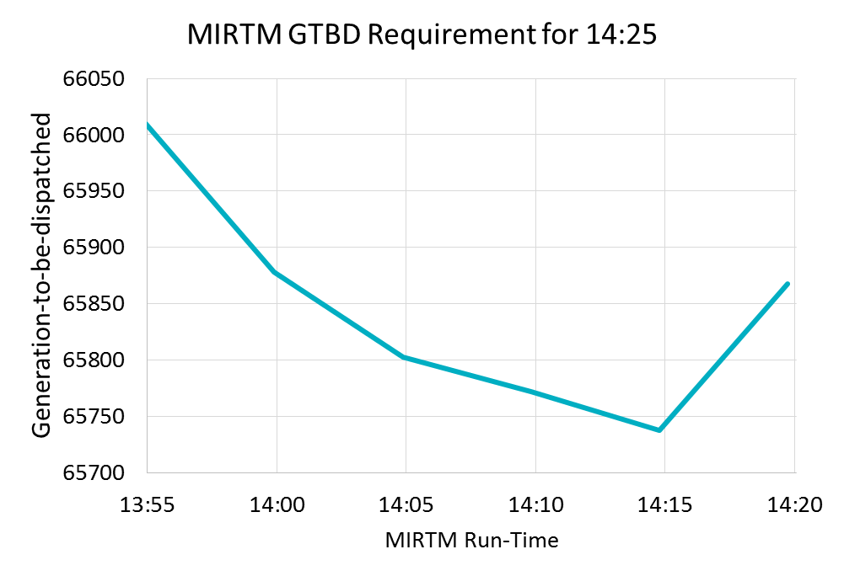
August 13, 2015
MIRTM 3PO had a spike due to a combination of a unit tripping (~160 MW) and missed load forecast
By waiting until the last minute, binding QSGR commitments were not made in this time frame due to forecast decrease

Slide 22
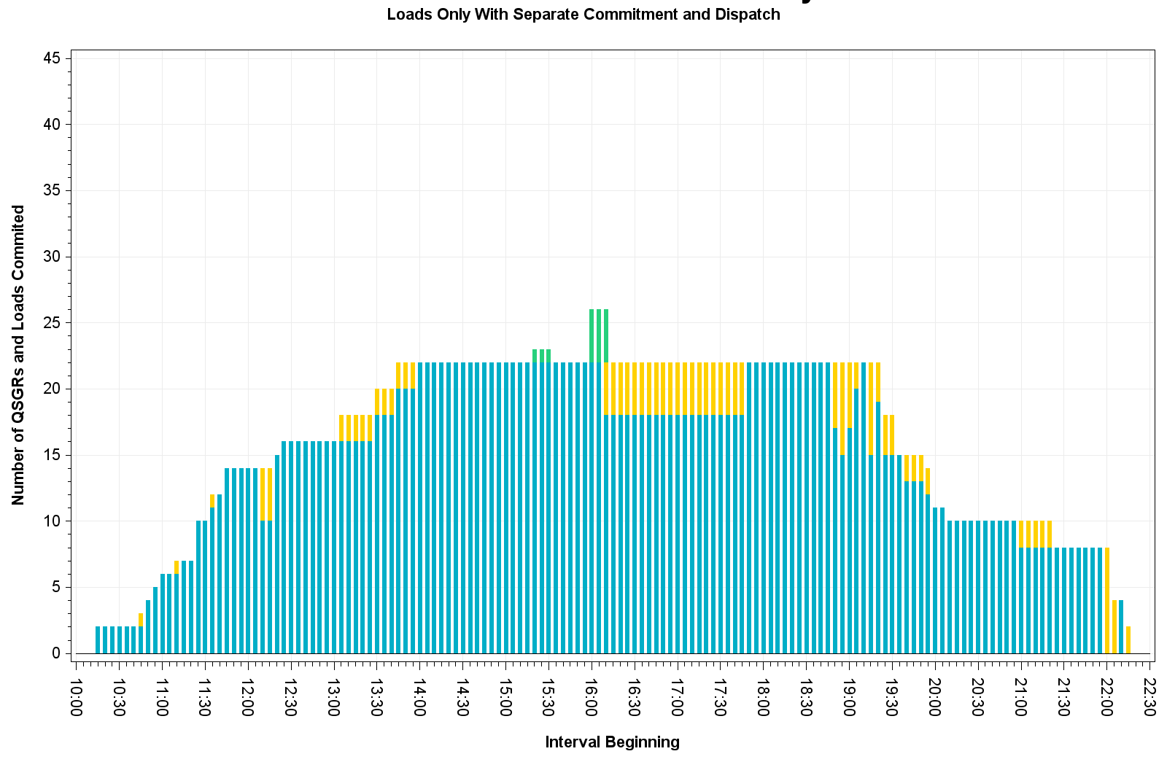
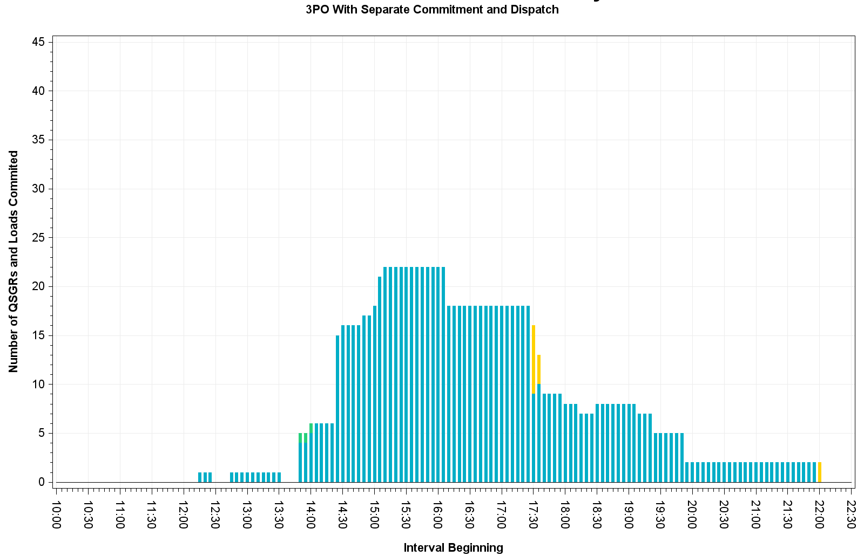
August 13, 2015 – Commitment Summary
Tighter QSGR commitment with MIRTM 3PO than with production self-commitment. Loads committed in both scenarios.

Slide 23
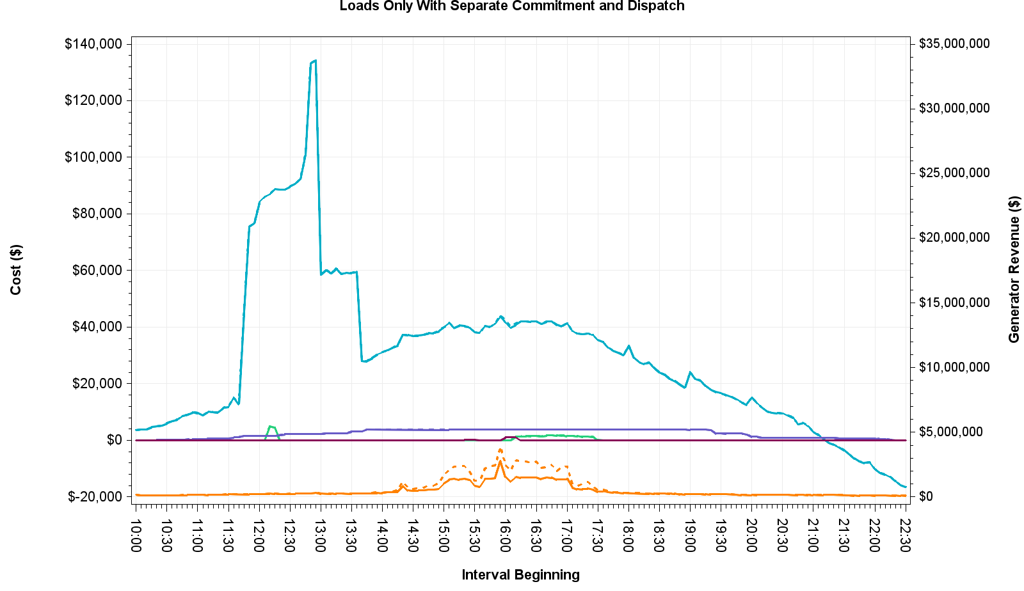
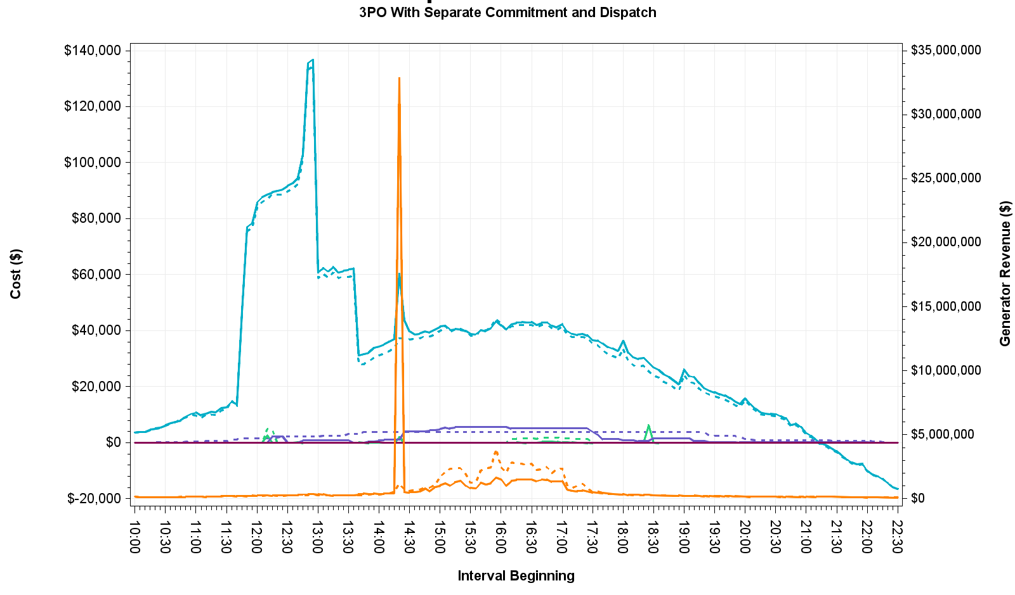
August 13, 2015 – Cost and Revenue

Slide 24
July 1, 2015 – Observations
Luminant Request
Little congestion and low system lambda
MIRTM 3PO prices slightly higher due to no QSGRs being committed and the load requirement distributed to rest of generation fleet

Slide 25
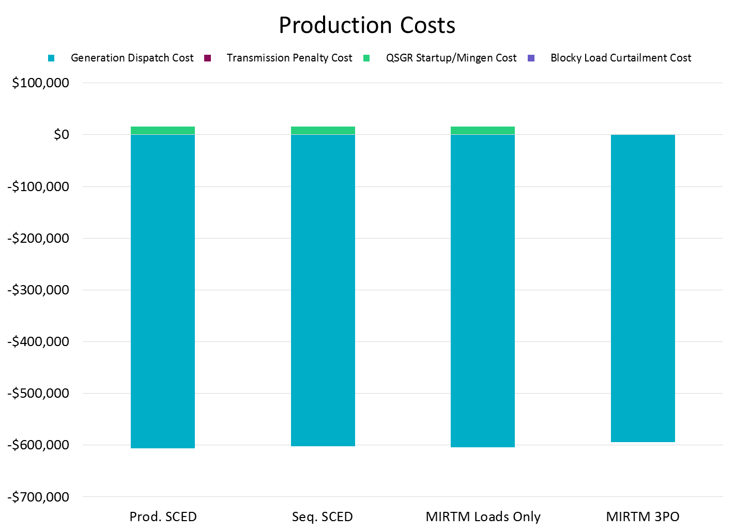
July 1, 2015
Negative production costs are due to significant MW on output schedules. Production costs for those resources are -$250/MWh from LSL to output schedule.

Slide 26
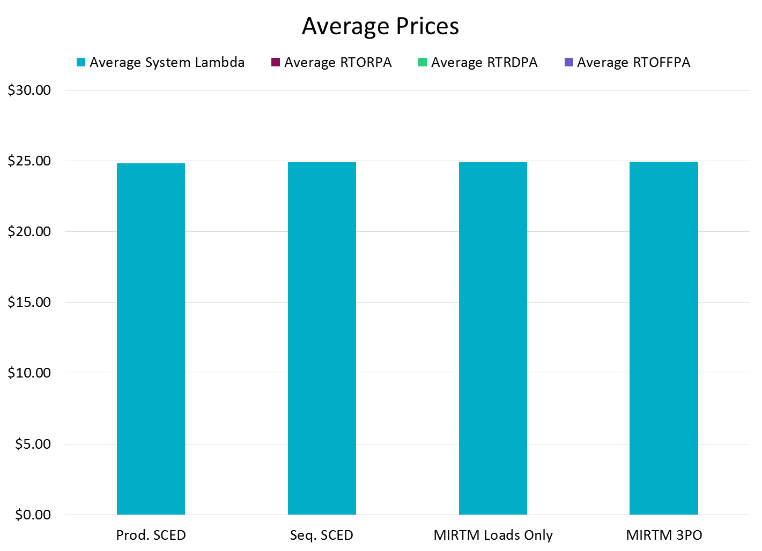
July 1, 2015

Slide 27
July 1, 2015
Zero make-whole on July 1, 2015

Slide 28
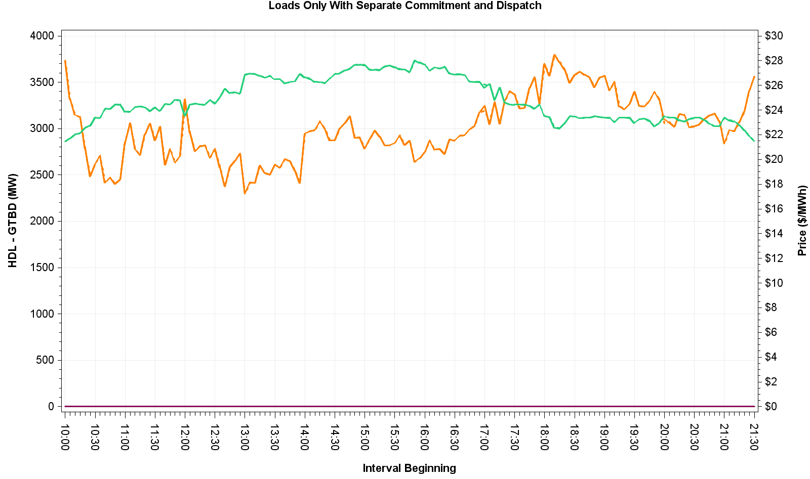
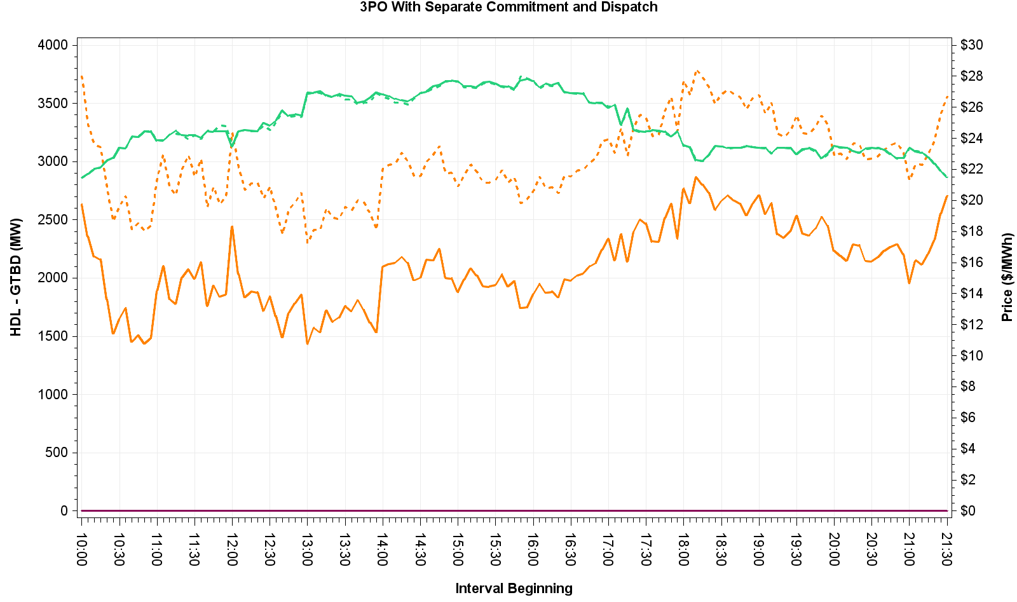
July 1, 2015 – HDL-GTBD & Price

Slide 29
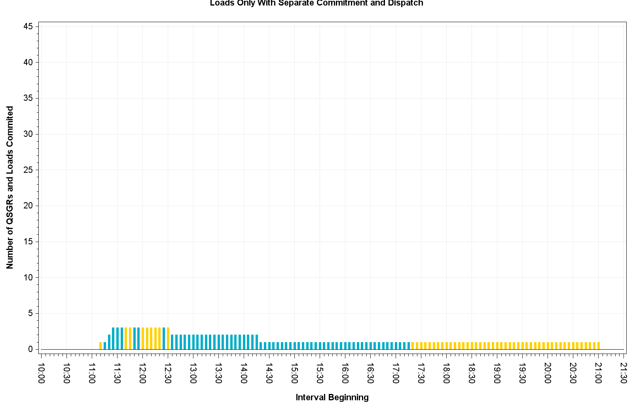
July 1, 2015 – Commitment Summary
These QSGRs mimic self-commitment in production
No QSGRs were committed in 3PO
Notes:
MIRTM Load Only commitment of QSGR is mimicking production self commitments.

Slide 30
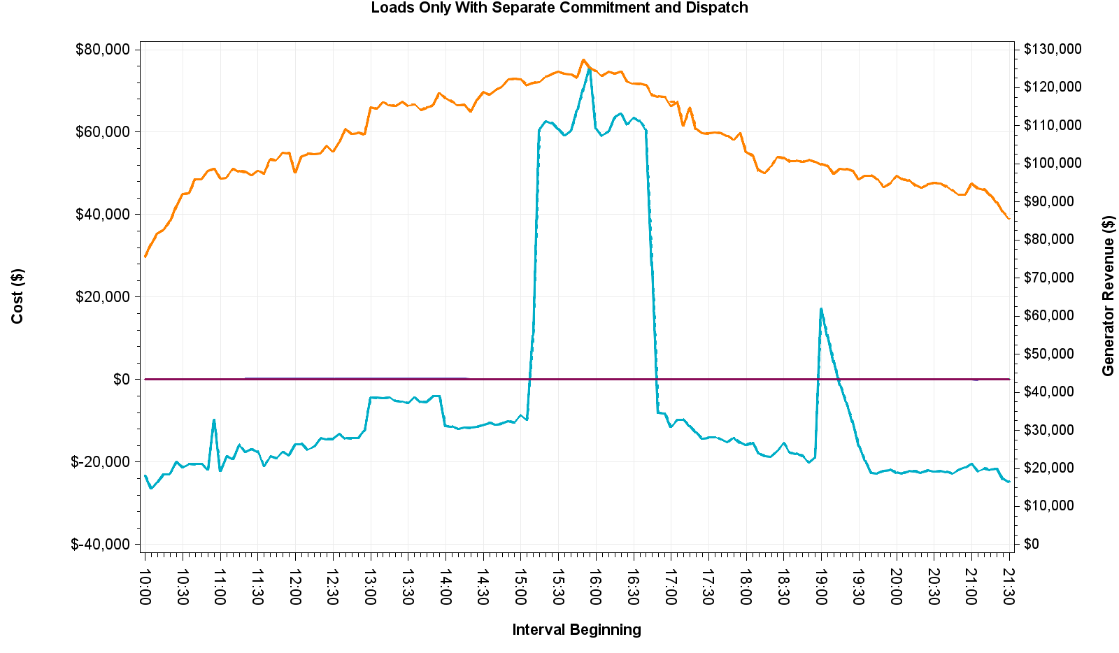
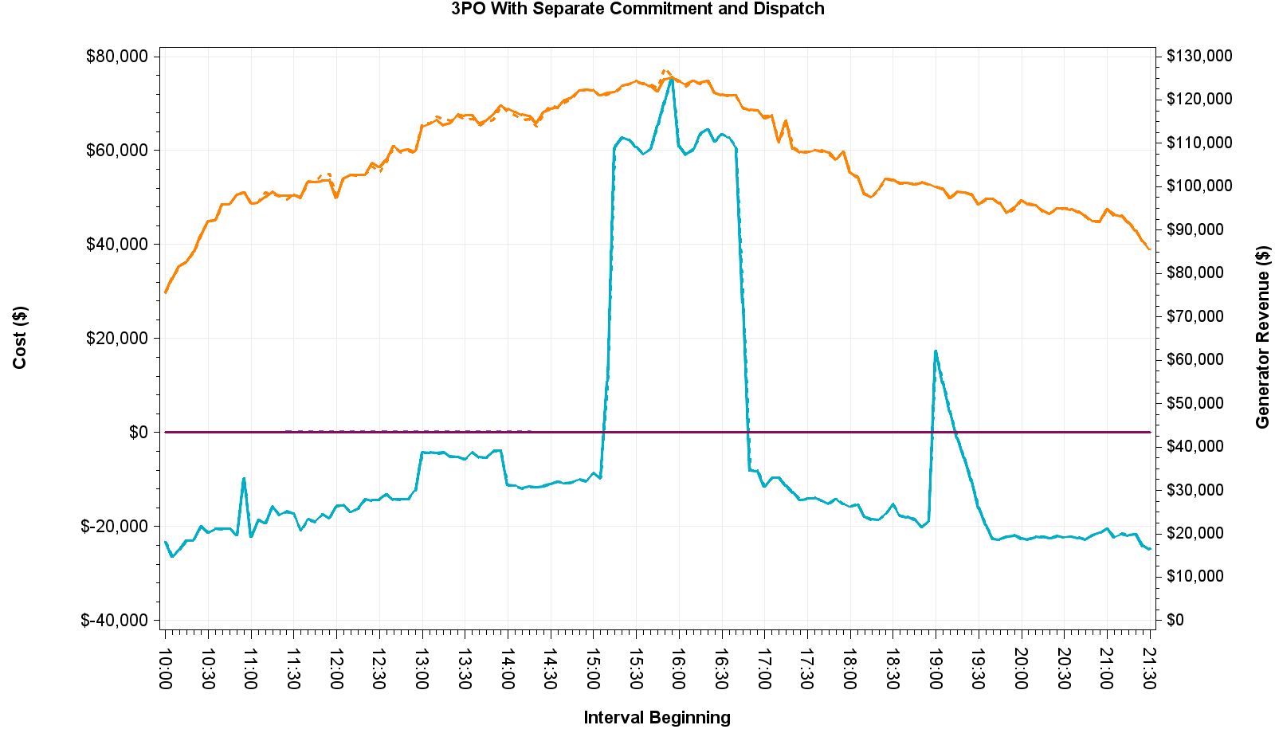
July 1, 2015 – Cost and Revenue

Slide 31
August 11, 2015 – Observations
Luminant Request
Little congestion and low dispatchable capacity
Higher LMP and dispatch cost in MIRTM 3PO scenario than Seq. SCED due to tighter QSGR commitment
MIRTM had no make-whole payments due to high ORDC price adders

Slide 32
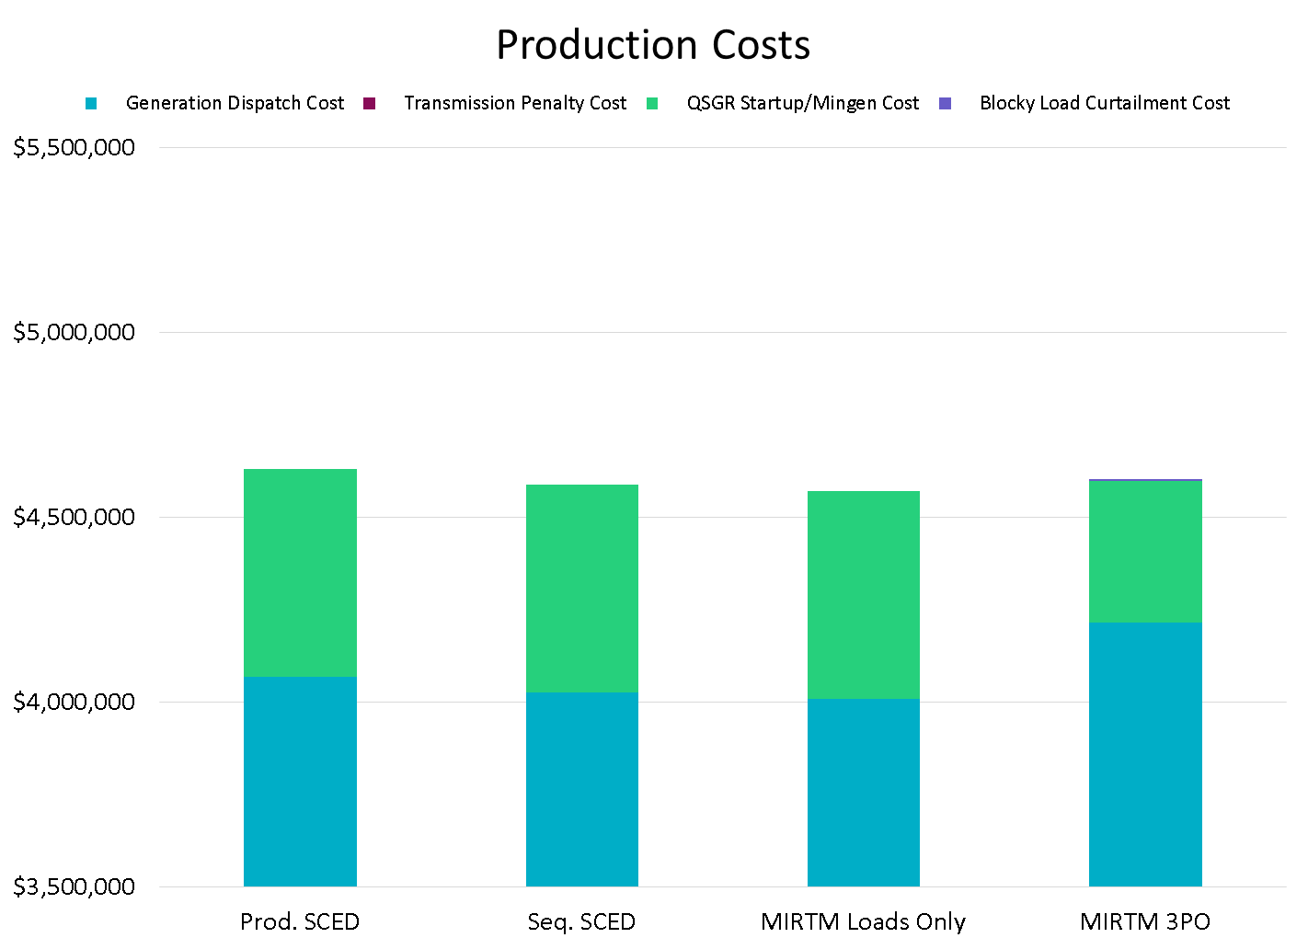
August 11, 2015

Slide 33
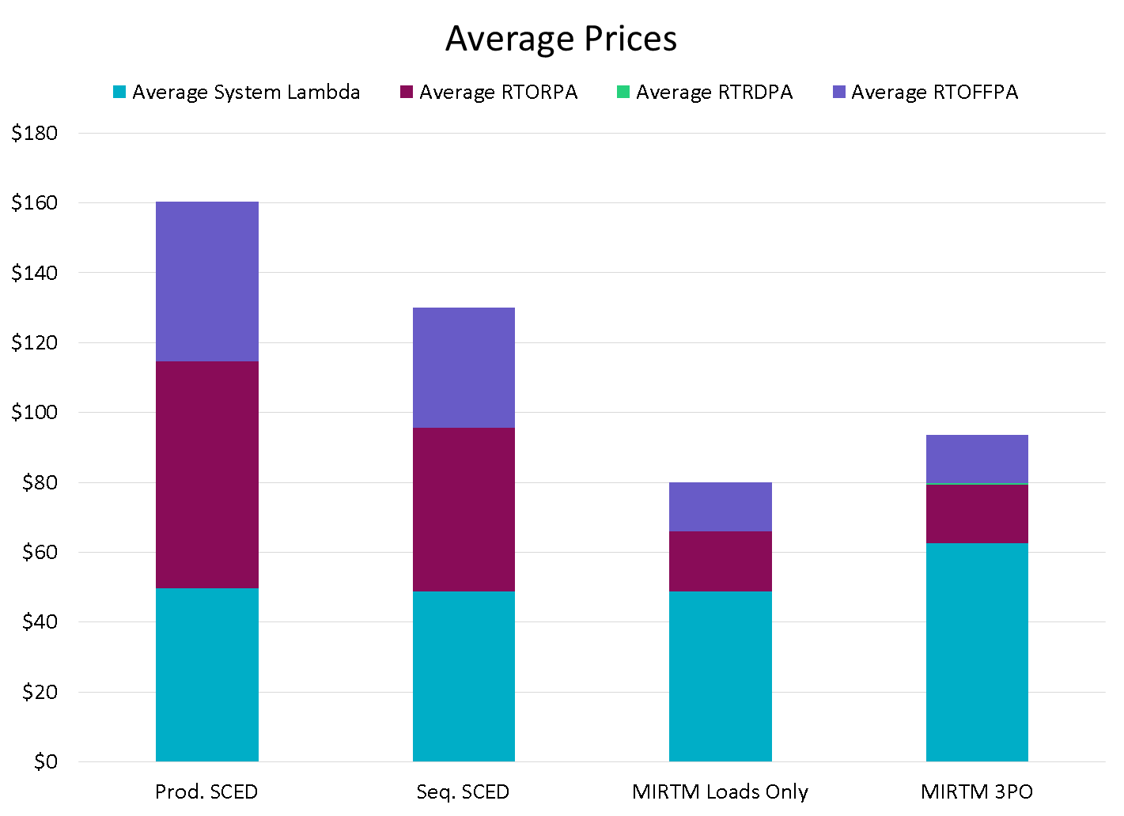
August 11, 2015

Slide 34
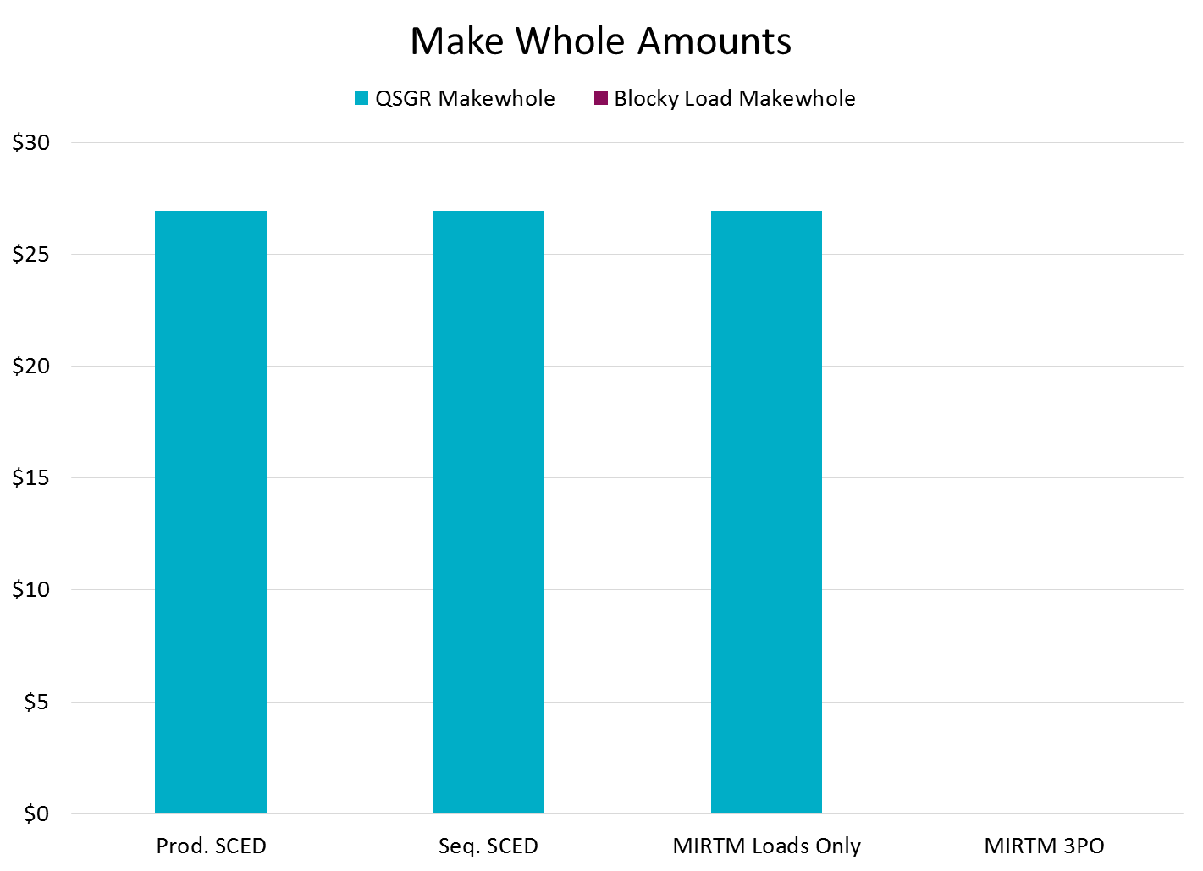
August 11, 2015
MIRTM study scenarios had no make-whole

Slide 35
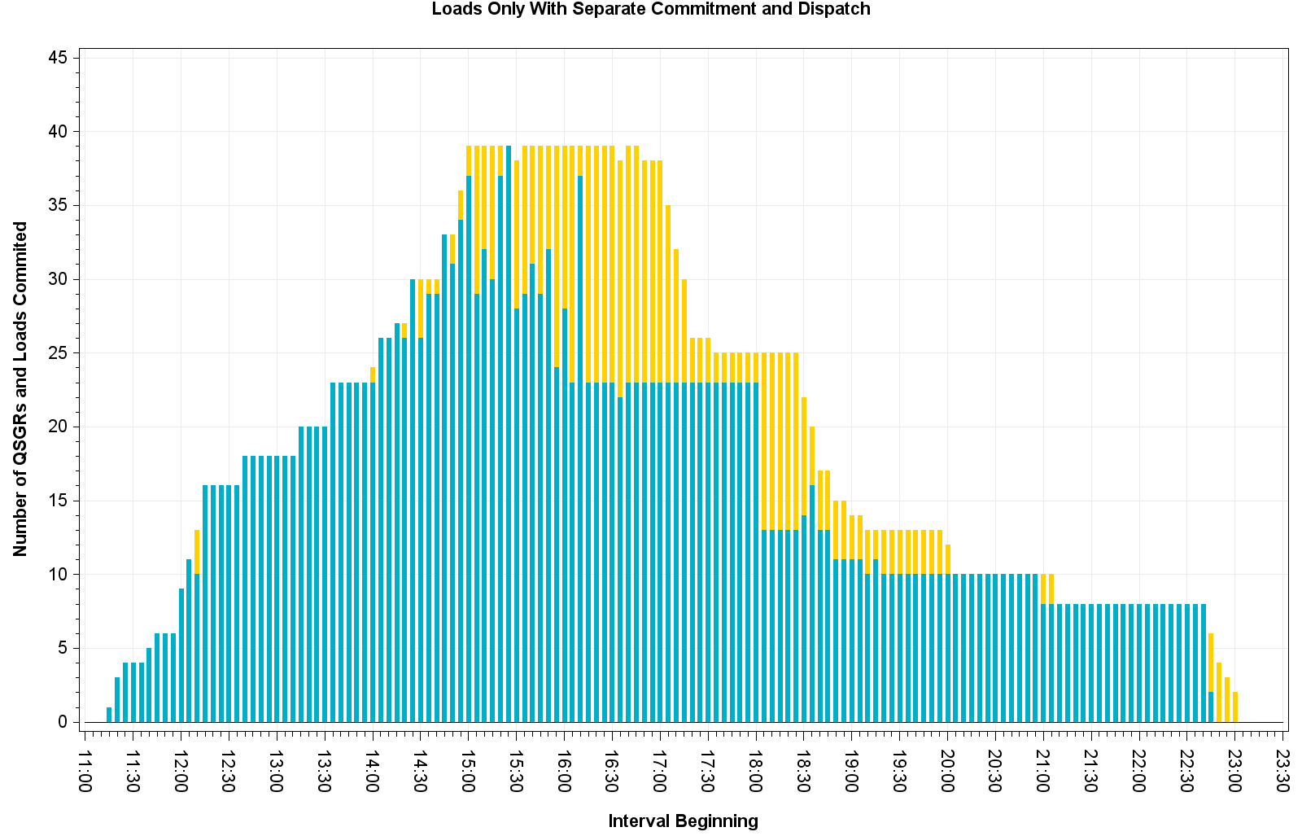
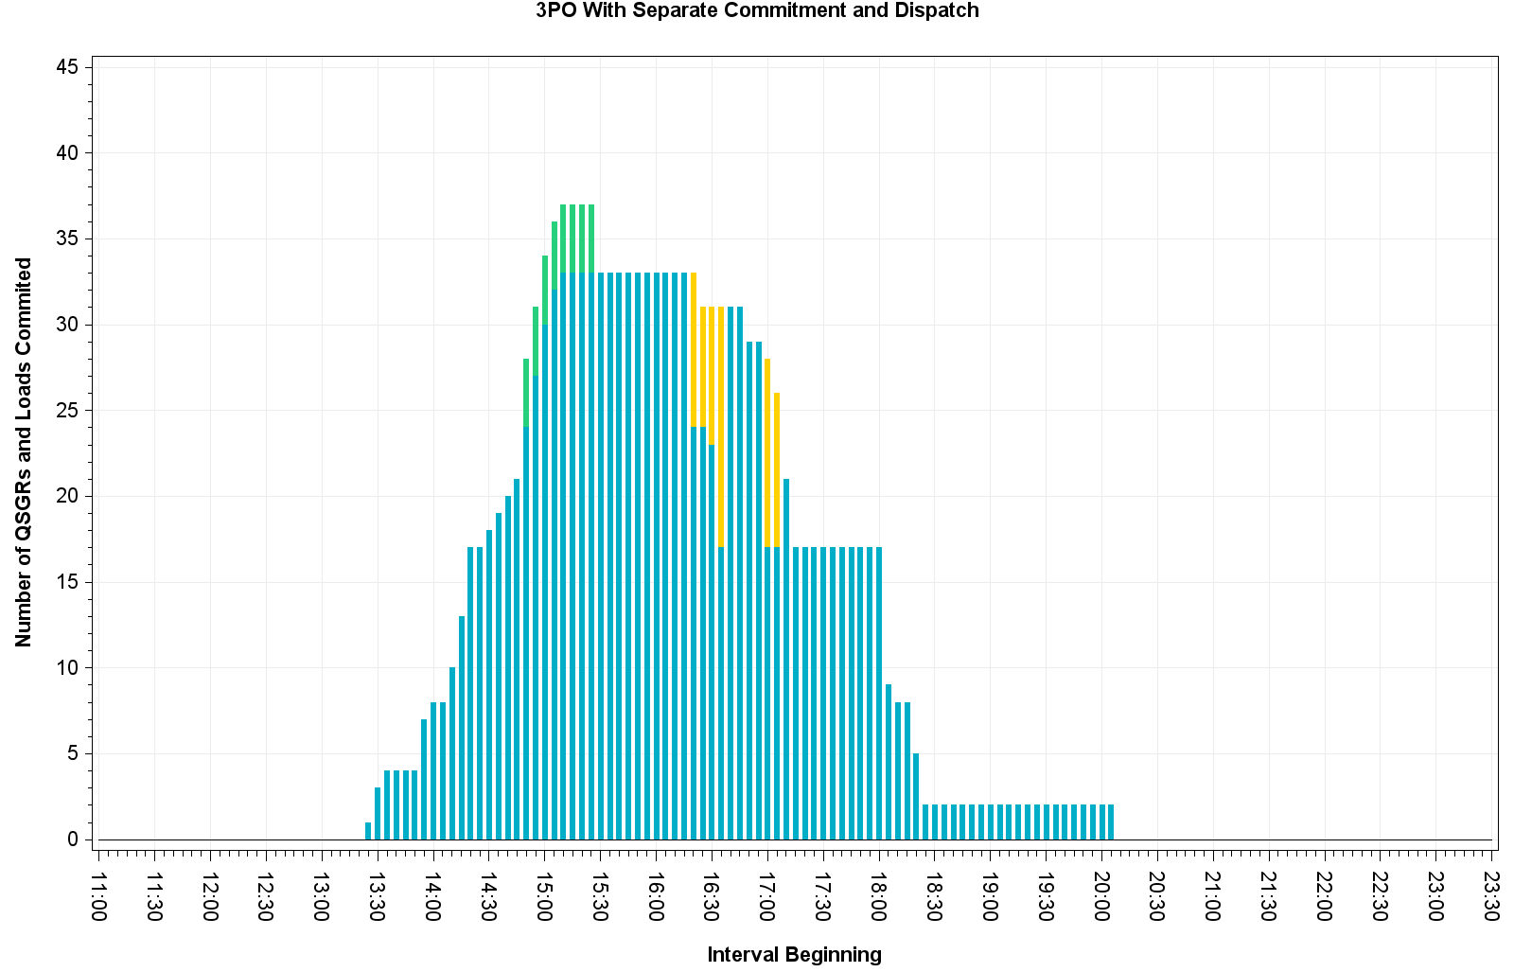
August 11, 2015 – Commitment Summary
Many QSGRs had LMPs below cost in Seq. SCED. No loads were committed.

Slide 36
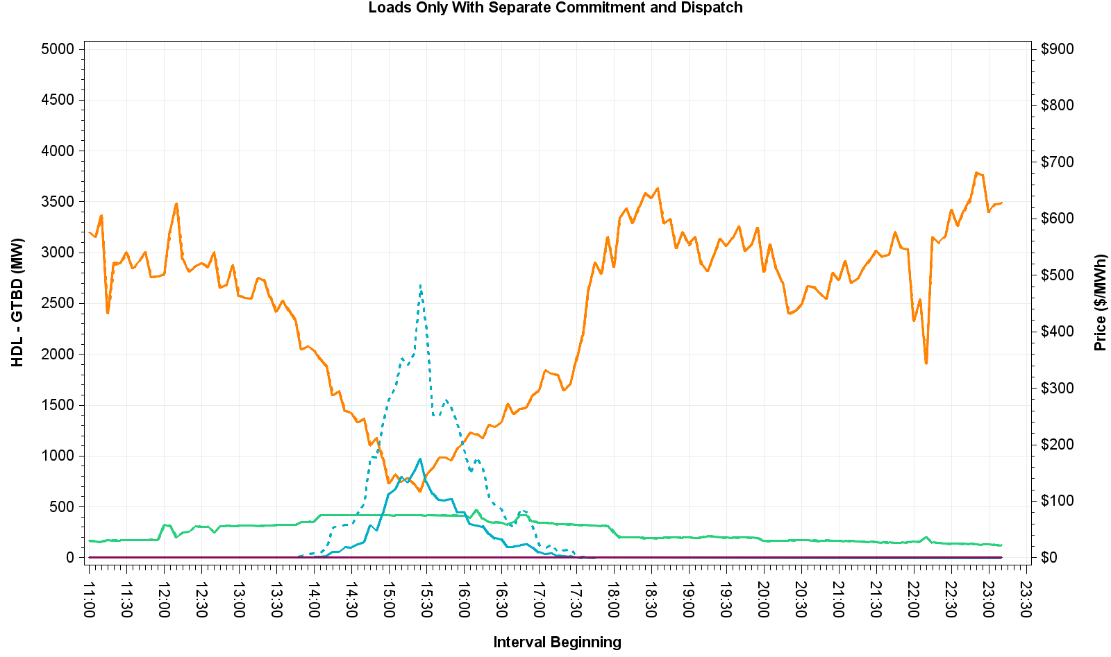
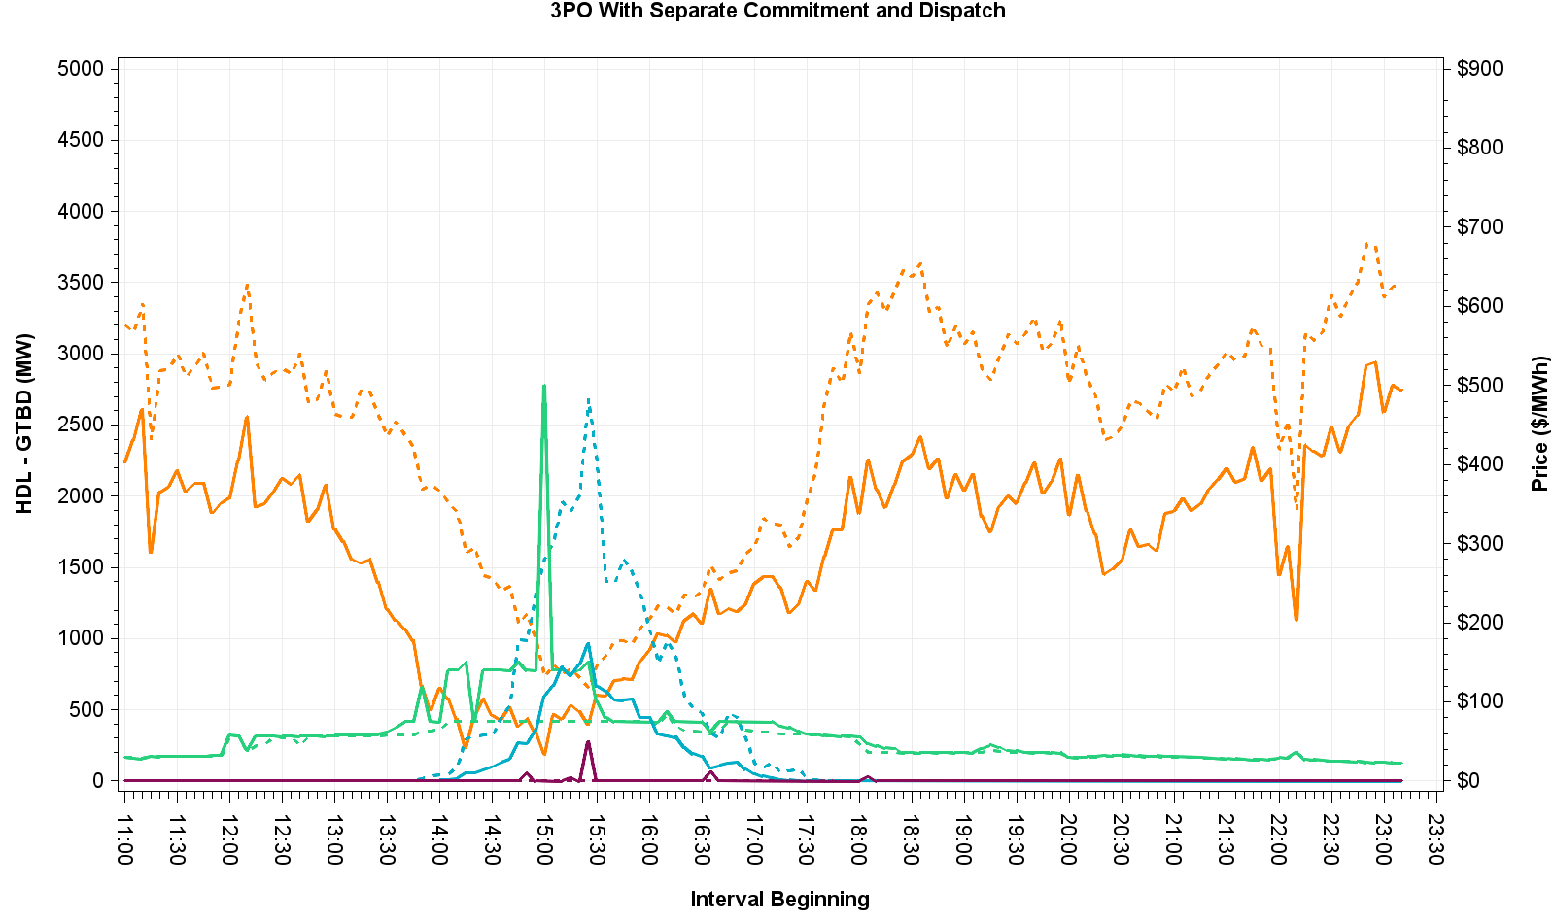
August 11, 2015 – HDL-GTBD & Price

Slide 37
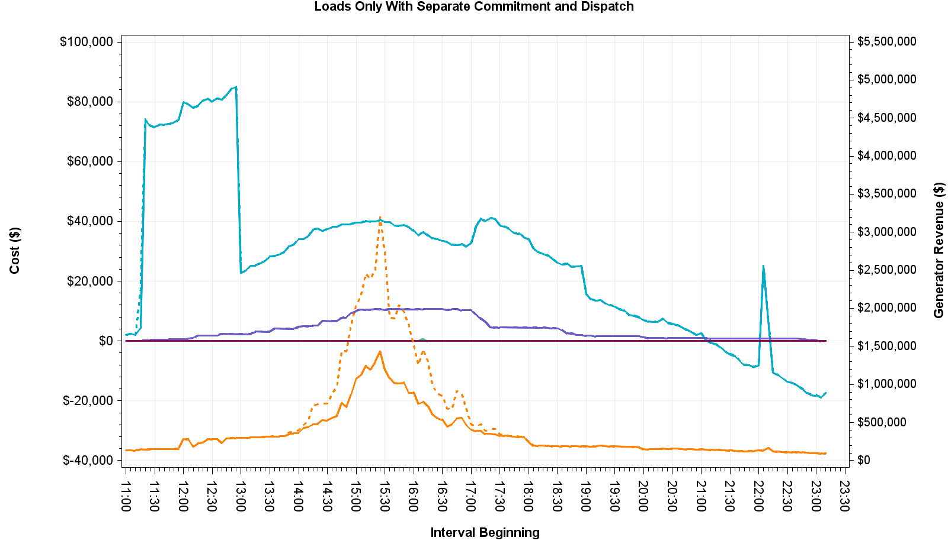
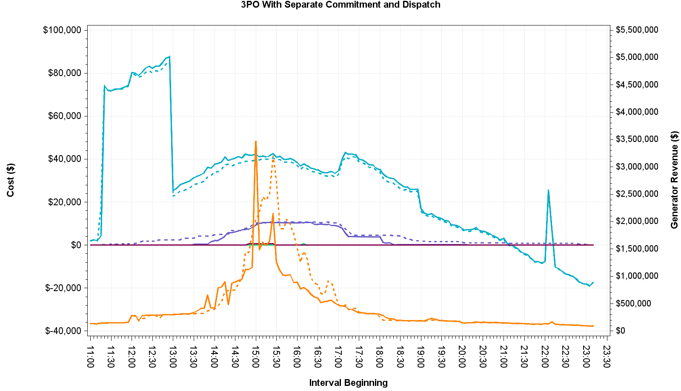
August 11, 2015 – Cost and Revenue

Slide 38
November 11, 2015 – Observations
Large wind down ramp
Many active constraints
Make-whole payments were necessary as a result of tight commitment window for MIRTM 3PO but less than in production SCED

Slide 39
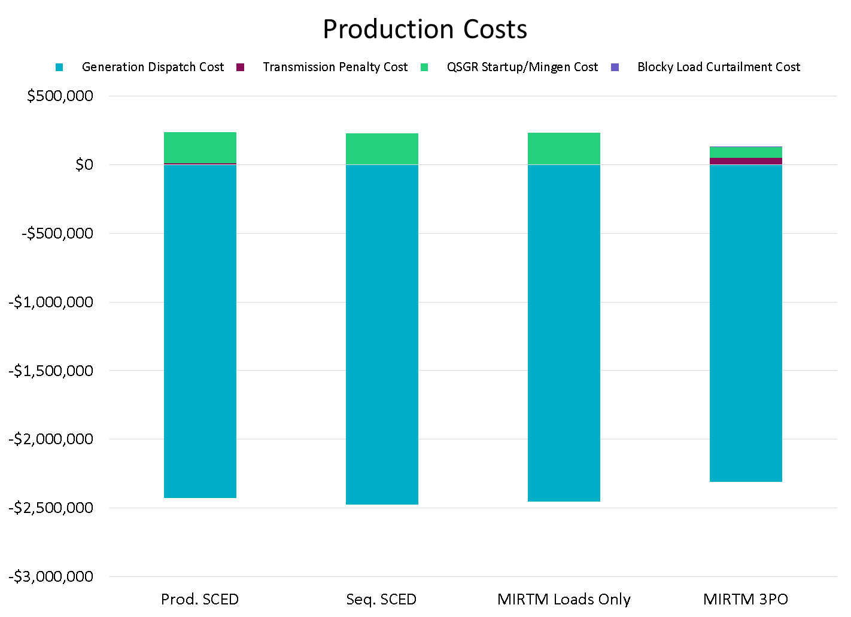
November 11, 2015

Slide 40
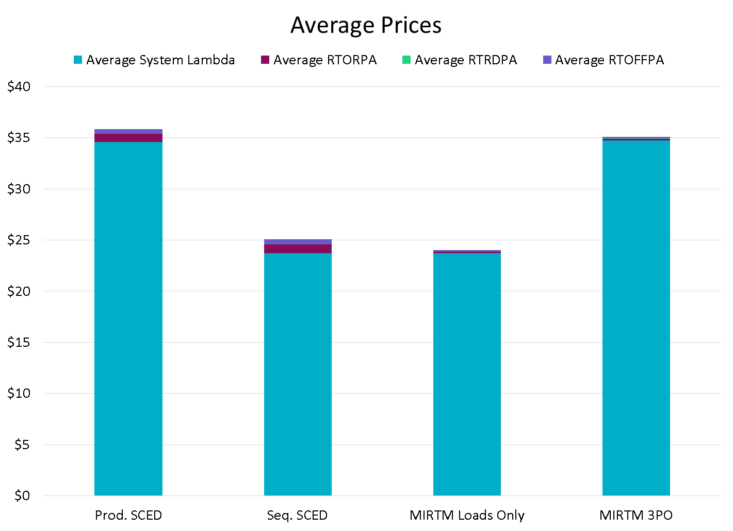
November 11, 2015

Slide 41
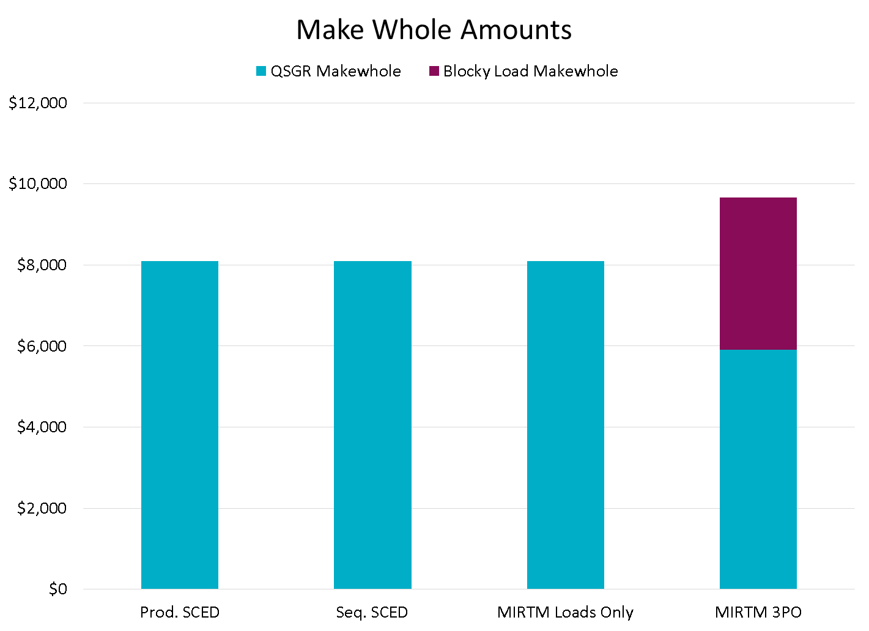
November 11, 2015

Slide 42
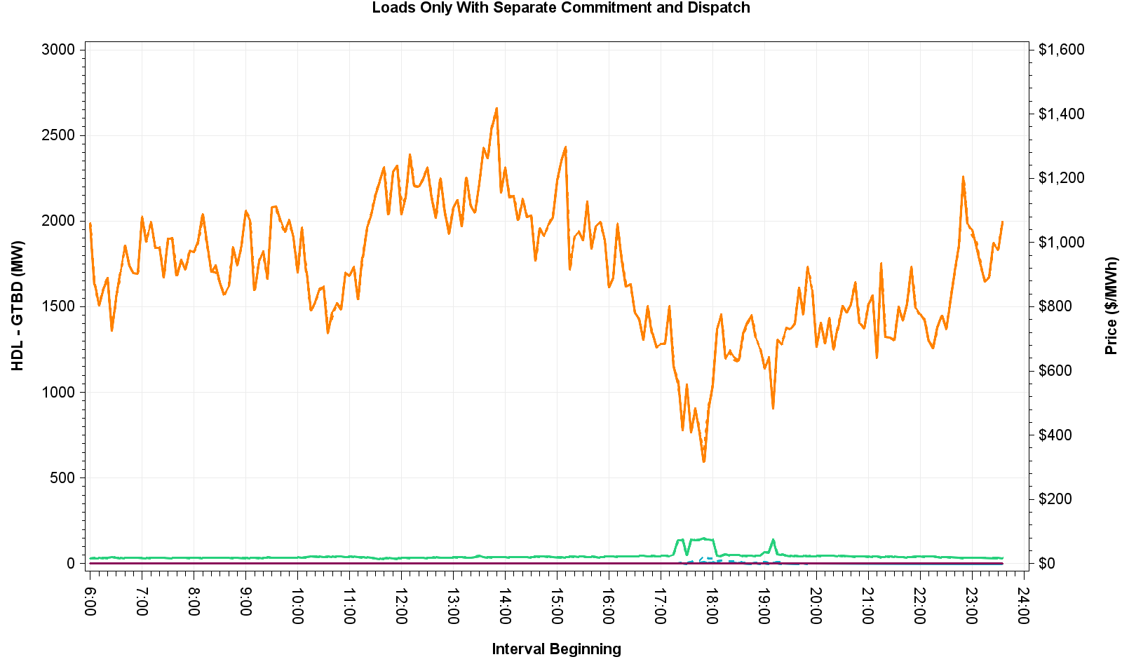
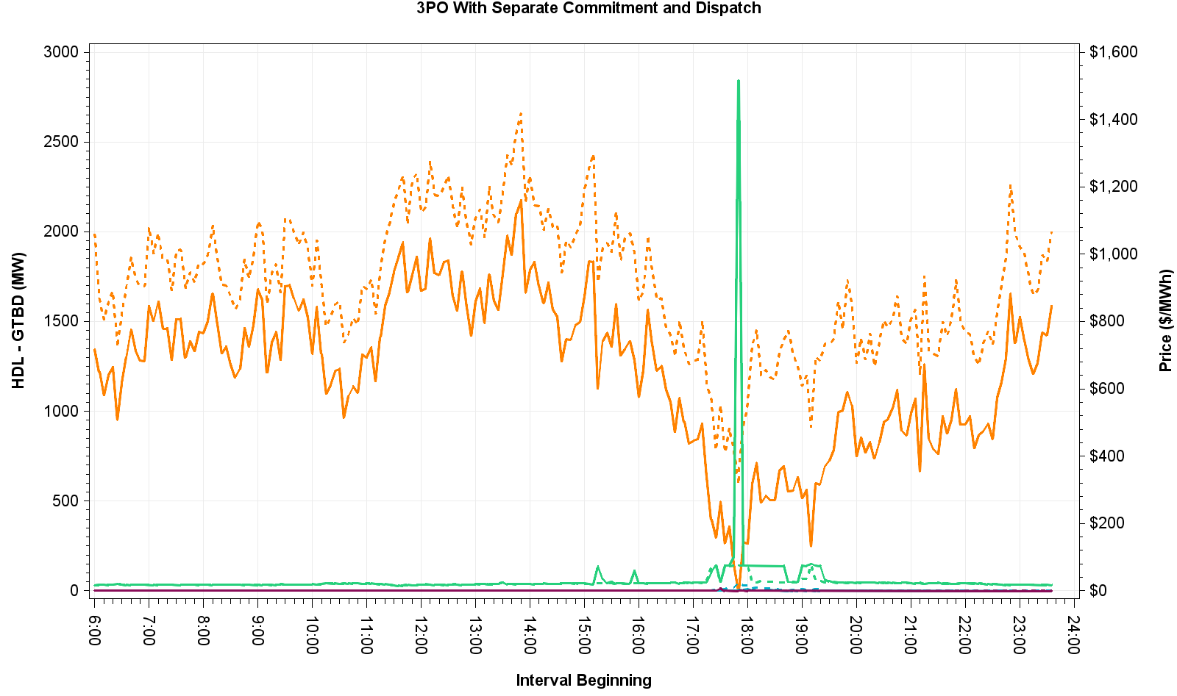
November 11, 2015 – HDL-GTBD & Prices
Cause for price spike at 17:50 in MIRTM 3PO explained on next slide

Slide 43
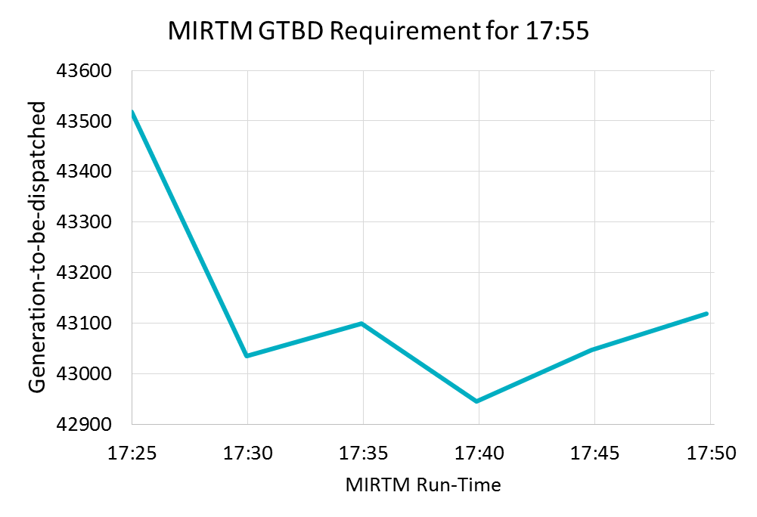
November 11, 2015 – Analysis
MIRTM 3PO had a spike primarily due to low dispatchable capacity and missed forecast
GTBD used for Binding Prices
By waiting until the last minute, binding QSGR commitments were not made in this time frame due to forecast decrease

Slide 44
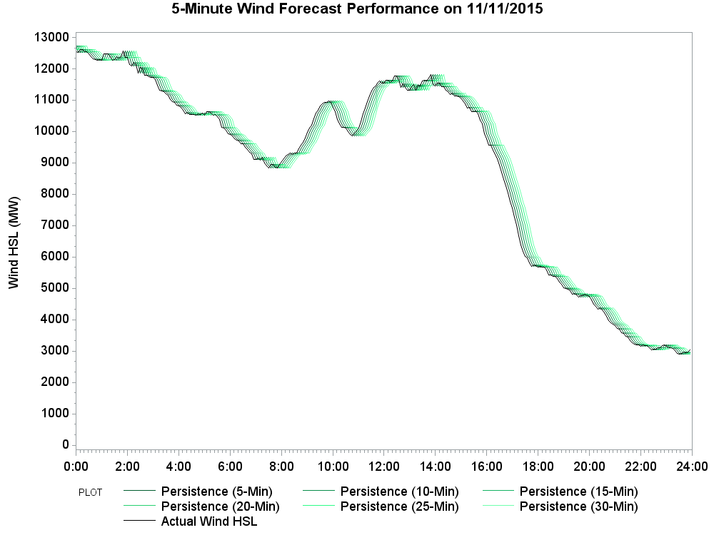
November 11, 2015 – Wind HSL Estimation
Sudden drop in HDL-GTBD due to very large wind down ramp

Slide 45
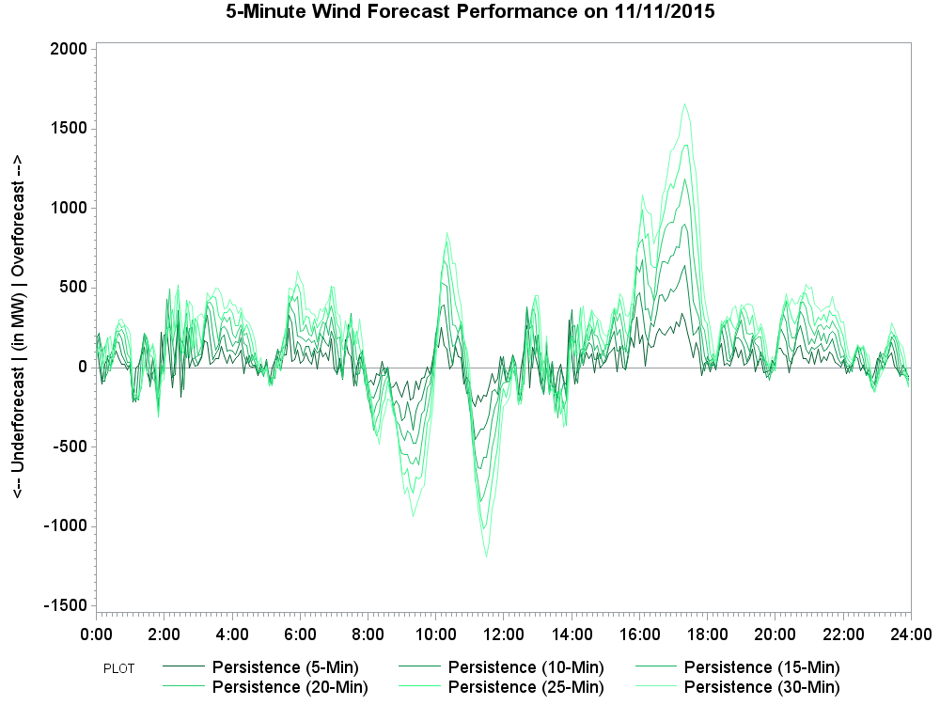
November 11, 2015 – Wind HSL Estimation Error
Persistence results in a large wind HSL estimation error during the down ramp

Slide 46
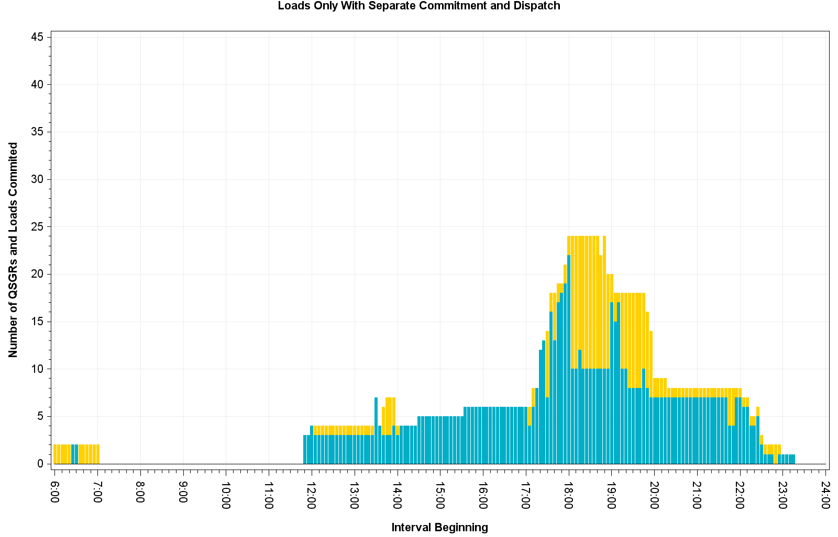
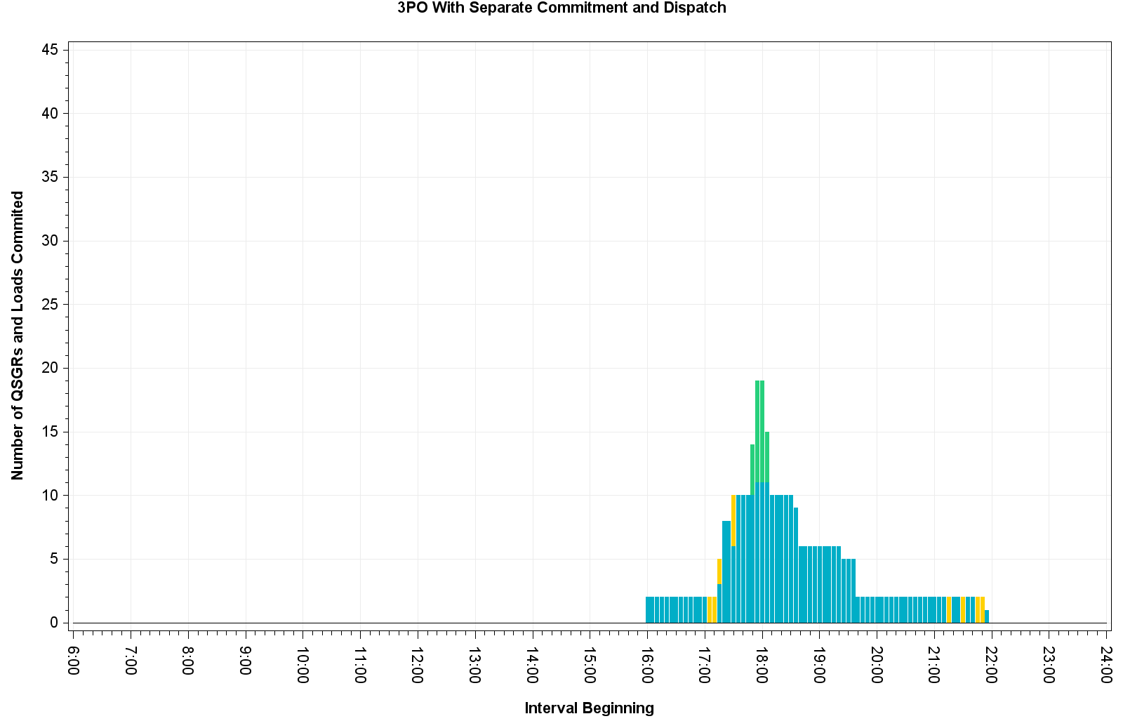
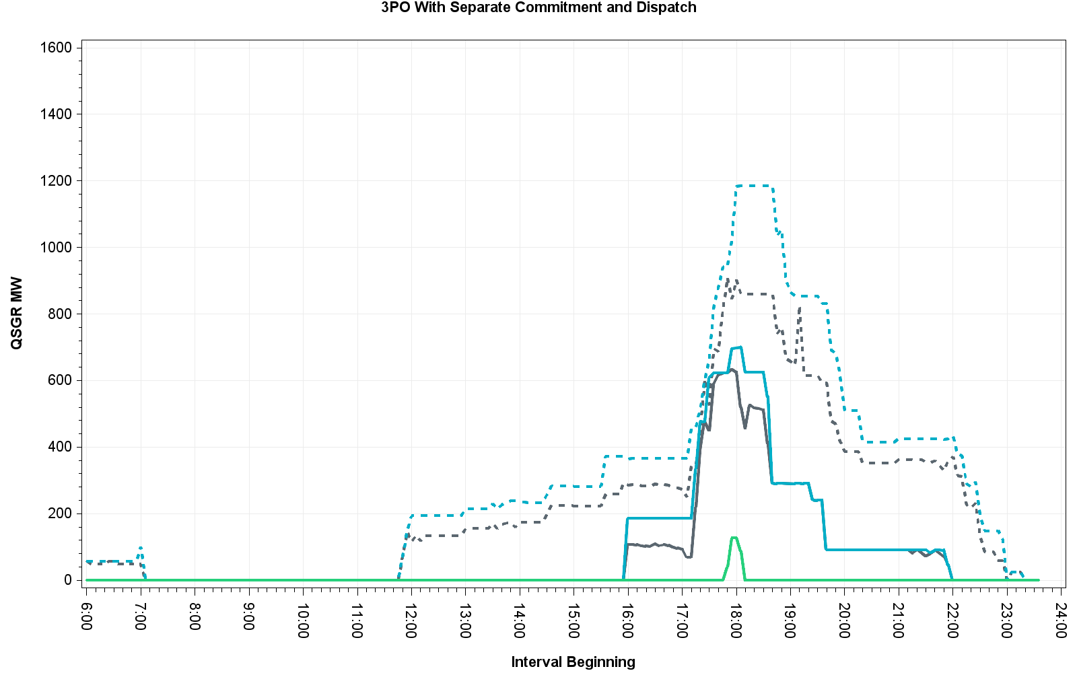
November 11, 2015 – Commitment Summary
Increase Load commitment

Slide 47
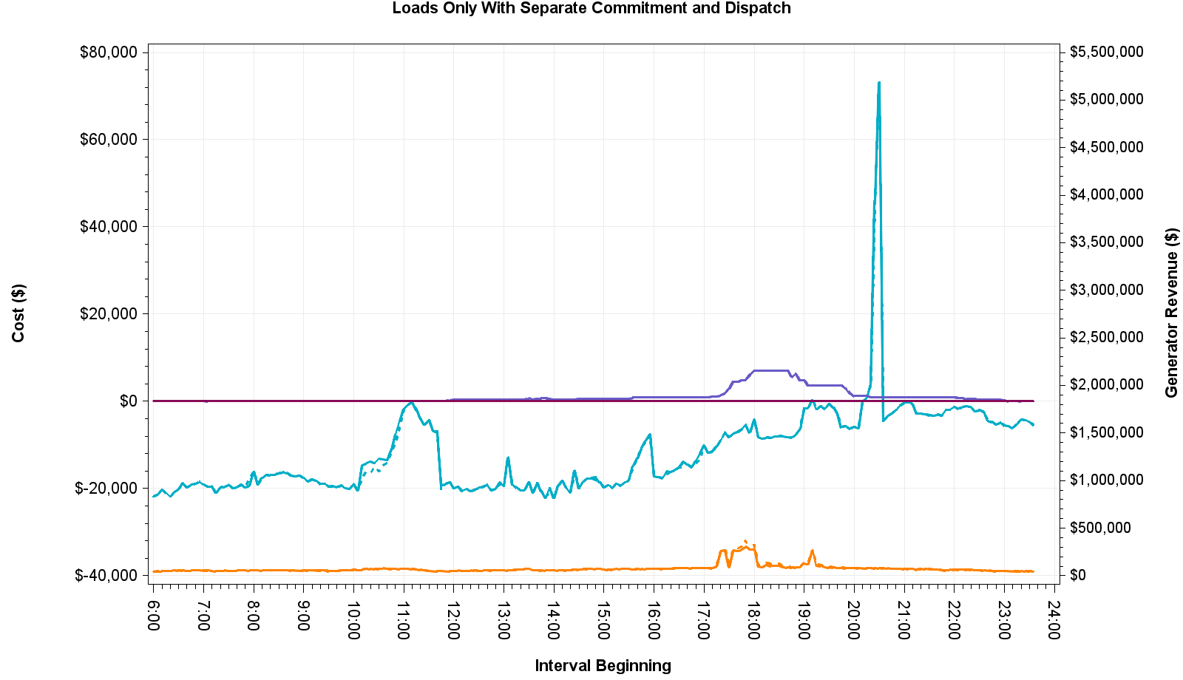
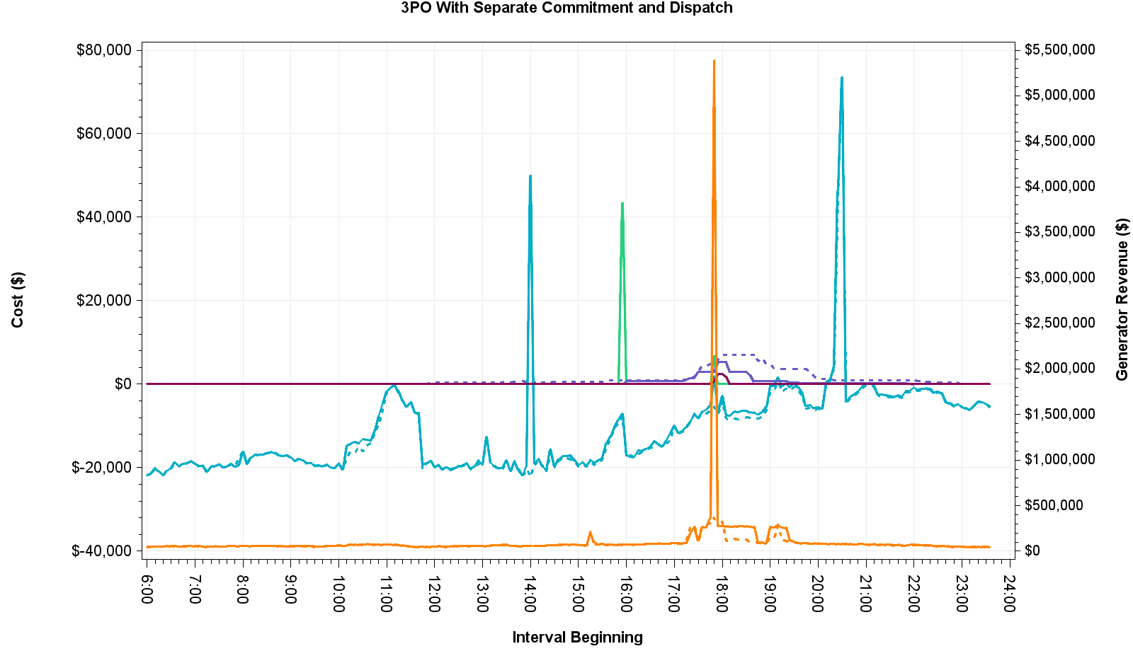
November 11, 2015 – Cost and Revenue
Base case constraint activated at 15:55 and was immediately violated in MIRTM. QSGRs with helping shift factor were self-committed in production but MIRTM could not dispatch QSGR until 16:00 due to temporal constraint
MIRTM production cost spike due to combination of telemetry error from outaged coal unit and unit’s EOC not being mitigated

Slide 48
November 27, 2015 – Observations
Wind steadily decreasing throughout the day
Very little congestion
New short-term load forecast over-forecast over peak contributes to make-whole payments
High price spike in MIRTM 3PO caused by unit shutting down, wind HSL decrease, and AS responsibility increase
Binding commitments made at 17:35 and 17:45 cause LMPs to go below some QSGR costs and they are subsequently de-committed after fulfilling minimum run time

Slide 49
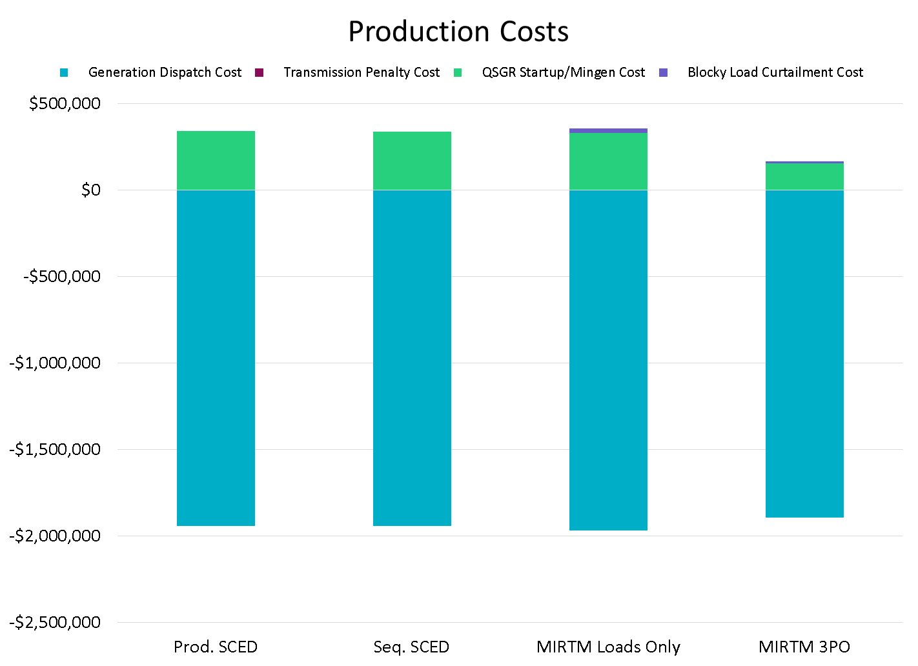
November 27, 2015

Slide 50
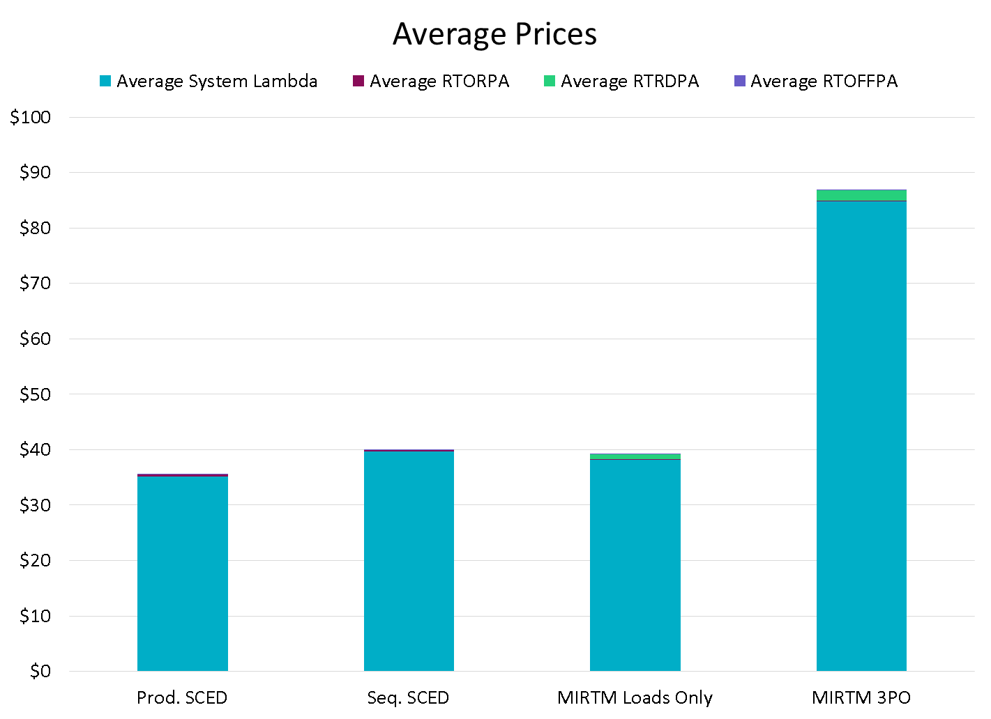
November 27, 2015

Slide 51
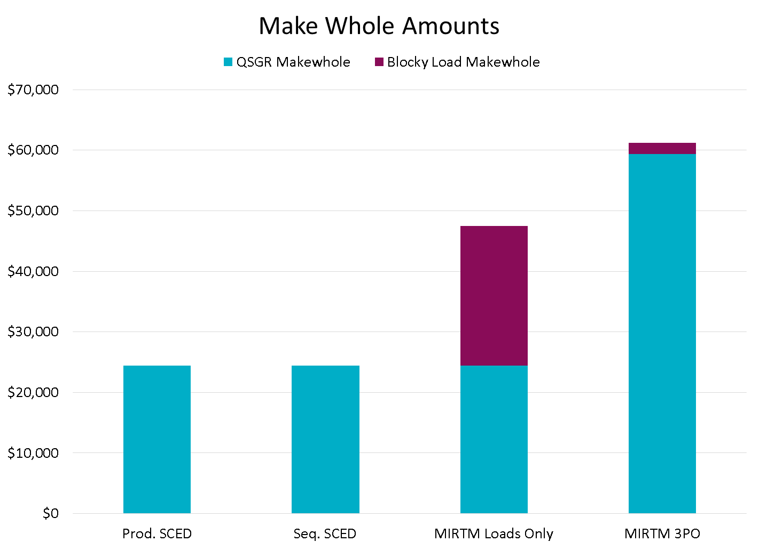
November 27, 2015

Slide 52
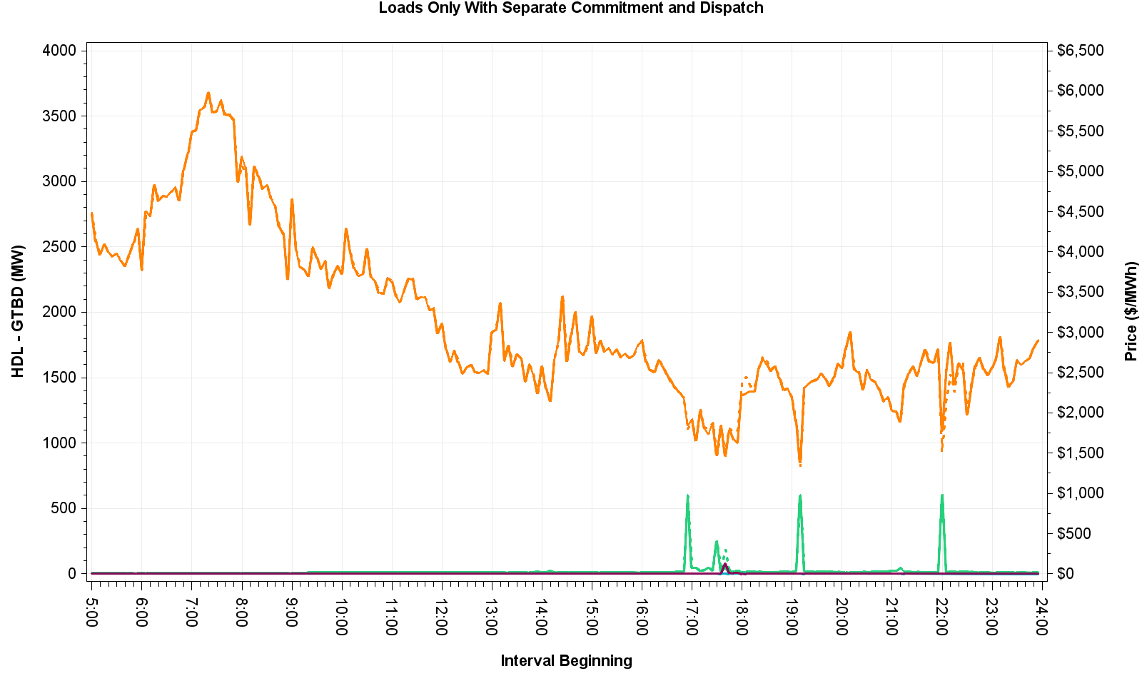
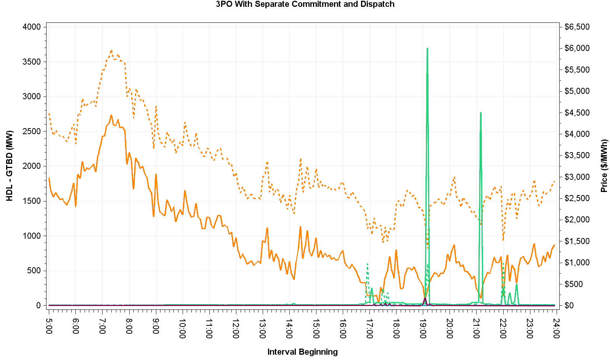
November 27, 2015 – HDL-GTBD & Price
Multiple contributors to MIRTM 3PO price spike at 19:10:
Missed load forecast
Unit shutting down
Multiple contributors to MIRTM 3PO price spike at 21:05:
When HDL-GTBD is very low, prices are very sensitive to GTBD
Regulation Up AS responsibility increased by 100 MW across the hour
170 MW of wind HSL decrease from 20:55 to 21:05
Unit shutting down, unit going from ON to ONTEST at a lower output, and combined cycle changing configurations

Slide 53
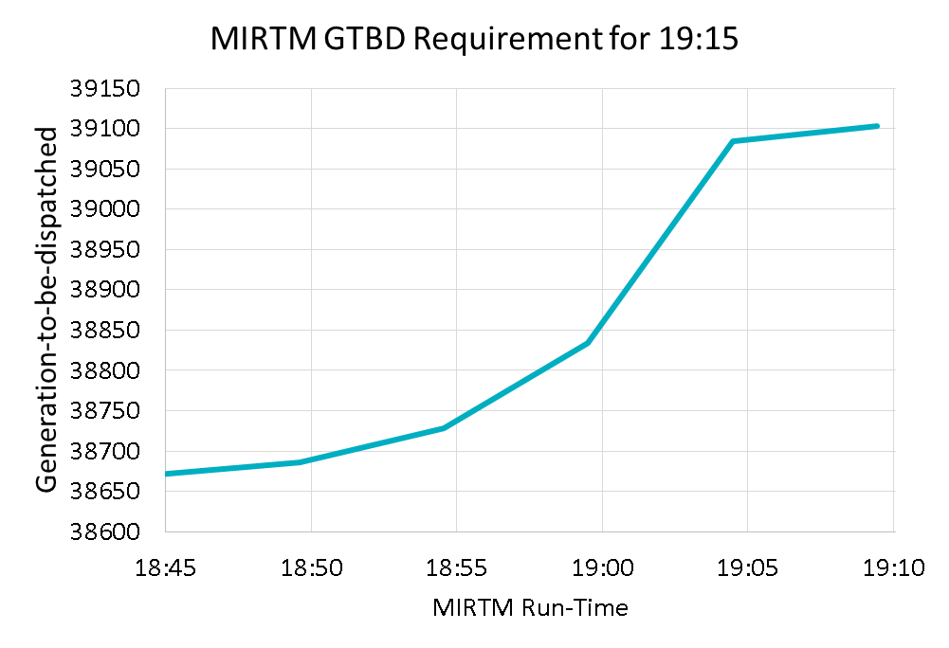
November 27, 2015 – Analysis
MIRTM 3PO had a spike primarily due to low dispatchable capacity and missed forecast
GTBD used for Binding Prices

Slide 54
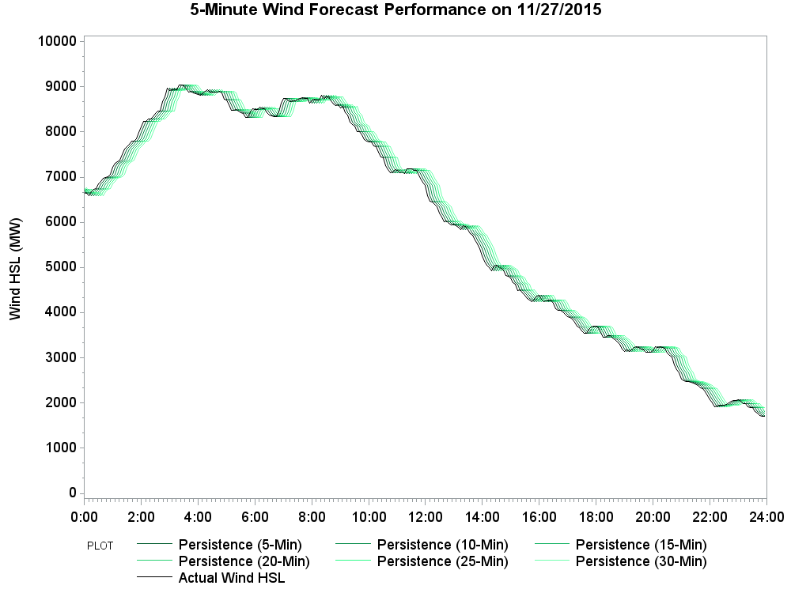
November 27, 2015 – Wind HSL Estimation
Wind steadily decreases throughout the day

Slide 55
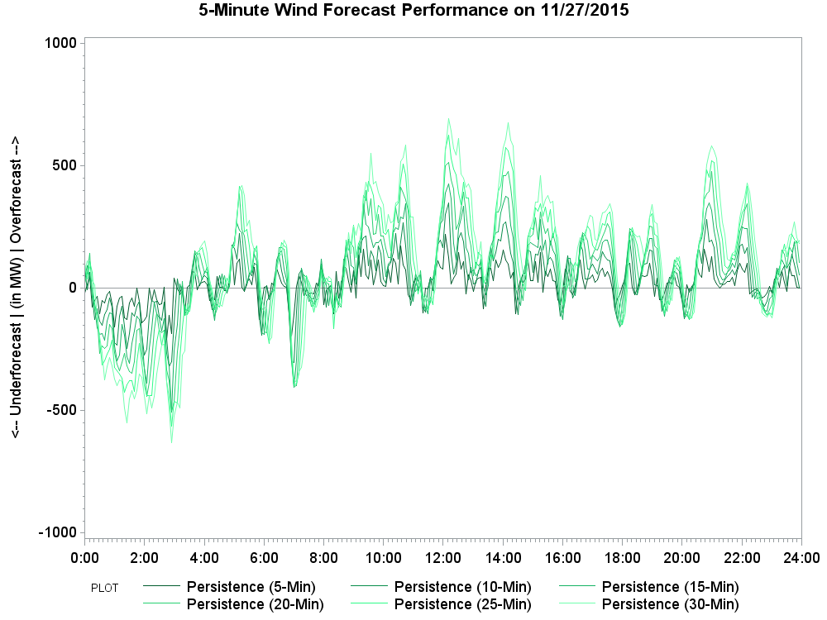
November 27, 2015 – Wind HSL Estimation Error
Wind over-estimates due to steady wind down ramp

Slide 56
November 27, 2015 – Commitment Summary
Binding commitments made at 17:35 and 17:45 cause LMPs to go below some QSGR costs and they are subsequently de-committed after fulfilling minimum run time

Slide 57
November 27, 2015 – Cost and Revenue

Slide 58
March 27, 2016 – Observations
Very low dispatchable capacity and inability to commit QSGRs in 5 minutes led to sudden capacity shortage
Low wind
Unit shutting down
Missed load forecast

Slide 59
March 27, 2016

Slide 60
March 27, 2016

Slide 61
March 27, 2016

Slide 62
March 27, 2016 – HDL-GTBD & Prices
Multiple contributors to MIRTM 3PO price spikes around 20:00:
Very low dispatchable capacity period is greatly affected by accuracy of input data
Load forecast missed multiple intervals (300-500 MW)
Multiple units shutting down (~200 MW)

Slide 63
March 27, 2016 – Analysis
MIRTM 3PO had spikes primarily due to load under forecast 300-500 MW for consecutive intervals
GTBD used for Binding Prices
By waiting until the last minute, binding QSGR commitments were not made in this time frame due to forecast decrease

Slide 64
March 27, 2016 – Analysis
STLF thought load would stop ramping up when in reality load was rapidly increasing
New STLF was recently modified to be based on regression model of ramp rates so this issue should be mitigated

Slide 65
March 27, 2016 – Analysis
This was a case where the current STLF also missed the ramp

Slide 66
March 27, 2016 – Commitment Summary

Slide 67
March 27, 2016 – Cost and Revenue

Slide 68
July 25, 2016 – Observations
New short-term load forecast performs well
Low wind and dispatchable capacity
Much tighter QSGR commitment in MIRTM 3PO scenario still reduces LMPs by ~$29 million and production cost by ~$57k at the expense of ~$58k more make-whole than sequential SCED
MIRTM Load scenario reduces prices by ~$26 million and production cost by ~$29k at the expense of $27k more make-whole than sequential SCED

Slide 69
July 25, 2016

Slide 70
July 25, 2016

Slide 71
July 25, 2016

Slide 72
July 25, 2016 – HDL-GTBD & Prices

Slide 73
July 25, 2016 – Commitment Summary

Slide 74
July 25, 2016 – Cost and Revenue

Slide 75
Appendix

Slide 76
Refresher on the MIRTM Process
MIRTM six 5-minute intervals (30 minutes total) with separate commitment and dispatch
RT Market Execution: Depicts the start and end times of the clearing process and the length of symbol is indicative of maximum time allowed to clear market
Interval where the LMPs, MW awards (energy, AS) and Commitment Instructions are ALL binding commitment instructions
Intervals where ONLY Commitment Instructions are binding and the LMPs and MW awards (energy, AS) are indicative
8:40 8:45 8:50 8:55 9:00 9:05 9:10 9:15 9:20 9:25 9:30 9:35
Analysis window of rolling 30 minutes
Dispatch Run & Pricing run
Binding commitments for ALL intervals
1st Interval Binding Base Point & Binding LMPs
Dispatch Run & Pricing Run
Sequence of Multi-Interval RT Markets
Note: The introduction of the Binding Dispatch/Base Point run while eliminating make-Whole payments to Generation Resources due to binding ramp constraints, can however, lead to missed commitments or too early decommitments/recalls. The assumption is that the benefits of eliminating this category of make-whole payments outweighs the disadvantages of missed commitments or too early decommitments/recalls.

Slide 77
Overview of Recent Activity
Implement Dispatch Module
Implement Pricing Module
Developed three part offers (TPO) based on average verifiable costs and unit HSL
Developed single part offers (SPO) from TPO allocating start costs over minimum up time and LSL
Allowed for Wartsila units to have zero start time and zero min off time (allows fast ramping resources to meet demand in same interval)
Studied the following dates:7/1/2015, 8/11/2015, 8/13/2015, 11/11/2015, 11/27/2015, 3/27/2016, 7/25/2016

Slide 78
MIRTM – Changes since August SAWG
Make the processing of Combined Cycles consistent between MIRTM and Sequential SCED
Correct the Minimum Energy for Resources carrying Non Spin to agree with $75 Energy offer curve
Streamline the Commitment Summary to two categories:
Count of Resources below cost
Count of Resources at or above cost
Corrected two study days that had short SCED runs which caused double counting in the MIRTM post process
Determination and book keeping of noncompetitive constraints are different between MIRTM and Seq. SCED: ERCOT will evaluate the impact and actions taken, if any, at a future SAWG meeting

