Slide 1
Multi-Interval Real-Time Market (MIRTM)
Update to DSWG
Pamela Shaw, Sai Moorty, Paul Wattles
ERCOT Staff
October 21, 2016

Slide 2
MIRTM Background
MIRTM is one of two Real-Time Market enhancements that have been under discussion since the early design phase of the Nodal Market
The other is Real-Time Co-optimization of Energy and Ancillary Services
See direct testimony of ERCOT IMM Dr. David B. Patton, PUC Docket No. 31540, pp.23-41, Nov. 10, 2005
MIRTM would forecast near-term system conditions and issue binding commitment instructions, if required, to Resources to meet those conditions in the most economical manner
Quality of the solution depends on ERCOT’s ability to produce acceptably accurate short-term forecasts of system conditions
Key forecasted input data are:
Load Forecast
Wind Forecast
Resource Status Forecast

Slide 3
Benefits of MIRTM
IMM recommendation, 2014 State of the Market Report:
‘We continue to believe there is opportunity to improve the commitment and dispatch of both load and generation resources that require longer than 5 minutes to come on line, but are available within 30 minutes. Therefore, we recommend that ERCOT evaluate improvements to this process that would allow it to facilitate better real-time generator and load commitments.’
MIRTM could mitigate other shortcomings inherent in the current single interval (5-minute) RT Market
Could allow ERCOT Operations to rely on market forces to address anticipated conditions, rather than out-of-market instructions

Slide 4
MIRTM Timeline
Date | Action
2010 | Direct Testimony of Dr. David B. Patton, PUCT Docket No. 31540, pp.23-41, November 10th, 2005
2012 | TAC creates Market Enhancements Task Force to evaluate Real-time Co-optimization and Multi-Interval SCED Major vendors and ISOs provided presentations and their implementation experiences (most other ISOs have already implemented multi-interval market and/or real-time co-optimization)
2013 | METF disbanded; no consensus
11/8/13 | PUC Staff requests comments on MIRTM in Project 41837
12/12/13 | ERCOT and IMM file joint comments providing overview and scope of MIRTM
12/19/13 | MIRTM and real-time co-optimization discussed at PUC Open Meeting
1/17/14 | ERCOT and IMM file follow-up comments to 41837
9/25/14 | ERCOT posts MIRTM white paper to TAC meeting page; TAC assigns MIRTM issues to Supply Adequacy Working Group
4Q2014 | Market participants with ERCOT support develop a high-level scope of work to evaluate MIRTM by developing a prototype MIRM simulation tool and analyze historical days of interest … http://www.ercot.com/content/wcm/key_documents_lists/51007/Proposed_Study_Process_MIRTM.doc
1/16/15 | SAWG requests that ERCOT conduct a feasibility study of MIRTM, based on the scope of work described in the “Proposed Study Process … http://www.ercot.com/content/wcm/key_documents_lists/51007/Proposed_Study_Process_MIRTM.doc
3/9/15 | Demand Side Working Group inputs (LR offers with prices and MW values) posted and discussed at DSWG meeting
8/8/15 | Commissioners discuss MIRTM in Open Meeting and ask questions of ERCOT Staff
8/11/15 | IMM (David Patton) makes presentation to ERCOT Board regarding dispatch and pricing of peaking resources (QSGRs); comments were generally supportive of MIRTM concepts
10/13/15 | Joel Mickey provides MIRTM overview and description of feasibility study to ERCOT Board
11/12/15 | ERCOT files comments to 41837 providing status report on MIRTM feasibility study development…. http://interchange.puc.state.tx.us/WebApp/Interchange/Documents/41837_7_872244.PDF
11/19/15 | Commissioners discuss MIRTM in OM; urge ERCOT to continue working on the feasibility study and to work with stakeholders on inputs
12/2/15 | WMS votes to include QSGRs in the MIRTM feasibility study

Slide 5
How it would work
MIRTM would extend the Real-Time Market’s study period (time horizon) from the current 5-minute interval to X minutes in the future
Currently, ERCOT contemplates a 30-minute study period
This study period would be divided into 5 minute intervals
MIRTM will commit and dispatch Resources in any of the intervals during the study period while considering costs and temporal constraints
The longer horizon enables more efficient dispatch of current fleet of Resources
Additionally, MIRTM could open the Real Time market to different Resource types, including:
Generators that are fast-responding, but not fast enough for the current 5-minute SCED
‘Blocky’ resources such as DR that is either on or off
Resources with temporal constraints including:
Ramp period >5 minutes
Minimum run time
Maximum run time
Return-to-service time

Slide 6
Key points for Load Resource participation
Temporal constraints are important:
Ramp Period (time needed to curtail) plus Minimum Run Time (minimum curtailment time) must be less than or equal to the MIRTM study period (30 minutes)
Committed LR would be eligible to receive make-whole payment if the binding prices are lower than their submitted bid-to-buy over the commitment period

Slide 7
DSWG activity to date
Supply Analysis Working Group (SAWG) asked ERCOT to collect MIRTM input data from Load Resources
ERCOT presented a MIRTM overview to DSWG on March 15, 2015
Followed up with email requests for input data
Provided template to ensure uniform data received
http://www.ercot.com/calendar/2015/3/9/51663-DSWG
These inputs were reported to SAWG and are being used in the MIRTM Simulator
http://www.ercot.com/calendar/2015/4/29/55029-SAWG

Slide 8
Simulation Assumptions – Blocky LRs
Valid offers (Ramp + MINRUN ≤ 30 minute horizon) were received for 12 Blocky Loads from DSWG
A total of 366 MW
For each LZ to be indifferent, ERCOT divided the MW capacity of each LR by 4 and applied these offers across the four competitive Load Zones
IE, each zone has 12 resources

Slide 9
Valid LR inputs from DSWG
Load Resource | $/MWh | MW | Ramp Period | Minimum Run Time | Maximum Run Time | Return to Service Time
1 | 200 | 40 | 10 Min. | 15 Min. | 48 hours | 24 hours
2 | 250 | 50 | 10 Min. | 15 Min. | 4 hours | 0 hours
3 | 250 | 100 | 10 Min. | 15 Min. | 0.5 hours | 0.5 hours
4 | 300 | 1 | 10 Min. | 15 Min. | 1 hour | 1.5 hours
5 | 498 | 30 | 15 Min. | 15 Min. | 1.25 hours | 2 hours
6 | 500 | 5 | 15 Min. | 15 Min. | 2 hours | 10 Min.
7 | 665 | 30 | 15 Min. | 15 Min. | 3 hours | 20 hours
8 | 800 | 30 | 15 Min. | 15 Min. | 2 hours | 5 Min.
9 | 1431 | 25 | 15 Min. | 15 Min. | 1.25 hours | 1 hour
10 | 2008 | 20 | 15 Min. | 15 Min. | 6 hours | 20 hours
11 | 2008 | 20 | 15 Min. | 15 Min. | 3 hours | 20 hours
12 | 3365 | 15 | 15 Min. | 15 Min. | 6 hours | 20 hours

Slide 10
Housekeeping note
Participation in current Loads in SCED v1 is limited to LSE QSEs, who would submit ‘bids to buy’ up to a specified price
Offers to sell (from 3rd party DR providers) would require implementation of LMP Minus Proxy $G, or other solution
Not a component of MIRTM
Could be developed separately

Slide 11
Current Status & Next Steps
ERCOT staff has conducted studies on several historical days incorporating data from the new short-term load and wind forecast
Historical days selected by ERCOT and Market Participants
At SAWG, ERCOT is starting to present the results of the study with preliminary analysis
Large volume of results
ERCOT requests stakeholder feedback on :
Are the LR inputs submitted by DSWG reflective of reality?
Is there a better way to present the results?
Do we need to analyze other specific dates/times?
Are there any recommended changes to the MIRTM simulation tool?
Are there any recommendations on the metrics to determine the feasibility of MIRTM?
ERCOT is expected to report to the PUC on the MIRTM feasibility study by the end of 2016

Slide 12
Refresher on the MIRTM Process
MIRTM six 5-minute intervals (30 minutes total) with separate commitment and dispatch
RT Market Execution: Depicts the start and end times of the clearing process and the length of symbol is indicative of maximum time allowed to clear market
Interval where the LMPs, MW awards (energy, AS) and Commitment Instructions are ALL binding commitment instructions
Intervals where ONLY Commitment Instructions are binding and the LMPs and MW awards (energy, AS) are indicative
8:40 8:45 8:50 8:55 9:00 9:05 9:10 9:15 9:20 9:25 9:30 9:35
Analysis window of rolling 30 minutes
Dispatch Run & Pricing run
Binding commitments for ALL intervals
1st Interval Binding Base Point & Binding LMPs
Dispatch Run & Pricing Run
Sequence of Multi-Interval RT Markets
Note: The introduction of the Binding Dispatch/Base Point run while eliminating make-Whole payments to Generation Resources due to binding ramp constraints, can however, lead to missed commitments or too early decommitments/recalls. The assumption is that the benefits of eliminating this category of make-whole payments outweighs the disadvantages of missed commitments or too early decommitments/recalls.

Slide 13
Examples of MIRTM Outcomes for LRs
LR is committed and Binding LMP materializes in Real-Time
No make-whole needed
LR is committed and Binding LMP fails to materialize in Real-Time
Make-whole needed

Slide 14
Example 1: Make Whole not needed
NAME | LZ | RAMP | MINRUN | MAXRUN | RETURN | LOAD_MW | BID_PRICE
A3_H | LZ_HOUSTON | 10 min | 15 min | 48 min | 24 min | 10 | $200
The MIRTM engine committed the LR because the MIRTM solution (optimized across the six intervals including MINRUN) found the LR to be economical solution. In this case, the make-whole payment was not needed.
15:55 time stamp
INTERVAL | Interval time | STLPNT | TYPE | LMP
1 | 15:55 | LZ_HOUSTON | LZ | 349.9734
2 | 16:00 | LZ_HOUSTON | LZ | 250.1901
3 | 16:05 | LZ_HOUSTON | LZ | 250.1901
4 | 16:10 | LZ_HOUSTON | LZ | 149.9997
5 | 16:15 | LZ_HOUSTON | LZ | 199.9964
6 | 16:20 | LZ_HOUSTON | LZ | 400.3236
MIRTM solution
Actual (binding prices)
Interval time | INTERVAL | NAME | COMMIT | MW | BID_ PRICE | LZ | LMP | RTORPA | RTRDPA | Sum prices | Bid x MW (÷ 12) | SUM PRICE x MW (÷ 12)
8/13/2015 16:00 | 1 | A3_H | 1 | 10 | 200 | LZ_HOUSTON | $139.99 | $132.36 | $6.42 | $278.78 | $166.67 | $ 232.32
8/13/2015 16:05 | 1 | A3_H | 1 | 10 | 200 | LZ_HOUSTON | $86.82 | $108.53 | $15.41 | $210.76 | $166.67 | $ 175.63
8/13/2015 16:10 | 1 | A3_H | 1 | 10 | 200 | LZ_HOUSTON | $138.32 | $130.05 | $5.89 | $274.25 | $166.67 | $ 228.55
Make Whole = Max(0, [Bid Price * Commit MW] - [Sum Price * Commit MW])
Max (0, [$500] - [$636.49]) = $0

Slide 15
Example 2: Make Whole needed
The MIRTM engine again committed the LR because the MIRTM solution (optimized across the six intervals including MINRUN) found the LR to be economical solution. In this case; however, the make-whole payment was needed because the prices in the binding interval were lower than the bid to buy price.
NAME | LZ | RAMP | MINRUN | MAXRUN | RETURN | LOAD_MW | BID_PRICE
A6_S | LZ_SOUTH | 15 min | 15 min | 120 min | 60 min | 1.25 | $500
17:25 time stamp
INTERVAL | Interval time | STLPNT | TYPE | LMP
1 | 17:25 | LZ_SOUTH | LZ | $80.32
2 | 17:30 | LZ_SOUTH | LZ | $80.54
3 | 17:35 | LZ_SOUTH | LZ | $430.38
4 | 17:40 | LZ_SOUTH | LZ | $1,100.18
5 | 17:45 | LZ_SOUTH | LZ | $1,135.45
6 | 17:50 | LZ_SOUTH | LZ | $1,150.04
MIRTM solution
Actual (binding prices)
Interval time | INTERVAL | NAME | COMMIT | MW | BID_PRICE | LZ | LMP | RTORPA | RTRDPA | Sum prices | Bid x MW (÷ 12) | SUM PRICE x MW (÷ 12)
11/11/2015 17:35 | 1 | A6_S | 1 | 1.25 | $500 | LZ_SOUTH | $35.26 | $0.36 | $0.00 | $35.62 | $52.08 | $3.71
11/11/2015 17:40 | 1 | A6_S | 1 | 1.25 | $500 | LZ_SOUTH | $78.72 | $0.98 | $0.00 | $79.70 | $52.08 | $8.30
11/11/2015 17:45 | 1 | A6_S | 1 | 1.25 | $500 | LZ_SOUTH | $81.02 | $2.33 | $0.00 | $83.35 | $52.08 | $8.68
Make Whole = Max(0, [Bid Price * Commit MW] - [Sum Price * Commit MW])
Max (0, [$156.25] - [$20.69]) = $135.56

Slide 16
Appendix: Example MIRTM Study Run

Slide 17
Example MIRTM Study Run
System with the following conditions:
Initial load is 50,000 MW
Assume demand (GTBD) forecast is correct
Generation Mix:
50,001 MW of dispatchable generation priced at $50/MWh
40 MW Blocky Load Resource:
Modeled in MIRTM as a Generation Unit with LSL=HSL=40 MW
Single Part Bid at $200/MWh
Minimum Run Time = 15 minutes
Ramp Time = 10 minutes
When a blocky load is committed for a future interval, the MW reduction remains zero till its first committed interval. At the end of the first committed interval, the MW reduction of the blocky load is the desired Base Point. Thus, this blocky load resource will be fully at its Base Point in 10 minutes.

Slide 18
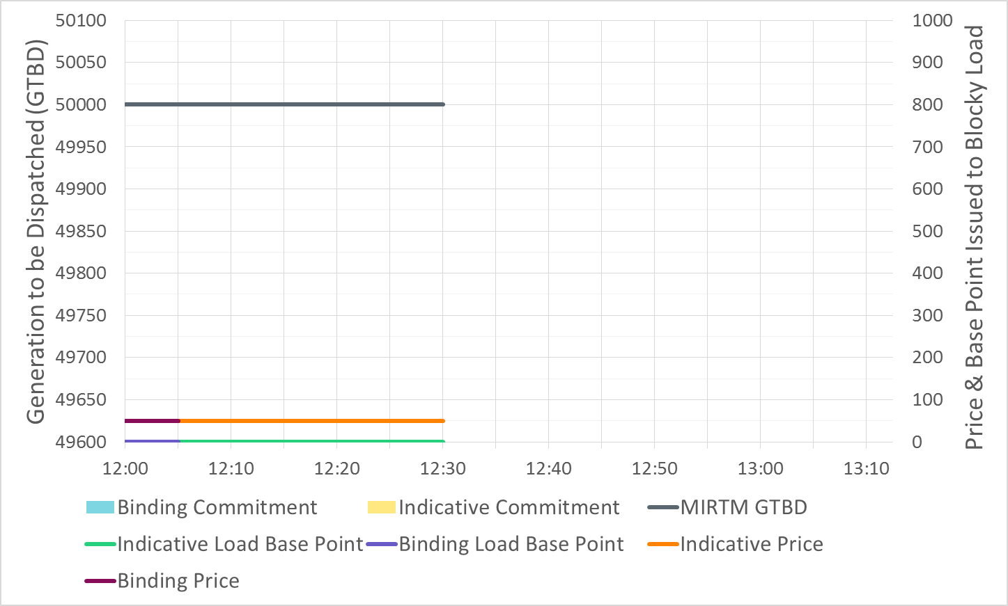
Example MIRTM Study Run

Slide 19
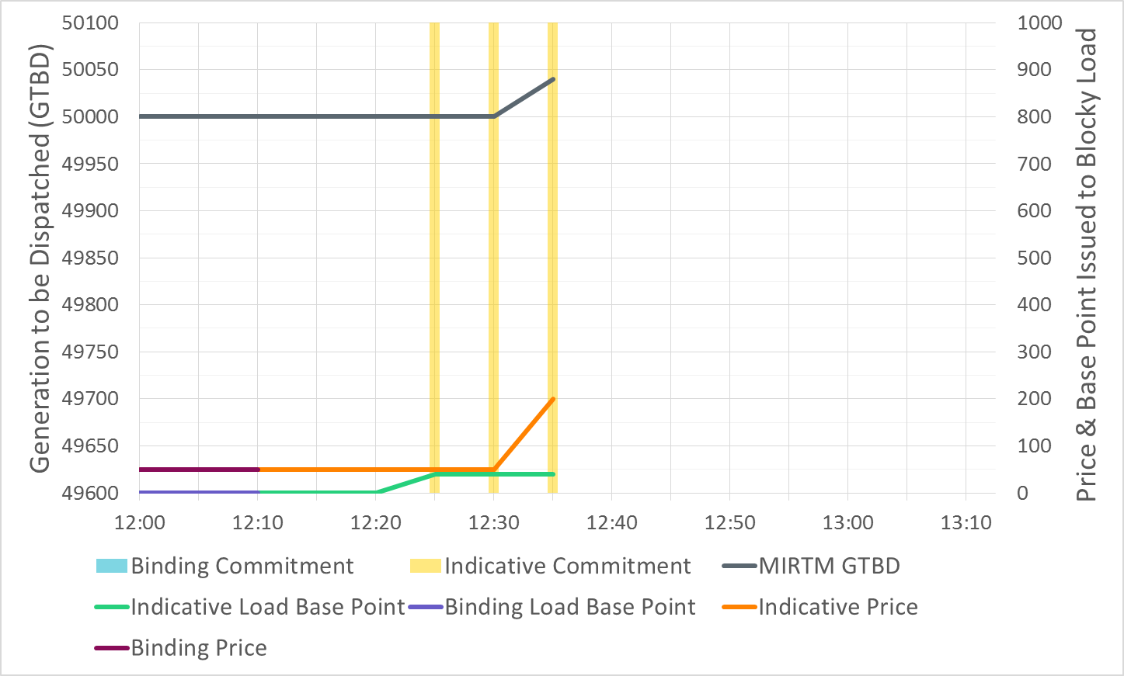
Example MIRTM Study Run
Results are interval ending. In this run, indicative commitment lasts from 12:20 – 12:35
Indicative price increase comes only after pricing run (blocky load becomes part of price formation when LSL is relaxed)

Slide 20
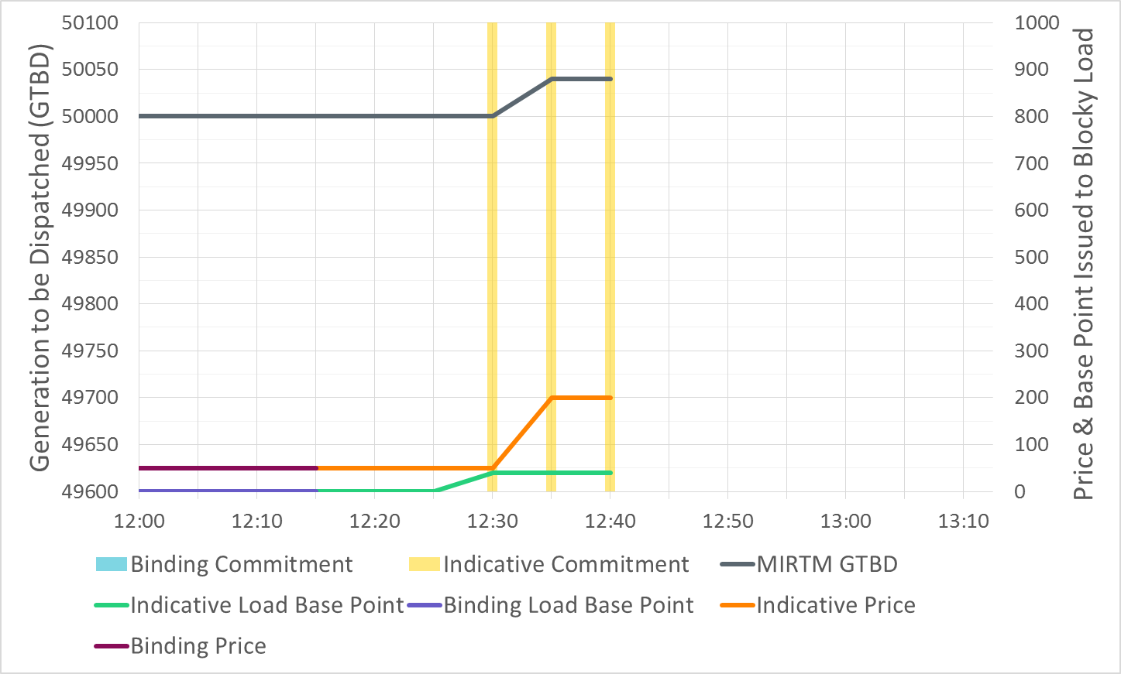
Example MIRTM Study Run

Slide 21
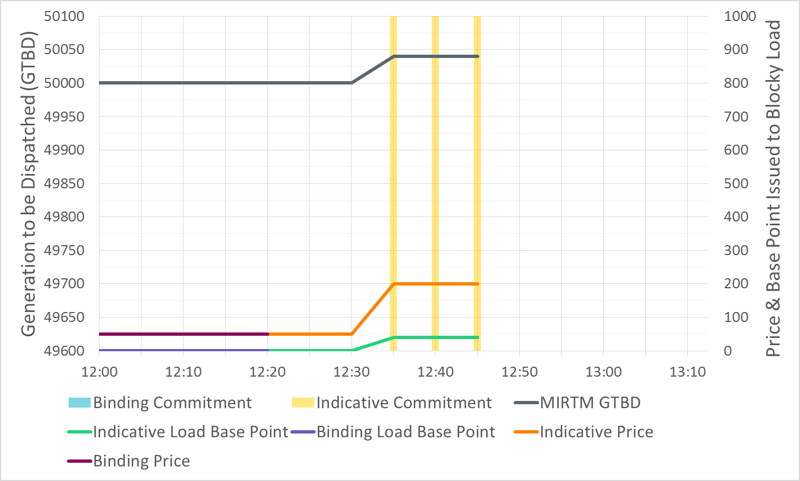
Example MIRTM Study Run

Slide 22
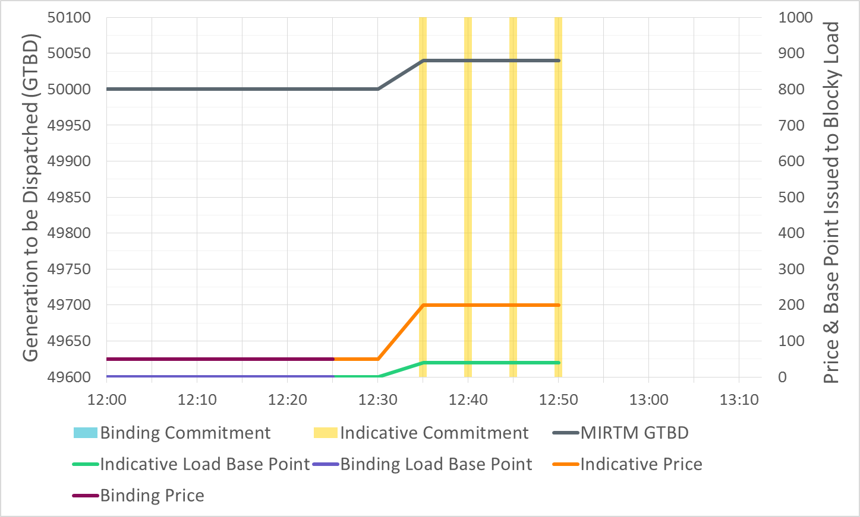
Example MIRTM Study Run

Slide 23
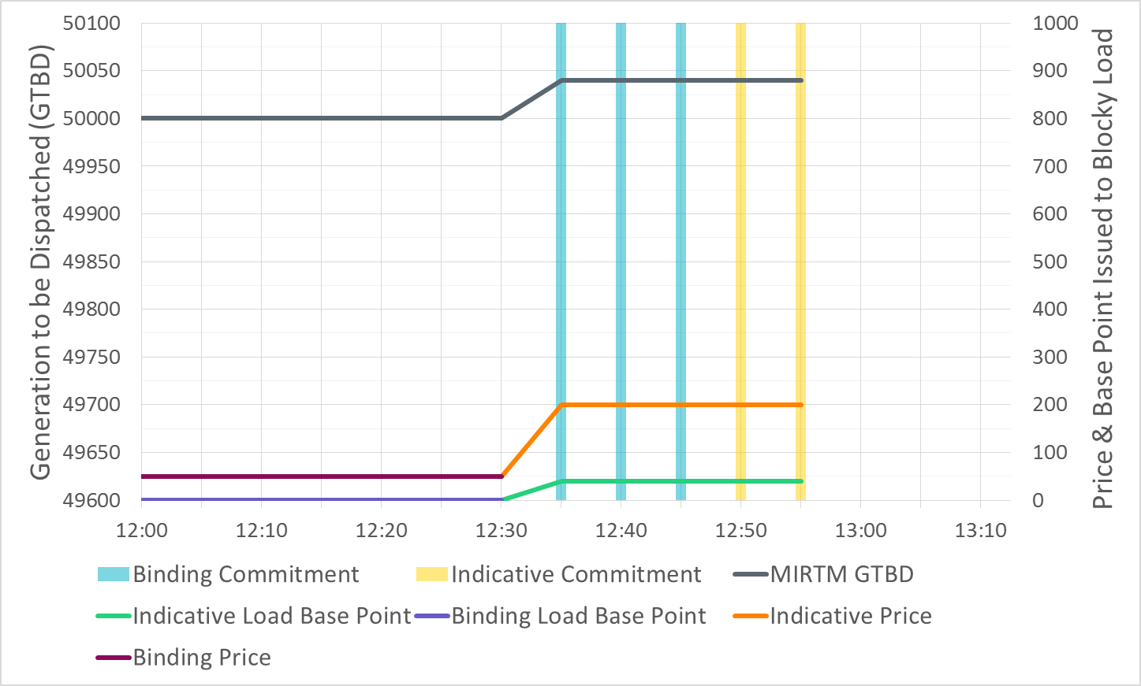
Example MIRTM Study Run

Slide 24
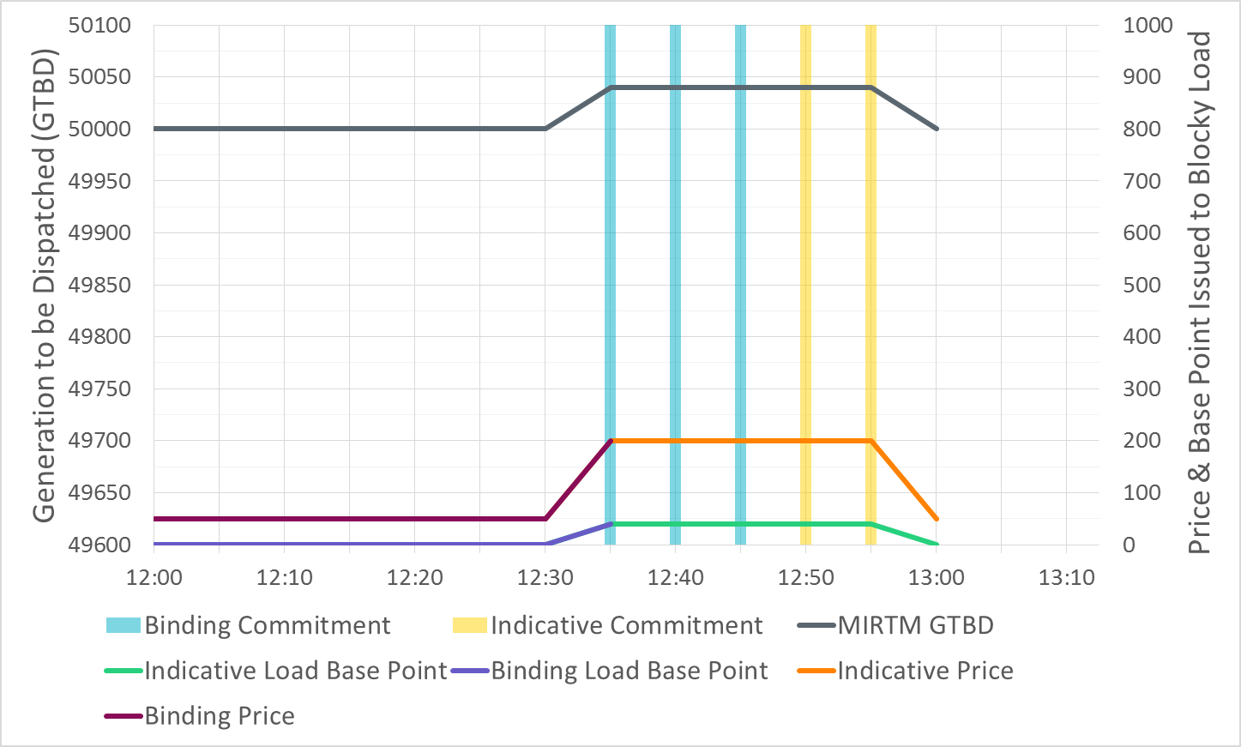
Example MIRTM Study Run

Slide 25
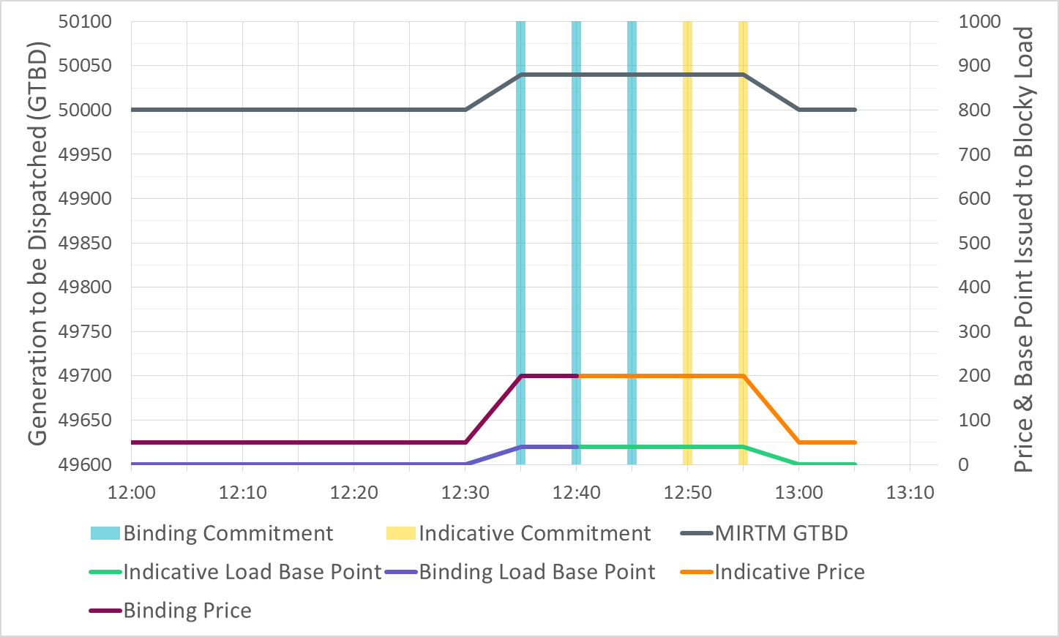
Example MIRTM Study Run

Slide 26
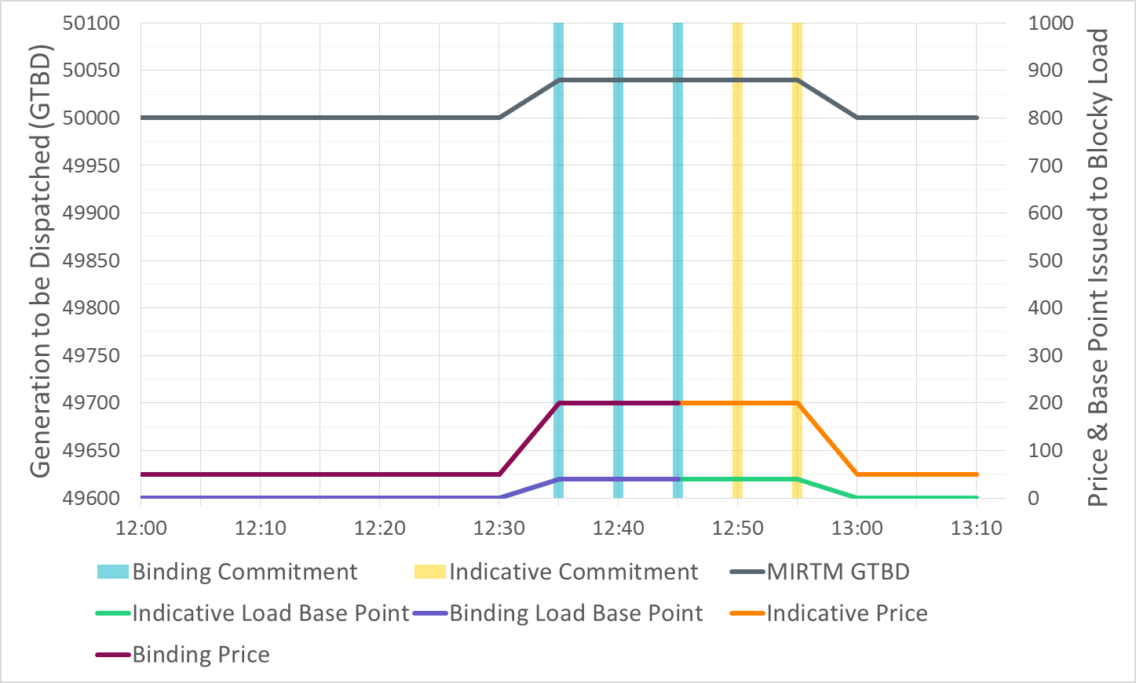
Example MIRTM Study Run

Slide 27
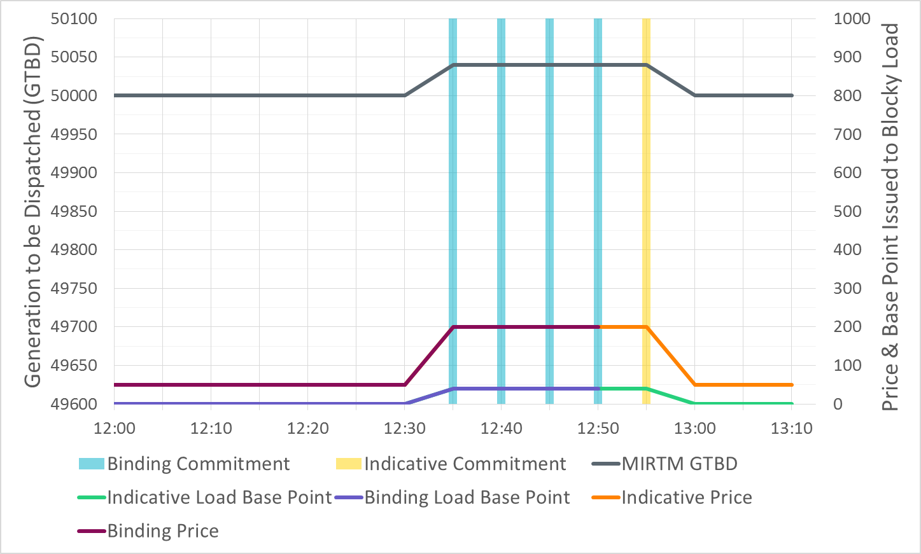
Example MIRTM Study Run

Slide 28
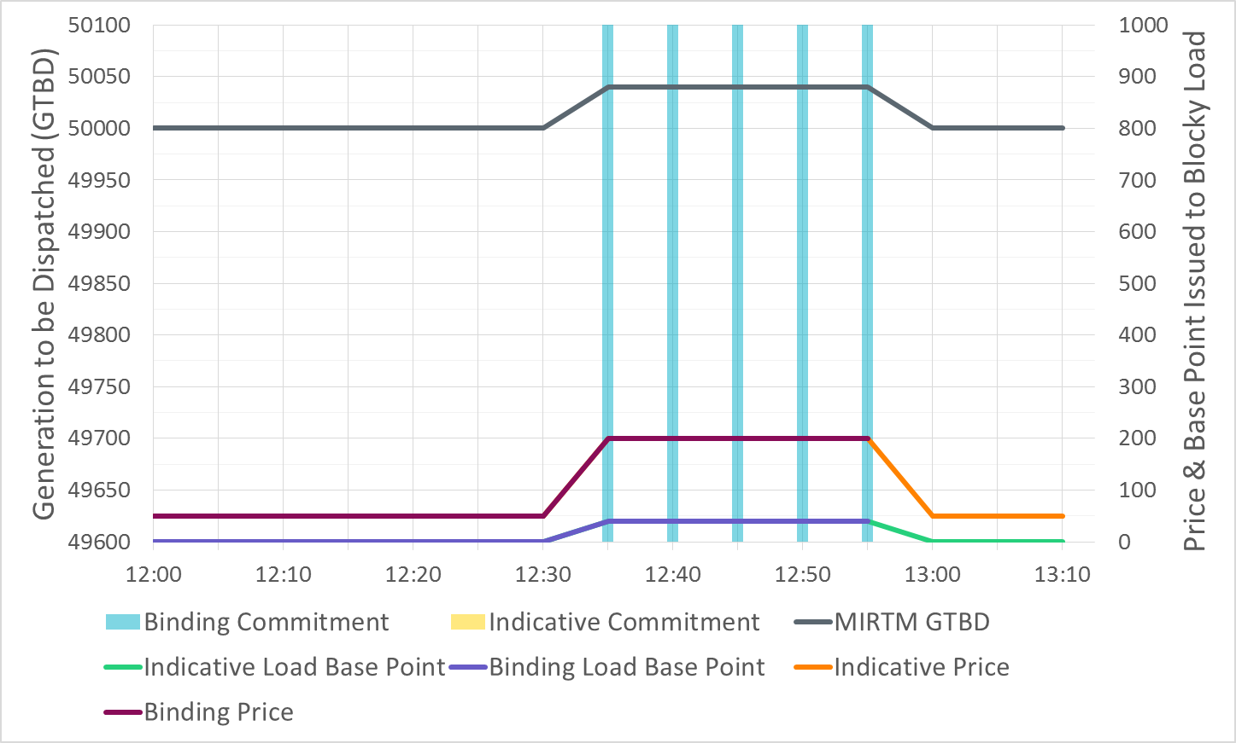
Example MIRTM Study Run

Slide 29
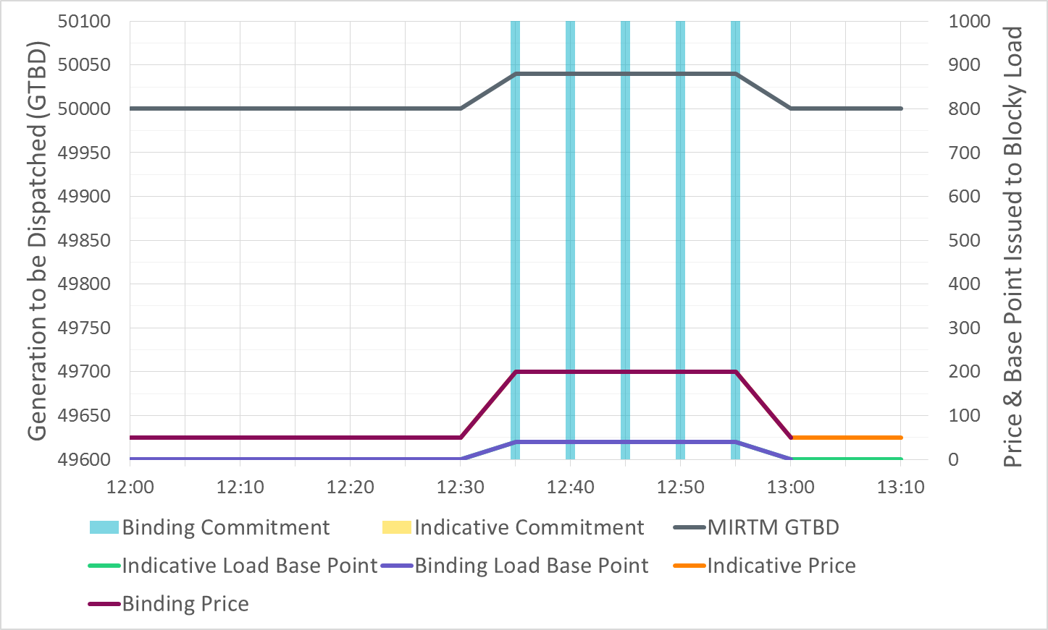
Example MIRTM Study Run

Slide 30
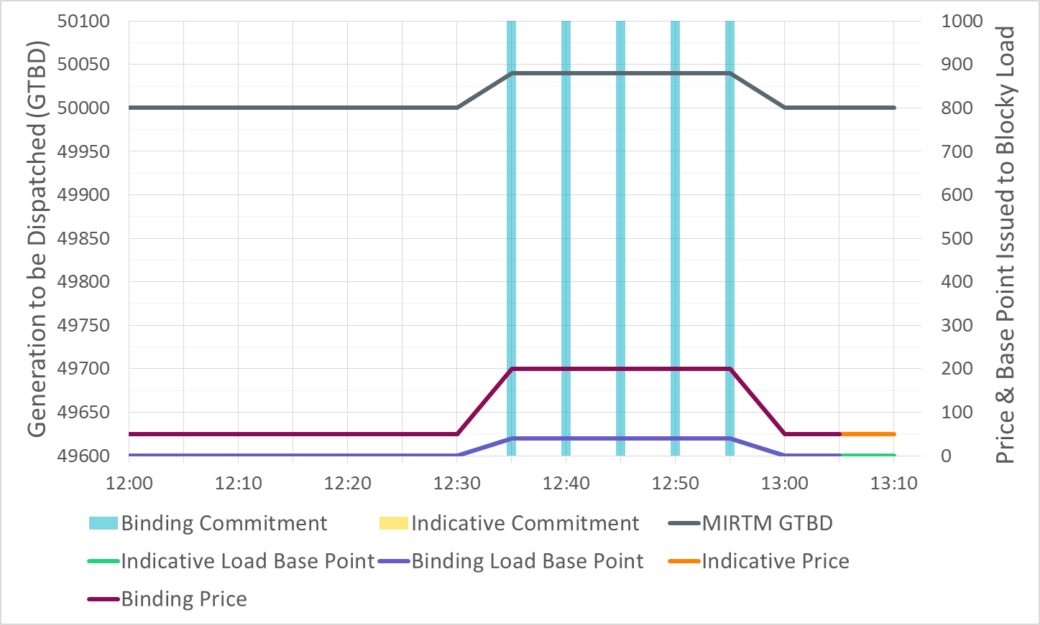
Example MIRTM Study Run

Slide 31
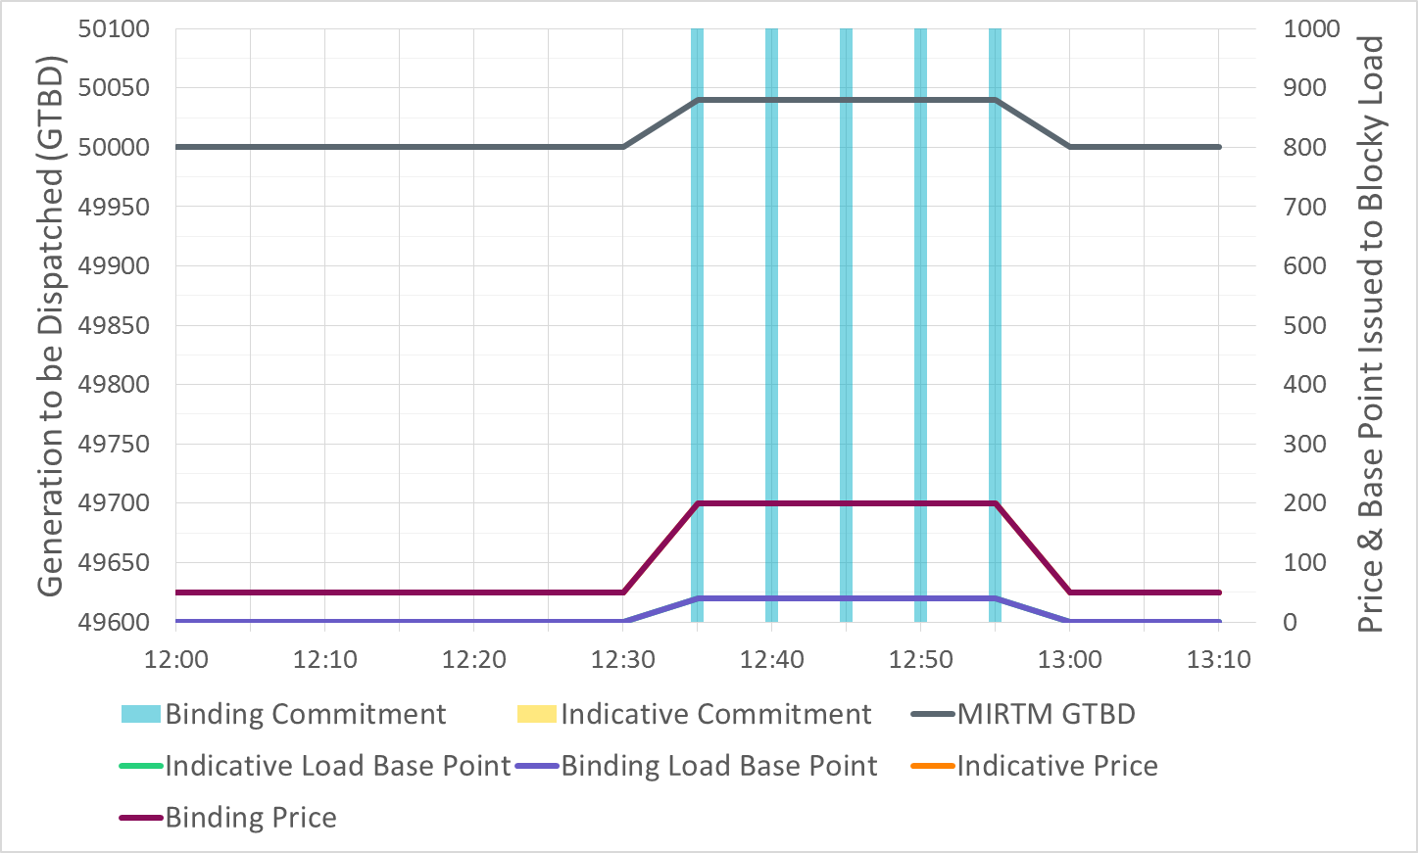
Example MIRTM Study Run

Slide 32
Appendix:
Example Study Day

Slide 33
Overview of Recent Activity
Implement Dispatch Module
Implement Pricing Module
Developed three part offers (TPO) based on average verifiable costs and unit HSL
Developed single part offers (SPO) from TPO allocating start costs over minimum up time and LSL
Allowed for Wartsila units to have zero start time and zero min off time (allows fast ramping resources to meet demand in same interval)
Studied the following dates:7/1/2015, 8/11/2015, 8/13/2015, 11/11/2015, 11/27/2015, 3/27/2016, 7/25/2016

Slide 34
MIRTM – Changes since August SAWG
Make the processing of Combined Cycles consistent between MIRTM and Sequential SCED
Correct the Minimum Energy for Resources carrying Non Spin to agree with $75 Energy offer curve
Streamline the Commitment Summary to two categories:
Count of Resources below cost
Count of Resources at or above cost
Corrected two study days that had short SCED runs which caused double counting in the MIRTM post process
Determination and book keeping of noncompetitive constraints are different between MIRTM and Seq. SCED: ERCOT will evaluate the impact and actions taken, if any, at a future SAWG meeting

Slide 35
MIRTM - Changes since September SAWG
Changes made after discussion with Market Participant’s at last SAWG:
GTBD in first interval altered in both Sequential SCED and MIRTM in order to be consistent
Include Start Up and Minimum Energy calculation in Sequential SCED in order to be consistent with MIRTM
Update Energy Offer Curve for fast responding resources based on commitment decision in Production (suggested by IMM after the SAWG meeting):
If the Resource was self committed in production and the EOC is lower in production, then use the lower offer in MIRTM instead of the higher “bucketed average” value
If the Resource was in QS mode in production, use the “bucketed average” value in MIRTM (assumes that the production EOC would have considered some value for SU/ME)

Slide 36
MIRTM - Changes since September SAWG cont.
Changes made after finding a bug in optimization
After deeper analysis of results, ERCOT staff found that the dollars per Start in the MIRTM optimization were in $perStart and the Minimum Energy and Energy Offer Curve were in $/MWh. The result was that each 5 minute interval had only 1/12 the $perStart.
There was two ways to fix this issue, scaling the ME/EOC or scaling the $perStart. ERCOT chose the simpler route and multiplied the $perStart by 12 in each interval.
ERCOT staff re-ran and re-analyzed all of the study days.

Slide 37
Introduction
A new methodology for calculating GTBD of MIRTM intervals has been found to be an improvement over current methodology
Applying Look-Ahead SCED methodology:
$MIRTM GTBD\left(i\right)=\left\{\begin{aligned}SCED GTBD i=1 \\ {STLF}_{i}+DCTie_{i} i>1\end{aligned}\right.$
Modified methodology for MIRTM:
$$MIRTM GTBD\left(i\right)=\left\{\begin{aligned}SCED GTBD i=1 \\ TelemMW_{0}+\left(STLF_{i}−STLF_{0}\right)+\left(DCTie_{i}−DCTie_{0}\right) all intervals \end{aligned}\right.$$
TelemMW₀ = Sum of Telemetered Gen output at MIRTM Run time
i = 5-Minute MIRTM Intervals Within Study Window
(ex: i=6 represents 30 Min. Ahead)

Slide 38
Study Runs
For the 8/13 run we will step incrementally through the progression of studies as follows:
Production SCED (information only)
Sequential SCED
MIRTM with Separate Commitment and Dispatch:
Loads only with QSGR not committable to mimic production (LOAD)
QSGRs have three-part offer based on average Verifiable Costs (3PO)
Note: we could come back at a later date with a comparison between MIRTM Combined Commitment and Dispatch and MIRTM Separate Commitment and Dispatch. It was too much data to show in one session.

Slide 39
Study Process
Determine the study period based on the day of interest and run a sequential SCED for the entire study period using the Energy Offers from actual Real Time SCED runs.
Sequential SCED considered the “baseline” that simulates all resources following base points while the GTBD mimics the production case is consistent with MIRTM.
Run MIRTM Separate Commitment and Dispatch with different offer structures (SPO Prod. SCED EOCs, 3PO) as inputs
Use new STLF and Wind Persistence to “look ahead” 30 minutes to determine if commitments needed

Slide 40
Study Process
Calculate Production Costs: Four Components
Generation Costs: Integrate Step 2 EOC from LSL to BP + Power Balance Violation
Transmission Penalty Cost: Violated MW * Shadow Price
QSGR Startup/Mingen Cost: Startup and Minimum Energy Costs
Blocky Load Cost: Bid Price * Commit MW
Calculate Make Whole
QSGR Make whole across entire study period
Prod. SCED & Seq. SCED: Emergency Operations QSGR payments (Per 6.6.9 (3))
MIRTM: Max(0,QSGR Verifiable Cost - QSGR Revenue)
Blocky Load Make whole across entire study period
MIRTM: Max(0, [Bid Price * Commit MW] -[Binding LMP * Commit MW])
Notes:
QSGR revenue:
(Binding LMP + Operating Reserve Demand Curve (ORDC) Online Price Adder + Pricing Run Price Adder) * Binding Base Point of Committable QSGR Unit List
QSGR Verifiable cost:
QSGR Verifiable Cost Above LSL - Integrate Input EOC or Verifiable Cost EOC (if no QSGRs in MIRTM) from LSL to BP of Committable QSGR Unit List
plus
QSGR Startup/Mingen Cost of Committable QSGR Unit List - Startup and Minimum Generation Costs of Committable QSGR Unit List

Slide 41
Simulation Assumptions – Fast Generation Resource Temporal Constraints
All Resources that are Quick Start qualified are considered “fast responding resources”. If the Resource was “OUT” or “ONTEST” during the study period they are not considered as “committable”
Gas Turbines (36 units)
Minimum On Time | Minimum Off Time | Cold Start-Up Time | Intermedate Start-Up Time | Hot Start-Up Time
15 Min. | 15 Min. | 10-15 Min. | 10-15 Min. | 10-15 Min.
Reciprocating Engines (3 units)
Minimum On Time | Minimum Off Time | Cold Start-Up Time | Intermedate Start-Up Time | Hot Start-Up Time
5 Min. | 15 Min. | 10 Min. | 10 Min. | 10 Min.
Wartsilas (4 units)
Minimum On Time | Minimum Off Time | Cold Start-Up Time | Intermedate Start-Up Time | Hot Start-Up Time
5 Min. | 5 Min. | 5 Min. | 5 Min. | 5 Min.

Slide 42
Simulation Assumptions – Fast Responding Resources
Four average Verifiable Costs groups were identified.
Each Fast Responding Resources is assigned a group cost based on HRL/LSL
The Single Part offer is structured in order to recover Start Up and Minimum Energy cost over the Minimum On time and can vary due to individual units’ LSL
Minimum EOC and Min. Gen. is $75 if Resource had Non-Spin responsibility during study period

Slide 43
Simulation Assumptions – Fast Responding Resources
Sample of costs used (SPO can vary per unit depending on LSL):
Res Type | HRL (MW) | LRL (MW) | Seasonal LSL (MW) | Startup Cost ($) | Min-Energy Price ($/MWh) | Min EOC ($/MWh) | Max EOC ($/MWh) | Single Part Cost ($/MWh)
SCLE90 | 54.0 | 10.0 | 13.0 | 4,322.05 | 52.39 | 30.86 | 33.91 | 1,287.26
SCLE90 | 60.0 | 0.0 | 12.0 | 3,448.99 | 48.85 | 28.47 | 31.05 | 1,198.51
SCLE90 | 95.0 | 0.0 | 41.0 | 6,058.75 | 56.12 | 40.35 | 41.88 | 647.21
DSL | 8.9 | 6.0 | 6.0 | 962.21 | 39.93 | 34.84 | 39.79 | 1,964.34
NOTE: Min EOC will be equal to the production EOC if the Resource was self committed in production and the EOC value is lower

Slide 44
Other Assumptions – Days Analyzed
The Capacity from all Fast Responding Resources is considered online in MIRTM study runs; this has the impact of changing the Operating Reserve Demand Curve (ORDC) calculation slightly; however, the resource capacity is only shifted from offline to online.
The Block Load Resources are considered “new” Resources for MIRTM which increases the RTOLCAP and shifts the curve to the right by 366MW.
The Reliability Deployment Price Adder in MIRTM treats the deployment by ERCOT as a “deployment event” therefore MIRTM may find a RTDP when Production and Sequential SCED did not.

Slide 45
August 13, 2015

Slide 46
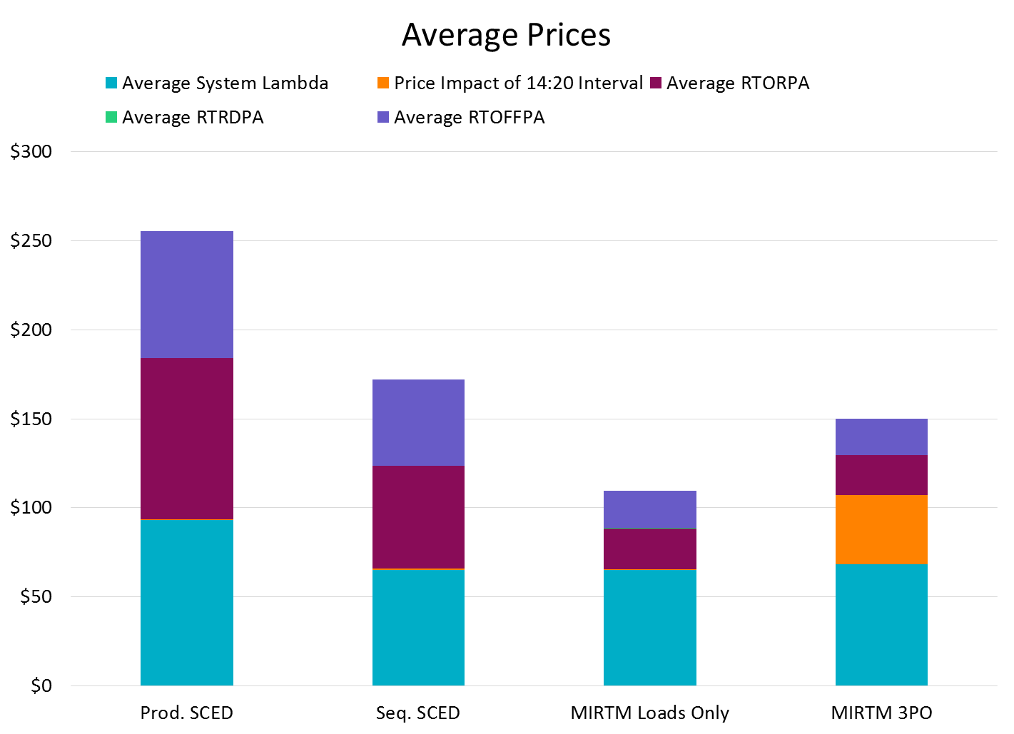
August 13, 2015
Changes in ORDC price adders due to NCLRRRS calculation change in Seq. SCED (NPC-LPC)
Changes in ORDC price adders due to 366 MW of new Blocky Load capacity in RTOLCAP
Impact of high price interval separated for all 4 scenarios

Slide 47
August 13, 2015

Slide 48
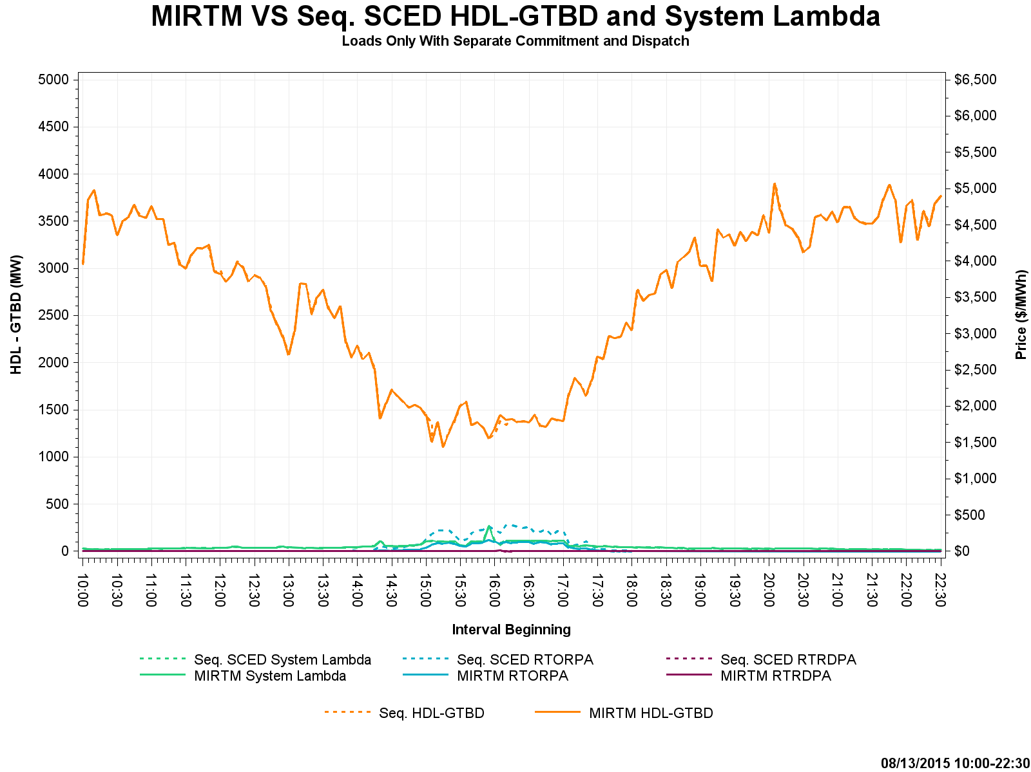
August 13, 2015 – HDL-GTBD & Price

Slide 49
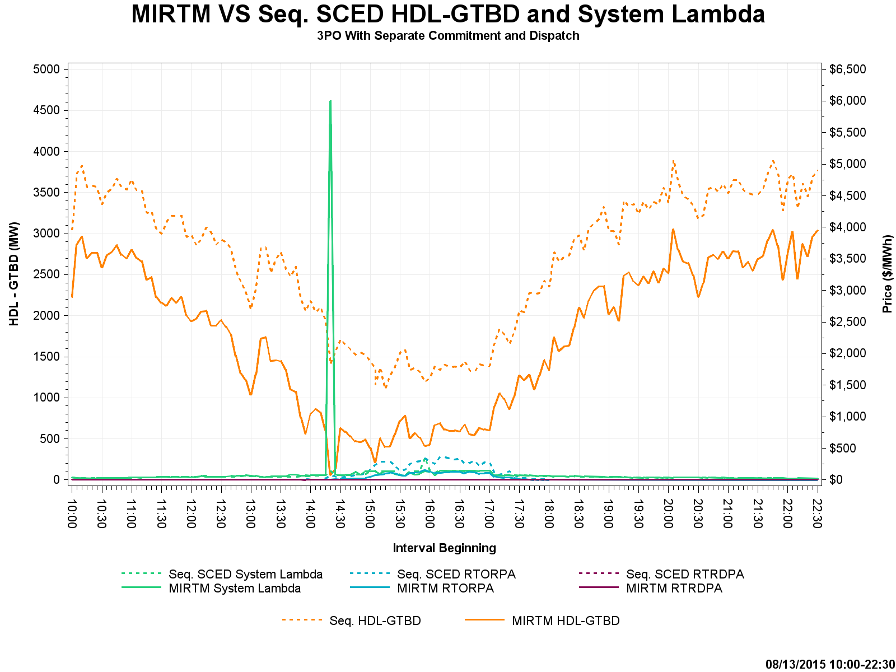
August 13, 2015 – HDL-GTBD & Price
Cause for price spike at 14:20 in MIRTM 3PO explained on next slide

Slide 50
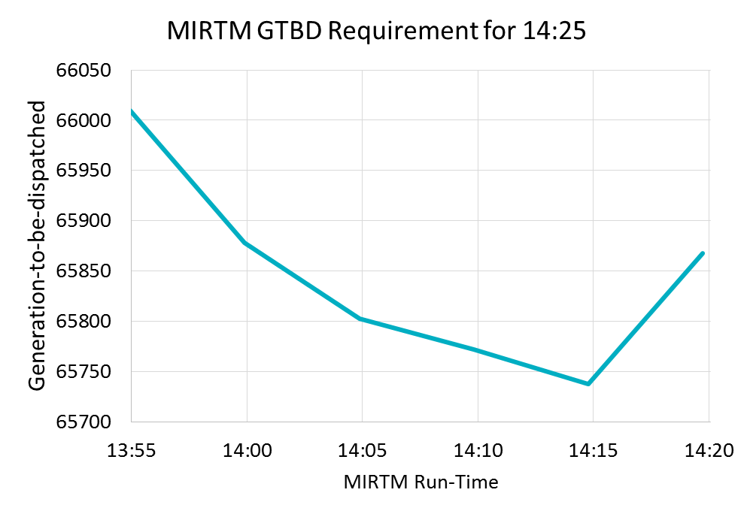
August 13, 2015
MIRTM 3PO had a spike due to a combination of a unit tripping (~160 MW) and missed load forecast
By waiting until the last minute, binding QSGR commitments were not made in this time frame due to forecast decrease

Slide 51
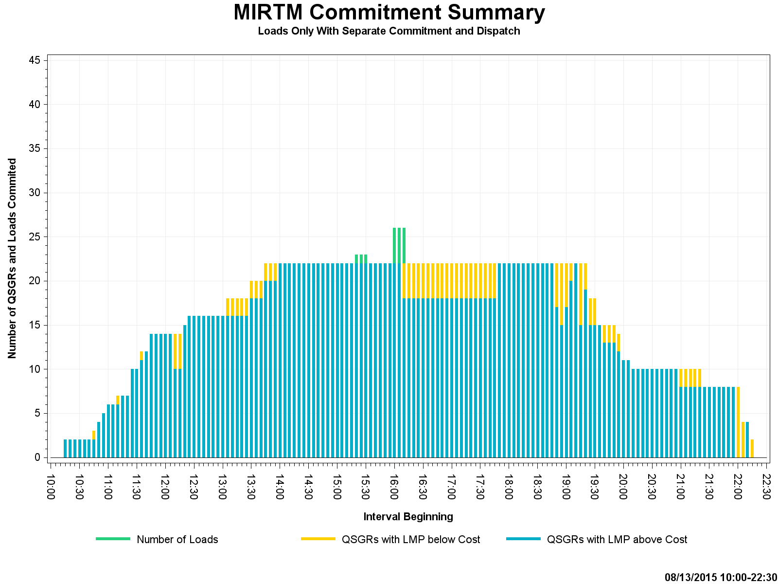
August 13, 2015 – Commitment Summary

Slide 52
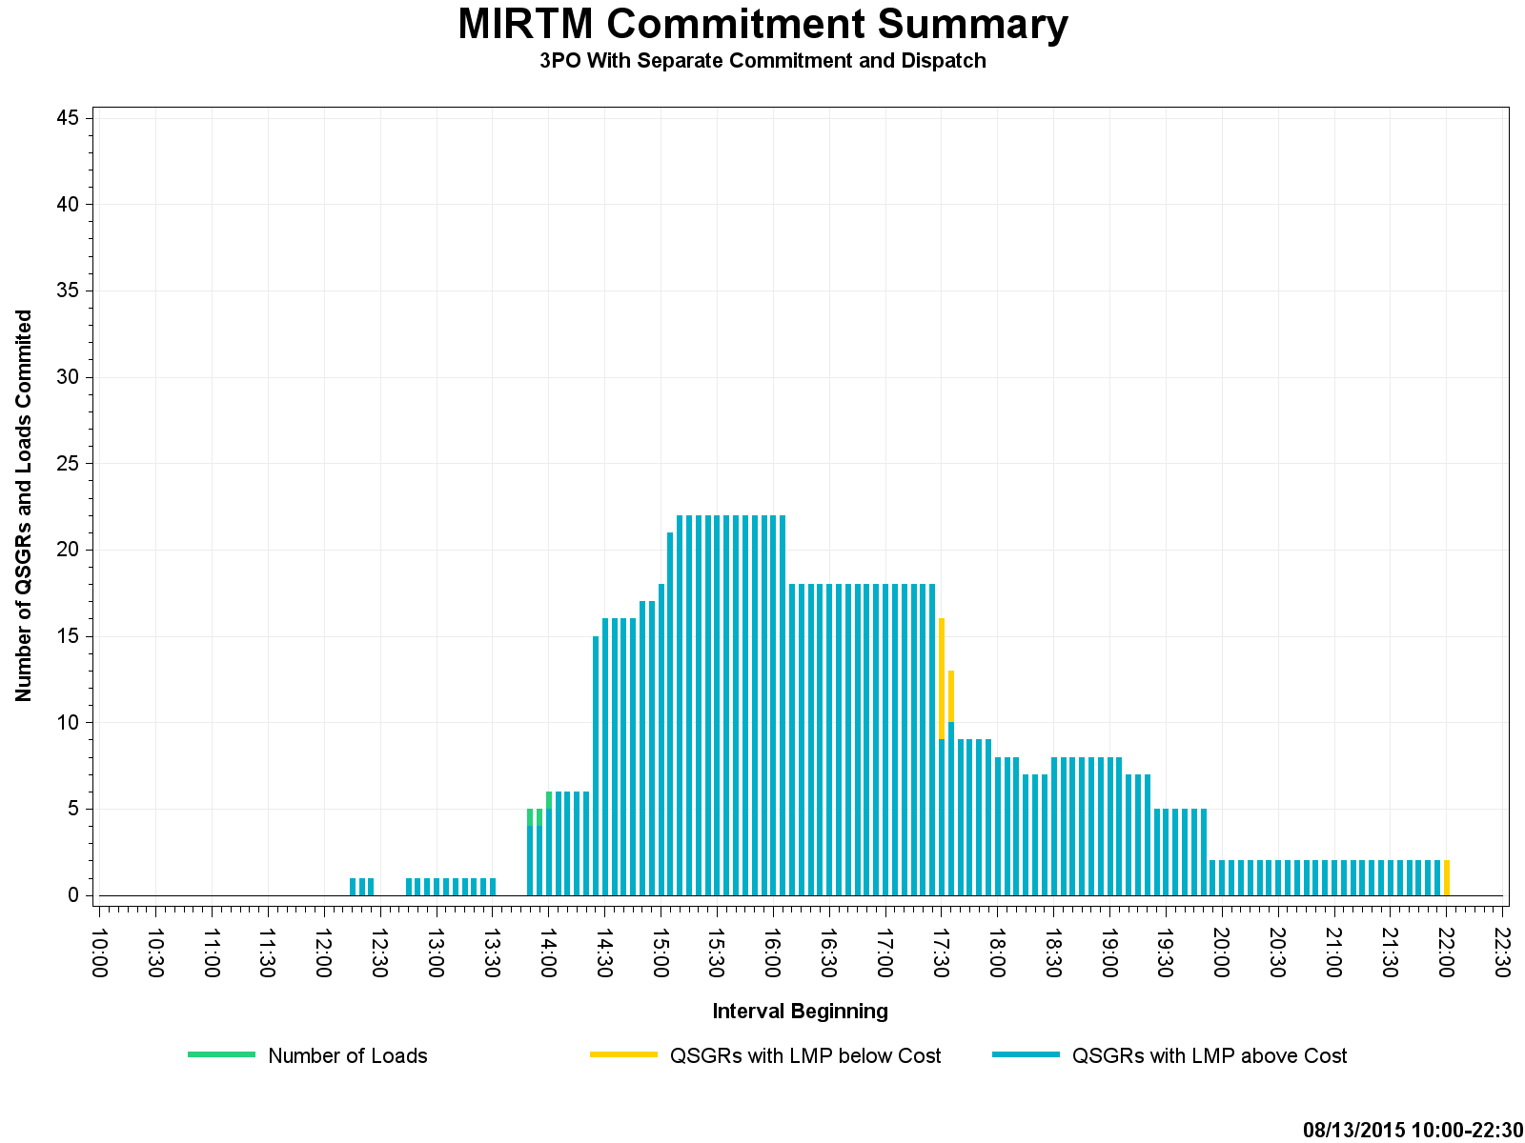
August 13, 2015 – Commitment Summary
Tighter QSGR commitment with MIRTM 3PO than with production self-commitment

Slide 53
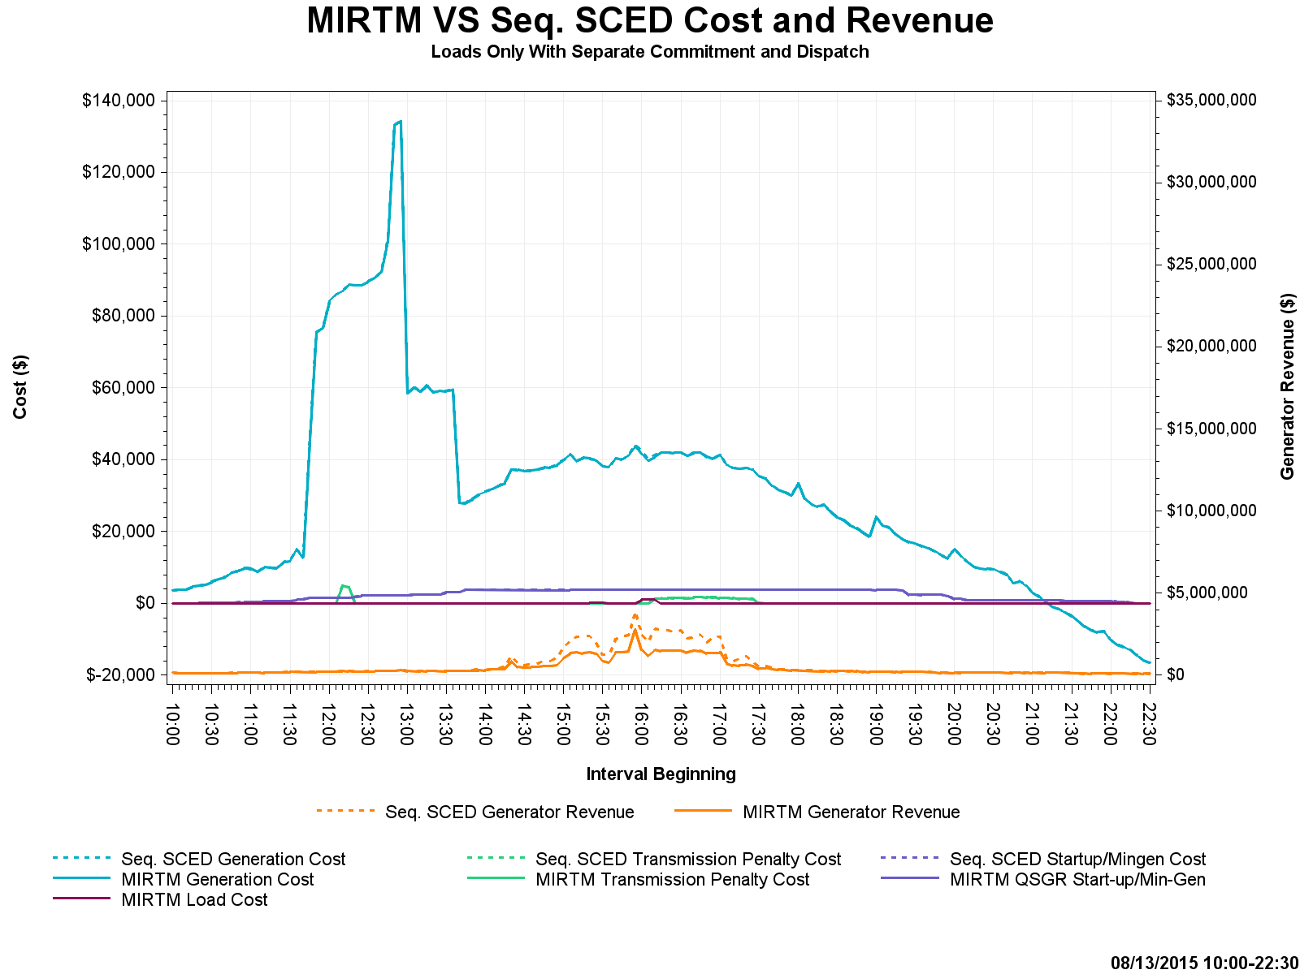
August 13, 2015 – Cost and Revenue

Slide 54
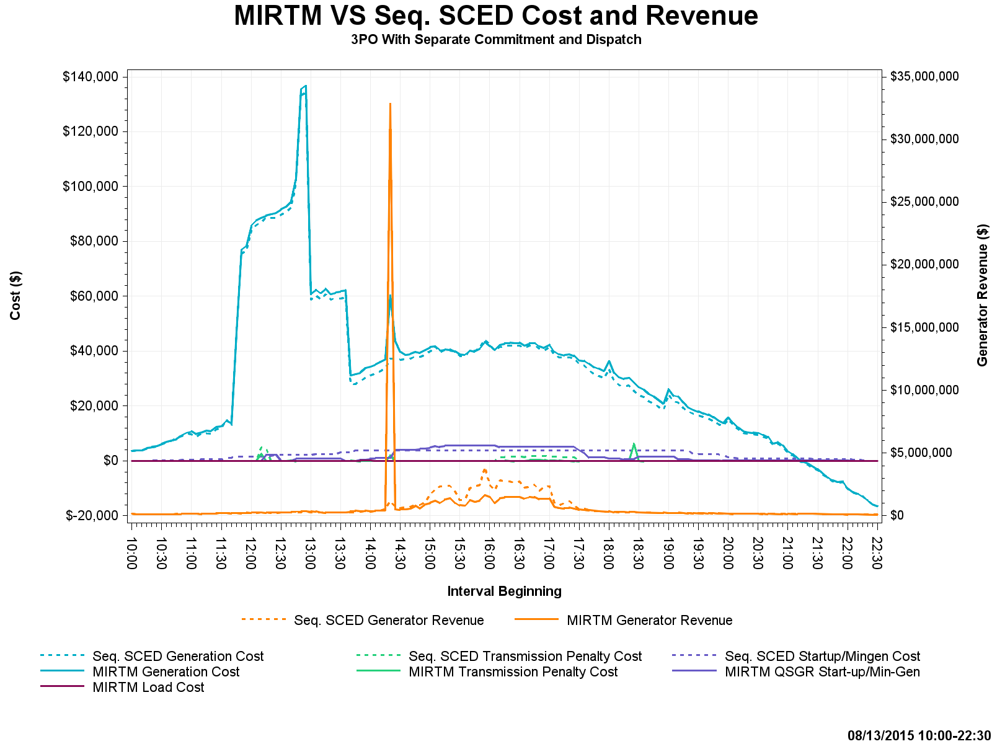
August 13, 2015 – Cost and Revenue

