Slide 1
Multi-Interval Real-Time Market (MIRTM)
Demand and Wind Estimation Updates
SAWG
Sean Chang
Market Analysis
October 24, 2016

Slide 2
Table of Contents
Introduction
Improving Demand Estimation
Improving Wind HSL Estimation
Examining Net Load Estimation Error Distribution
Observations & Next Steps
Appendix

Slide 3
Introduction
1. Improving Demand Estimation
Short-Term Load Forecast (STLF)
Generation-To-Be-Dispatched (GTBD) Calculation Methodology
2. Improving Wind HSL Estimation
Indicative Pricing Tool currently uses a heuristically determined linear equation to estimate wind HSL
Currently, MIRTM is using persistence to estimate wind HSL at a resource-specific level
Improvements using ARIMA at the system-wide level show the potential for improvement in short-term wind HSL estimation

Slide 4
Introduction
3. Examining Net Load Error Distribution
Combines the impact of demand and wind estimation
  Note that this is not a direct input into MIRTM
Examine error distribution to see performance at outer percentiles
Net Load for this presentation is defined as:
  Estimated Demand – Estimated Wind HSL
  and
  Actual Demand – Actual Wind HSL

Slide 5
Improving Demand Estimation

Slide 6
Introduction
Both STLFs use weather and calendar variables as basic inputs.
Current STLF (Legacy system in the EMMS)
  Based on regression similar day model using lagged load values as well as lagged load from 24 hours ago of a similar day
New STLF (Blended Model)
  First 15 minutes is based on a regression model using lagged load values (forecast of total MW for a weather zone)
  Next 45+ minutes is based on a regression model of ramp rates (forecast of total MW change from last actual value)
See May 2015 SAWG meeting page for previous presentation: http://www.ercot.com/calendar/2015/5/27/55033-SAWG

Slide 7
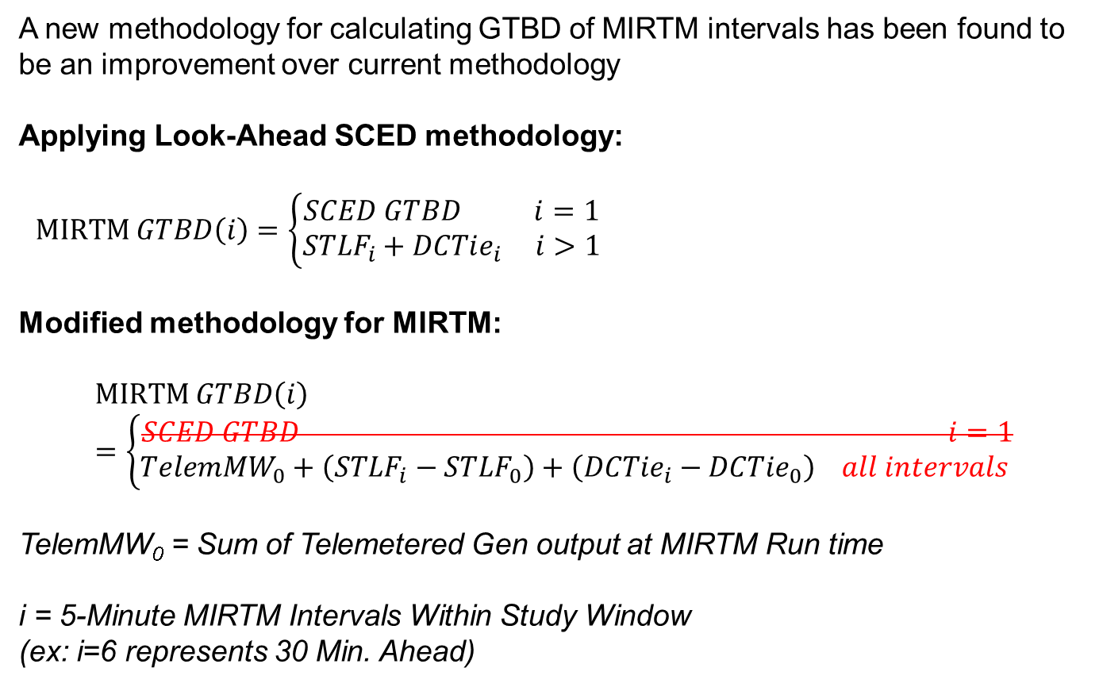
Introduction
A new methodology for calculating GTBD of MIRTM intervals has been found to be an improvement over current methodology
Applying Look-Ahead SCED methodology:
$MIRTM GTBD\left(i\right)=\left\{\begin{aligned}SCED GTBD i=1 \\ {STLF}_{i}+DCTie_{i} i>1\end{aligned}\right.$
Modified methodology for MIRTM:
$$MIRTM GTBD\left(i\right)=\left\{\begin{aligned}SCED GTBD i=1 \\ TelemMW_{0}+\left(STLF_{i}−STLF_{0}\right)+\left(DCTie_{i}−DCTie_{0}\right) all intervals \end{aligned}\right.$$
TelemMW₀ = Sum of Telemetered Gen output at MIRTM Run time
i = 5-Minute MIRTM Intervals Within Study Window
(ex: i=6 represents 30 Min. Ahead)

Slide 8
Introduction
Both the current STLF and new STLF are used in the analysis along with the modified methodology for four combinations:
  MIRTM GTBD with current STLF
  MIRTM GTBD with new STLF
  MIRTM GTBD Modified with current STLF
  MIRTM GTBD Modified with new STLF
The calculated MIRTM GTBD errors are benchmarked using Estimated – Reference where Reference is:
  First interval (i=1): Actual SCED GTBD
  Intervals 1 – 6 (i=1…6): Sum of generator output at end of SCED interval

Slide 9
Statistics of MIRTM GTBD Modified with New STLF vs. Reference

Slide 10
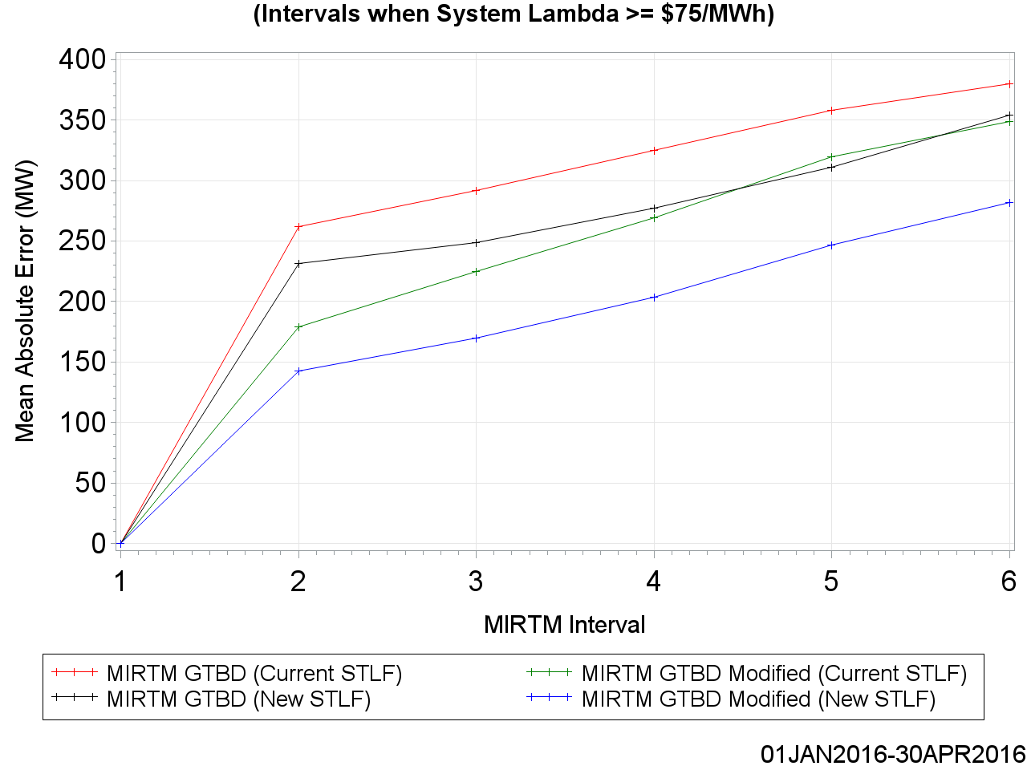
Statistics of MIRTM GTBD Modified with New STLF vs. Reference

Slide 11
Improving Wind HSL Estimation

Slide 12
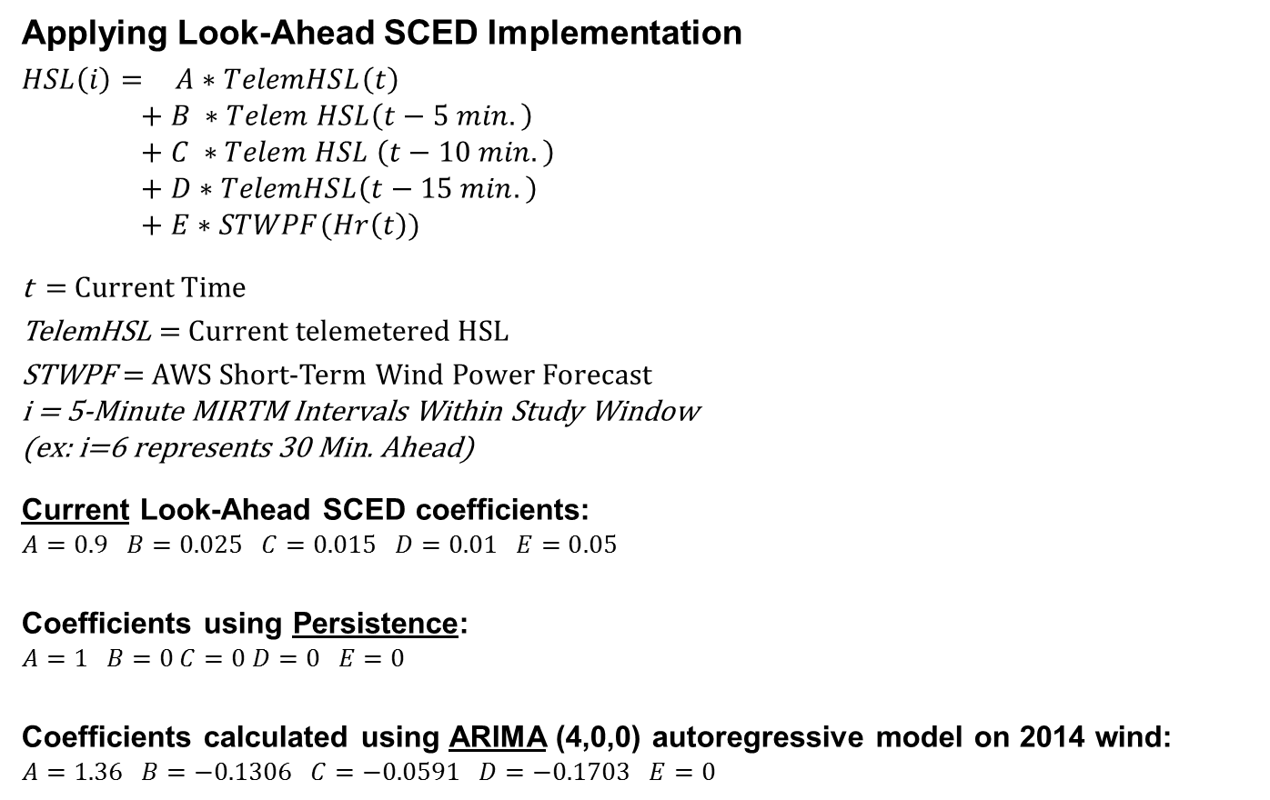
Improving Wind HSL Estimation in MIRTM
Applying Look-Ahead SCED Implementation
$HSL\left(i\right)=$ $A∗TelemHSL\left(t\right)$
$$+ B ∗Telem HSL\left(t−5 min.\right)$$
$$+ C ∗Telem HSL \left(t−10 min.\right)$$
$$+ D∗TelemHSL\left(t−15 min.\right)$$
$$+ E∗STWPF(Hr\left(t\right))$$
t = Current Time
TelemHSL = Current telemetered HSL
STWPF = AWS Short-Term Wind Power Forecast
i = 5-Minute MIRTM Intervals Within Study Window
(ex: i=6 represents 30 Min. Ahead)
Current Look-Ahead SCED coefficients:
$$A=0.9 B=0.025 C=0.015 D=0.01 E=0.05$$
Coefficients using Persistence:
$$A=1 B=0 C=0 D=0 E=0$$
Coefficients calculated using ARIMA (4,0,0) autoregressive model on 2014 wind:
$$A=1.36 B=−0.1306 C=−0.0591 D=−0.1703 E=0$$
Notes:
Performance is calculated using system-wide wind. Actual implementation would require each unit to be treated separate. Further work is being done.

Slide 13
Statistics of Estimated Wind HSL vs. Actual Wind HSL

Slide 14
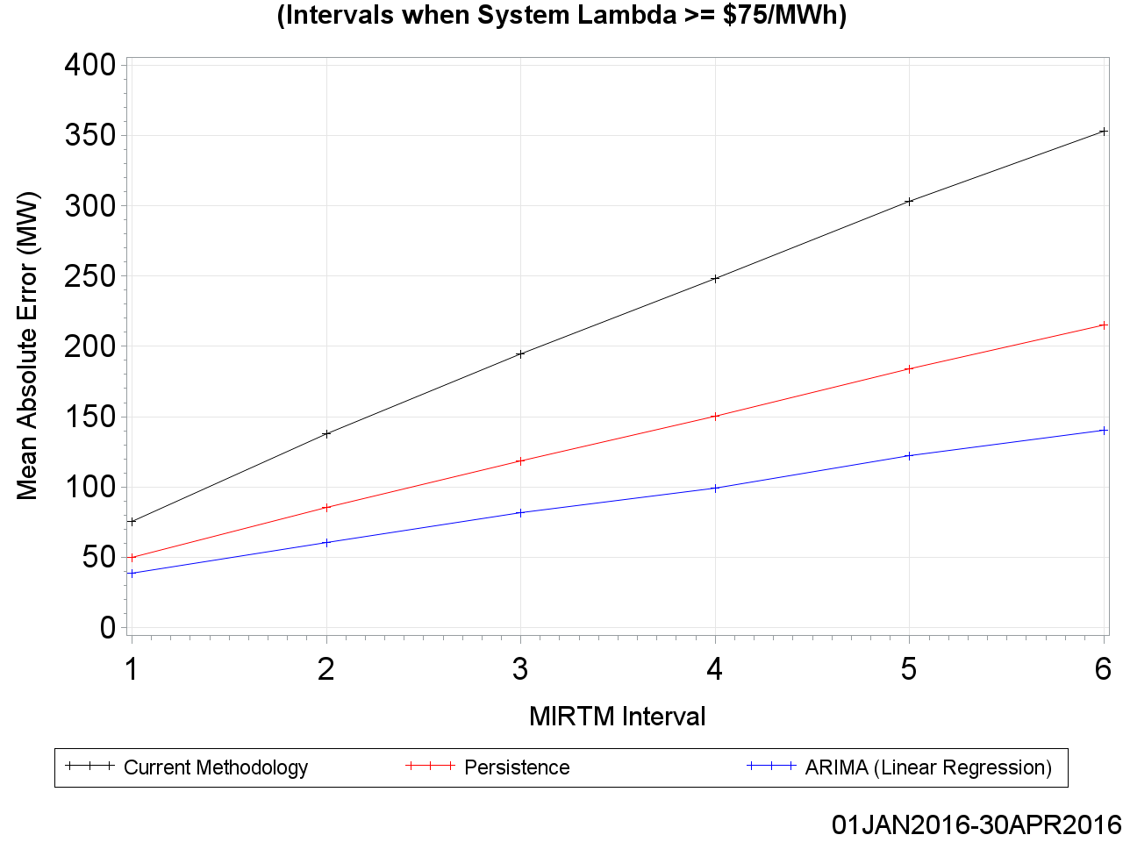
Statistics of Estimated Wind HSL vs. Actual Wind HSL

Slide 15
Examining Net Load Error Distribution

Slide 16
Examining Net Load Error Distribution
Both the STLF and Wind HSL Estimation are combined into a singular value to examine its distribution. The following three combinations are chosen:
  MIRTM GTBD Modified with Current STLF minus Persisted Wind HSL
  MIRTM GTBD Modified with New STLF minus Persisted Wind HSL
  MIRTM GTBD Modified with New STLF minus ARIMA Wind HSL
The calculated net load errors are benchmarked using:
(Actual Demand – Actual Wind HSL) – (Estimated Demand – Estimated Wind HSL).

Slide 17
Net Load Estimation Error Analysis
May 1, 2016 – September 30, 2016
All Intervals

Slide 18
MAE of Load, Wind, and Net Load Forecasts

Slide 19
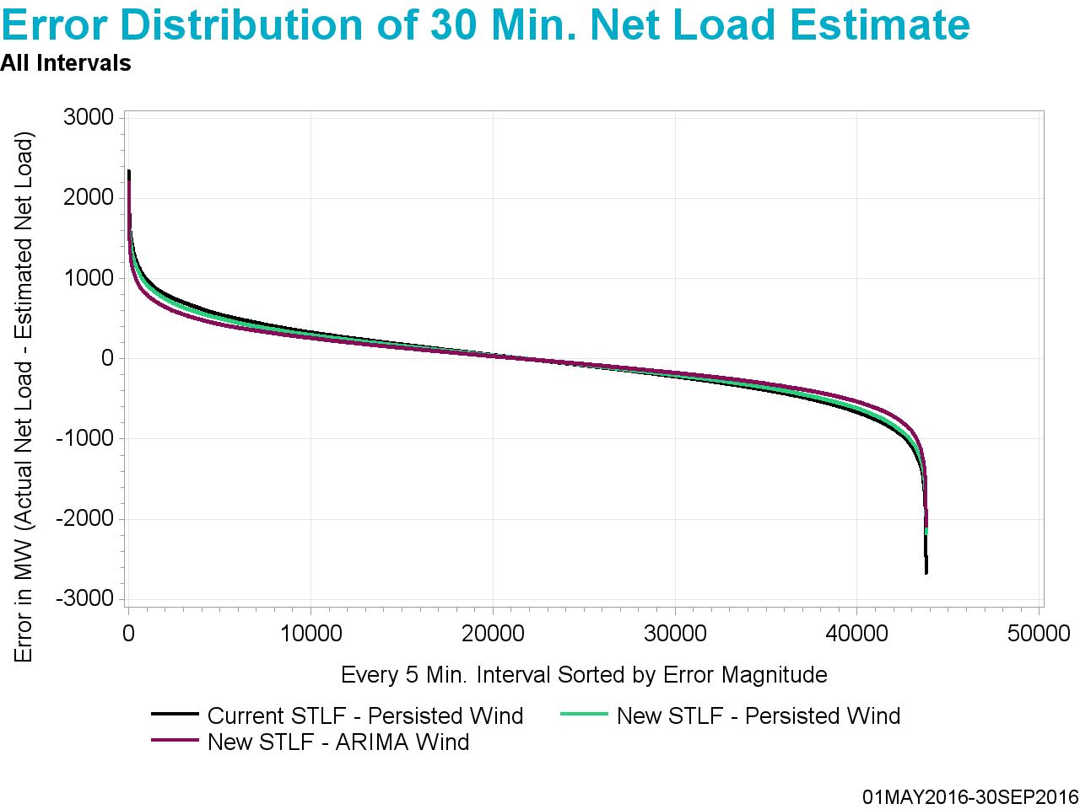
Underestimate
Overestimate

Slide 20
Underestimate
Overestimate

Slide 21
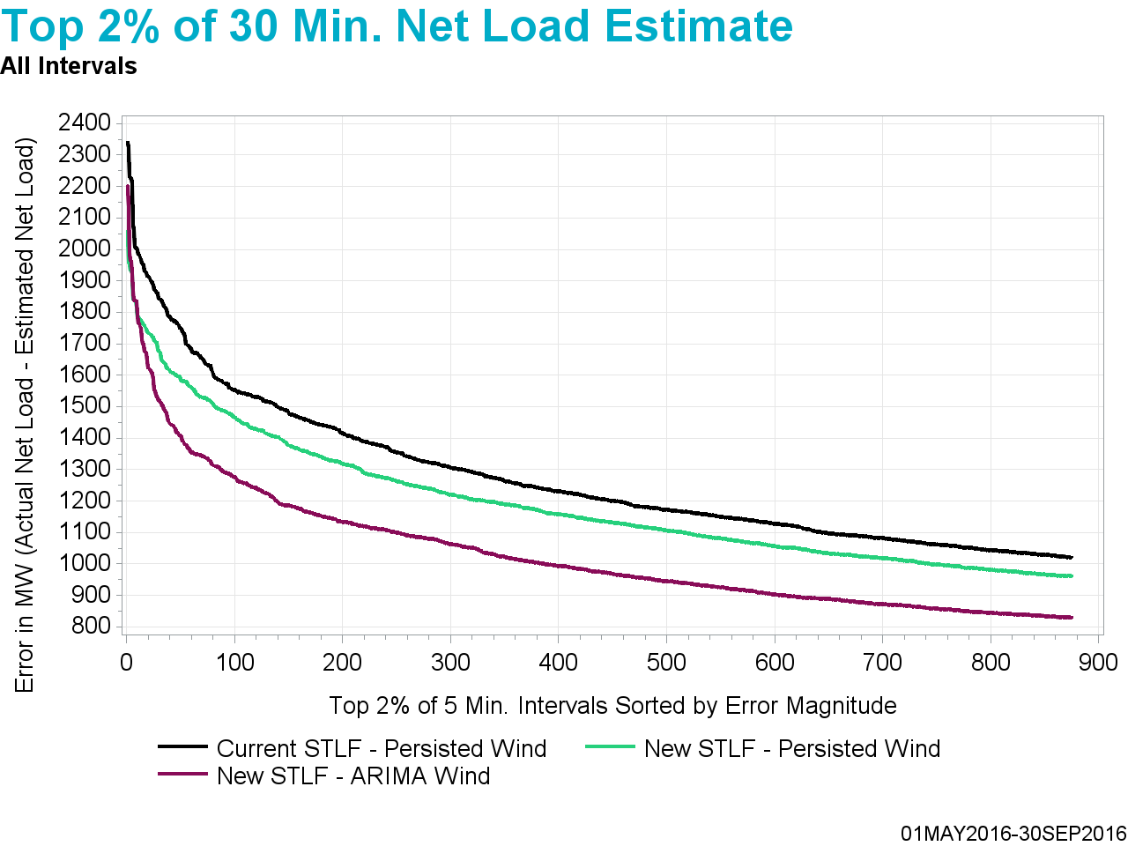
Underestimate

Slide 22
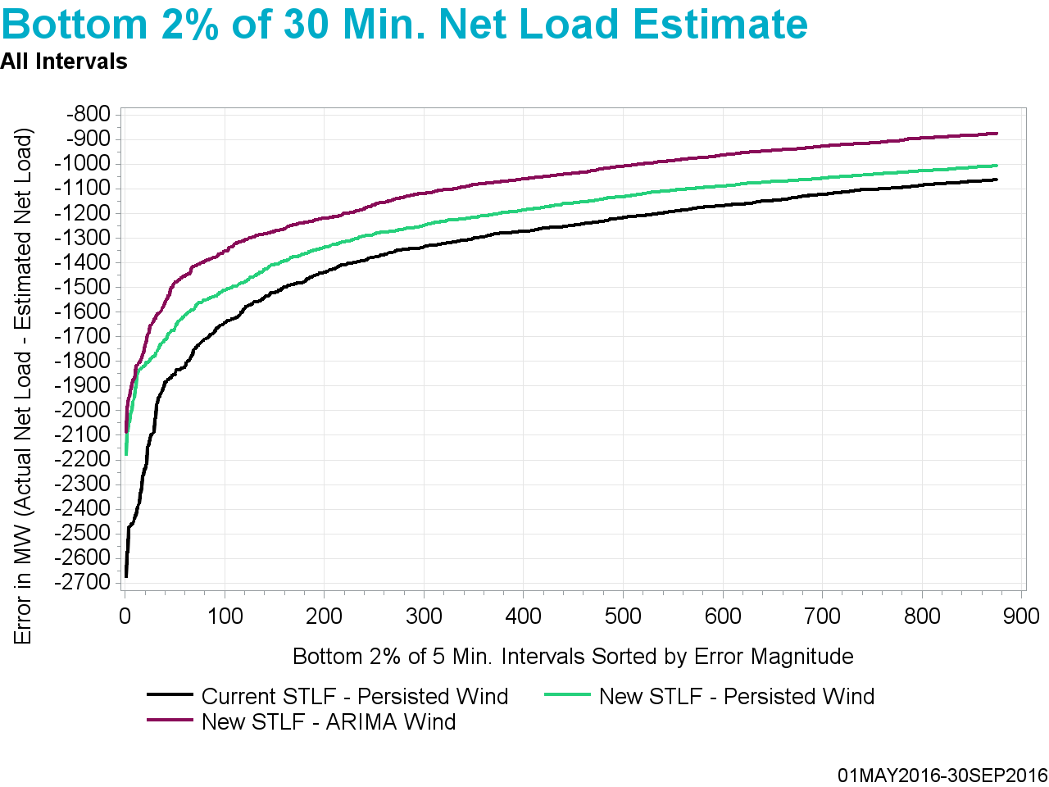
Overestimate

Slide 23
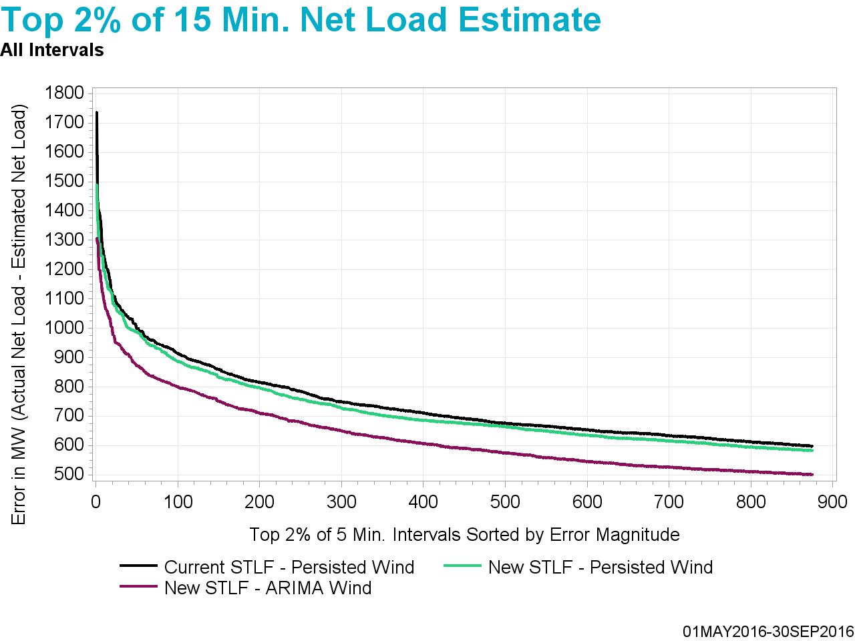
Underestimate

Slide 24
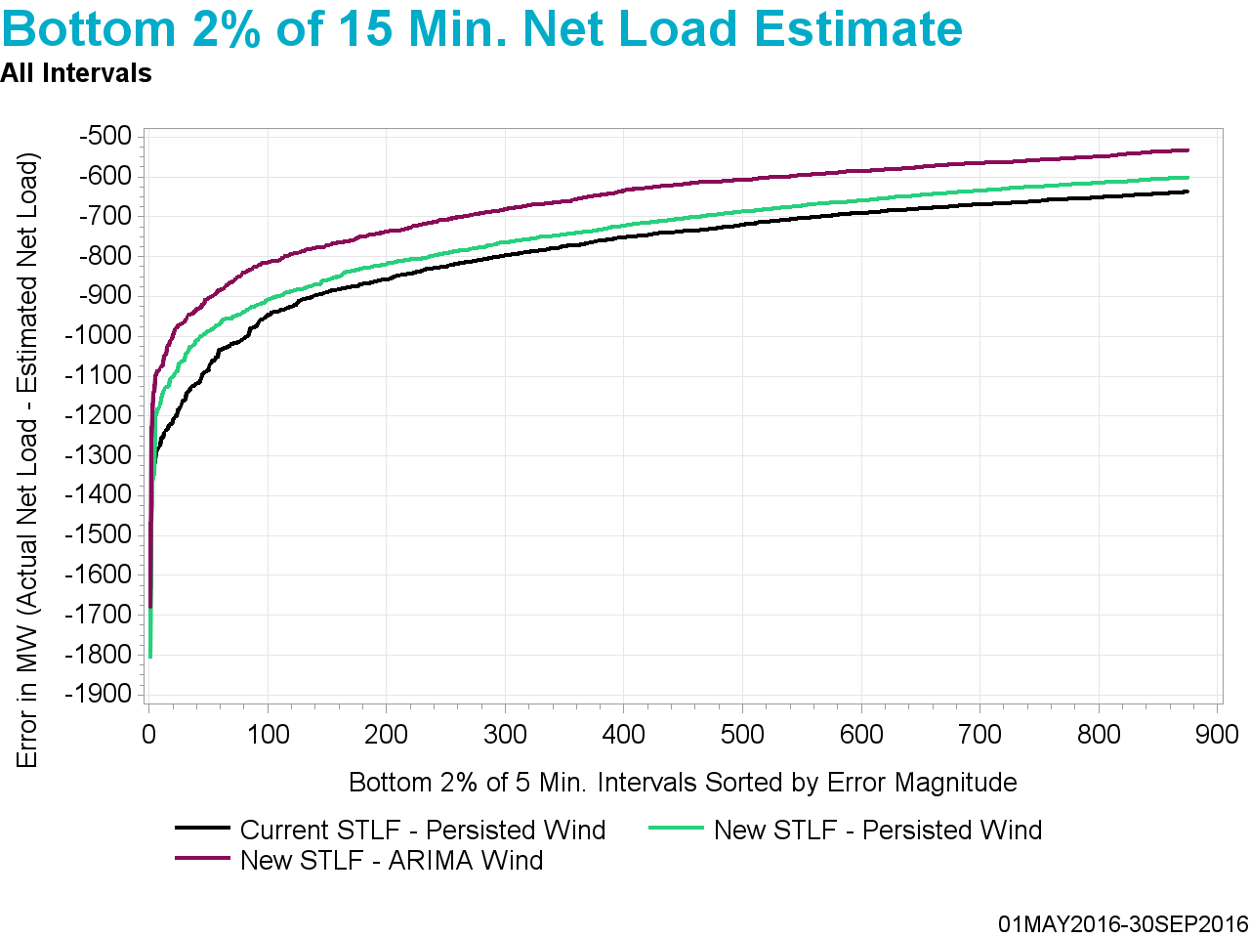
Overestimate

Slide 25
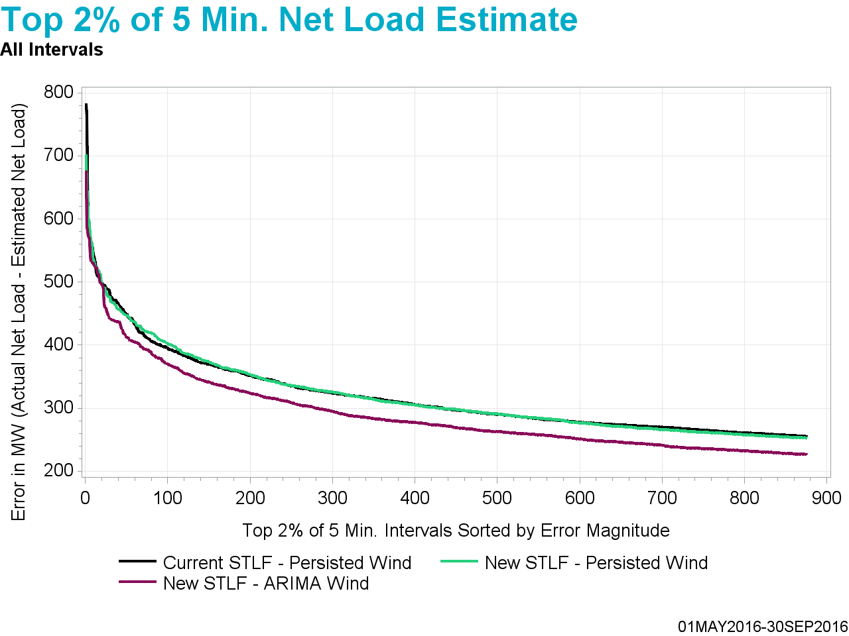
Underestimate

Slide 26
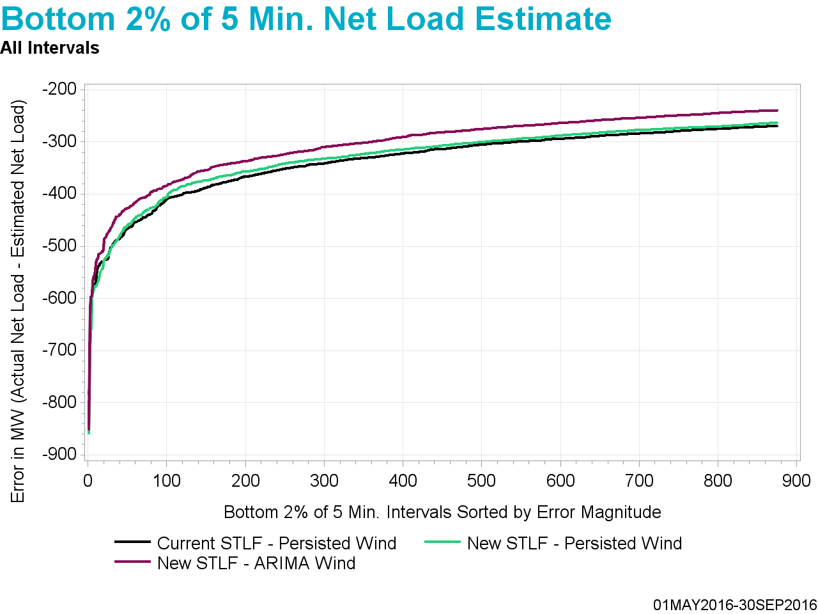
Overestimate

Slide 27
Observations
New STLF continues to outperform current STLF on average
Estimating wind HSL using ARIMA at the system-wide level continues to outperform persistence on average
Examining net load error distribution demonstrates that the combination of new STLF and estimating wind HSL using ARIMA at the system-wide level outperforms other methods even at the outliers

Slide 28
Conclusions and Next Steps
New STLF is used in MIRTM studies
Persistence is still being used to estimate wind HSL for MIRTM studies
ERCOT will conduct further studies on developing ARIMA models to estimate Wind HSL on a seasonal/time of day and regional/wind plant granularity
ERCOT is still engaged with AWS to see if they can create a 5 min. resolution Wind HSL forecast
Appendix contains detailed graphs in the same order and format of the February 22, 2016 and May 16, 2016 SAWG meeting presentation

Slide 29
Questions?

Slide 30
Appendix

Slide 31
MIRTM Demand Estimation Performance
May 1, 2016 – September 30, 2016
All Intervals

Slide 32
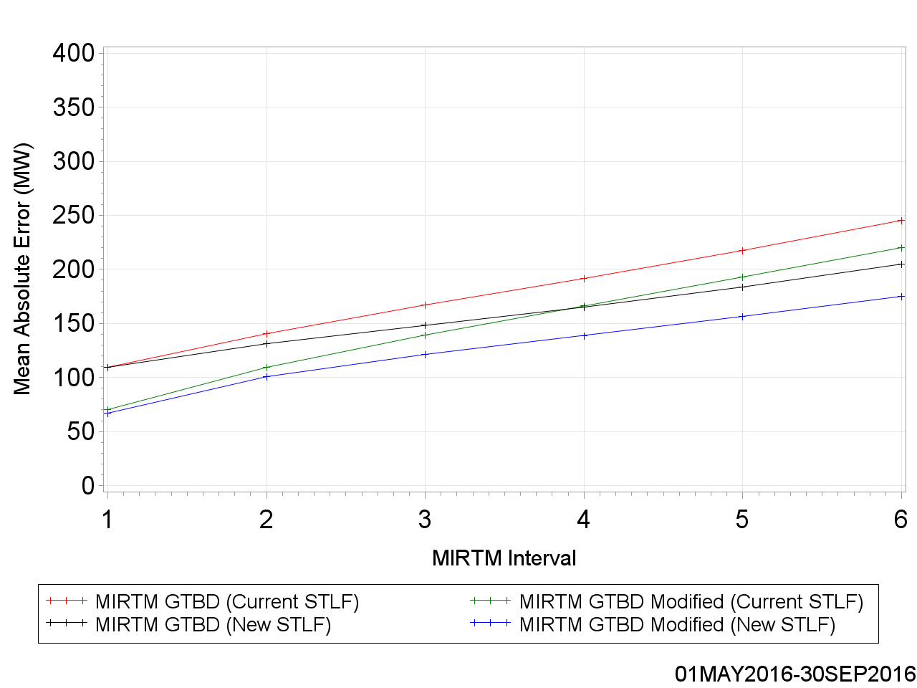
MAE of Estimated GTBD vs. Reference

Slide 33
MAE of Estimated GTBD vs. Reference

Slide 34
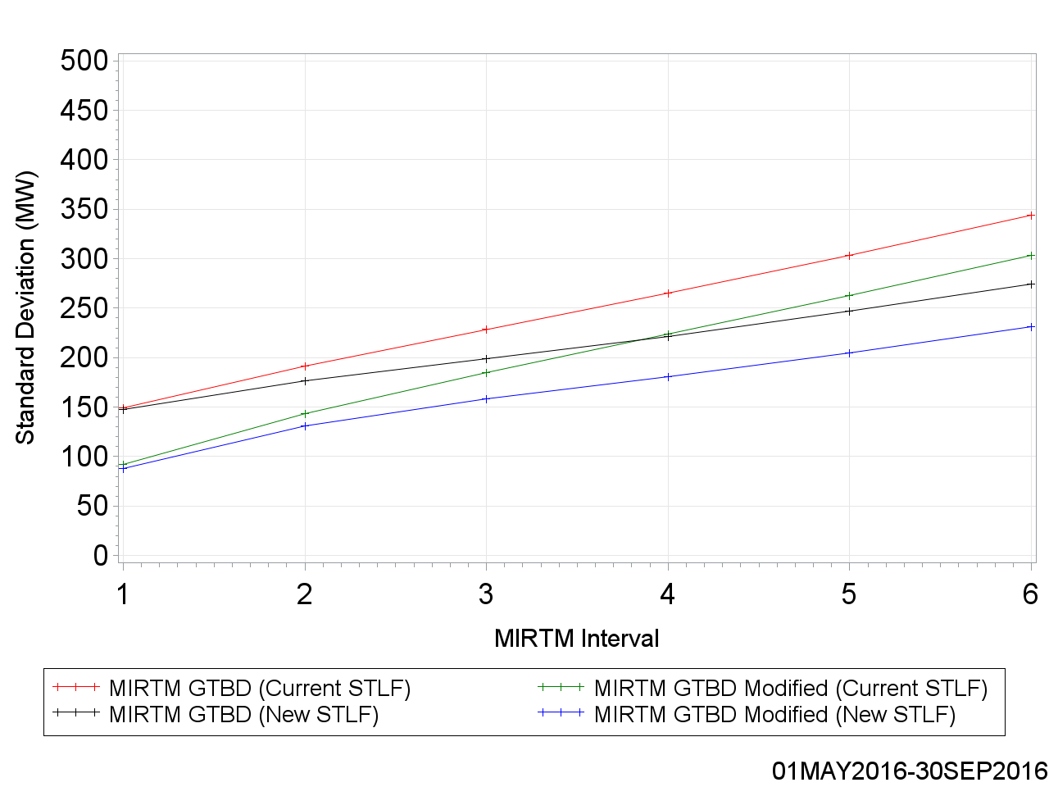
Standard Deviation of Estimated GTBD vs. Reference

Slide 35
Standard Deviation of Estimated GTBD vs. Reference

Slide 36
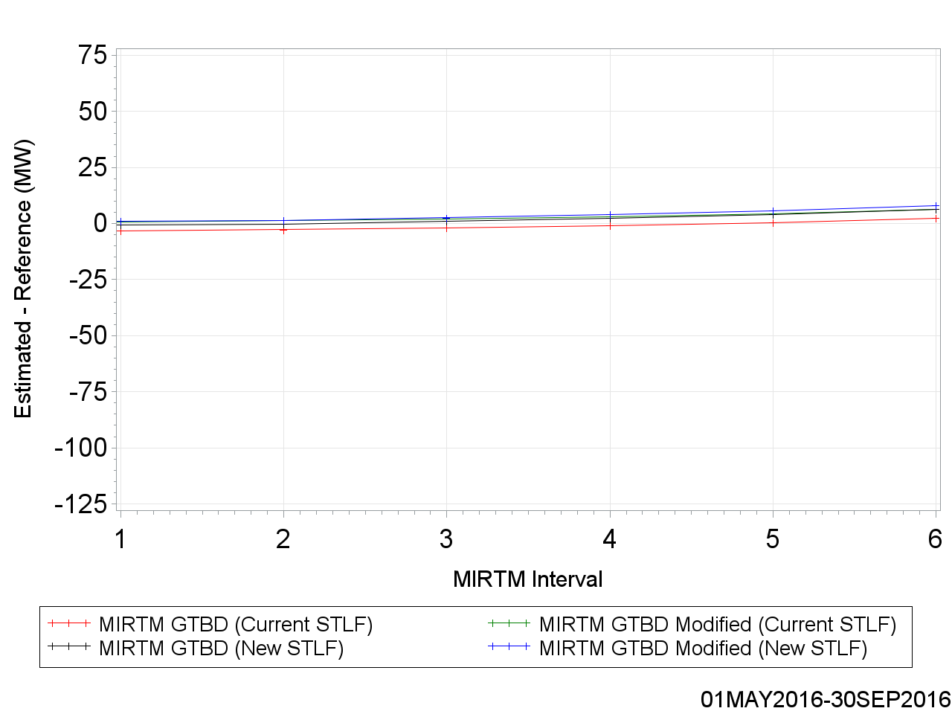
Mean of Estimated GTBD vs. Reference

Slide 37
Mean of Estimated GTBD vs. Reference

Slide 38
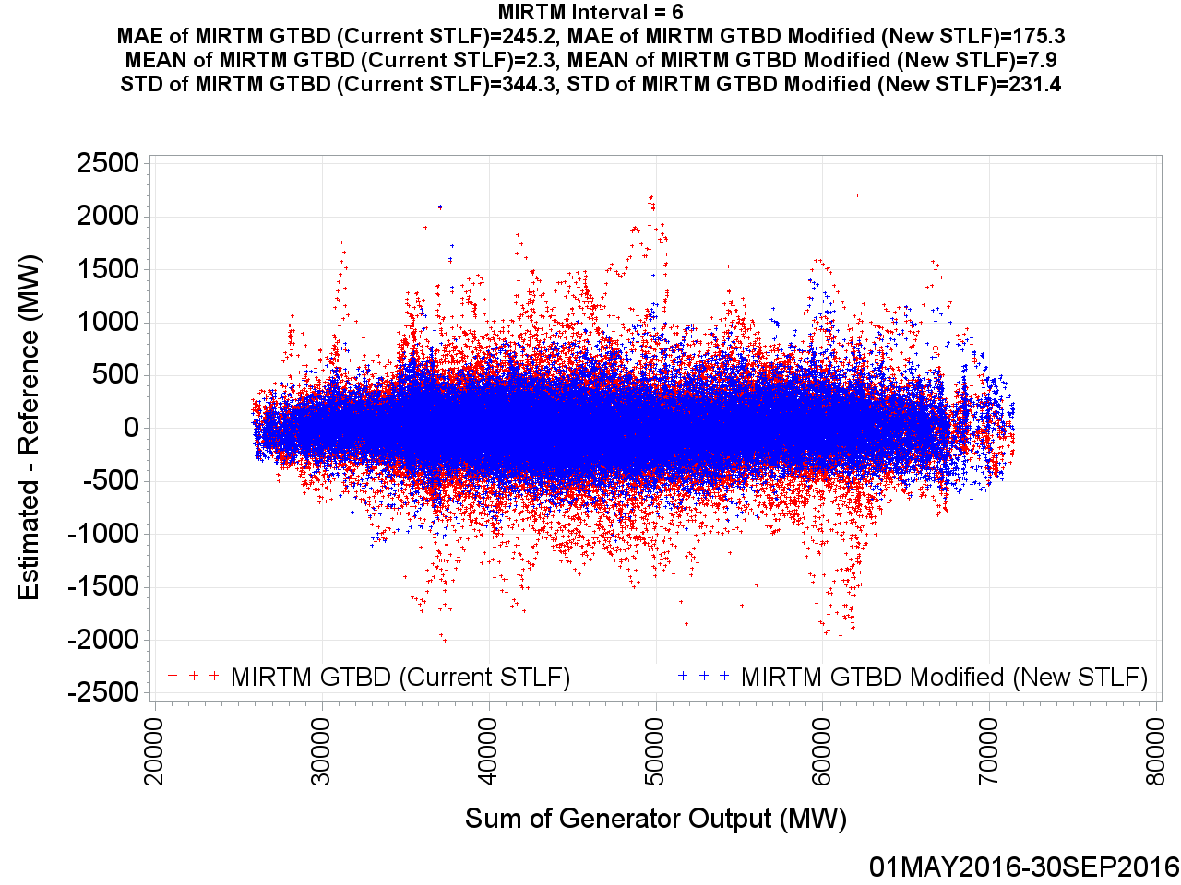
MIRTM GTBD Error by Reference (30 min. ahead)

Slide 39
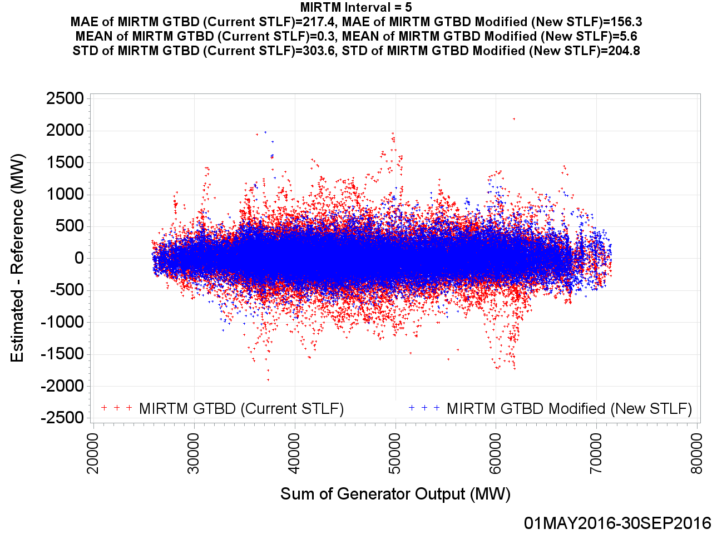
MIRTM GTBD Error by Reference (25 min. ahead)

Slide 40
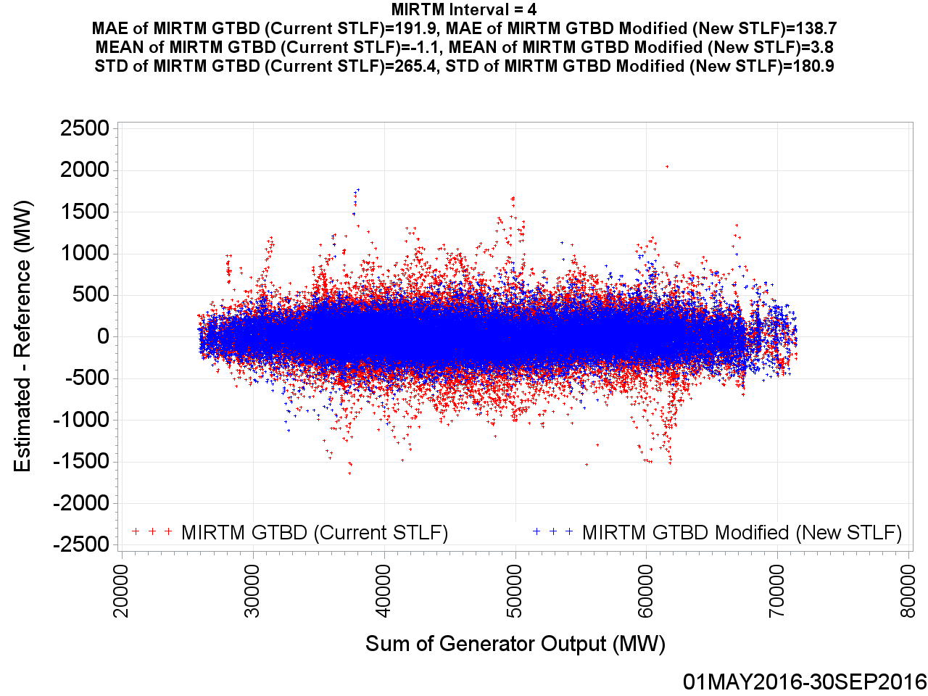
MIRTM GTBD Error by Reference (20 min. ahead)

Slide 41

MIRTM GTBD Error by Reference (15 min. ahead)

Slide 42
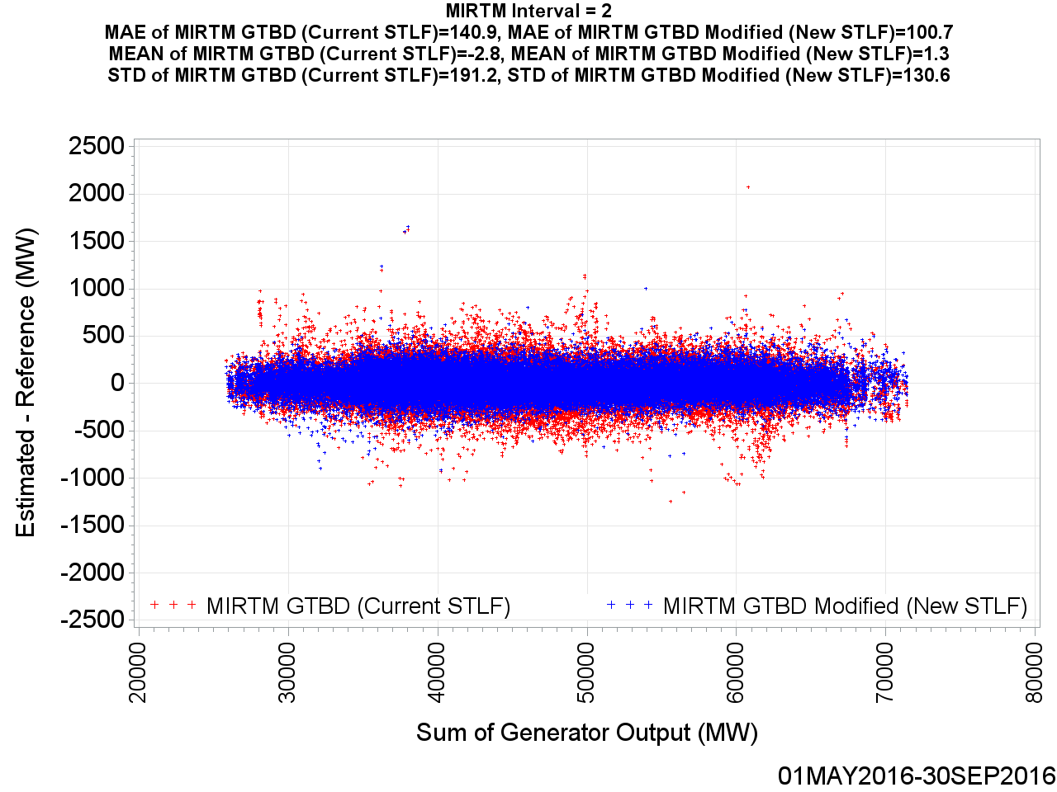
MIRTM GTBD Error by Reference (10 min. ahead)

Slide 43
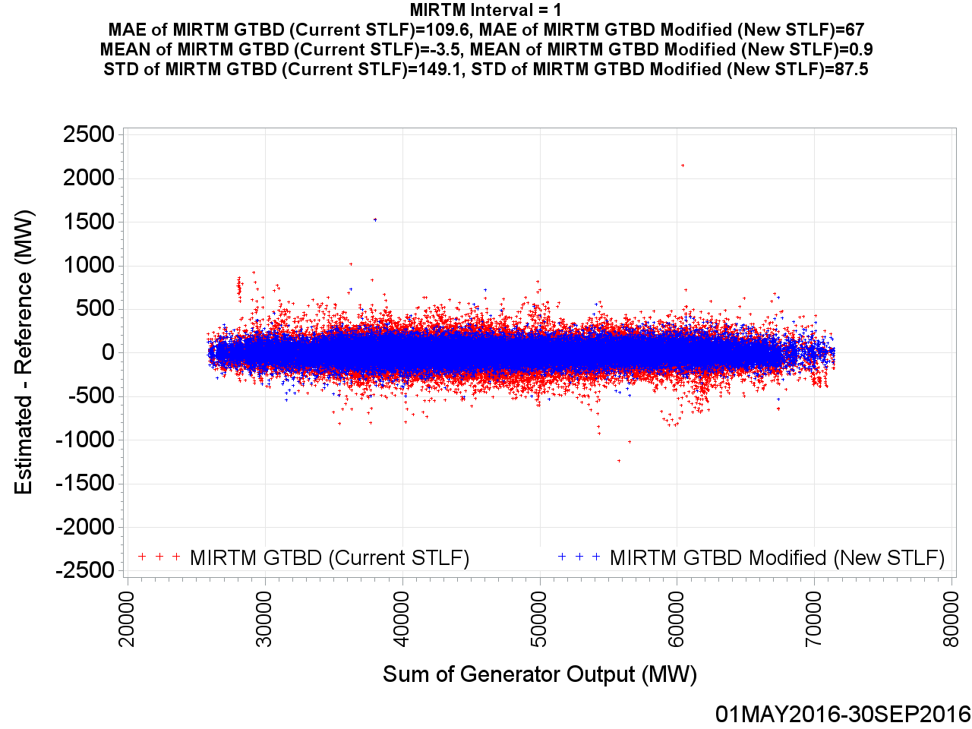
MIRTM GTBD Error by Reference (5 min. ahead)

Slide 44
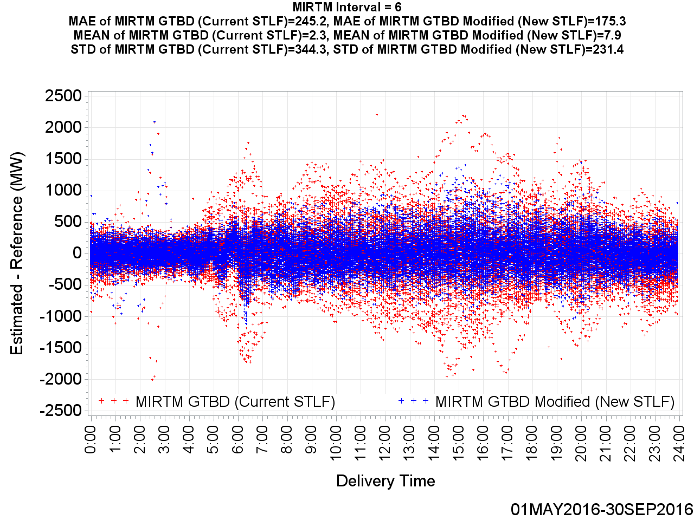
MIRTM GTBD Error by Delivery Time (30 min. ahead)

Slide 45
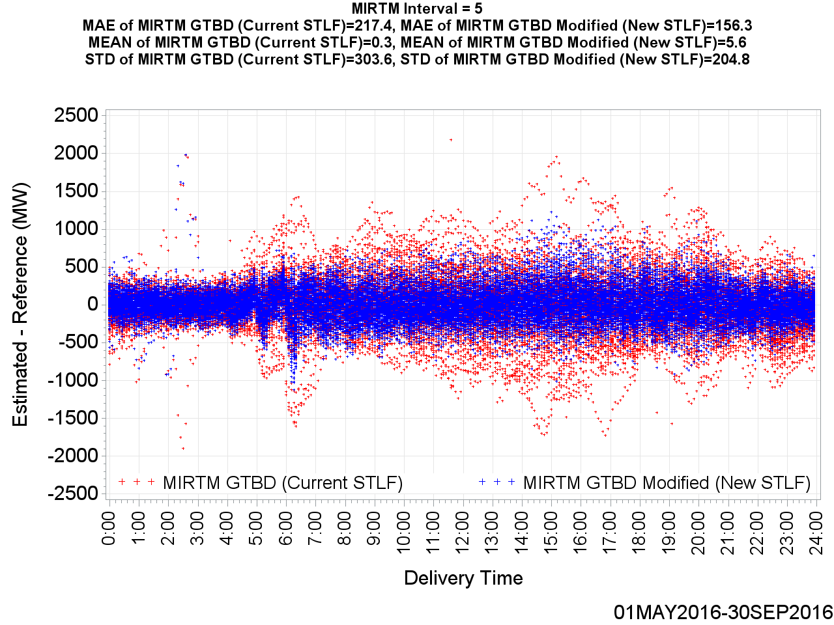
MIRTM GTBD Error by Delivery Time (25 min. ahead)

Slide 46
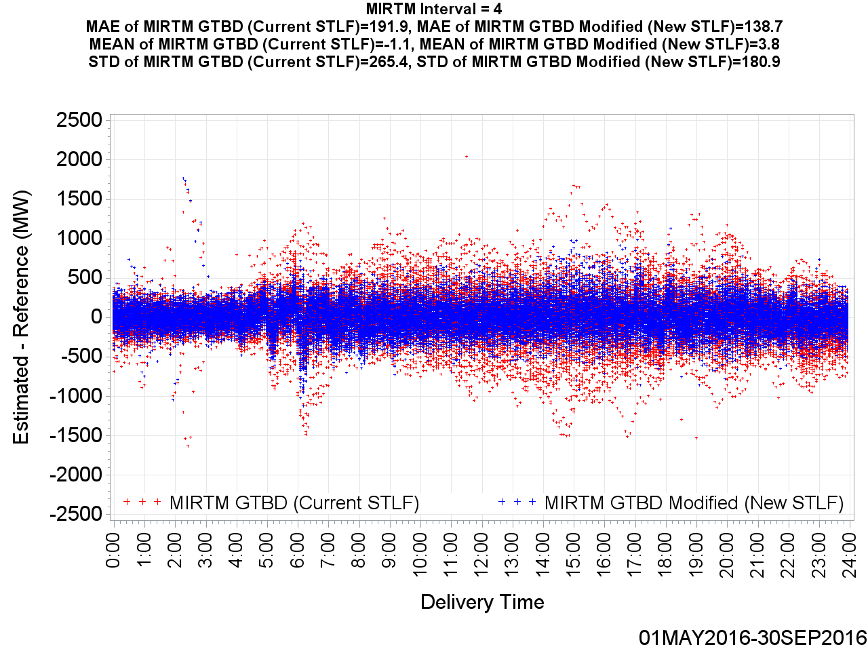
MIRTM GTBD Error by Delivery Time (20 min. ahead)

Slide 47
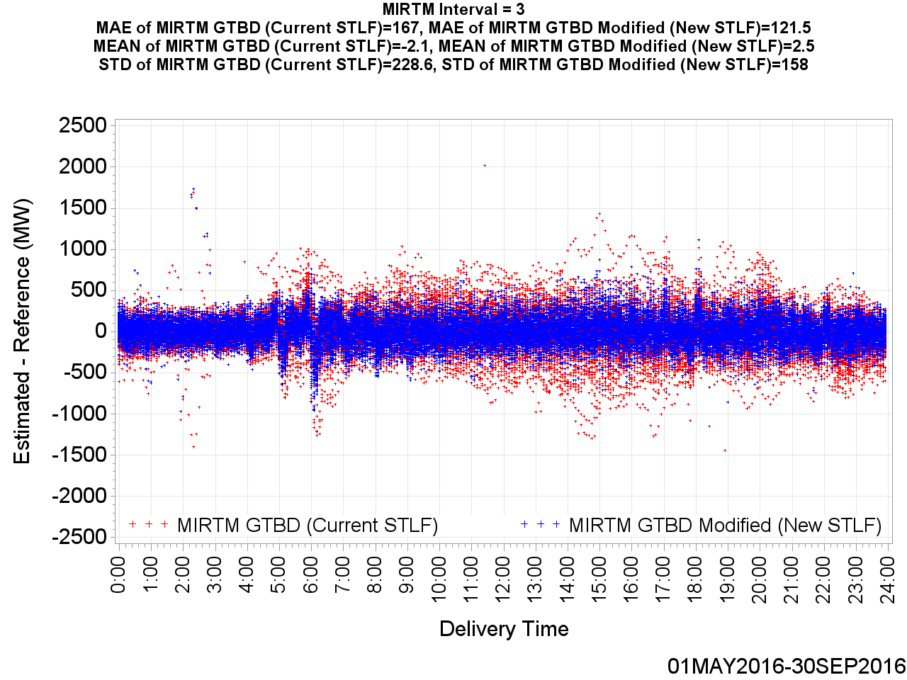
MIRTM GTBD Error by Delivery Time (15 min. ahead)

Slide 48
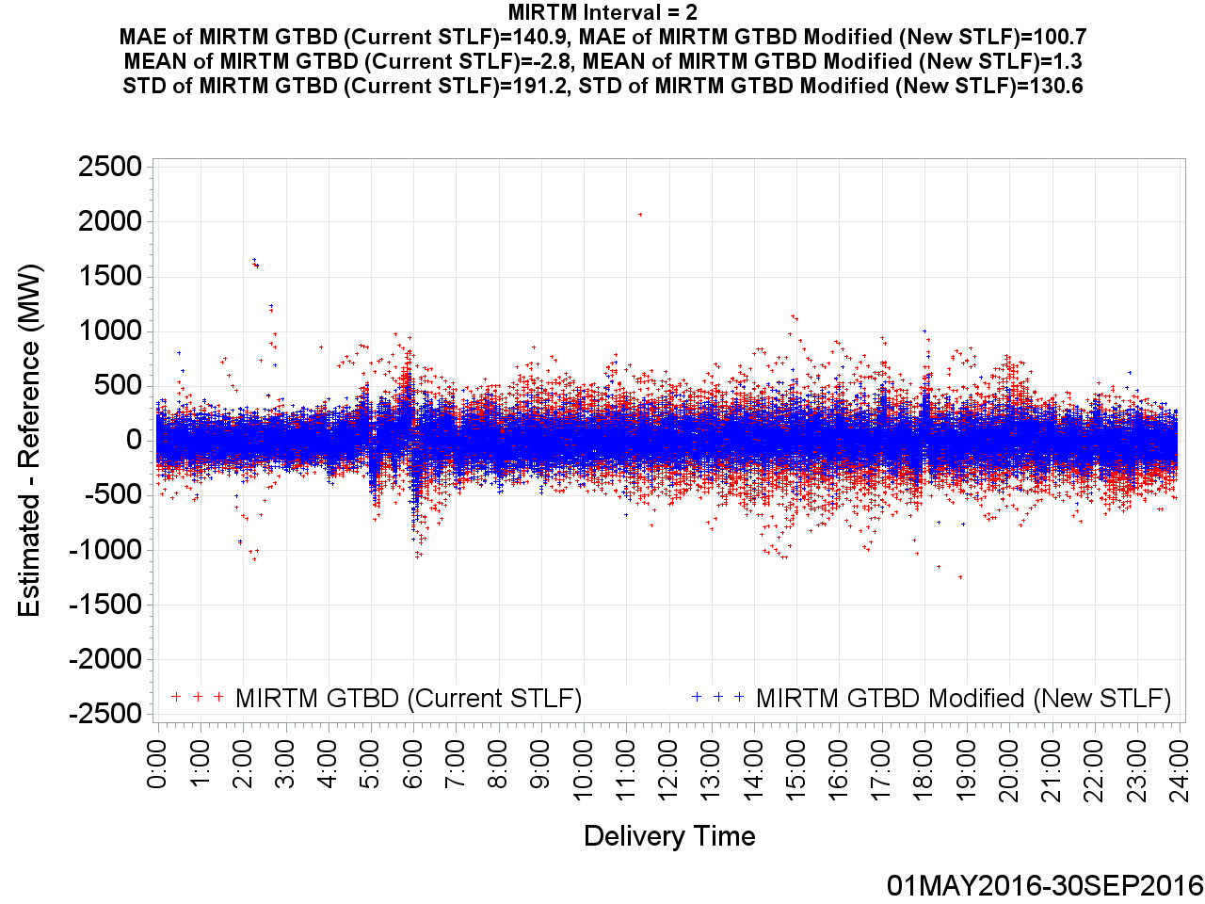
MIRTM GTBD Error by Delivery Time (10 min. ahead)

Slide 49

MIRTM GTBD Error by Delivery Time (5 min. ahead)

Slide 50
MIRTM Demand Estimation Performance
May 1, 2016 – September 30, 2016
952 Intervals when System Lambda >= $75/MWh

Slide 51
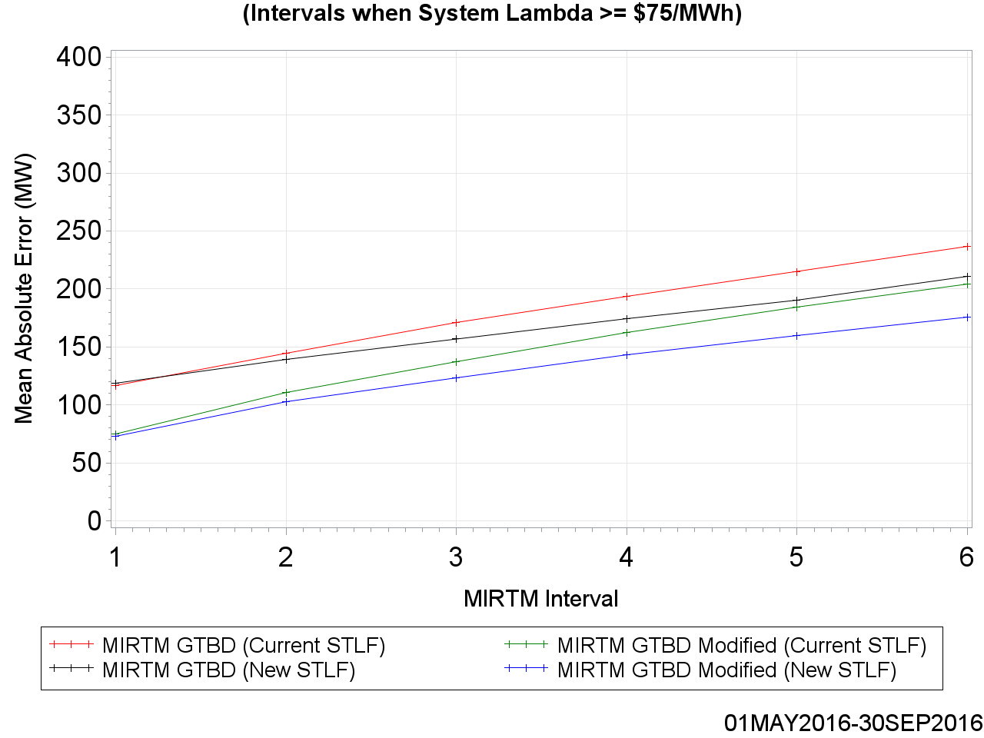
MAE of Estimated GTBD vs. Reference

Slide 52
MAE of Estimated GTBD vs. Reference

Slide 53
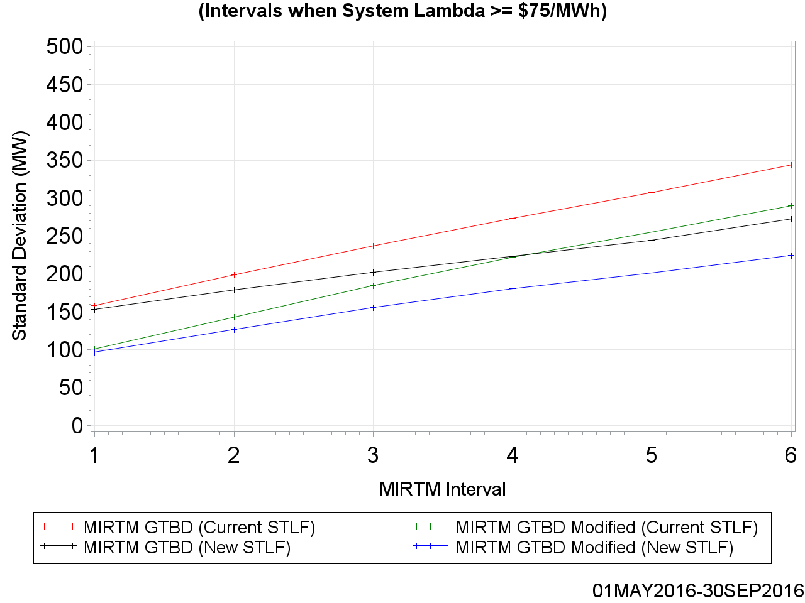
Standard Deviation of Estimated GTBD vs. Reference

Slide 54
Standard Deviation of Estimated GTBD vs. Reference

Slide 55
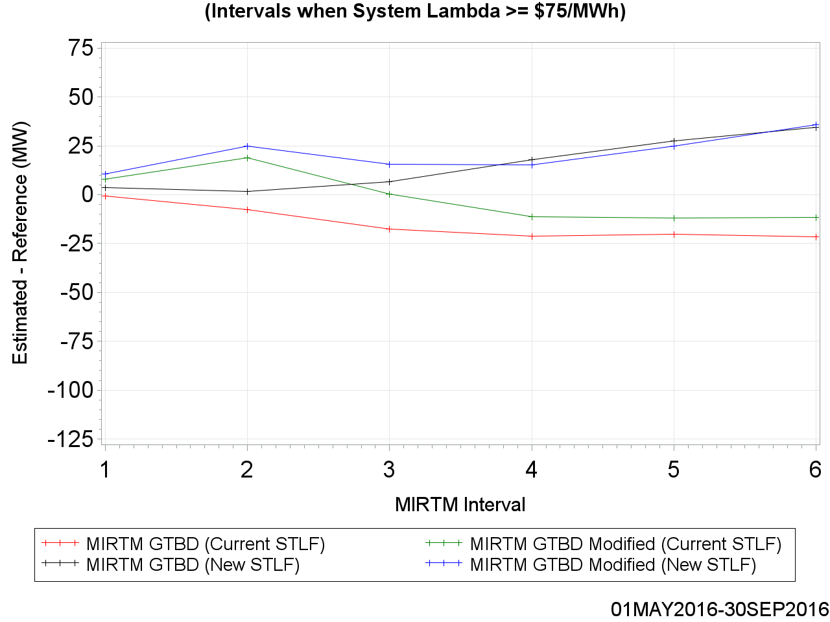
Mean of Estimated GTBD vs. Reference

Slide 56
Mean of Estimated GTBD vs. Reference

Slide 57
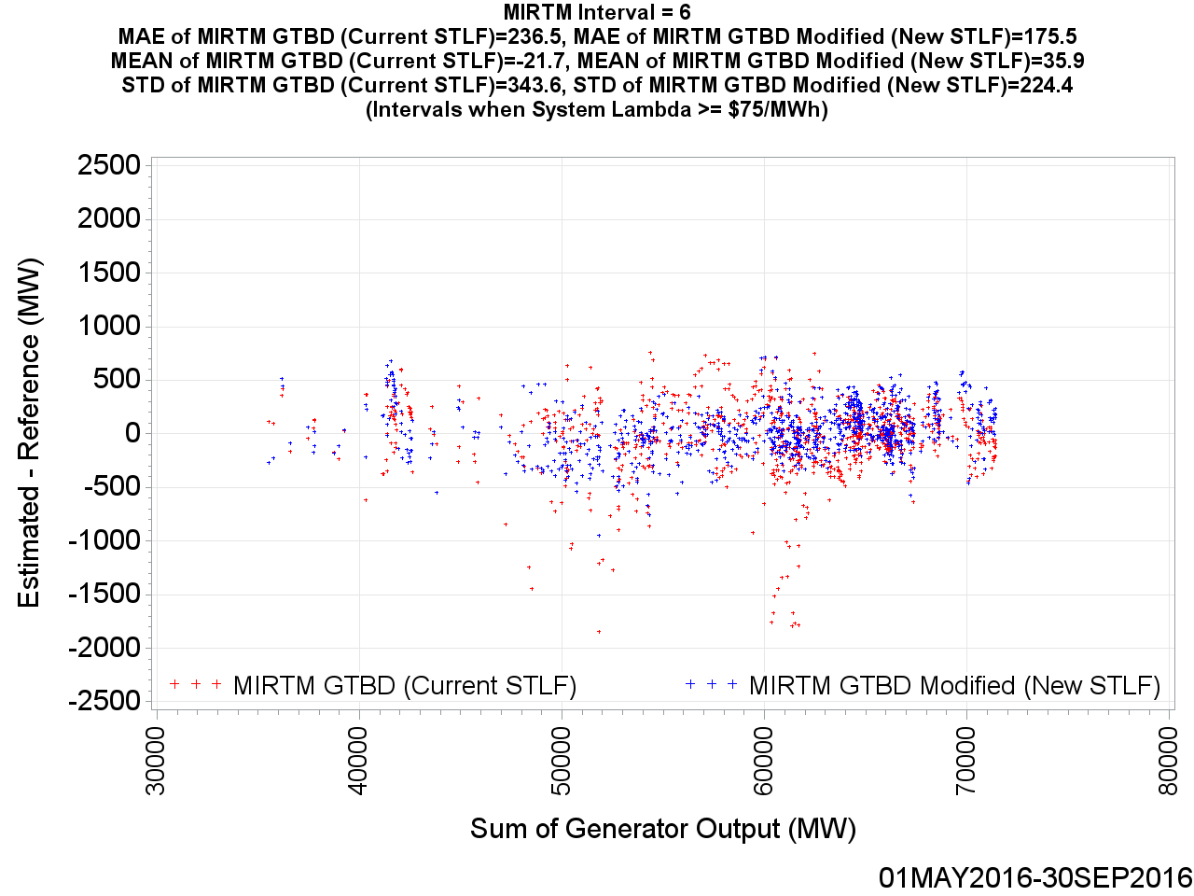
MIRTM GTBD Error by Reference (30 min. ahead)

Slide 58

MIRTM GTBD Error by Reference (25 min. ahead)

Slide 59

MIRTM GTBD Error by Reference (20 min. ahead)

Slide 60

MIRTM GTBD Error by Reference (15 min. ahead)

Slide 61
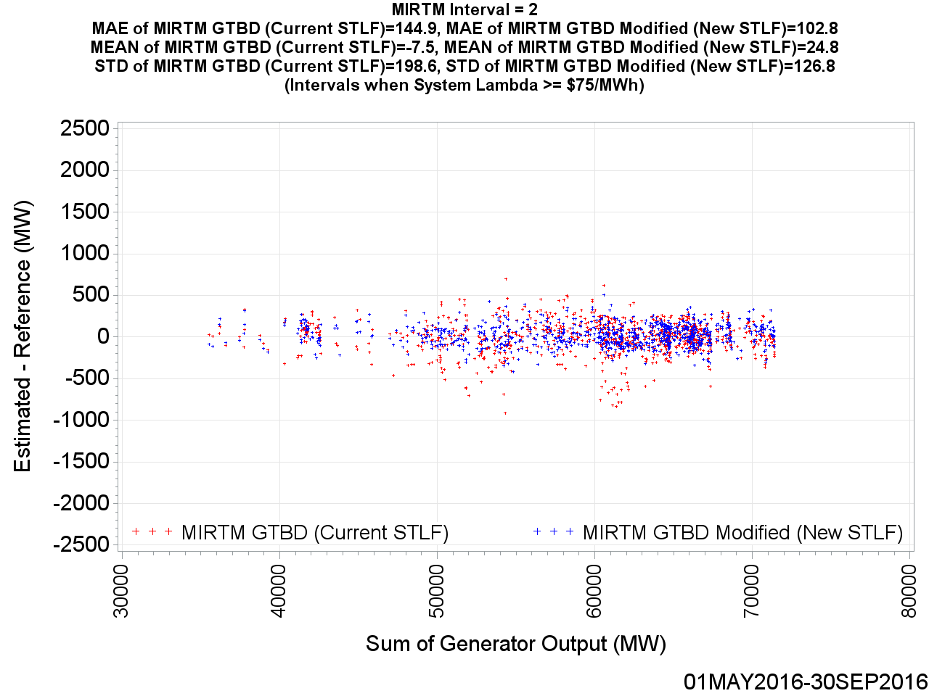
MIRTM GTBD Error by Reference (10 min. ahead)

Slide 62
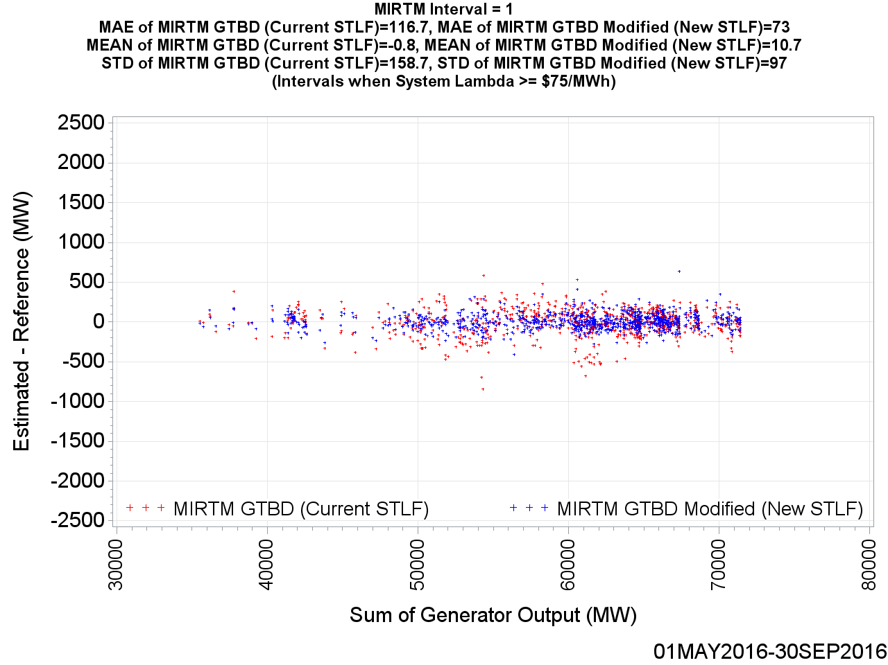
MIRTM GTBD Error by Reference (5 min. ahead)

Slide 63
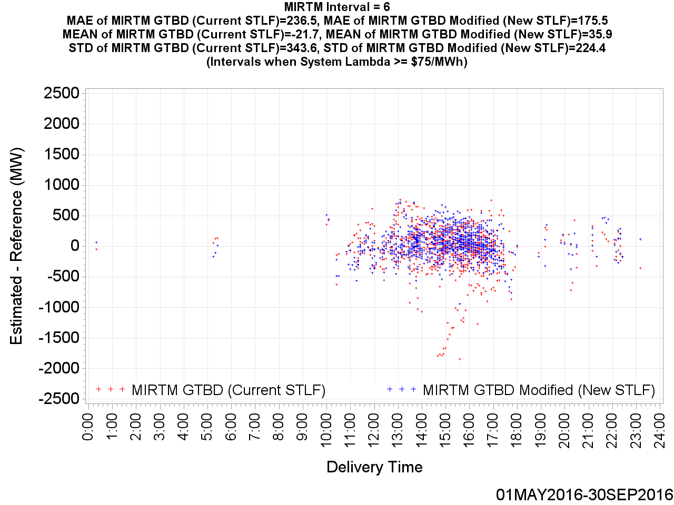
MIRTM GTBD Error by Delivery Time (30 min. ahead)

Slide 64
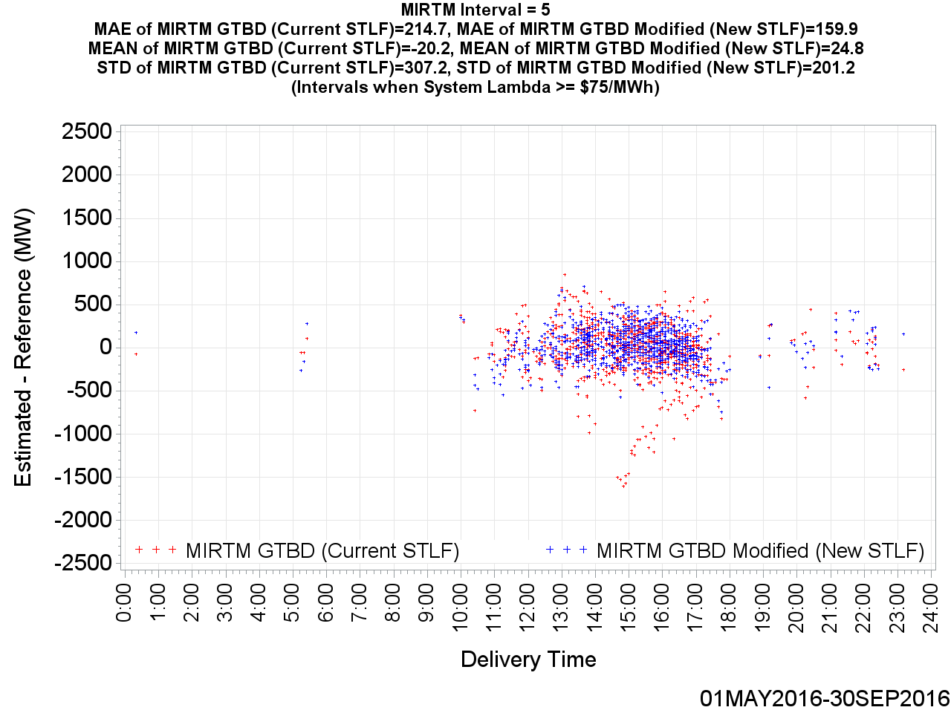
MIRTM GTBD Error by Delivery Time (25 min. ahead)

Slide 65

MIRTM GTBD Error by Delivery Time (20 min. ahead)

Slide 66

MIRTM GTBD Error by Delivery Time (15 min. ahead)

Slide 67

MIRTM GTBD Error by Delivery Time (10 min. ahead)

Slide 68
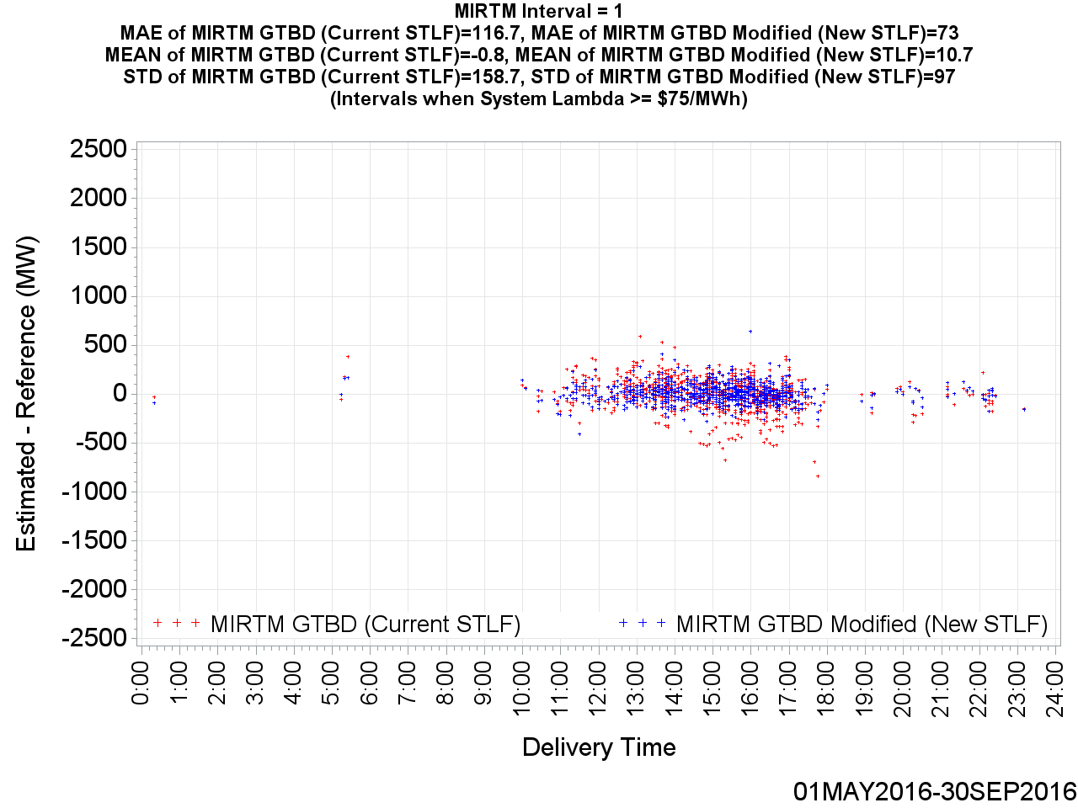
MIRTM GTBD Error by Delivery Time (5 min. ahead)

Slide 69
MIRTM Demand Estimation Performance on Specific Days
In the following slides, the estimation performance of the following specific days are analyzed:
  July 25, 2016
  August 11, 2016
  August 27, 2016

Slide 70
MIRTM Demand Estimation Performance
July 25, 2016

Slide 71
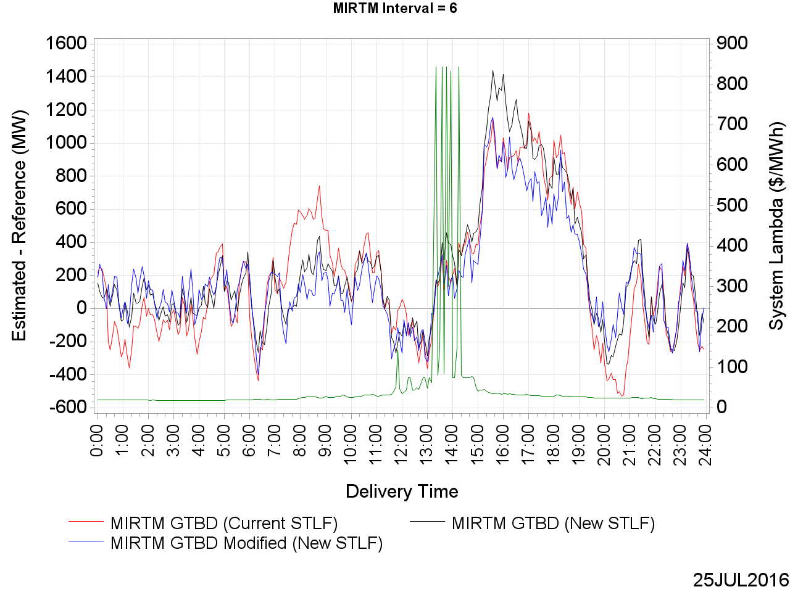
MIRTM GTBD Error on July 25, 2016 (30 min. ahead)

Slide 72
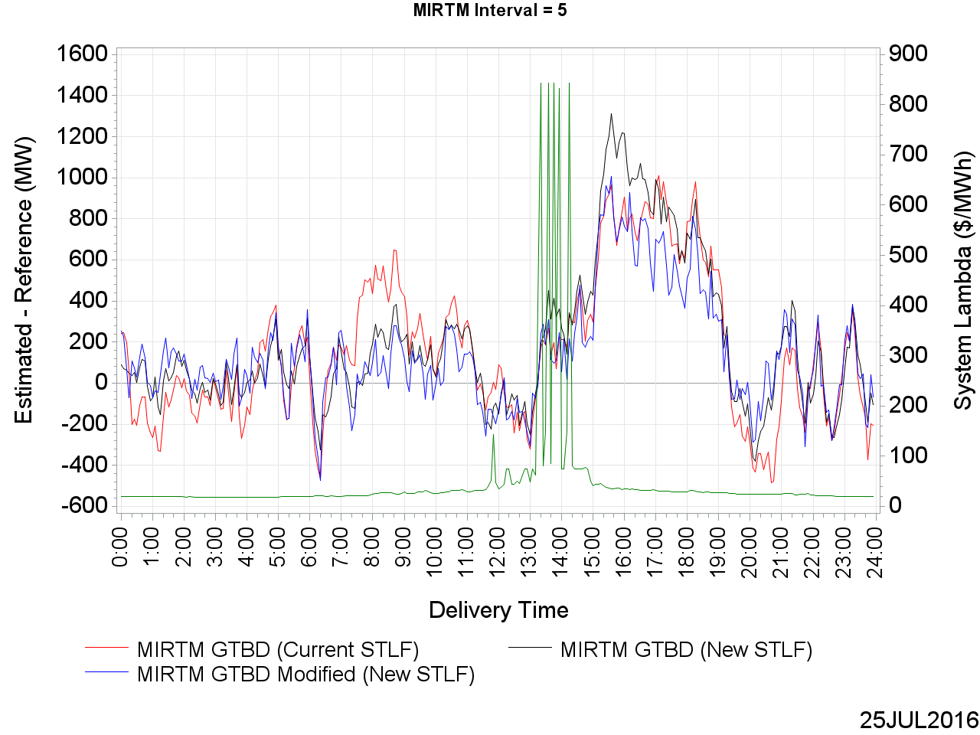
MIRTM GTBD Error on July 25, 2016 (25 min. ahead)

Slide 73
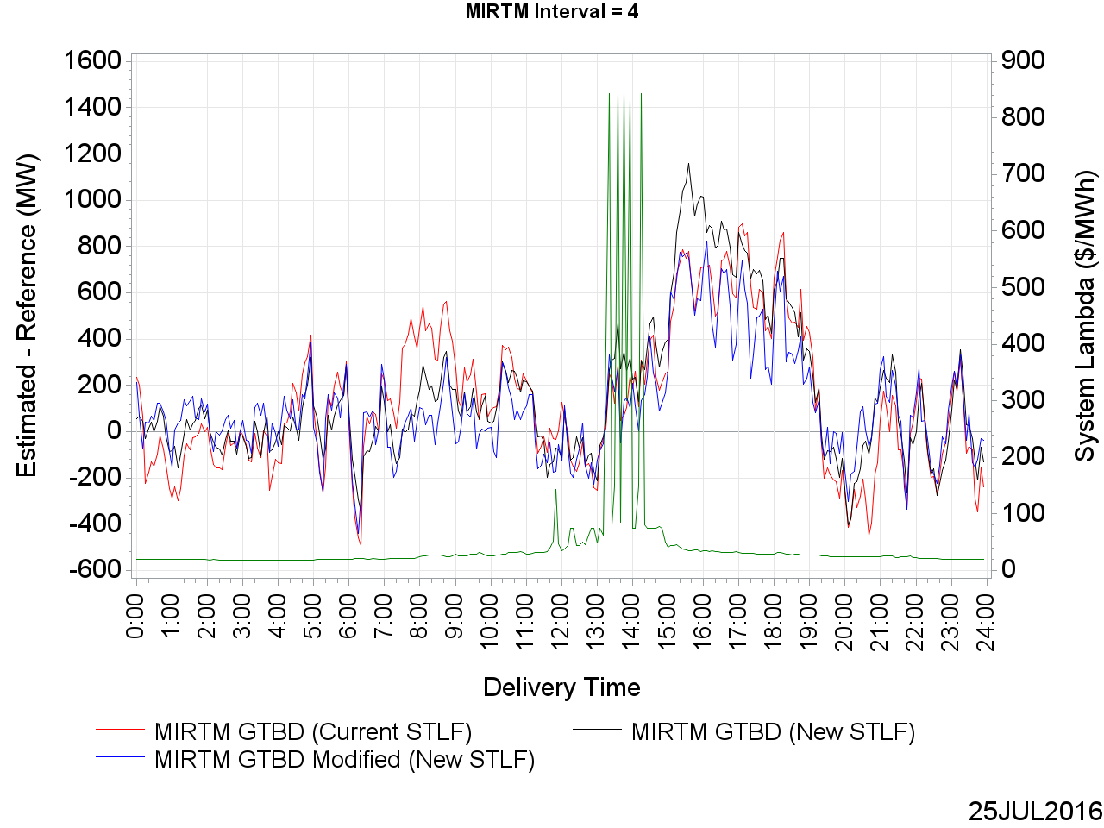
MIRTM GTBD Error on July 25, 2016 (20 min. ahead)

Slide 74
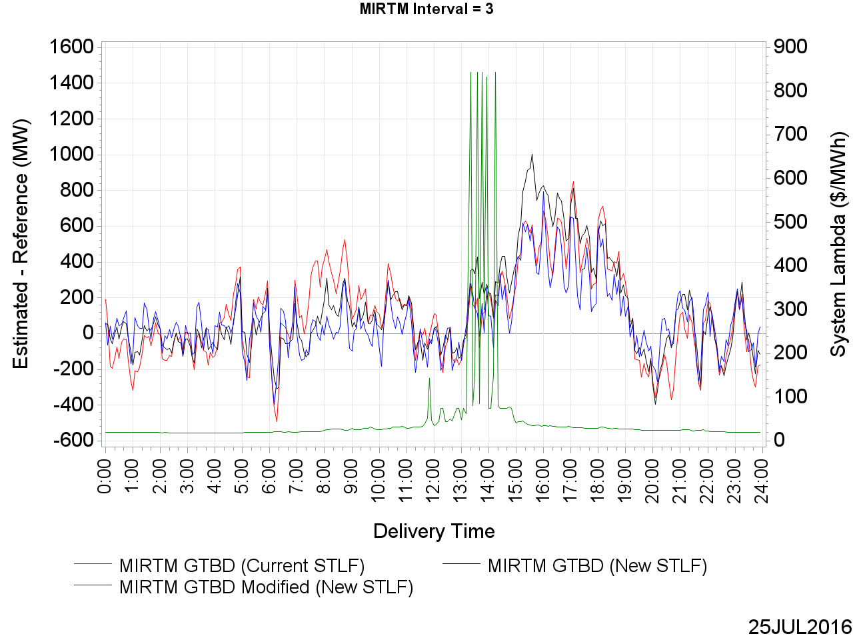
MIRTM GTBD Error on July 25, 2016 (15 min. ahead)

Slide 75
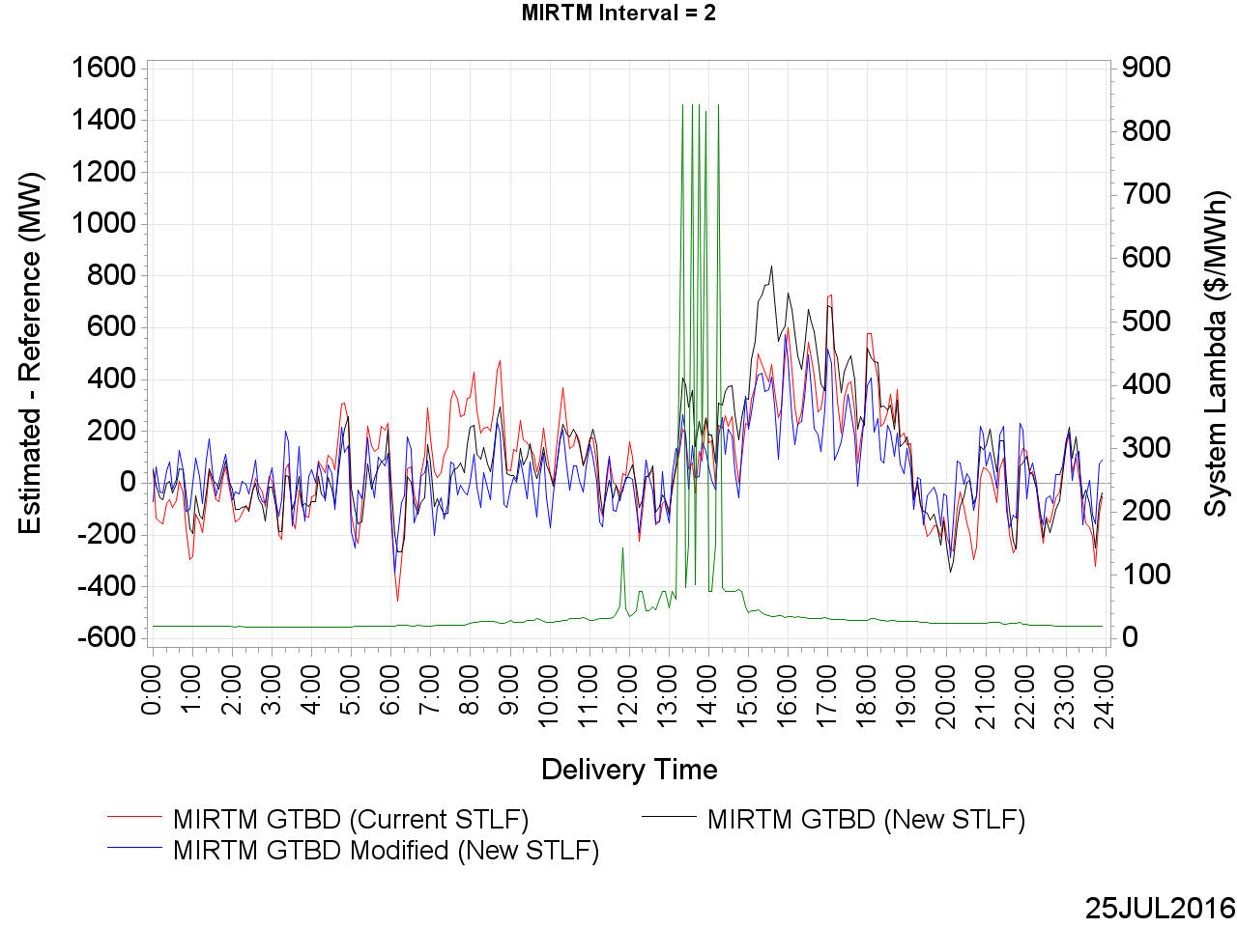
MIRTM GTBD Error on July 25, 2016 (10 min. ahead)

Slide 76
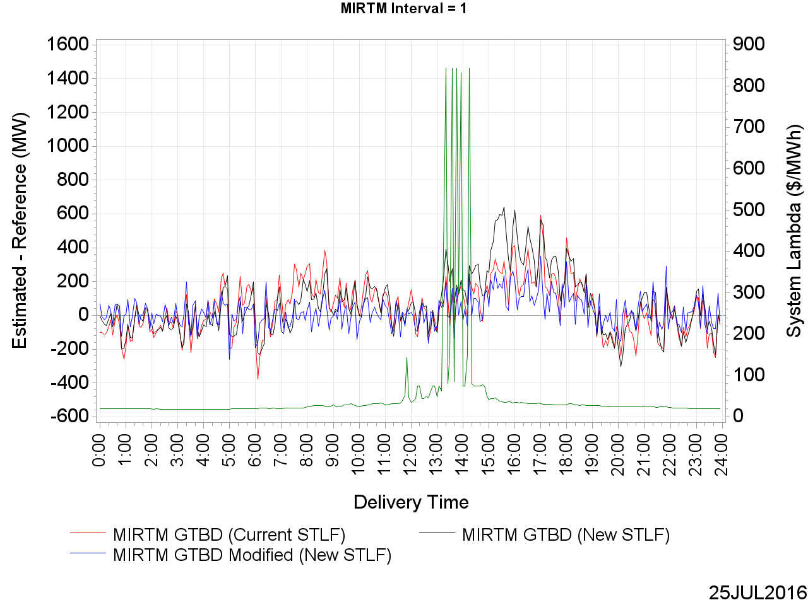
MIRTM GTBD Error on July 25, 2016 (5 min. ahead)

Slide 77
MIRTM Demand Estimation Performance
August 11, 2016

Slide 78
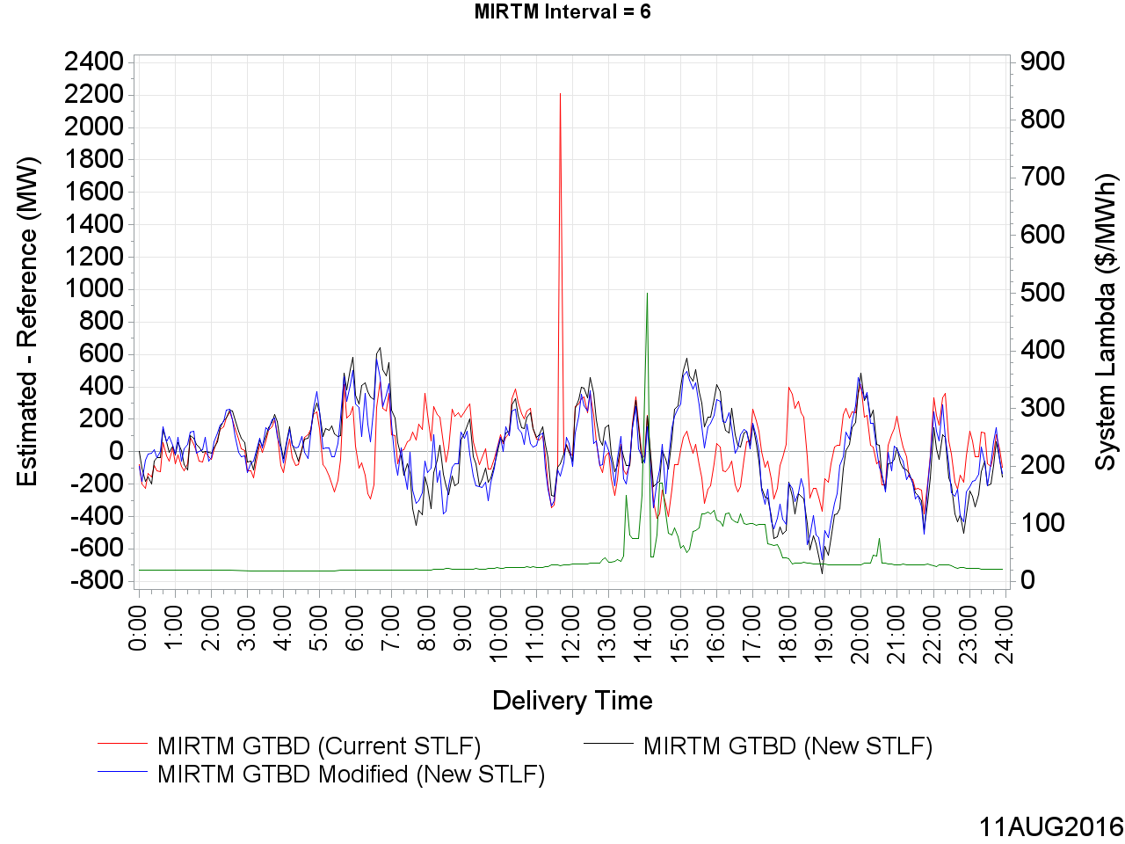
MIRTM GTBD Error on August 11, 2016 (30 min. ahead)

Slide 79
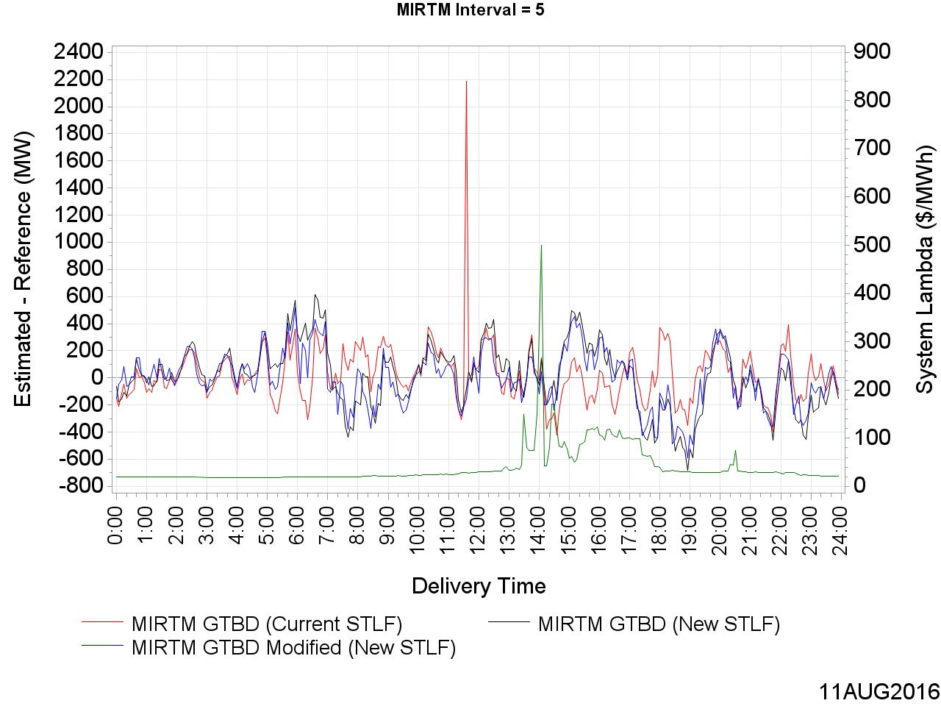
MIRTM GTBD Error on August 11, 2016 (25 min. ahead)

Slide 80
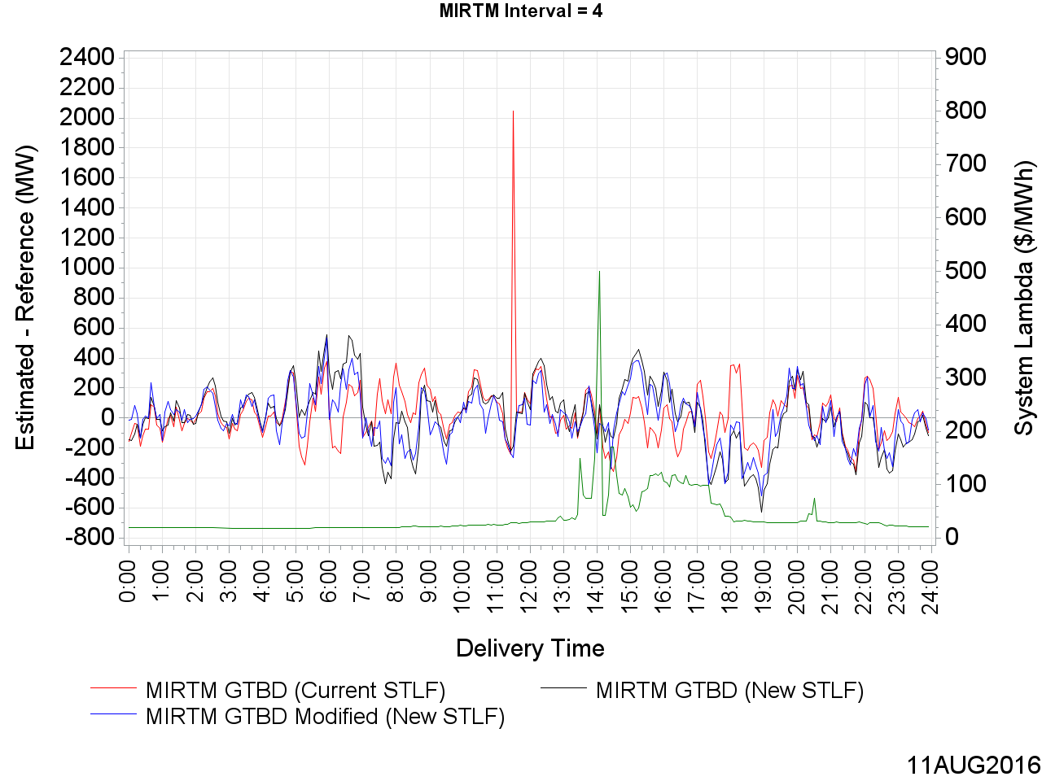
MIRTM GTBD Error on August 11, 2016 (20 min. ahead)

Slide 81
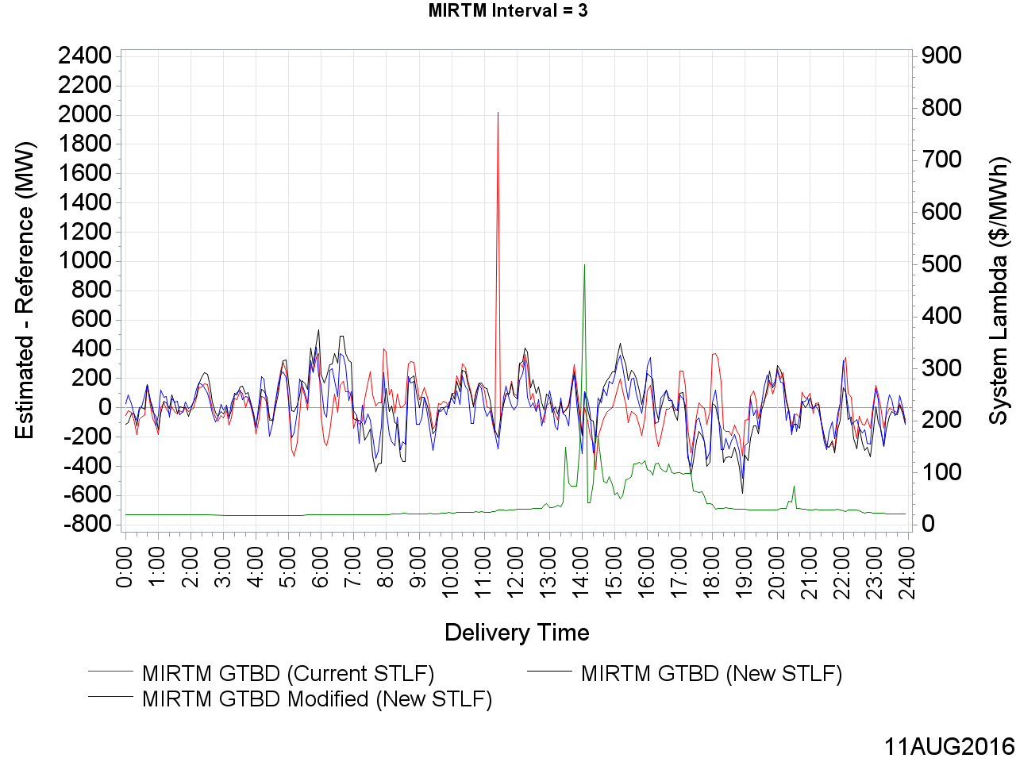
MIRTM GTBD Error on August 11, 2016 (15 min. ahead)

Slide 82
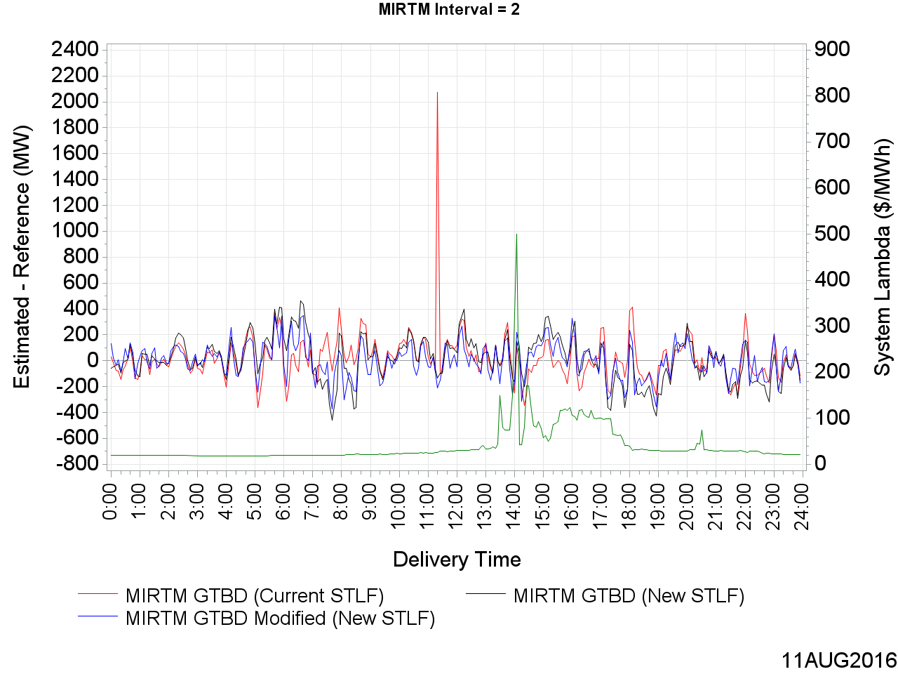
MIRTM GTBD Error on August 11, 2016 (10 min. ahead)

Slide 83
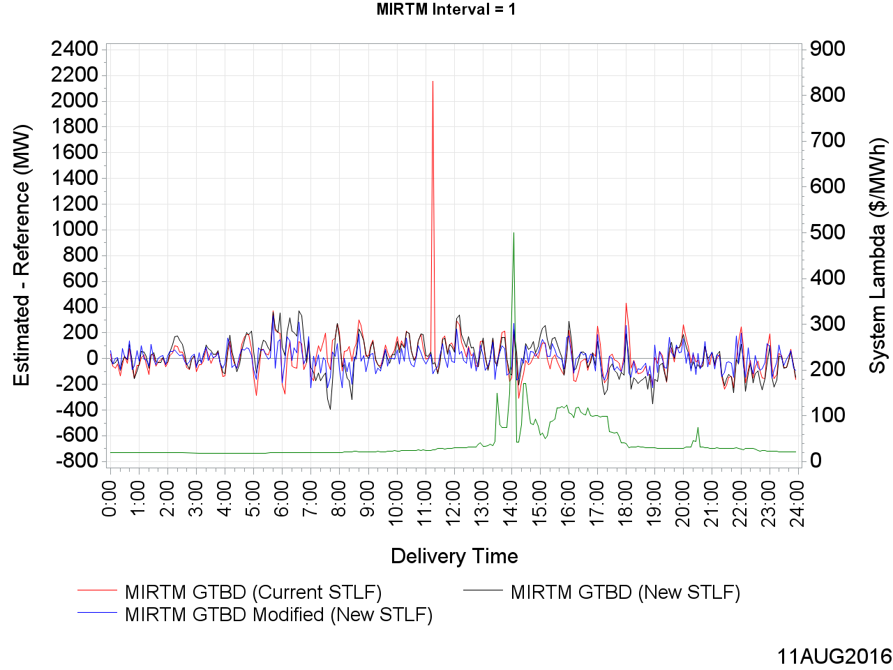
MIRTM GTBD Error on August 11, 2016 (5 min. ahead)

Slide 84
MIRTM Demand Estimation Performance
August 27, 2016

Slide 85
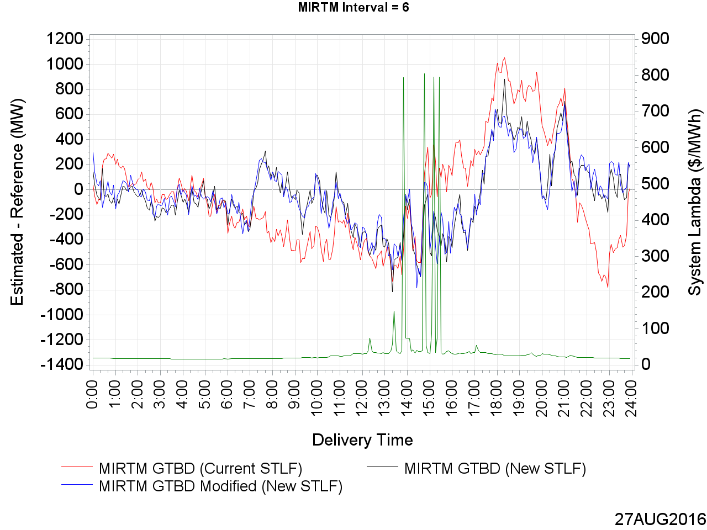
MIRTM GTBD Error on August 27, 2016 (30 min. ahead)

Slide 86
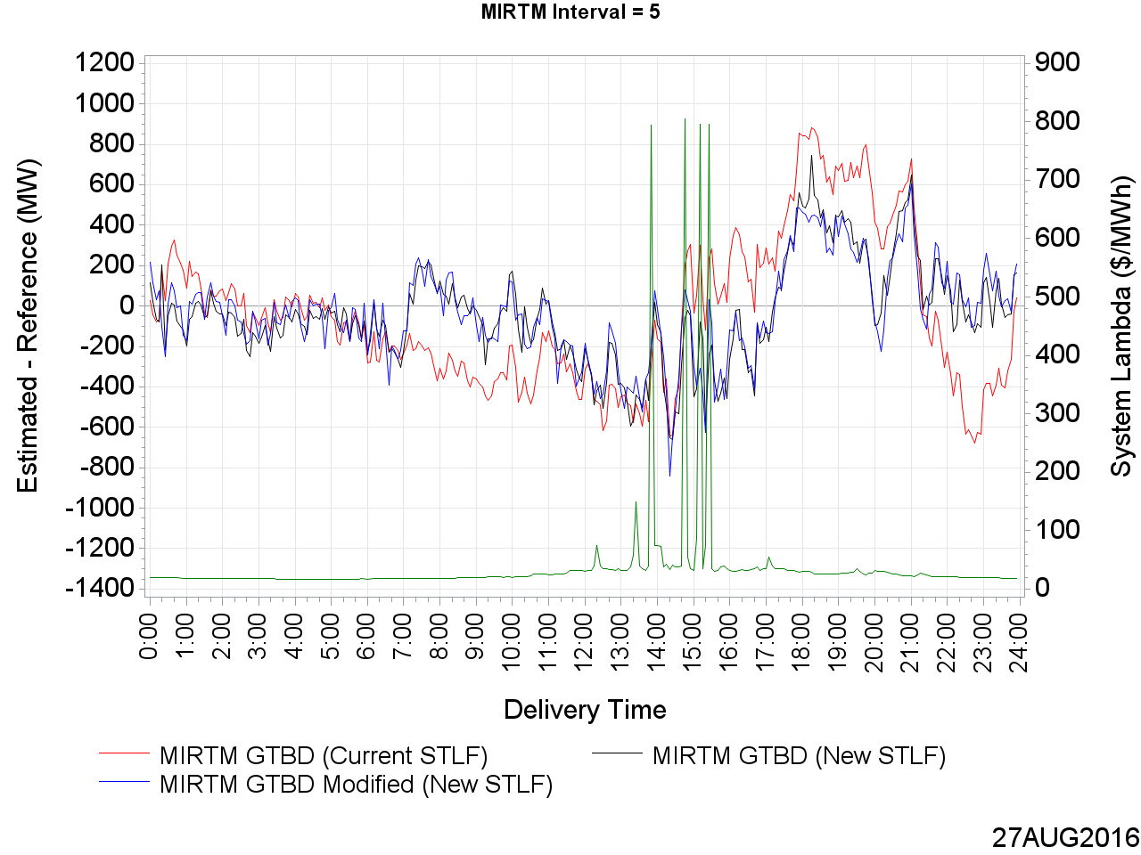
MIRTM GTBD Error on August 27, 2016 (25 min. ahead)

Slide 87
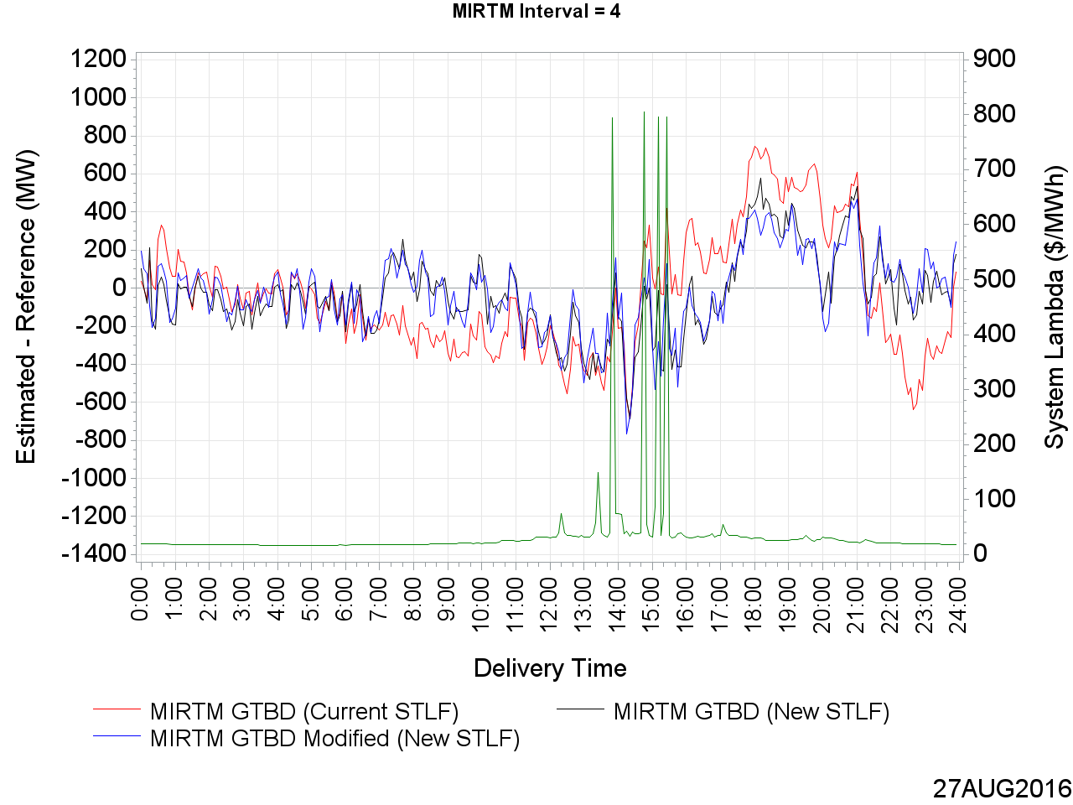
MIRTM GTBD Error on August 27, 2016 (20 min. ahead)

Slide 88
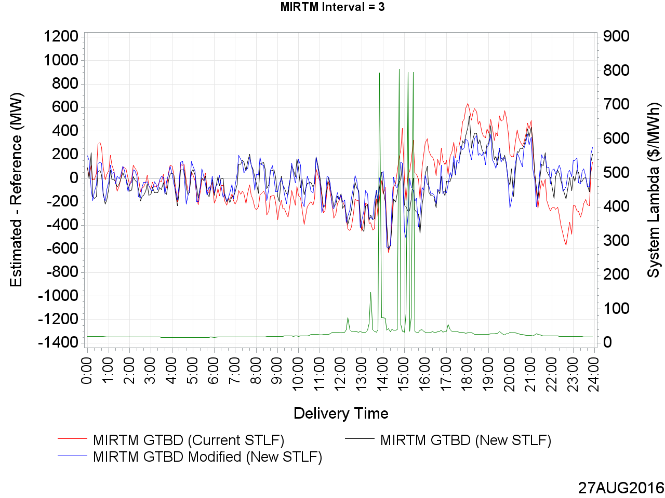
MIRTM GTBD Error on August 27, 2016 (15 min. ahead)

Slide 89
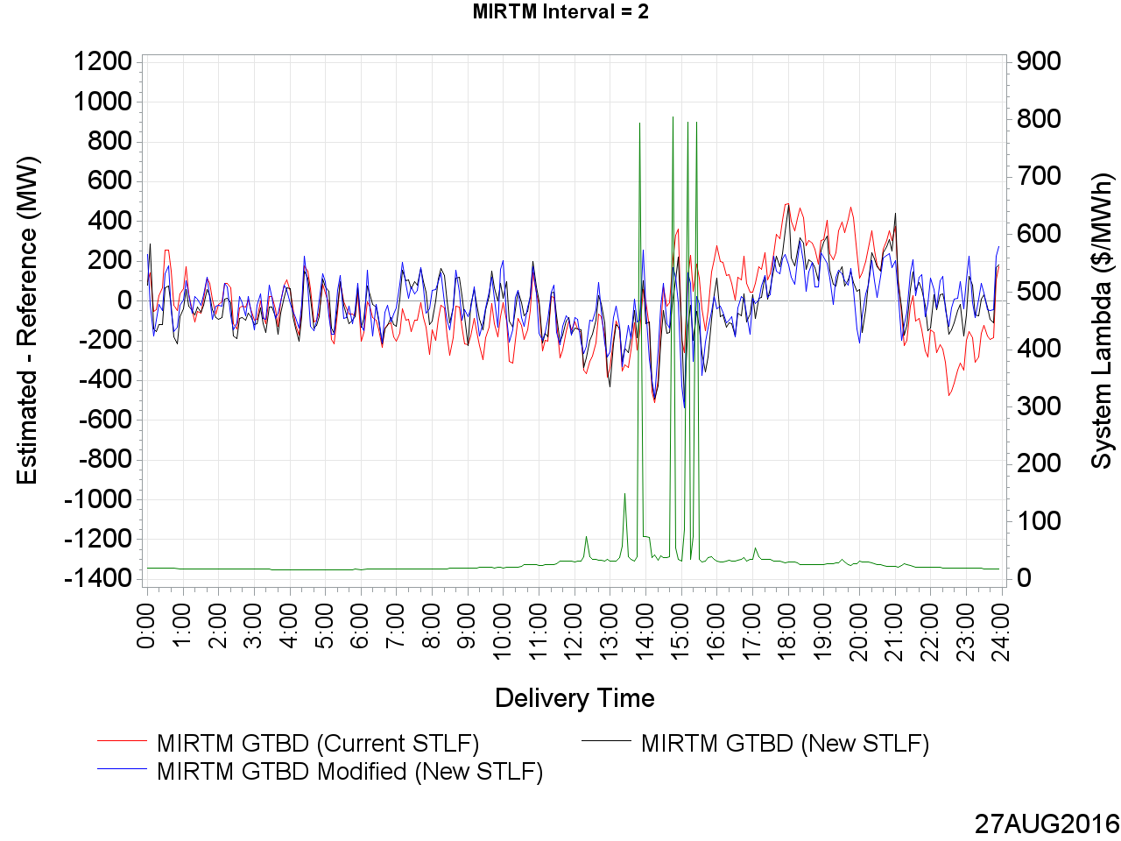
MIRTM GTBD Error on August 27, 2016 (10 min. ahead)

Slide 90

MIRTM GTBD Error on August 27, 2016 (5 min. ahead)

Slide 91
Wind HSL Estimation Performance
May 1, 2016 – September 30, 2016
All Intervals

Slide 92

MAE of Estimated Wind HSL vs. Actual Wind HSL

Slide 93
MAE of Estimated Wind HSL vs. Actual Wind HSL

Slide 94

Standard Deviation of Estimated Wind HSL vs. Actual Wind HSL

Slide 95
Standard Deviation of Estimated Wind HSL vs. Actual Wind HSL

Slide 96

Mean of Estimated Wind HSL vs. Actual Wind HSL

Slide 97
Mean of Estimated Wind HSL vs. Actual Wind HSL

Slide 98

MIRTM Wind HSL Error by Actual Wind HSL (30 min. ahead)

Slide 99

MIRTM Wind HSL Error by Actual Wind HSL (25 min. ahead)

Slide 100

MIRTM Wind HSL Error by Actual Wind HSL (20 min. ahead)

Slide 101

MIRTM Wind HSL Error by Actual Wind HSL (15 min. ahead)

Slide 102

MIRTM Wind HSL Error by Actual Wind HSL (10 min. ahead)

Slide 103

MIRTM Wind HSL Error by Actual Wind HSL (5 min. ahead)

Slide 104

MIRTM Wind HSL Error by Delivery Time (30 min. ahead)

Slide 105

MIRTM Wind HSL Error by Delivery Time (25 min. ahead)

Slide 106

MIRTM Wind HSL Error by Delivery Time (20 min. ahead)

Slide 107

MIRTM Wind HSL Error by Delivery Time (15 min. ahead)

Slide 108

MIRTM Wind HSL Error by Delivery Time (10 min. ahead)

Slide 109

MIRTM Wind HSL Error by Delivery Time (5 min. ahead)

Slide 110
Wind HSL Estimation Performance
May 1, 2016 – September 30, 2016
952 Intervals when System Lambda >= $75/MWh

Slide 111

MAE of Estimated Wind HSL vs. Actual Wind HSL

Slide 112
MAE of Estimated Wind HSL vs. Actual Wind HSL

Slide 113

Standard Deviation of Estimated Wind HSL vs. Actual Wind HSL

Slide 114
Standard Deviation of Estimated Wind HSL vs. Actual Wind HSL

Slide 115

Mean of Estimated Wind HSL vs. Actual Wind HSL

Slide 116
Mean of Estimated Wind HSL vs. Actual Wind HSL

Slide 117

MIRTM Wind HSL Error by Actual Wind HSL (30 min. ahead)

Slide 118

MIRTM Wind HSL Error by Actual Wind HSL (25 min. ahead)

Slide 119

MIRTM Wind HSL Error by Actual Wind HSL (20 min. ahead)

Slide 120

MIRTM Wind HSL Error by Actual Wind HSL (15 min. ahead)

Slide 121

MIRTM Wind HSL Error by Actual Wind HSL (10 min. ahead)

Slide 122

MIRTM Wind HSL Error by Actual Wind HSL (5 min. ahead)

Slide 123

MIRTM Wind HSL Error by Delivery Time (30 min. ahead)

Slide 124

MIRTM Wind HSL Error by Delivery Time (25 min. ahead)

Slide 125

MIRTM Wind HSL Error by Delivery Time (20 min. ahead)

Slide 126

MIRTM Wind HSL Error by Delivery Time (15 min. ahead)

Slide 127

MIRTM Wind HSL Error by Delivery Time (10 min. ahead)

Slide 128

MIRTM Wind HSL Error by Delivery Time (5 min. ahead)

Slide 129
Wind HSL Estimation Performance
July 25, 2016

Slide 130

Wind HSL on July 25, 2016

Slide 131

MIRTM Wind HSL Error on July 25, 2016 (30 min. ahead)

Slide 132

MIRTM Wind HSL Error on July 25, 2016 (25 min. ahead)

Slide 133

MIRTM Wind HSL Error on July 25, 2016 (20 min. ahead)

Slide 134

MIRTM Wind HSL Error on July 25, 2016 (15 min. ahead)

Slide 135

MIRTM Wind HSL Error on July 25, 2016 (10 min. ahead)

Slide 136

MIRTM Wind HSL Error on July 25, 2016 (5 min. ahead)

Slide 137
Wind HSL Estimation Performance
August 11, 2016

Slide 138

Wind HSL on August 11, 2016

Slide 139

MIRTM Wind HSL Error on August 11, 2016 (30 min. ahead)

Slide 140

MIRTM Wind HSL Error on August 11, 2016 (25 min. ahead)

Slide 141

MIRTM Wind HSL Error on August 11, 2016 (20 min. ahead)

Slide 142

MIRTM Wind HSL Error on August 11, 2016 (15 min. ahead)

Slide 143

MIRTM Wind HSL Error on August 11, 2016 (10 min. ahead)

Slide 144

MIRTM Wind HSL Error on August 11, 2016 (5 min. ahead)

Slide 145
Wind HSL Estimation Performance
August 27, 2016

Slide 146

Wind HSL on August 27, 2016

Slide 147

MIRTM Wind HSL Error on August 27, 2016 (30 min. ahead)

Slide 148

MIRTM Wind HSL Error on August 27, 2016 (25 min. ahead)

Slide 149

MIRTM Wind HSL Error on August 27, 2016 (20 min. ahead)

Slide 150

MIRTM Wind HSL Error on August 27, 2016 (15 min. ahead)

Slide 151

MIRTM Wind HSL Error on August 27, 2016 (10 min. ahead)

Slide 152

MIRTM Wind HSL Error on August 27, 2016 (5 min. ahead)

