Slide 1
Black Start Overview

Slide 2
Operational Risk Management: Layers of Protection
Prevent
Plan and operate the system so loss of a single transmission line or generator causes no problems and additional contingencies cause no major problems. Reserve enough generation/load resource capacity to maintain frequency when load and generation output vary, up to loss of two largest units.
Respond
If more severe conditions occur, manually reduce demand to protect the system (localized or systemwide rotating outages). If frequency drops to extremely low levels, automated protection systems that reduce demand systemwide provide a safety net.
Recover
Maintain, and routinely practice, a coordinated “black start” plan to restart the system in unlikely event these responses fail and system collapses.

Slide 3
Black Start Units
ERCOT contracts bi-annually with certain units that have the ability to start even under black start conditions
For 2016 and 2017 we have 14 Black Start Units
Black start capability of these units is tested annually

Slide 4
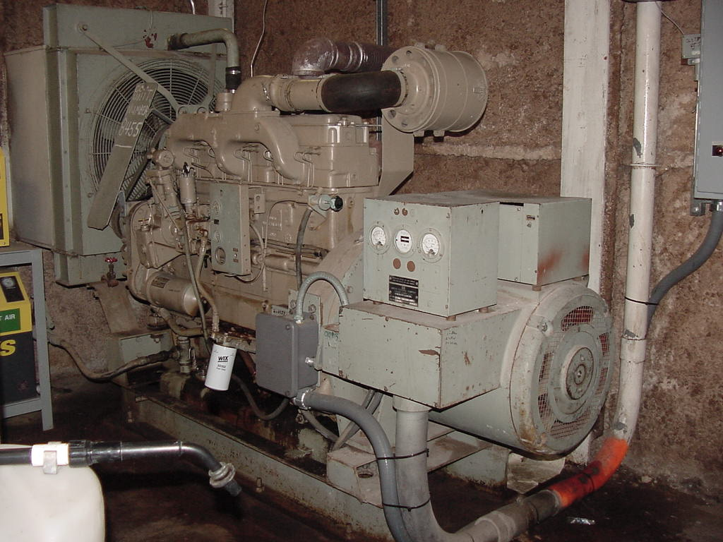
Black Start Units – Diesel Start-up
Blackout event occurs
Loss Of AC To Aux Bus
Diesel Generator immediately starts up and energizes the Aux Bus
FIRST STEP IN SYSTEM RESTORATION

Slide 5
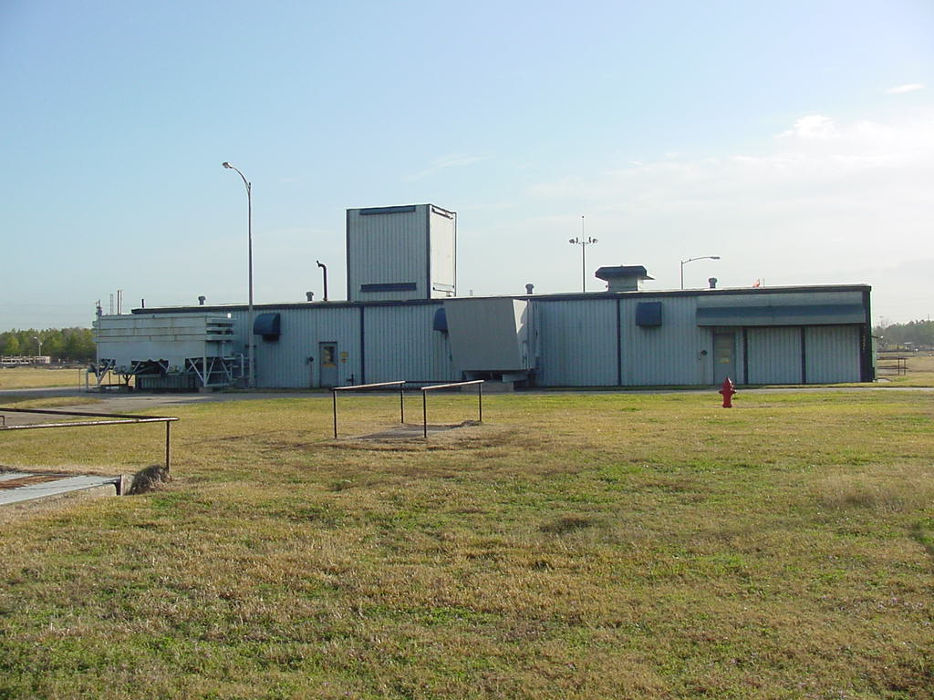
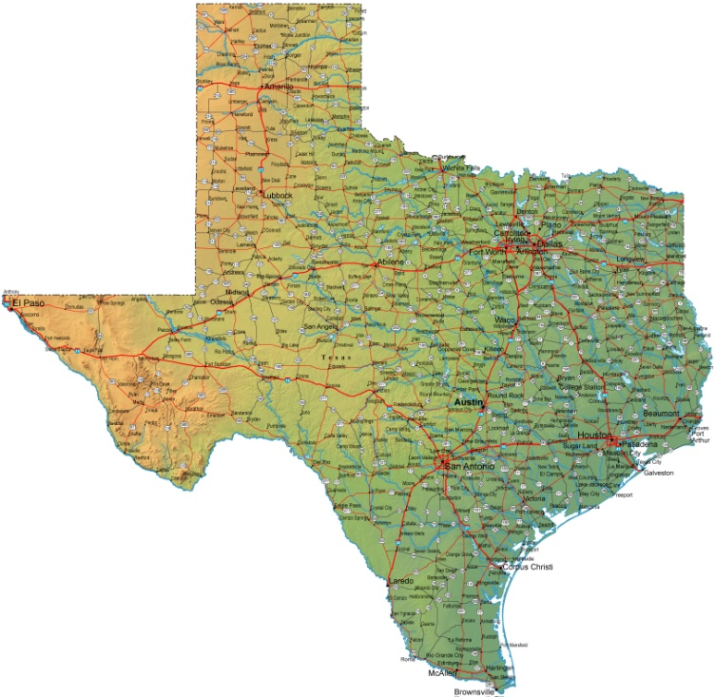
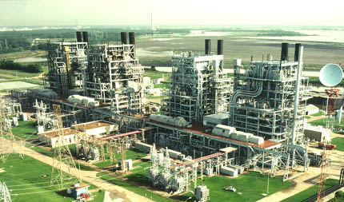
Emergency Diesel Generator
Black Start Unit
Next Start Units

Slide 6
TO’s Responsibilities – Plan Development
Each TO develops a Black Start Plan for their island(s)
These plans identify:
  The contracted Black Start Unit(s)
  The primary and secondary next-start units associated with each black start unit
  Stabilizing loads
  Primary and secondary transmission corridors
  Synchronization points between islands.
Plans include coordination with gas pipeline operators to consider interrelationship between gas pipeline compression and gas–fired generation availability
The TO will be responsible for maintaining appropriate voltage levels and reactive controls during restoration

Slide 7
Black Start Units – Primary Corridors
2016 ERCOT BS Units Primary Corridor

Slide 8
Black Start Plan Implementation
System Restoration process
  Identify the extent of the blackout (partial/complete) and the nature of the disturbance.
  Assess and verify communication capabilities
  Initial stages of the restoration proceed based on the local black start plans maintained by the transmission operators (TOs)
    Start the Black Start resources
    Build stable islands
    Re-establishing off-site power to nuclear power plants to take high priority.
  Reach the synchronization points and tie the islands together
  Load restoration after synchronization

Slide 9
TO’s Responsibilities – System Restoration
The Transmission Operator will be in control of their system and will determine:
  Which breakers to close and lines to energize
  When the Black Start Unit(s) is ready to energize transmission
  Which Next Start Units to start and when
  When load will be picked up and where during the restoration of their Islands.
They will keep ERCOT informed on load, resources and lines used for recovery.

Slide 10
Training
ERCOT conducts annual training sessions for entities’ staff that would be involved in a black start
Black Start training:
  Eight sessions of 100 to 120 operators per session
  Operators consist of TOs, GOs, QSEs and ERCOT.
  NERC and TRE representatives observed multiple sessions of the training.
  Held at ERCOT

Slide 11
Black Start Training
This training includes the use of a training simulator
  Allows different entities to practice the procedures and communications that would need to occur
  Processes the response of the power system to the actions of each entity
This training allows participating entities not only to practice but improve their procedures and plans
The following slides illustrate the results of one of the two-day training simulation

Slide 12
Illustration

Slide 13
Questions?

