Slide 1
Day Ahead Make Whole Adjustments due
to Ancillary Infeasible MW in Real-Time
Follow up to NPRR782
Austin Rosel
ERCOT
October 14, 2016

Slide 2
NPRR782 Impacts on DAM Make Whole
NPRR782 introduced a clawback mechanism for infeasible Ancillary services.
A QSE incurs a clawback charge equal to the infeasible MW times the DAM clearing price for the Ancillary Service.
This is a reduction in a payment that is used to offset Day Ahead Guaranteed Costs used in the Day Ahead Make Whole Payment.
It’s possible this reduction could cause a Resource to not recover all costs covered under the Day Ahead Make Whole Payment.
The lost Make Whole is not accounted for in NPRR782.

Slide 3
Day Ahead Make Whole Payment
DAASREV is essentially reduced due to the Ancillary Services clawback introduced in NPRR782.
It’s possible the reduction could cause the resource to not be made whole in DAM.

Slide 4
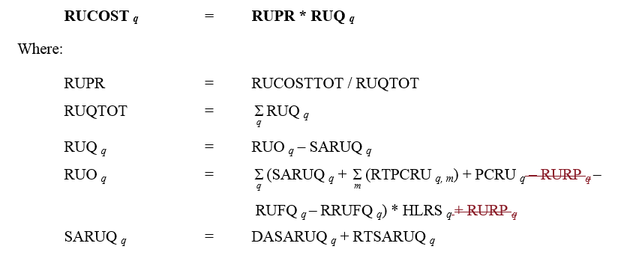
NPRR782 Clawback Allocation

Slide 5
DAM Make-Whole Adjustment Charge
Funds to pay for any DAM Make-Whole adjustments need to be collected. Where should these be collected?
NPRR 782 uses clawed back AS revenues to offset the total costs allocated to load via NP6.7.4 Adjustments to Cost Allocations for Ancillary Services Procurement. This is done for each AS type separately and is based on Hourly Load Ratio Share. DAM Make-Whole is not separated by AS type so a simple adjustment to NPRR782 formulas shouldn’t be done.

Slide 6
Proposed Solution For Allocation
 | “DAM Solution” | “RTM Solution”
Keep 782 as is | Spread charges for DAM Make-Whole adjustment on DAM purchase ratio share | Spread costs for DAM Make-Whole adjustment on HLRS
Adjust 782, keep the concept but remove clawback payment from AS adjustment formulas | Net the clawback payments and charges on a DAM purchase ratio share | Same as above only net the clawback payments and allocate on HLRS
DAM Make Whole Charges are spread over DAM purchase ratio share

Slide 7
DAM Make-Whole Adjustment Payment
Proposed calculation to true-up DAM Make-Whole amounts in situations where the claw-back charges would introduce additional make-whole amounts. This calculation nets the original Dam Make-Whole result with the result of the calculation considering revenue from the AS clawback and nets the new DAM Make-Whole with DAM Make-Whole that occurred in DAM Settlements. Any required incremental payments would be made on a RTM invoice
NPR782 clawback amounts at a Resource level
Recalculate DAM make-whole considering clawed back revenues for DAM committed intervals only
Allocates payment (and charge) to infeasible intervals. Could also be spread evenly over the DAM block

