Slide 1
Project Update and Summary of
Project Priority List (PPL) Activity
October 13, 2016

Slide 2
Project Update Agenda
Project Portfolio Update p. 3-8
  Recent/Upcoming Project Highlights
  2016 Release Targets
  2016 Project Spending Forecast
  Revision Request Funding Placeholder Status
  Aging Projects Review
  Priority/Rank Options for Revision Requests with Impacts
Appendix
  Project Portfolio Gantt Chart p. 9-17
Location of Project Priority List (PPL): http://www.ercot.com/services/projects/index

Slide 3
Recent / Upcoming Project Highlights
2016 September Release – Week of 9/26/2016 Complete
  NPRR219 – TSPs Must Submit Outages for Resource Owned Equipment and Clarification of Changes in Status of Transmission Element Postings
  SCR783 – Outage Scheduler Enhancements -- Groups 2 and 3, Group Outage, Usability and Filtering Enhancements
  NOGRR050 – Resolution of Reporting Issues Related to NPRR219
  NOGRR143 – Alignment of Nodal Operating Guides with NERC Reliability Standard, BAL-001-TRE-1
2016 November Release – Week of 11/1/2016 In Flight
  NPRR495 – Changes to Ancillary Services Capacity Monitor
  NPRR736 – Updates to the Ancillary Service Capacity Monitor Display
  NPRR770 – Addition of Outaged Resource Capacity to the A/S Capacity Monitor
Note: Projected Go-Live dates are subject to change.
Please watch for market notices as the effective dates approach.

Slide 4
2016 Release Targets – Board Approved NPRRs / SCRs / xGRRs
February 2/2 – 2/4 | April 4/12 – 4/14 | June 6/21 – 6/23 | August 8/30 – 9/1 | September 9/26 – 9/30 | December 12/6 – 12/8
NPRR588 NPRR615 NPRR686(b) | NPRR419 NPRR728 COPMGRR040 | NPRR515 NPRR617 NPRR700 NPRR719 NPRR742 VMCRR008 EMS Upgrade | NPRR662 NPRR712(a) RMGRR126 RMGRR137 | NPRR219 SCR783 NOGRR050 NOGRR143(a) NPRR712(b) NOGRR143(b) NPRR495 NPRR736 NPRR770 | NPRR573 NPRR754 NOGRR147 SCR787 SCR788 RMGRR127 RMGRR140 SCR786
3 | 3 | 6 | 4 | 9 | 7
E
E
E
E
E
H
E
E
E
E
E
E
E
11/1 – 11/3
12/5 – NMMS Upgrade
5/1
6/16
7/23 – 7/24
(Retail)
12/10 – 12/11 (Retail)
EMS Upgrade “Chill”
2016 TBD Items (and point at which they became “TBD”)
2014 | 2015 | Feb. 2016 | April 2016 | June 2016 | Aug. 2016 | October 2016
NOGRR084, NPRR664 | None | SCR781 H | None | None | None | NPRR775, NPRR778, NPRR782, NPRR785, NPRR789, RMGRR134
Go-live dates can differ from Protocol effective dates – Please refer to market notices for more details
APPENDIX
Red Text: New additions and target release changes
Strike-Through Text: Previous target release changes
(a), (b), etc. indicates multiple phases
In-Flight Items Planned for Future Delivery
CMM bundle (Planning): NPRR519, NPRR620, NPRR683, NPRR702, NPRR741, NPRR743, NPRR755, NPRR760
CRR Upgrade (Planning): SCR777
Release targets are subject to change
NPRR686(b) – Solar portion
Items Originally Targeted for 2016 Now Planned for 2017 Delivery
RRGRRs 03,06,07,09 (2017-R1 target)
NPRR272 (2017-R1 target)
NPRR714 (2017-R3 target)
Project Status Codes: NS = Not Started, I = Initiation, P = Planning, E = Execution, H = On Hold

Slide 5
2016 Project Spending Forecast
2016 PPL Budget = $22.5M
“Potential Demand” represents internal ERCOT projects that have not been fully approved

Slide 6
Revision Request Funding Placeholder Status
In 2016 and 2017, ERCOT forecasted $4.0M for Revision Request work
Yearly Revision Request Spending Forecast Summary
Project Status | 2016 | 2017
YTD Actuals | $2.05M | –
Approved – In-Flight / Complete | $2.78M | $0.77M
Approved – On Hold | $0.01M | $0.40M
Approved – Not Started | $0.05M | $0.26M
Remaining Funding | $1.16M | $2.57M
Total Allocation | $4.00M | $4.00M
As of 9/30/2016
Each year, an additional $400k is held in reserve in the event the $4M allocation is insufficient

Slide 7
Aging Projects Review
Definition of “Aging Item”
  PPL Source Doc = Revision Request
  PPL Project Status = “Not Started”
  PPL Priority < Current Year
Request PRS members review these items and be prepared for a detailed discussion in November

Slide 8
Aging Projects Review
Item | Description | Board Approval Date | Submitter | Target PPL Start Date | Comments | ERCOT Opinion
NOGRR084 | Daily Grid Operations Summary Report | 5/15/2012 | MISUG | TBD | Pending NOGRR to revise NOGRR084 language. ERCOT is the author. Discussion held at 10/10/2016 MDWG. | Do not proceed on NOGRR084 at this time
NPRR439 | Updating a Counter-Party's Available Credit Limit for Current Day DAM | 5/15/2012 | ERCOT | TBD | Proposed for elimination by NPRR803 | Do not proceed on NPRR439 at this time
NPRR714 | Real-Time Make-Whole Payment for Exceptional Fuel Cost | 10/13/2015 | GDF Suez | TBD | Pending submission of an NPRR by ERCOT that may eliminate NPRR714 | Do not proceed on NPRR714 at this time
NPRR664 | Index Fuel Price | 12/9/2014 | RCWG | TBD | TAC asked that ERCOT not proceed until further notice | Do not start – path forward is TBD

Slide 9
Priority / Rank Options for Revision Requests with Impacts
Options for…
Revision Request | Description | Priority | Rank | Comments
NPRR790 | Addition of Phase Angle Limits to the Network Operations Model [ERCOT] | 2017 | 1850 | Add to 2017 queue
NPRR797 | Actual Load by Forecast Zone Report and Display [Reliant Energy] | 2017 | 1860 | Add to 2017 queue
NPRR801 | Non-Controllable Load Resource MW in PRC [ERCOT] | 2017 | 1870 | Add to 2017 queue

Slide 10
Appendix
  9/30/2016 Project Gantt
    In-flight items sorted by Project End Date
    “On Hold” projects listed separately
    “Not Started” items sorted by Project Start Date

Slide 11
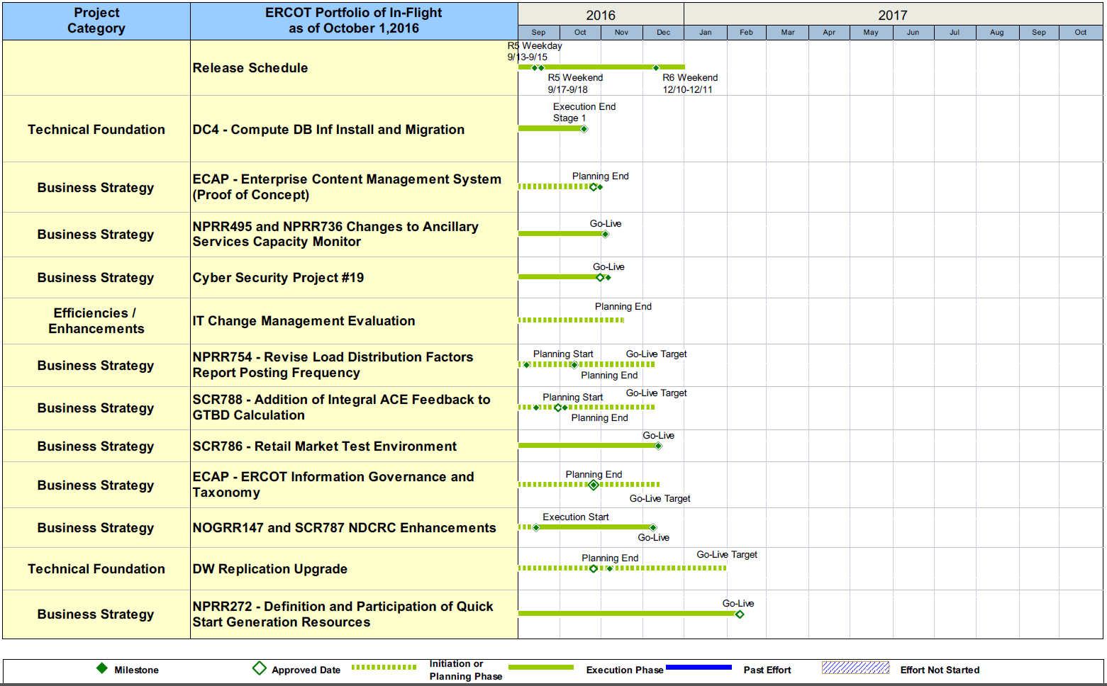
Project Portfolio Status – as of 9/30/2016

Slide 12
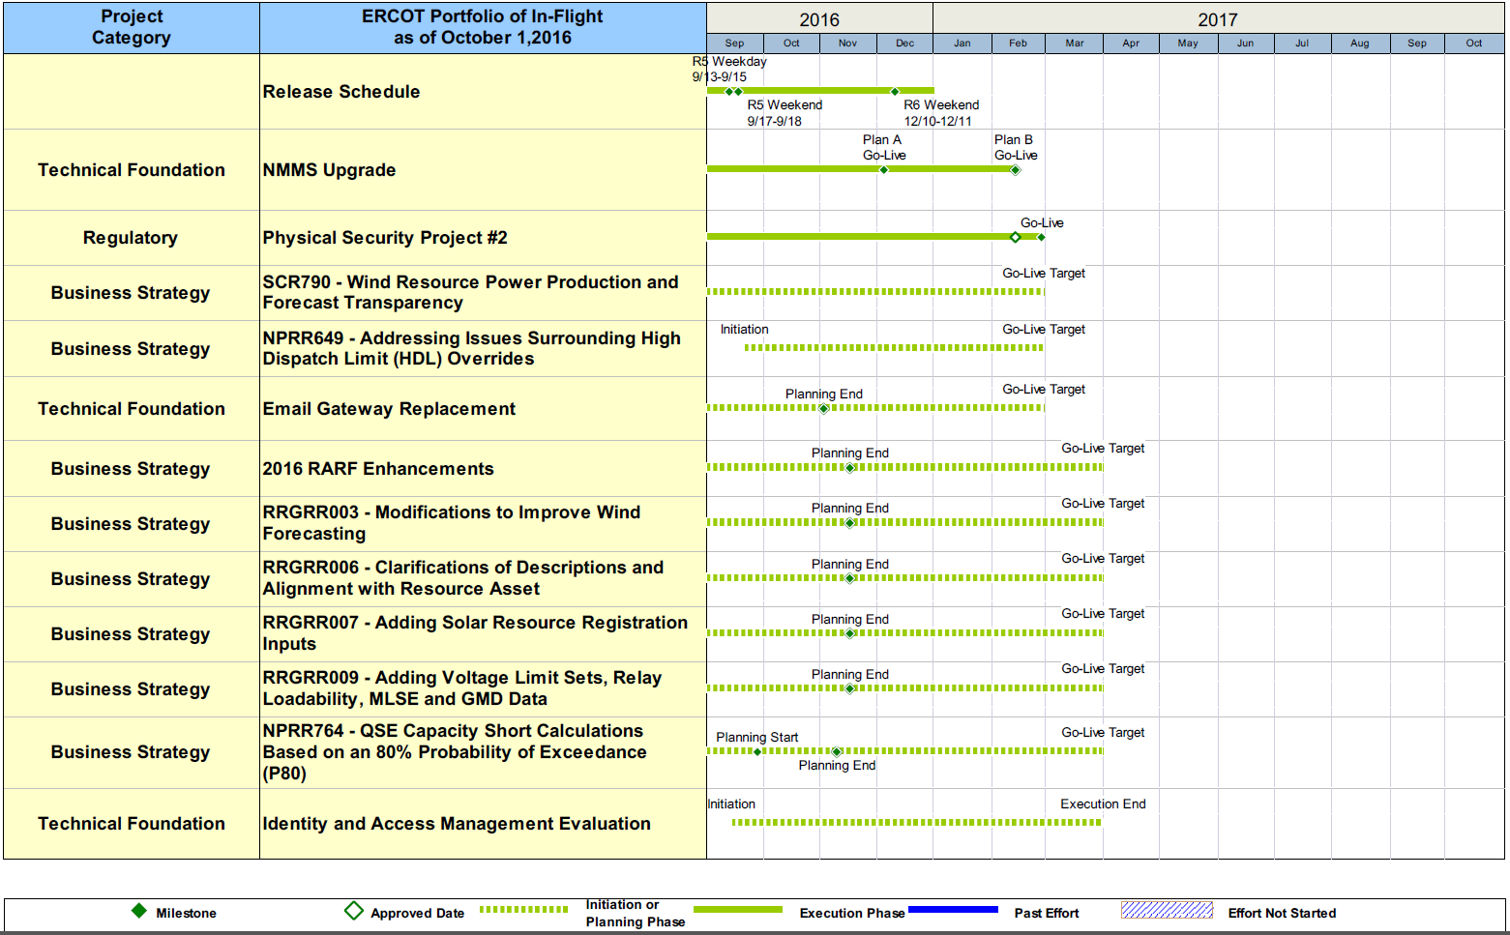
Project Portfolio Status – as of 9/30/2016

Slide 13
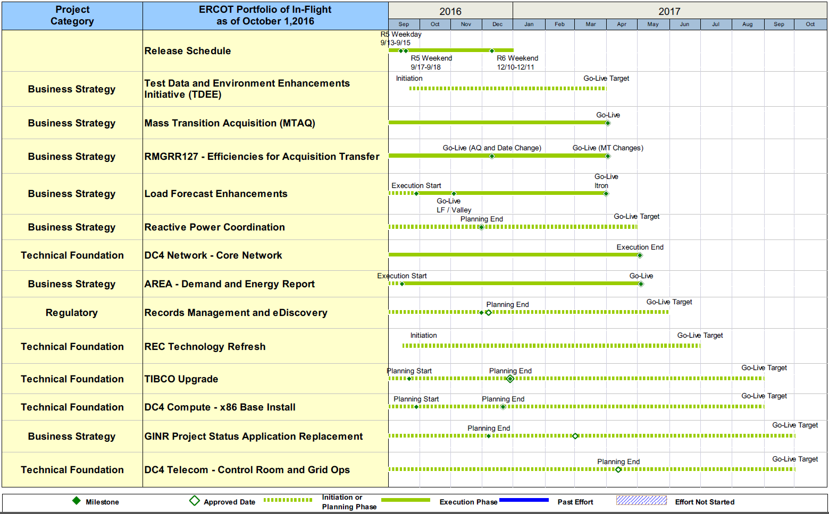
Project Portfolio Status – as of 9/30/2016

Slide 14
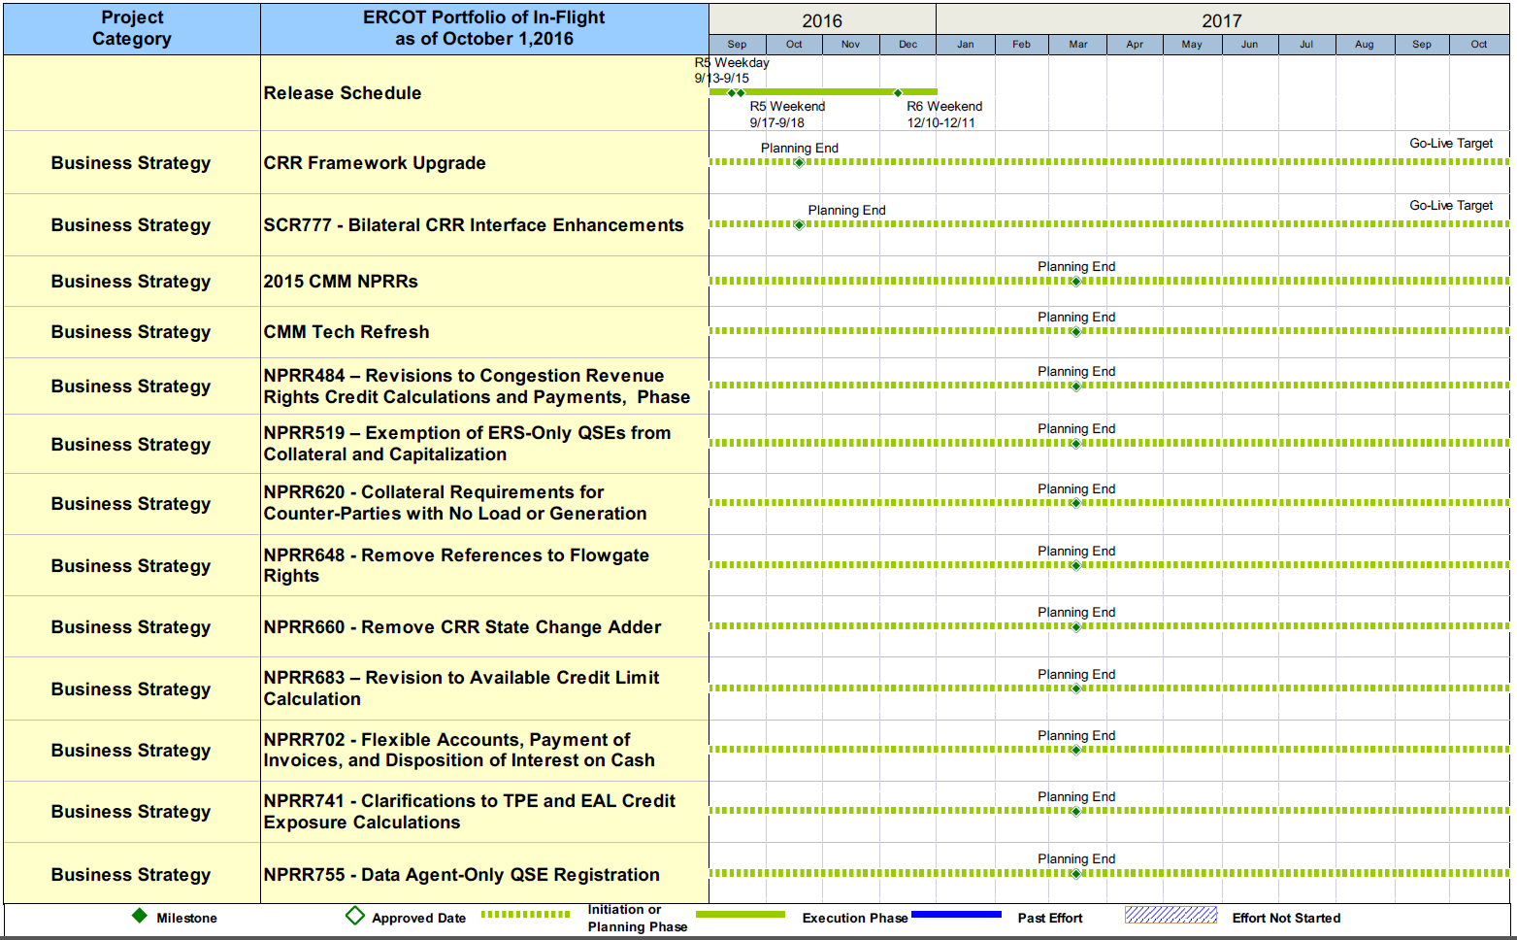
Project Portfolio Status – as of 9/30/2016

Slide 15
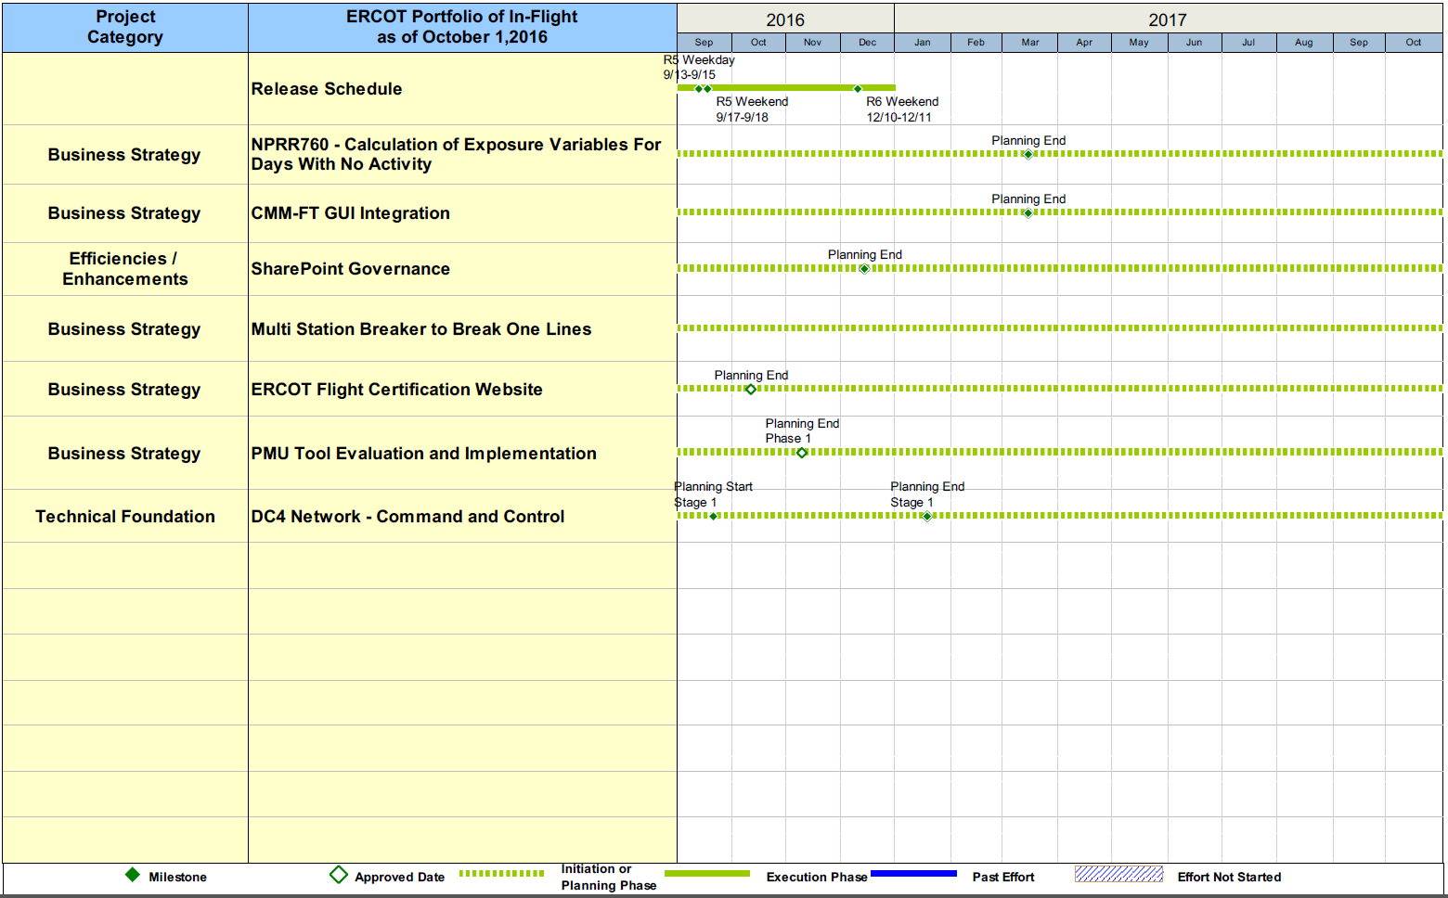
Project Portfolio Status – as of 9/30/2016

Slide 16
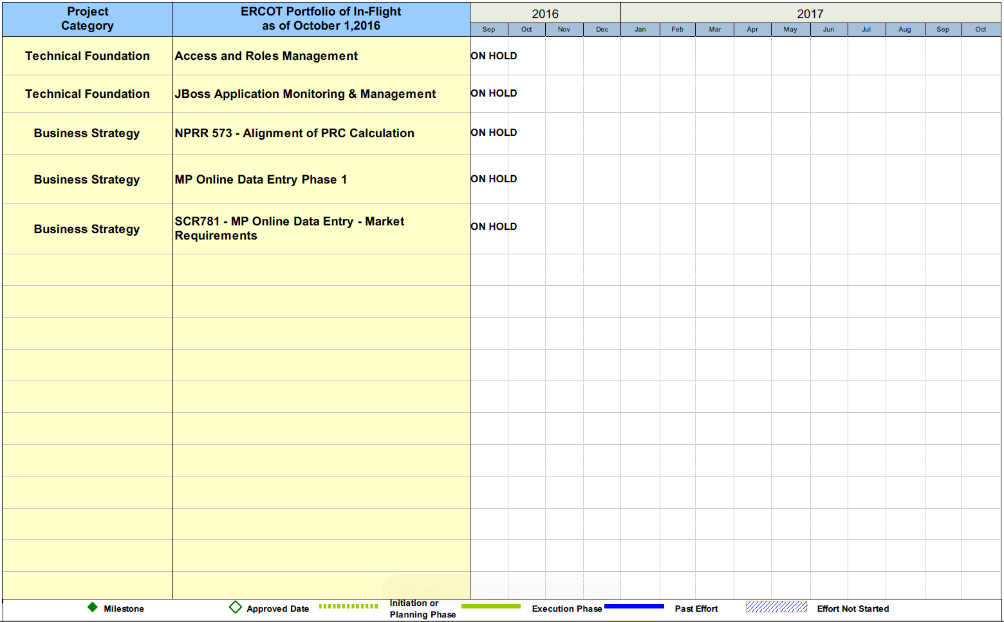
Project Portfolio Status – as of 9/30/2016

Slide 17
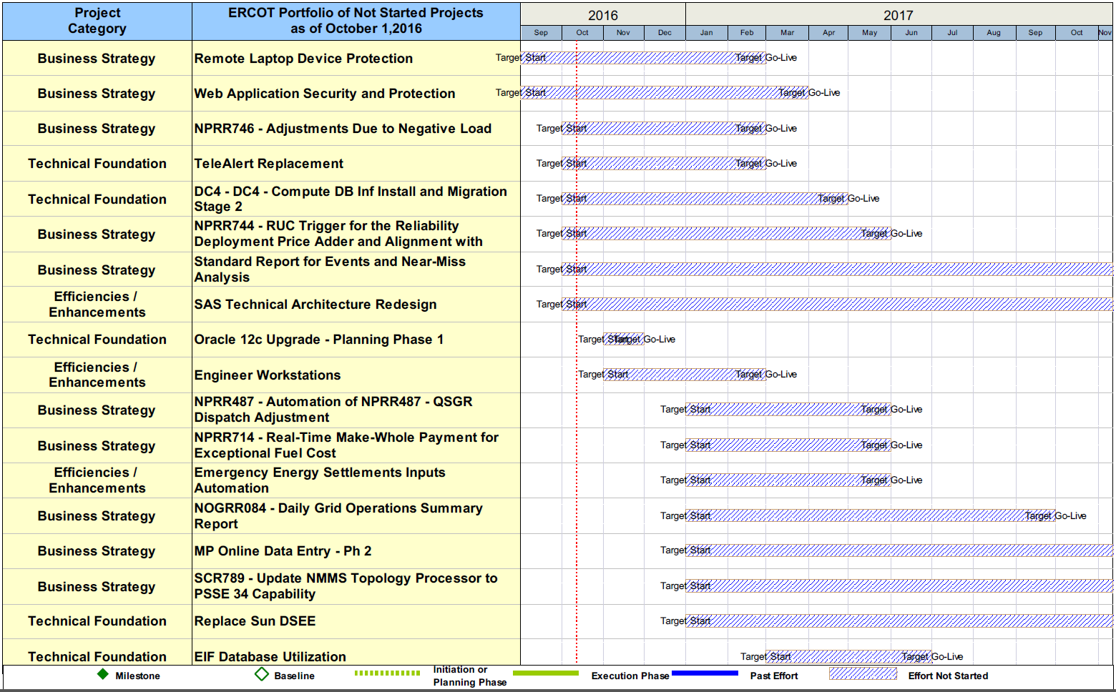
Project Portfolio Status – as of 9/30/2016

Slide 18
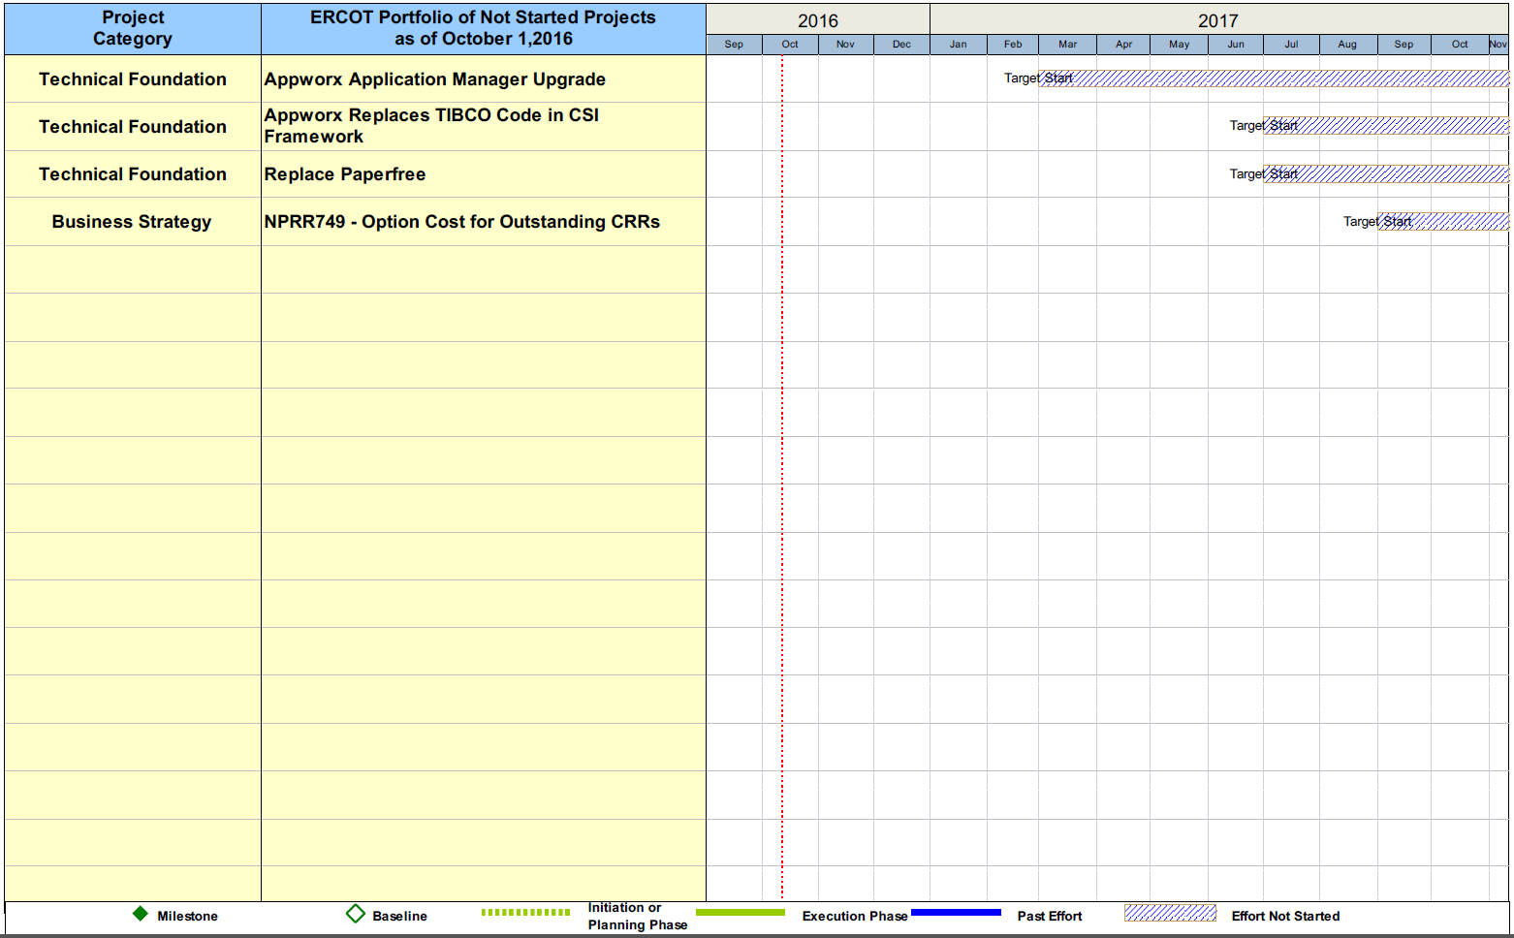
Project Portfolio Status – as of 9/30/2016

