Slide 1
Overview of the Reliability Unit Commitment Process
ERCOT Staff
October 14, 2016

Slide 2
Today’s Agenda
Overview of the Reliability Unit Commitment (RUC) timeline
The RUC engine
Control Room activities
RUC settlement
RUC and ONOPTOUT telemetry
Current RUC-related reporting

Slide 3
Overview of the RUC Timeline

Slide 4
Where RUC Fits

Slide 5
When are RUC Studies Executed?
Day-Ahead RUC (DRUC) is executed following a period after the completion of the Day-Ahead Market (DAM), typically at 14:30, and evaluates the next Operating Day
Hourly RUC (HRUC) occurs hourly and re-evaluates hours that have already been studied as part of DRUC
1800
1700
1600
DRUC Study Period
HRUC runs each hour
0200
0100
0000
Day 1
Day 2
1430
DRUC runs

Slide 6
Process Timeline Example
DRUC
14:31- Engine starts
14:43- Execution Complete
14:52- Results Published to the Market (6)
14:30
RUC engine analyzing system conditions and deciding on commitments (2)
ERCOT Operators reviewing RUC recommendations (3)
HRUC
10:00
10:03- Engine starts
10:13- Execution Complete
10:29- Results Published to the Market (6)

Slide 7
The RUC Engine

Slide 8
Engine Process Overview
Offers
Current Operating Plans (COPs)
Reliability Unit Commitment
Resource Commitments
Transmission
Security Analysis
(TSA)
Reliability Unit Commitment
(RUC)
Network
Operations
Model
Resource De-commitments
Contingencies
Constraint Information
Load Forecast
Additional Resource Information

Slide 9
Inputs
COPs for individual Resources
High and Low Sustained Limits (HSL and LSL), status, Ancillary Service (AS) responsibilities, etc…
Offers (discussed in more detail on the next slide)
Network model including equipment ratings, transmission outages, etc.
Contingencies
Hourly load forecasts and load distribution factors
Additional Resource information
Initial status, warm status, offline time, start time, etc…

Slide 10
Resource Offers Used by RUC
For projecting potential congestion and Resource-specific output levels, RUC uses a scaled version of the Mitigated Offer Caps (0.1%)
Submitted Energy Offer Curves are not used by RUC
RUC does use the Startup and Minimum Energy Offers from the Three-Part Supply Offers (3POs) in cases where they are available
In cases where there is not a 3PO and the Resource is Off-Line and available for commitment, RUC will use 150% of approved verifiable or generic costs

Slide 11
Outputs
Recommended Resource commitments
ERCOT Operators review the recommendations and decide which ones to select
They may also manually select Resources
Resource de-commitments
ERCOT may de-commit a Resource for a security violation that is otherwise unresolvable
Would be done manually by an ERCOT Operator, but not aware or this occurring in practice
Binding constraint information
Element, contingency, equipment flow and limits, etc…

Slide 12
RUC Optimization
RUC minimizes total cost over the entire study period, under the following constraints:
System power balance
Transmission constraints
Thermal constraints
Generic Transmission Constraints (GTCs)
Resource constraints
HSL and LSL with capacity reserved for AS deemed as unavailable
Temporal constraints (i.e startup time and minimum On-Line time)
Maximum daily starts
Note: Resource ramp rates are not considered in RUC

Slide 13
RUC Engine Process
After processing the input data, the first step is determine an initial unit commitment
Looks at self-committed Resources, previous RUC commitments, and expected demand, but ignores transmission constraints
RUC then begins looking at transmission security and dispatches Resources to manage any congestion
Unit commitments are then revised, if needed, and the process repeats
Transmission
Security Analysis
(TSA)
Reliability Unit Commitment
(RUC)

Slide 14
Control Room Activities

Slide 15
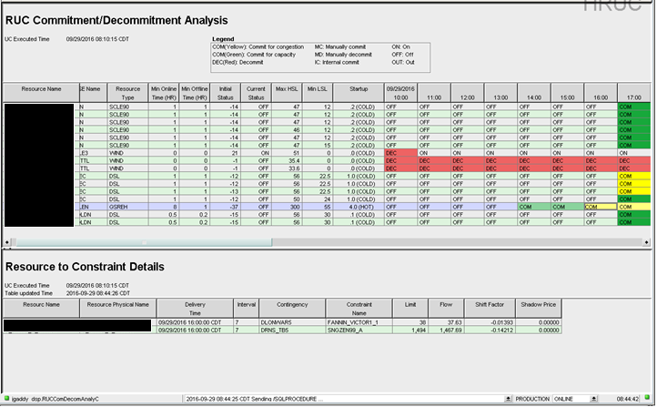
MMS Displays

Slide 16
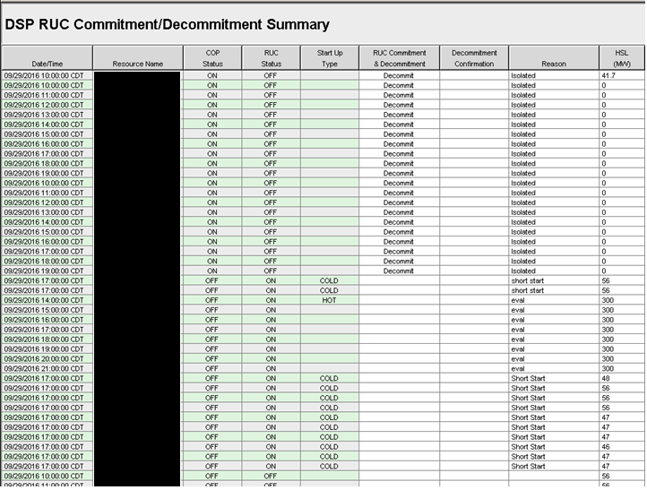
MMS Displays

Slide 17
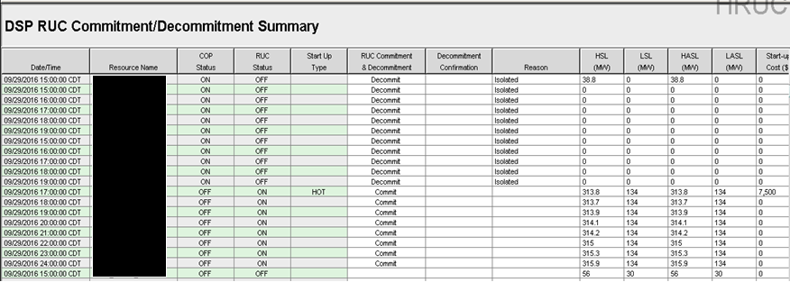
Walkthrough: RUC Commitment Summary

Slide 18
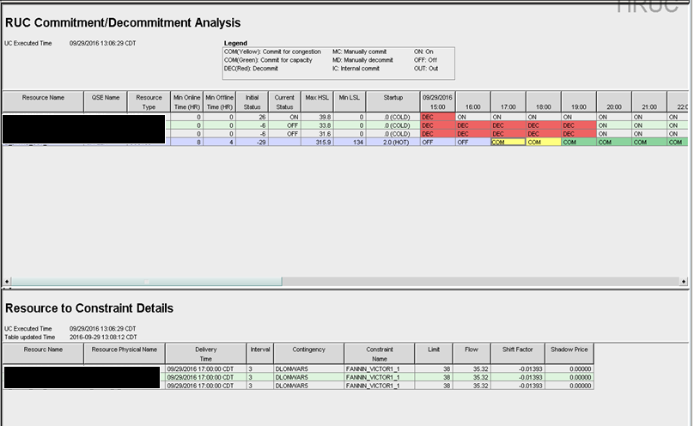
Walkthrough: RUC Commitment Summary

Slide 19
Commitment Decision Tree
RUC Desk Procedure, Section 3.2
Check to see if the suggested commitment is valid
Check the start-up (lead) time
Check if manual commit is needed
Review COP, MTLF, Weather forecast, Real-Time conditions, transmission real-time snapshots and future study recommendations
Every hour an off-line study is performed for four hours in the future to review voltage issues
Consider all other generation before committing an RMR unit for capacity

Slide 20
Commitment Rationale
Evaluate Later – used when waiting to last hour to commit
Short Start – reserved for <1 hour lead time units
Voltage Support – used for voltage contingencies (not seen by RUC)
Valley Import – committing units for the Valley GTC
Capacity
Constraint Name – commitment for local congestion

Slide 21
Why Commit?
Evaluate Later – No time left to wait
Short Start – Real-Time issues (VDI may be issued)
Voltage Support – Likely outage driven
Valley Import – Combination of issues
Capacity – Short over peak

Slide 22
Walkthrough: RUC Commitment Summary

Slide 23
Assigning Rationale to Defer
Unit has a 3 hour lead time and HRUC 7 hours ahead is suggesting commitment
Operator has 4 hours to decide to commit the unit
QSE has 4 hours to decide to self-schedule the unit
Outages
Outage returned early (or recalled), OS not updated before RUC executes
Weather / Load Forecast issues

Slide 24
RUC Settlement

Slide 25
Options After Resource is RUC Committed
Options when Resource has received a RUC commitment.
Follow the RUC commitment.
QSE is considered for RUC Settlements: make whole payments and clawback charges.
“buy back” the commitment.
Current procedure - Opt out by setting COP status to ONOPTOUT for any hour within a contiguous block of RUC committed hours before the end of the adjustment period of the first hour of the block.
Post 744 (R4) procedure – Opt out by setting telemetered Resource Status to ONOPTOUT for the first SCED interval that the resource is On-Line and available for SCED dispatch during the first hour of the contiguous block of RUC committed hours.
Resource is excluded from all RUC Settlements, settled as if the RUC commitment never occurred.

Slide 26
RUC Make Whole and Clawback
Resources are made whole to the RUC Guarantee for RUC committed intervals.
RUC Guarantee is startup costs + minimum energy costs
Resources have revenues above costs clawed back for RUC committed and QSE Clawback intervals.
Revenue Less Cost Above LSL During RUC-Committed Hours
Revenue Less Cost During QSE Clawback Intervals
Revenues | Costs
Energy Revenue above LSL | Average Incremental Energy Cost above LSL
Voltage Support Service
Emergency Power Increase
Revenues | Costs
Energy Revenue | Minimum Energy Costs
Voltage Support Service | Average Incremental Energy Cost above LSL
Emergency Power Increase

Slide 27
QSE-Clawback Interval
Qualified Scheduling Entity (QSE) Clawback Interval (NP2)
Any QSE-Committed Interval that is part of a contiguous block that includes at least one RUC-Committed Hour unless it is:
QSE-committed in the COP and Trades Snapshot before the first RUC instruction for any RUC-Committed Hour in that contiguous block;
Part of a contiguous block of a QSE-Committed Intervals, at least one of which was committed by the QSE in the COP and Trades Snapshot before the RUC instruction described in paragraph (a) above; or
Part of a contiguous block of QSE-Committed Intervals, at least one of which is a RUC Buy-Back Hour.

Slide 28
RUC Make-Whole Payment
RUC Guarantee (NP 5.7.1.1)
Start up Costs + Minimum Energy Costs
RUC Make-Whole Payment (NP 5.7.1)
RUC Guarantee – RUC minimum energy revenue – RUC revenue less cost above LSL – QSE clawback revenue less cost
These calculations are done in aggregate for the entire operating day with payments spread evenly across all RUC intervals

Slide 29
Clawback
A percentage of revenues in excess of the cost guarantee is clawed back for RUC committed intervals and QSE Clawback intervals.
The percentage factors used for clawback are adjusted depending on the QSE’s participation in DAM for the Resource.
 | Three-Part Supply Offer in DAM | No Three-Part Supply Offer in DAM
RUC Clawback Factor for RUC hours | 50% | 100%
RUC Clawback Factor for QSE hours | 0% | 50%
These clawed back amounts are allocated to load on a Load Ratio Share Basis.

Slide 30
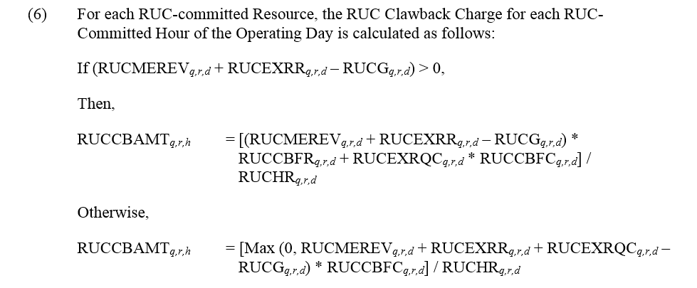
RUC Clawback
Revenue in excess of cost guarantee (NP 5.7.2(6))

Slide 31
RUC Make-Whole Charges
NP5.7.4(1)
All QSEs that were capacity-short in each RUC will be charged for that shortage, as described in Section 5.7.4.1, RUC Capacity-Short Charge. If the revenues from the charges under Section 5.7.4.1 are not enough to cover all RUC Make-Whole Payments for a Settlement Interval, then the difference will be uplifted to all QSEs on a Load Ratio Share (LRS) basis, as described in Section 5.7.4.2, RUC Make-Whole Uplift Charge
There have been 3 days since Nodal Go Live with amounts over $1 allocated to load.
The last time amounts over $1 were allocated to load was June 2011.

Slide 32
QSE Shortfall
Measure QSE Shortfall twice for each hour:
Execution of RUC
Real-time Operations
Worst case wins!
Capacity required to meet QSE Obligations
Capacity required to meet QSE Obligations
QSE Shortfall
QSE Shortfall
Capacity arranged by QSE
Capacity arranged by QSE
RUC (DRUC / HRUC)
Real-Time

Slide 33
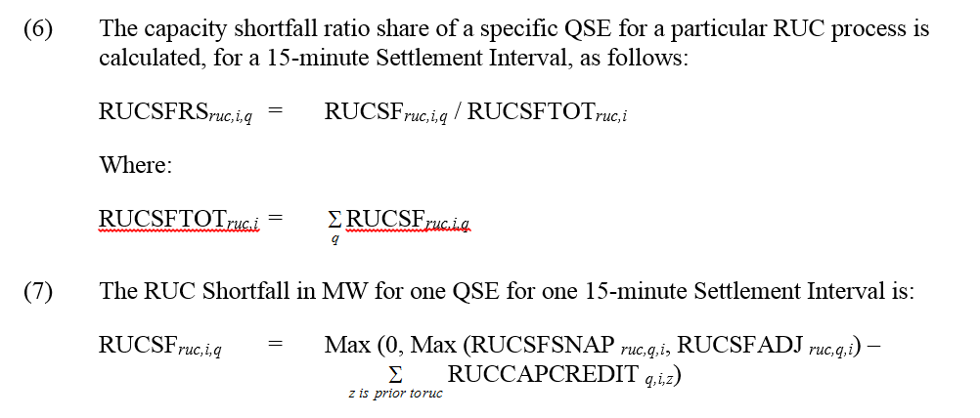
RUC Capacity Short MW
NP5.7.4.1.1

Slide 34
RUC Capacity Short Charge
NP5.7.4.1

Slide 35
RUC Decommitment
If a Resource is decommitted it is considered for compensation for its start up costs reduced by any avoided losses.
These costs are allocated to load on a Load Ratio share basis.
ERCOT has never made a RUC decommitment payment.
NP5.7.3

Slide 36
Current Implementation RUC and ONOPTOUT Telemetry

Slide 37
RUC and ONOPTOUT telemetry, Protocol review
Currently, ONOPTOUT has to be shown in the COP before the end of the adjustment period for the first hour of a contiguous block of RUC committed hours to opt-out of RUC settlement for any hours of the RUC block
5.5.2 Reliability Unit Commitment (RUC) Process
(11) A QSE with a Resource that is not a Reliability Must-Run (RMR) Unit that has been committed in a RUC process or by a RUC Verbal Dispatch Instruction (VDI) may choose, at its sole discretion, to self-commit that Resource in lieu of the RUC instruction. The QSE must notify ERCOT of the intent to self-commit the Resource by either:
Setting the COP Resource Status to ONOPTOUT before the end of the Adjustment Period for the first hour of a contiguous block of RUC-Committed Hours that includes the RUC Buy-Back Hour.
SCED will calculate a Reliability Deployment Price Adder if a SCED resource telemeters resource status of ONRUC and has a RUC commitment for that hour
6.5.7.3.1 Determination of Real-Time On-Line Reliability Deployment Price Adder
(1) The following categories of reliability deployments are considered in the determination of the Real-Time On-Line Reliability Deployment Price Adder:
RUC-committed Resources with a telemetry Resource Status of ONRUC;

Slide 38
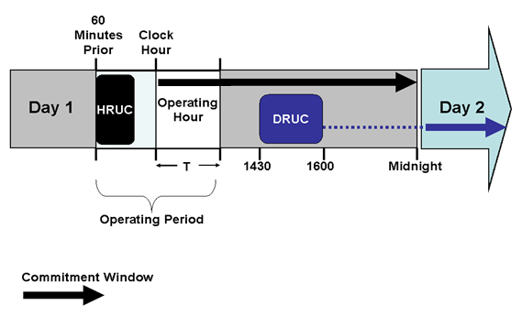
RUC timeline for examples
Example A
Example B

Slide 39
Status ONRUC and ONOPTOUT telemetry
Example A1: A 400 MW resource, with an LSL of 100 MW, was committed by a RUC process and communicated by ERCOT at 13:20 for Hour Ending 16-18
QSE A updates COP at 13:45 for its RUC committed resource to reflect ONRUC for hours ending 16-18
In Real-Time telemeters a resource status of ONRUC for hours ending 16-18
Outcome:
SCED Energy Offer Curve for resource will be set from zero to HSL at greater of the submitted EOC and the RUC floor of $1500 / MWh
SCED will calculate a Reliability Deployment Price Adder and the Energy Offer Curve’s for RUC committed resources will be extended from LSL to zero at greater of first point on the resource’s EOC or the RUC floor of $1500 /MWh and the RUC resources LSL, LASL and LDL will be set to zero
COP & Telemetry Correction:
None; QSE A accurately updated COP and real-time telemetry

Slide 40
Status ONRUC and ONOPTOUT telemetry
Example A2: A 400 MW resource, with an LSL of 100 MW, was committed by a RUC process and communicated by ERCOT at 13:20 for Hour Ending 16-18
QSE A updates COP at 13:45 for its RUC committed resource to reflect ONRUC for hours ending 16-18
In Real-Time telemeters a resource status of ON
Outcome:
No Energy Offer Curve check/adjustment for RUC floor
No Reliability Deployment Price Adder since the resource telemetry was ON and not ONRUC
COP & Telemetry Correction:
QSE A accurately updated it’s COP but should have telemetered a resource status of ONRUC

Slide 41
Status ONRUC and ONOPTOUT telemetry
Example A3: A 400 MW resource, with an LSL of 100 MW, was committed by a RUC process and communicated by ERCOT at 13:20 for Hour Ending 16-18
QSE A updates COP at 13:45 for its RUC committed resource to reflect ONOPTOUT for hours ending 16-18
In Real-Time telemeters a resource status of ONRUC
Outcome:
SCED Energy Offer Curve for resource will be set from zero to HSL at greater of the submitted EOC and the RUC floor of $1500 / MWh
SCED will calculate a Reliability Deployment Price Adder and the Energy Offer Curve’s for RUC committed resources will be extended from LSL to zero at greater of first point on the resource’s EOC or the RUC floor of $1500 /MWh and the RUC resources LSL, LASL and LDL will be set to zero
QSE opted out of RUC settlement for RUC committed resource
COP & Telemetry Correction:
QSE A accurately updated it’s COP but it’s telemetered resource status should have been ONOPTOUT not ONRUC

Slide 42
Status ONRUC and ONOPTOUT telemetry
Example B1: A 400 MW resource, with an LSL of 100 MW, was committed by a RUC process and communicated by ERCOT at 14:20 for Hour Ending 16-18
QSE A can not update its COP after the end of the adjustment period for HE16 so the resource status of OFF is shown for hour ending 16 and ONRUC for hours ending 17 and18
In Real-Time telemeters a resource status of ONRUC
Outcome:
Can not ONOPTOUT due to RUC commitment after the end of the adjustment period
SCED Energy Offer Curve for resource will be set from zero to HSL at greater of the submitted EOC and the RUC floor of $1500 / MWh
SCED will calculate a Reliability Deployment Price Adder and the Energy Offer Curve’s for RUC committed resources will be extended from LSL to zero at greater of first point on the resource’s EOC or the RUC floor of $1500 /MWh and the RUC resources LSL, LASL and LDL will be set to zero
COP & Telemetry Correction:
QSE A’s COP and real-time telemetry were correct

Slide 43
Status ONRUC and ONOPTOUT telemetry
Example B2: A 400 MW resource, with an LSL of 100 MW, was committed by a RUC process and communicated by ERCOT at 14:20 for Hour Ending 16-18
QSE A can not update its COP after the end of the adjustment period for HE16 so the resource status of ON is shown for hour ending 16 and ONOPTOUT for hours ending 17 and18
In Real-Time telemeters a resource status of ONOPTOUT
Outcome:
Can not ONOPTOUT due to RUC commitment after the end of the adjustment period
No Energy Offer Curve check/adjustment for RUC floor
No Reliability Deployment Price Adder since the resource telemetry was ON and not ONRUC
COP & Telemetry Correction:
QSE inaccurately updated it’s COP to ONOPTOUT for hours when ONOPTOUT was not a settlement option.
QSE should have telemetered a resource status of ONRUC instead of ONOPTOUT

Slide 44
Status ONRUC and ONOPTOUT Summary
Currently, ONOPTOUT has to be shown in the COP before the end of the adjustment period for the first hour of a contiguous block of RUC committed hours to opt-out of RUC settlement for any hours of the RUC block
RUC trigger for the Reliability Deployment Price Adder is if telemetered resource status of any SCED resource is ONRUC

Slide 45
NPRR 744 Overview
Currently projected for 2017-R3 release
Regardless of when the RUC is communicated take a Resource Status telemetry snapshot when the following are all true:
The resource has a confirmed RUC commitment
The first hour of the RUC commitment block
First SCED run when resource is on-line and available for SCED dispatch
This Resource status snapshot will be used -
For the entire RUC block and any extensions of the RUC commitment block, unless the RUC goes into the next operating day.
For the QSE’s settlement for the entire RUC commitment block
As the decision for the RUC trigger for the RTRDP pricing run
If snapshot is ONOPTOUT then Resource is opted-out of RUC settlement and RTRDP pricing run will not be initiated
If any online status is shown, other than ONOPTOUT, then Resource will be settled as per RUC settlement and the RTRDP pricing runs will be initiated for the entire block

Slide 46
Current RUC-Related Reporting

Slide 47
RUC Reports (Public)
Weekly RUC Active and Binding Transmission Constraints (NP5-753-CD)
Daily RUC Active and Binding Transmission Constraints (NP5-754-CD)
Hourly RUC Active and Binding Transmission Constraints (NP5-755-CD)
For each RUC process, ERCOT shall post all active and binding transmission constraints (contingency and overloaded element pair information where available) used as inputs to RUC. The posting may include the RUC time stamp, RUC type(DRUC or HRUC), binding transmission constraints. (Posts immediately after RUC process)
Complete Current Operating Plan Data (NP1-301)
Complete Current Operating Plan data for each QSE snapshot on each hour; confidentiality expired 60 day data (Posts daily)
RUC Payments Made to Resources with Power Purchase Agreements (PPA) Annual Report (NP5-661-M)
Percentage of RUC make-whole payments for Resources with PPAs during the 12 months of the previous calendar year. Based on Final Settlements, includes total number of Resources that used a PPA for their most recent VC submission approved by ERCOT (Posts in April each year if there is data to report)

Slide 48
RUC Reports (MIS Secure)
Contingencies Deselected in RUC (NP5-200-CD)
Deselected contingencies and reasons for removal. Deselected contingencies posted following the first RUC run after deselection. (Posts immediately after RUC process in which a contingency is deselected)
DRUC Deselected Capacity (NP5-523-CD)
Generated after each successfully approved DRUC processes in which the Operator manually removed a recommended commitment or de-commitment. (Posts after DRUC run)
Daily RUC Committed or Decommitted Resources (NP5-751-CD)
All resources that have been committed or decommitted for the daily RUC process including resources names, commit/decommit and the associated RUC process type/time (Posts 24 hours after DRUC run)
Deselected Daily RUC Recommendations (NP5-757-CD)
All deselected recommendations for the daily RUC process including resources names and the associated RUC process type/time (Posts 24 hours after DRUC run)
HRUC Deselected Capacity (NP5-524-CD)
Generated after each successfully approved HRUC processes in which the Operator manually removed a recommended commitment or de-commitment. (Posts after HRUC run)
Hourly RUC Committed or Decommitted Resources (NP5-752-CD)
All resources that have been committed or decommitted for the hourly RUC process including resources names, commit/decommit
(Posts 24 hours after HRUC run)
Deselected Hourly RUC Recommendations (NP5-758-CD)
All deselected recommendations for the hourly RUC process including resources names and the associated RUC process type/time
(Posts 24 hours after HRUC run)
Verbal RUC Committed or Decommitted Resources (NP5-756-CD)
All resources that have been commited/decomitted via VDI for the hourly RUC process including resources names, commit/decommit

Slide 49
RUC Reports (MIS Secure)
RUC Buy-Back Hours (NP5-513-CD)
Hourly report identifying those hours that were considered as RUC Buy-Back Hours (Posted Hourly)
Monthly RUC Make Whole Charge and Clawback Payment Report (NP5-772)
Total RUC Make-Whole Charges and RUC Clawback Payments, by Settlement Interval, by QSE capacity-shortfall and by amount uplifted (Posts middle of following month)
QSE RUC Commitment Performance Summary (NP8-568-ER)
Generation Resources committed in each RUC process, the reason for the commitment, Resource name and intervals deployed, and the hours committed for Voltage Support Service (VSS) (Posts early in the following month)
DRUC and HRUC Performance (NP8-569-ER)
DRUC & HRUC Commitment Performance by QSEs and Generation Resources (Posted early in the following month)
Monthly DRUC Load Forecast vs Actual ERCOT Load Accuracy Report (NP8-928)
Accuracy of the Load forecast used for Day-Ahead Reliability Unit Commitment (DRUC) compared to the actual ERCOT Load for each hour of the Operating Day
Daily DRUC Load Forecast Accuracy Report (NP8-929)
The accuracy of the Load forecast for the following items compared to the average of the SE Load at each Electrical Bus for each hour for Hourly Load forecast used in the DRUC by Load Zone, Hourly Load forecast used in the DRUC by Weather Zone
Daily HRUC Load Forecast Accuracy Report (NP8-930)
The accuracy of the Load forecast for the following items compared to the average of the SE Load at each Electrical Bus for each hour for Hourly Load forecast used in the Hourly Reliability Unit Commitment (HRUC) by Load Zone and Hourly Load forecast used in the HRUC by Weather Zone

Slide 50
RUC Reports (MIS Certified)
Hourly RUC Off-Line Generation Resources Initial Conditions (NP5-300-CD)
Temporal constraints the RUC optimization is using (Posted after HRUC run)

Slide 51
Questions and Additional Information
Client Services for Market Participants
512-248-3900 ClientServices@ercot.com
ERCOT market training
Basic Training Program
http://www.ercot.com/services/training/course/52#overview
Market Settlements 301
http://www.ercot.com/services/training/course/44#overview
Operating Reserve Demand Curve eLearning
http://www.ercot.com/services/training/course/107

Slide 52
Appendix

Slide 53
NPRR 744 Protocol Review
5.5.2 Reliability Unit Commitment (RUC) Process
(11) A QSE with a Resource that is not a Reliability Must-Run (RMR) Unit that has been committed in a RUC process or by a RUC Verbal Dispatch Instruction (VDI) may opt out of the RUC Settlement (or “buy back” the commitment) by setting the telemetered Resource Status of the RUC-committed Resource to ONOPTOUT for the first SCED run that the Resource is On-Line and available for SCED dispatch during the first hour of a contiguous block of RUC-Committed Hours. A QSE that opts out of RUC Settlement forfeits RUC Settlement for the affected Resource for a given block of RUC Buy-Back Hours. A QSE that opts out of RUC Settlement treatment must make the Resource available to SCED for all RUC Buy-Back Hours. All hours in a contiguous block of RUC-Committed Hours that includes the RUC Buy-Back Hour shall be considered RUC Buy-Back Hours. However, if a contiguous block of RUC-Committed Hours spans more than one Operating Day, each contiguous block of RUC-Committed Hours within each Operating Day shall be treated as an independent block for purposes of opting out, and a QSE that wishes to opt out of RUC Settlement for the RUC-Committed Hours in the next Operating Day must set its telemetered Resource Status to ONOPTOUT for the first SCED run the next Operating Day.

Slide 54
RUC timeline
Example A
Example B
Example C
HE 10
HE 11
HE 12

Slide 55
NPRR 744 Examples
Off-line Example A: Off-line resource, is committed by a RUC process and communicated by ERCOT at 08:20 for Hour Ending 11-12
8:25 Updates COP resource status of RUCed resource to ONOPTOUT for HE 11 and 12
9:45 Real-Time telemeters a resource status of STARTUP
9:58 Real-Time telemeters a resource status of ONOPTOUT
10:02 SCED snapshot captures ONOPTOUT status
The resource has a confirmed RUC commitment (TRUE)
The first hour of the RUC commitment block (TRUE)
SCED snapshot when resource is on-line and available for SCED dispatch (TRUE)
Outcome:
QSE opted out of RUC settlement for RUC committed resource
RTRDP was NOT calculated

Slide 56
NPRR 744 Examples
On-line Example A: On-line resource, is committed by a RUC process and communicated by ERCOT at 08:20 for Hour Ending 11-12
8:25 Updates COP resource status of RUCed resource to ONOPTOUT from OFF for HE 11 and 12
9:30 Real-Time telemeters a resource status of ON
9:58 Real-Time telemeters a resource status of ONOPTOUT
10:02 SCED snapshot captures ONOPTOUT status
The resource has a confirmed RUC commitment (TRUE)
The first hour of the RUC commitment block (TRUE)
SCED snapshot when resource is on-line and available for SCED dispatch (TRUE)
Outcome:
QSE opted out of RUC settlement for RUC committed resource
RTRDP was NOT calculated

Slide 57
NPRR 744 Examples
Off-line Example B: Off-line resource, is committed by a RUC process and communicated by ERCOT at 10:30 for Hour Ending 12
10:50 Real-Time telemeters a resource status of STARTUP
10:58 Real-Time telemeters a resource status of ONOPTOUT
11:02 SCED snapshot captures ONOPTOUT status
The resource has a confirmed RUC commitment (TRUE)
The first hour of the RUC commitment block (TRUE)
SCED snapshot when resource is on-line and available for SCED dispatch (TRUE)
Outcome:
QSE opted out of RUC settlement for RUC committed resource
RTRDP was NOT calculated

Slide 58
NPRR 744 Examples
On-line Example B: On-line resource, is committed by a RUC process and communicated by ERCOT at 10:30 for Hour Ending 12
10:30 Real-Time telemeters a resource status of ON
10:58 Real-Time telemeters a resource status of ONOPTOUT
11:02 SCED snapshot captures ONOPTOUT status
The resource has a confirmed RUC commitment (TRUE)
The first hour of the RUC commitment block (TRUE)
SCED snapshot when resource is on-line and available for SCED dispatch (TRUE)
Outcome:
QSE opted out of RUC settlement for RUC committed resource
RTRDP was NOT calculated

Slide 59
NPRR 744 Examples
Off-line Example C: Off-line resource, is committed by a RUC process and communicated by ERCOT at 11:20 for Hour Ending 12
11:22 Real-Time telemeters a resource status of STARTUP
11:23 Real-Time telemeters a resource status of ONOPTOUT
11:24 SCED snapshot captures ONOPTOUT status
The resource has a confirmed RUC commitment (TRUE)
The first hour of the RUC commitment block (TRUE)
SCED snapshot when resource is on-line and available for SCED dispatch (TRUE)
Outcome:
QSE opted out of RUC settlement for RUC committed resource
RTRDP was NOT calculated

Slide 60
NPRR 744 Examples
On-line Example C: On-line resource, is committed by a RUC process and communicated by ERCOT at 11:20 for Hour Ending 12
11:22 Real-Time telemeters a resource status of ON
11:23 Real-Time telemeters a resource status of ONOPTOUT
11:24 SCED snapshot captures ONOPTOUT status
The resource has a confirmed RUC commitment (TRUE)
The first hour of the RUC commitment block (TRUE)
SCED snapshot when resource is on-line and available for SCED dispatch (TRUE)
Outcome:
QSE opted out of RUC settlement for RUC committed resource
RTRDP was NOT calculated

