Slide 1
CSWG Update to COPS
October 2016

Slide 2
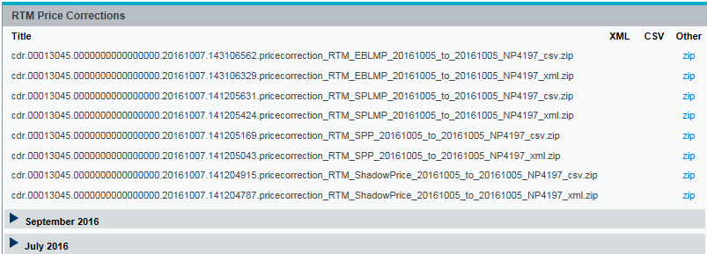
CSWG Update “Price Correction” posts to MIS within 48 e
Received clarification from ERCOT concerning NPRR696 Price Corrections Following a SCED Failure. Essentially real-time substitutions/replacements because these prices will be in data before a Price Correction or a Price Change. Last known good SCED price.
“Price Correction” posts to MIS within 48 hours (and before Initial Settlement)
Whereas,
“Price Change” is a change to a financially settled price and is reported on in the Settlement Stability Report. Should not be duplicative of RTM Price Corrections.

Slide 3
CSWG Update
Options for Priority 1 Extracts: Do we need a Settlement SLA?
No Change – Content and Communication is sufficient
Missed Postings Report is really “Skipped Posting” not a “Missed Deadline”
Add more detail to Extract Incident Report (also monthly but more specific)
Targeted Market Notices – which exploders will guarantee? Settlement points to Public
“Extra Credit” Close-of-business or other time threshold warning when data is posted

Slide 4
CSWG Update
When would additional notification be helpful?
COB Day 5
Upon approval Status=“A”
Upon systems completion
Upon posting
By 5pm
Before noon on day invoice is due

Slide 5
Next CSWG Meeting
Next CSWG Meeting
October 24, 2016 9:30am
WebEx Only
Short meeting for endorsement of COPMGRR044

