Slide 1
Settlement Stability
2016 Q3 Update to COPS
Blake Holt
ERCOT
10/12/16

Slide 2
8.2(2)(c)(i) Track number of price changes
Reporting Period: 2016 Q3
Operating Day | # of Corrected Settlement Point Prices |  |  |  | # of Intervals Affected
 | DASPP | RTSPP | RTRMPR | ORDC Adders | DASPP | RTSPP | RTRMPR | ORDC Adders
- | - | 5028 | 4165 | - | - | 8 | 8 | -
Notes:
Price corrections for OD 7/7/2016 were due to a system issue.

Slide 3
8.2(2)(c)(ii) Track number and types of disputes submitted
YEAR | 2016
QUARTER | Q3
Row Labels | Denied | Granted | Granted w/Exc. | Open | Total Submitted
Congestion Revenue Rights-RTM | 11 | 0 | 0 | 0 | 11
CRR Auction | 1 | 0 | 0 | 0 | 1
Energy-DAM | 1 | 1 | 0 | 0 | 2
Energy-RTM | 7 | 2 | 0 | 0 | 9
Invoice | 1 | 0 | 0 | 0 | 1
Reliability Unit Commitment | 1 | 0 | 0 | 0 | 1
Gene. Res. Base Pt Deviation | 2 | 0 | 0 | 0 | 2
Emergency Operations | 0 | 1 | 0 | 0 | 1
DA/RT Invoice | 1 | 0 | 0 | 0 | 1
Grand Total

Slide 4
8.2(2)(c)(iii) Compliance with timeliness of response to disputes
YEAR | 2016
QUARTER | Q3
Row Labels | FINAL | TRUE-UP | GRAND TOTAL
Congestion Revenue Rights-RTM | 100% |  | 100%
CRR Auction | 100% |  | 100%
Energy-DAM | 100% | 100% | 100%
Energy-RTM | 100% | 100% | 100%
Invoice | 100% |  | 100%
Reliability Unit Commitment | 100% |  | 100%
Gene. Res. Base Pt Deviation | 100% |  | 100%
Emergency Operations | 100% |  | 100%
Grand Total

Slide 5
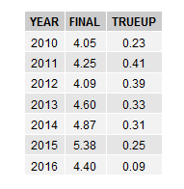
8.2(2)(c)(iv) Other Settlement metrics
NOTE: ERS Final settlement OD data is not represented in graph.
Average percent change

Slide 6
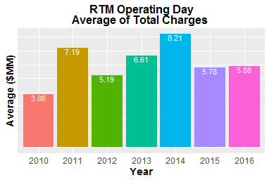
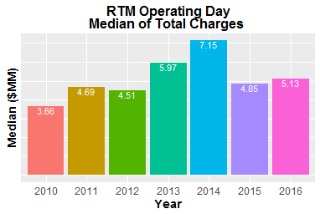
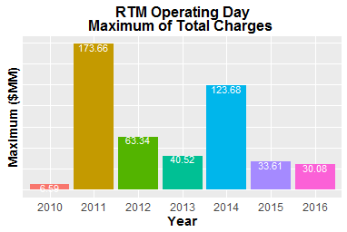
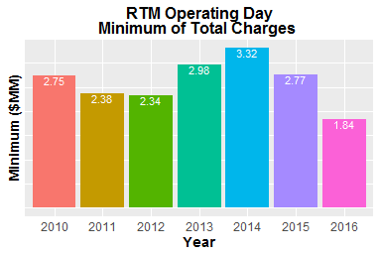
8.2(2)(c)(iv) Other Settlement metrics

Slide 7
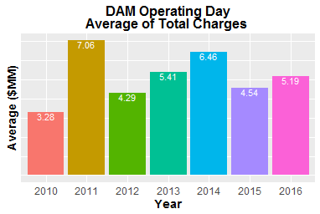
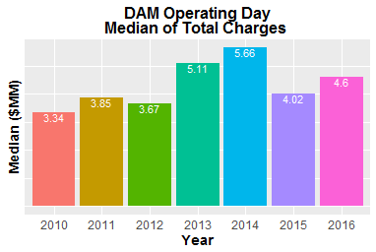
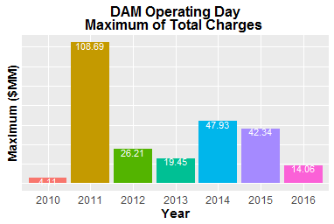
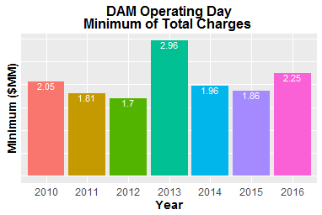
8.2(2)(c)(iv) Other Settlement metrics

Slide 8
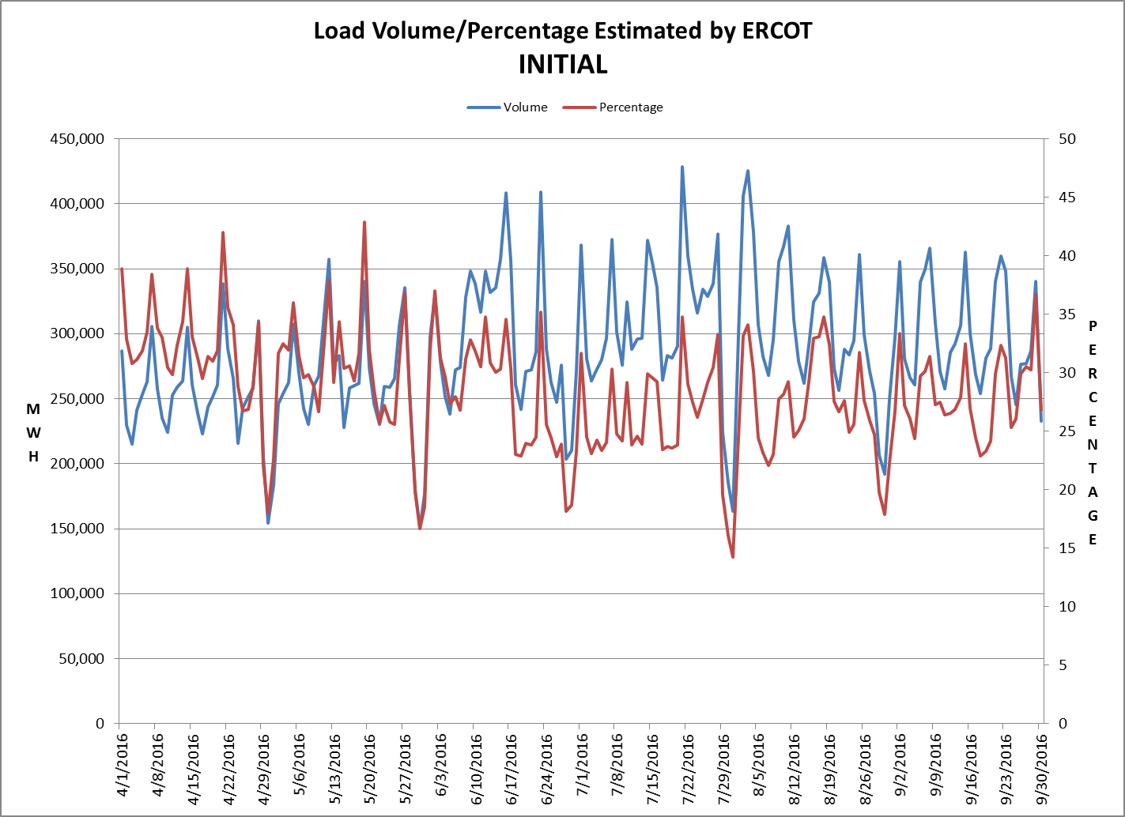
8.2(2)(c)(v) Availability of ESIID consumption data

Slide 9
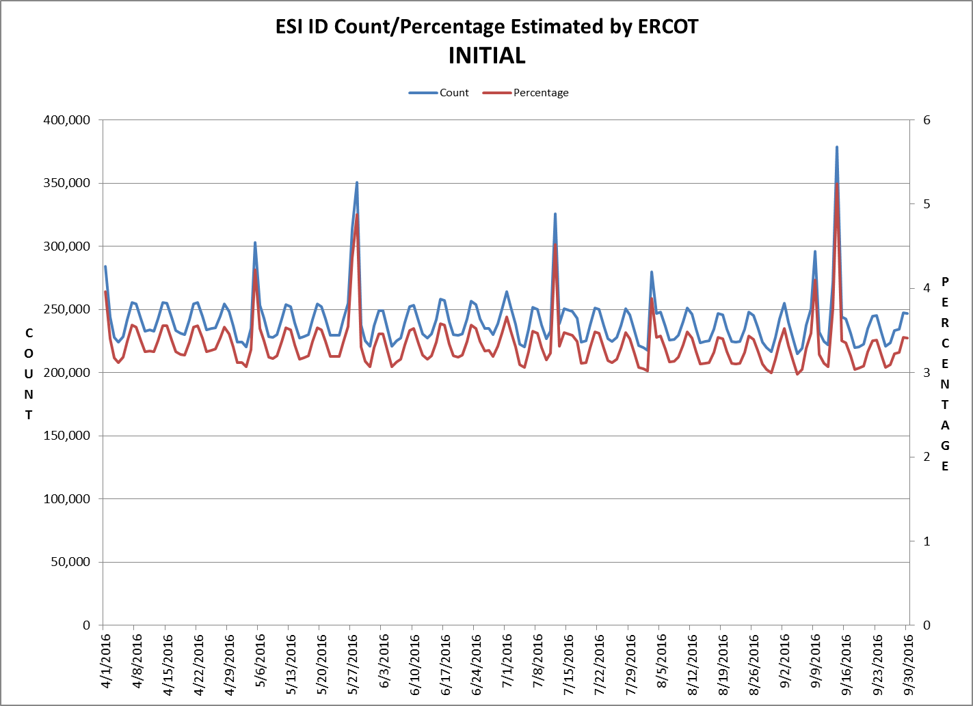
8.2(2)(c)(v) Availability of ESIID consumption data

Slide 10
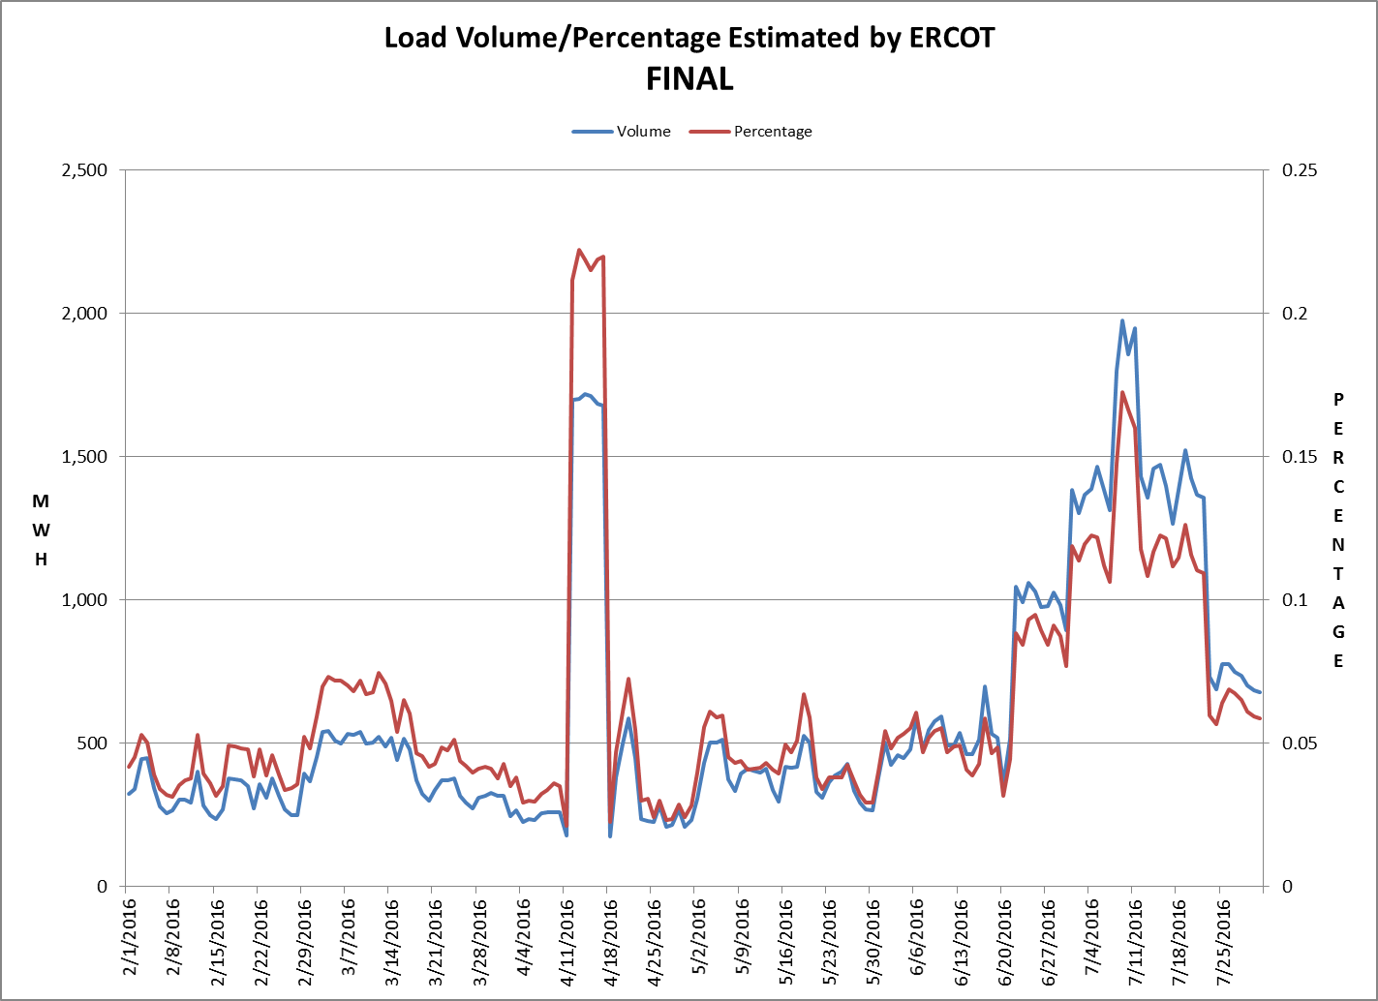
8.2(2)(c)(v) Availability of ESIID consumption data

Slide 11
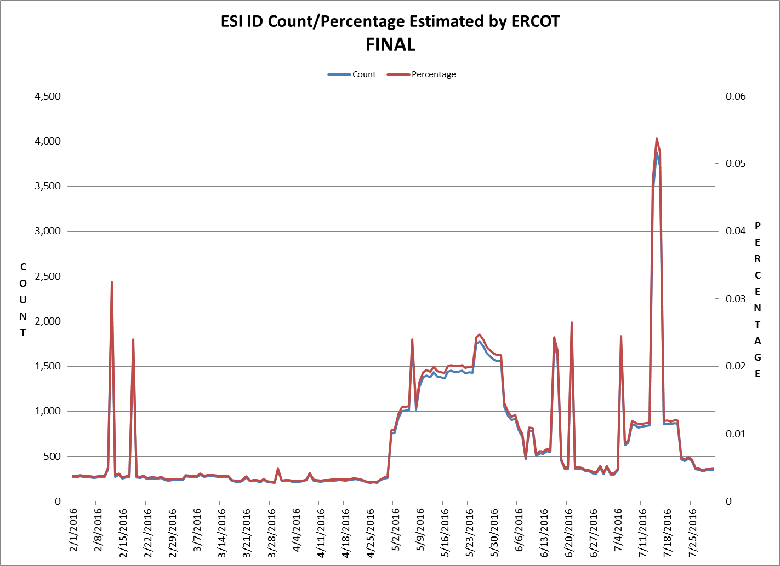
8.2(2)(c)(v) Availability of ESIID consumption data

Slide 12
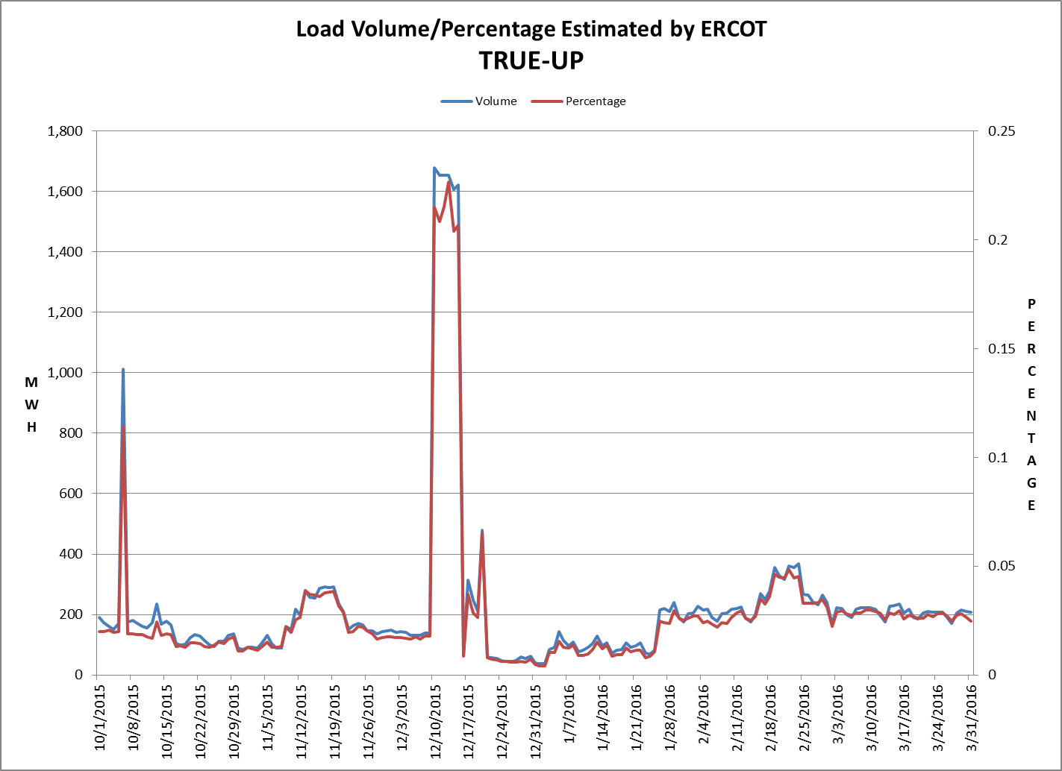
8.2(2)(c)(v) Availability of ESIID consumption data

Slide 13
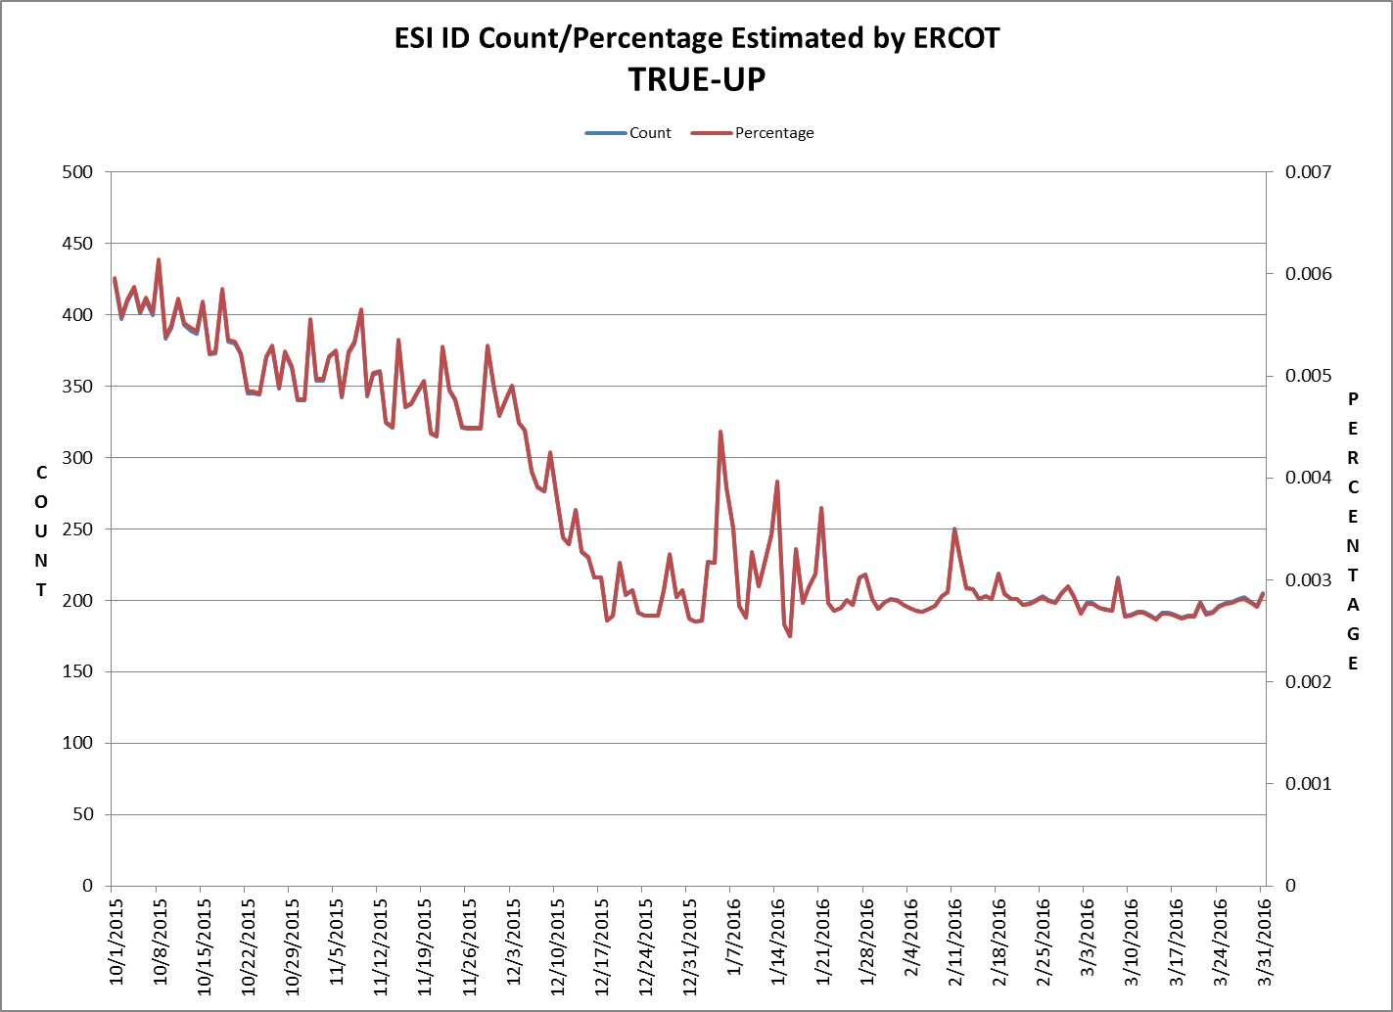
8.2(2)(c)(v) Availability of ESIID consumption data

Slide 14
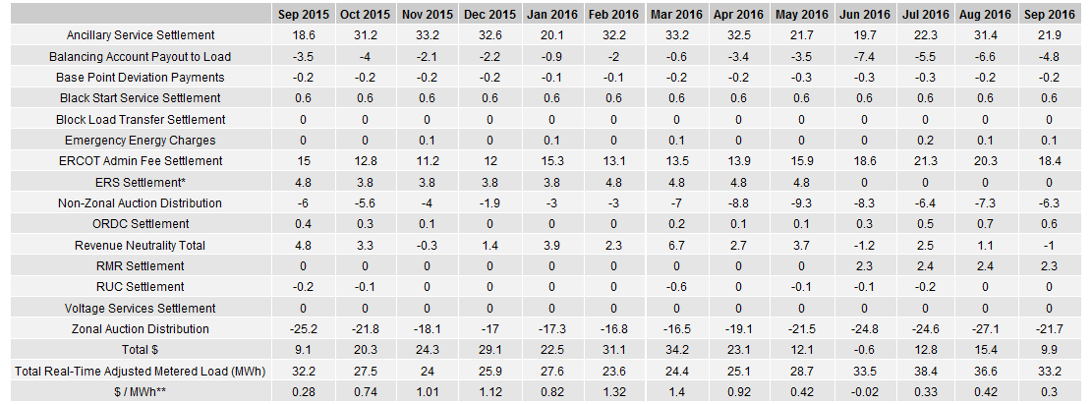
8.2(2)(g) Net Allocation to Load (Board Report)- Totals and $/MWh
NET ALLOCATION TO LOAD (MM)
AUCTION REVENUE PER CONGESTION MANAGEMENT ZONE ($MM)
* The total ERS charges have been evenly allocated across the contract period.
** The $/MWh value as calculated per PR 8.2 (2) g

