Slide 1
SMT Update To AMWG
SEP 2016

Slide 2
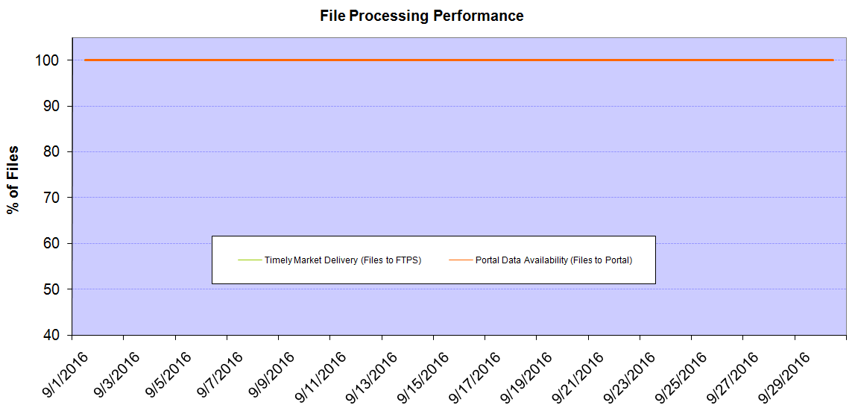
Monthly SMT Data Timelines AMWG CR 2014 002 End to End File Processing Completeness – SEP 2016
% Timely Market Delivery - % of files posted to market (FTPS) by 11:00pm out of # of files received by SMT by 11:00pm.
% Portal Data Availability - % of files loaded to the database for data availability on portal by 6:00am next day for the files received by 11:00pm
* A LSE file includes usage data for up to 50,000 ESIIDs.
Observed Anomalies:
2

Slide 3
SMT API and FTPS Services Availability – SEP 2016
The service availability is measured as a percentage of number of minutes the service was available out of the total number of minutes in a month, excluding planned outages.
Observed Anomalies:
Mar-Apr 2015: SMT outage and subsequent recovery/catch-up impacted API availability. FTPS was available for most of the part except on 03/21-03/22 for 36 hours.
26 Jul 2015: Services were unavailable for 12 hours due to Flash storage issue
25 Jan 2016: Services were unavailable for 19 hours due to storage configuration issue
07 Mar 2016: API Services were unavailable for 7hours due to Oracle archiver issue.
Notes:
3

Slide 4
SMT Number of Accounts by Type AMWG CR 2014 009 – SEPTEMBER 2016
Registered Users | ONC | CNP | AEPN | AEPC | TNMP | TOTAL
Active Residential Accounts | 40327 | 25067 | 1894 | 5471 | 2733 | 75492
Active Residential English Accounts | 40113 | 24877 | 1889 | 5351 | 2722 | 74952
Active Residential Spanish Accounts | 214 | 190 | 5 | 120 | 11 | 540
Non Active Residential Accounts | 19836 | 13500 | 1612 | 3477 | 759 | 38833
Total Residential Accounts | 60163 | 3856 | 3506 | 8948 | 3492 | 114325
TDSP User | 346 | 36 | 12 | 18 | 1 | 413
TDSP Admin | 4 | 4 | 4 | 4 | 3 | 19
Small Business User | 119 | 55 | 1 | 4 | 5 | 184
Small Business Admin | 2696 | 1468 | 78 | 293 | 113 | 4775
Total Agreements (Includes Active and Pending) | 755 | 981 | 2 | 9 | 42 | 1789
Energy Data Agreements (Includes Active and Pending) | 754 | 729 | 2 | 9 | 42 | 1536
Han Device Agreements (Includes Active and Pending) | 0 | 251 | 0 | 0 | 0 | 251
Han Service Agreements (Includes Active and Pending) | 1 | 1 | 0 | 0 | 0 | 2
IN SMT
ESI IDs | 3498159 | 2423672 | 197931 | 859899 | 240405 | 7220066
Meters | 3433567 | 2423619 | 198724 | 860128 | 240102 | 7156140
HAN Devices | 3708 | 4911 | 132 | 290 | 37 | 9078
Acknowledgement | 0 | 0 | 0 | 0 | 0
Pending | 0 | 0 | 0 | 0 | 0
Meter Ready | 6 | 12 | 40 | 113 | 25
Provisioned | 3702 | 4899 | 92 | 177 | 12
HAN Messages (MTD) | 3 | 0 | 0 | 0 | 0 | 3
HAN Messages (YTD) | 20 | 3 | 0 | 0 | 0 | 23
HAN Messages (Cumulative) | 342 | 7400 | 0 | 0 | 0 | 7742
Simple Text Messages | 103 | 2925 | 0 | 0 | 0
Load Control Messages | 100 | 2658 | 0 | 0 | 0
Pricing Messages | 95 | 53 | 0 | 0 | 0
Cancellation Messages | 44 | 1764 | 0 | 0 | 0
Supplemental – (Friends)
Total Agreements | 1736 | 1357 | 75 | 88 | 60 | 3316
Accepted Agreements | 761 | 525 | 33 | 29 | 19 | 1367
Pending Agreements | 2 | 0 | 0 | 1 | 0 | 3
Revoked Agreements | 256 | 259 | 10 | 8 | 6 | 539
Expired Agreements | 684 | 544 | 30 | 50 | 35 | 1343
Terminated Agreements | 33 | 29 | 2 | 0 | 0 | 64
 | TDSPs | REP | Small Business | Regulatory | Third Party
Registered Entities | 5 | 112 | 4635 | 2 | 105
Registered Users | 413 | 983 | 184 | 8 | 23
Registered Admins | 19 | 179 | 4648 | 4 | 112
HAN Messages Sent By | 335 | 7383

Slide 5
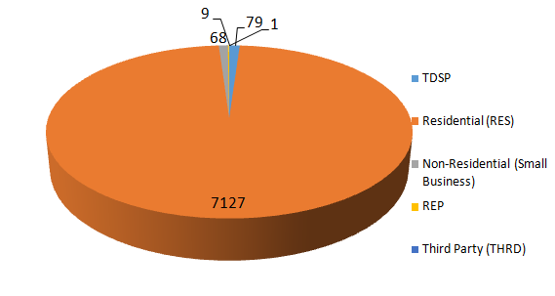
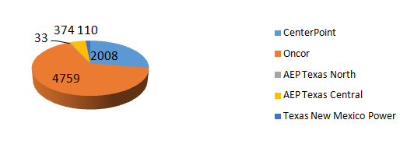
SMT ODR Details – SEP 2016
Total ODR Requests TDSP wise statistics:
Total ODR Requests User type statistics:

