Slide 1
PDCWG Report to ROS
Chair: Percy Galliguez, Brazos Electric Power Cooperative, Inc.
Vice Chair: Stewart Rake, Luminant
ROS
October 6th, 2016

Slide 2
Report Overview & Notes
Report Overview
  Meeting Minutes
  BAL-001-TRE-1 FMEs & IMFR
    1 FME in the month of September
    BAL-001-TRE-1 Unit Performance Report now includes Solar resources.
  Frequency Control Report

Slide 3
Meeting Minutes
PDCWG Meeting 9/14/16
  Regulation & Frequency Control Reports
  GREDP Performance Analysis
  MOD-026-1 & MOD-027-1 Discussion
    NPRR Proposal/Review
  Time Error Correction & BAL-001-TRE-1 Performance
  Telemetry Differences in BAL-001-TRE-1 Evaluation
  Reviewed Frequency Events
    7/24/2016 16:22:56
      Loss of 547MW
      558 MW/0.1HZ Response
      4 of 42 Generation Resources providing RRS had less than 75% of their expected Initial Primary Frequency Response.
      0 of 42 Generation Resources providing RRS had less than 75% of their expected Sustained Primary Frequency Response
    7/25/2016 16:45:54
      Loss of 733MW
      873 MW/0.1HZ Response
      2 of 41 Generation Resources providing RRS had less than 75% of their expected Initial Primary Frequency Response.
      1 of 41 Generation Resources providing RRS had less than 75% of their expected Sustained Primary Frequency Response
To be reviewed at the next PDCWG meeting

Slide 4
Meeting Minutes (cont.)
  Reviewed Frequency Events
    8/2/2016 18:37:36
      Loss of 526MW
      822 MW/0.1HZ Response
      5 of 50 Generation Resources providing RRS had less than 75% of their expected Initial Primary Frequency Response.
      1 of 50 Generation Resources providing RRS had less than 75% of their expected Sustained Primary Frequency Response
    8/15/2016 19:39:40
      Loss of 856MW
      940 MW/0.1HZ Response
      0 of 40 Generation Resources providing RRS had less than 75% of their expected Initial Primary Frequency Response.
      0 of 40 Generation Resources providing RRS had less than 75% of their expected Sustained Primary Frequency Response
    8/23/2016 18:05:20 (non-FME)
      Loss of -518MW
      678 MW/0.1HZ Response
To be reviewed at the next PDCWG meeting

Slide 5
Frequency Measurable Events Performance
September 2016

Slide 6
Frequency Measurable Events
There was 1 FME in September.
  9/8/2016 13:22:56
    Loss of 582 MW
    Interconnection Frequency Response: 746 MW/0.1 Hz
    10 of 40 Evaluated Generation Resources had less than 75% of their expected Initial Primary Frequency Response.
    10 of 40 Evaluated Generation Resources had less than 75% of their expected Sustained Primary Frequency Response.

Slide 7
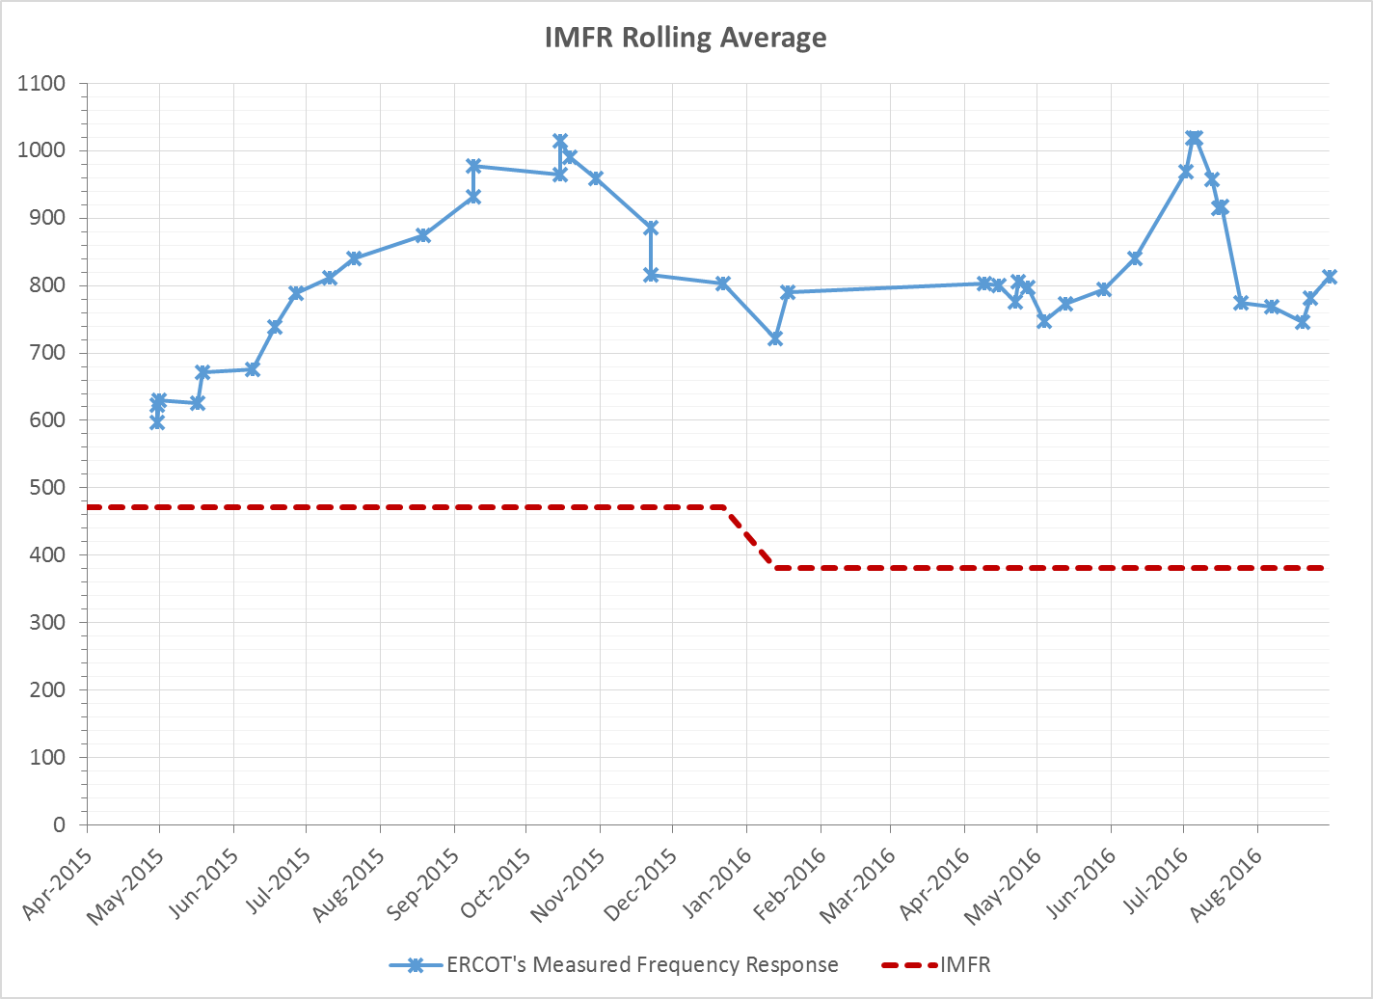
Interconnection Minimum Frequency Response (IMFR) Performance
IMFR Performance currently 812.25 MW/0.1Hz

Slide 8
Frequency Control Report
September 2016

Slide 9
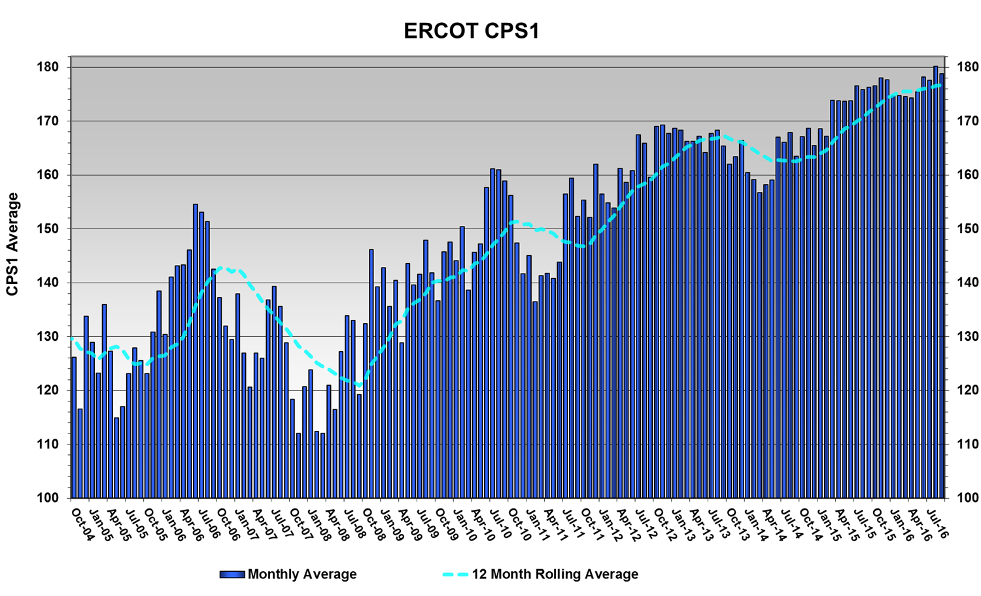
CPS1 Performance
CPS1 12 Month Rolling Average = 176.75%

Slide 10
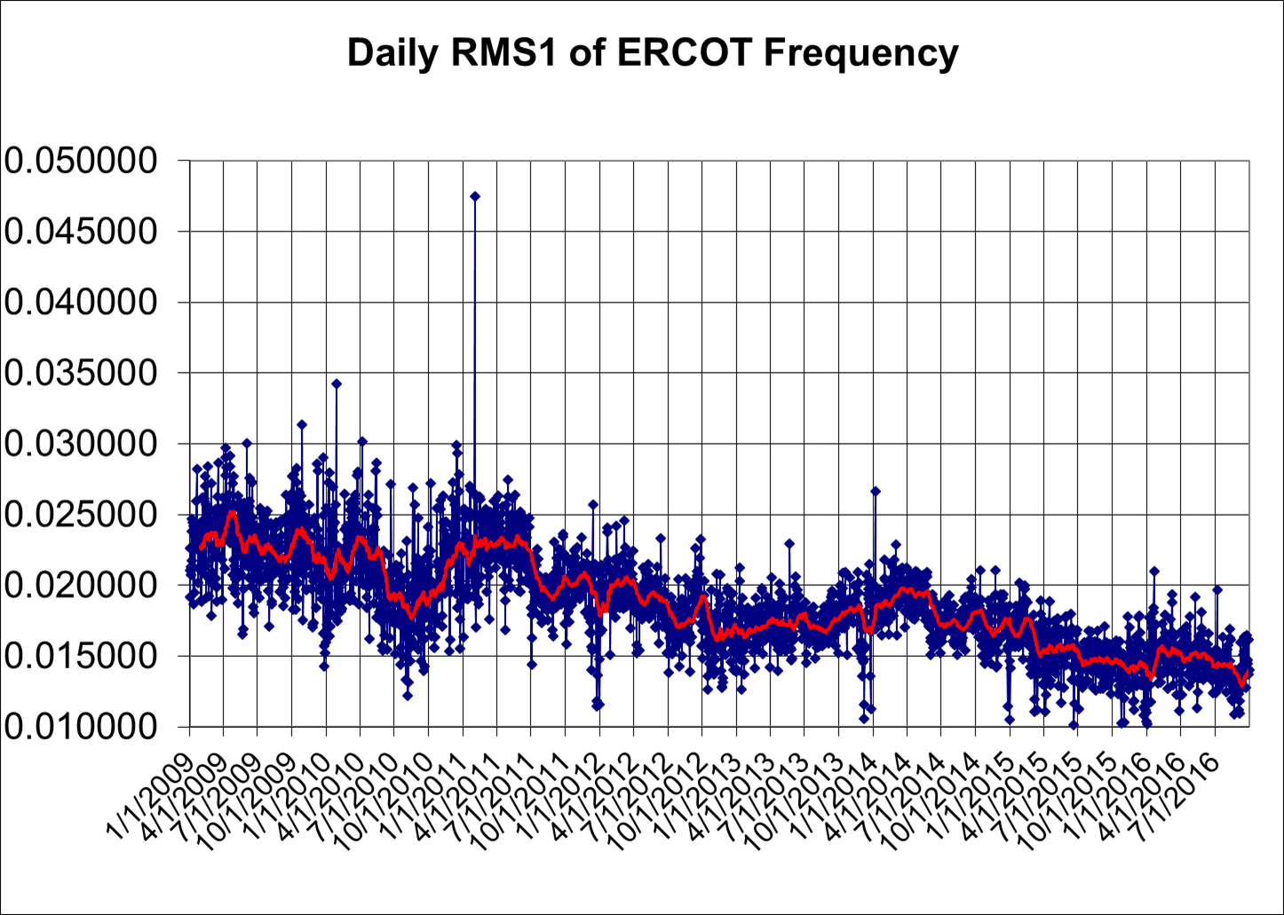
RMS1 Performance of ERCOT Frequency

Slide 11
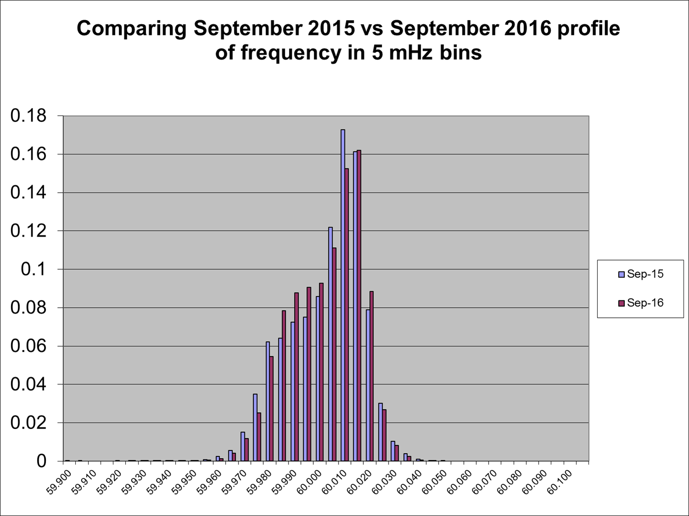
Frequency Profile Analysis
Year | Low Side (<60Hz) | High Side (>60Hz)
2015 | 173.87 | 178.00
2016 | 175.76 | 181.26
Year | Mean | Standard Deviation
2015 | 60.00010 | 0.016091
2016 | 59.99997 | 0.015385

Slide 12
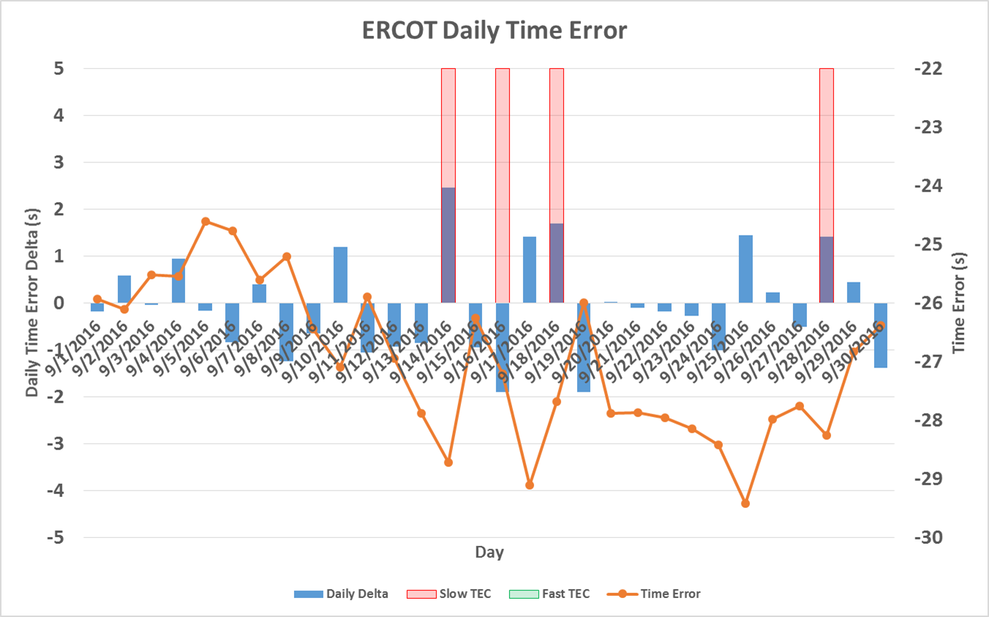
Time Error Corrections
There were 5 Time Error Corrections (TEC) in July.

Slide 13
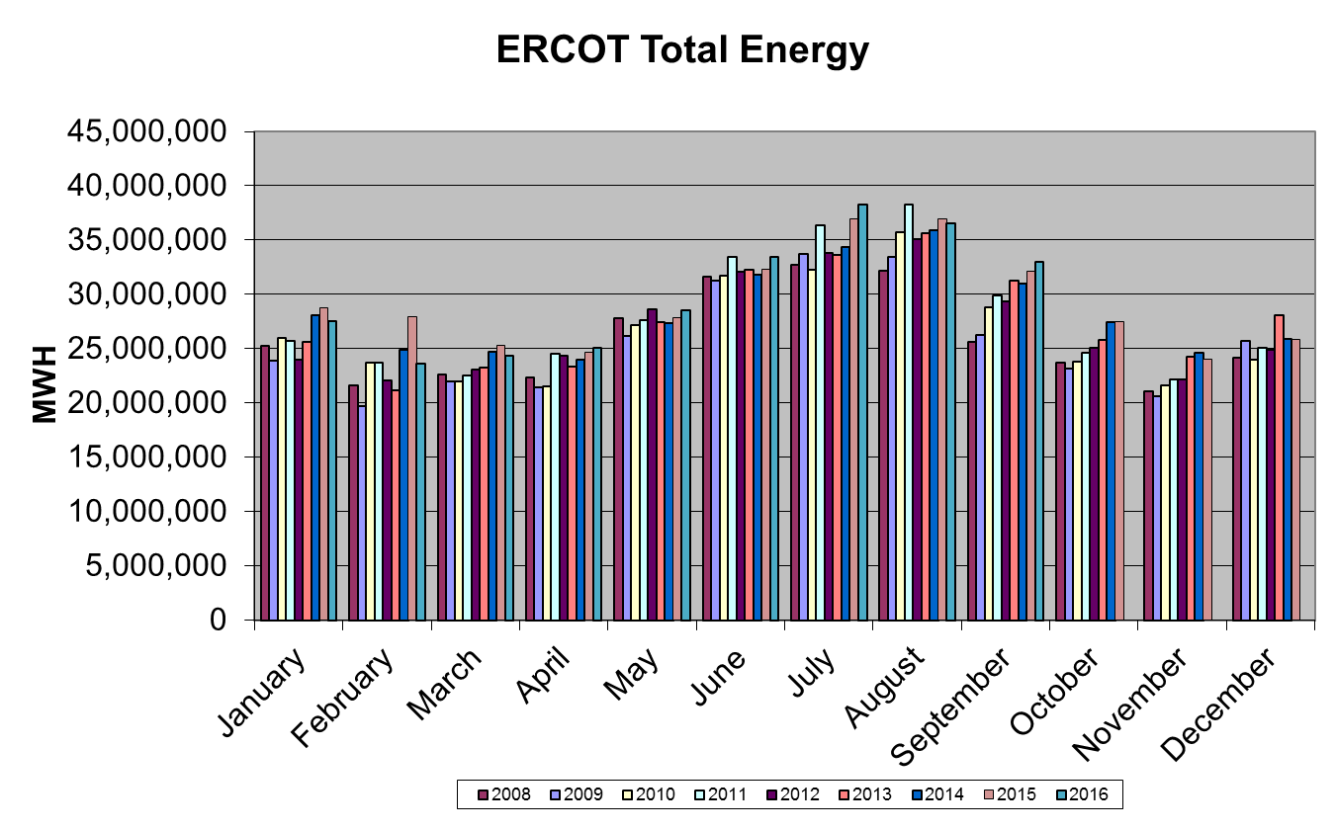
Wind Generation Performance

Slide 14
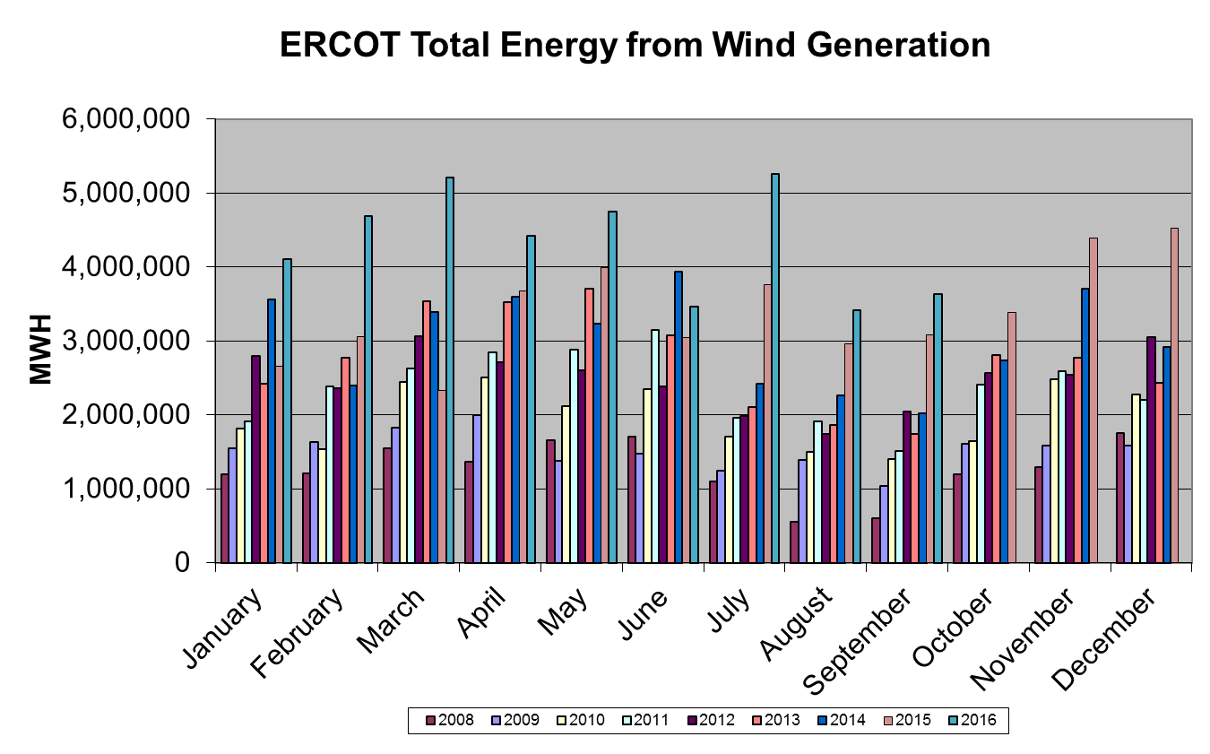
Wind Generation Performance

Slide 15
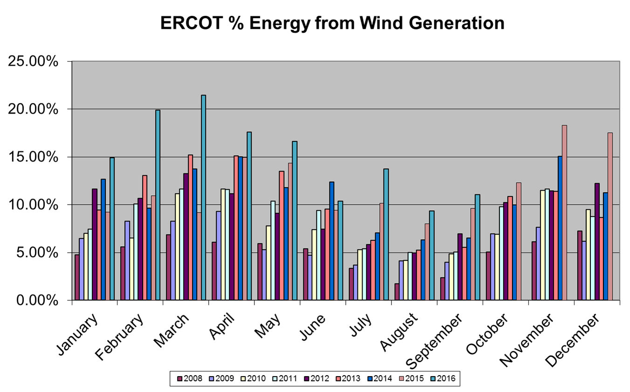
Wind Generation Performance

Slide 16
Questions?

