Slide 1
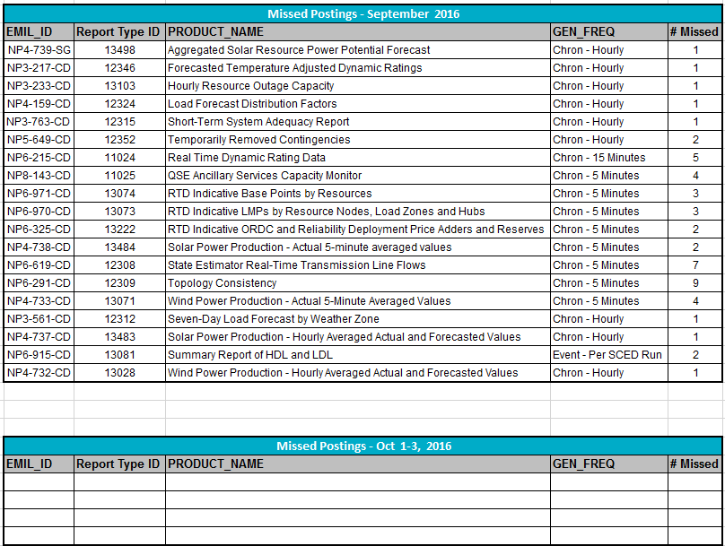
Missed Postings September 2016 through October 3, 2016: Summary

Slide 2
Missed Postings September 2016: Detail

Slide 3
Missed Postings October 1-3, 2016 : Detail (none to date)

