Slide 1
Inertia Background
Dan Woodfin
Director, System Operations
ROS
ERCOT Public
October 6, 2016

Slide 2
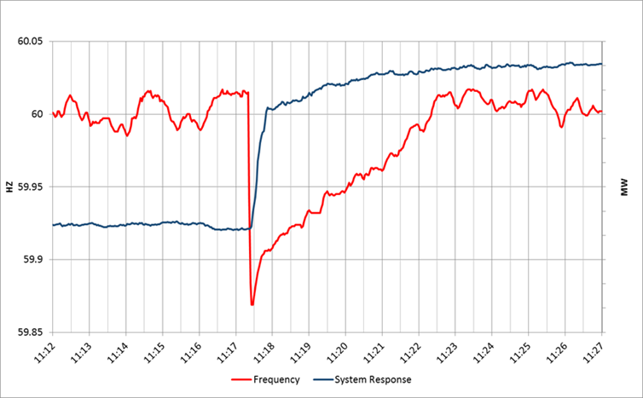
System Response following a Unit Trip

Slide 3
Background Facts
Only synchronous machines provide inertia to the system
Everything else provides a response, but does not provide system inertia

Slide 4
Inertial Effect
Initial rate of change of frequency (RoCoF) prior to any resource response is solely a function of inertia

Slide 5
Inertial Effect
Slope of the RoCoF line changes due to resources’ response

Slide 6
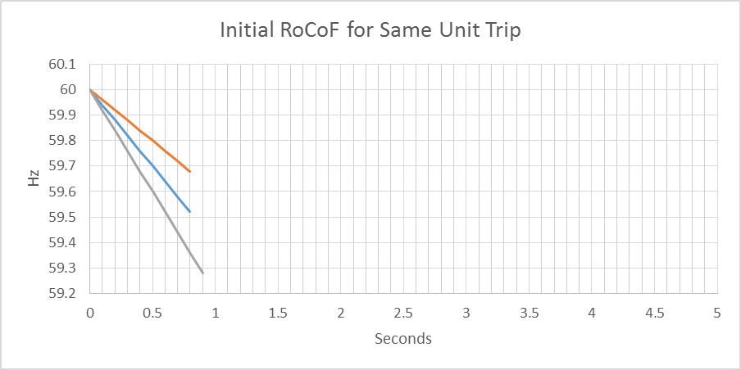
Inertial Effect
Higher Inertia
Lower Inertia

Slide 7
Frequency Response Times
Load Resources (LR) providing RRS have underfrequency relays that respond in about 0.5s after the frequency drops below the trigger level (currently 59.7Hz)
Governors of thermal generating units begin to respond “immediately” but will take a few seconds to provide significant response (requires more steam or more combustion)

Slide 8
Response Time Definitions
Early – response is triggered earlier after the unit trip (e.g. a Resource that triggers at 59.8Hz would respond earlier than a Resource that triggers at 59.7Hz, all else equal)
Fast – response is delivered faster after the unit trip (e.g. a Resource that trips within 15 cycles is faster than one that trips within 30 cycles)

Slide 9
Design Criteria
Underfrequency Load Shed (UFLS) relays will shed firm load if frequency drops to 59.3 Hz (5% of total ERCOT load)
To consistently meet BAL-003 Interconnection Frequency Response Obligation, ERCOT must plan not to activate UFLS for the simultaneous trip of the two STP units

Slide 10
Two Inertia Issues to be Considered
Must maintain at least a Critical Inertia Level that is based on the current operation practices and characteristics of frequency responsive resources
As inertia approaches critical level, RRS requirements increase exponentially
Will discuss these on next few slides

Slide 11
Critical Inertia Concept
The level of inertia which causes the frequency to drop below the UFLS trigger before the “fastest” resources can provide sufficient frequency response (for the two STP trip) is the “Critical Inertia”
0.4 Hz
0.5 s

Slide 12
Critical Inertia
Currently, the Critical Inertia Level for ERCOT appears to be around 100 GW-s (based on current operations and response characteristics of current resources)
  Simulation results have shown that this is level at which RoCoF is high enough that frequency would drop below 59.3 HZ for the two STP trip
  Simulation results have also shown wide-area voltage oscillations at inertia below this level; this is a separate but somewhat related issue as identified in the Panhandle region as weak grid

Slide 13
Solutions to Maintain Critical Level of Inertia
Bring synchronous units with sufficient inertia online
Lower the critical level of inertia by having “earlier” or “faster” frequency response resources
  Although these resources may not help with voltage oscillation issue if they do not also provide system strength

Slide 14
Impact of Resource Types on Low Inertia Issues
Load Resources help to lower the Critical Inertia Level (but do not provide inertia to meet that requirement once it is set) and reduce the quantity of RRS needed as inertia approaches critical level (fast MW/s)
  Separating LRs so that some respond “earlier” (at 59.8Hz, e.g.) could provide additional improvement
  Moving some LRs to respond faster than 0.5s. Could also provide improvement
Synchronous Generators provide inertia
  Also produce a minimum amount of power; committing additional generation to provide inertia or RRS during low inertia periods will negatively affect RT market
  Different generators have different inertia; committing different synchronous generators could provide higher inertia while minimally affecting RT market prices
Synchronous Condensers provide inertia that needs to be included in calculation of inertia on system and may already be needed to resolve system strength issues; do not inject uneconomic MW into market
“Synthetic Inertia” from inverter-based resources may help lower Critical Inertia Level because of faster response (but do not provide inertia to meet that requirement once it is set)

Slide 15
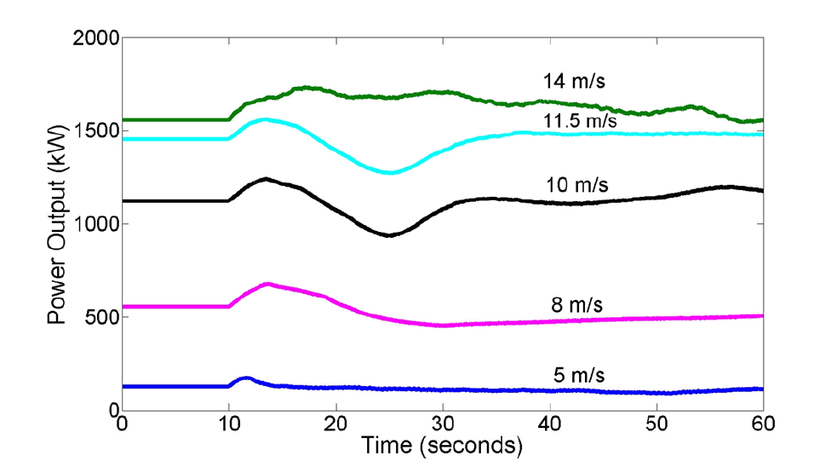
Synthetic Inertia (GE)
Source: Damian Flynn, Lisa Ruttledge University College Dublin & Energy Research Centre

Slide 16
Increasing RRS as Inertia Approaches Critical
Other studies have shown that the amount of RRS (if all provided by gen) required goes up asymptotically as inertia approaches the critical level

Slide 17
Solutions to Mitigate Near-Crit. Inertia RRS Need
Procure RRS from earlier and/or faster responding resources
Procure RRS from resources having relatively more inertia
Distribute RRS across a larger number of generators (results in faster aggregate response)

Slide 18
Example: LRs Reduce Low Inertia RRS MW Need
 | Case1 | Case2 | Case3 | Case4 | Case5 | Case6 | Case7 | Case8 | Case9 | Case10 | Case11 | Case12 | Case13
FFR/PFR | 2.35:1 | 2.2:1 | 2.0:1 | 1.5:1 | 1.4:1 | 1.3:1 | 1.25:1 | 1.13 :1 | 1.08:1 | 1.0:1 | 1.0:1 | 1.0:1 | 1.0:1
Netload(GW) | 10-15 | 15-20 | 15-20 | 20-25 | 25-30 | 30-35 | 35-40 | 40-45 | 45-50 | 50-55 | 55-60 | 60-65 | 60-65
Inertia (GW∙s) | 100 | 120 | 136 | 152 | 177 | 202 | 230 | 256 | 278 | 297 | 316 | 332 | 350
PFR Requirement (no FFR) | 7350 | 5200 | 4700 | 3750 | 3370 | 3100 | 3040 | 2640 | 2640 | 2240 | 2280 | 2140 | 2140
 | Case1 | Case2 | Case3 | Case4 | Case5 | Case6 | Case7 | Case8 | Case9 | Case10 | Case11 | Case12 | Case13
FFR/PFR | 2.35:1 | 2.2:1 | 2.0:1 | 1.5:1 | 1.4:1 | 1.3:1 | 1.25:1 | 1.13 :1 | 1.08:1 | 1.0:1 | 1.0:1 | 1.0:1 | 1.0:1
PFR Min | 1240 | 1240 | 1240 | 1240 | 1240 | 1240 | 1240 | 1240 | 1240 | 1240 | 1240 | 1240 | 1240
FFR needed with PFR min | 2600 | 1800 | 1696 | 1641 | 1511 | 1431 | 1440 | 1239 | 1296 | 1000 | 1040 | 900 | 900
Combined Total | 3840 | 3040 | 2936 | 2881 | 2751 | 2671 | 2680 | 2479 | 2536 | 2240 | 2280 | 2140 | 2140

Slide 19
Representative Inertia by Unit Type

Slide 20
Number of Governors Supplying RRS
12 Governors

Slide 21
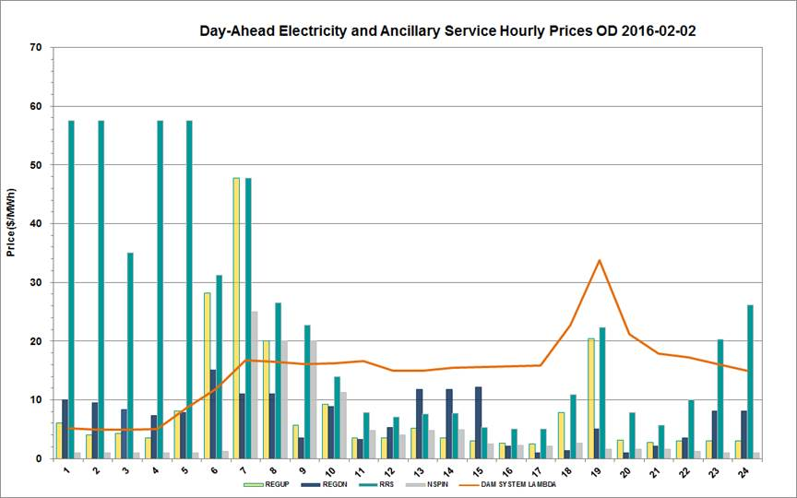
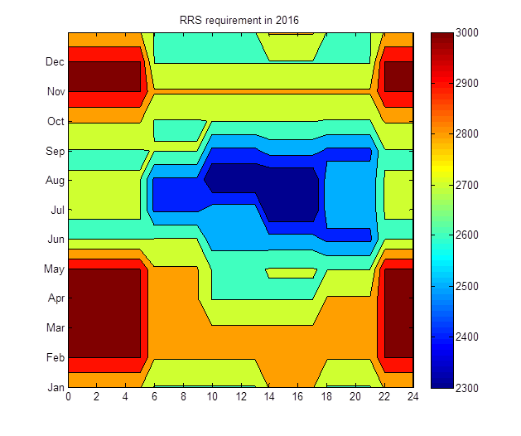
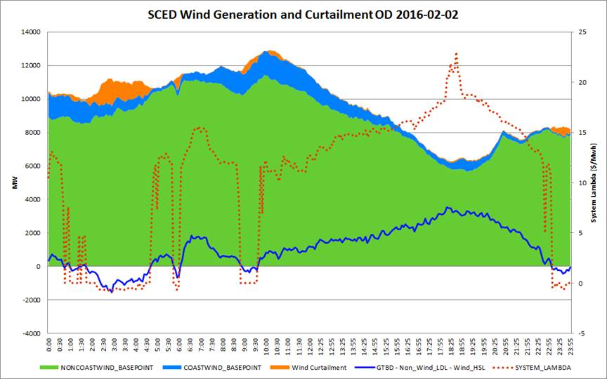
Higher Commitment during Low Inertia Periods

Slide 22
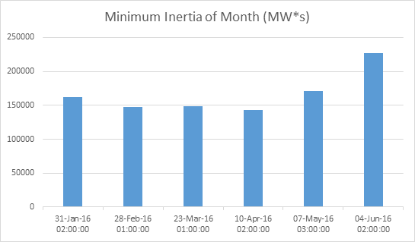
Minimum Inertia by Month

Slide 23
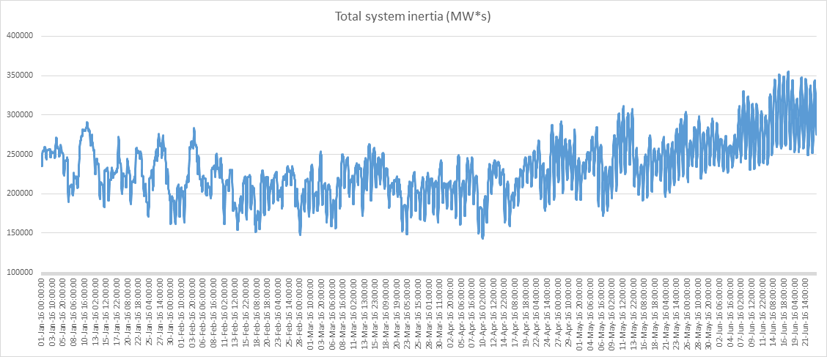
Inertia over time

Slide 24
Inertia in April 2016 by Unit Type

Slide 25
Questions?

