Slide 1
PLWG Report to ROS
October 6, 2016

Slide 2
Topics
PGRR051, Alignment with NPRR792, Changing Special Protection System (SPS) to Remedial Action Scheme (RAS) (Vote)
NPRR759, Segmentation of the Total New Capacity Estimate in the ERCOT CDR (Vote)
ALDR 2016 Process

Slide 3
PGRR051, Alignment with NPRR792, Changing Special Protection System (SPS) to Remedial Action Scheme (RAS) (Vote)
Alignment with NPRR792
NPRR792 was reviewed by ROS in August
PGRR changes are administrative
Changes term “Special Protection System” to “Remedial Action Scheme”
Introduces a reference to the term “Automatic Mitigation Plan”

Slide 4
NPRR759, Segmentation of the Total New Capacity Estimate in the ERCOT CDR (Vote)
PLWG recommended a change to the CDR to make it easier for market participants to reconcile CDR to the generating capacity available in the SSWG power flow cases
The contents of the CDR are defined by ERCOT Protocols
ROS authorized PLWG to submit an NPRR that would introduce two new lines to the CDR to clearly identify planned generation meeting all Planning Guide Section 6.9 requirements
SAWG and ERCOT proposes to add a tab to the CDR that removes the need for the NPRR

Slide 5
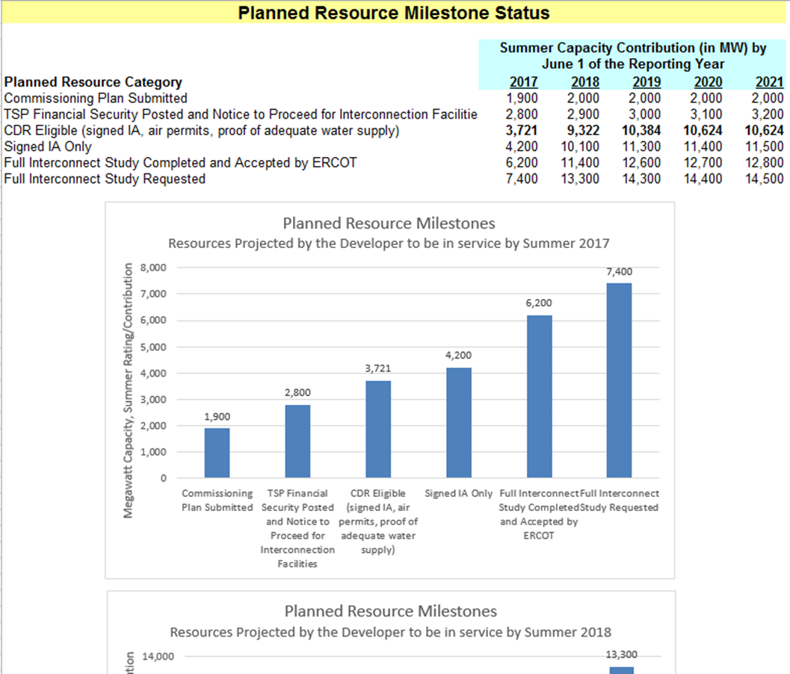
NPRR759, Segmentation of the Total New Capacity Estimate in the ERCOT CDR (Vote)
WMS asked ROS to withdraw NPRR759
PLWG reviewed the proposed addition (shown to the right)
Suggested that ERCOT provide a row that indicated the “Capacity Available for Planning.”
ERCOT agreed
Options
  Withdraw now
  Wait for revised CDR report then withdraw
Sample

Slide 6
2016 ALDR Process
PLWG participants asked PLWG to consider providing oversight to the ALDR
ERCOT asked PLWG what oversight it wanted
  Data form / instructions review, updates and approval
  Issue resolution
  Data request schedule
  ALDR training
Providing oversight to the ALDR process is not in PLWG Charter
Possible options
  Add a Planning Guide requirement
  Revise Charter
  Other as directed/suggested by ROS

Slide 7
Other Updates
Stability Issues Identified during FIS --
Process/Impact on Generic Transmission Constraints
  Two PGRRs Submitted
  One PGRR and one NPRR under development

Slide 8
the end

