Slide 1
Emergency Response Service Baselines
Carl L Raish
Principal Load Profiling and Modeling

Slide 2
ERS Resource Identification
Drop-by baseline options
  Mid 8-of-10 (M810) – average of 10 most recent days of same day-type excluding the highest and lowest
  Matching-Day-Pair (MDP - A variation of a proxy day routine)
    Finds and average of 10 best fitting pairs of non-event days of the same day-type based on intervals for the prior day and up to one hour before the event on the event day
  Regression (REG) – three stage models are estimated
    Daily energy, hourly fraction, 15-minute interval models
    Based on weather, calendar, sunrise/sunset
  Meter-Before-Meter-After* (MBMA) – specific for Loads with flat load shapes
    Baseline is the first full interval prior to the dispatch instruction
  Nearest 20 Like Days* (Near20) – already in use for Alternate baseline loads for fleet/QSE portfolio performance
    Average of the 20 days occurring closest to the event that have the same day-type as the event day
  Control group (Residential only)
    Random sample of sites in the Load are selected by ERCOT and withheld from deployment
    Load must be large enough to meet its obligation with the deployed sites

Slide 3
ERS Resource Identification
Day-of-Adjustment
  Applicable to
    Mid 8-of-10 Like Days
    Matching Day Pair
    Regression
    Near 20 Like Days
  Scalar adjustment based on ratio of actual kWh to baseline kWh for the two-hour window beginning three hours before the dispatch instruction
  Baseline is multiplied by the scalar adjustment factor

Slide 4
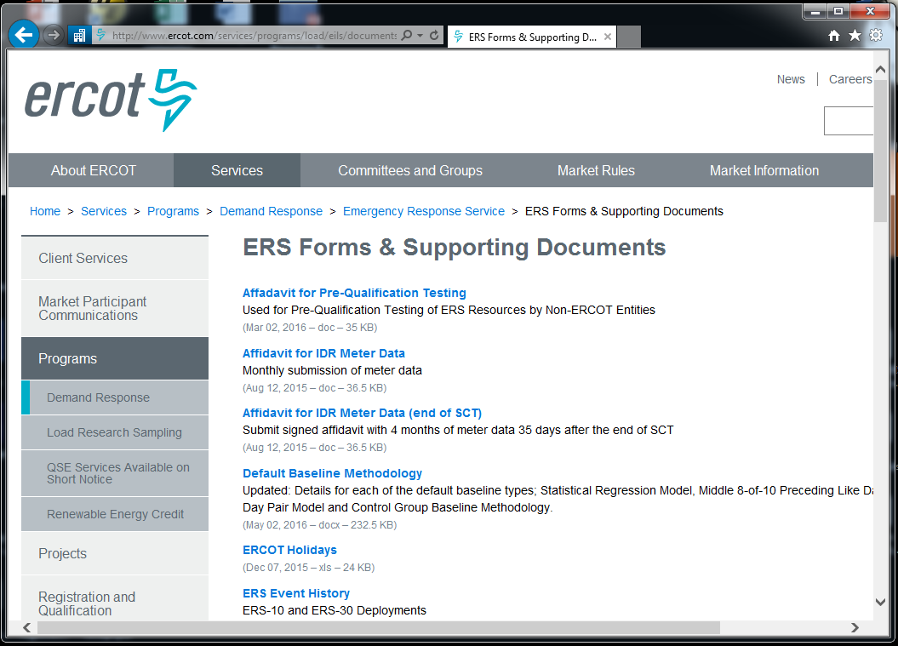
ERS Resource Identification

Slide 5
ERS Baseline Analysis
Historical interval data required to qualify for a default baseline
  Regression – 270 days
  M810, MDP, MBMA, Near20 6 months
  Control group – none
ERCOT simulates consecutive 2-hour events for the submitter-selected time-periods across all available historical interval data
Applies baseline methodology (including day-of-adjustment) for each simulated event
Compares baseline interval estimates to actuals and computes “goodness-of-fit statistics” (R², MAPE, Mean Difference, 90th, 95th and 99th percentile differences)
Alternate baseline is always available as a choice

Slide 6
ERS Baseline Ranking
Ranking algorithm used to select the “best” baseline method(s) from among the available choices
  Head-to-head scoring between all combinations of pairs of baselines … low score wins
    R²
      If the difference for a pair of baselines > 3% then the baseline with the lower R² gets one point; otherwise
      both baselines get 0.5 point
    MAPE
      If the difference for a pair of baselines > 2% then the baseline with the higher MAPE gets one point; otherwise
      both baselines get 0.5 point
    Bias (Absolute Value of Mean percent Difference)
      If the difference for a pair of baselines > 2% then the baseline with the higher bias gets one point; otherwise
      both baselines get 0.5 point
    95th Percentile Percent Difference as Percent of Average Load
      If the difference for a pair of baselines > 2% then the baseline with the higher difference gets one point; otherwise
      both baselines get 0.5 point
  If the MAPE for a baseline > 20% or the bias > 5% the baseline is given score of 24
  Baseline(s) with lowest score (or tied with the lowest score) allowed as choice(s)
  If all baselines scores are 24, only the Alternate baseline option is allowed

Slide 7
ERCOT Baseline Usage
Results from October 2016 – January 2017 Resource Identification Process
Site-level Baseline Qualification
Site-level Baseline Qualification History

Slide 8
ERCOT Baseline Usage
Results from October 2016 – January 2017 Resource Identification Process
Resource-level Baseline Qualification
Resource-level Baseline Qualification History

Slide 9
ERCOT Baseline Usage
Results from June – September 2016 procurement

Slide 10
ERCOT Baseline Usage
Results from October – January 2017 procurement

Slide 11
ERCOT Control Group Methodology
Pre-stratify resource customers on average summer day use
  4 Strata with boundaries at 55, 75, and 100 kWh / day
  Proportional allocation of control group sites to strata
  Typically select 2 separate control groups per month … one to use for first half of a month and the other for the second half
  Expand control group to deployment group level to check accuracy
    Use Combined ratio estimation
    Compare control group estimates to deployment actuals for summer week days noon – 8:00 pm
Evaluation of test/event performance
  Post-stratify based on customer’s kWh consumption for previous 24-hour period (noon on day before to noon on day of test/event)
  3 Strata with boundaries at 80 and 120 kWh / day
  Use combined ratio estimation for expansion
  Note: the post-stratification expansion also is checked for accuracy at the time of control group design and selection
  Use of both the pre- and post-stratification process improves baseline accuracy

Slide 12
Control Group Accuracy – Premise Load
Control group accuracy depends on the size of both the control and deployment groups
Graphs are based on average accuracy across 20 independently selected control groups

Slide 13
Control Group Accuracy – Load Reduction

Slide 14
Residential Aggregation – Regression Baseline
ERID Statistics
  Initial Sites - 2,564
Event Statistics
  Residential Sites - 2,273
  Average MW reduction - 1.00
  MAPE – 4.2%
  R² – 98.8%
Midnight to noon

Slide 15
Commercial Aggregation – Regression Baseline
ERID Statistics
  Initial Sites - 143
Event Statistics (Excluding 4 hours around event)
  Commercial sites - 230
  Average MW reduction - 0.35
  MAPE – 2.7%
  R² – 99.9%
Midnight to noon

Slide 16
Residential Aggregation – Control Group
ERID Statistics
  Initial Sites - 8,250
Event Statistics
  Deployed sites - 10,016
  Control Group – 1,000
  Average MW reduction – 17.2
  MAPE – 2.0%
  R² – 99.8%
Midnight to noon

Slide 17
Questions?
ON
OFF
craish@ercot.com 512/248-3876

