Slide 1
October 2016 – January 2017 SCT ERS Procurement Update to DSWG
Mark Patterson
September 23, 2016

Slide 2
Time Period 1 Procurement - Oct16Jan17
Clearing Price: $17.63
MW Procured: 845.701
MW Not Procured: .45
Resources Procured: 376
Resources Not Procured: 4
Expenditure Limit | $3,795,438.22
Amount Spent | $3,667,788.32
Unspent | $127,649.89
 | NWS ERS-10 | NWS ERS-30 | WS ERS-30
MW Procured | 299.408 | 544.383 | 1.91
ERS Generators (Resources) Procured | 9 | 14 | 0
Number of Resources Procured | 133 | 243 | 2

Slide 3
Time Period 2 Procurement - Oct16Jan17
Clearing Price: $6.32
MW Procured: 895.854
MW Not Procured: .95
Resources Procured: 442
Resources Not Procured: 4
Expenditure Limit | $2,372,148.89
Amount Spent | $2,321,336.88
Unspent | $50,812.00
 | NWS ERS-10 | NWS ERS-30
MW Procured | 309.348 | 586.506
ERS Generators (Resources) Procured | 9 | 14
Number of Resources Procured | 146 | 296

Slide 4
Time Period 3 Procurement - Oct16Jan17
Clearing Price: $2.07
MW Procured: 881.777
MW Not Procured: 5.1
Resources Procured: 444
Resources Not Procured: 7
Expenditure Limit | $474,429.78
Amount Spent | $449,018.48
Unspent | $25,411.29
 | NWS ERS-10 | NWS ERS-30 | WS ERS-30
MW Procured | 307.197 | 572.900 | 1.68
ERS Generators (Resources) Procured | 9 | 14 | 0
Number of Resources Procured | 145 | 297 | 2

Slide 5
Time Period 4 Procurement - Oct16Jan17
Clearing Price: $17.14
MW Procured: 866.347
MW Not Procured: 0.3
Resources Procured: 415
Resources Not Procured: 2
Expenditure Limit | $3,795,438.22
Amount Spent | $3,652,900.14
Unspent | $142,538.07
 | NWS ERS-10 | NWS ERS-30 | WS ERS-30
MW Procured | 301.417 | 562.770 | 2.16
ERS Generators (Resources) Procured | 9 | 14 | 0
Number of Resources Procured | 141 | 272 | 2

Slide 6
Time Period 5 Procurement - Oct16Jan17
Clearing Price: $18.26
MW Procured: 837.853
MW Not Procured: .35
Resources Procured: 359
Resources Not Procured: 3
Expenditure Limit | $3,795,438.22
Amount Spent | $3,763,602.16
Unspent | $31,836.06
 | NWS ERS-10 | NWS ERS-30
MW Procured | 297.547 | 540.306
ERS Generators (Resources) Procured | 9 | 14
Number of Resources Procured | 131 | 228

Slide 7
Time Period 6 Procurement - Oct16Jan17
Clearing Price: $2.52
MW Procured: 749.780
MW Not Procured: 3
Resources Procured: 324
Resources Not Procured: 6
Expenditure Limit | $3,006,650.50
Amount Spent | $2,945,645.69
Unspent | $61,004.81
 | NWS ERS-10 | NWS ERS-30
MW Procured | 270.698 | 479.082
ERS Generators (Resources) Procured | 9 | 14
Number of Resources Procured | 121 | 195

Slide 8
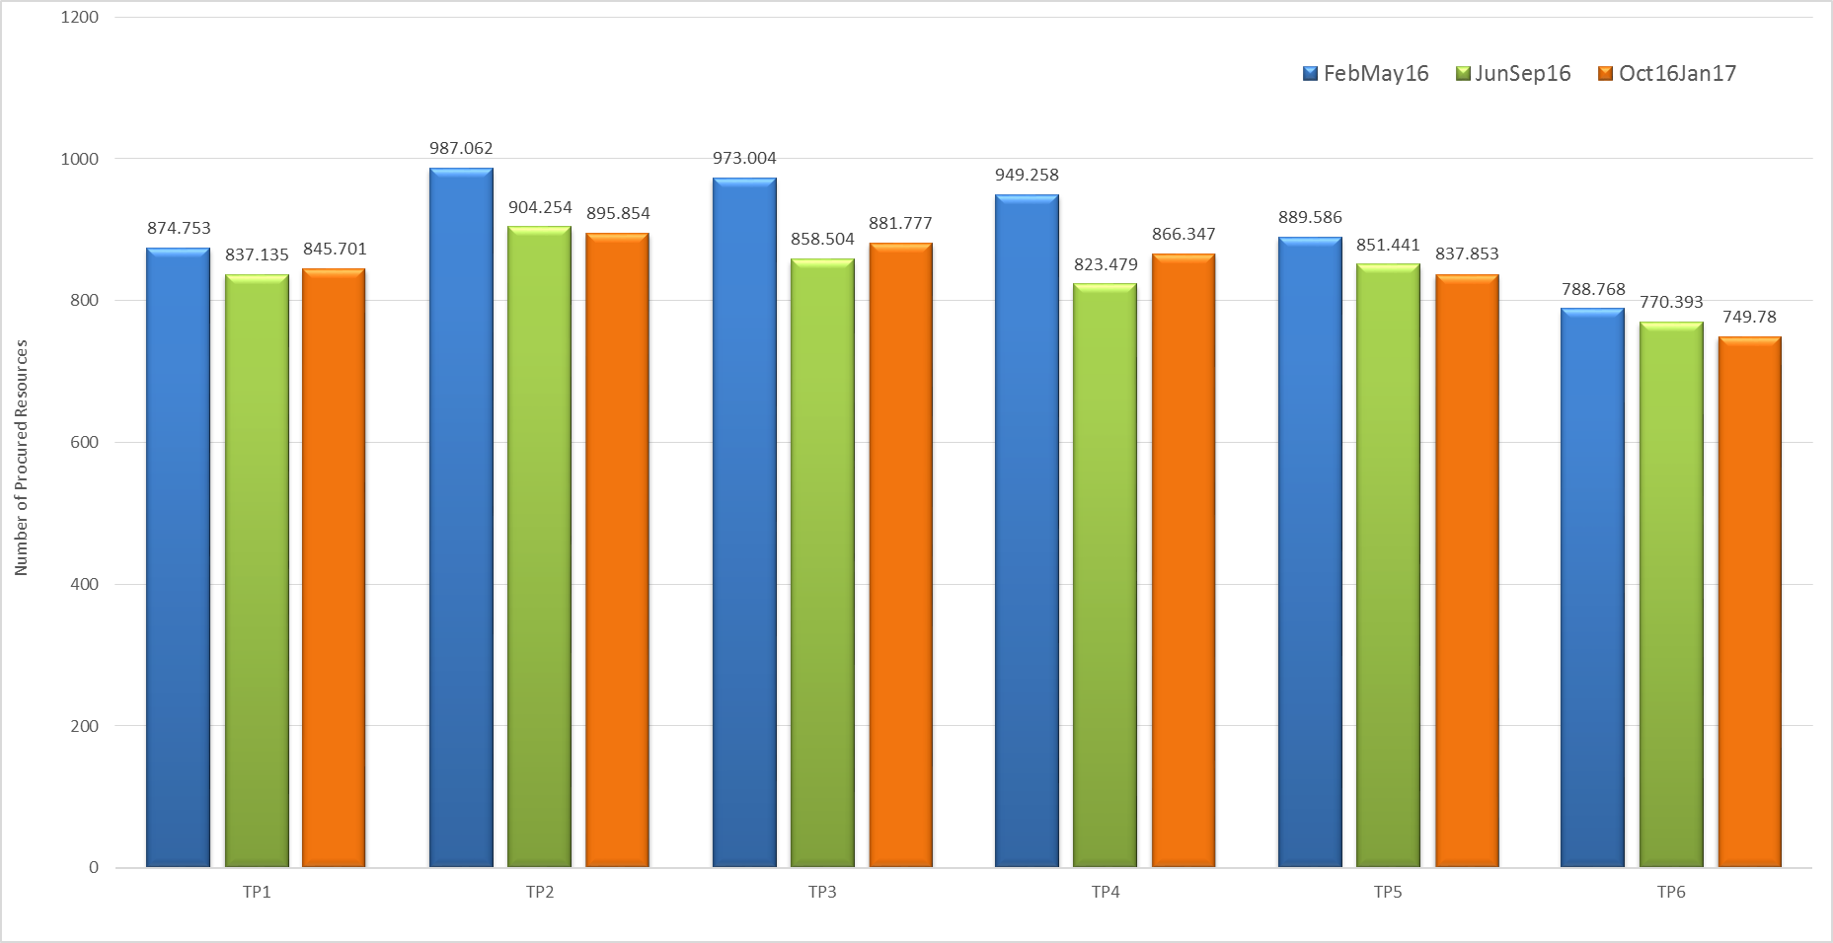
ERS MW Procurement

Slide 9
Emergency Response Service (ERS) Trends

Slide 10
Procurement Expenditure Limit Allocation Table

