Slide 1
2016 ERCOT
Load Forecast Performance
Calvin Opheim
Load Forecasting & Analysis
PLWG
September 21, 2016

Slide 2
Outline of Today’s Presentation
Definitions
Load forecast performance measures –
looking back at the 2016 summer peak
Additional SCENT data
Questions
Appendix - historical August weather data

Slide 3
Load Forecast Model Performance
2016 Summer Peak

Slide 4
Definitions
Backcast
Uses the actual values for all variables which are included in the load forecast model. The backcast is what the model calculates assuming all variable values are known.
Model error
Actual load minus the backcast load value. Quantifies what the existing model is not accounting for.
Forecast error
Forecast load minus the actual load. Quantifies how good the forecast was.
Notes:
Model error is looking back.

Slide 5
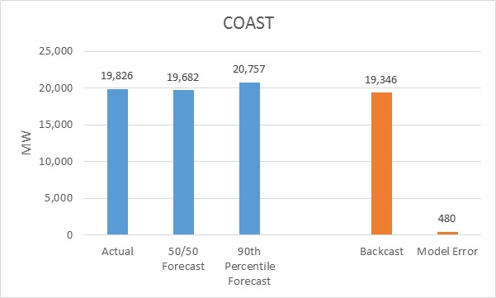
2016 Summer Peak Review

Slide 6
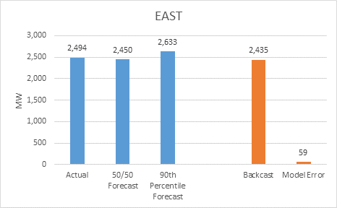
2016 Summer Peak Review

Slide 7
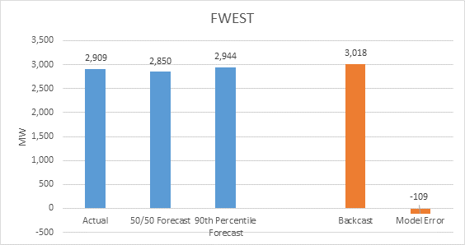
2016 Summer Peak Review
Notes:
FWEST peak was in July

Slide 8
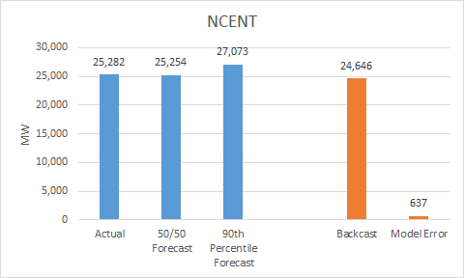
2016 Summer Peak Review

Slide 9
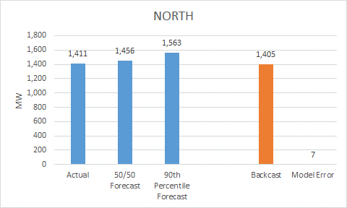
2016 Summer Peak Review

Slide 10
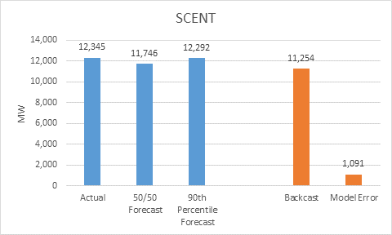
2016 Summer Peak Review

Slide 11
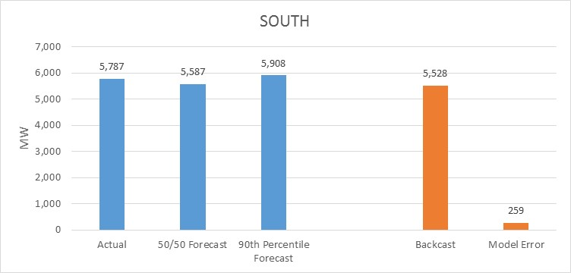
2016 Summer Peak Review

Slide 12
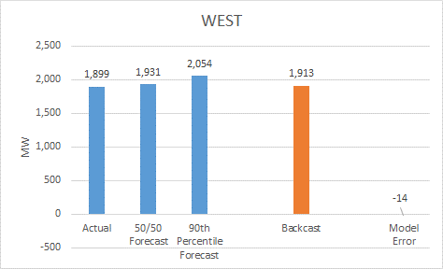
2016 Summer Peak Review
Notes:
WEST peak was in July

Slide 13
SCENT Additional Data

Slide 14
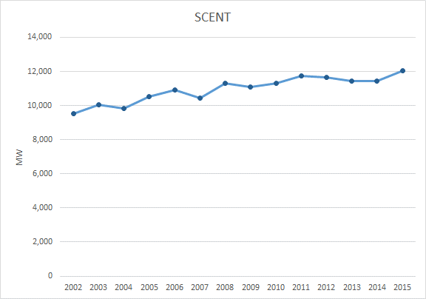
Historical Non-coincident Peak Demand

Slide 15
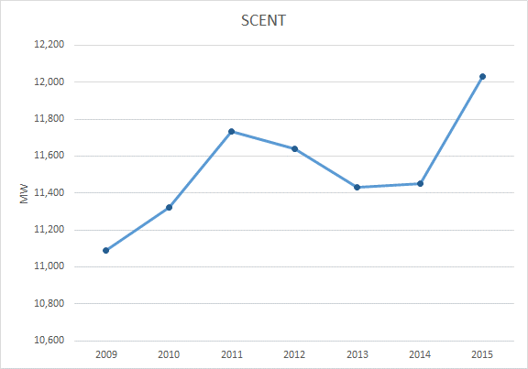
Historical Non-coincident Peak Demand
Notes:
Comment on the difference in the scales of the two graphs

Slide 16
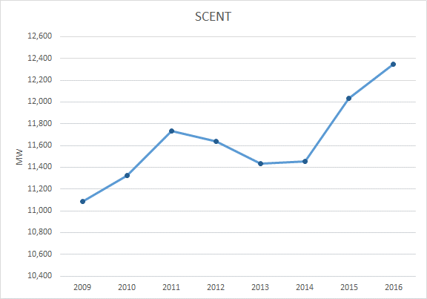
Historical Non-coincident Peak Demand

Slide 17
Challenges
SCENT has a significant portion of NOIE load
Premise growth is the driver of load growth in the load forecast model
ERCOT only has data on premises in competitive areas
Model assumption was that premise growth in competitive areas would be a good estimate of growth in SCENT
Notes:
Didn’t want to be dependent on premise data from NOIEs

Slide 18
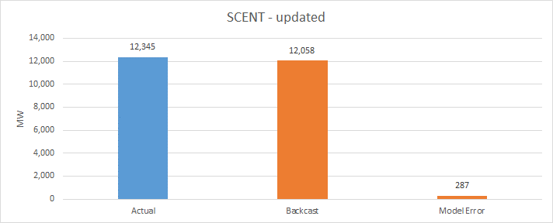
2016 Summer Peak Review

Slide 19
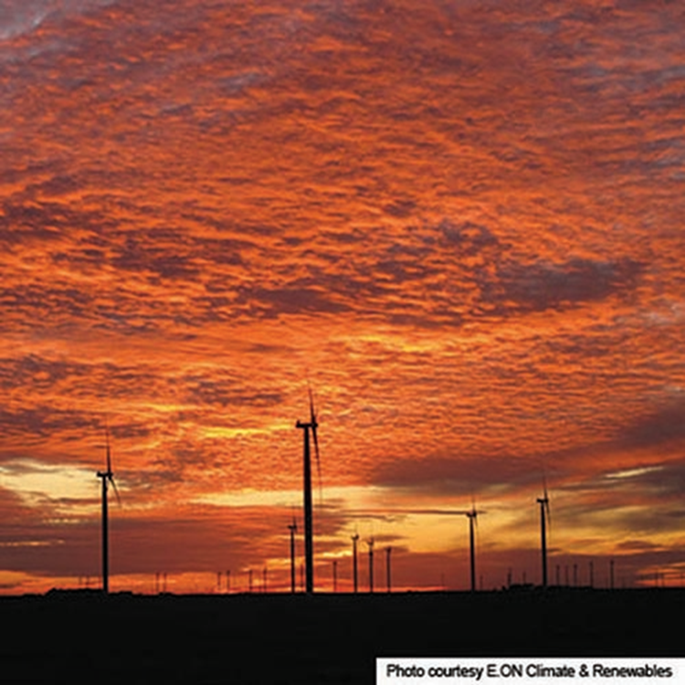
Questions

Slide 20
Appendix
2016 Weather Data

Slide 21
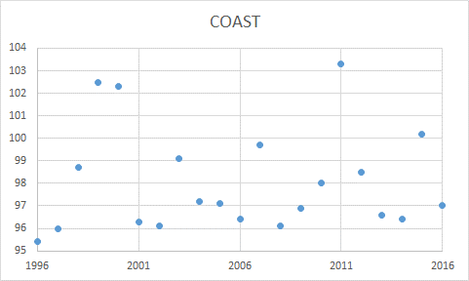
High Temperature in August

Slide 22
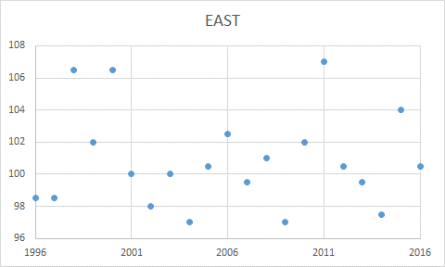
High Temperature in August

Slide 23
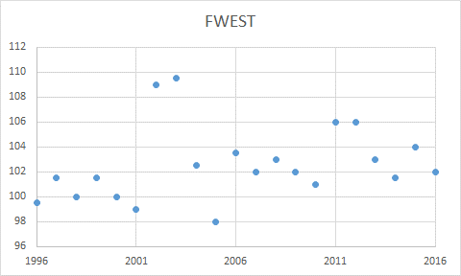
High Temperature in August

Slide 24
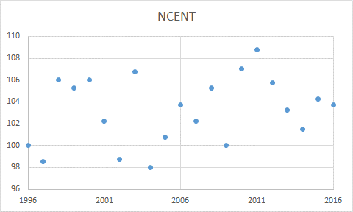
High Temperature in August

Slide 25
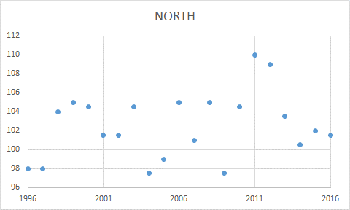
High Temperature in August

Slide 26
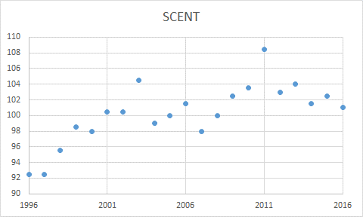
High Temperature in August

Slide 27
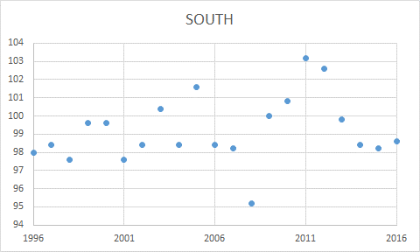
High Temperature in August

Slide 28
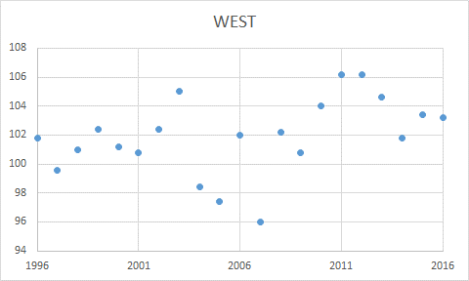
High Temperature in August

Slide 29
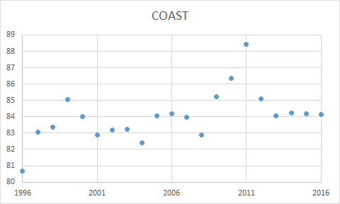
Average Temperature in August

Slide 30
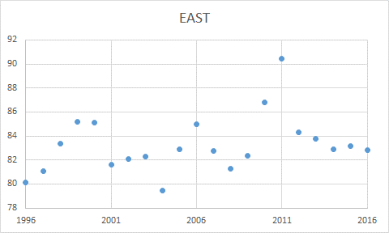
Average Temperature in August

Slide 31
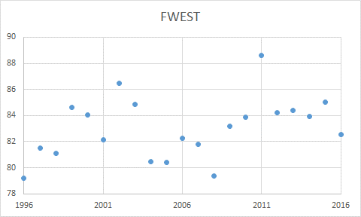
Average Temperature in August

Slide 32
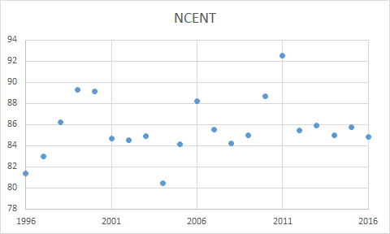
Average Temperature in August

Slide 33
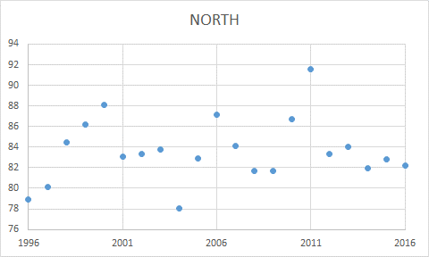
Average Temperature in August

Slide 34
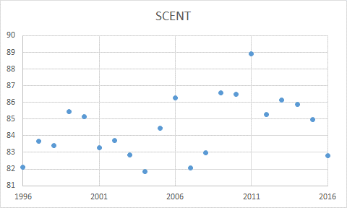
Average Temperature in August

Slide 35
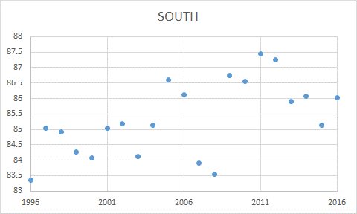
Average Temperature in August

Slide 36
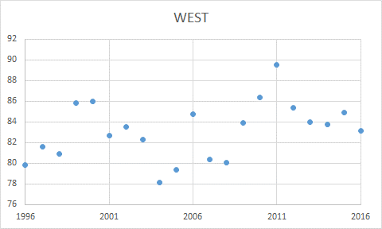
Average Temperature in August

