Slide 1
Multi-Interval Real-Time Market (MIRTM)
Update to SAWG – WebEx
ERCOT Staff
Market Design & Analysis
September 21, 2016

Slide 2
MIRTM Background
For the Real-Time Market, two features, namely, co-optimization of ancillary service with energy and commitment of fast resources have been discussed even during the initial design of the Nodal Market.
Direct Testimony of Dr. David B. Patton, PUCT Docket No. 31540, pp.23-41, November 10th, 2005
The Multi-Interval Real-Time Market (MRITM) is the initiative to scope out an enhancement that utilizes forecasts of near-term system conditions to create binding commitments, if required, for relatively quick responding (but not quick enough for the current 5-minute SCED) Generation and Load Resources to meet those conditions in the most economical manner
The greatest challenge to an effective MIRTM has been ERCOT’s ability to generate as input to the MIRTM, short-term forecasts of system condition that is of acceptable accuracy. Stakeholders and the Commission have raised this concern.
The key forecasted input data are:
Load Forecast
Wind Forecast
Resource Status Forecast

Slide 3
MIRTM Background - continued
Stakeholders with ERCOT support developed a study process to evaluate the feasibility of MIRTM in the ERCOT market. This involves:
Development of a simulation tool that can rerun historical days of interest
Development of a new short-term load forecasting tool
Re-run historical days of interest and evaluate the effectiveness of MIRTM
ERCOT staff have conducted studies on several historical days utilizing the data from the new short-term load forecast
Historical days selected by ERCOT and Market Participants

Slide 4
Current Status on MIRTM Feasibility Study
ERCOT is starting to present the results of the study with preliminary analysis
Large amount of results
ERCOT encourages stakeholders to engage with ERCOT staff to understand the study results
ERCOT requests stakeholder feedback on :
Are there any issues with the study approach to determine MIRTM feasibility?
Is there a better way to present the results?
Do we need to analyze other specific dates/times?
Are there any recommended changes to the MIRTM simulation tool?
Are there any recommendations on the metrics to determine the feasibility of MIRTM?

Slide 5
Next Steps on MIRTM
ERCOT is expected to report to the PUC on the MIRTM feasibility study by the end of 2016
ERCOT requests stakeholder input in completing the MIRTM feasibility study

Slide 6
MIRTM Timeline
Date | Action
2010 | Direct Testimony of Dr. David B. Patton, PUCT Docket No. 31540, pp.23-41, November 10th, 2005
2012 | TAC creates Market Enhancements Task Force to evaluate Real-time Co-optimization and Multi-Interval SCED Major vendors and ISOs provided presentations and their implementation experiences (most other ISOs have already implemented multi-interval market and/or real-time co-optimization)
2013 | METF disbanded; no consensus
11/8/13 | PUC Staff requests comments on MIRTM in Project 41837
12/12/13 | ERCOT and IMM file joint comments providing overview and scope of MIRTM
12/19/13 | MIRTM and real-time co-optimization discussed at PUC Open Meeting
1/17/14 | ERCOT and IMM file follow-up comments to 41837
9/25/14 | ERCOT posts MIRTM white paper to TAC meeting page; TAC assigns MIRTM issues to Supply Adequacy Working Group
4Q2014 | Market participants with ERCOT support develop a high-level scope of work to evaluate MIRTM by developing a prototype MIRM simulation tool and analyze historical days of interest … http://www.ercot.com/content/wcm/key_documents_lists/51007/Proposed_Study_Process_MIRTM.doc
1/16/15 | SAWG requests that ERCOT conduct a feasibility study of MIRTM, based on the scope of work described in the “Proposed Study Process … http://www.ercot.com/content/wcm/key_documents_lists/51007/Proposed_Study_Process_MIRTM.doc
3/9/15 | Demand Side Working Group inputs (LR offers with prices and MW values) posted and discussed at DSWG meeting
8/8/15 | Commissioners discuss MIRTM in Open Meeting and ask questions of ERCOT Staff
8/11/15 | IMM (David Patton) makes presentation to ERCOT Board regarding dispatch and pricing of peaking resources (QSGRs); comments were generally supportive of MIRTM concepts
10/13/15 | Joel Mickey provides MIRTM overview and description of feasibility study to ERCOT Board
11/12/15 | ERCOT files comments to 41837 providing status report on MIRTM feasibility study development…. http://interchange.puc.state.tx.us/WebApp/Interchange/Documents/41837_7_872244.PDF
11/19/15 | Commissioners discuss MIRTM in OM; urge ERCOT to continue working on the feasibility study and to work with stakeholders on inputs
12/2/15 | WMS votes to include QSGRs in the MIRTM feasibility study

Slide 7
Refresher on the MIRTM Process
MIRTM six 5-minute intervals (30 minutes total) with separate commitment and dispatch
RT Market Execution: Depicts the start and end times of the clearing process and the length of symbol is indicative of maximum time allowed to clear market
Interval where the LMPs, MW awards (energy, AS) and Commitment Instructions are ALL binding commitment instructions
Intervals where ONLY Commitment Instructions are binding and the LMPs and MW awards (energy, AS) are indicative
8:40 8:45 8:50 8:55 9:00 9:05 9:10 9:15 9:20 9:25 9:30 9:35
Analysis window of rolling 30 minutes
Dispatch Run & Pricing run
Binding commitments for ALL intervals
1st Interval Binding Base Point & Binding LMPs
Dispatch Run & Pricing Run
Sequence of Multi-Interval RT Markets
Note: The introduction of the Binding Dispatch/Base Point run while eliminating make-Whole payments to Generation Resources due to binding ramp constraints, can however, lead to missed commitments or too early decommitments/recalls. The assumption is that the benefits of eliminating this category of make-whole payments outweighs the disadvantages of missed commitments or too early decommitments/recalls.

Slide 8
Overview of Recent Activity
Implement Dispatch Module
Implement Pricing Module
Developed three part offers (TPO) based on average verifiable costs and unit HSL
Developed single part offers (SPO) from TPO allocating start costs over minimum up time and LSL
Allowed for Wartsila units to have zero start time and zero min off time (allows fast ramping resources to meet demand in same interval)
Studied the following dates:7/1/2015, 8/11/2015, 8/13/2015, 11/11/2015, 11/27/2015, 3/27/2016, 7/25/2016

Slide 9
Today’s Agenda
Refresher on study inputs
For study day 8/13/2015 review and compare all of the Separate Commitment and Dispatch MIRTM runs listed on the next slide
For remaining six study days
7/1/2015 – Luminant request (Volatile wind, little congestion, low system lambda)
8/11/2015 - Luminant request (Little congestion, low dispatchable capacity)
11/11/2015 - ERCOT (New STLF over forecasts load)
11/27/2015 – ERCOT (New STLF under forecast load, large wind down ramp)
3/27/2016 – ERCOT (Low wind, units shutting down, low dispatchable capacity)
7/25/2016 – ERCOT (Low wind, low dispatchable capacity)
Compare two MIRTM runs:
Fast responding resources and load (3PO)
Fast responding resources to mimic production i.e. not committable by MIRTM (LOAD)

Slide 10
Study Runs
For the 8/13 run we will step incrementally through the progression of studies as follows:
Production SCED
Sequential SCED
MIRTM with Separate Commitment and Dispatch:
Loads only with QSGR not committable to mimic production (LOAD)
QSGRs have Production offers with single part offers (SPO Prod. SCED EOCs)
QSGRs have three-part offer based on average Verifiable Costs (3PO)
QSGRs have single-part offer based on average Verifiable Costs (SPO)
Note: we could come back at a later date with a comparison between MIRTM Combined Commitment and Dispatch and MIRTM Separate Commitment and Dispatch. It was too much data to show in one session.

Slide 11
Study Process
Determine the study period based on the day of interest and run a sequential SCED for the entire study period using the Energy Offers from actual Real Time SCED runs.
Sequential SCED considered the “baseline” that simulates all resources following base points while the GTBD mimics the production case.
Run MIRTM Separate Commitment and Dispatch with different offer structures (SPO Prod. SCED EOCs, 3PO, SPO) as inputs while the GTBD mimics the production case.
Use new STLF and Wind Persistence to “look ahead” 30 minutes to determine if commitments needed

Slide 12
Study Process
Calculate Production Costs: Four Components
Generation Costs: Integrate Step 2 EOC from LSL to BP + Power Balance Violation
Transmission Penalty Cost: Violated MW * Shadow Price
QSGR Startup/Mingen Cost: Startup and Minimum Energy Costs
Blocky Load Cost: Bid Price * Commit MW
Calculate Make Whole
QSGR Make whole across entire study period
Prod. SCED & Seq. SCED: Emergency Operations QSGR payments (Per 6.6.9 (3))
MIRTM: Max(0,QSGR Verifiable Cost - QSGR Revenue)
Blocky Load Make whole across entire study period
MIRTM: Max(0, [Bid Price * Commit MW] -[Binding LMP * Commit MW])
Notes:
QSGR revenue:
(Binding LMP + Operating Reserve Demand Curve (ORDC) Online Price Adder + Pricing Run Price Adder) * Binding Base Point of Committable QSGR Unit List
QSGR Verifiable cost:
QSGR Verifiable Cost Above LSL - Integrate Input EOC or Verifiable Cost EOC (if no QSGRs in MIRTM) from LSL to BP of Committable QSGR Unit List
plus
QSGR Startup/Mingen Cost of Committable QSGR Unit List - Startup and Minimum Generation Costs of Committable QSGR Unit List

Slide 13
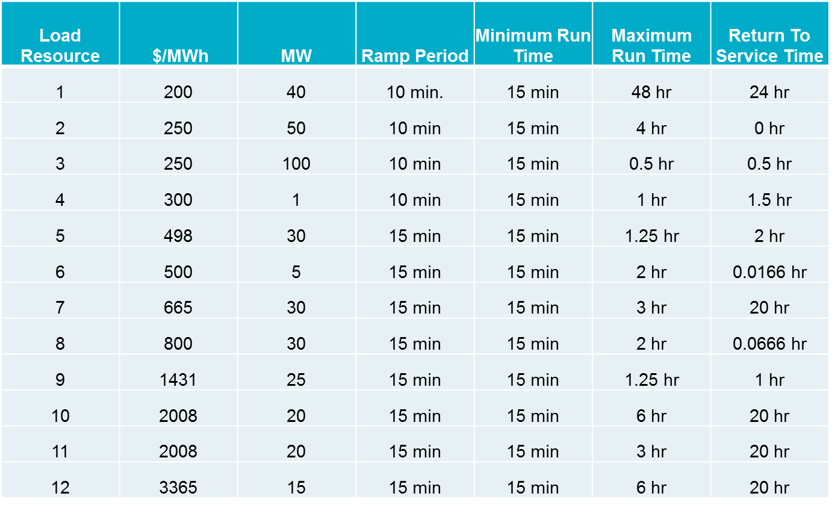
Simulation Assumptions – Blocky Load Resources
Offers were received for 12 Blocky Loads from DSWG
A total of 366 MW split between the load zones (each zone has 12 resources)

Slide 14
Simulation Assumptions – Fast Generation Resource Temporal Constraints
All Resources that are Quick Start qualified are considered “fast responding resources”. If the Resource was “OUT” or “ONTEST” during the study period they are not considered as “committable”
Gas Turbines (36 units)
Minimum On Time | Minimum Off Time | Cold Start-Up Time | Intermedate Start-Up Time | Hot Start-Up Time
15 Min. | 10 Min. | 5-10 Min. | 5-10 Min. | 5-10 Min.
Reciprocating Engines (3 units)
Minimum On Time | Minimum Off Time | Cold Start-Up Time | Intermedate Start-Up Time | Hot Start-Up Time
5 Min. | 10 Min. | 5 Min. | 5 Min. | 5 Min.
Wartsilas (4 units)
Minimum On Time | Minimum Off Time | Cold Start-Up Time | Intermedate Start-Up Time | Hot Start-Up Time
0 Min. | 0 Min. | 0 Min. | 0 Min. | 0 Min.

Slide 15
Simulation Assumptions – Fast Responding Resources
Four average Verifiable Costs groups were identified.
Each Fast Responding Resources is assigned a group cost based on HRL/LSL
The Single Part offer is structured in order to recover Start Up and Minimum Energy cost over the Minimum On time and can vary due to individual units’ LSL
Minimum EOC and Min. Gen. is $75 if Resource had Non-Spin responsibility during study period

Slide 16
Simulation Assumptions – Fast Responding Resources
Sample of costs used (SPO can vary per unit depending on LSL):
Res Type | HRL (MW) | LRL (MW) | Seasonal LSL (MW) | Startup Cost ($) | Min-Energy Price ($/MWh) | Min EOC ($/MWh) | Max EOC ($/MWh) | Single Part Cost ($/MWh)
SCLE90 | 54.0 | 10.0 | 13.0 | 4,322.05 | 52.39 | 30.86 | 33.91 | 1,287.26
SCLE90 | 60.0 | 0.0 | 12.0 | 3,448.99 | 48.85 | 28.47 | 31.05 | 1,198.51
SCLE90 | 95.0 | 0.0 | 41.0 | 6,058.75 | 56.12 | 40.35 | 41.88 | 647.21
DSL | 8.9 | 6.0 | 6.0 | 962.21 | 39.93 | 34.84 | 39.79 | 1,964.34

Slide 17
Other Assumptions – Days Analyzed
The Capacity from all Fast Responding Resources is considered online in MIRTM study runs; this has the impact of changing the Operating Reserve Demand Curve (ORDC) calculation slightly; however, the resource capacity is only shifted from offline to online.
The Block Load Resources are considered “new” Resources for MIRTM which increases the RTOLCAP and shifts the curve to the right by 366MW.
The Reliability Deployment Price Adder in MIRTM treats the deployment by ERCOT as a “deployment event” therefore MIRTM may find a RTDP when Production and Sequential SCED did not.
MIRTM Commitment decisions are based on new short-term load forecast and DC tie schedule changes while dispatch uses production SCED GTBD based on old short-term load forecast ramp and regulation component

Slide 18
GTBD Calculation Methodology Recap
Production SCED Methodology
$$SCED GTBD={TelemMW}_{0}$$
$+ K3∗\left(Current STLF 5 Min. Ramp\right)$
$+ K4 ∗(Rolling Average Reg. Up Deployed)$
Methodology for MIRTM Study
$$MIRTM GTBD\left(i\right)=\left\{\begin{aligned}SCED GTBD i=1 \\ TelemMW_{0}+\left(New STLF_{i}−New STLF_{0}\right)+(DCTie_{i}−DCTie_{0}) i>1\end{aligned}\right.$$
TelemMW₀ = Sum of Telemetered Generation output at run time
K3 value varies from 1.2 to 1.3 depending on study date
K4 value varies from 0.3 to 0.5 depending on study date
i = 5-Minute MIRTM Intervals Within Study Window
(ex: i=6 represents 30 Min. Ahead)

Slide 19
MIRTM – Changes since August SAWG
Make the processing of Combined Cycles consistent between MIRTM and Sequential SCED
Correct the Minimum Energy for Resources carrying Non Spin to agree with $75 Energy offer curve
Streamline the Commitment Summary to two categories:
Count of Resources below cost
Count of Resources at or above cost
Corrected two study days that had short SCED runs which caused double counting in the MIRTM post process
Determination and book keeping of noncompetitive constraints are different between MIRTM and Seq. SCED: ERCOT will evaluate the impact and actions taken, if any, at a future SAWG meeting

Slide 20
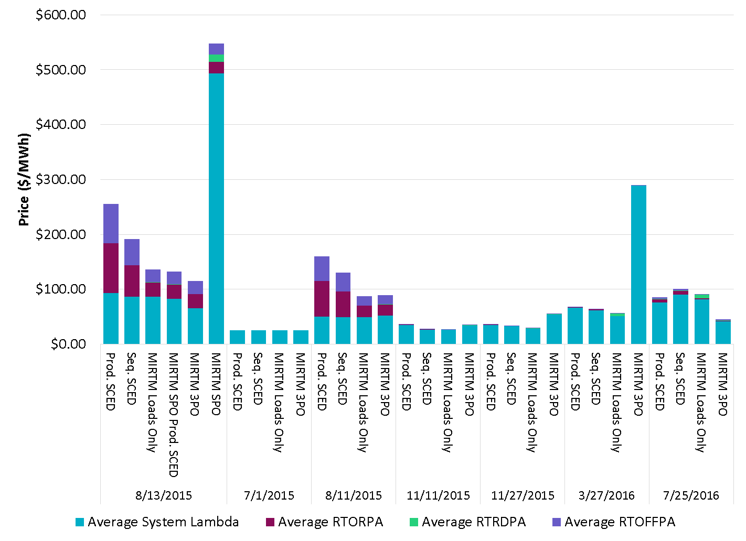
Average Price of All Study Dates

Slide 21
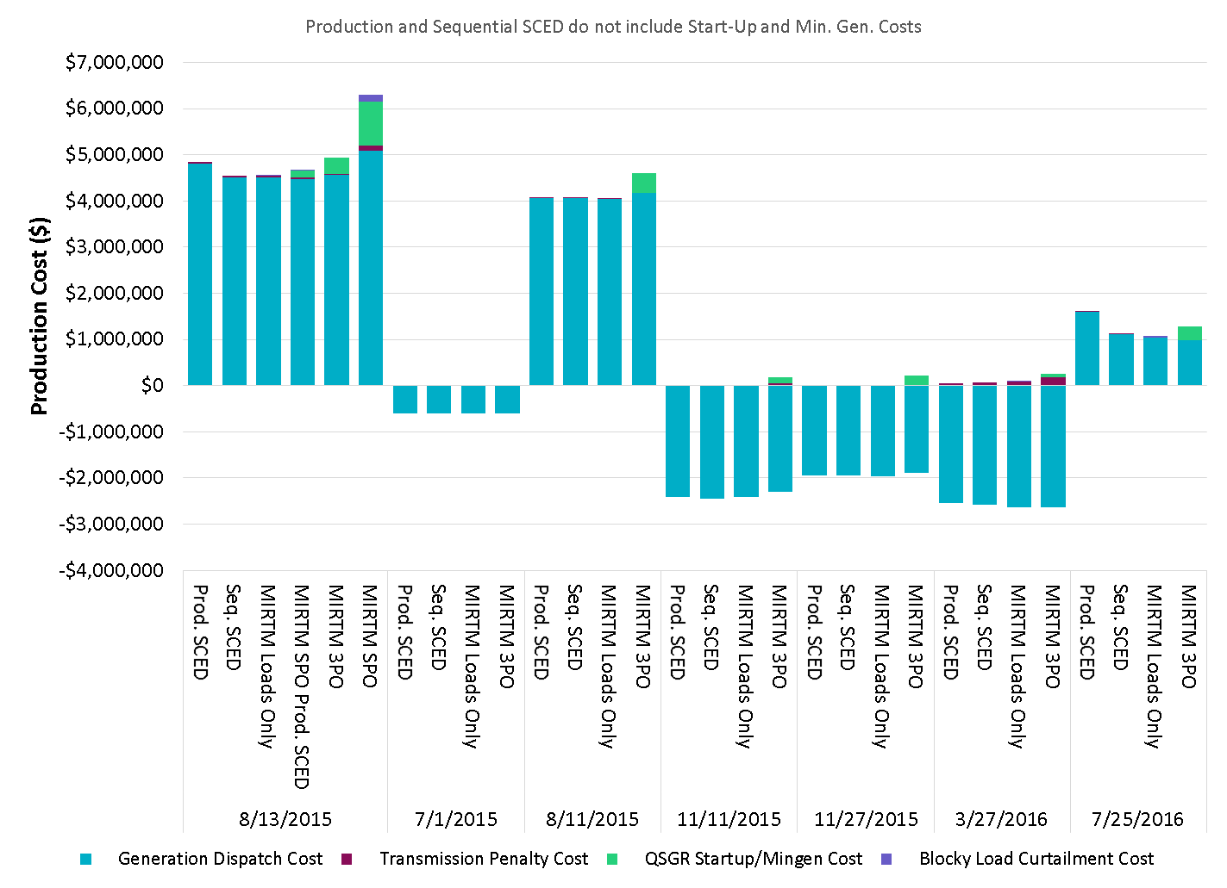
Production Cost of All Study Dates
Negative production costs are due to significant MW on output schedules. Production costs for those resources are -$250/MWh from LSL to output schedule.

Slide 22
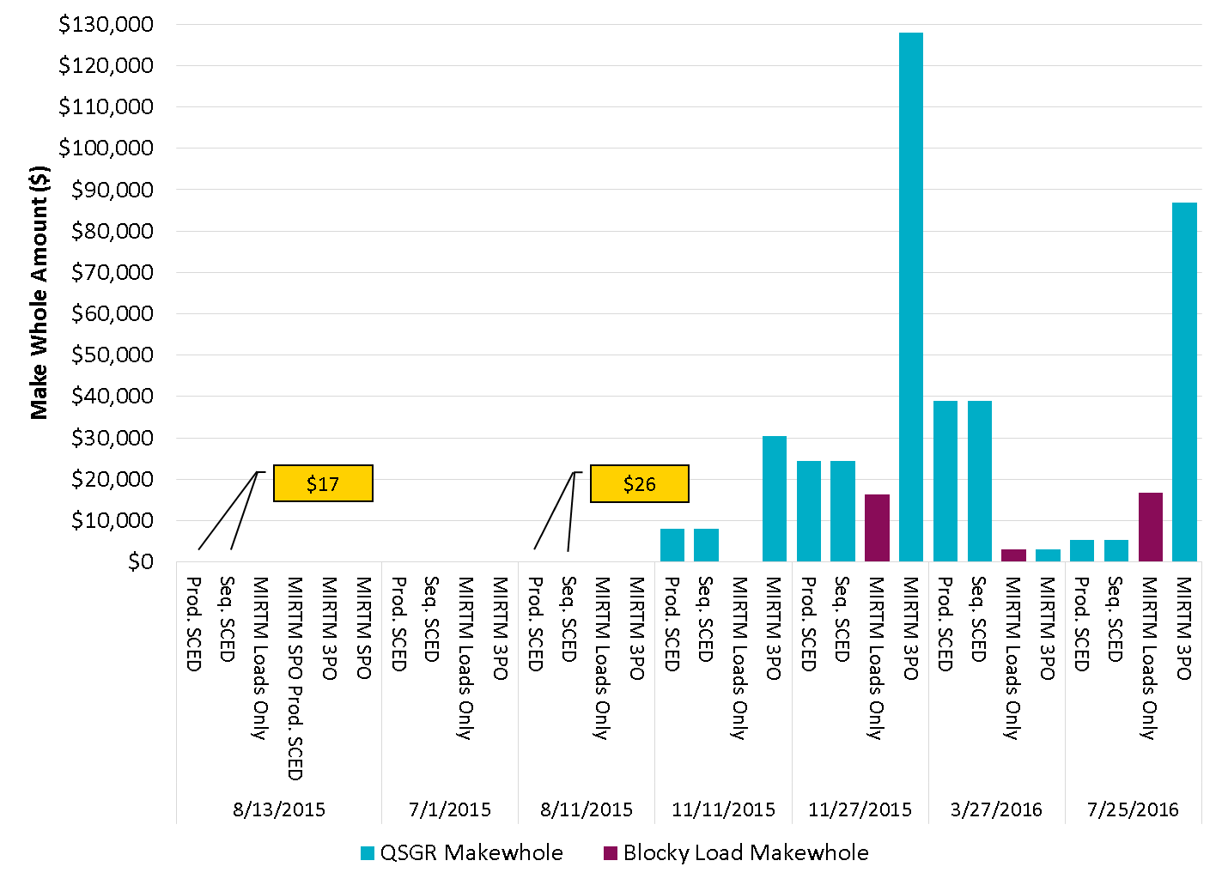
Make Whole Amounts of All Study Dates

Slide 23
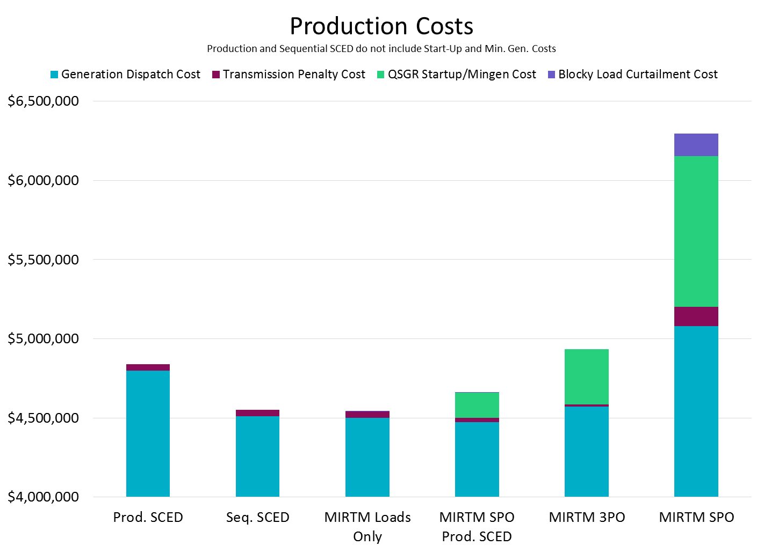
August 13, 2015

Slide 24
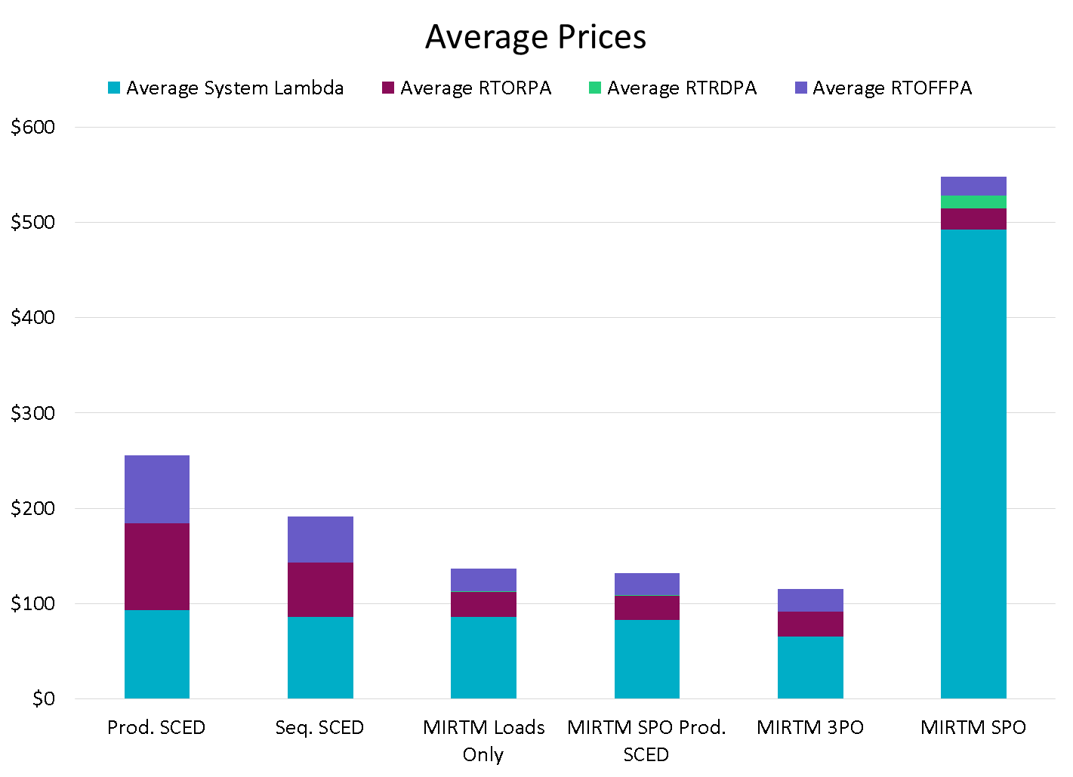
August 13, 2015
Changes in ORDC price adders due to 366 MW of new Blocky Load capacity in RTOLCAP
Changes in ORDC price adders due to NCLRRRS calculation change in Seq. SCED (NPC-LPC)
Increase in prices due to offer assumptions (see offers slide)

Slide 25
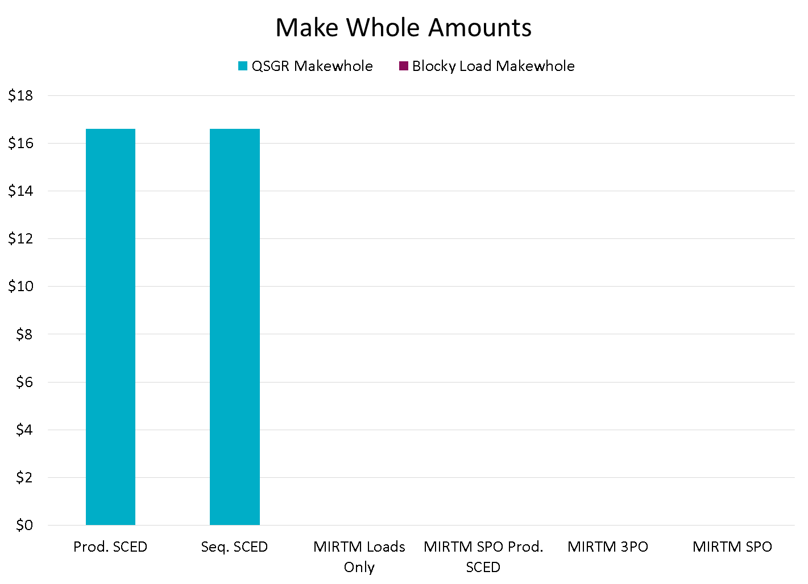
August 13, 2015
MIRTM study scenarios had no make-whole

Slide 26
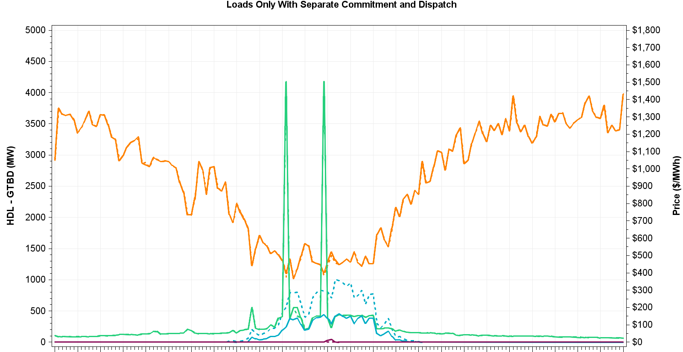
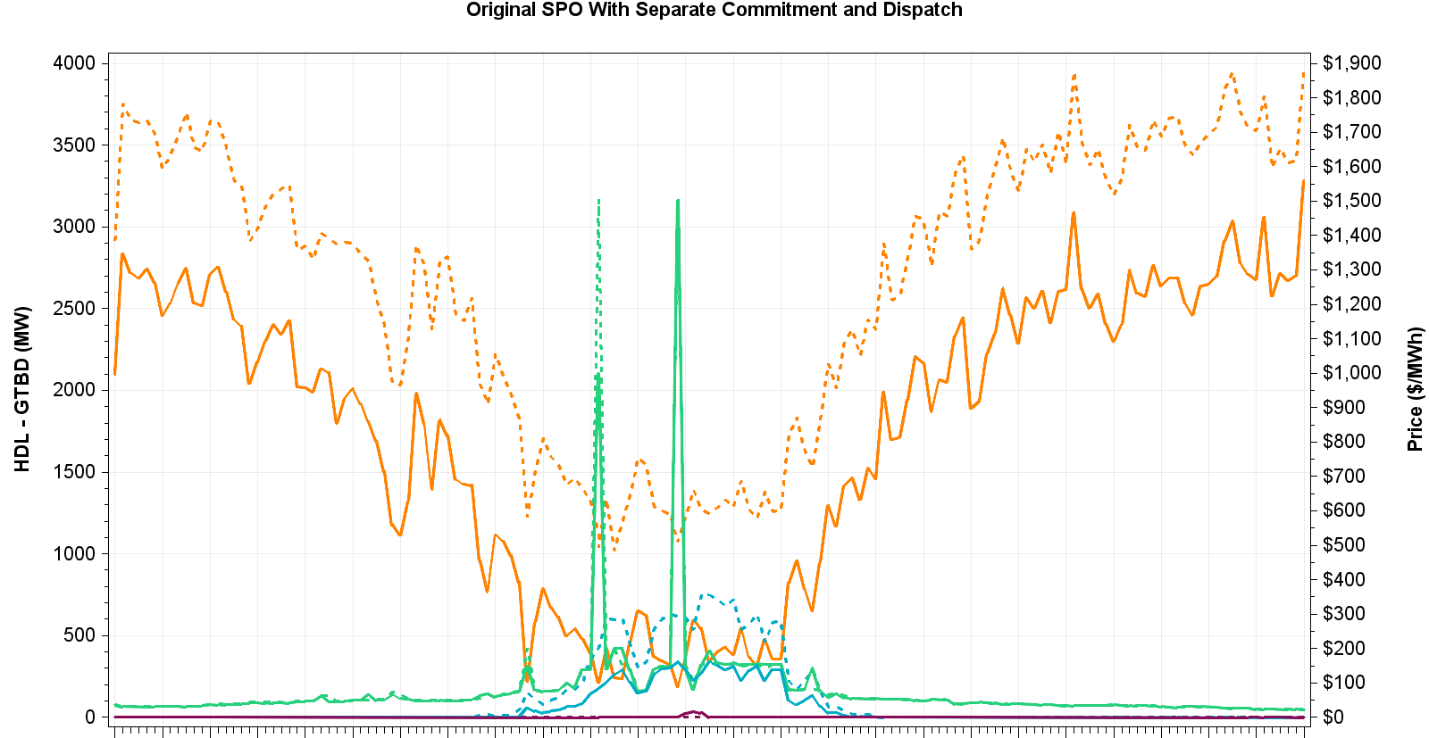
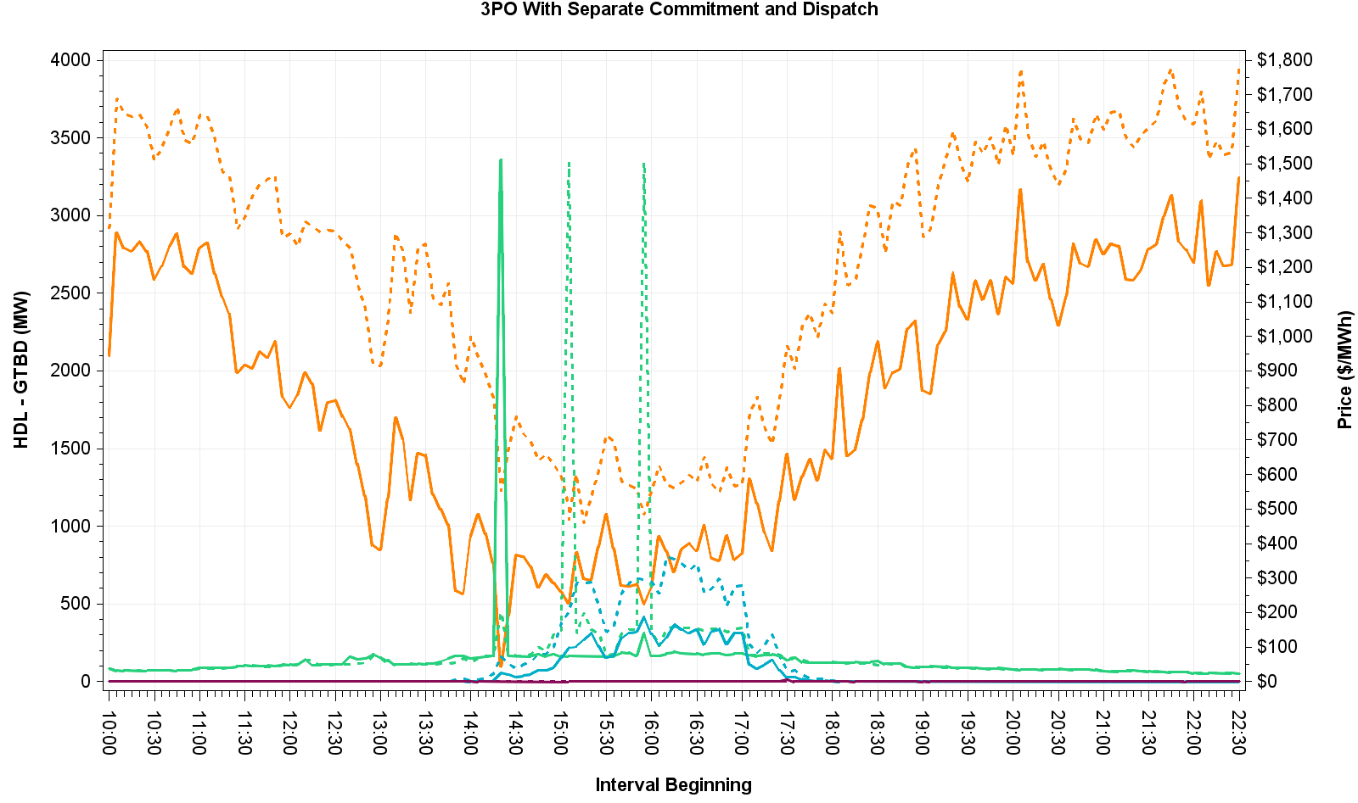
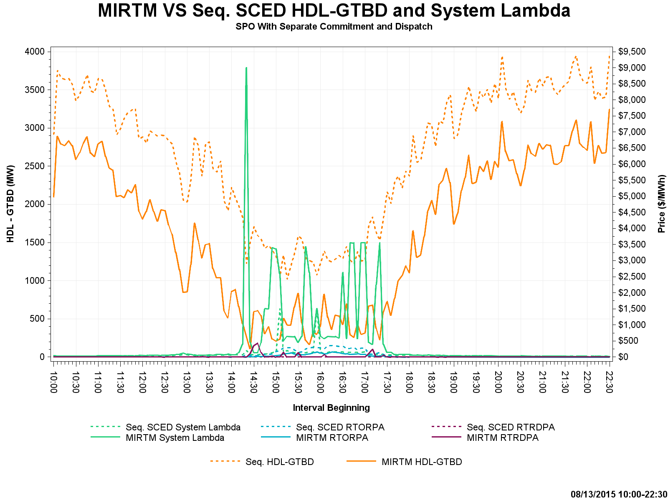
August 13, 2015 – HDL-GTBD & Price
Cause for price spike at 14:20 in MIRTM 3PO explained on next slide
Using Single Part Offers results in very high QSGR offers and resultant prices (note the scale difference)

Slide 27
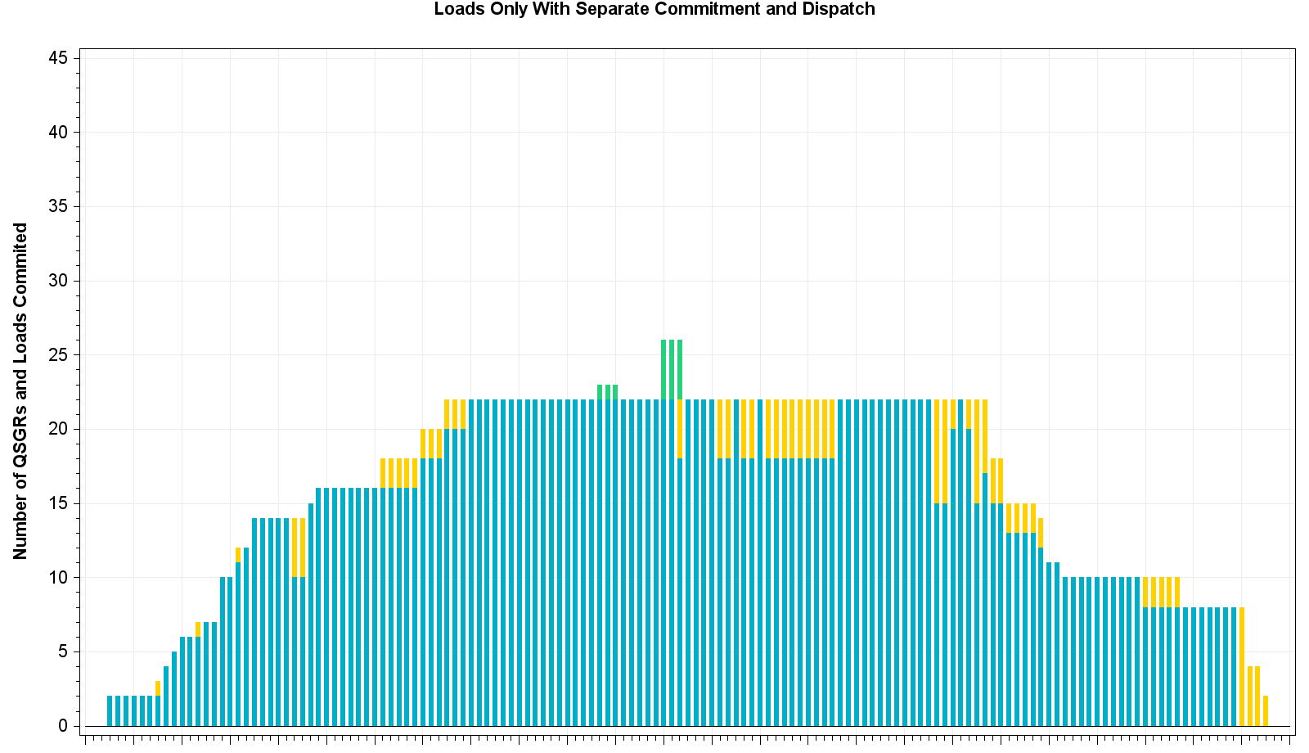
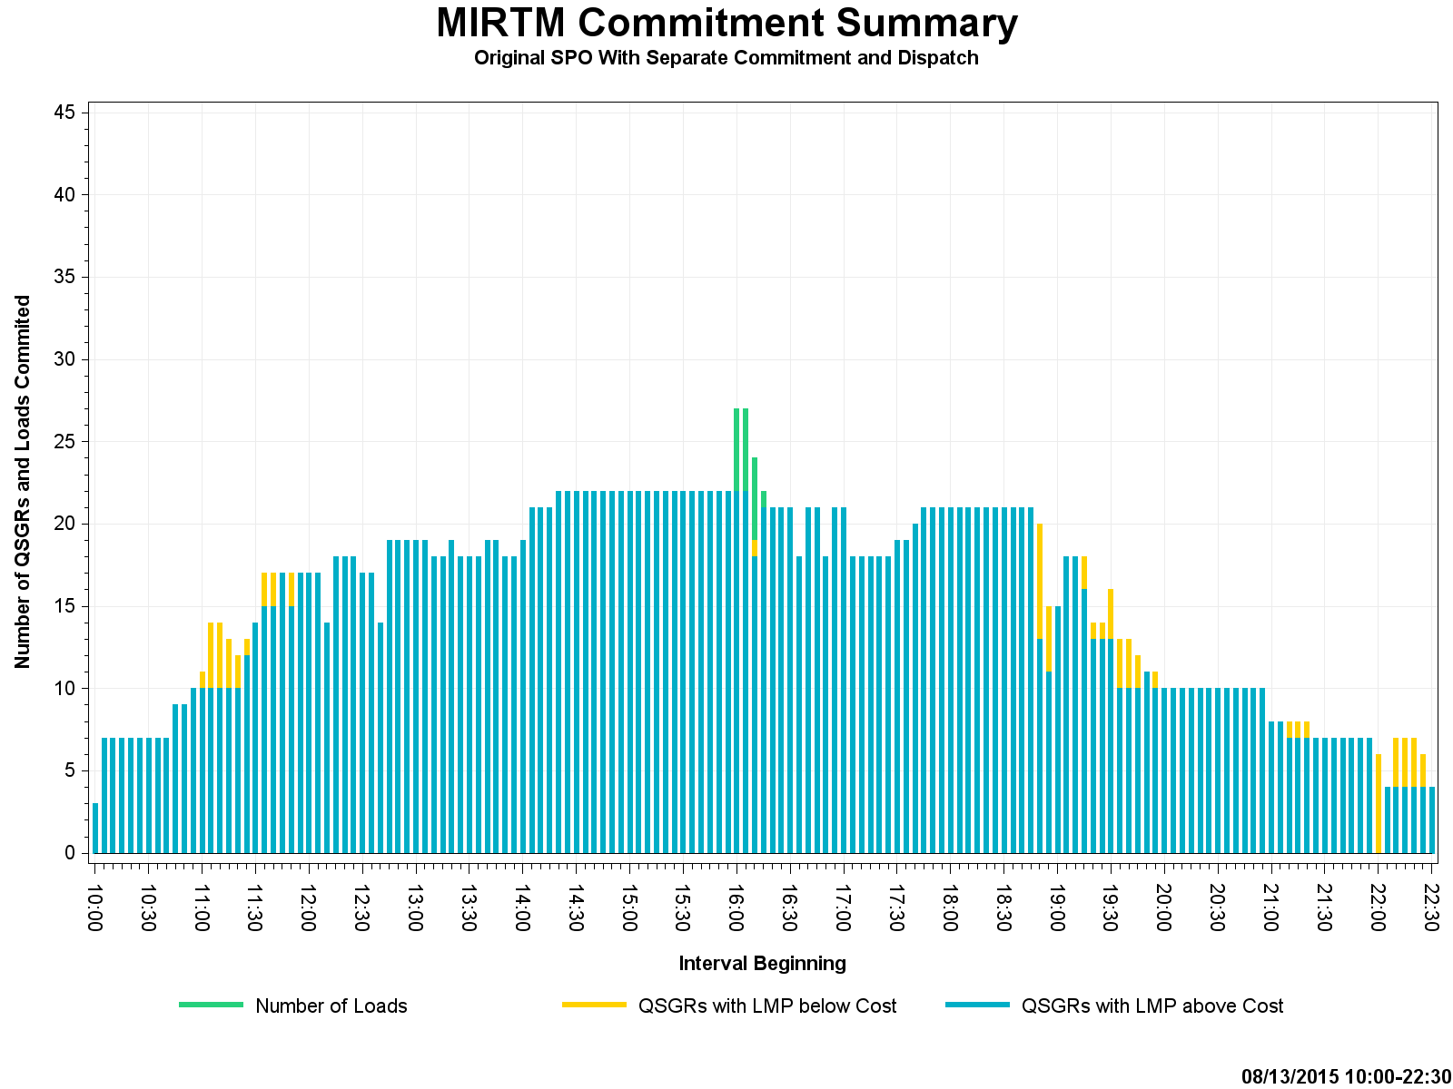
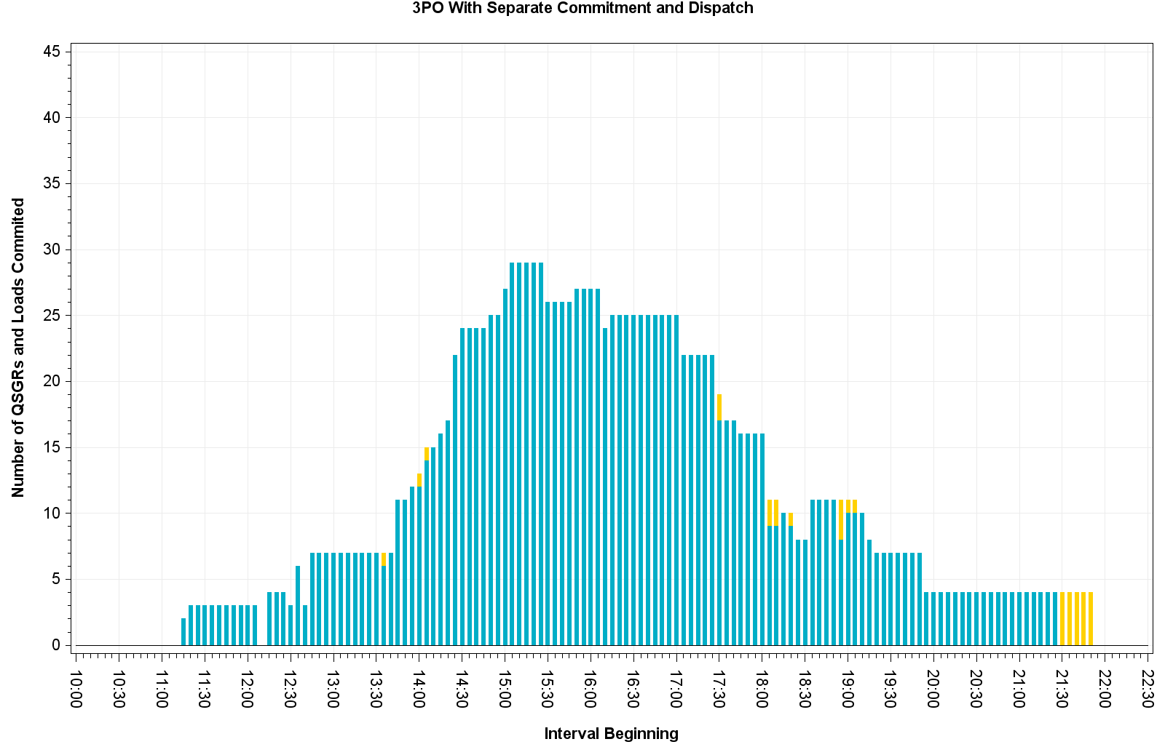
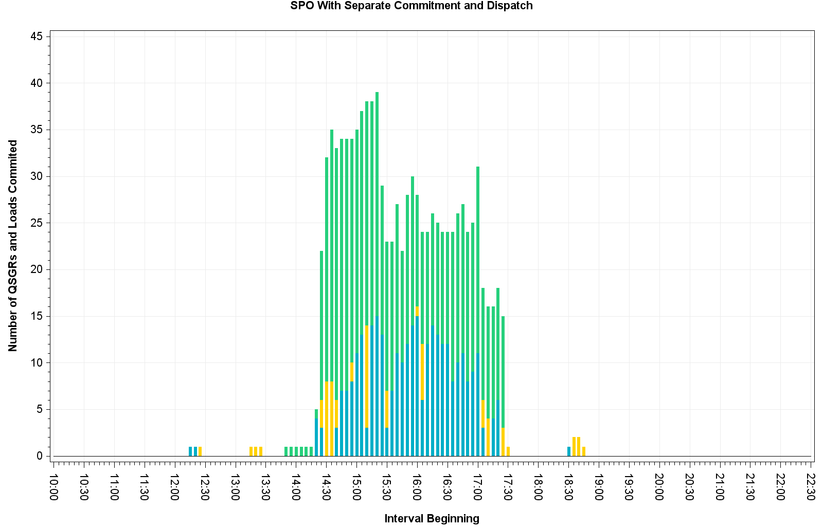
August 13, 2015 – Commitment Summary
Tighter QSGR commitment with MIRTM 3PO than with production self-commitment
LMP is only <$0.50/MWh below the 4 QSGRs cost curve. System cost is kept lower by keeping them online.
With QSGRs using SPOs, load bids are cheaper for MIRTM to commit

Slide 28
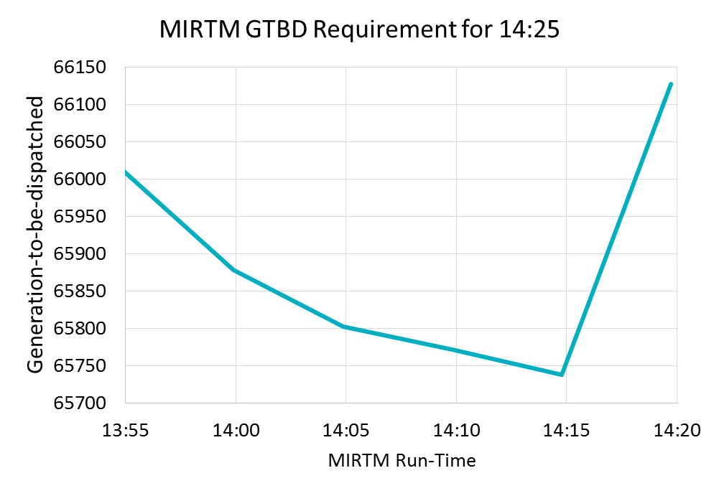
August 13, 2015 – Analysis
MIRTM 3PO had a spike primarily due to regulation component (349 MW) and load under forecast.
GTBD from Production SCED = MIRTM GTBD
By waiting until the last minute, binding QSGR commitments were not made in this time frame due to forecast decrease

Slide 29
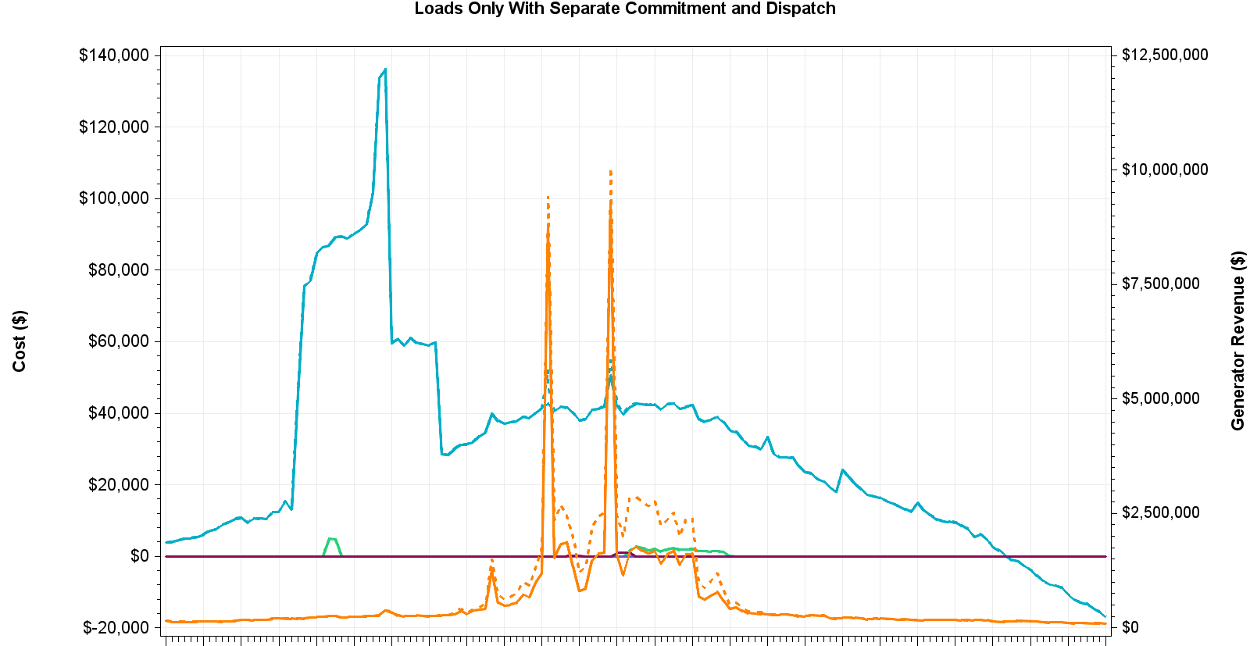
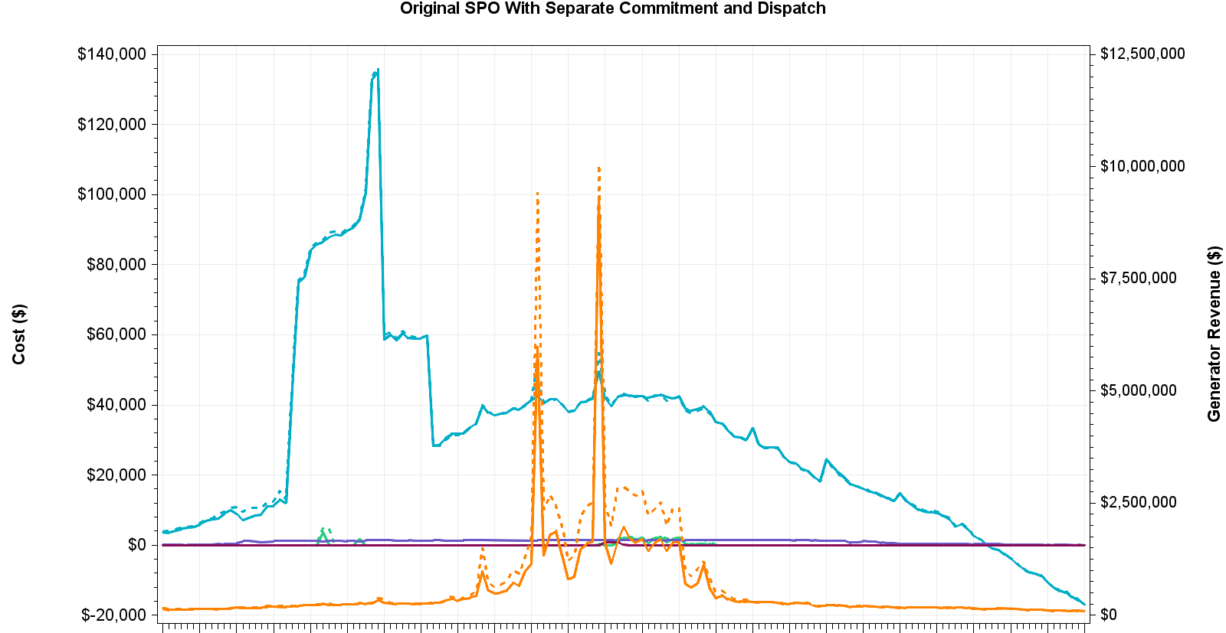
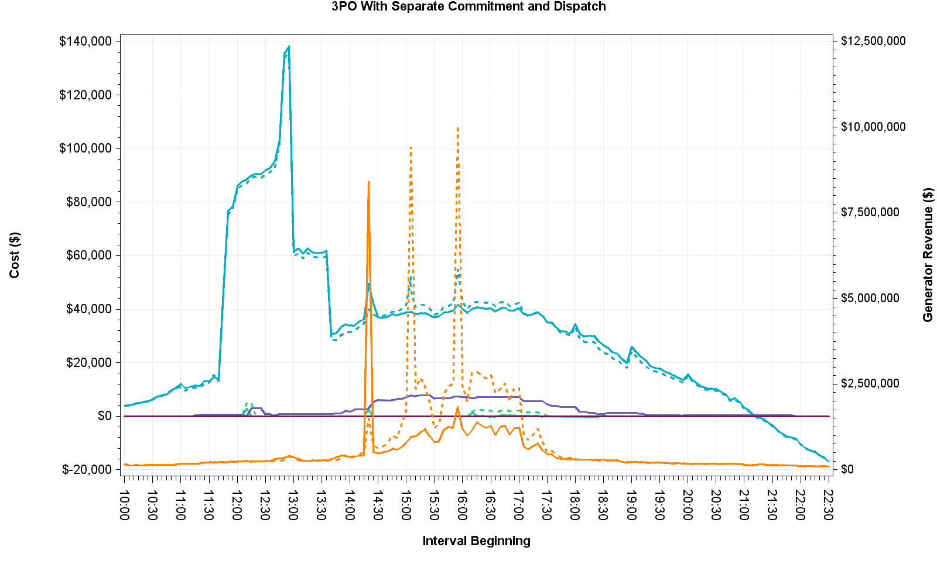
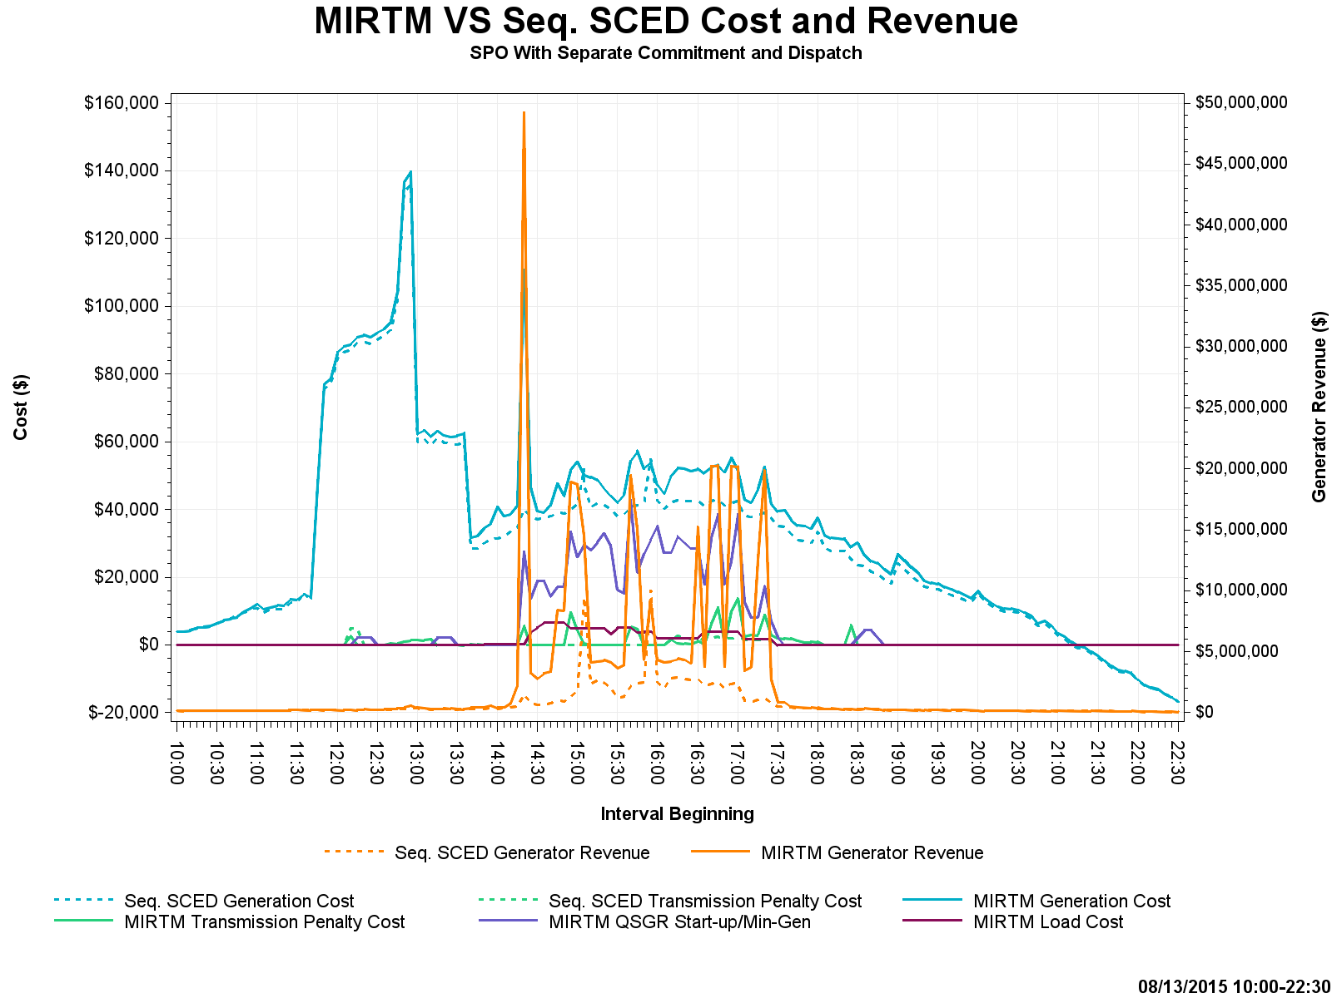
August 13, 2015 – Cost and Revenue

Slide 30
July 1, 2015 – Observations
Luminant Request
Little congestion and low system lambda
MIRTM 3PO prices slightly higher due to no QSGRs being committed and the load requirement distributed to rest of generation fleet

Slide 31
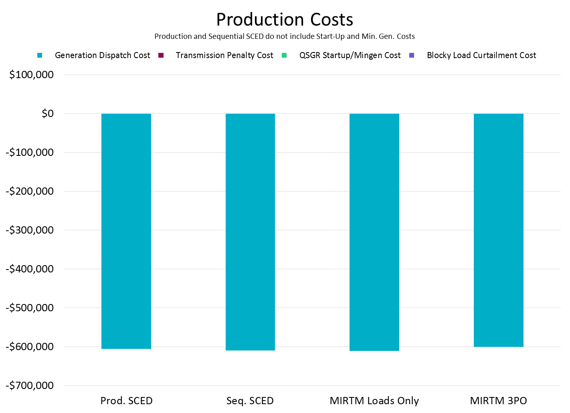
July 1, 2015
Negative production costs are due to significant MW on output schedules. Production costs for those resources are -$250/MWh from LSL to output schedule.

Slide 32
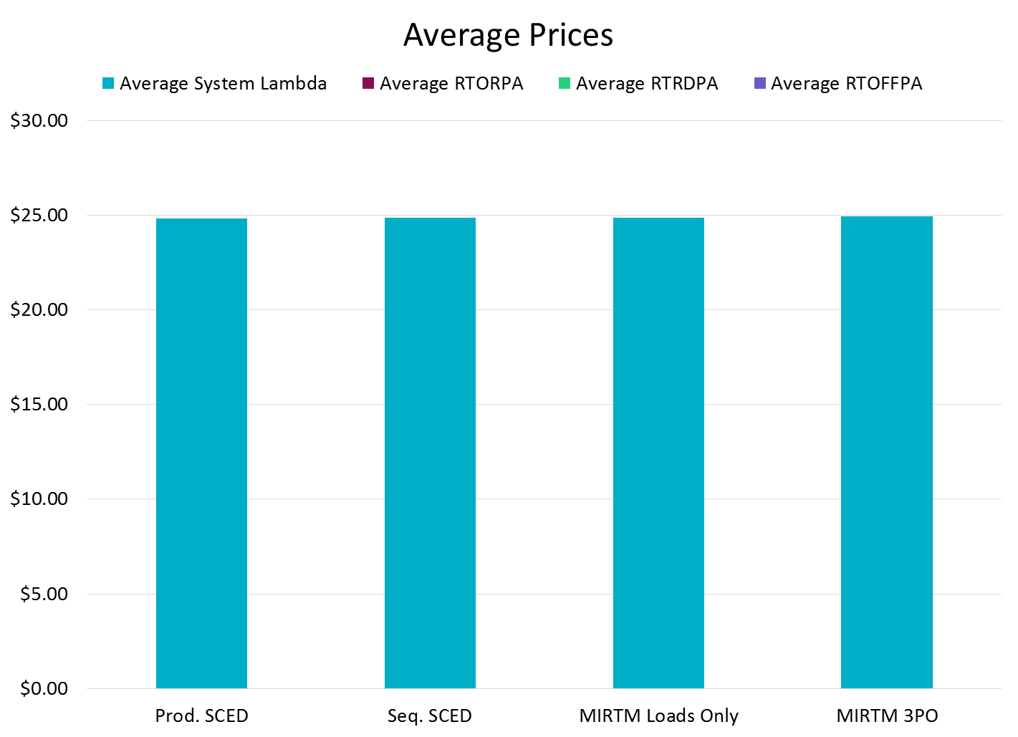
July 1, 2015
MIRTM 3PO prices are slightly higher due to no QSGRs being committed and the load requirement distributed to rest of generation fleet.

Slide 33
July 1, 2015
Zero make-whole on July 1, 2015

Slide 34
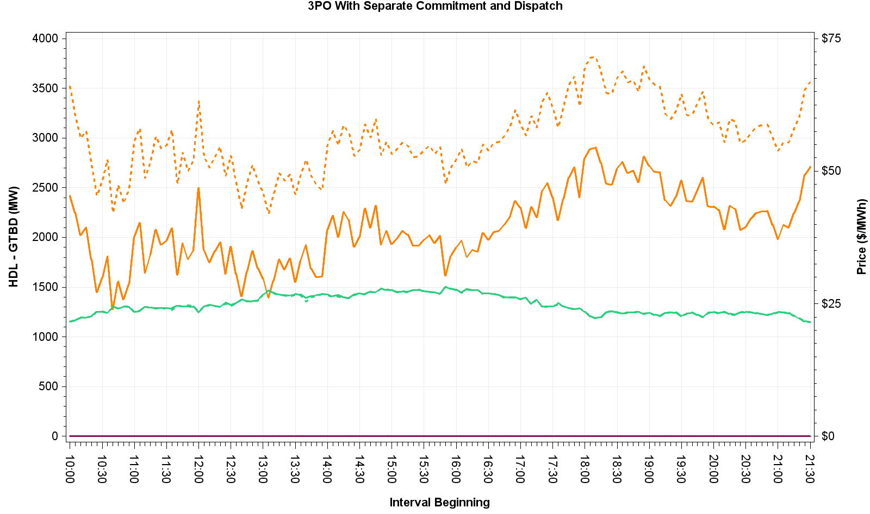
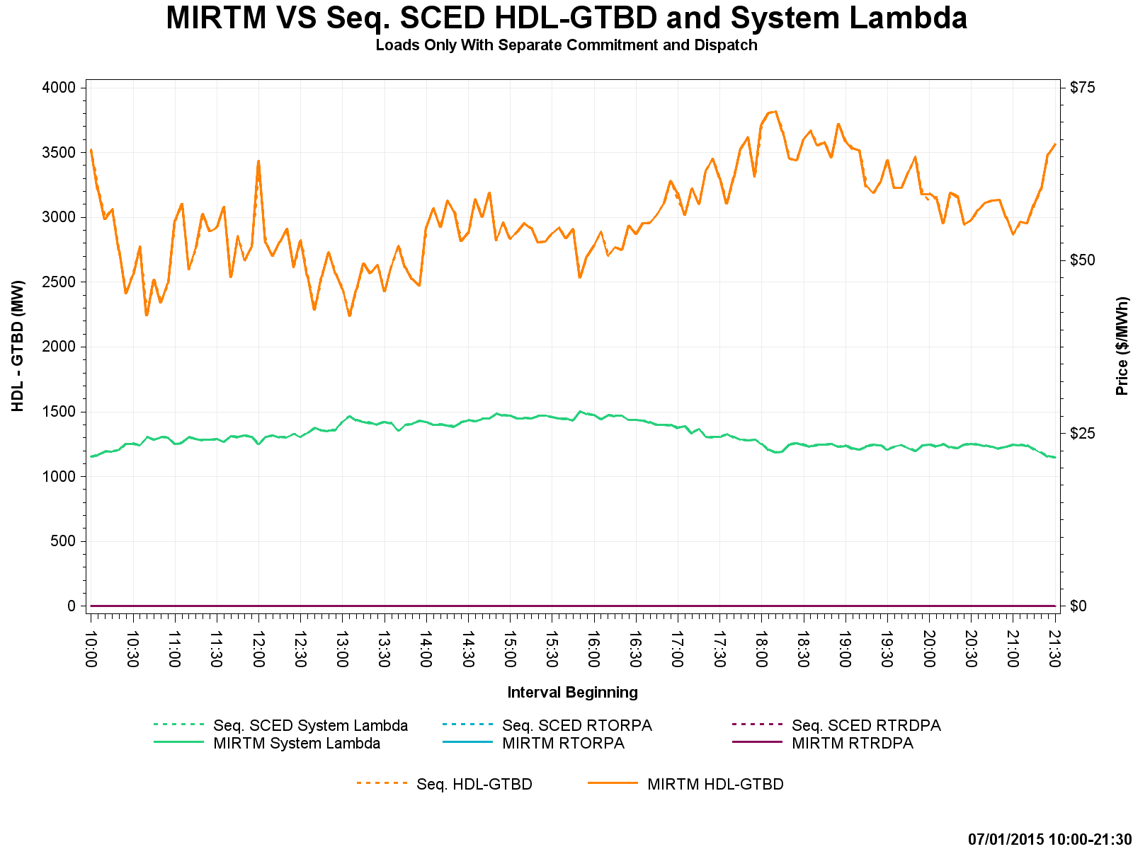
July 1, 2015 – HDL-GTBD & Price
HDL is reduced in MIRTM 3PO due to all QSGRs except for Wartsilas no longer dispatchable in next 5 minutes

Slide 35
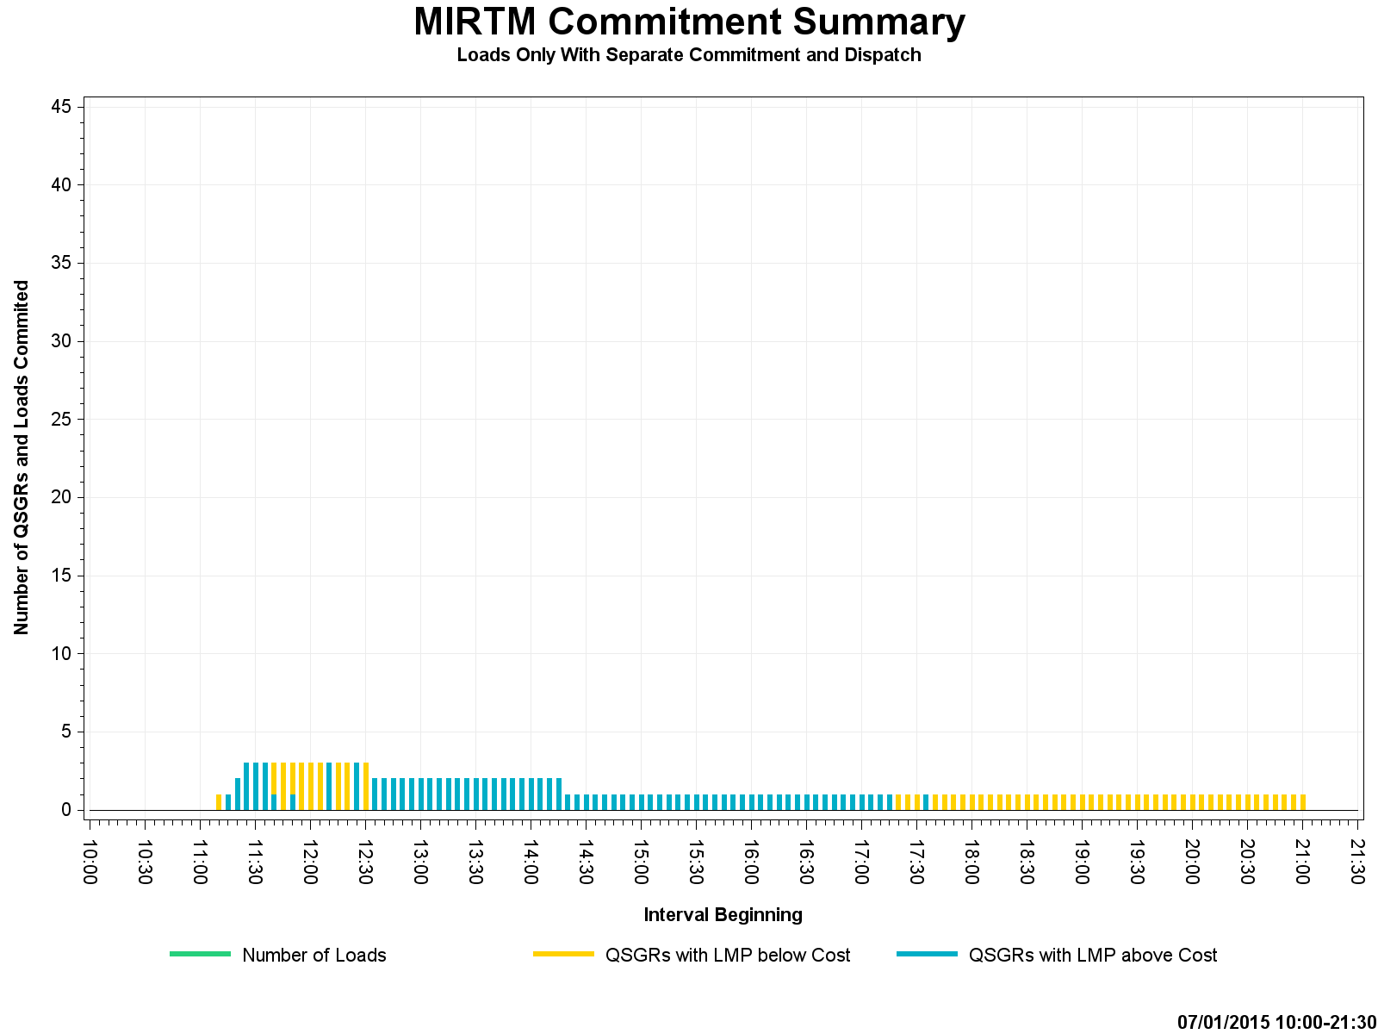
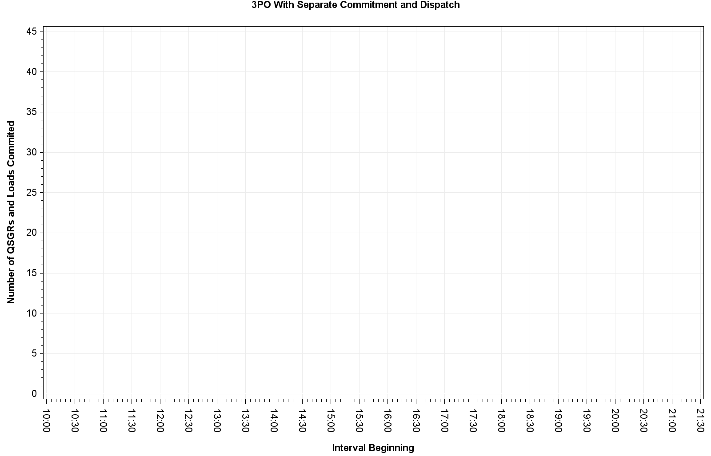
July 1, 2015 – Commitment Summary
These QSGRs mimic self-commitment in production
No QSGRs were committed in 3PO
Notes:
MIRTM Load Only commitment of QSGR is mimicking production self commitments.

Slide 36
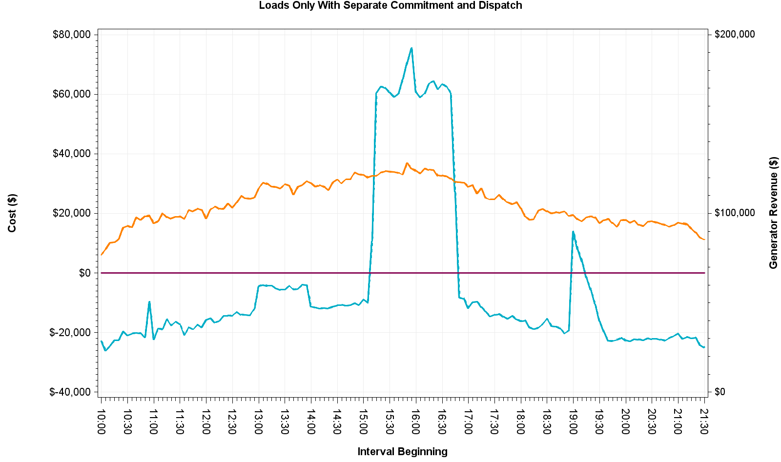
July 1, 2015 – Cost and Revenue

Slide 37
August 11, 2015 – Observations
Luminant Request
Little congestion and low dispatchable capacity
$1.8 million extra LMP revenue and $112k extra dispatch cost in MIRTM 3PO scenario than Seq. SCED due to tighter QSGR commitment
MIRTM had no make-whole payments due to high ORDC price adders

Slide 38
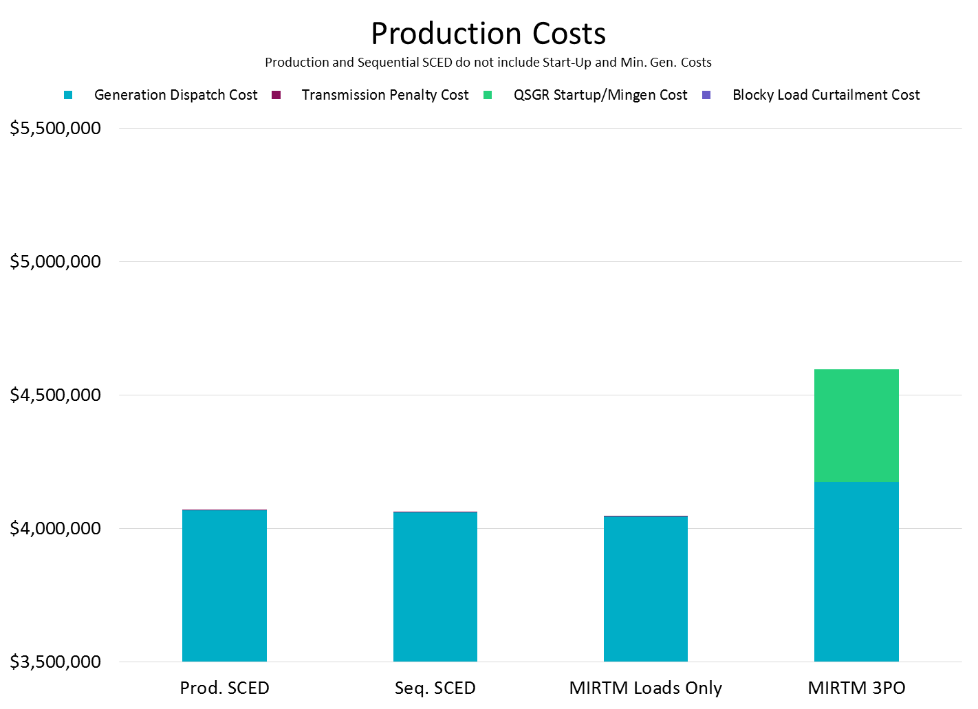
August 11, 2015

Slide 39
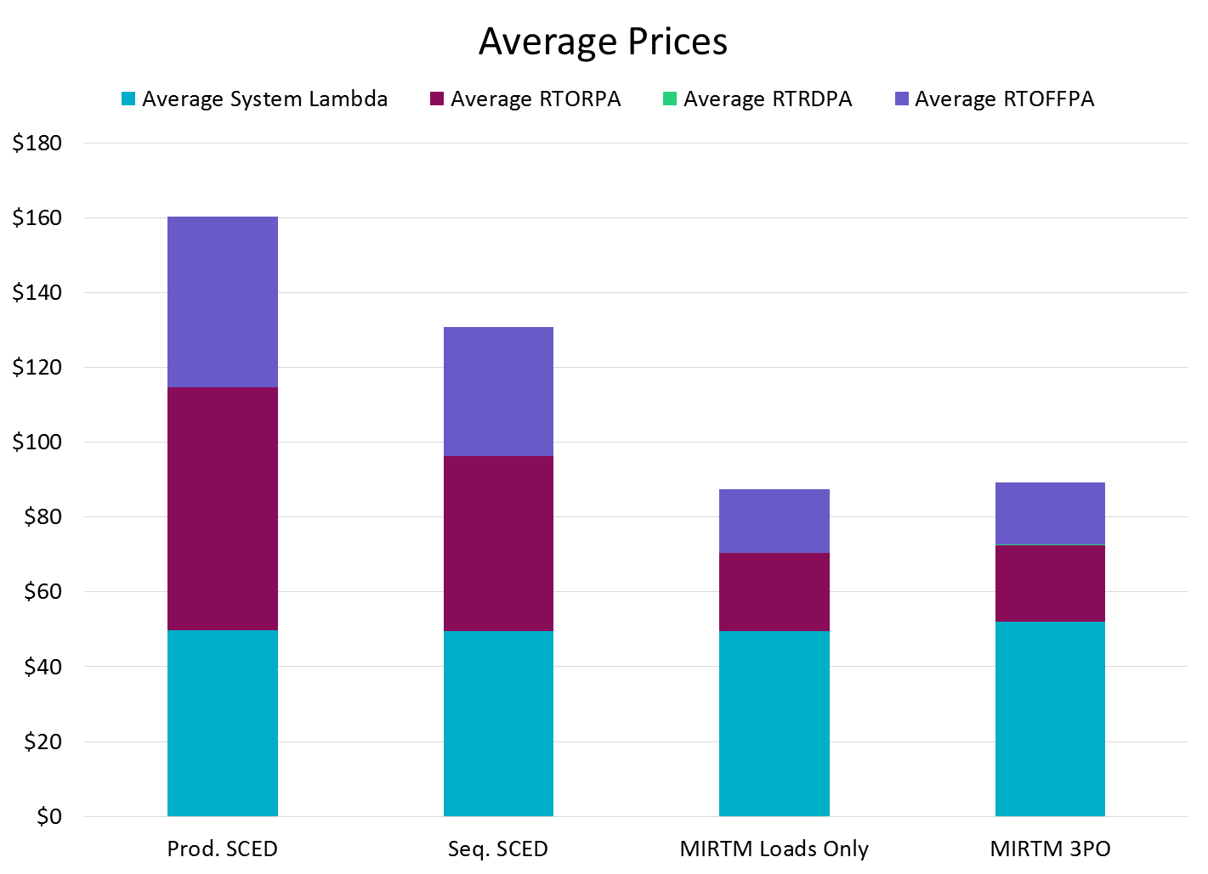
August 11, 2015

Slide 40
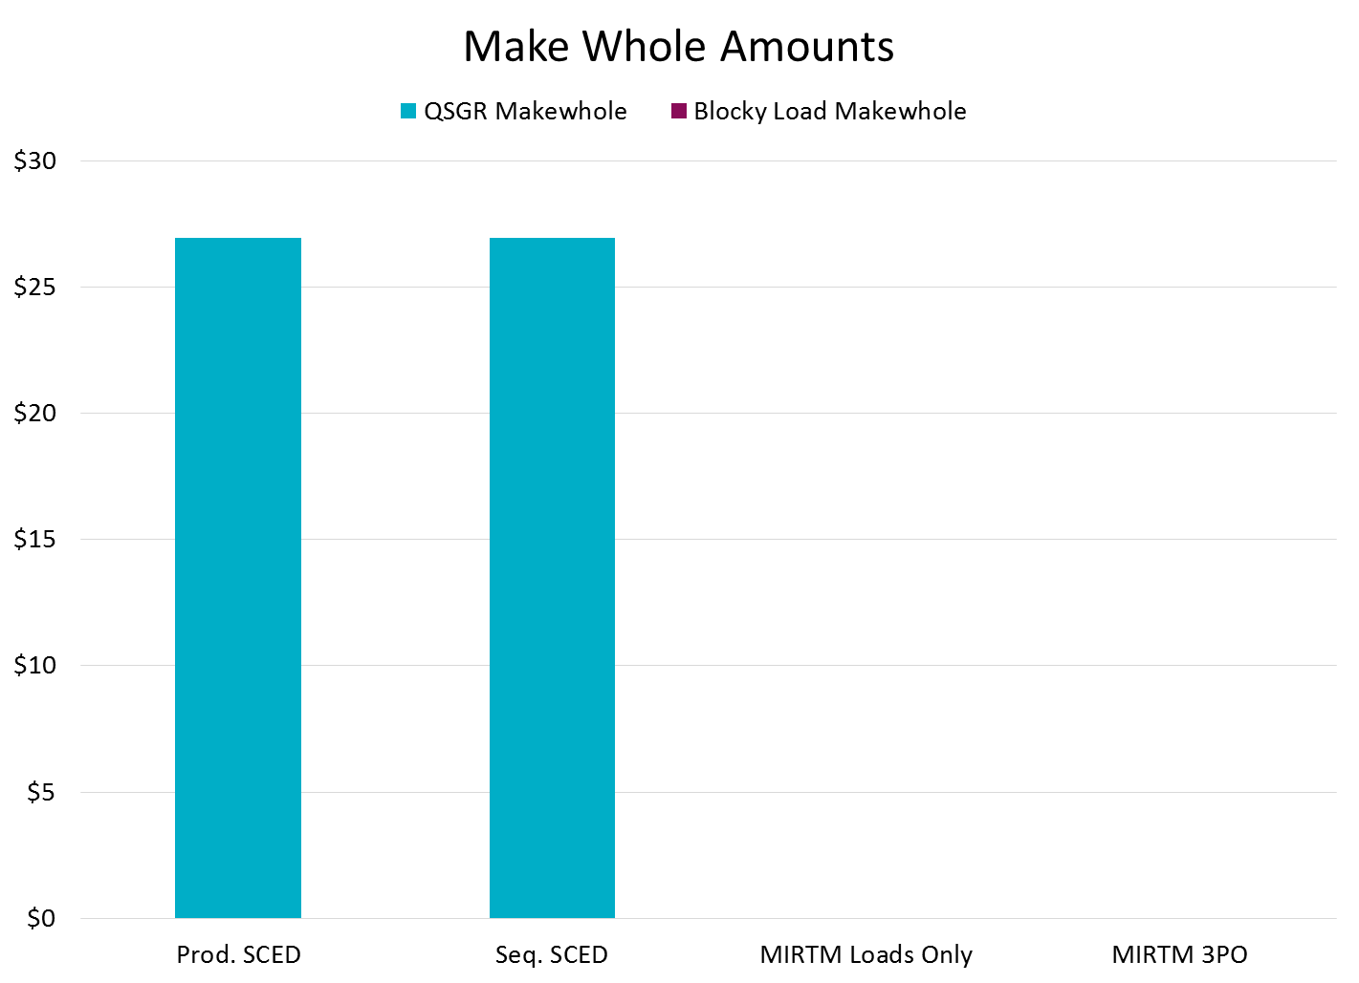
August 11, 2015
MIRTM study scenarios had no make-whole

Slide 41
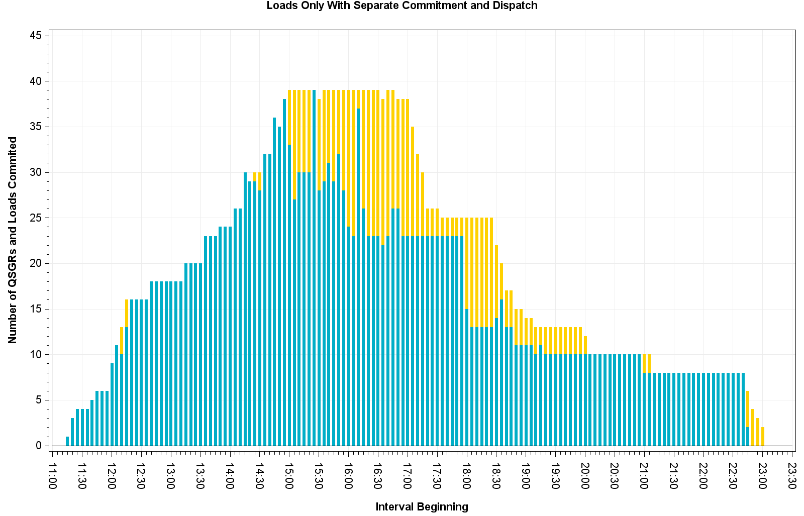
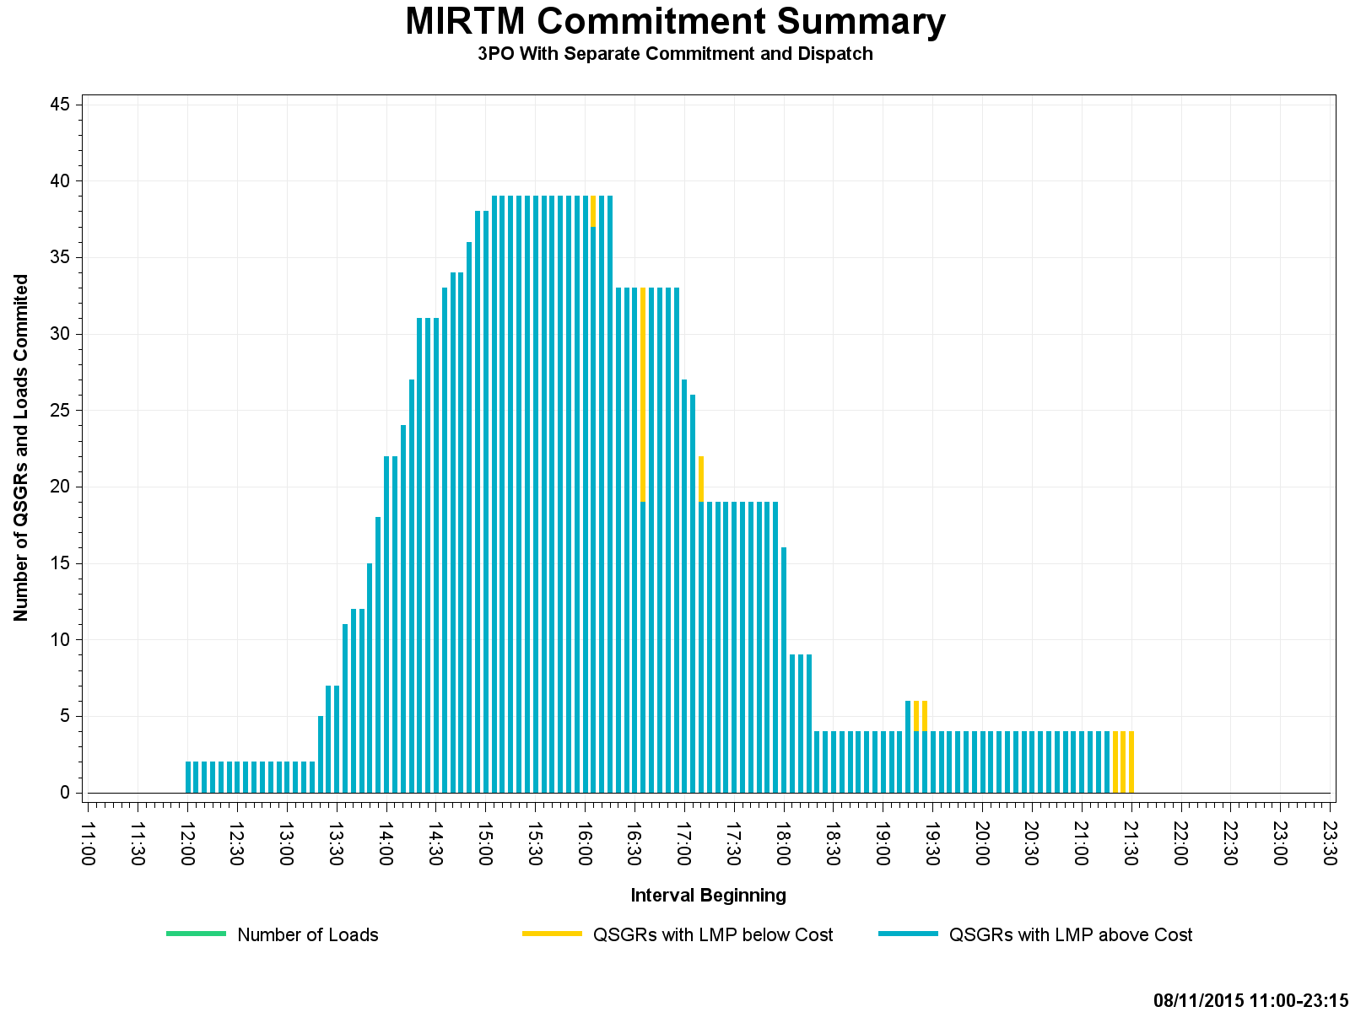
August 11, 2015 – Commitment Summary
Many QSGRs had LMPs below cost in Seq. SCED. No loads were committed.
LMP is only <$0.50/MWh below the 4 QSGRs cost curve. System cost is kept lower by keeping them online.

Slide 42
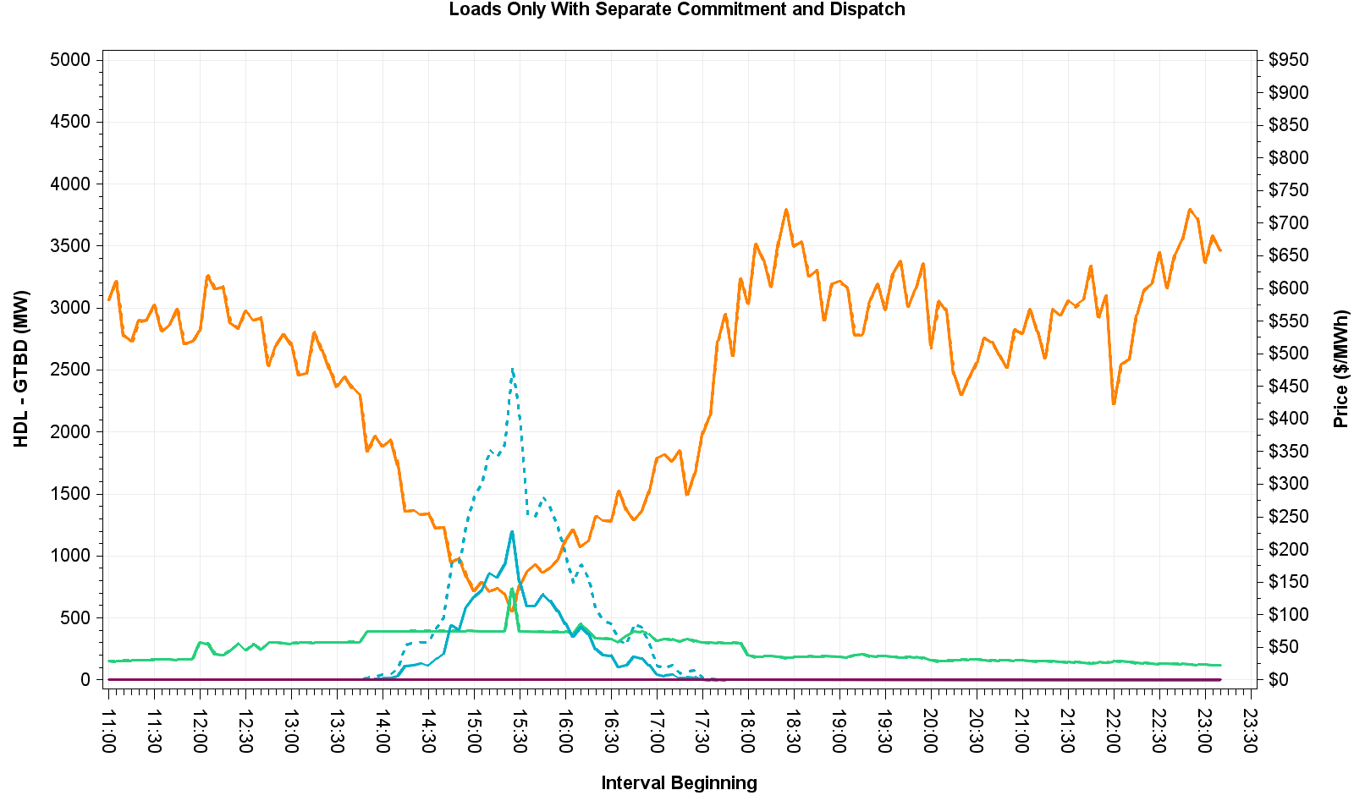
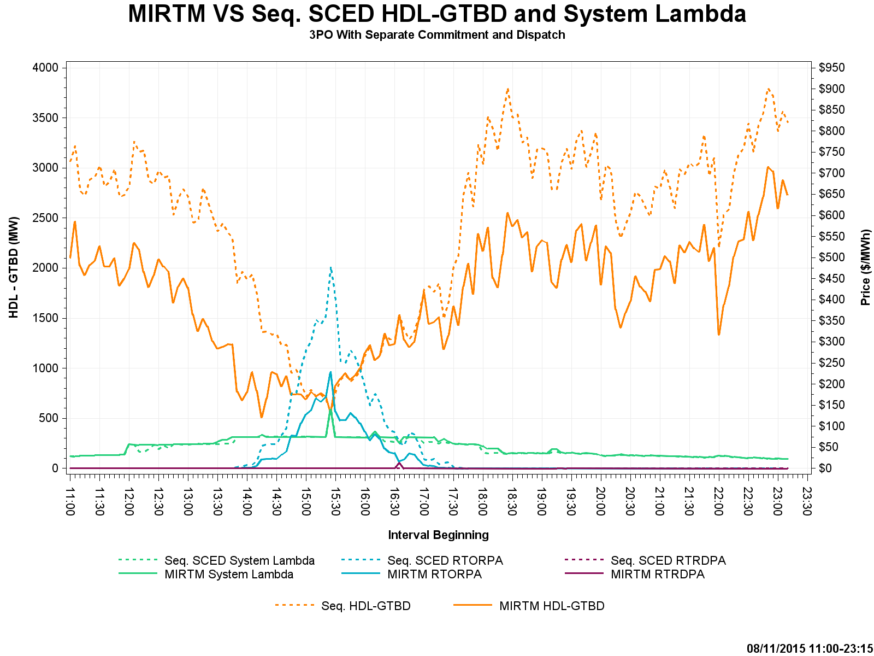
August 11, 2015 – HDL-GTBD & Price

Slide 43
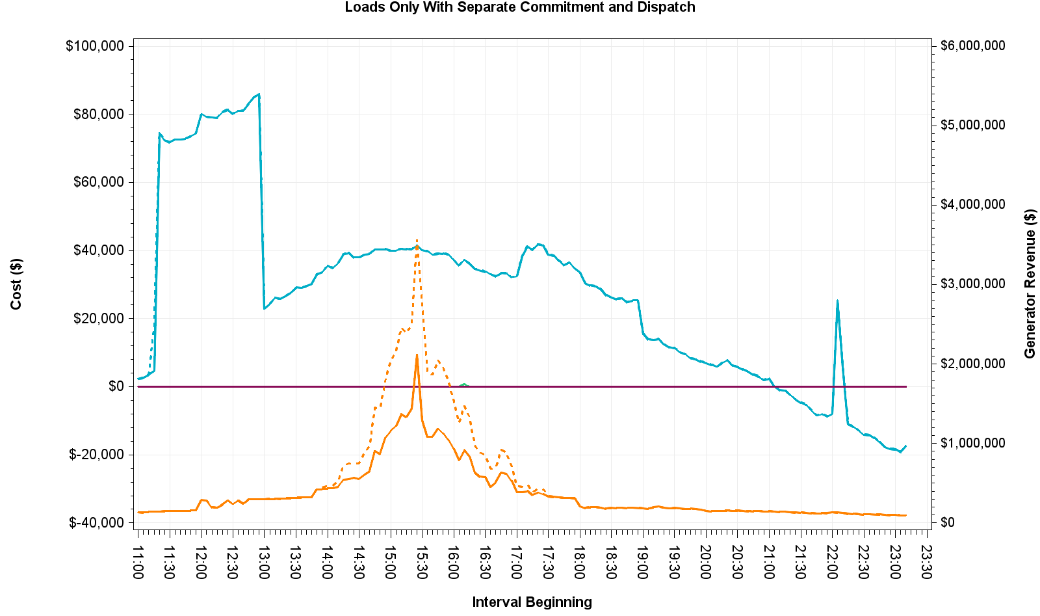
August 11, 2015 – Cost and Revenue

Slide 44
November 11, 2015 – Observations
Large wind down ramp
Many active constraints
Make-whole payments were necessary as a result of tight commitment window

Slide 45
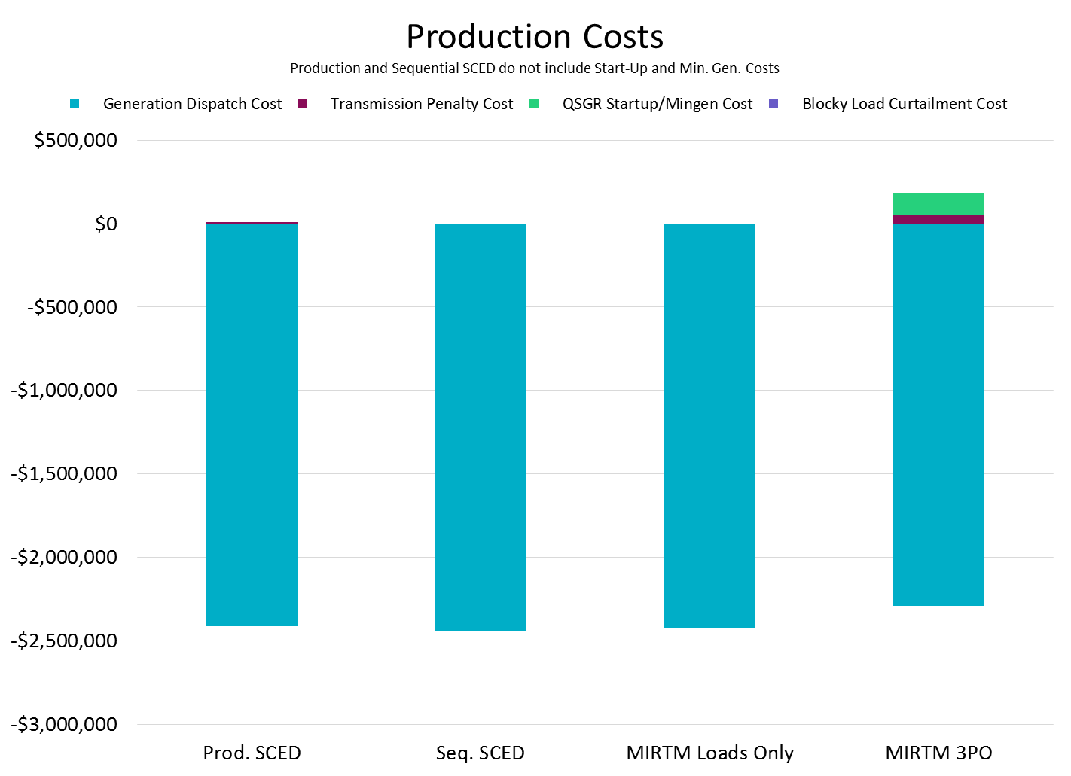
November 11, 2015

Slide 46
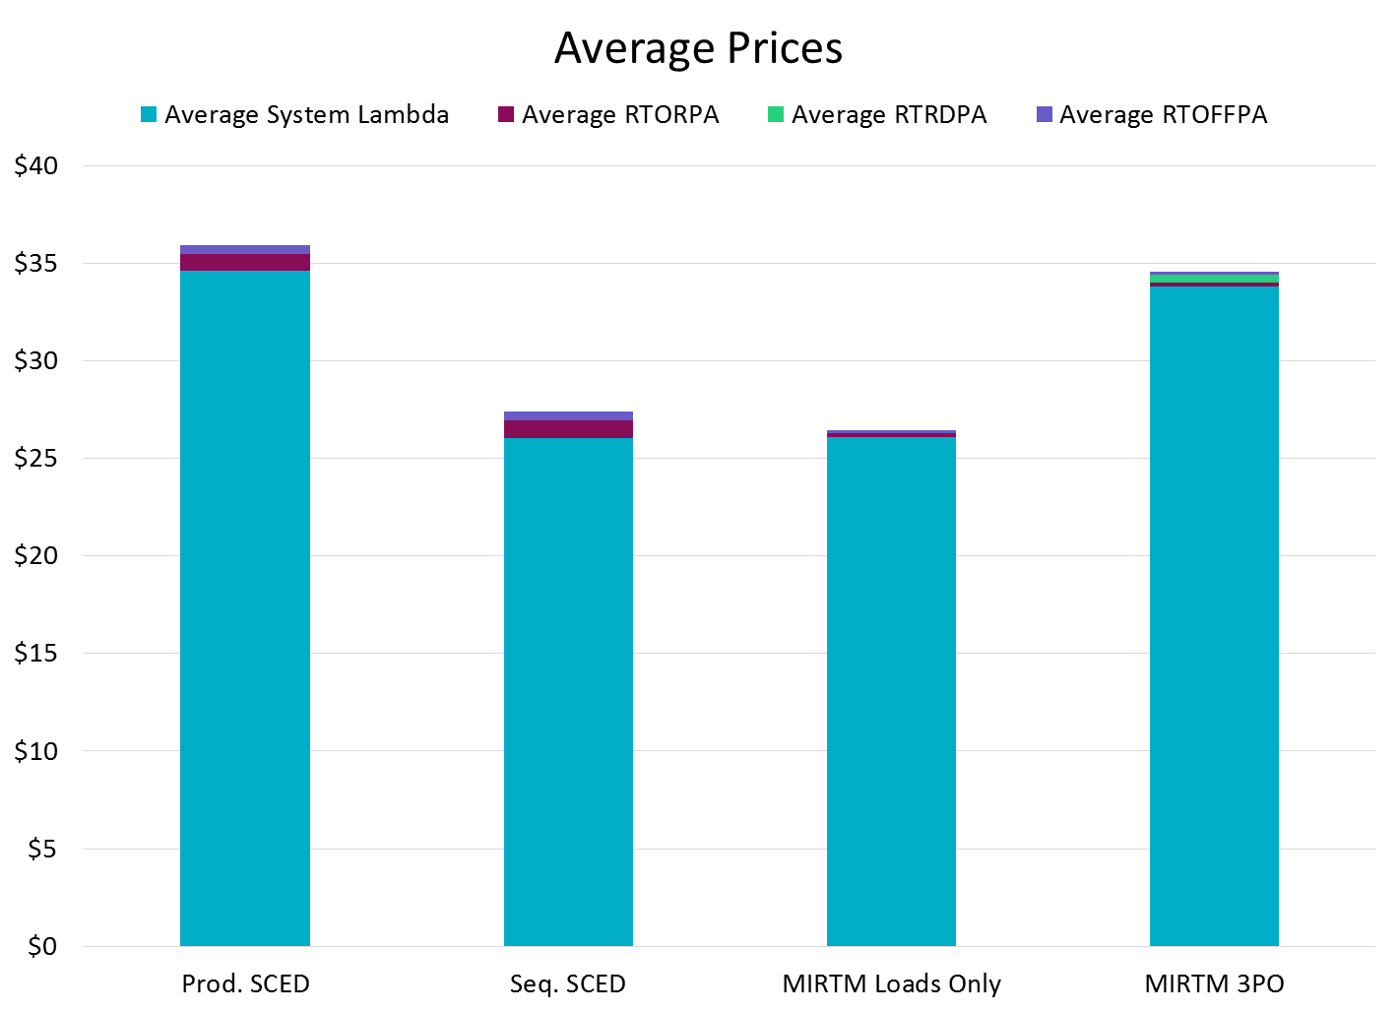
November 11, 2015

Slide 47
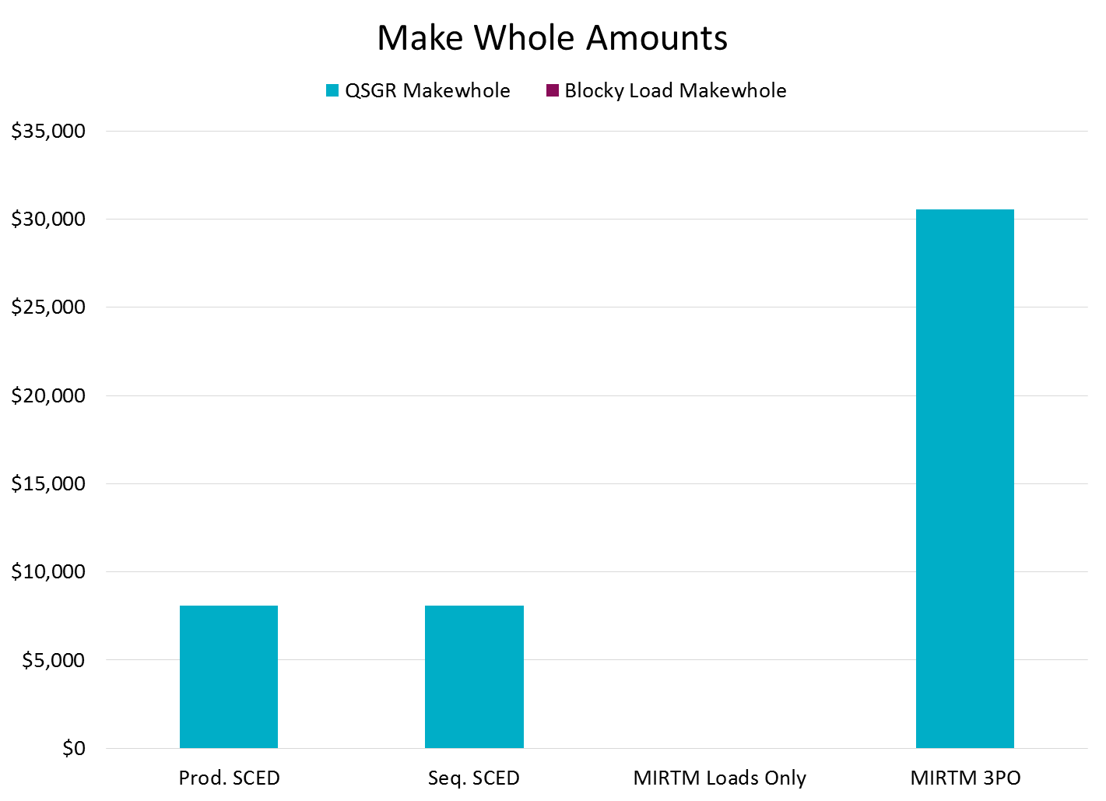
November 11, 2015

Slide 48
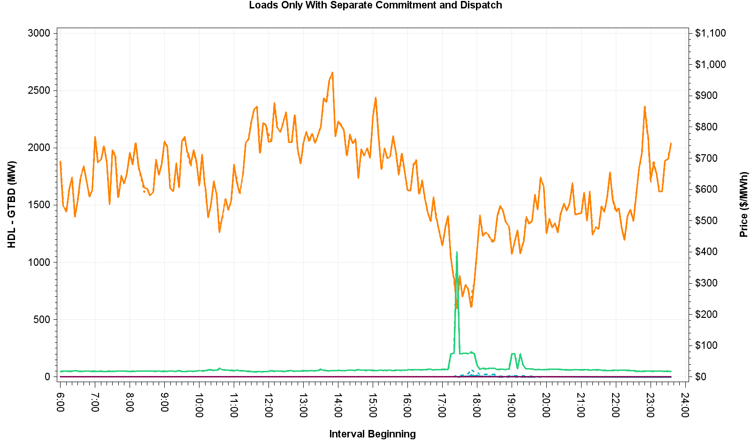
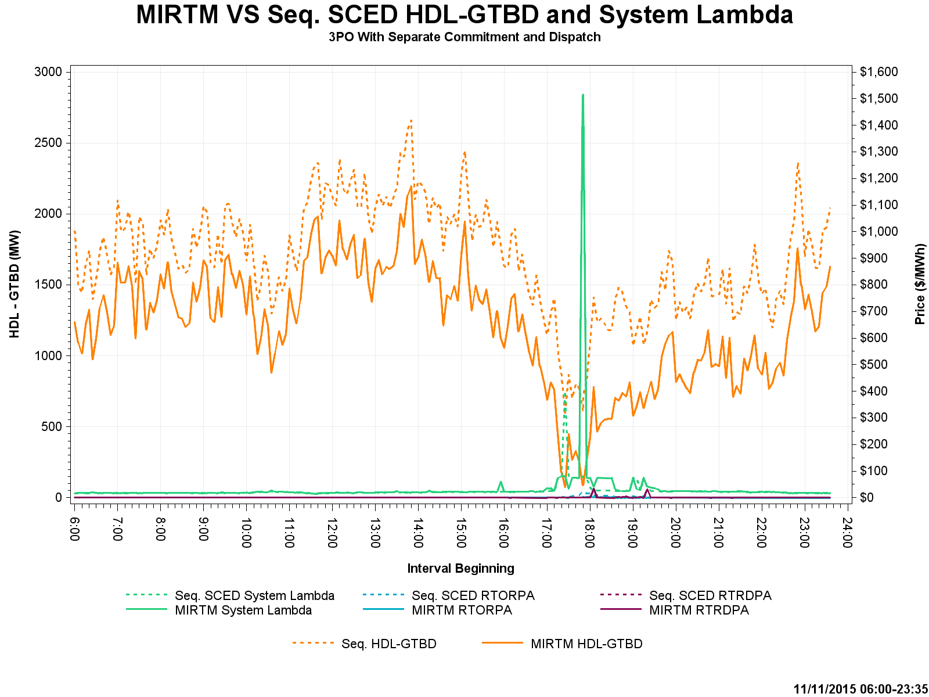
November 11, 2015 – HDL-GTBD & Prices
Cause for price spike at 17:50 in MIRTM 3PO explained on next slide

Slide 49
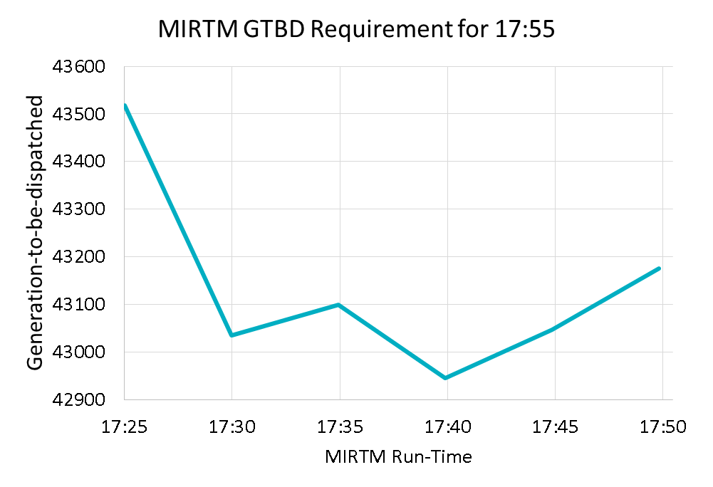
November 11, 2015 – Analysis
MIRTM 3PO had a spike primarily due to regulation up component (73 MW) and load under forecast.
GTBD from Production SCED = MIRTM GTBD
By waiting until the last minute, binding QSGR commitments were not made in this time frame due to forecast decrease

Slide 50
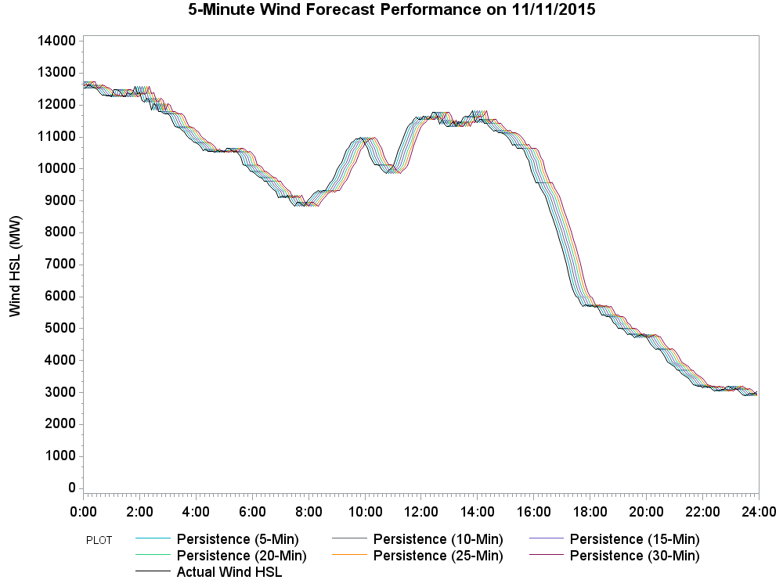
November 11, 2015 – Wind HSL Estimation
Sudden drop in HDL-GTBD due to very large wind down ramp

Slide 51
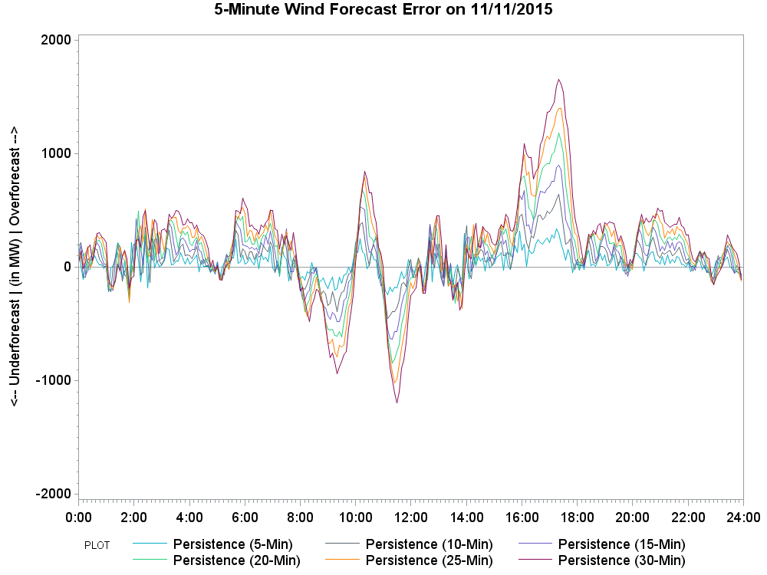
November 11, 2015 – Wind HSL Estimation Error
Persistence results in a large wind HSL estimation error during the down ramp

Slide 52
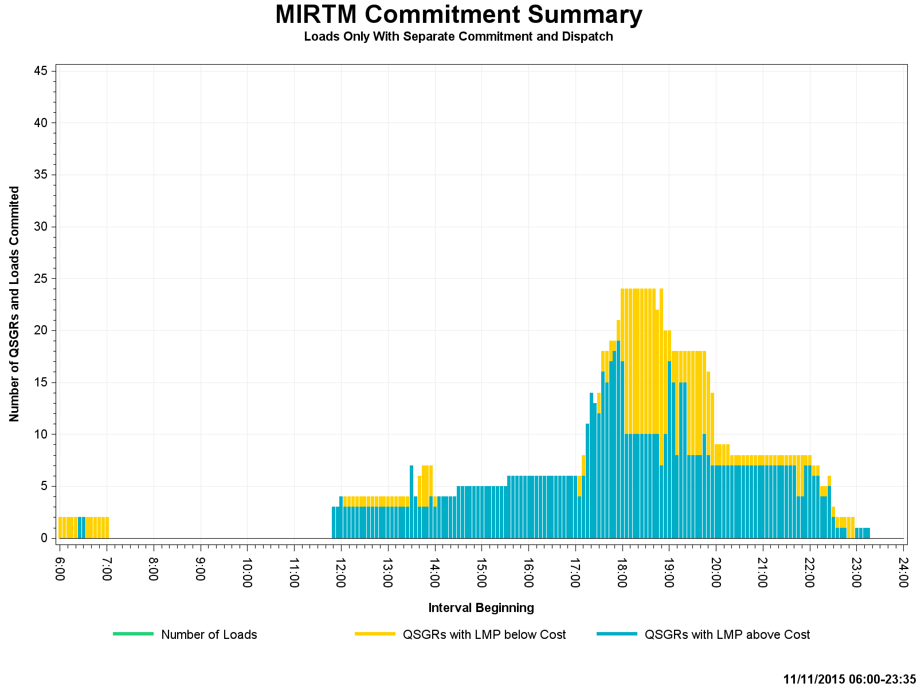
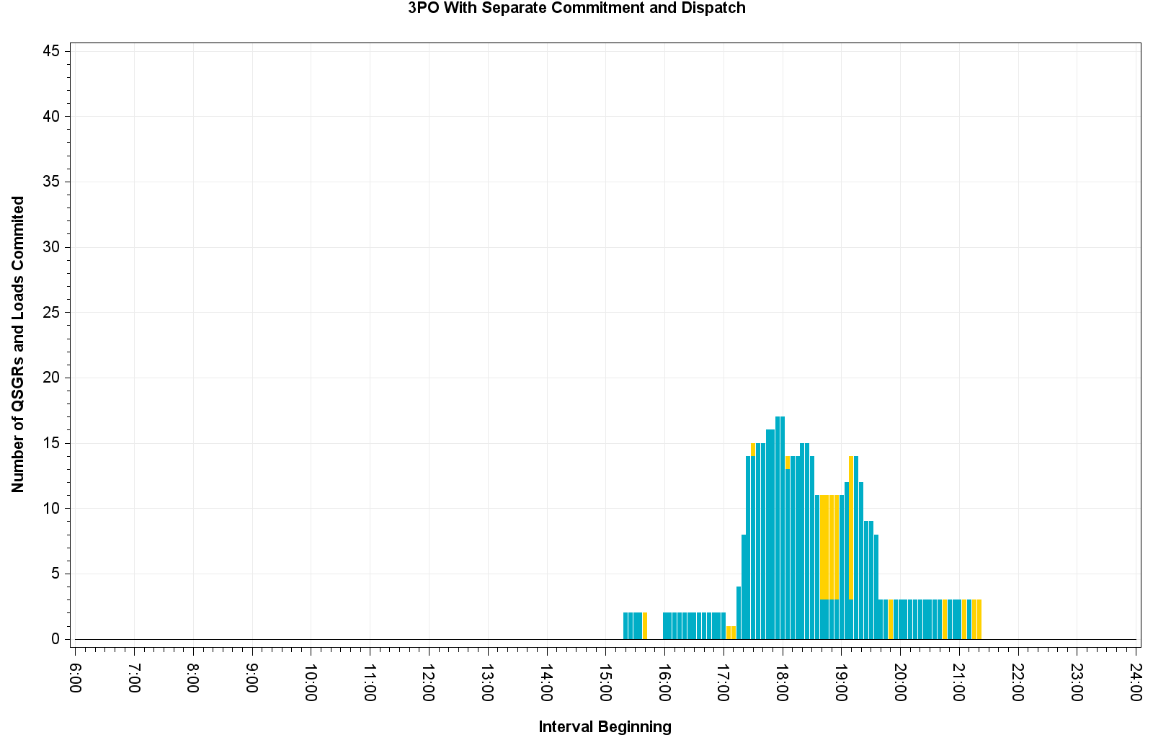
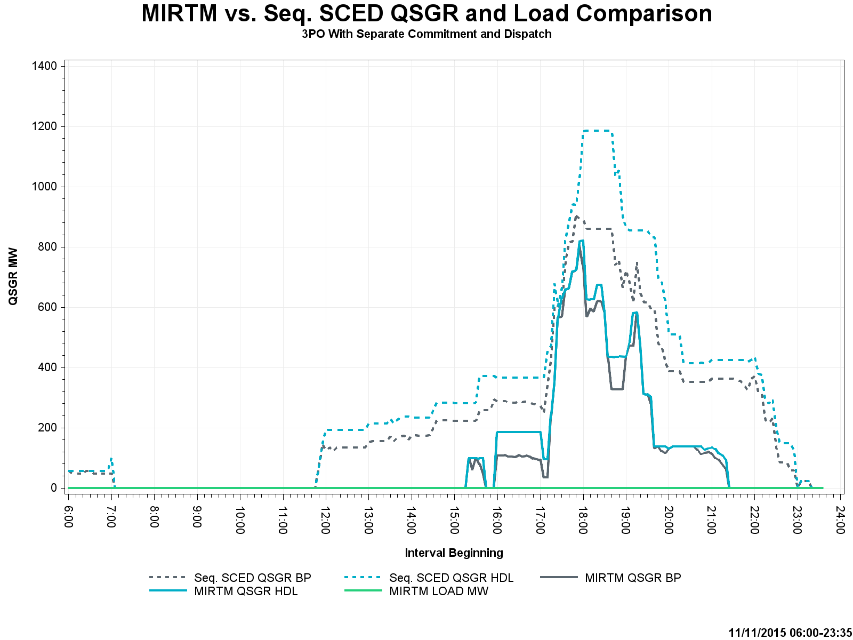
November 11, 2015 – Commitment Summary
MIRTM saw high prices in the future and kept 9 QSGRs online below cost
Sum of Seq. SCED QSGR Base Point @ 17:50 was 185 MW greater than MIRTM 3PO QSGR Base Points.

Slide 53
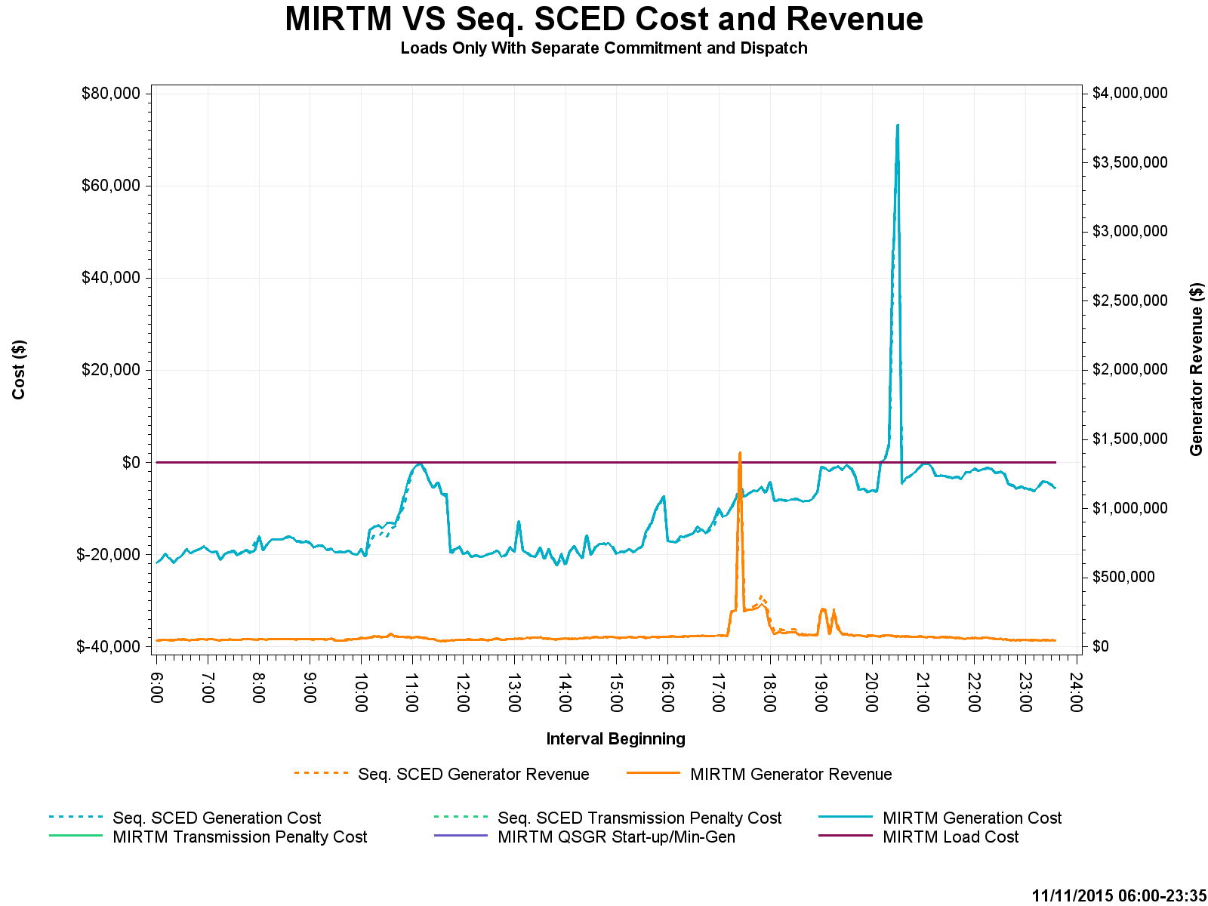
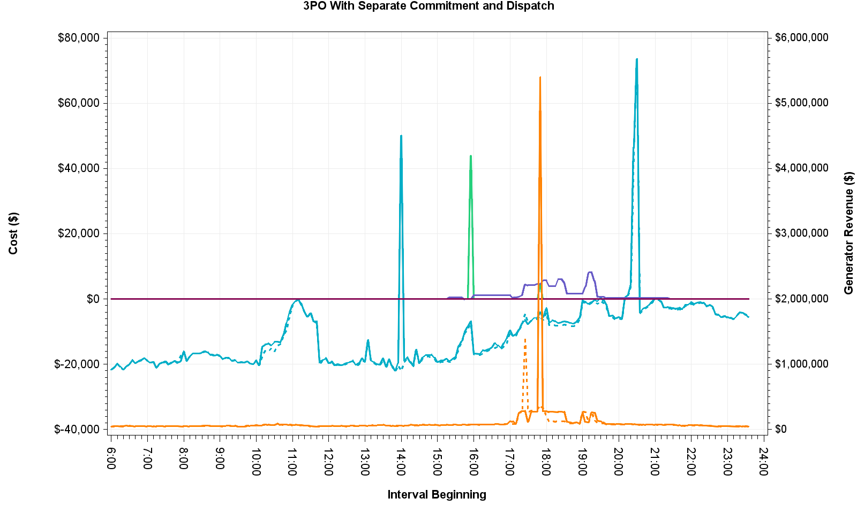
November 11, 2015 – Cost and Revenue
Base case constraint activated at 15:55 and was immediately violated in MIRTM. QSGRs with helping shift factor were self-committed in production but MIRTM could not dispatch QSGR until 16:00 due to temporal constraint
MIRTM production cost spike due to combination of telemetry error from outaged coal unit and unit’s EOC not being mitigated

Slide 54
November 27, 2015 – Observations
Wind steadily decreasing throughout the day
Very little congestion
New short-term load forecast over-forecast over peak contributes to make-whole payments
High price spike in MIRTM 3PO caused by unit shutting down, wind HSL decrease, regulation component in production GTBD, and AS responsibility increase
Binding commitments made at 17:35 and 17:45 cause LMPs to go below some QSGR costs and they are subsequently de-committed after fulfilling minimum run time

Slide 55
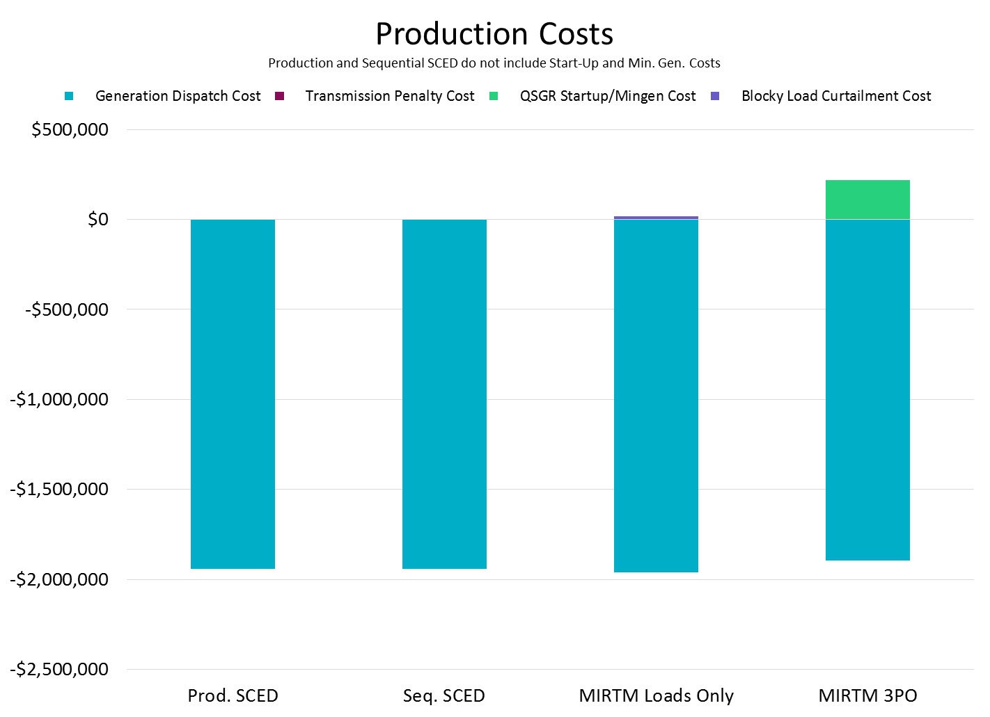
November 27, 2015

Slide 56
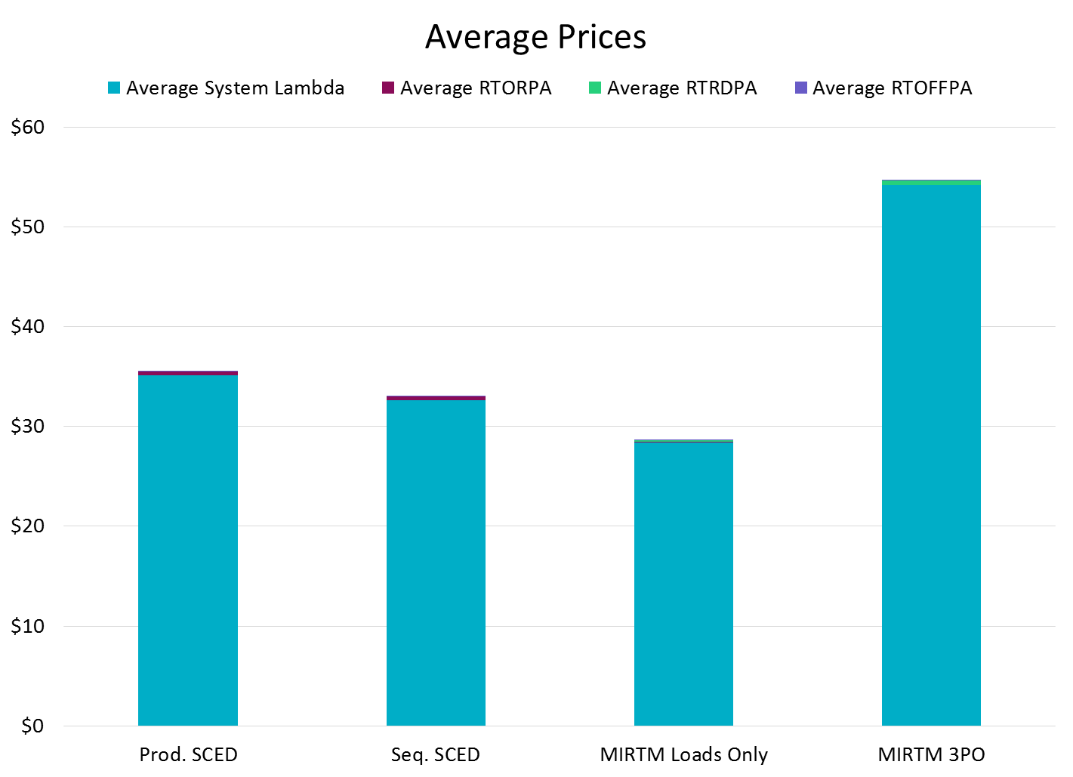
November 27, 2015

Slide 57
November 27, 2015

Slide 58
November 27, 2015 – HDL-GTBD & Price
Note the different y2 axis
Multiple contributors to MIRTM 3PO price spike at 21:05:
When HDL-GTBD is very low, prices are very sensitive to GTBD
Missed GTBD forecast by ~100 MW due to 254 MW regulation component
Regulation Up AS responsibility increased by 96 MW across the hour
170 MW of wind HSL decrease from 20:55 to 21:05
Unit shutting down

Slide 59
November 27, 2015 – Wind HSL Estimation
Wind steadily decreases throughout the day

Slide 60
November 27, 2015 – Wind HSL Estimation Error
Wind over-estimates due to steady wind down ramp

Slide 61
November 27, 2015 – Commitment Summary
Binding commitments made at 17:35 and 17:45 cause LMPs to go below some QSGR costs and they are subsequently de-committed after fulfilling minimum run time
Less QSGR capacity at 21:05 in MIRTM 3PO than Seq. SCED due to reasons mentioned in prior slide

Slide 62
November 27, 2015 – Cost and Revenue
Note the different y2 axis

Slide 63
March 27, 2016 – Observations
Very low dispatchable capacity and inability to commit QSGRs in 5 minutes led to sudden capacity shortage
Low wind
Units shutting down

Slide 64
March 27, 2016

Slide 65
March 27, 2016

Slide 66
March 27, 2016
Make-whole due to a single unit committed for minimum run time (15 minutes) during non-high price period.

Slide 67
March 27, 2016 – HDL-GTBD & Prices
Note the different y2 axis
Cause for price spikes at 21:05 – 21:20 in MIRTM 3PO explained on next slide

Slide 68
March 27, 2016 – Analysis
MIRTM 3PO had spikes primarily due to regulation up component (193 MW) and load under forecast 300-500 MW for consecutive intervals
GTBD from Production SCED = MIRTM GTBD
By waiting until the last minute, binding QSGR commitments were not made in this time frame due to forecast decrease

Slide 69
March 27, 2016 – Commitment Summary

Slide 70
March 27, 2016 – Cost and Revenue
Note the different y-axis

Slide 71
July 25, 2016 – Observations
New short-term load forecast performs well
Low wind and dispatchable capacity
Much tighter QSGR commitment in MIRTM 3PO scenario still reduces LMPs by ~$34 million and dispatch cost by $130k at the expense of $81k more make-whole than sequential SCED
MIRTM Load scenario reduces prices by ~$2 million at the expense of $11k more make-whole than sequential SCED

Slide 72
July 25, 2016

Slide 73
July 25, 2016

Slide 74
July 25, 2016

Slide 75
July 25, 2016 – HDL-GTBD & Prices
Note the different y-axis

Slide 76
July 25, 2016 – Commitment Summary

Slide 77
July 25, 2016 – Cost and Revenue
Note the different y2 axis

Slide 78
Appendix: Example MIRTM Study Run

Slide 79
Example MIRTM Study Run
System with the following conditions:
Initial load is 50,000 MW
Assume demand (GTBD) forecast is correct
Generation Mix:
50,001 MW of dispatchable generation priced at $50/MWh
100 MW Fast Start Resource:
Single Part Offer with all MWs at $200/MWh
LSL=40, HSL=100
Minimum Run Time = 15 minutes
Notification Time = 5 minutes
When a Generation Resource is committed for a future interval, the MW output remains zero till its first committed interval. At the end of the first committed interval, the MW output of the Generation Resource is the desired Base Point. Thus, this fast start resource will be fully at its Base Point in 10 minutes with a notification time of 5 minutes.

Slide 80
Example MIRTM Study Run

Slide 81
Example MIRTM Study Run
Results are interval ending. In this run, binding commitment lasts from 12:20 – 12:35
Indicative price increase comes only after pricing run (fast start becomes part of price formation when LSL is relaxed)

Slide 82
Example MIRTM Study Run

Slide 83
Example MIRTM Study Run

Slide 84
Example MIRTM Study Run

Slide 85
Example MIRTM Study Run

Slide 86
Example MIRTM Study Run

Slide 87
Example MIRTM Study Run

Slide 88
Example MIRTM Study Run

Slide 89
Example MIRTM Study Run

Slide 90
Example MIRTM Study Run

Slide 91
Example MIRTM Study Run

Slide 92
Example MIRTM Study Run

Slide 93
Example MIRTM Study Run

