Slide 1
Standards 102
Rachel Coyne
Manager, Reliability Standards Program

Slide 2
Resources
Rules of Procedure Appendix 3A – Standards Processes Manual
  NERC Standards Webpage
  One Stop Shop Spreadsheet
  Reliability Standards
  U.S. Enforcement Dates
  Functional Applicability Spreadsheet
  Balloting and Commenting
NSRS Mailing List
NERC Standards Balloting System

Slide 3
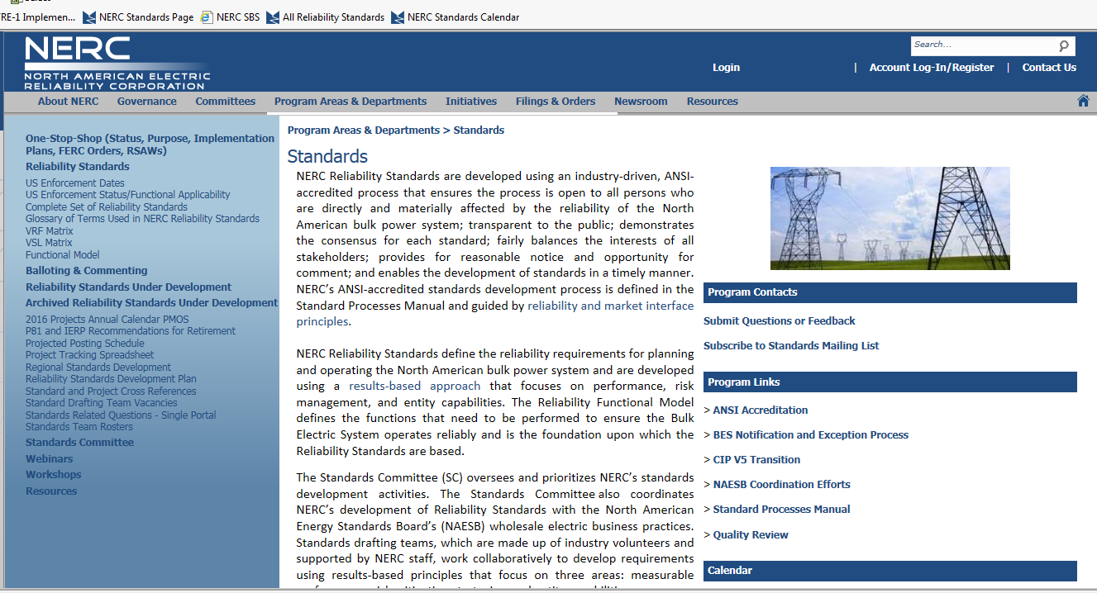
NERC Standards Webpage

Slide 4
SAR Posting
SAR is posted for 30 or 45 days
Industry provides comments
SDT reviews comments

Slide 5
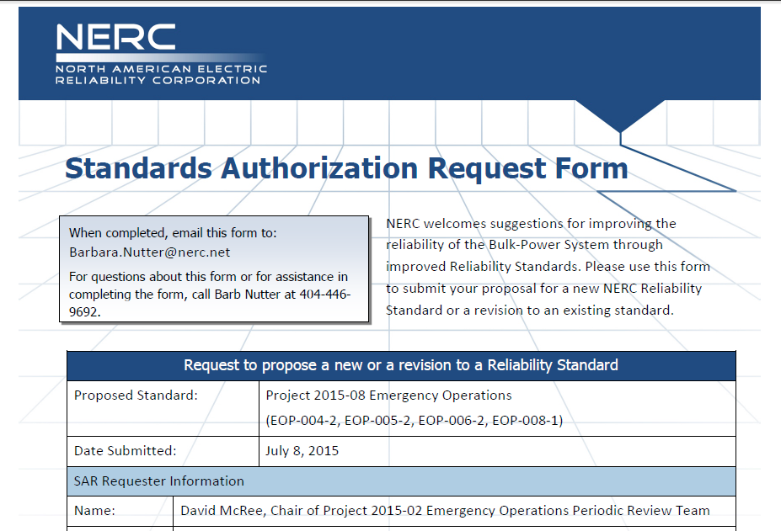
SAR Posting
A Standard Authorization Request (SAR) is the form used to document the scope and reliability benefit of a proposed project for one or more new or modified Reliability Standards or definitions or the benefit of retiring one ore more approved Reliability Standards.

Slide 6
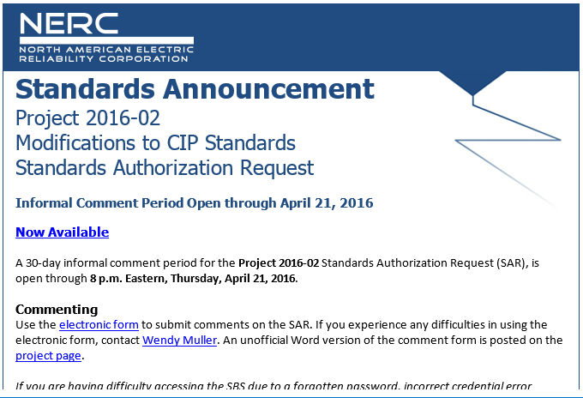
SAR Posting
NERC sends a Standards Announcement

Slide 7
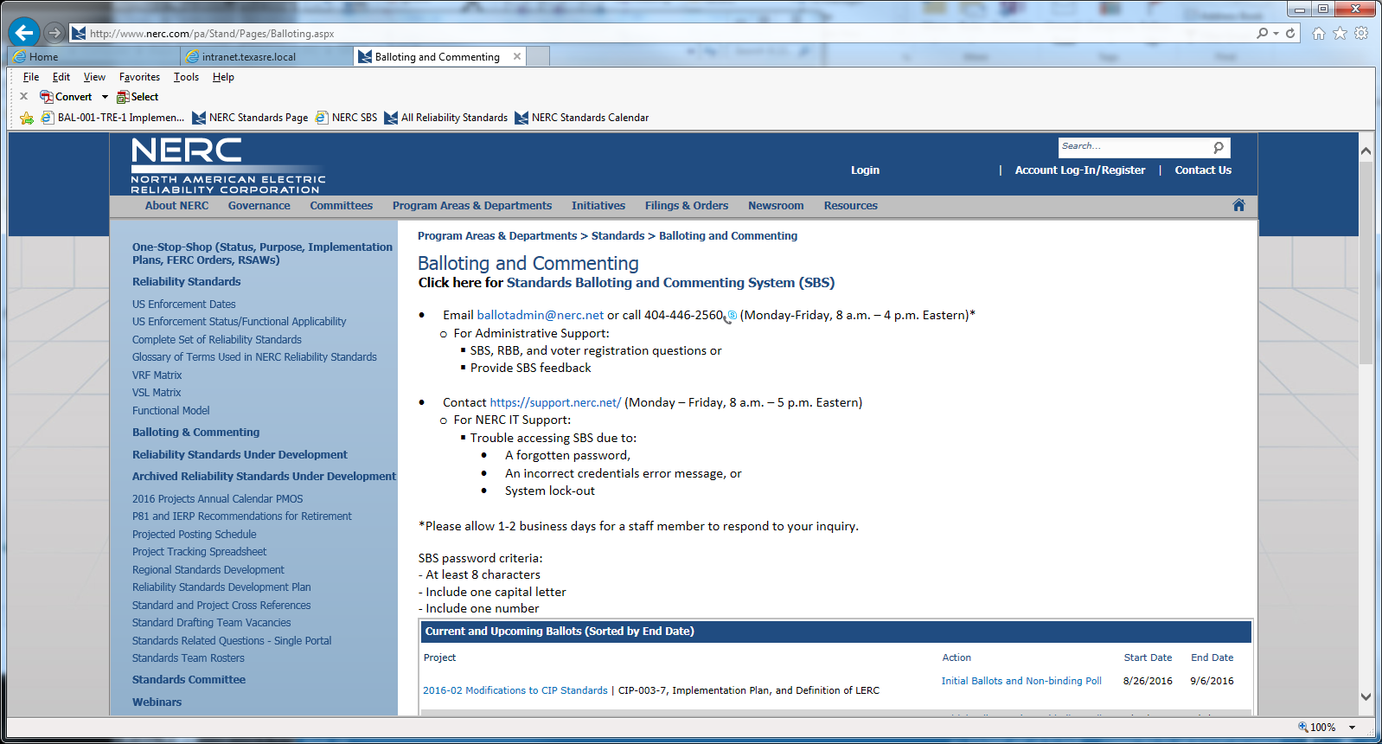
SAR Posting
Look up project on the project page

Slide 8
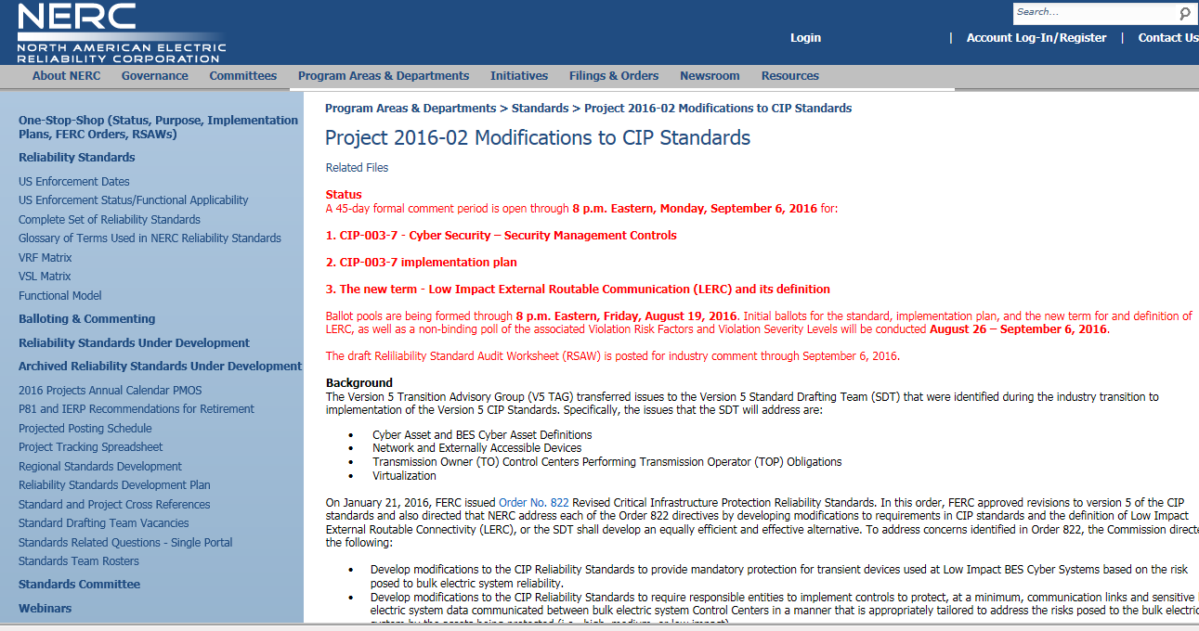
SAR Posting
Look up project on the project page

Slide 9
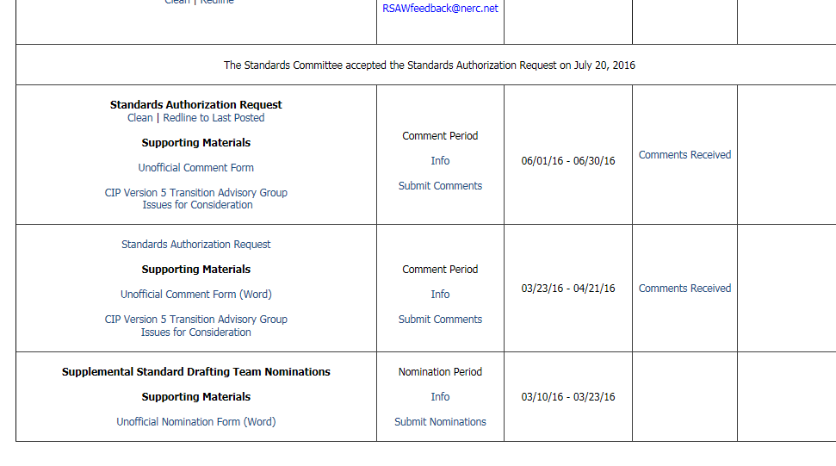
SAR Posting

Slide 10
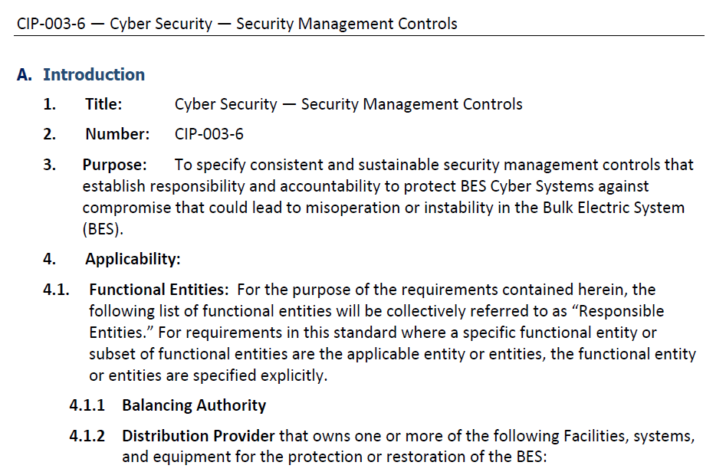
SAR Posting
Does the Standard apply to my organization?
  Check applicability section
Functional Applicability Spreadsheet

Slide 11
SAR Posting
Draft comments
  Are there any other pain points in this Standard?
  Are there any implications for this region?

Slide 12
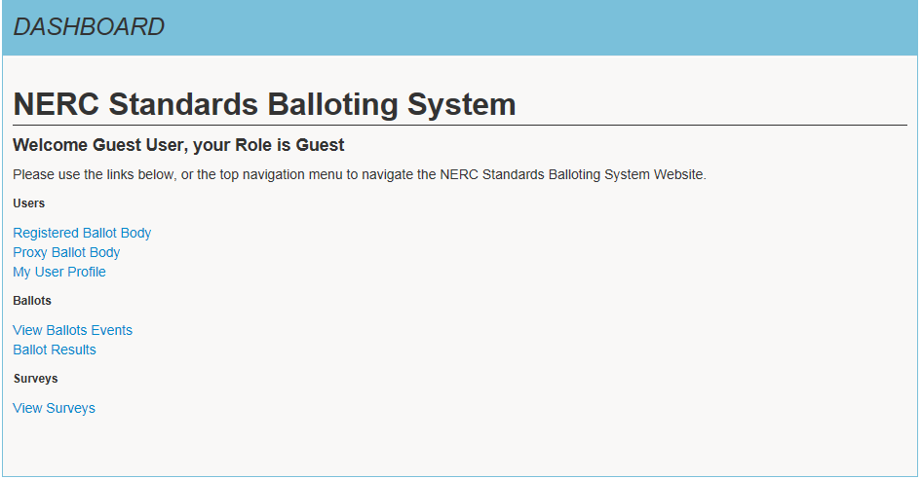
SAR Posting
Submit comments using the NERC Standards Balloting System (SBS).
Training slides for SBS located on NERC’s website: Balloting and Commenting page.

Slide 13
Draft Standard is Posted
Standard is posted for initial and formal 45 day comment period
Join Ballot Pool during the first 30 days of the comment period
Industry provides comments
SDT reviews comments
Notes:
Ballot pool formation. Join ballot pool.

Slide 14
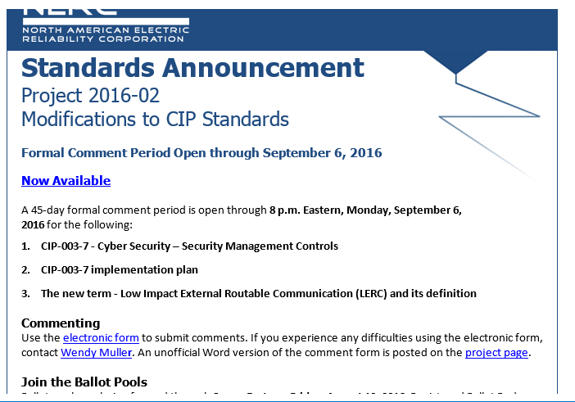
Draft Standard is Posted
NERC sends a Standards Announcement

Slide 15
Draft Standard is Posted
Look up project on the project page

Slide 16
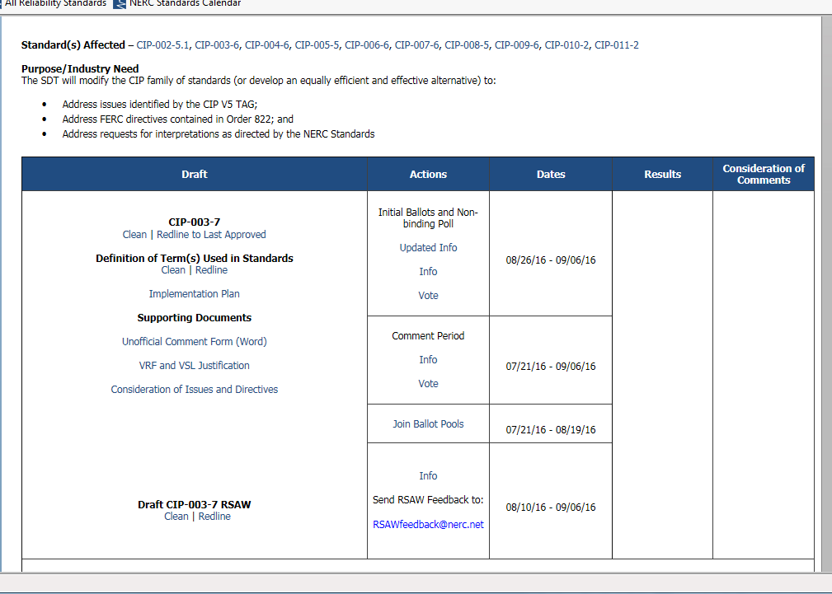
Draft Standard is Posted
Look up project on the project page

Slide 17
Draft Standard is Posted
Does the Standard apply to my organization?
  Check applicability section
Functional Applicability Spreadsheet

Slide 18
Join Ballot Pool
Ballot pool is established during the first 30 calendar days of the 45-day formal comment period.
NERC Standards Balloting System

Slide 19
Draft Standard is Posted
Draft comments
  Review comments submitted during SAR phase.
  Will the proposed revisions change the way things are done in this region?
  Review the draft RSAW.
Texas RE Website > Standards > National Reliability Standards > NERC Standards Review Guidance and Checklist for Registered Entities

Slide 20
Draft Standard is Posted
Submit comments using the NERC Standards Balloting System (SBS).
Training slides for SBS located on NERC’s website: Balloting and Commenting page.
The Standard Drafting will then meet and review all comments.

Slide 21
Conduct Ballot
Standard is posted for 10 day initial ballot period
Industry votes
NERC provides ballot results

Slide 22
Conduct Ballot
NERC sends a Standards Announcement
Submit vote via NERC SBS, if you had previously joined the ballot pool.

Slide 23
Additional and Final Ballots

Slide 24

Questions?
Contact Rachel Coyne at rsm@texasre.org
512-583-4956
Notes:
Should my contact info be on here somewhere?

