Slide 1
Project Update and Summary of
Project Priority List (PPL) Activity
September 15, 2016

Slide 2
Project Update Agenda
Project Portfolio Update p. 3-8
  Recent/Upcoming Project Highlights
  2016 Release Targets
  2016 Project Spending Forecast
  Revision Request Funding Placeholder Status
  TAC Referral: Tracking Funds for Upgrade Revision Requests
  Priority/Rank Options for Revision Requests with Impacts
Appendix
  Project Portfolio Gantt Chart p. 9-17
Location of Project Priority List (PPL): http://www.ercot.com/services/projects/index

Slide 3
Recent / Upcoming Project Highlights
2016 August Release – Week of 8/30/2016 Complete
  NPRR662 – Proxy Energy Offer Curves
  NPRR712 – Clarification of RUC Process
2016 September Release – Week of 9/26/2016 In Flight
  NPRR219 – TSPs Must Submit Outages for Resource Owned Equipment and Clarification of Changes in Status of Transmission Element Postings
  SCR783 – Outage Scheduler Enhancements -- Groups 2 and 3, Group Outage, Usability and Filtering Enhancements
  NOGRR050 – Resolution of Reporting Issues Related to NPRR219
  NOGRR143 – Alignment of Nodal Operating Guides with NERC Reliability Standard, BAL-001-TRE-1
Note: Projected Go-Live dates are subject to change.
Please watch for market notices as the effective dates approach.

Slide 4
2016 Release Targets – Board Approved NPRRs / SCRs / xGRRs
February 2/2 – 2/4 | April 4/12 – 4/14 | June 6/21 – 6/23 | August 8/30 – 9/1 | September 9/26 – 9/30 | December 12/6 – 12/8
NPRR588 NPRR615 NPRR686(b) | NPRR419 NPRR728 COPMGRR040 | NPRR515 NPRR617 NPRR700 NPRR719 NPRR742 VMCRR008 EMS Upgrade | NPRR662 NPRR712 RMGRR126 RMGRR137 | NPRR219 SCR783 NOGRR050 NOGRR143 NMMS Upgrade NPRR495 NPRR736 NPRR770 | NPRR573 NPRR754 NOGRR147 SCR787 SCR788 RMGRR127 RMGRR140 SCR786
3 | 3 | 6 | 4 | 7 | 8
E
E
E
E
E
E
E
E
H
P
P
P
I
E
E
E
9/22 TBD
5/1
6/16
7/23 – 7/24
12/10 – 12/11
11/1 – 11/3
EMS Upgrade “Chill”
2016 TBD Items (and point at which they became “TBD”)
2014 | 2015 | February 2016 | April 2016 | June 2016 | August 2016
NOGRR084, NPRR664 | None | SCR781 H | None | None | None
Go-live dates can differ from Protocol effective dates – Please refer to market notices for more details
APPENDIX
Red Text: New additions and target release changes
Strike-Through Text: Previous target release changes
(a), (b), etc. indicates multiple phases
In-Flight Items Planned for 2017 Delivery
CMM bundle (Planning): NPRR519, NPRR620, NPRR683, NPRR702, NPRR741, NPRR743
CRR Upgrade (Planning): SCR777
Release targets are subject to change
NPRR686(b) – Solar portion
Items Originally Targeted for 2016 Now Planned for 2017 Delivery
RRGRRs 03,06,07,09 (2017-R1 target)
NPRR272 (2017-R1 target)
NPRR714 (2017-R3 target)
Project Status Codes: NS = Not Started, I = Initiation, P = Planning, E = Execution, H = On Hold

Slide 5
2016 Project Spending Forecast
2016 PPL Budget = $22.5M
“Potential Demand” represents internal ERCOT projects that have not been fully approved

Slide 6
Revision Request Funding Placeholder Status
In 2016 and 2017, ERCOT forecasted $4.0M for Revision Request work
Yearly Revision Request Spending Forecast Summary
Project Status | 2016 | 2017
YTD Actuals | $1.72M | –
Approved – In-Flight / Complete | $2.55M | $0.63M
Approved – On Hold | $0.01M | $0.40M
Approved – Not Started | $0.24M | $1.34M
Remaining Funding | $1.20M | $1.63M
Total Allocation | $4.00M | $4.00M
As of 7/31/2016
Each year, an additional $400k is held in reserve in the event the $4M allocation is insufficient

Slide 7
Prioritization of Upgrade Revision Requests
PRS and TAC have discussed the fact that SCR789 – Update NMMS Topology Processor to PSSE 34 Capability is an upgrade project that should have market awareness but may not be appropriate for tracking against the market’s target project budget allocation
Options
  When ERCOT and PRS agree that a Revision Request is not an enhancement it is excluded from market spending metric
  No change – these situations don’t come up very frequently
Request PRS members consider these options and bring forward any other alternatives for a detailed discussion in September
ERCOT supports an approach where such projects are excluded from market funding tracking when a consensus to exclude is reached at PRS

Slide 8
Priority / Rank Options for Revision Requests with Impacts
Options for…
Revision Request | Description | Priority | Rank | Comments
NPRR755 | Data Agent-Only QSE Registration [ERCOT] | 2016 | 1559 | Closely aligns with NPRR519 – try to include in the CMM project since it is still in Planning
NPRR775 | Enhanced Implementation of Limits for Fast Responding Regulation Service [ERCOT] | 2017 | 1830 | Add to 2017 queue
NPRR789 | Publish All Mid-Term Load Forecast Results [Citigroup Energy] | 2017 | 1840 | Add to 2017 queue

Slide 9
Appendix
  8/31/2016 Project Gantt
    In-flight items sorted by Project End Date
    “On Hold” projects listed separately
    “Not Started” items sorted by Project Start Date

Slide 10
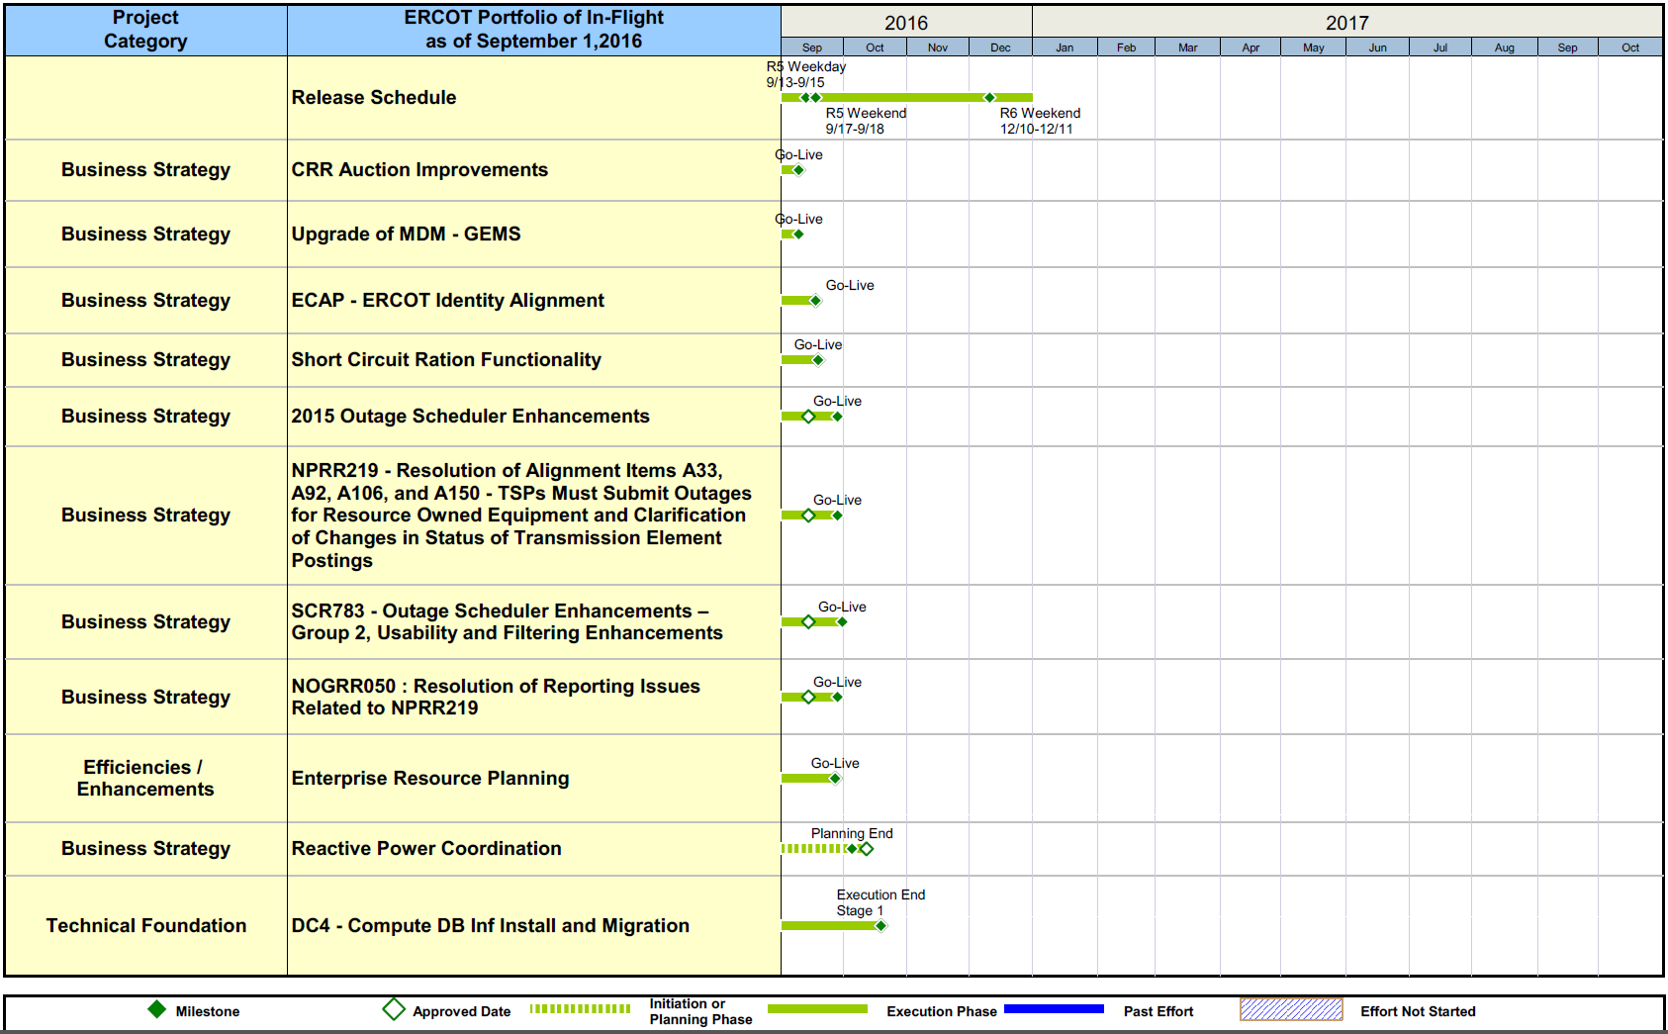
Project Portfolio Status – as of 8/31/2016

Slide 11
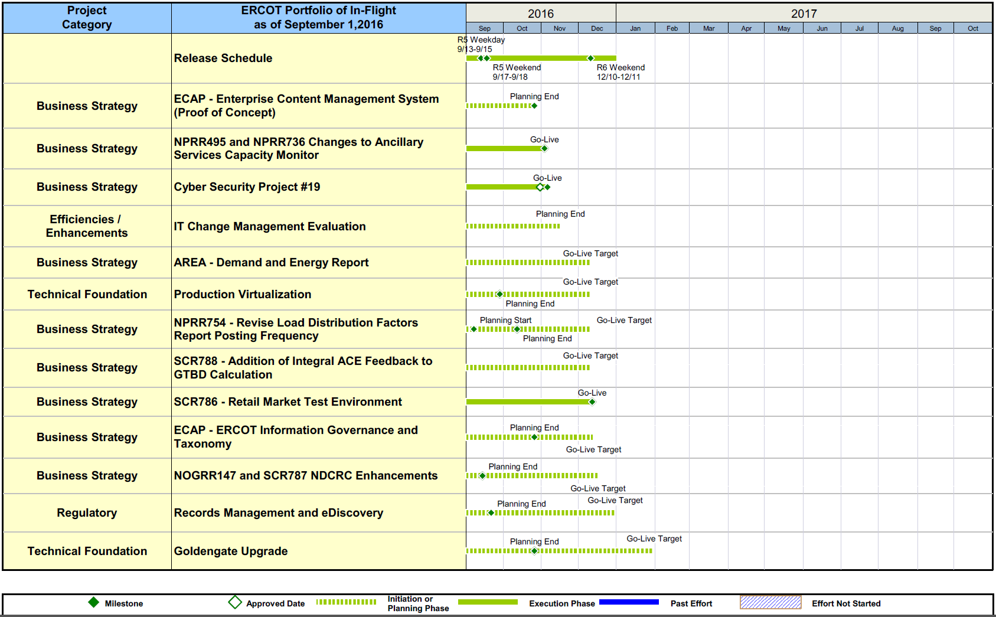
Project Portfolio Status – as of 8/31/2016

Slide 12
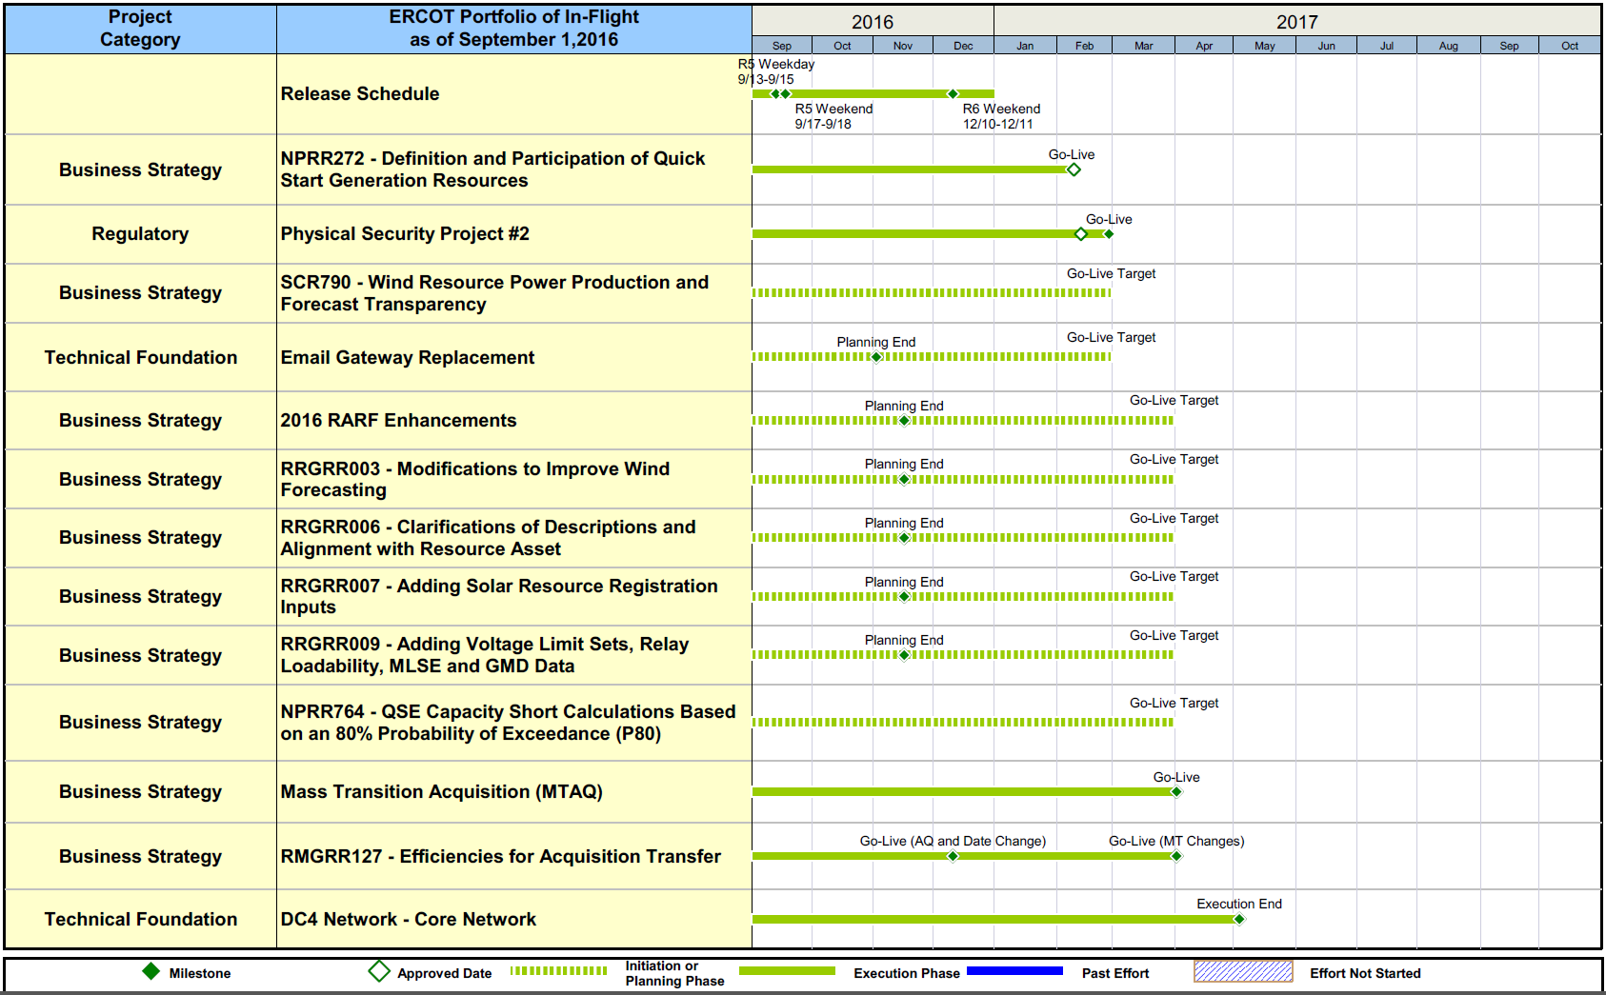
Project Portfolio Status – as of 8/31/2016

Slide 13
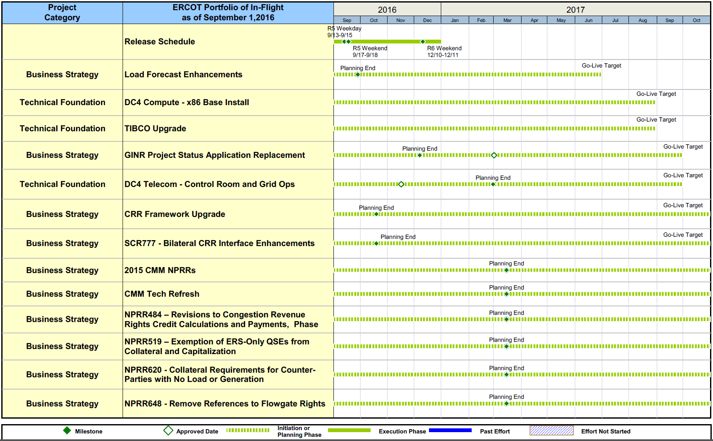
Project Portfolio Status – as of 8/31/2016

Slide 14
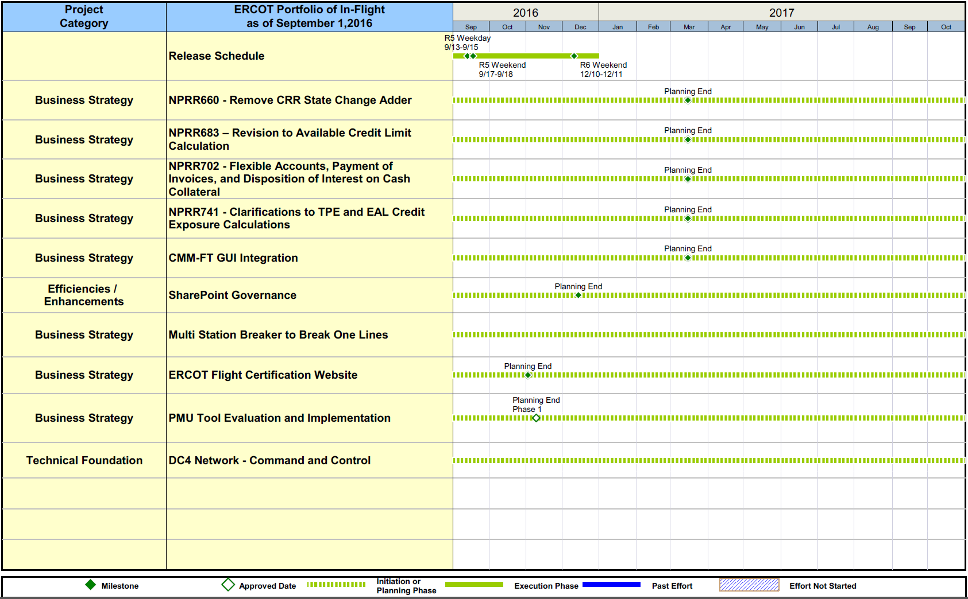
Project Portfolio Status – as of 8/31/2016

Slide 15
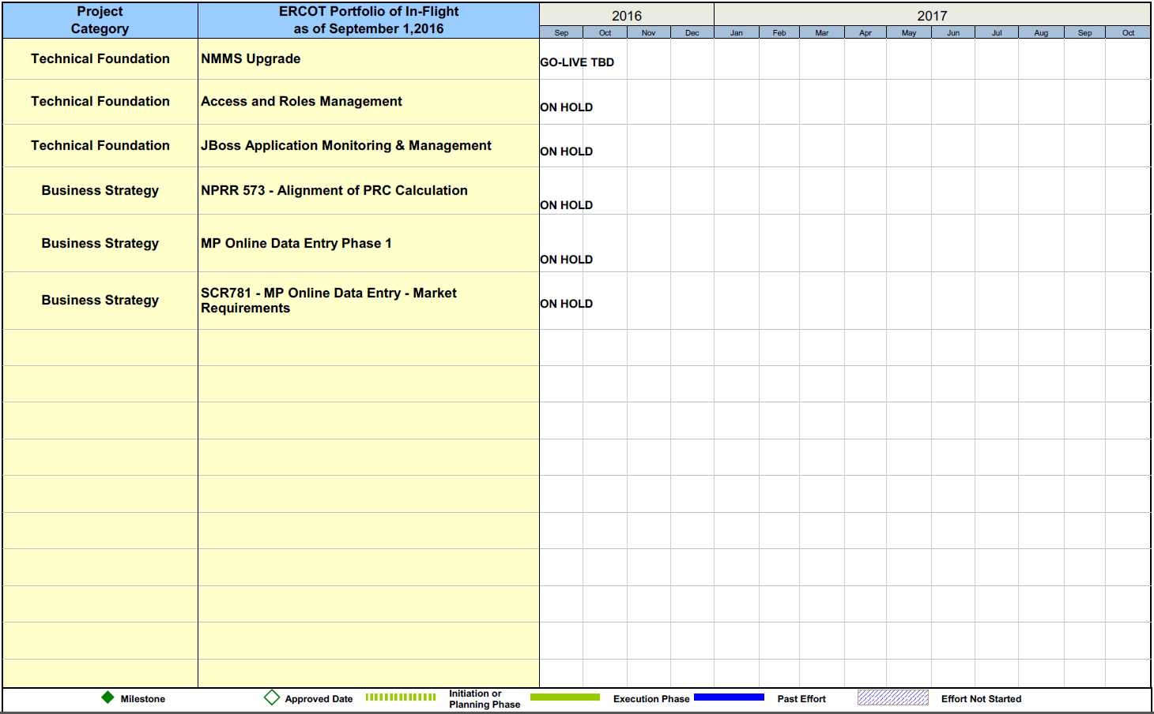
Project Portfolio Status – as of 8/31/2016

Slide 16
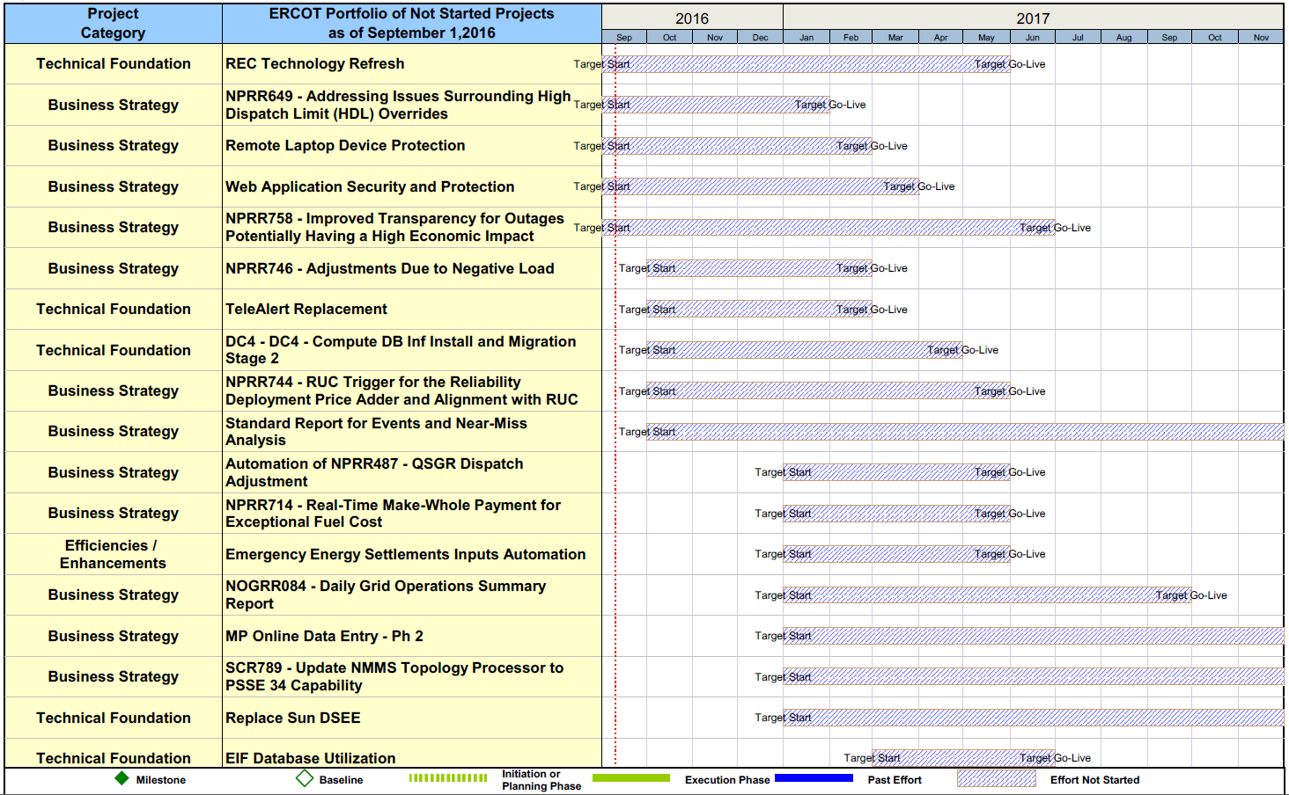
Project Portfolio Status – as of 8/31/2016

Slide 17
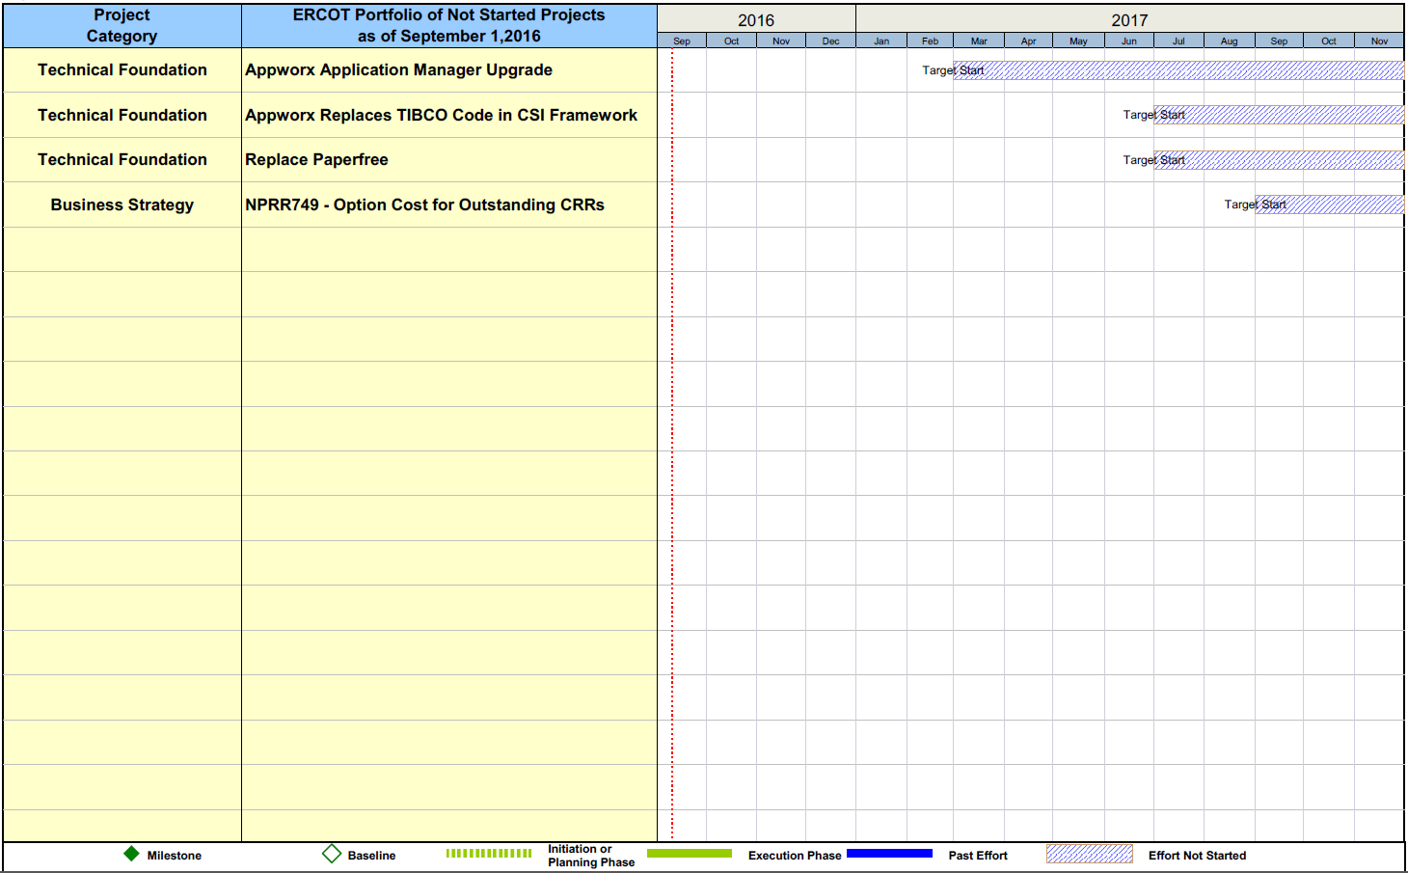
Project Portfolio Status – as of 8/31/2016

