Slide 1
PDCWG Report to ROS
Chair: Percy Galliguez, Brazos Electric Power Cooperative, Inc.
Vice Chair: Stewart Rake, Luminant
ROS
September 8th, 2016

Slide 2
Report Overview & Notes
Report Overview
  Meeting Minutes
  BAL-001-TRE-1 FMEs & IMFR
    4 FMEs in the month of July
    BAL-001-TRE-1 Unit Performance Report now includes Solar resources.
  Frequency Control Report

Slide 3
Meeting Minutes
PDCWG Meeting 8/10/16
  Regulation & Frequency Control Reports
  GREDP Performance Analysis
  MOD-026-1 & MOD-027-1 Discussion
    NPRR Proposal/Review
  Time Error Correction & BAL-001-TRE-1 Performance
  Reviewed 4 FME’s
    7/10/2016 18:54:24
      Loss of 1,376MW
      1,678 MW/0.1HZ Response
    7/13/2016 13:30:02
      Loss of 722 MW
      976 MW/0.1HZ Response
    7/14/2016 15:50:53
      Loss of 581 MW
      764 MW/0.1HZ Response
    7/21/2016 14:53:26
      Loss of 703 MW
      651 MW/0.1HZ Response

Slide 4
Frequency Measurable Events Performance
August 2016

Slide 5
Frequency Measurable Events
There were 2 FMEs in August.
  8/2/2016 18:37:36
    Loss of 526 MW
    Interconnection Frequency Response: 822 MW/0.1 Hz
    11 of 53 Generation Resources had less than 75% of their expected Initial Primary Frequency Response.
    5 of 53 Generation Resources had less than 75% of their expected Sustained Primary Frequency Response.
  8/15/2016 19:39:40
    Loss of 856 MW
    Interconnection Frequency Response: 976 MW/0.1 Hz
    9 of 47 Generation Resources had less than 75% of their expected Initial Primary Frequency Response.
    6 of 47 Generation Resources had less than 75% of their expected Sustained Primary Frequency Response.

Slide 6
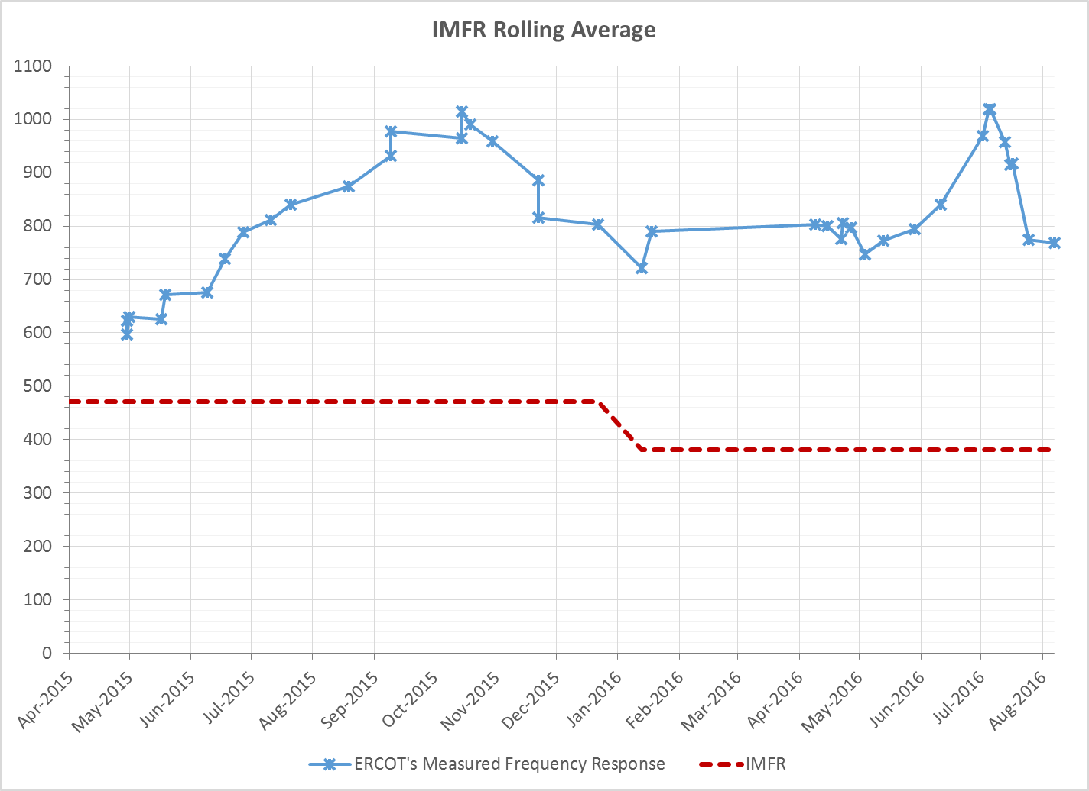
Interconnection Minimum Frequency Response (IMFR) Performance
IMFR Performance currently 768.07 MW/0.1Hz

Slide 7
Frequency Control Report
August 2016

Slide 8
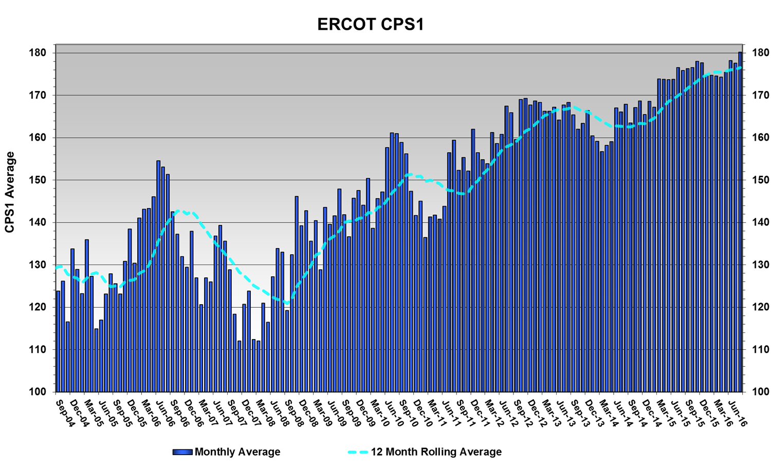
CPS1 Performance
CPS1 12 Month Rolling Average = 176.54%

Slide 9
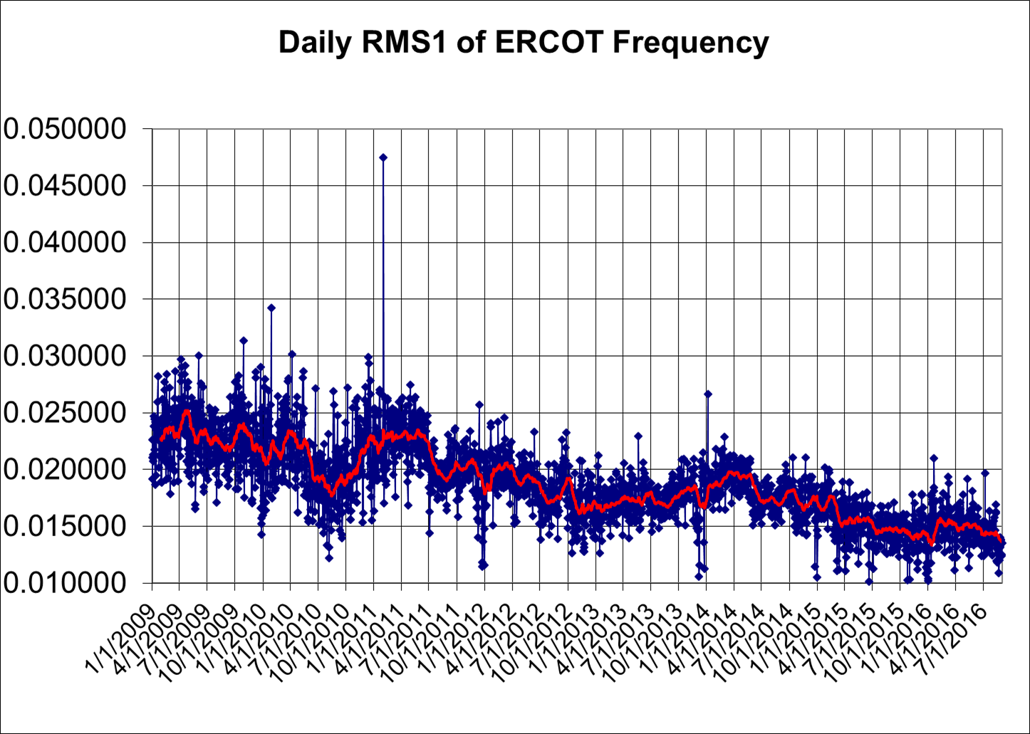
RMS1 Performance of ERCOT Frequency

Slide 10
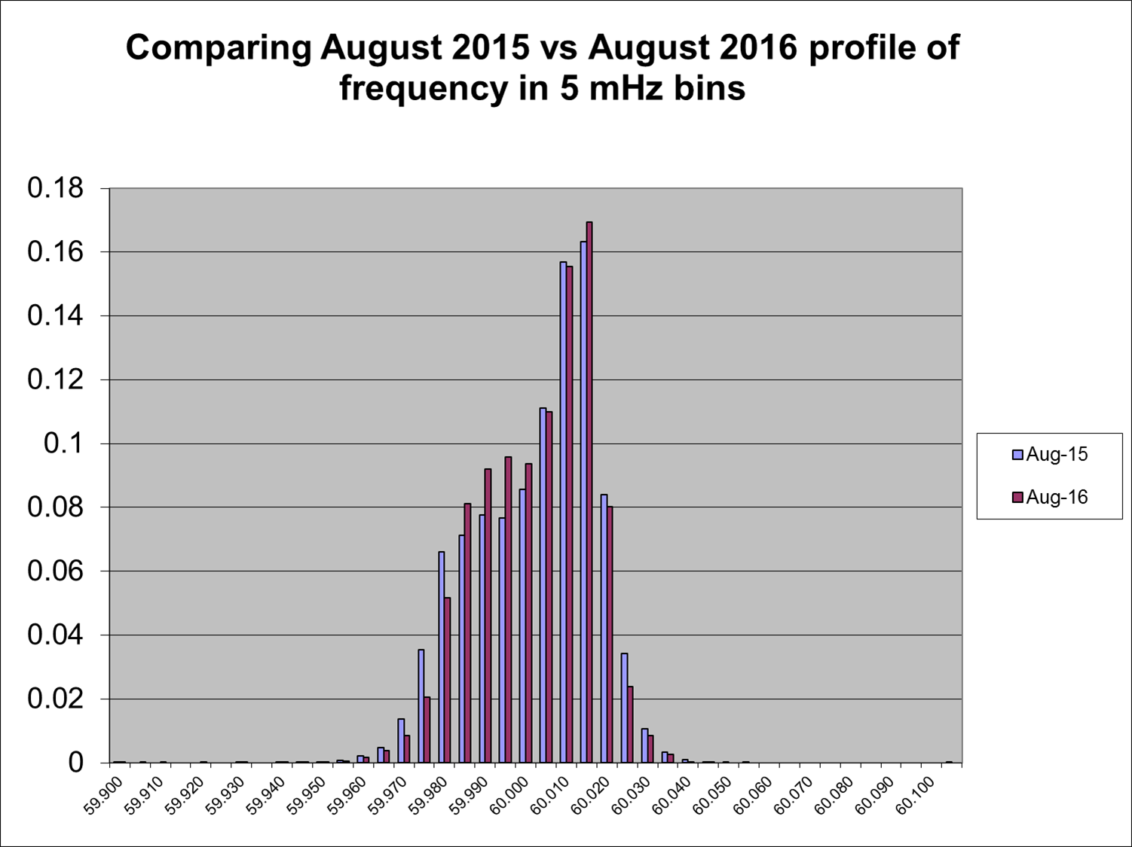
Frequency Profile Analysis
Year | Low Side (<60Hz) | High Side (>60Hz)
2015 | 173.55 | 177.73
2016 | 177.10 | 182.70
Year | Mean | Standard Deviation
2015 | 59.99994 | 0.015893
2016 | 60.00003 | 0.014884

Slide 11
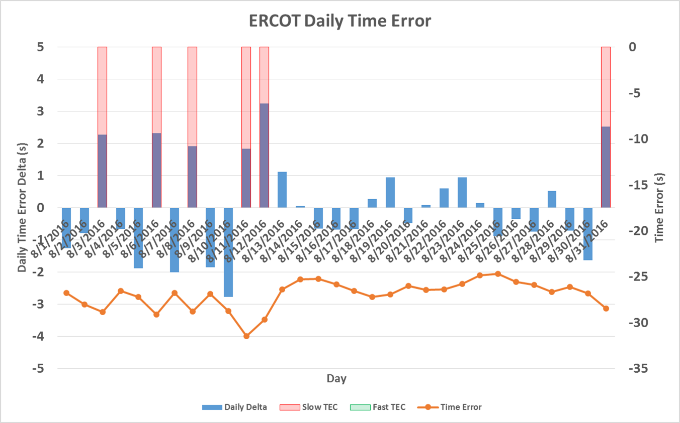
Time Error Corrections
There were 5 Time Error Corrections (TEC) in July.

Slide 12
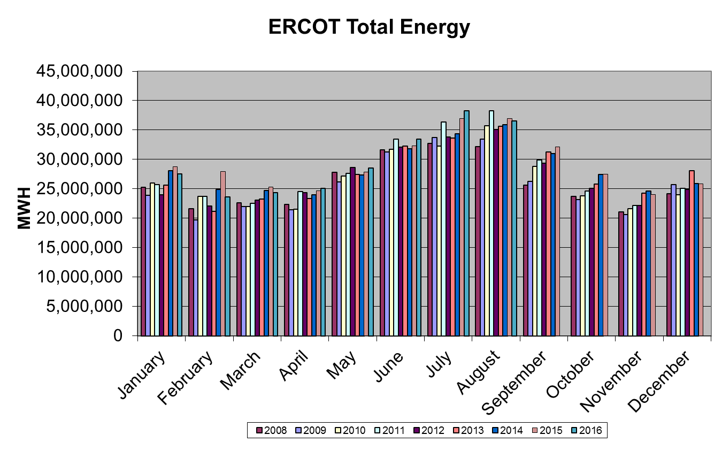
Wind Generation Performance

Slide 13
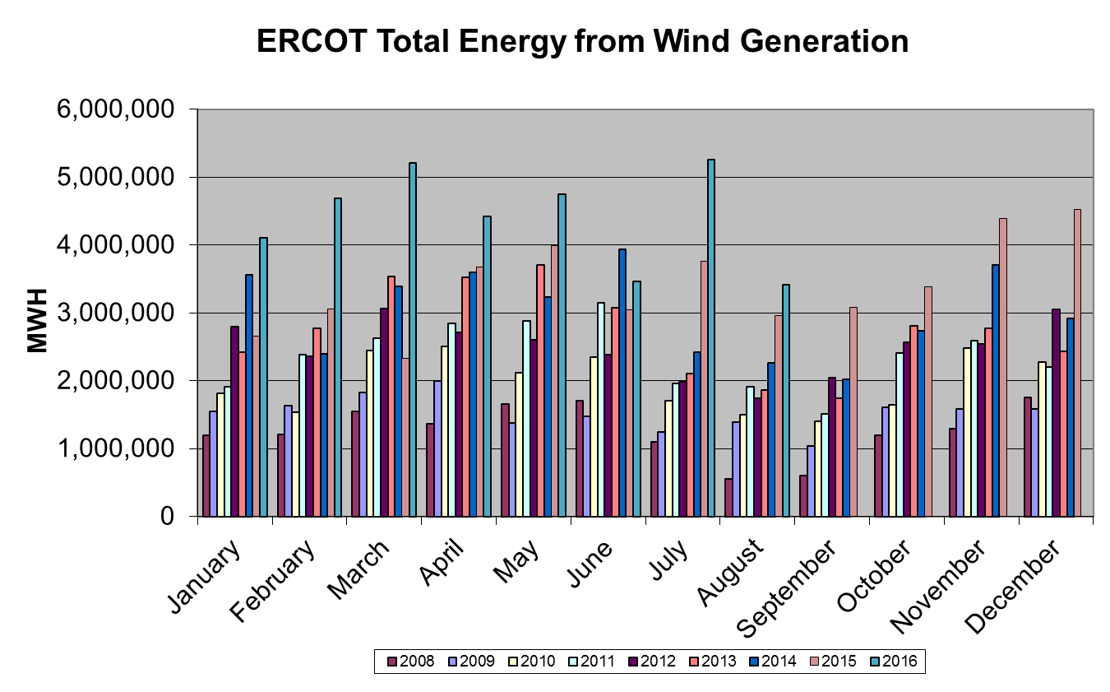
Wind Generation Performance

Slide 14
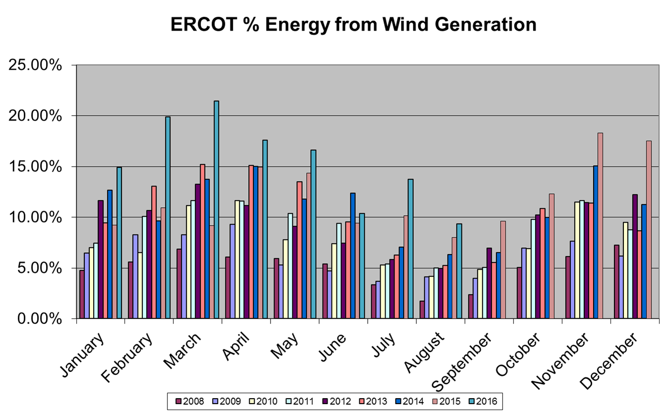
Wind Generation Performance

Slide 15
Questions?

