Slide 1
What does it mean to put the RMR unit “behind the highest offer”?
WMS discussion on RMR offer mitigation during transmission congestion

Slide 2
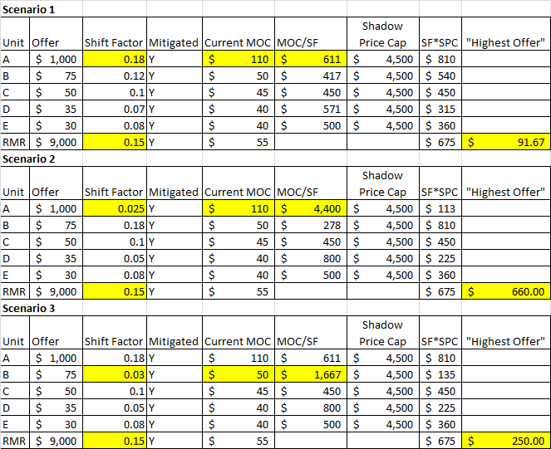
When all units are mitigated

Slide 3
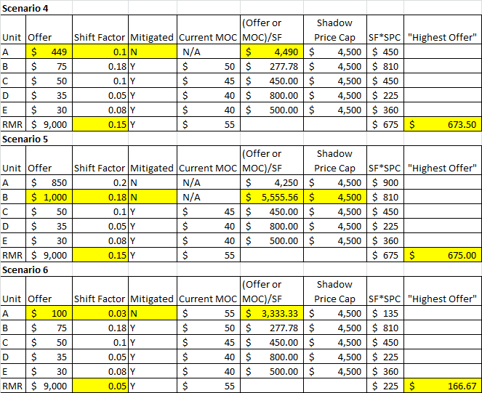
When NOT all units are mitigated
https://1drv.ms/v/s!AhZLJHWs5oV6o22GxBAYnN3ArC0F

