Slide 1
DREAM September Discussion
WMS

Slide 2
Suggested Settlement Comments
Assumptions:
Mapped Distribution Resources (MDR) will be modeled at the Load Zone Settlement Point
Metered generation values will be telemetered to ERCOT
All other COP data required of traditional resources will be telemetered to ERCOT by the QSE representing the MDR

Slide 3
Proposed Telemetry Requirements
Suggestion:
Require Mapped Distribution Resources to perform to the same telemetry standards as traditional resources.
Rationale:
Existing telemetry standards appear to be manageable dispatchable distributed energy resources.

Slide 4
Telemetry Requirements Review
Communicate with ERCOT over the secure Wide-Area Network (WAN)
Comply with ERCOT’s Nodal ICCP Communications Handbook
Comply with ERCOT Protocols and TAC-Approved Telemetry Standards

Slide 5
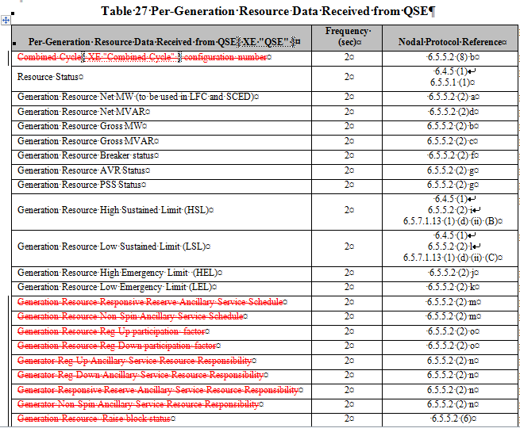
Data Points and Refresh Rate

Slide 6
Data Points and Refresh Rates (continued)

Slide 7
Inclusion of MDRs in Planning Models
Concern:
Existing price-responsive resources may not be adequately represented in the planning models if pricing outcomes are not consistent with peak (Summer/Winter) planning assumptions.
Proposal:
Develop logic to review load assumptions for substations with registered generation and fuel type of Diesel or Nat Gas

Slide 8
Suggested logic for MDR planning
If
the ESIID with a registered resource and fuel type of NG or Diesel is injecting energy when
Load Zone Price relative to the ESIID > 10*FIP for
X% of observed intervals in a calendar year,
Then
Model that injection in the Regional Transmission Plan

