Slide 1
SAWG Update to WMS
September 7th, 2016
Brandon Whittle

Slide 2
Report Releases
SARA Released
Fall 2016 Final Seasonal Assessment
Winter 2016-2017 Preliminary Seasonal Assessment
None
Housekeeping

Slide 3
MIRTM – Update
ERCOT Presented results from their study, but SAWG also needs more time to see these results. A Webex is scheduled for September 21. ERCOT also needs more time to work through the results on their end to make conclusions.
It will be soon time for WMS to recommend a course of action on MIRTM.
MIRTM Update Presentation to SAWG August '16 final

Slide 4
CDR Recommendations
SAWG recommends splitting the CDR in a way that highlights the first five years on the main page and placing the second five years on another page as supplemental information.
No Protocol change necessary
Factors considered include:
ERCOT Generator IA to Commercial Durations
Timing of financial security posting
ERCOT’s Load Forecast confidence
Removing focus from less confident data
Looking for WMS Endorsement

Slide 5
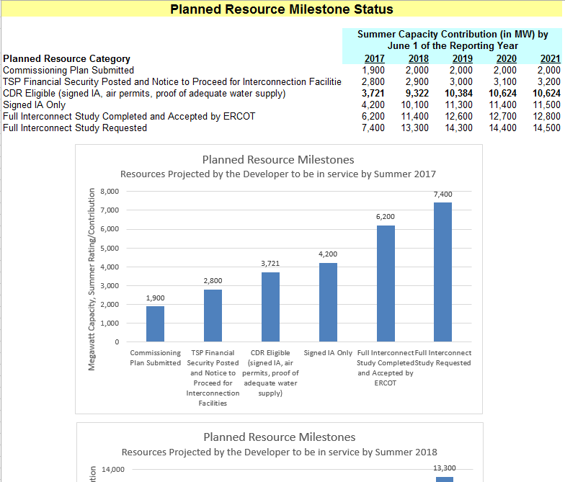
CDR Recommendations
SAWG recommends including a supplemental table with additional data surrounding Planned Resources.
No Protocol change necessary
ERCOT CDR Proposal 8-15-2016
Recommend NPRR759 Segmentation of the Total New Capacity Estimate in the ERCOT CDR be withdrawn or rejected.
Looking for WMS Endorsement
Example Only

Slide 6
CDR Open Issue – DC Ties
1) New DC-Ties: SAWG does not have a recommendation on how to include a new DC-Tie in the CDR. We lean towards converting calculation to a percentage, possibly a percentage based on the region of the interconnection.
2) Is DC Tie Capacity calculated correctly?
Protocol 3.2.6.2.2: Seasonal Net Max Sustainable Rating for DC Tie Resource—The average DC Tie capacity imported into the ERCOT Region during the highest 20 peak Load hours for each preceding three year period for Peak Load Season s and year i.
Question: Does the word imported mean the average of all DC Tie Flows or just when the flows are importing into ERCOT?
Current Methodology averages all flows: DC Tie Peak Ave Capacity Contribution Summer

Slide 7
Next Meeting – September 21, 2016 – Webex 1:30-3:30
Expected Agenda Items
MIRTM Data Review

