Slide 1
Unannounced Capacity Testing, Shortfall Analysis & Recommendation on Reserve Discount Factor (RDF)
ERCOT Staff
ROS
September 8th, 2016

Slide 2
Summer Unannounced Unit Testing Summary
194.77 MW NET excess of capacity.

Slide 3
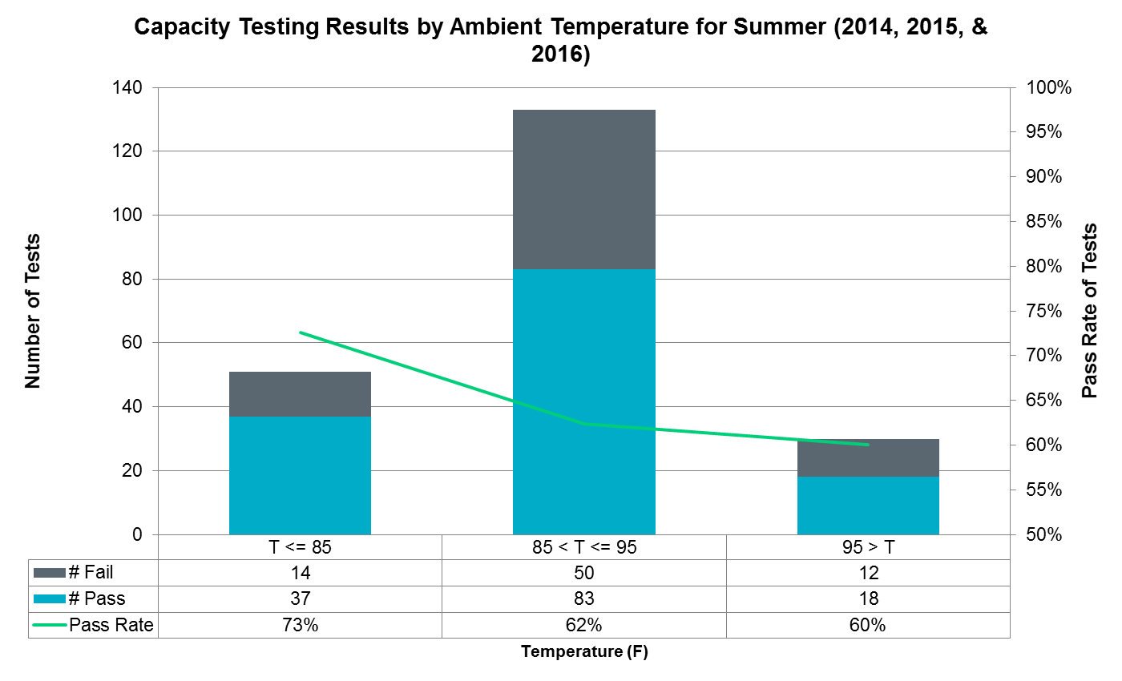
Summer Unannounced Unit Testing Summary
1.46 MW NET excess of capacity.
Capacity Shortfall (T > 95)
Excess | 60 MW
Shortfall | 58.54 MW
Net | -1.46 MW
13% decrease in Pass Rate for capacity tests at higher temperatures.
Total of 13,524MW tested > 95
7,320MW tested excess
5,976MW tested shortfall
No retests of resources during same season.

Slide 4
Protocol Requirements
  Protocol Section 8.1.1.2 General Capacity Testing Requirements
  (7) ERCOT shall maintain historical records of unannounced Generation Resource test results, using the information contained therein to adjust the Reserve Discount Factor (RDF) subject to the approval of the appropriate TAC subcommittee. ERCOT shall report to the Reliability and Operations Subcommittee (ROS) annually or as requested by ROS the aggregated results of such unannounced testing (excluding retests), including, but not limited to, the number and total capacity of Resources tested, the percentage of Resources that met or exceeded their HSL reported by telemetry, the percentage that failed to meet their HSL reported by telemetry, and the total MW capacity shortfall of those Resources that failed to meet their HSL reported by telemetry.
  Protocol Section 2, Reserve Discount Factor Definition
  A representation of the average amount of system-wide capability that, for whatever reason, is historically undeliverable during periods of high system demand. The RDF will be verified by ERCOT and then approved by the Reliability and Operations Subcommittee (ROS).

Slide 5
Shortfall Analysis
Shortfall is the amount of MW the unit is operating below it’s reported (telemetered) HSL when unit is expected to be operating at its HSL (excluded intervals where Regulation-Down is being deployed.)
Used five peak days from 2016.
  August 8th – August 12th
Used non-wind, non-nuclear, non-PUN Generation Resources
  Extracted 5 minute sample data; (snapshot @ 00:02,00:07, etc…)
    HSL, UDBP, MW Output, and Regulation-Down.
  Extracted Gen Resources when UDBP-REGDN = HSL (74 Units, ~23,953 MW)
    Calculated MW shortfall & MW excess for these Resources.
    Computed total shortfall and total net shortfall (including MW excess.)
    Computed average per unit shortfall and per unit net shortfall (including MW excess.)

Slide 6
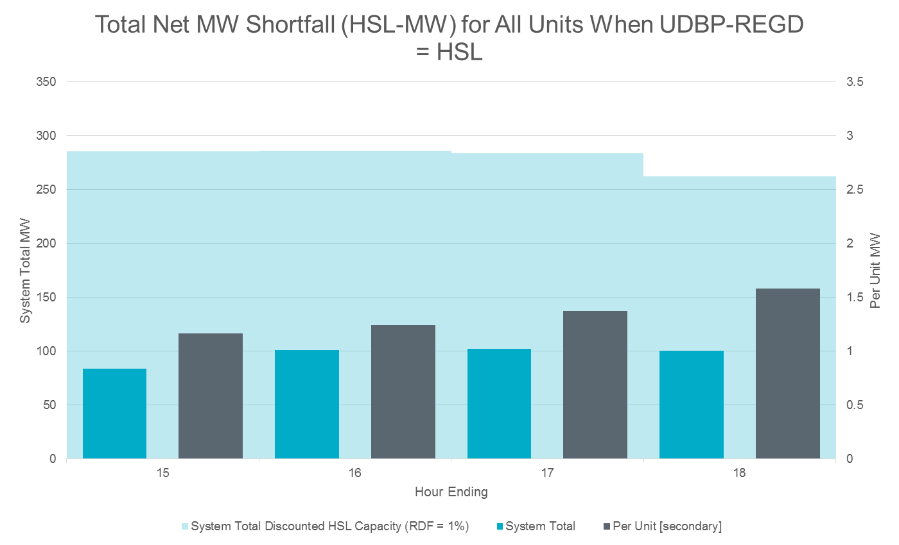
Shortfall Analysis (Net Shortfall)
UDBP–REGDN = HSL when Base-Point is at HSL (excluding Ramp) and no Reg-Down deployment.
17,561 samples
(+) means shortfall
(-) means excess
Notes:
Example: Of 329 units, for each 5-min SCED interval over the course of 4 peak hours of 5 days (78,960), 17,561 samples were taken when a unit was expected to be operating at its HSL.

Slide 7
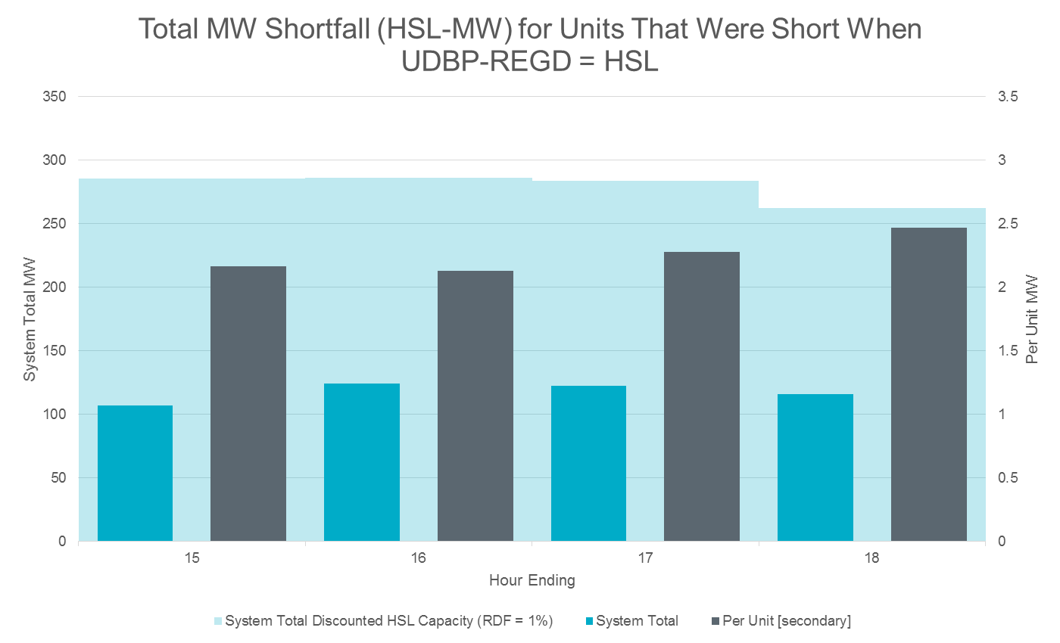
Shortfall Analysis
12,788 samples
(+) means shortfall
(-) means excess
Notes:
Example: Of 329 units, for each 5-min SCED interval over the course of 4 peak hours of 5 days (78,960), 17,561 samples were taken when a unit was expected to be operating at its HSL.

Slide 8
Summary
ERCOT conducted 214 unannounced tests during the Summers of 2014, 2015 and 2016 (up to Aug 15th).
  194 MW excess capacity available above HSL when adjusting for shortfall from failed tests.
Of the 214 tests, 30 tests were conducted at temperatures above 95°F
  1.46 MW excess capacity available above HSL when adjusting for shortfall from failed tests.
  A shortfall analysis was also conducted using five peaks days in August 2016 (week of Aug 8th). For HE15 through HE18 for 74 units operating at their HSL, totaling ~23,953 MW
  Average hourly net shortfall was…
    97.03 MW of total of 23,953 MW of capacity expected to be operating at HSL.
    1.34 MW per unit expected to be operating at its HSL.

Slide 9
Recommendation
  Based on the review, ERCOT recommends removing Reserve Discount Factor for temperature above 95 F, (this means HSL will not be discounted (RDF = 1)).

