Slide 1
Market Credit Working Group update to the Wholesale Market Subcommittee
9/07/2016

Slide 2
MCWG update to WMS
Joint meeting of MCWG and CWG on Wednesday, August 17th
3 NPRRs reviewed for credit impacts
3 NPRRs had no credit impact
Referrals
NPRR791 Clarifications to IEL, MCE and Aggregate Amount Owed by Breaching Party
Minor administrative revisions
ERCOT Collateral Document Review
Mostly administrative changes related to LoC Issuer, Surety Bond, Foreign Market Participant Guarantee, SFA alignment

Slide 3
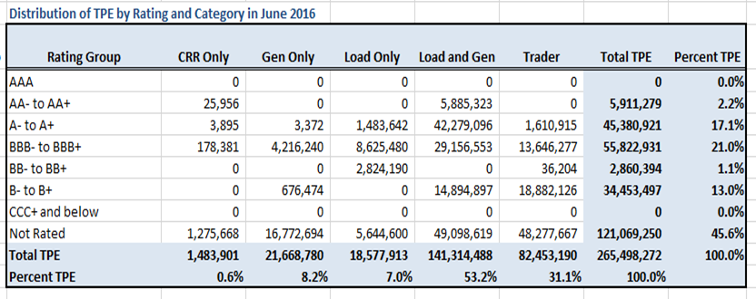
MCWG update to WMS
Credit Exposure and Loss Given Default

Slide 4
MCWG update to WMS
Market Continuity: Credit Assignments
Failure to pay invoices to ERCOT
Should the cash collateral be used to pay outstanding invoices
Should the SB/LCs be drawn or guarantees be used to pay outstanding invoices
In case of insufficient collateral for paying invoices, should the late payments or breach process be commenced or should it be put on hold
If secured collateral (Cash, LC, CB) is used for paying outstanding invoices, then there may not be sufficient collateral to cover TPES exposure
Potential advance payments to generation
Increase of unsecured credit limit
DAM/RTM valuation or exposure
CRR valuation or exposure

