Slide 1
CRR Update
Carrie Bivens
Manager, Forward Markets
August 18, 2016

Slide 2
CRR Framework Upgrade Project
Project Summary
  The CRR Framework Upgrade Project will improve the ability to support and maintain the CRR system by upgrading the User Interface framework and its related components to current versions.
  SCR777, Bilateral CRR Interface Enhancement, and NPRR648, Remove References to Flowgate Rights, will be delivered alongside this project.
  Completing October 2017, prior to Fall long-term auction sequences.

Slide 3
CRR Framework Upgrade Project
Market-facing impact:
  Portfolio and Bilateral Pages – all errors will be packaged and presented in a file; no longer one-by-one like today’s error messages
  “Template” portfolios going away – portfolios will always be targeted to an auction
  Downloads will be packaged in a zip file, no more .csv or .xml downloads
  Multiple downloads with one click – will be able to download all auction results files, or all network files, at once in one zip file
  Bilateral trades pages will have a buy tab and a sell tab, and more error checking; will offer an xml file upload capability for multiple trades instead of having to enter them one at a time like today
  Smart search, auto-complete, and sort capabilities on all pages
  Removes size limit on portfolio names (currently, limited to 35 characters)
  GUI will have slight changes in look and feel

Slide 4
CRR Framework Upgrade Project
Market-facing impact:
  All Market Participants must ‘re-qualify’ during market trials period in Jul-Sept 2017, which will be similar to current qualification:
    must be able to save credit for an auction
    must be able to create, upload, edit, save and submit a portfolio to an auction
    must be able to download market network files or market results

Slide 5
One-line protocol section
3.10.3 CRR Network Model

Slide 6
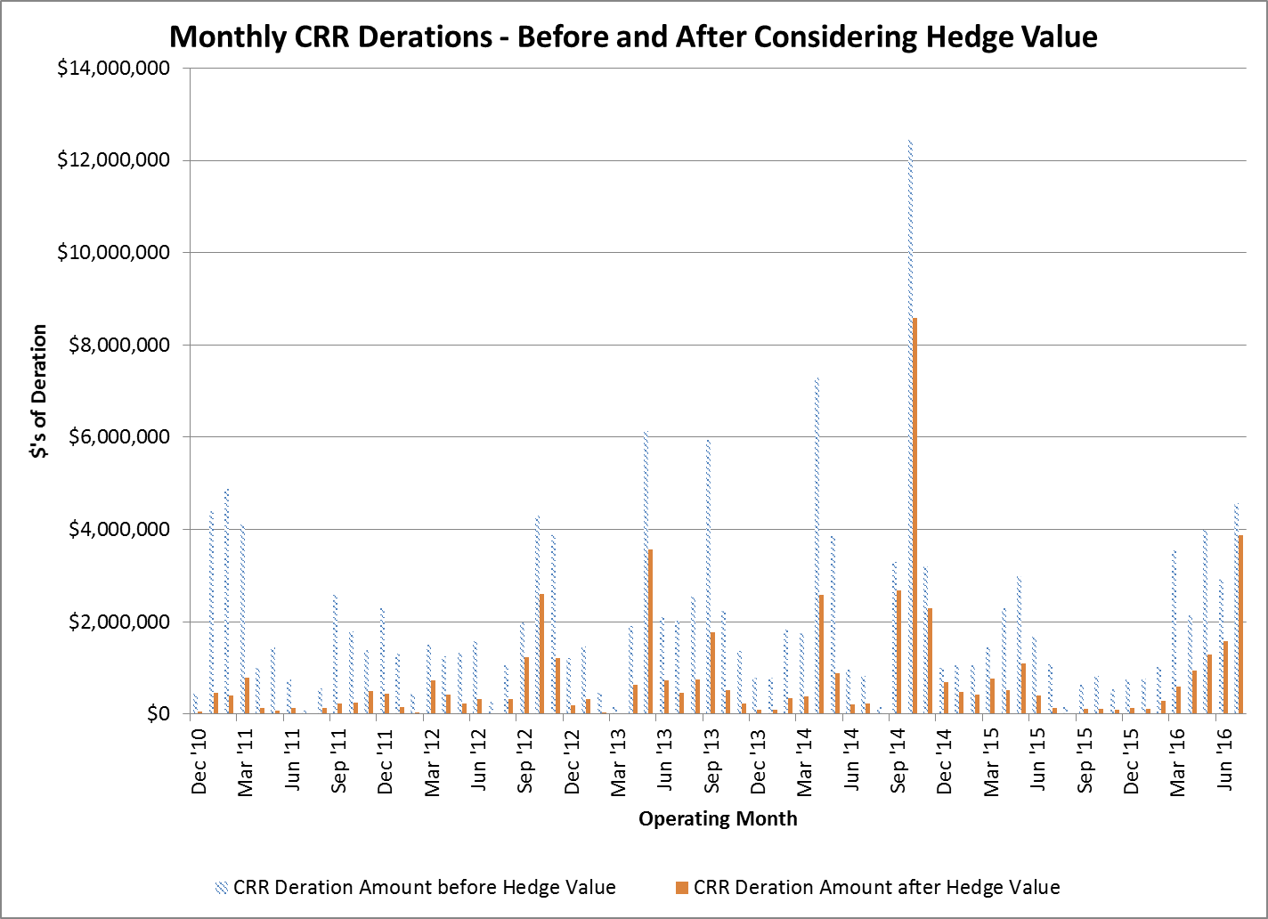

Slide 7
Appendix

Slide 8
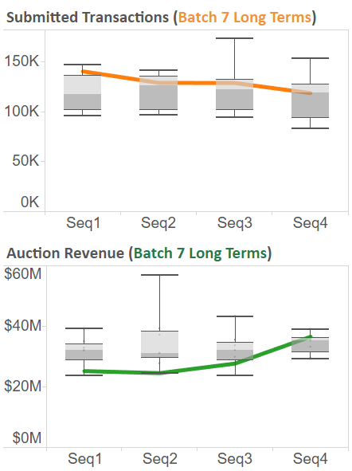
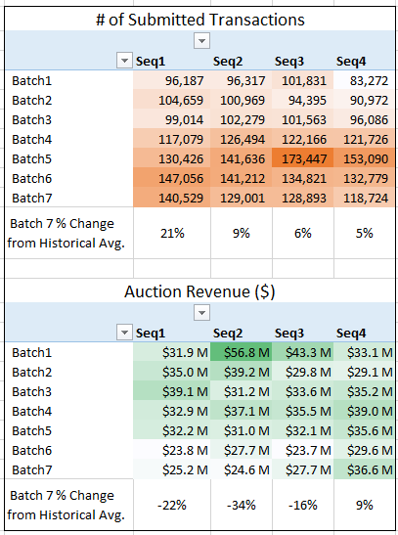
CRR Long Term Auction Metrics

Slide 9
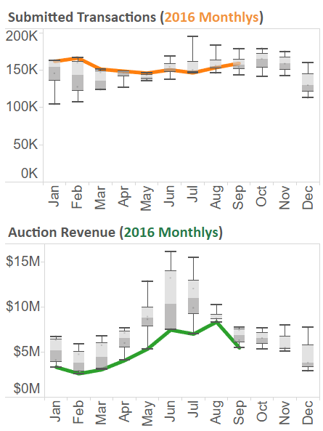
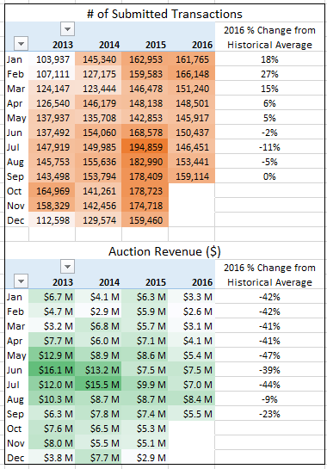
CRR Monthly Auction Metrics

