Slide 1
SMT Update To AMWG
July 2016

Slide 2
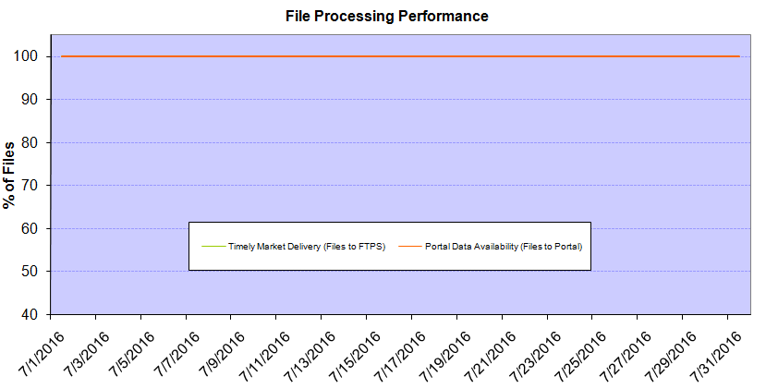
Monthly SMT Data Timelines AMWG CR 2014 002 End to End File Processing Completeness – JULY 2016
% Timely Market Delivery - % of files posted to market (FTPS) by 11:00pm out of # of files received by SMT by 11:00pm.
% Portal Data Availability - % of files loaded to the database for data availability on portal by 6:00am next day for the files received by 11:00pm
* A LSE file includes usage data for up to 50,000 ESIIDs.
Observed Anomalies:
2

Slide 3
SMT API and FTPS Services Availability – JULY 2016
The service availability is measured as a percentage of number of minutes the service was available out of the total number of minutes in a month, excluding planned outages.
Observed Anomalies:
25 Jan 2016: Services were unavailable for 19 hours due to storage configuration issue
07 Mar 2016: API Services were unavailable for 7hours due to Oracle archiver issue.
Notes:
3

Slide 4
SMT Number of Accounts by Type AMWG CR 2014 009 – JULY 2016
Registered Users | ONC | CNP | AEPN | AEPC | TNMP | TOTAL
Active Residential Accounts | 38783 | 24251 | 1924 | 5344 | 2660 | 72962
Active Residential English Accounts | 38580 | 24072 | 1919 | 5230 | 2651 | 72452
Active Residential Spanish Accounts | 203 | 179 | 5 | 114 | 9 | 510
Non Active Residential Accounts | 19134 | 13073 | 1545 | 3322 | 716 | 37464
Total Residential Accounts | 57917 | 37324 | 3469 | 8666 | 3376 | 110426
TDSP User | 331 | 36 | 12 | 17 | 1 | 397
TDSP Admin | 4 | 4 | 4 | 4 | 3 | 19
Small Business User | 115 | 53 | 0 | 4 | 5 | 177
Small Business Admin | 2629 | 1414 | 78 | 282 | 110 | 4635
Total Agreements (Includes Active and Pending) | 965 | 981 | 2 | 10 | 42 | 2000
Energy Data Agreements (Includes Active and Pending) | 965 | 725 | 2 | 10 | 42 | 1744
Han Device Agreements (Includes Active and Pending) | 0 | 255 | 0 | 0 | 0 | 255
Han Service Agreements (Includes Active and Pending) | 0 | 1 | 0 | 0 | 0 | 1
IN SMT
ESI IDs | 3488715 | 2415347 | 197679 | 858588 | 233876 | 7194205
Meters | 3422716 | 2415315 | 198475 | 858816 | 233619 | 7128941
HAN Devices | 3794 | 5024 | 132 | 280 | 39 | 9269
Acknowledgement | 0 | 0 | 0 | 0 | 0
Pending | 0 | 1 | 0 | 0 | 0
Meter Ready | 19 | 12 | 42 | 115 | 26
Provisioned | 3775 | 5011 | 90 | 165 | 13
HAN Messages (MTD) | 0 | 0 | 0 | 0 | 0 | 0
HAN Messages (YTD) | 17 | 3 | 0 | 0 | 0 | 20
HAN Messages (Cumulative) | 339 | 7400 | 0 | 0 | 0 | 7739
Simple Text Messages | 103 | 2925 | 0 | 0 | 0
Load Control Messages | 100 | 2658 | 0 | 0 | 0
Pricing Messages | 92 | 53 | 0 | 0 | 0
Cancellation Messages | 44 | 1764 | 0 | 0 | 0
Supplemental – (Friends)
Total Agreements | 1701 | 1341 | 75 | 85 | 58 | 3260
Accepted Agreements | 747 | 519 | 33 | 28 | 19 | 1346
Pending Agreements | 6 | 9 | 0 | 0 | 0 | 15
Revoked Agreements | 251 | 256 | 10 | 8 | 6 | 531
Expired Agreements | 664 | 528 | 30 | 49 | 33 | 1304
Terminated Agreements | 33 | 29 | 2 | 0 | 0 | 64
 | TDSPs | REP | Small Business | Regulatory | Third Party
Registered Entities | 5 | 110 | 4501 | 2 | 98
Registered Users | 397 | 956 | 177 | 8 | 23
Registered Admins | 19 | 174 | 4513 | 4 | 104
HAN Messages Sent By | 332 | 7383

Slide 5
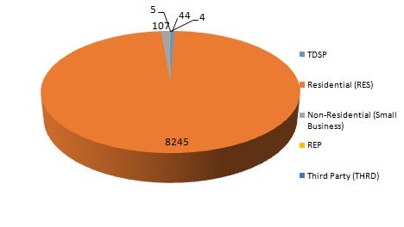
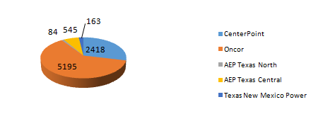
SMT ODR Details – JULY 2016
Total ODR Requests TDSP wise statistics:
Total ODR Requests User type statistics:

