Slide 1
Credit Exposure and Expected Loss update
Vanessa Spells
Manager, Credit
Suresh Pabbisetty, FRM, ERP, CQF, CSQA.
Lead Technical Analyst, Credit
August 17, 2016

Slide 2
Agenda
Background
Inputs and assumptions
Exposure and collateral distributions
Expected loss estimates
Observations

Slide 3
Credit Exposure and Expected Loss update
Background

Slide 4
Credit Exposure and Expected Loss update
Background:
As part of the discussion on ERCOT market risk appetite, ERCOT staff presented an analysis of market exposure to CWG/MCWG in November 2015
CWG/MCWG was requested to provide a quarterly update of the analysis

Slide 5
Credit Exposure and Expected Loss update
Inputs and Assumptions

Slide 6
Credit Exposure and Expected Loss update
Inputs and Assumptions:
Only Active Counter-Parties are included
Counter-Parties are classified by rating and market activity
TPE and collateral balances used are averages for June 2016
Negative excess collateral shown is due to the adjustment to remove unsecured credit
Counter-Parties that are subsidiaries of, or guaranteed by, rated entities are given the parent/guarantor’s rating, adjusted down one notch
Recovery Rate (RR) is assumed 0

Slide 7
Credit Exposure and Expected Loss update
Inputs and Assumptions:
Exposure at Default (EaD) is assumed to be equal to TPE
TPE will typically exceed invoice exposure, so this is a conservative metric. It should be viewed as a relative indicator of credit portfolio risk, not a forecast for losses or uplift
Probabilities of Default (PD) from “Global Corporate Average Cumulative Default Rates By Rating Modifier (1981-2014)”, from S&P publication “2014 Annual Global Corporate Default Study And Rating Transitions”
Expected Loss (EL) computed as follows;
EL = EaD * PD * LGD
Where: Loss Giver Default (LGD) = (1-Recovery Rate)
Recovery Rate is conservatively assumed at “0” as at the time of default, CP may be under stress and would have used up all funds

Slide 8
Credit Exposure and Expected Loss update
Inputs and Assumptions:
Assumed 1 year Probabilities of Default

Slide 9
Credit Exposure and Expected Loss update
Exposure and Collateral Distributions

Slide 10
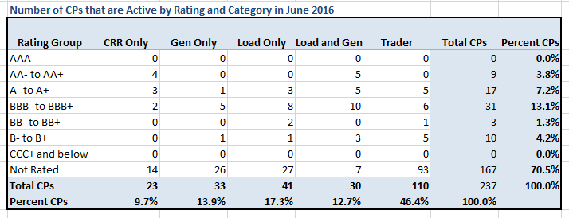
Credit Exposure and Expected Loss update
Active Counter-Parties distribution by rating and category

Slide 11
Credit Exposure & Expected Loss update
Average Total Potential Exposure distribution

Slide 12
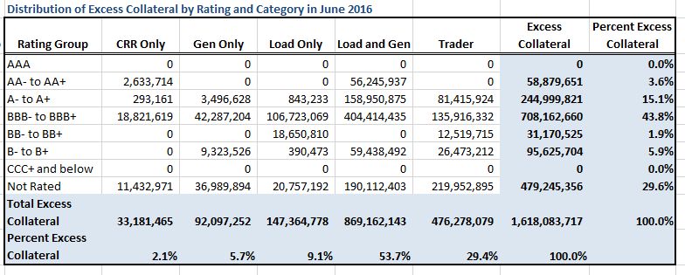
Credit Exposure & Expected Loss update
Average Excess Collateral distribution

Slide 13
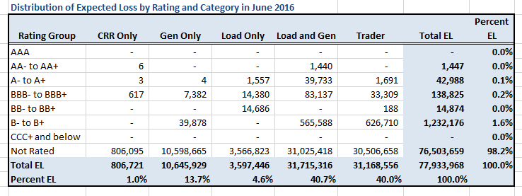
Credit Exposure & Expected Loss update
Expected Loss distribution

Slide 14
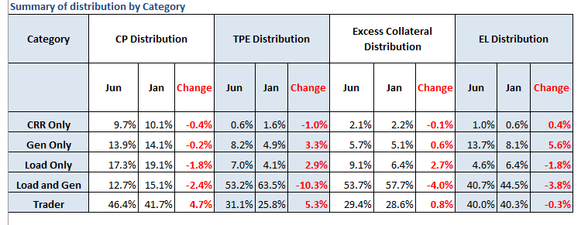
Credit Exposure and Expected Loss update
Summary statistics by market category

Slide 15
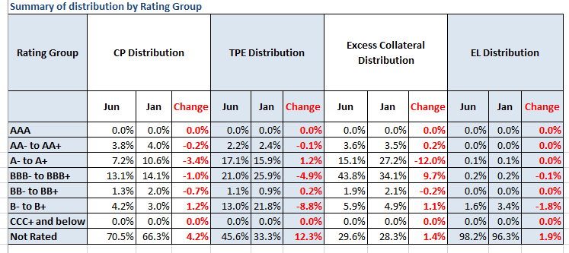
Credit Exposure and Expected Loss update
Summary statistics by rating group

Slide 16
Credit Exposure and Expected Loss update
Observations

Slide 17
Credit Exposure and Expected Loss update
Change from January 2016 to June 2016:
Number of active Counter-Parties has increased from 199 in January to 237
Market-wide TPE has increased from 228 million to 265 million while market-wide Excess Collateral has decreased from 1,695 million to 1,618 million
TPE of Load and Gen category has decreased from 63.5% to 53.2%
TPE of Traders has increased from 25.8% to 31.1%
TPE of “Not Rated” group has increased by 12.3% while TPE decreased by 8.8% and 4.9% for “B- to B+” and “BBB- to BBB+” groups respectively

Slide 18
Credit Exposure and Expected Loss update
Questions

