Slide 1
Multi-Interval Real-Time Market Update to SAWG
August 15, 2016

Slide 2
Refresher on the MIRTM Process
MIRTM six 5-minute intervals (30 minutes total) with separate commitment and dispatch
RT Market Execution: Depicts the start and end times of the clearing process and the length of symbol is indicative of maximum time allowed to clear market
Interval where the LMPs, MW awards (energy, AS) and Commitment Instructions are ALL binding commitment instructions
Intervals where ONLY Commitment Instructions are binding and the LMPs and MW awards (energy, AS) are indicative
8:40 8:45 8:50 8:55 9:00 9:05 9:10 9:15 9:20 9:25 9:30 9:35
Analysis window of rolling 30 minutes
Dispatch Run & Pricing run
Binding commitments for ALL intervals
1st Interval Binding Base Point & Binding LMPs
Dispatch Run & Pricing Run
Sequence of Multi-Interval RT Markets
Note: The introduction of the Binding Dispatch/Base Point run while eliminating make-Whole payments to Generation Resources due to binding ramp constraints, can however, lead to missed commitments or too early decommitments/recalls. The assumption is that the benefits of eliminating this category of make-whole payments outweighs the disadvantages of missed commitments or too early decommitments/recalls.

Slide 3
Overview of Recent Activity
Implement Dispatch module
Implement Pricing module
Developed Three part offers (TPO) based on average Verifiable Costs and unit HSL
Developed Single part offers (SPO) from TPO allocating start costs over min up time
Allowed for Wartsila units to have zero start time and zero min off time (allows fast ramping resources to meet demand in same interval)
Studied the following dates:7/1/2015, 8/11/2015, 8/13/2015, 11/11/2015, 11/27/2015, 3/27/2016, 7/25/2016

Slide 4
Today’s Agenda
Refresher on study inputs
For study day 8/13/2015 review and compare all of the Separate Commitment and Dispatch MIRTM runs listed on the next slide
For remaining six study days
7/1/2015 – Luminant request (Volatile wind, little congestion, low system lambda)
8/11/2015 - Luminant request (Little congestion, low dispatchable capacity)
11/11/2015 - ERCOT (New STLF over forecasts load)
11/27/2015 – ERCOT (New STLF under forecast load, large wind down ramp)
3/27/2016 – ERCOT (Low wind, units shutting down, low dispatchable capacity)
7/25/2016 – ERCOT (Low wind, low dispatchable capacity)
Compare two MIRTM runs:
Fast responding resources and load (3PO)
Fast responding resources to mimic production i.e. not committable by MIRTM (LOAD)

Slide 5
Study Runs
For the 8/13 run we will step incrementally through the progression of studies as follows:
Production SCED
Sequential SCED
MIRTM with Separate Commitment and Dispatch:
Loads only with QSGR not committable to mimic production (LOAD)
QSGRs have Production offers with single part offers (SPO Prod. SCED EOCs)
QSGRs have three-part offer based on average Verifiable Costs (3PO)
QSGRs have single-part offer based on average Verifiable Costs (SPO)
Note: we could come back at a later date with a comparison between MIRTM Combined Commitment and Dispatch and MIRTM Separate Commitment and Dispatch. It was too much data to show in one session.

Slide 6
Study Process
Determine the study period based on the day of interest and run a sequential SCED for the entire study period using the Energy Offers from actual Real Time SCED runs.
Sequential SCED considered the “baseline” that simulates all resources following base points while the GTBD mimics the production case.
Run MIRTM Separate Commitment and Dispatch with different offer structures (SPO Prod. SCED EOCs, 3PO, SPO) as inputs while the GTBD mimics the production case.
Use new STLF and Wind Persistence to “look ahead” 30 minutes to determine if commitments needed

Slide 7
Study Process
Calculate Production Costs: Four Components
Generation Costs: Integrate Step 2 EOC from LSL to BP + Power Balance Violation
Transmission Penalty Cost: Violated MW * Shadow Price
QSGR Startup/Mingen Cost: Startup and Minimum Energy Costs
Blocky Load Cost: Bid Price * Commit MW
Calculate Make Whole
QSGR Make whole across entire study period
Prod. SCED & Seq. SCED: Emergency Operations QSGR payments (Per 6.6.9 (3))
MIRTM: Max(0,QSGR Verifiable Cost - QSGR Revenue)
Blocky Load Make whole across entire study period
MIRTM: Max(0, [Bid Price * Commit MW] -[Binding LMP * Commit MW])
Notes:
QSGR revenue:
(Binding LMP + ORDC Online Price Adder + Pricing Run Price Adder) * Binding Base Point of Committable QSGR Unit List
QSGR Verifiable cost:
QSGR Verifiable Cost Above LSL - Integrate Input EOC or Verifiable Cost EOC (if no QSGRs in MIRTM) from LSL to BP of Committable QSGR Unit List
plus
QSGR Startup/Mingen Cost of Committable QSGR Unit List - Startup and Minimum Generation Costs of Committable QSGR Unit List

Slide 8
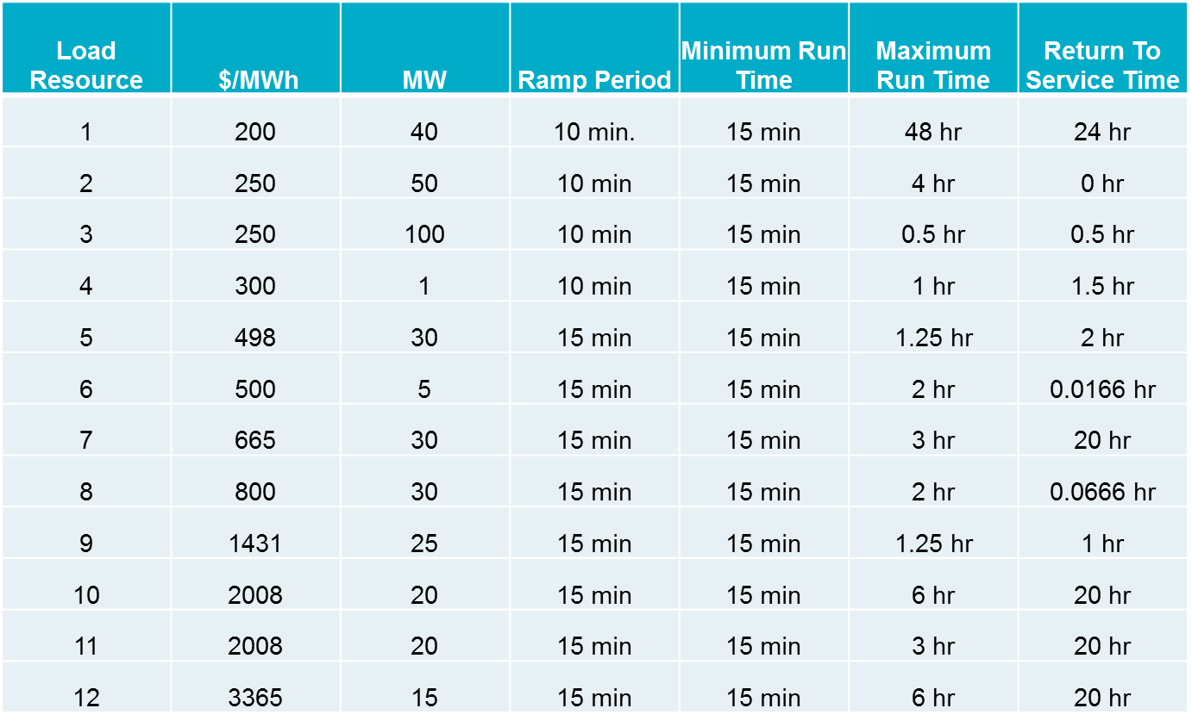
Simulation Assumptions – Blocky Load Resources
Offers were received for 12 Blocky Loads from DSWG
A total of 366 MW split between the load zones (each zone has 12 resources)

Slide 9
Simulation Assumptions – Fast Generation Resource Temporal Constraints
All Resources that are Quick Start qualified are considered “fast responding resources”. If the Resource was “OUT” or “ONTEST” during the study period they are not considered as “committable” Gas Turbines (36 units)
Reciprocating Engines (3 units)
Wartsilas (4 units)
Minimum On Time | Minimum Off Time | Hot to Intermediate Time | Intermediate to Cold Time | Cold StartUp Time | Intermediate StartUp Time | Hot StartUp Time
0 min. | 0 min. | 0 min. | 0 min. | 0 min. | 0 min. | 0 min.

Slide 10
Simulation Assumptions – Fast Responding Resources
Four average Verifiable Costs groups were identified.
Each Fast Responding Resources is assigned a group cost based on HRL/LSL
The Single Part offer is structured in order to recover Start Up and Minimum Energy cost over the Minimum On time
Minimum EOC is $75 if Resource had Non-Spin responsibility during study period
Res Type | HRL (MW) | LRL (MW) | Seasonal LSL (MW) | Startup Cost ($) | Min-Energy Price ($/MWh) | Min EOC ($/MWh) | Max EOC ($/MWh) | Single Part Cost ($/MWh)
SCLE90 | 54.0 | 10.0 | 13.0 | 4,322.05 | 52.39 | 30.86 | 33.91 | 1,287.26
SCLE90 | 60.0 | 0.0 | 12.0 | 3,448.99 | 48.85 | 28.47 | 31.05 | 1,198.51
SCLE90 | 95.0 | 0.0 | 41.0 | 6,058.75 | 56.12 | 40.35 | 41.88 | 647.21
DSL | 8.9 | 6.0 | 6.0 | 962.21 | 39.93 | 34.84 | 39.79 | 1,964.34

Slide 11
Other Assumptions – Days Analyzed
The Capacity from all Fast Responding Resources is considered online in MIRTM study runs; this has the impact of changing the ORDC calculation slightly; however, the resource capacity is only shifted from offline to online.
The Block Load Resources are considered “new” Resources which increases the RTOLCAP and shifts the curve to the right by 366MW.
Keep this in mind when comparing the ORDC price adder revenues across the Production SCED, Sequential SCED, and MIRTM study runs.
The Reliability Deployment Price Adder in MIRTM treats the deployment by ERCOT as a “deployment event” therefore MIRTM may find a RTDP when Production and Sequential SCED did not.

Slide 12
Study Day: August 13, 2015

Slide 13
Study Day: August 13, 2015
Increase in prices due to offer assumptions (see slide 10)

Slide 14
Study Day: August 13, 2015
Zero Make Whole

Slide 15
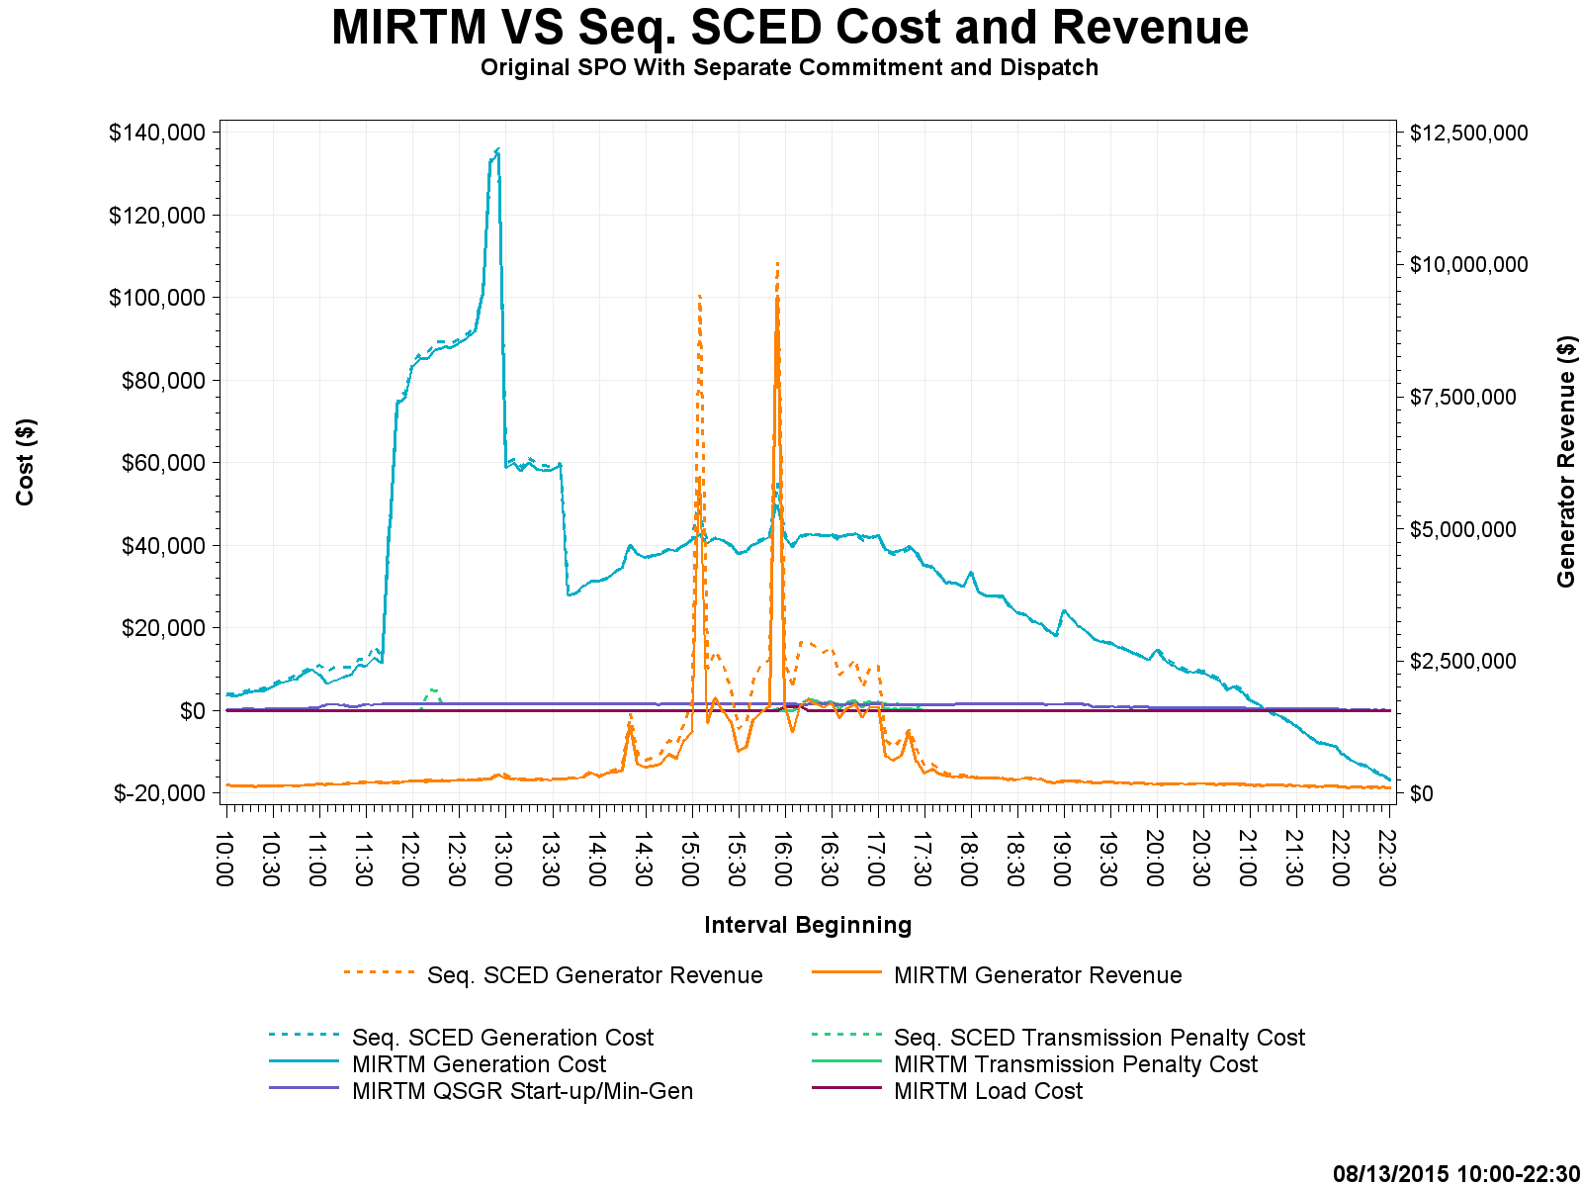
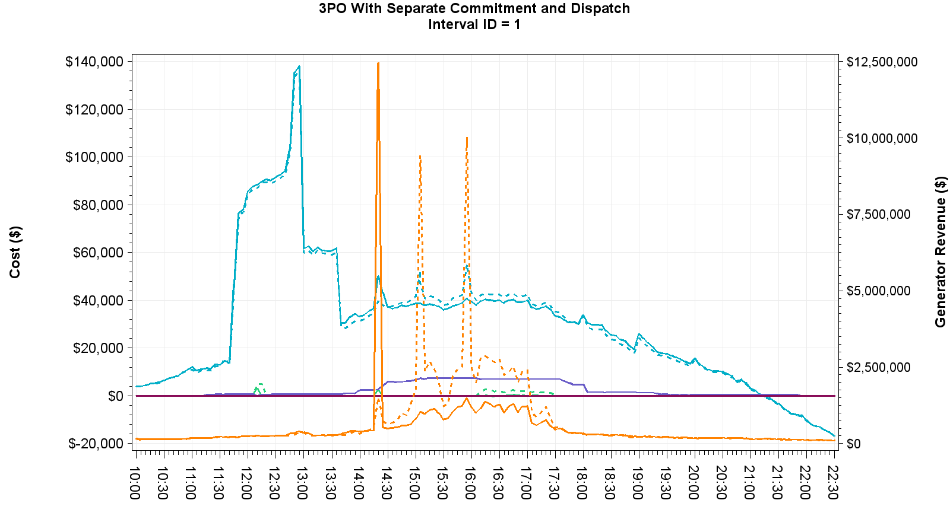
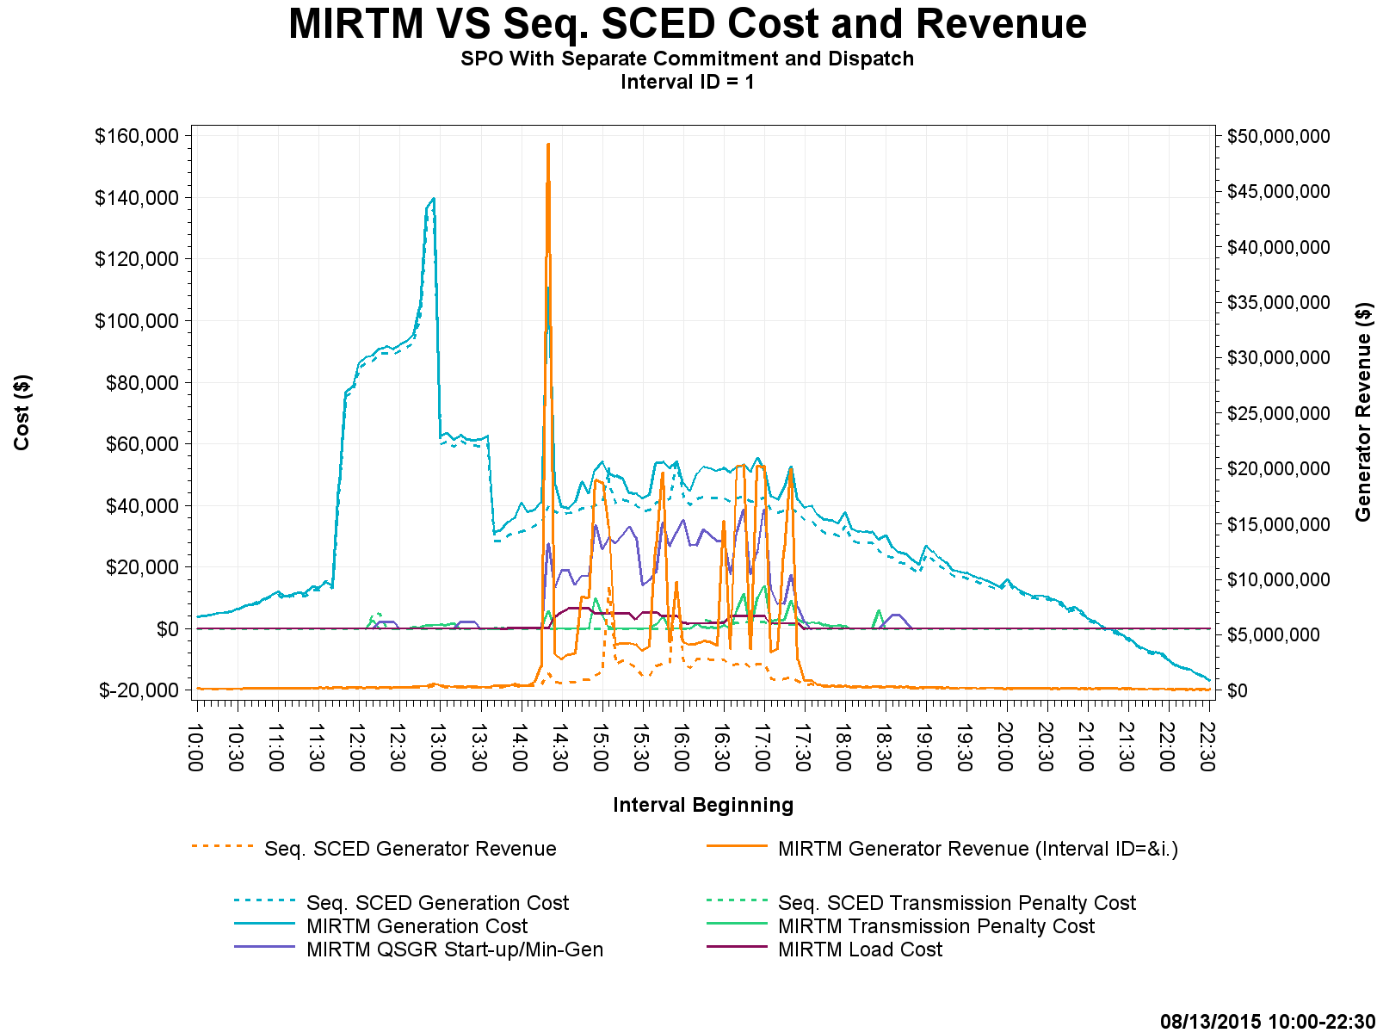
Study Day: August 13, 2015 Cost and Revenue
Notes:
Increase in Generator Revenue in 3PO and SPO due to price increase at 14:20 caused by GTBD regulation component and load ramp component

Slide 16
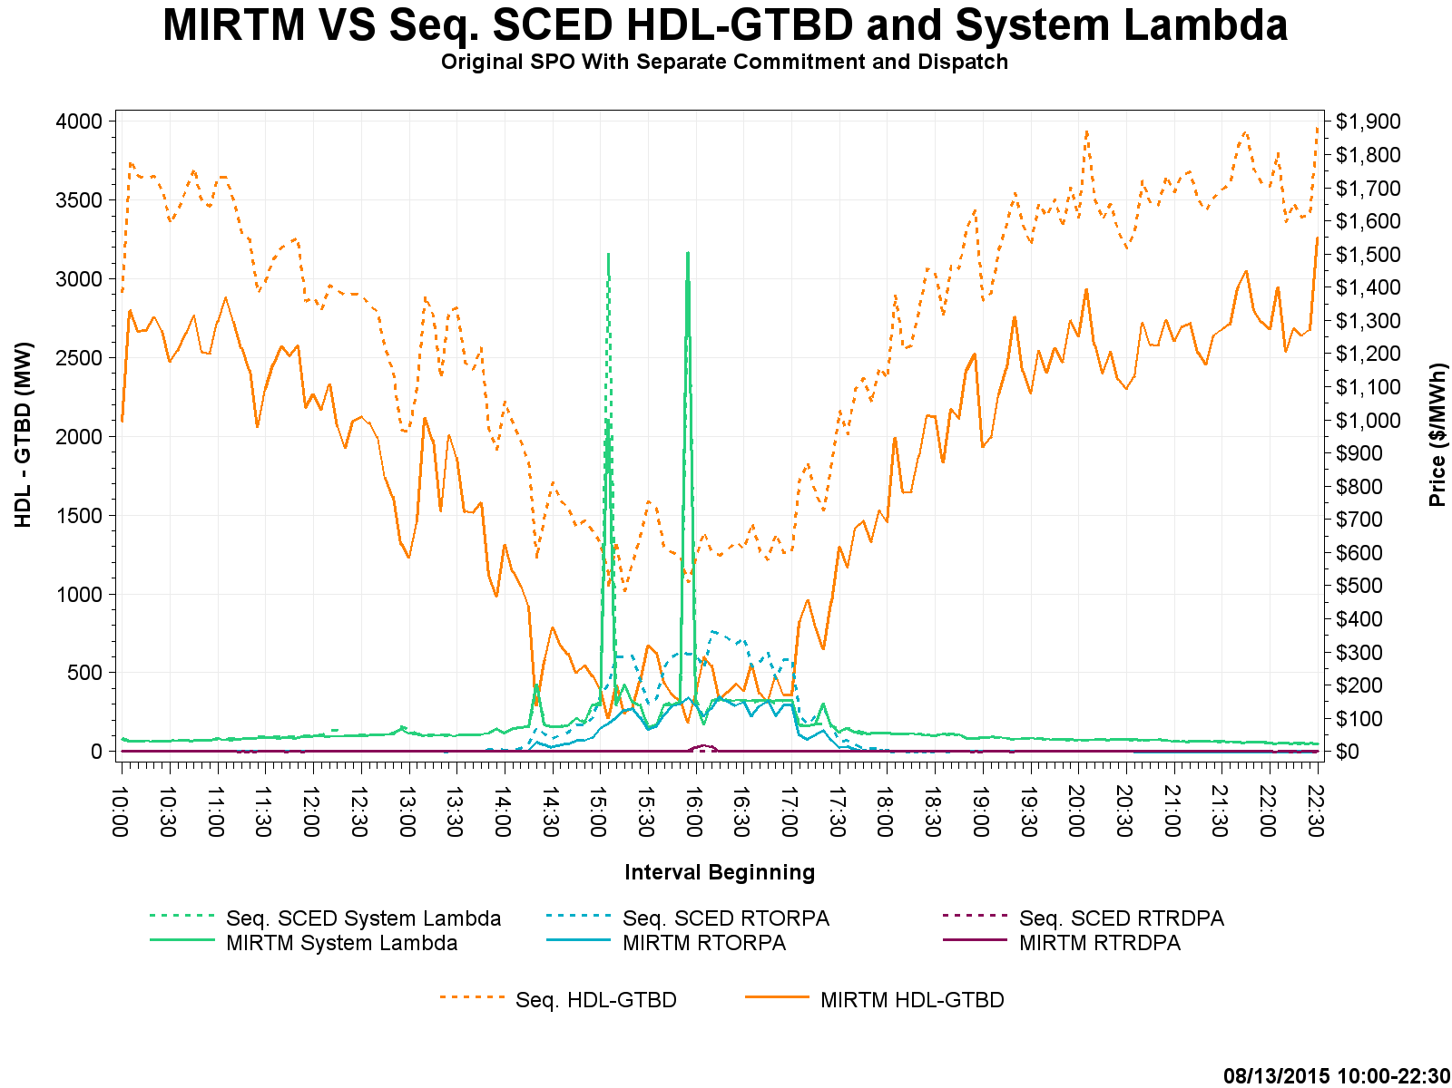
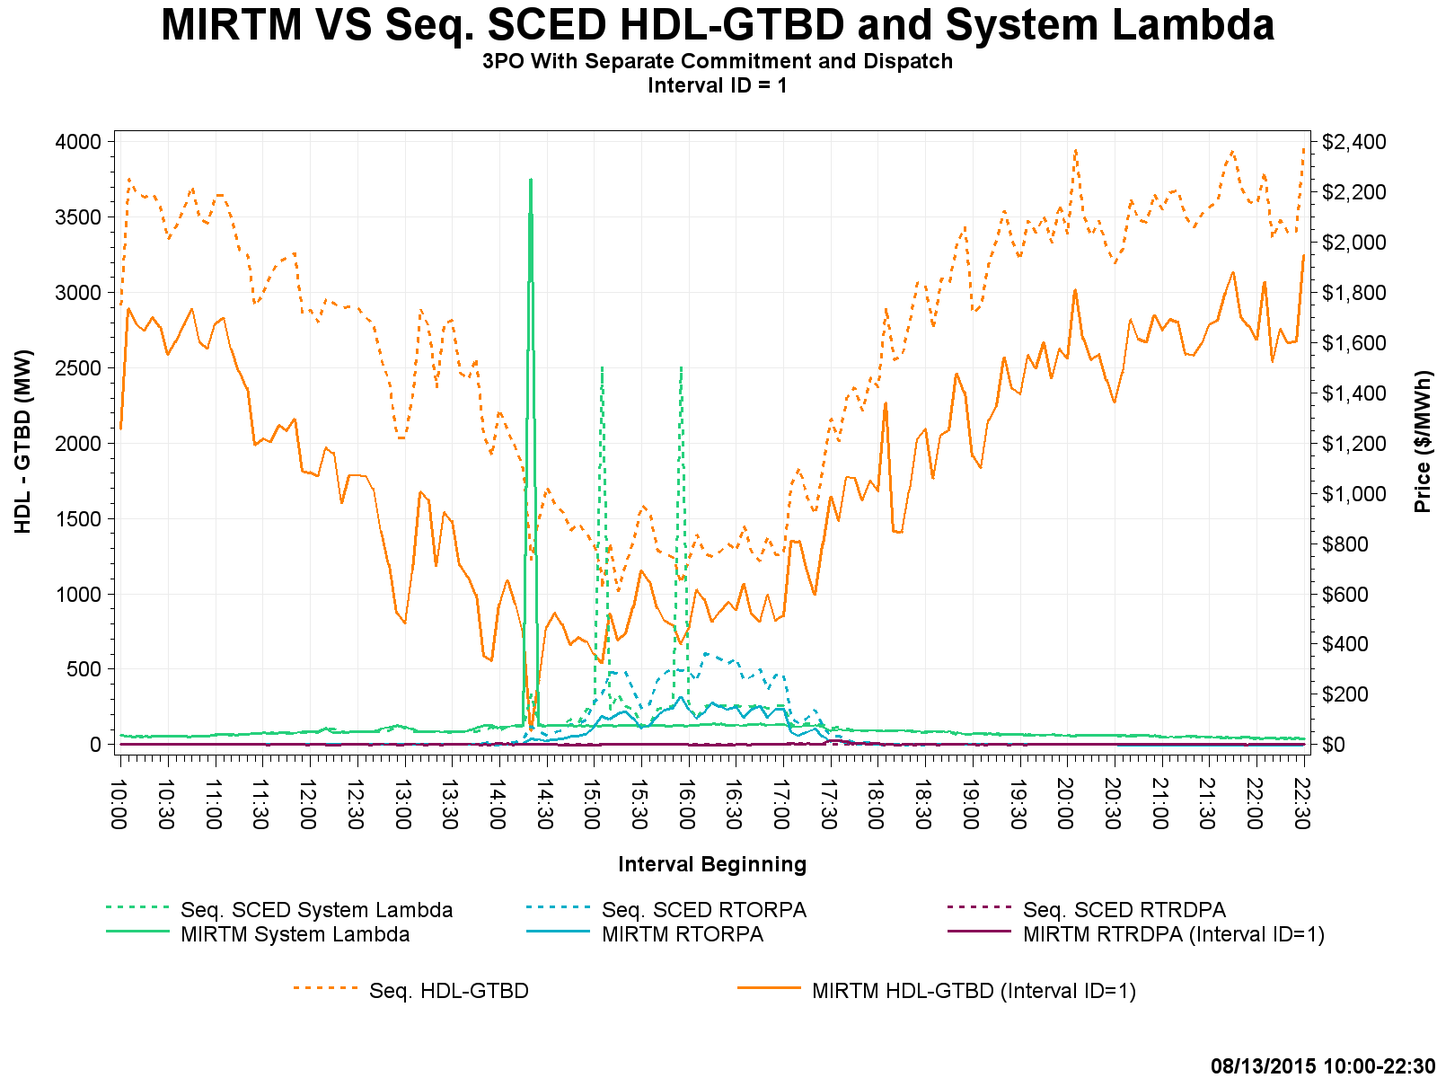
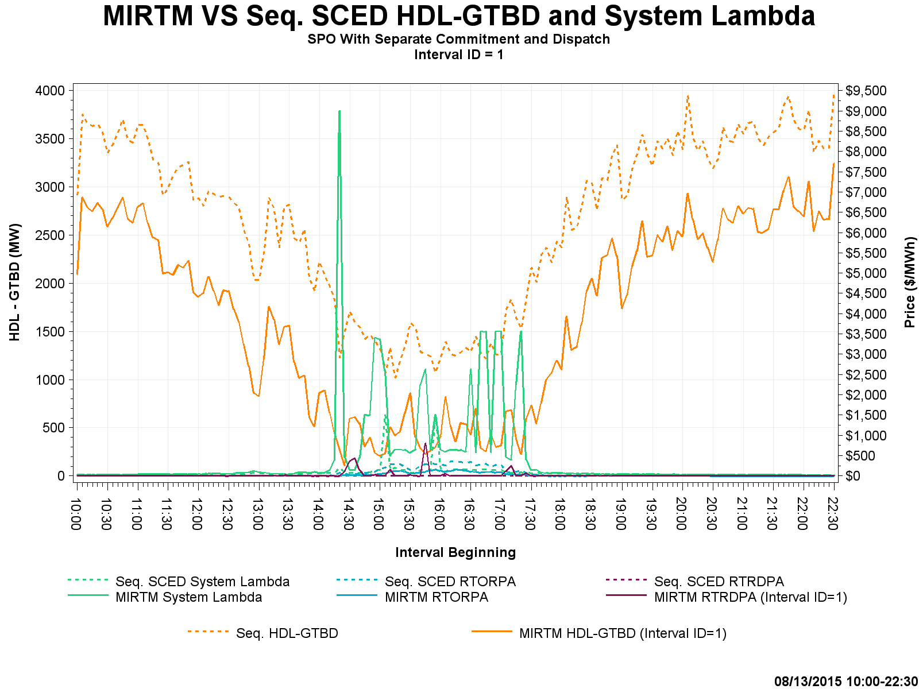
Study Day: August 13, 2015 HDL-GTBD, SL
$9k

Slide 17
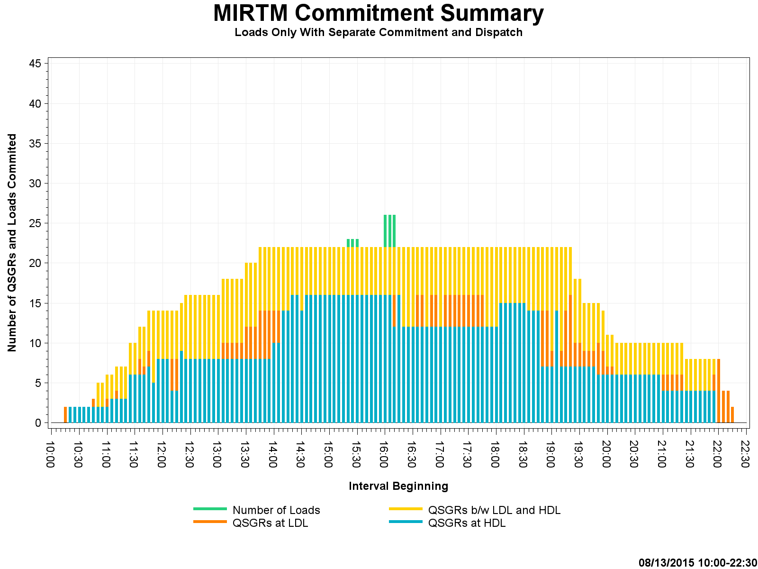
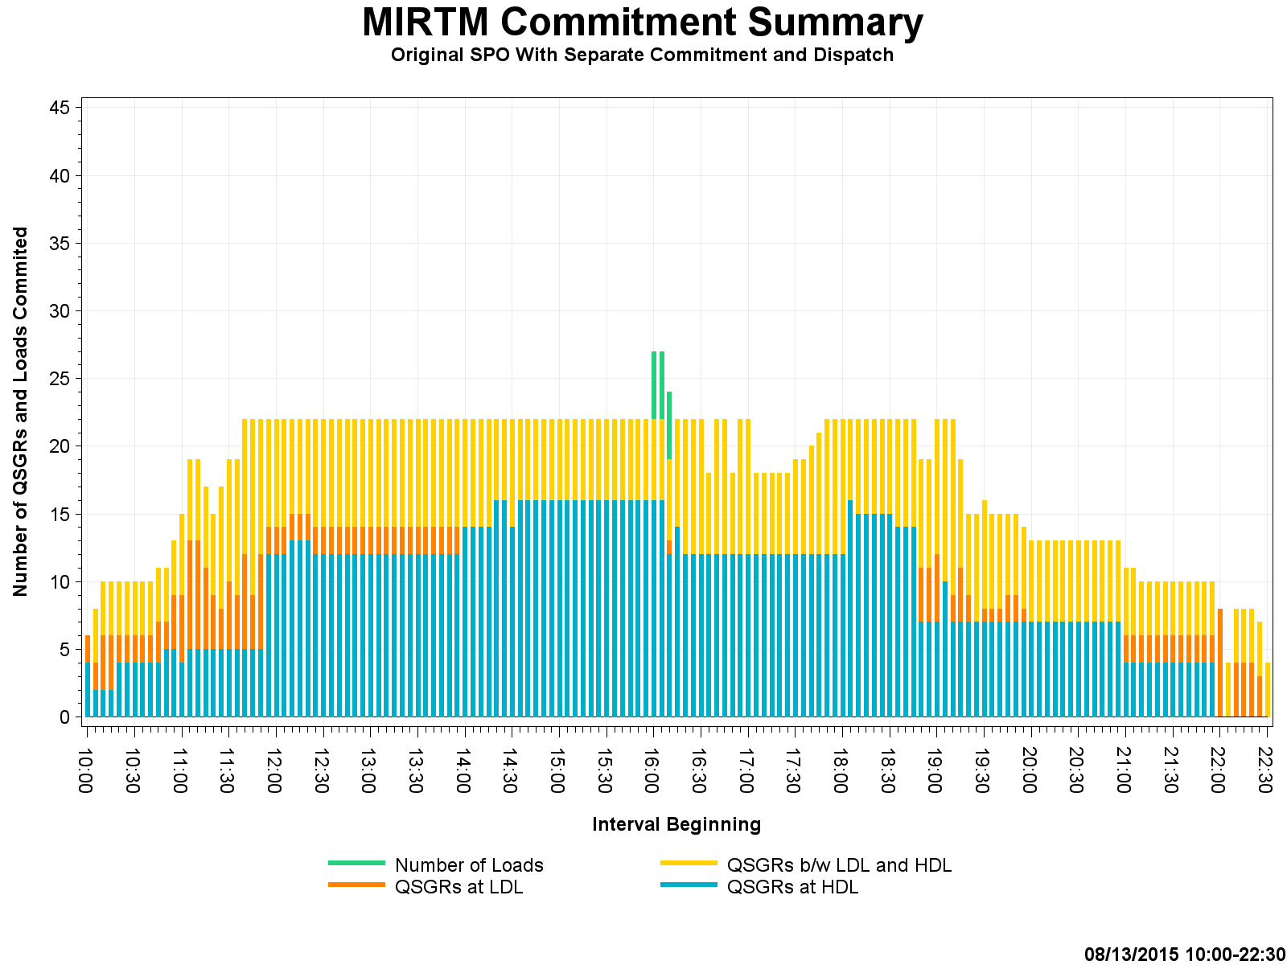
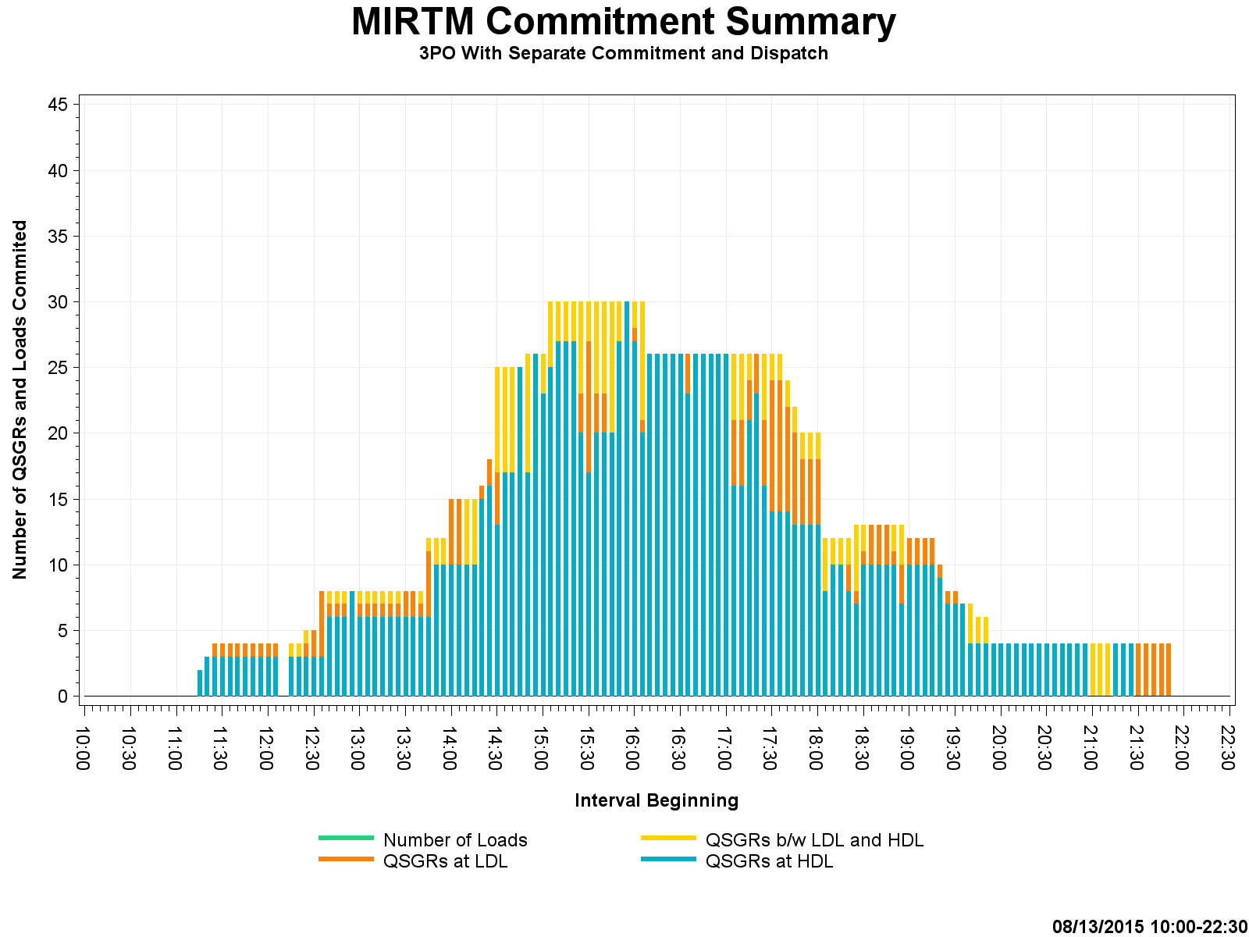
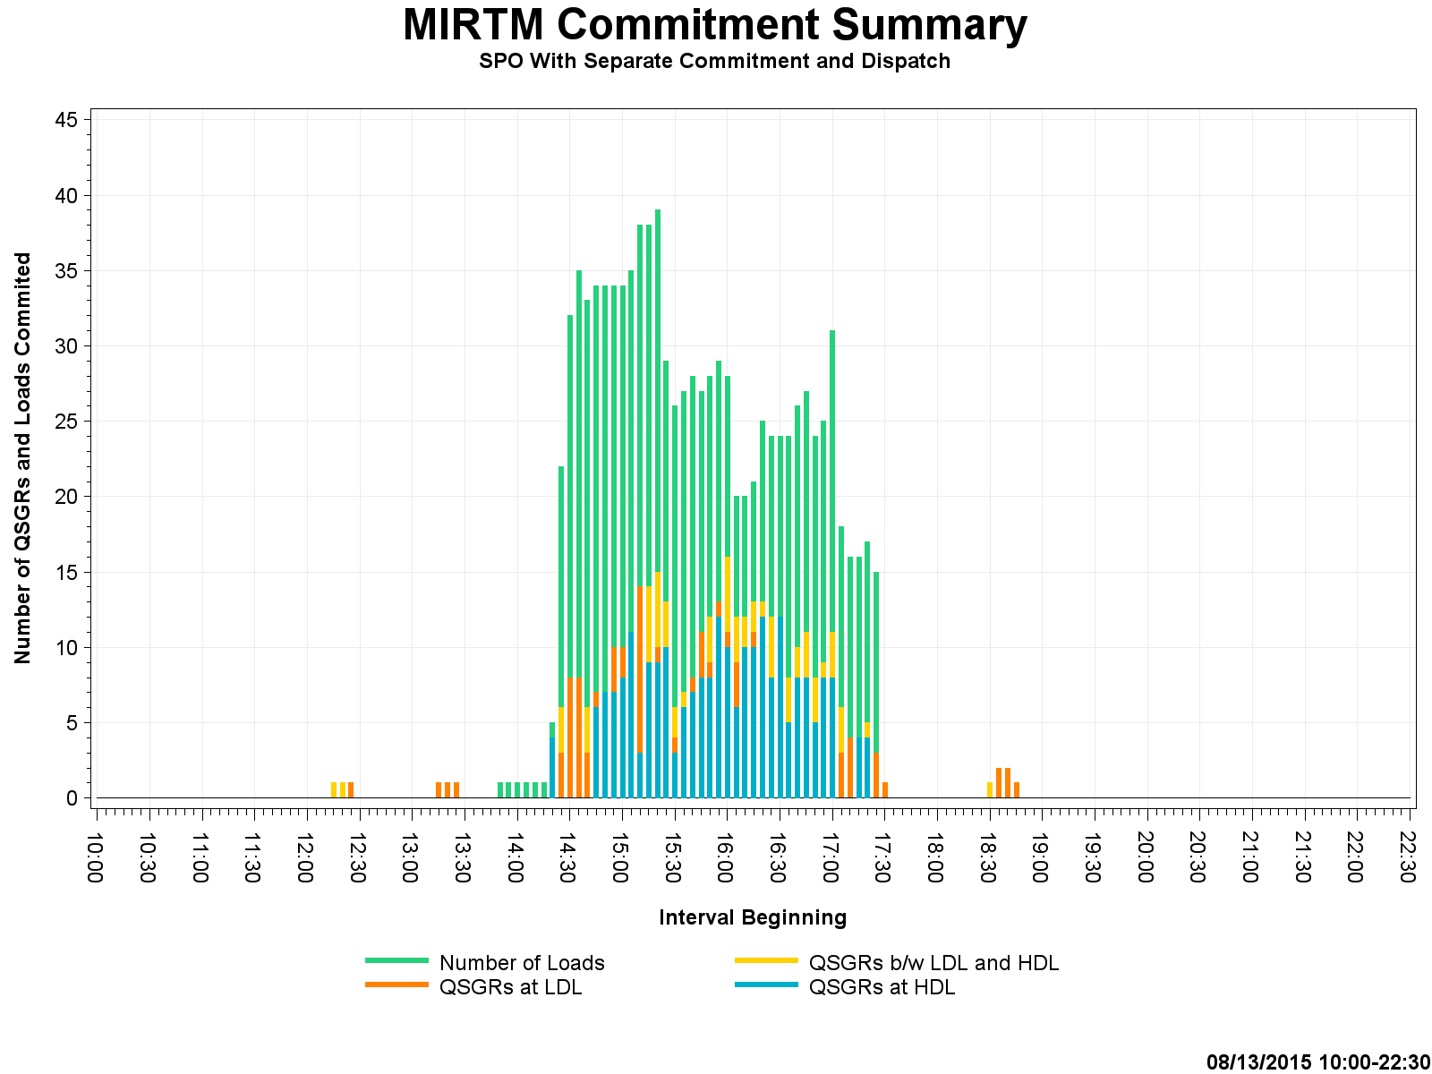
Study Day: August 13, 2015 Commitment Summary

Slide 18
Study Day: July 1, 2015
7/1/2015 – Luminant request (Volatile wind, little congestion, low system lambda)

Slide 19
Study Day: July 01, 2015
Note: Negative Production costs are because we have significant MW on output schedules. Production costs for those resources are integrated at $-250 from LSL to output schedule.
Notes:
Negative Production costs are because we have significant MW on output schedules. Production costs for those resources are integrated at $-250 from LSL to output schedule.

Slide 20
Study Day: July 01, 2015

Slide 21
Study Day: July 01, 2015
Zero Make Whole

Slide 22
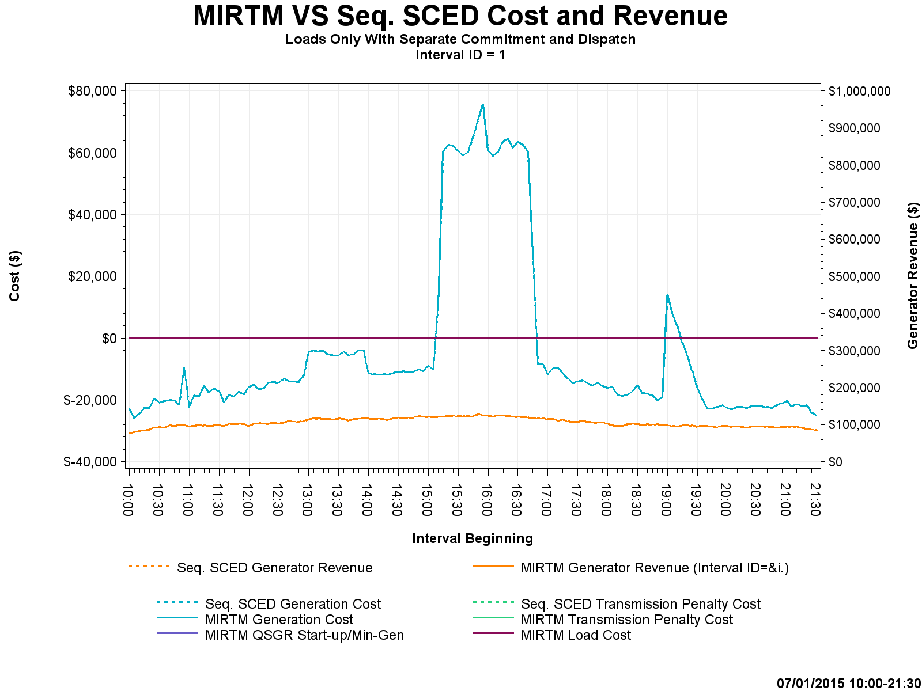
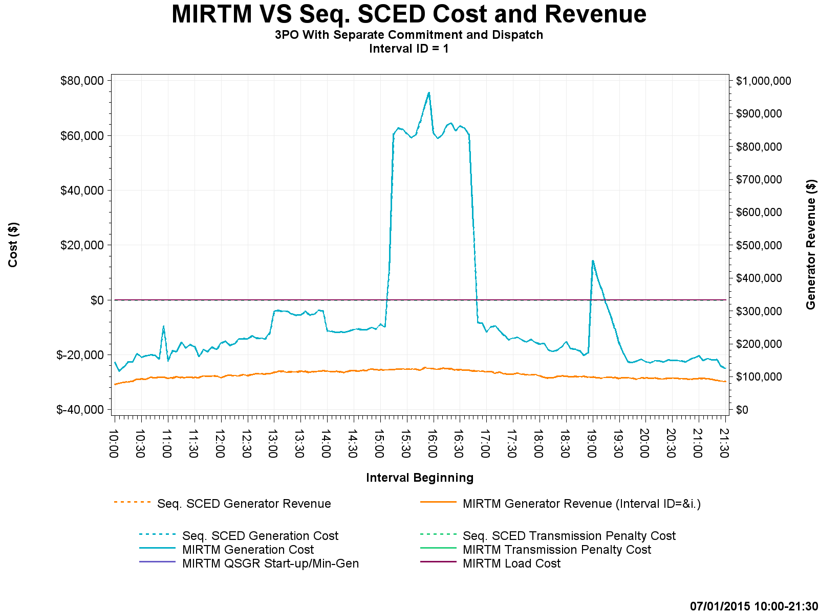
Study Day: July 1, 2015 – Cost and Revenue

Slide 23
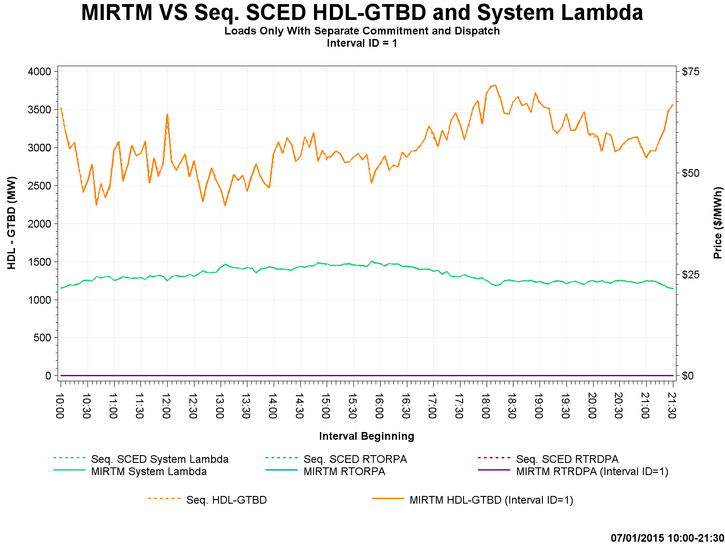
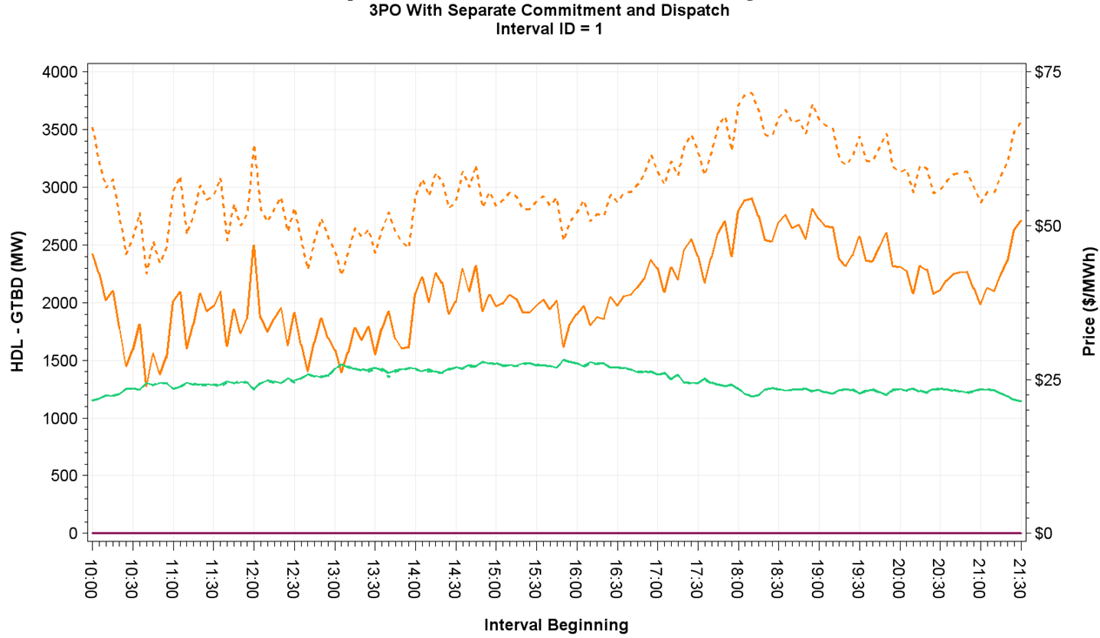
Study Day: July 1, 2015 – HDL-GTBD, SL

Slide 24
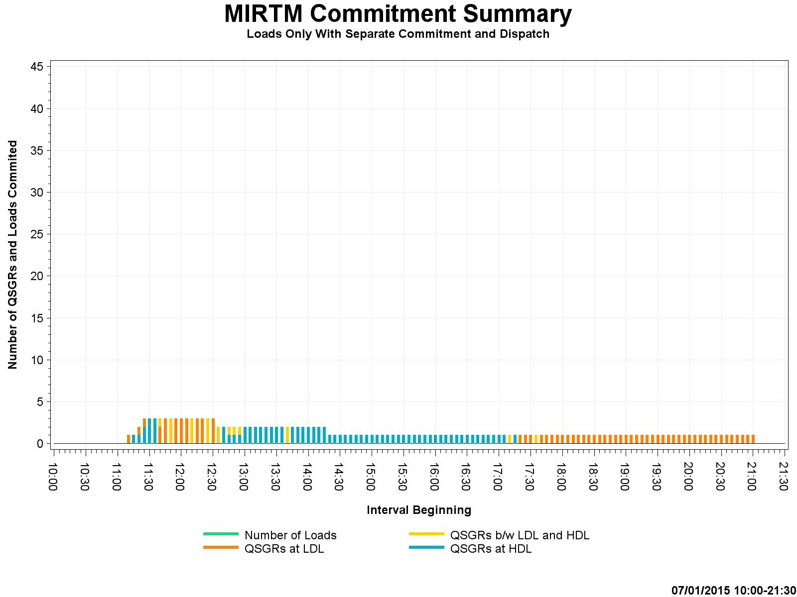
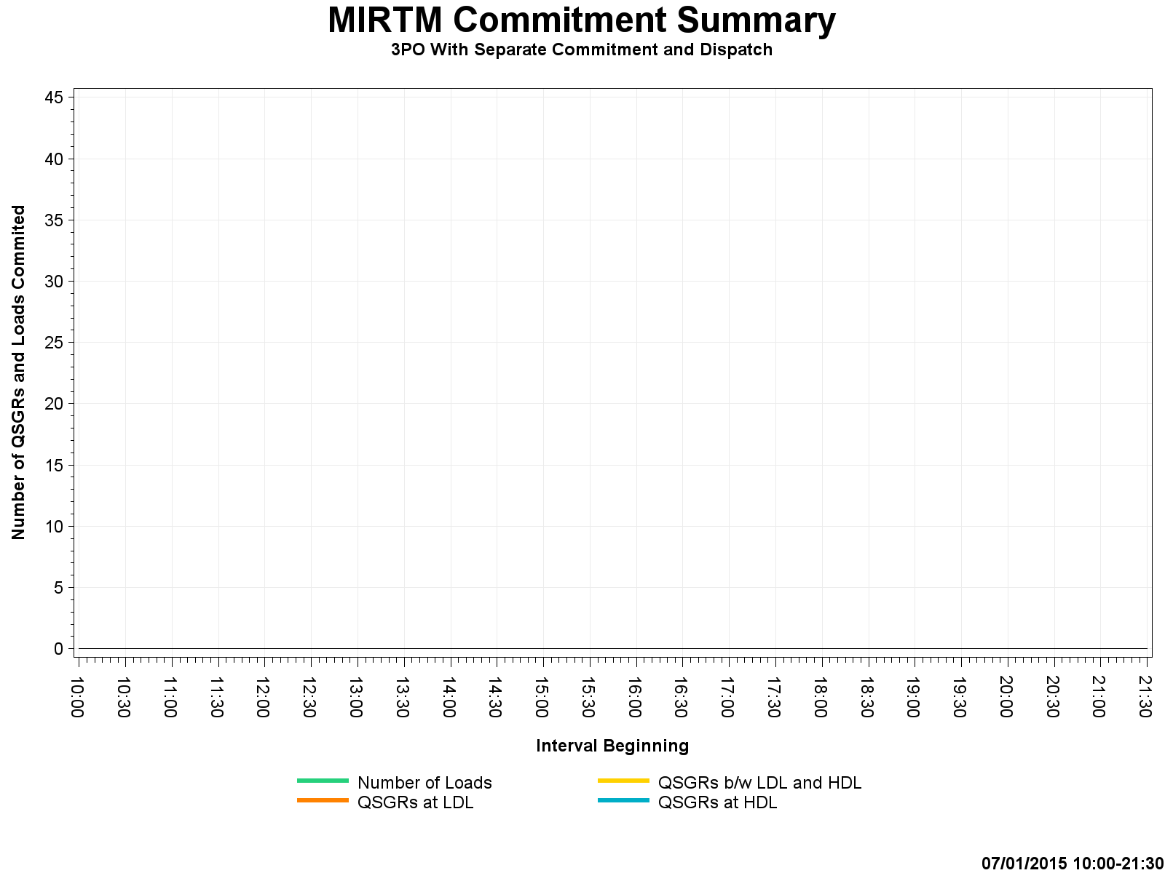
Study Day: July 1, 2015 – Commitment Summary
QSGR mimic Production self commitments
Zero Commitments
Notes:
MIRTM Load Only commitment of QSGR is mimicking production self commitments.

Slide 25
Study Day: August 11, 2015
8/11/2015 - Luminant request (Little congestion, low dispatchable capacity)

Slide 26
Study Day: August 11, 2015
Increases from Combined Cycle modeling, offer assumptions and dispatch decisions (see note)
Notes:
We have identified that MIRTM has increase Production costs due to a Combined Cycle assumption which causes ~$40k difference from Seq SCED. When a Combined Cycle changes configuration, that config has new HDL/LDL. Seq SCED uses the production SCED HDL/LDL. MIRTM sets HDL/LDL based on previous interval BP. Since the CC EOC did not cover to the new HDL, EOC was set to $9k causing the unit to be dispatched at LDL which caused separation of Production Costs between SS and MIRTM. Additionally, the assumed offers and dispatch decisions caused by withholding capacity drive production costs up.

Slide 27
Study Day: August 11, 2015

Slide 28
Study Day: August 11, 2015

Slide 29
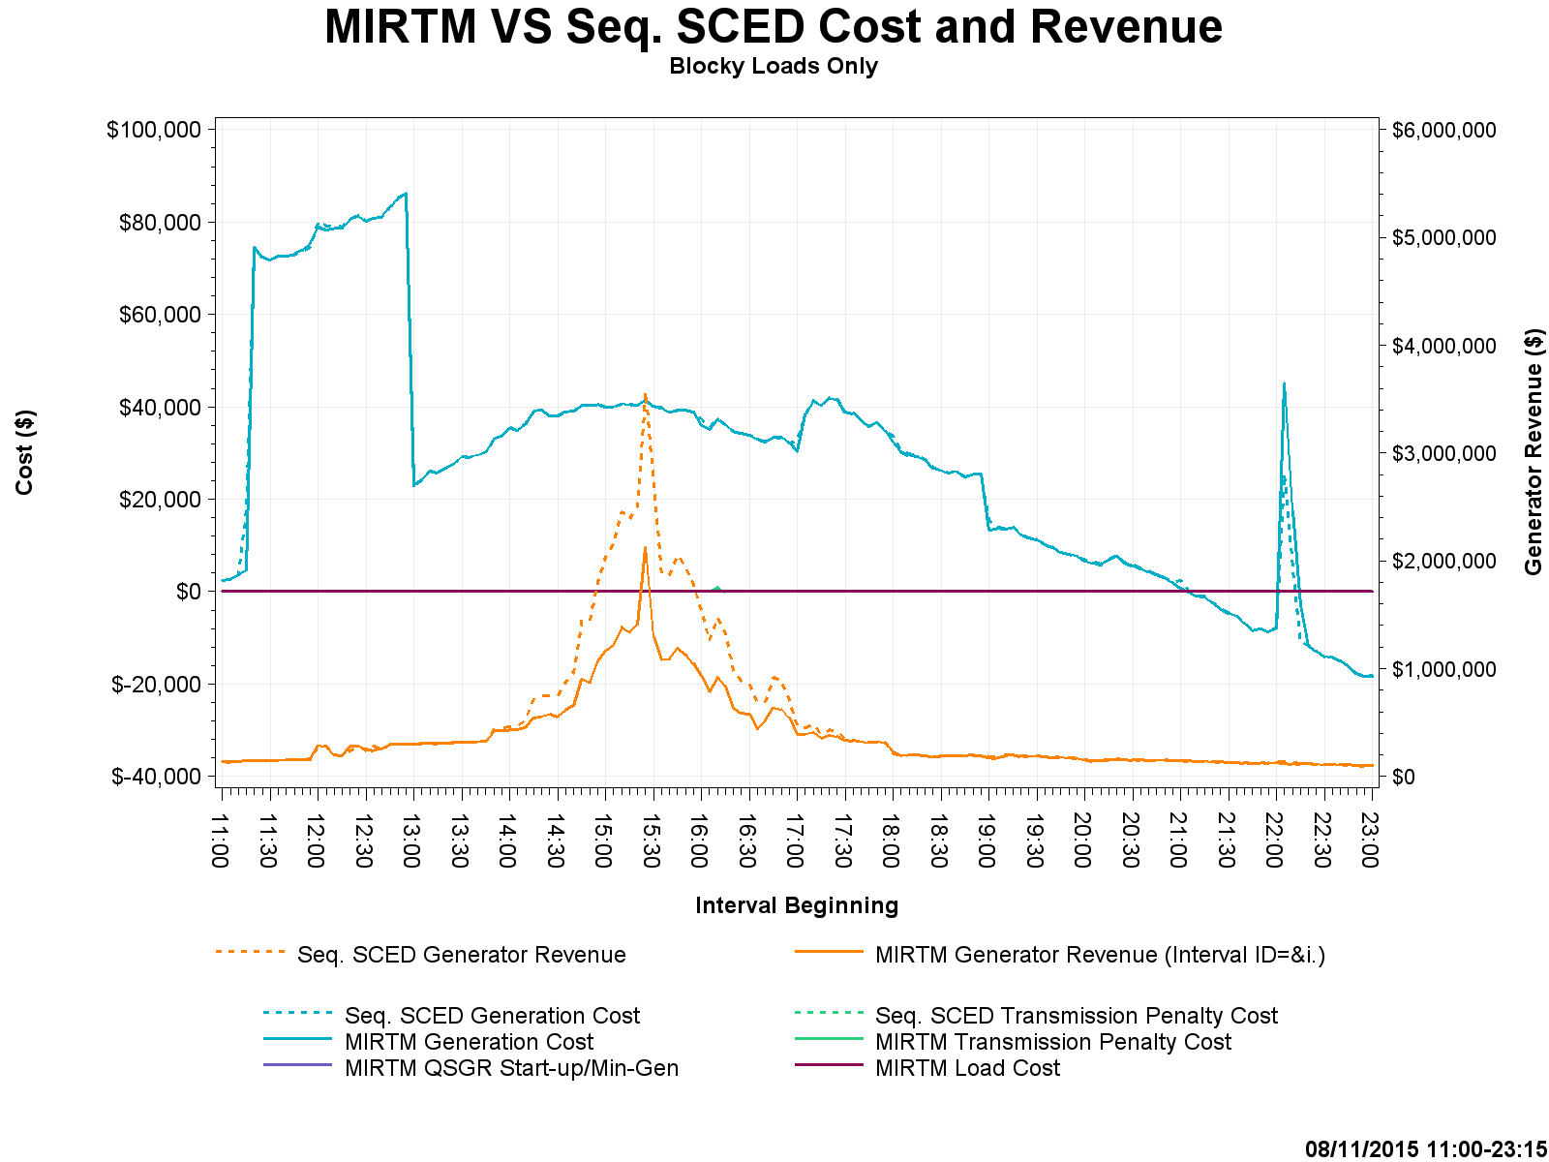
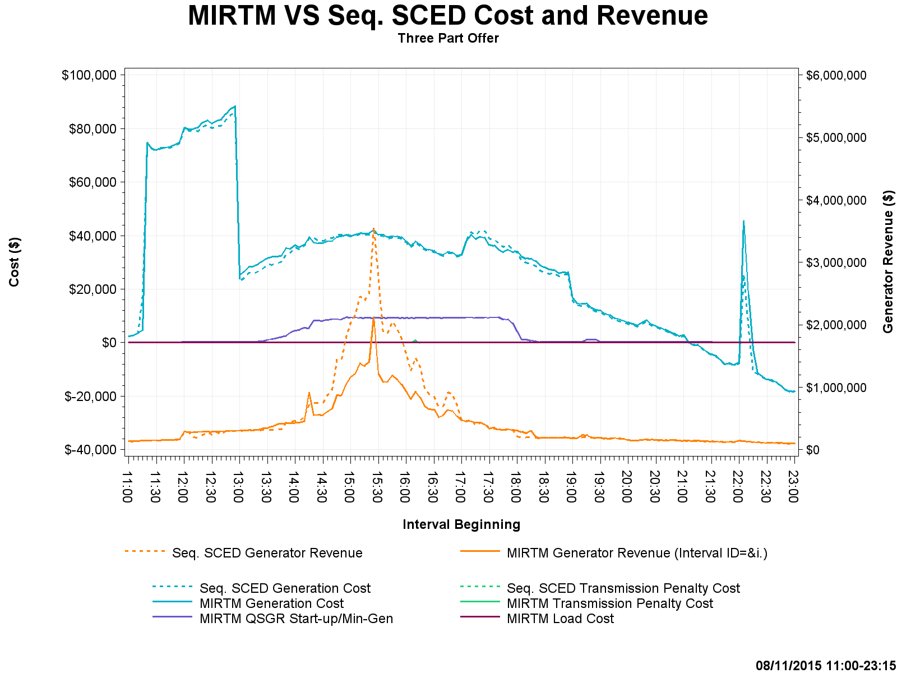
Study Day: August 11, 2015 – Cost and Revenue

Slide 30
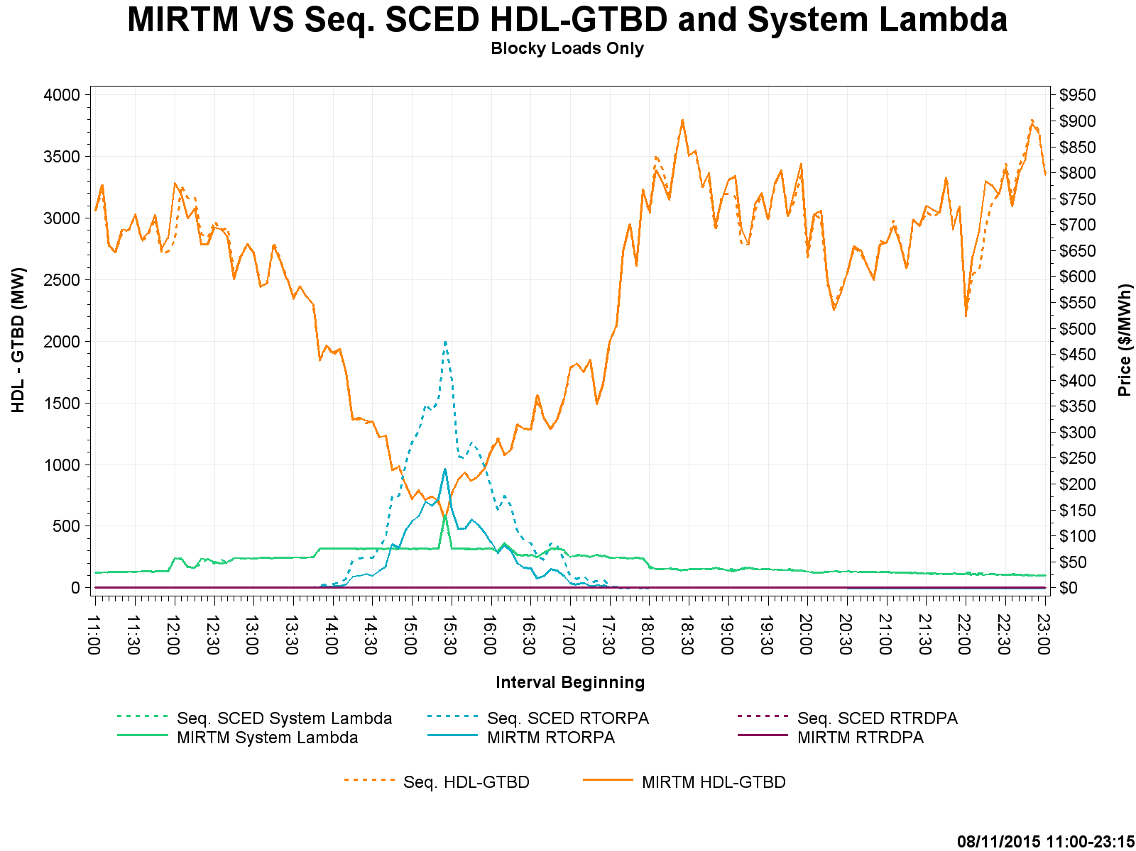
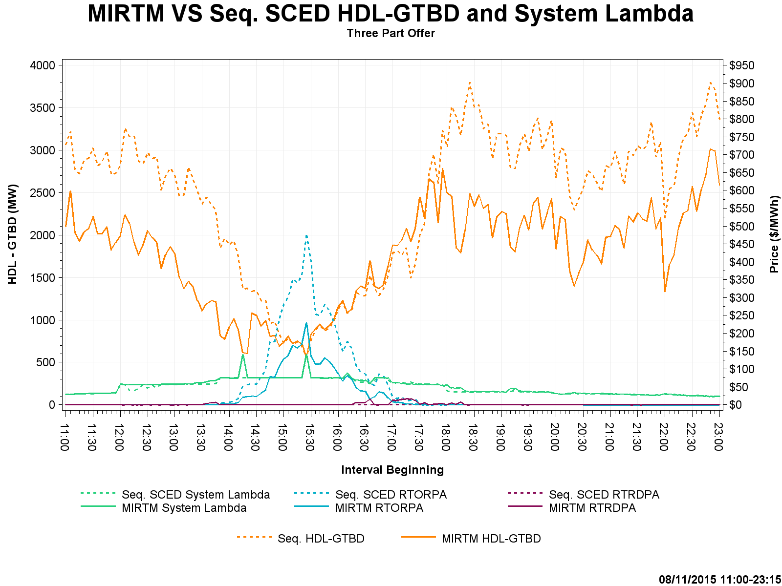
Study Day: August 11, 2015 – HDL-GTBD, SL

Slide 31
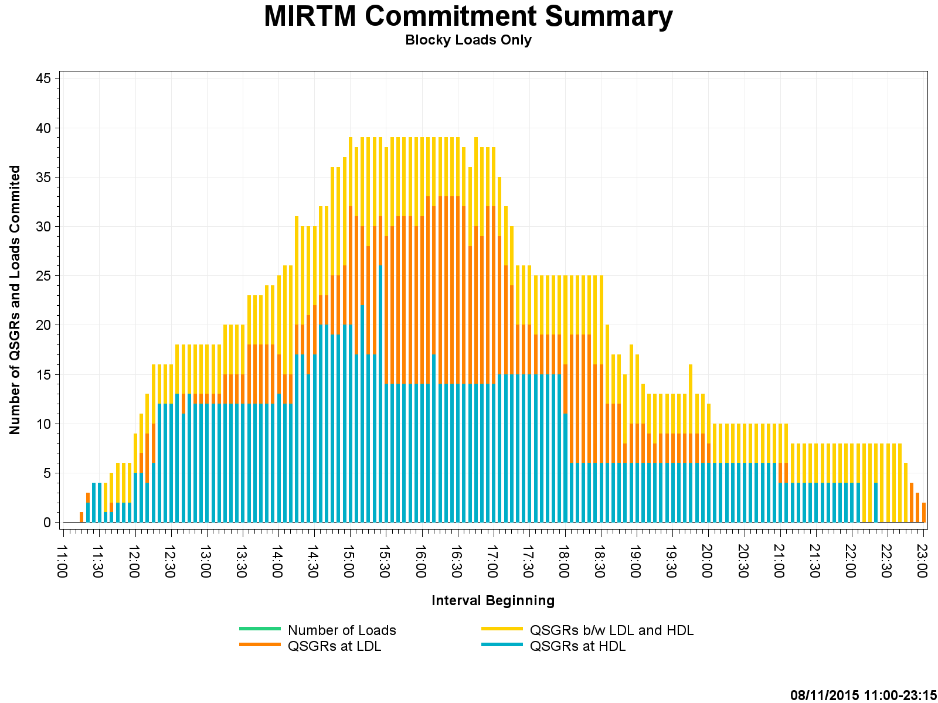
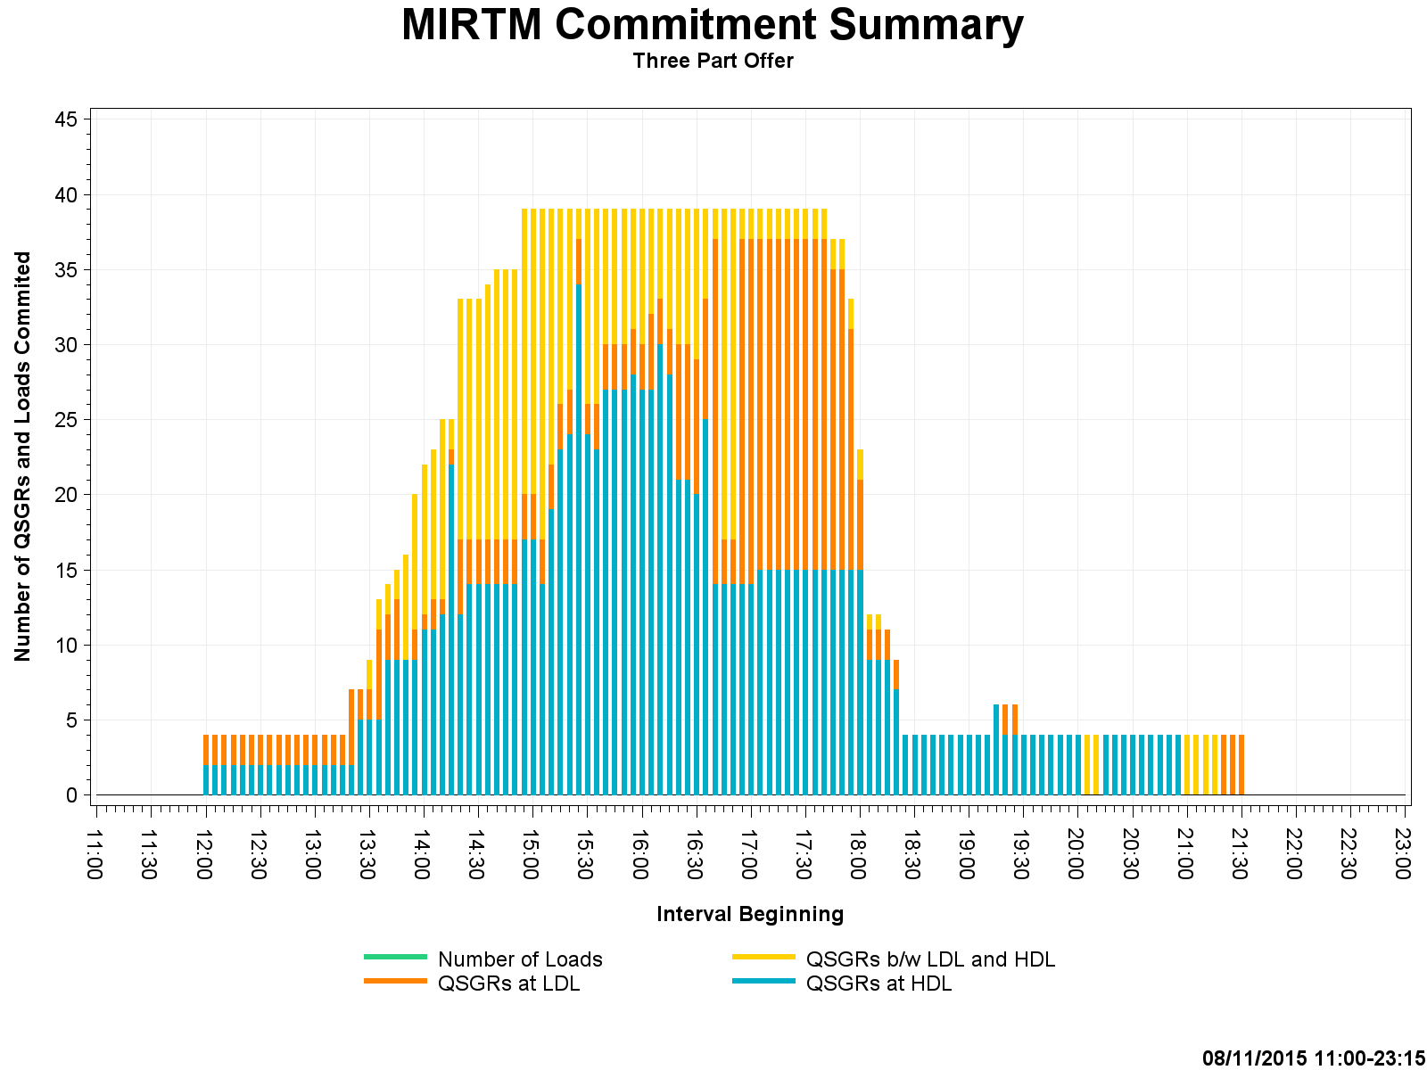
Study Day: August 11, 2015 – Commitment Summary

Slide 32
Study Day: Nov 11, 2015
11/11/2015 - ERCOT (New STLF over forecasts load)

Slide 33
Study Day: Nov 11, 2015

Slide 34
Study Day: Nov 11, 2015

Slide 35
Study Day: Nov 11, 2015

Slide 36
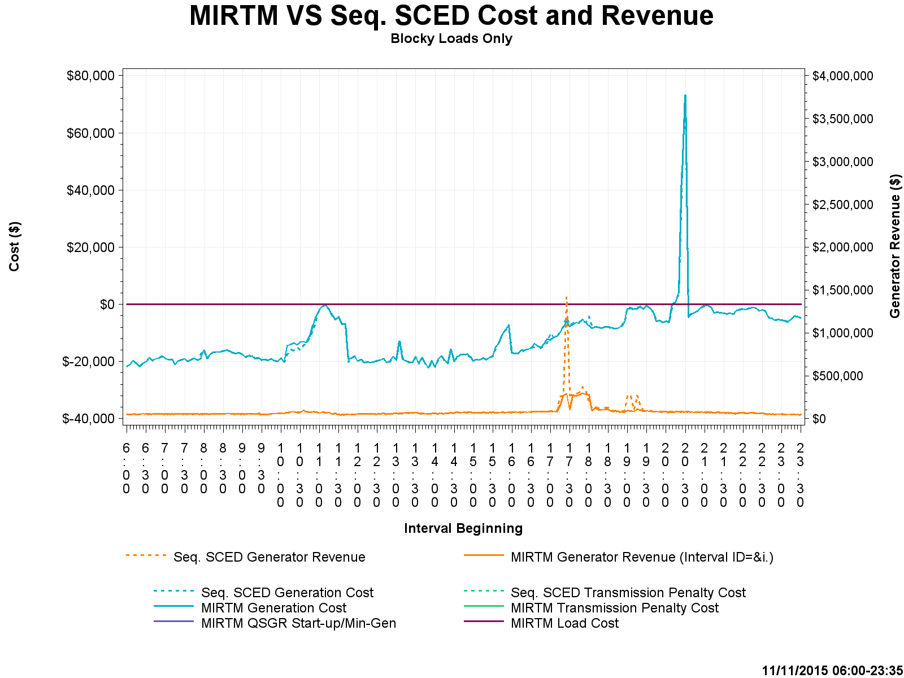
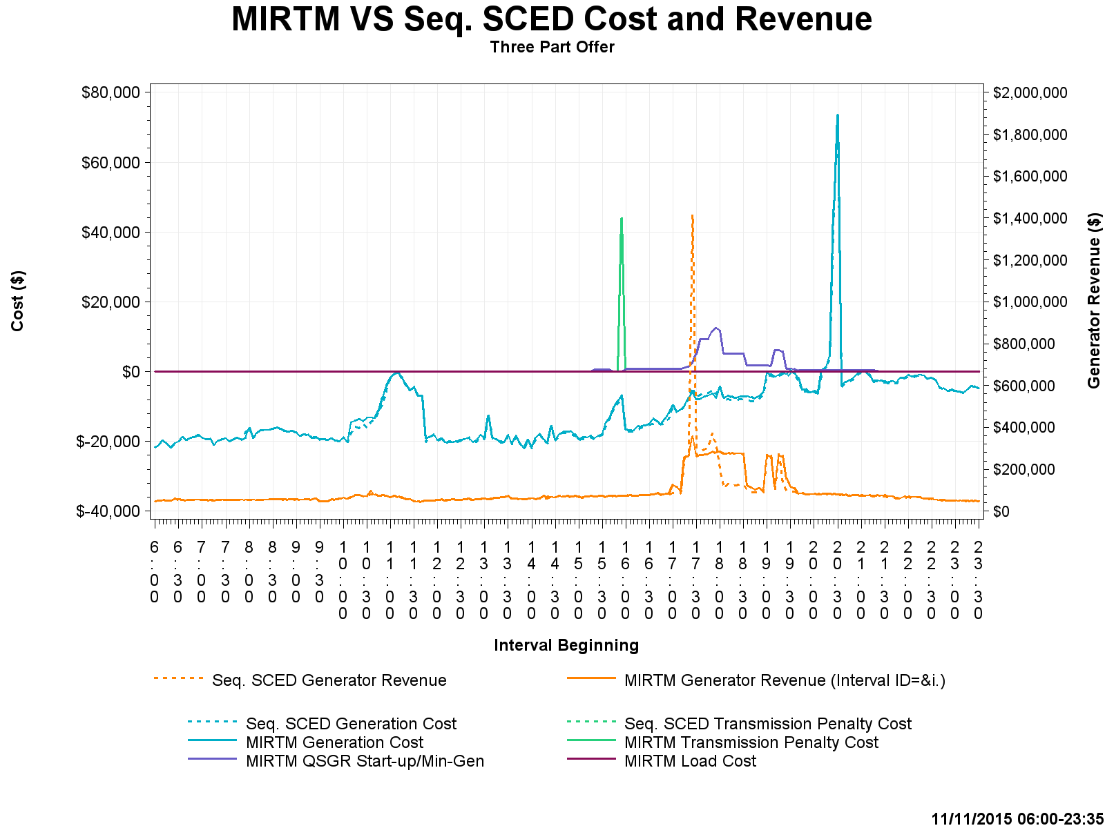
Study Day: Nov 11, 2015 – Cost and Revenue

Slide 37
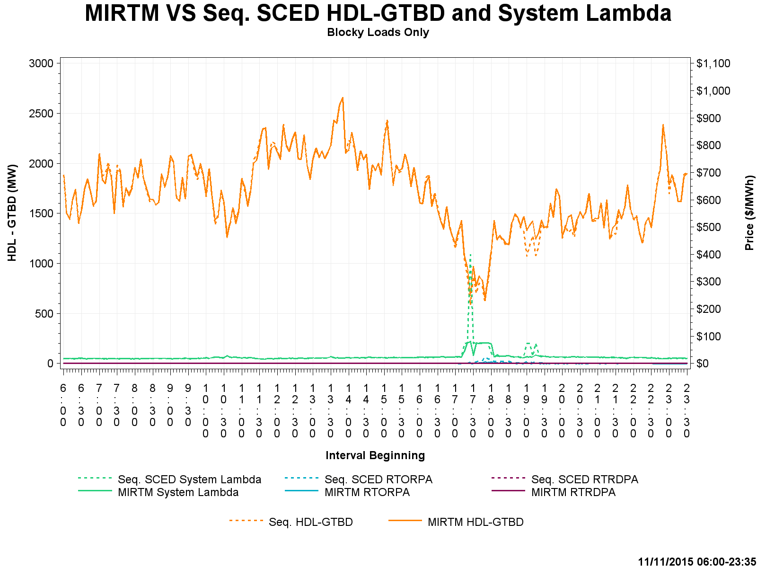
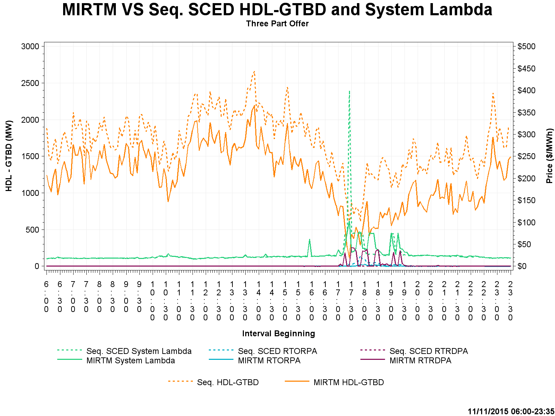
Study Day: Nov 11, 2015– HDL-GTBD, SL

Slide 38
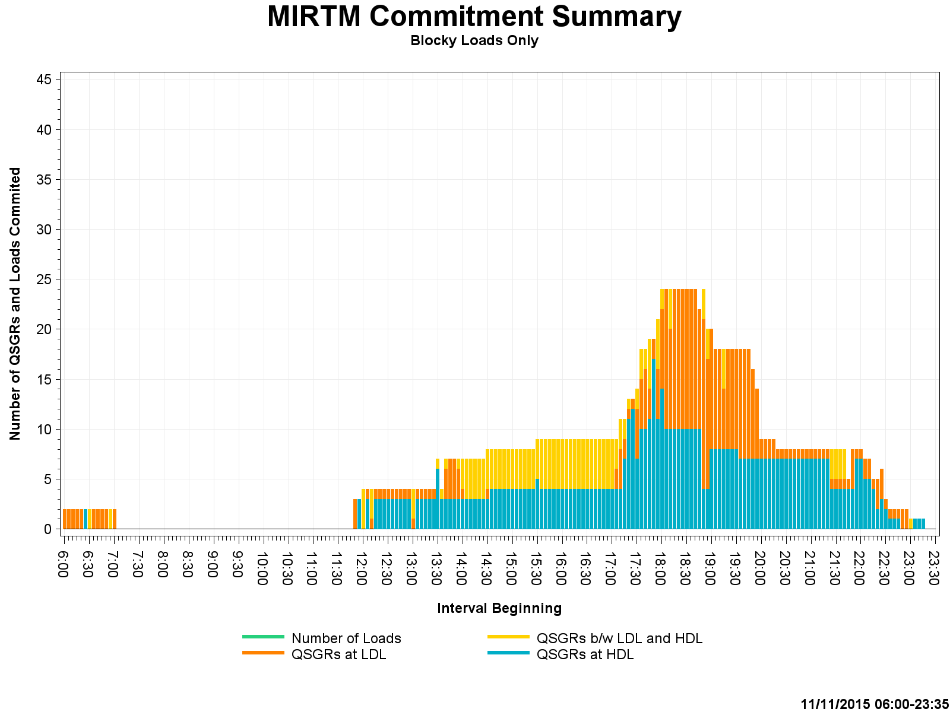
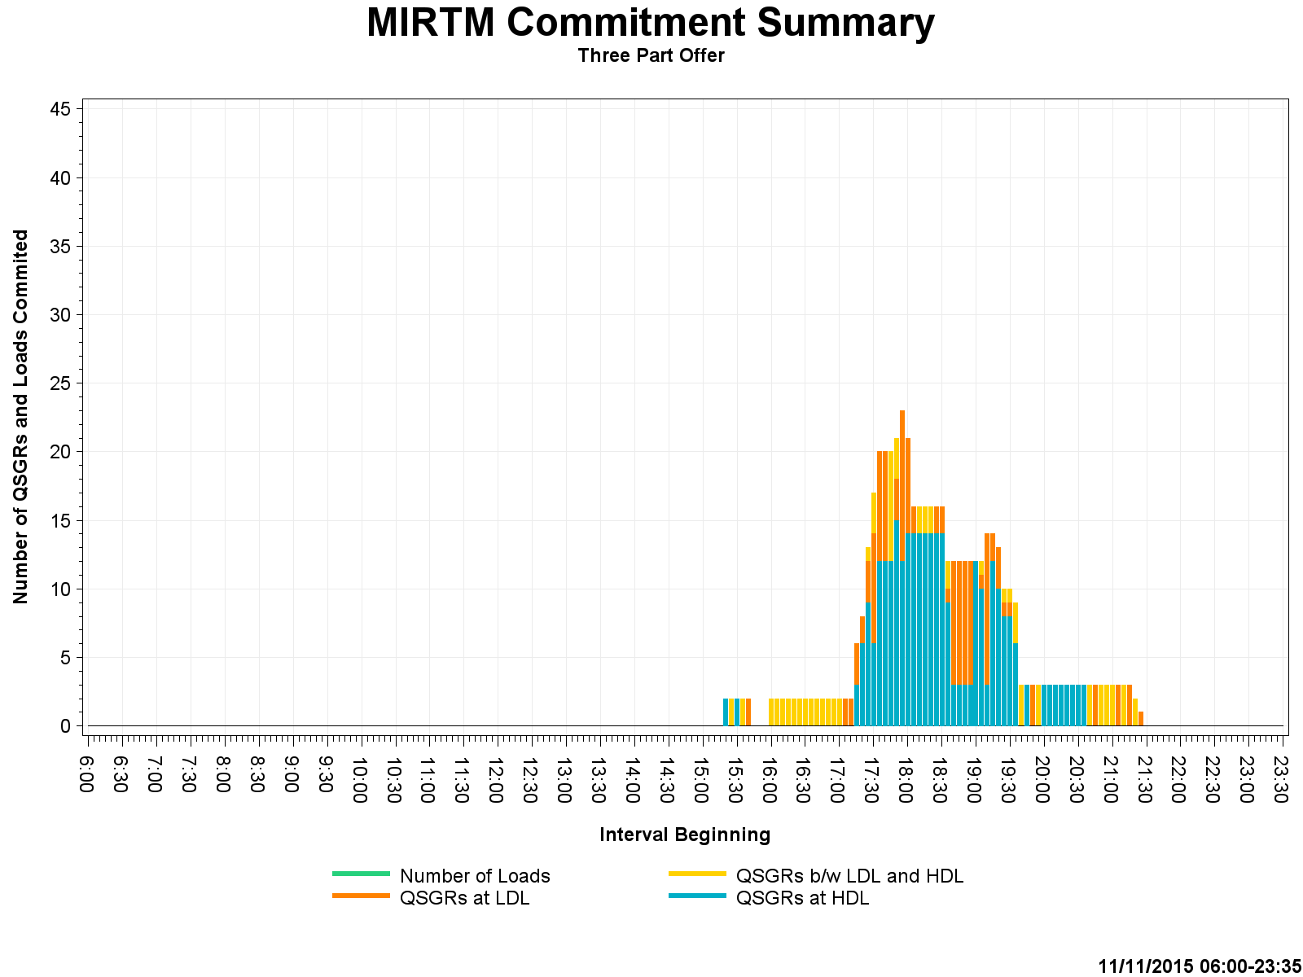
Study Day: Nov 11, 2015 – Commitment Summary

Slide 39
Study Day: Nov 27, 2015
11/27/2015 – ERCOT (New STLF under forecast load)

Slide 40
Study Day: Nov 27, 2015
Combined Cycle modeling
~$250k
Notes:
See 8/11 description of Combined cycle modeling. Same issue here which causes MIRTM to have ~$250k additional Production costs.

Slide 41
Study Day: Nov 27, 2015

Slide 42
Study Day: Nov 27, 2015
Notes:
QSGR Make Whole under Load only run is due to low system lambda and change in dispatch due to Load commitment.

Slide 43
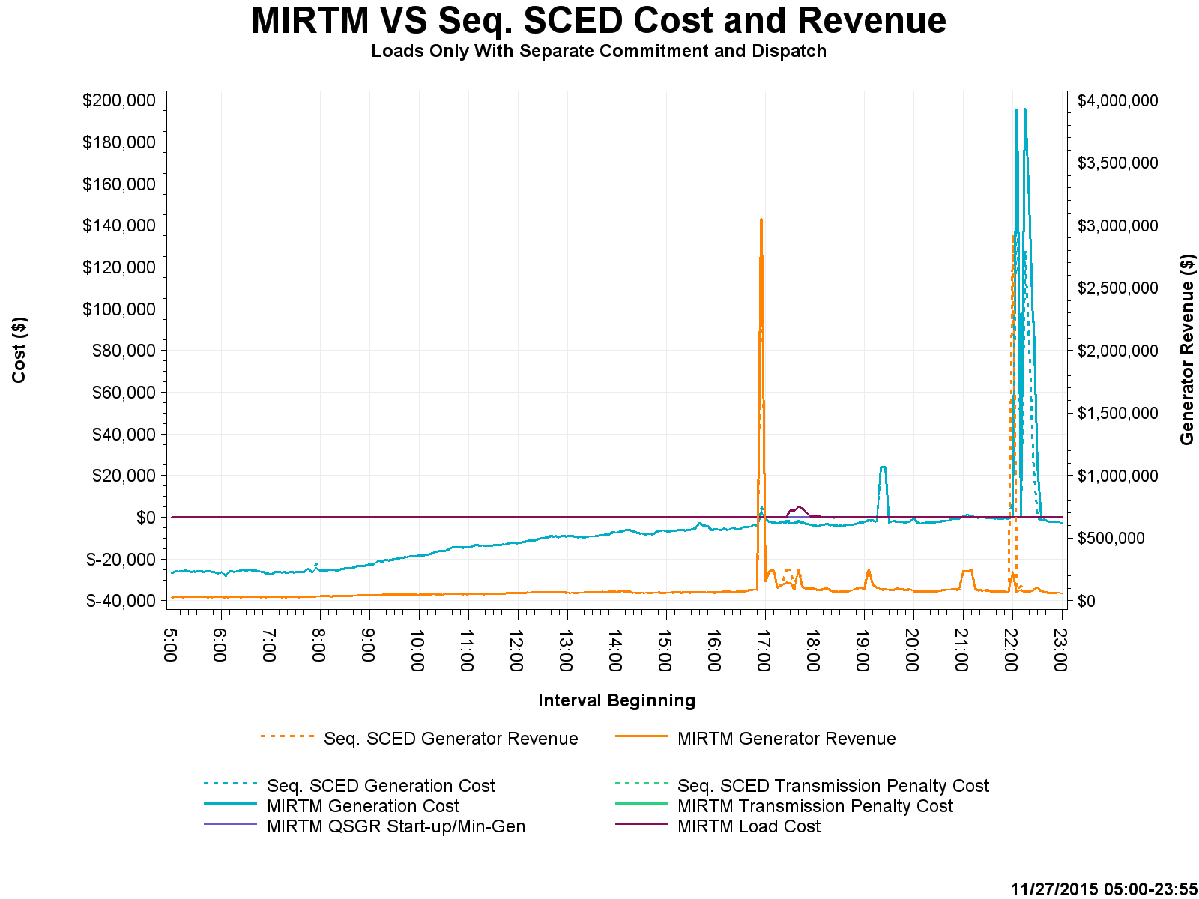
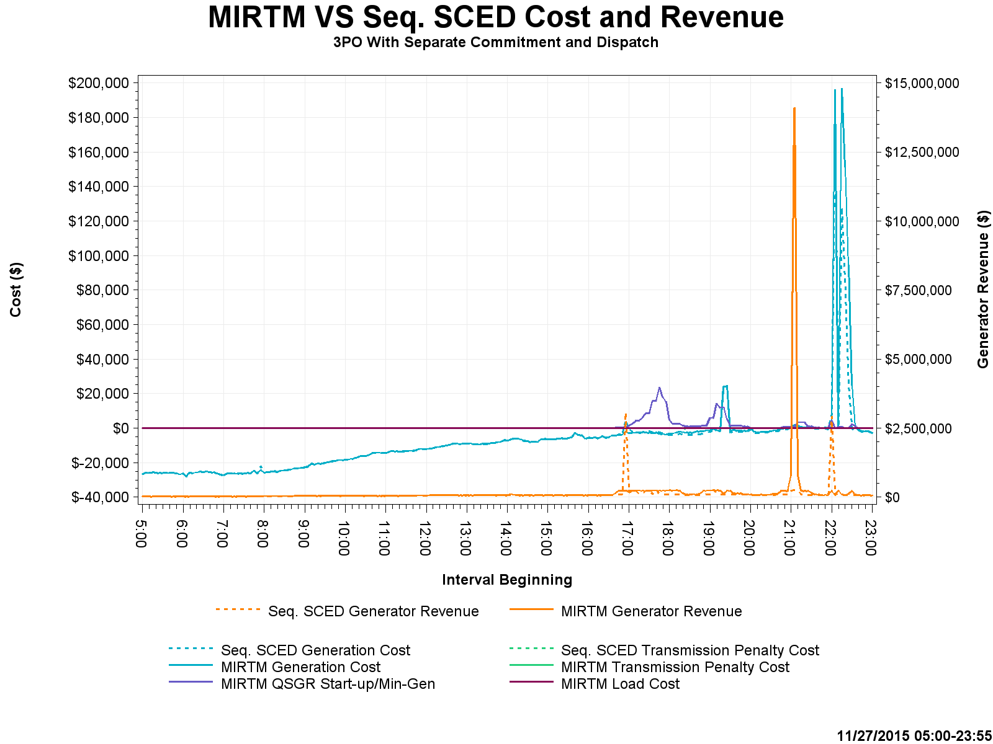
Study Day: Nov 27, 2015 – Cost and Revenue
$4M
$15M

Slide 44
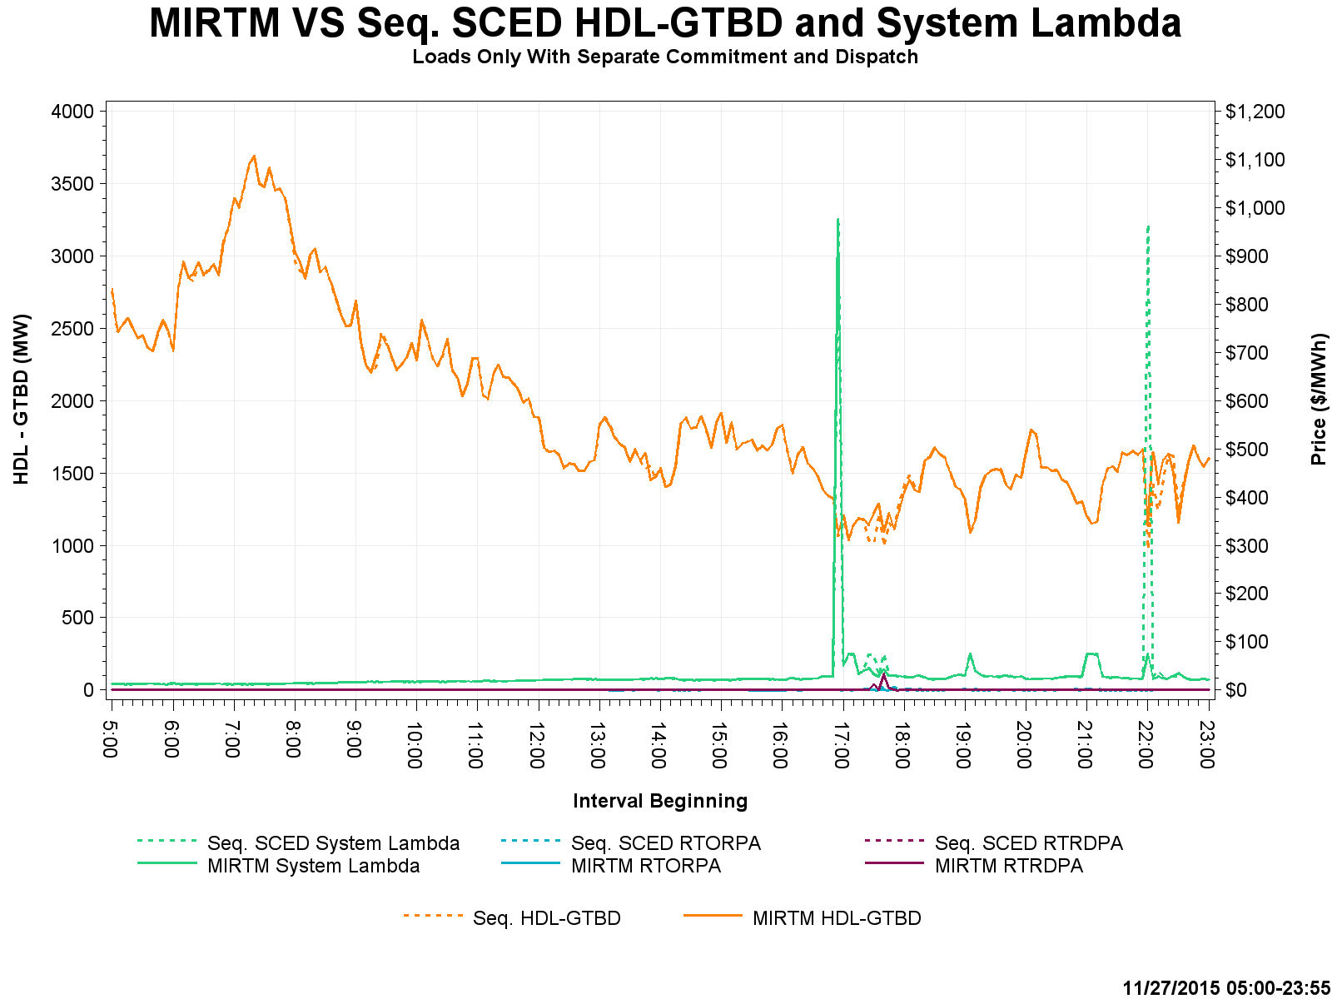
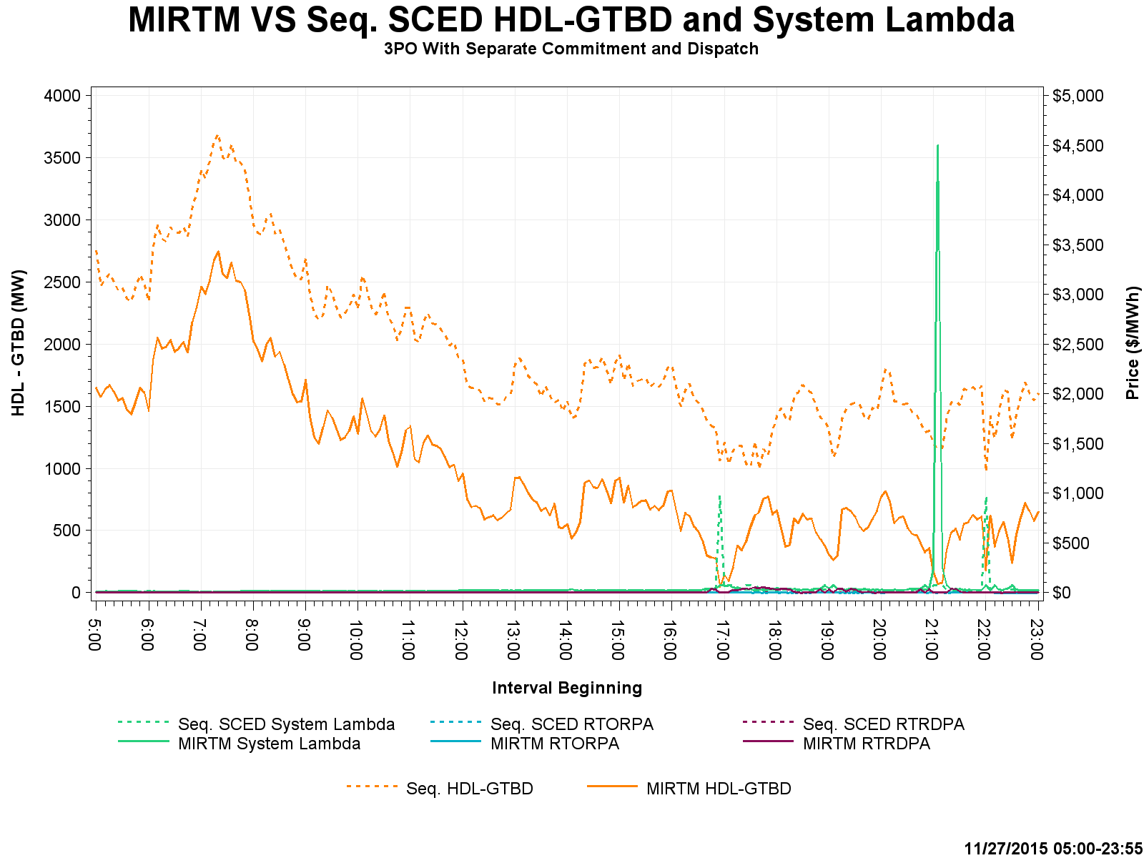
Study Day: Nov 27, 2015– HDL-GTBD, SL

Slide 45
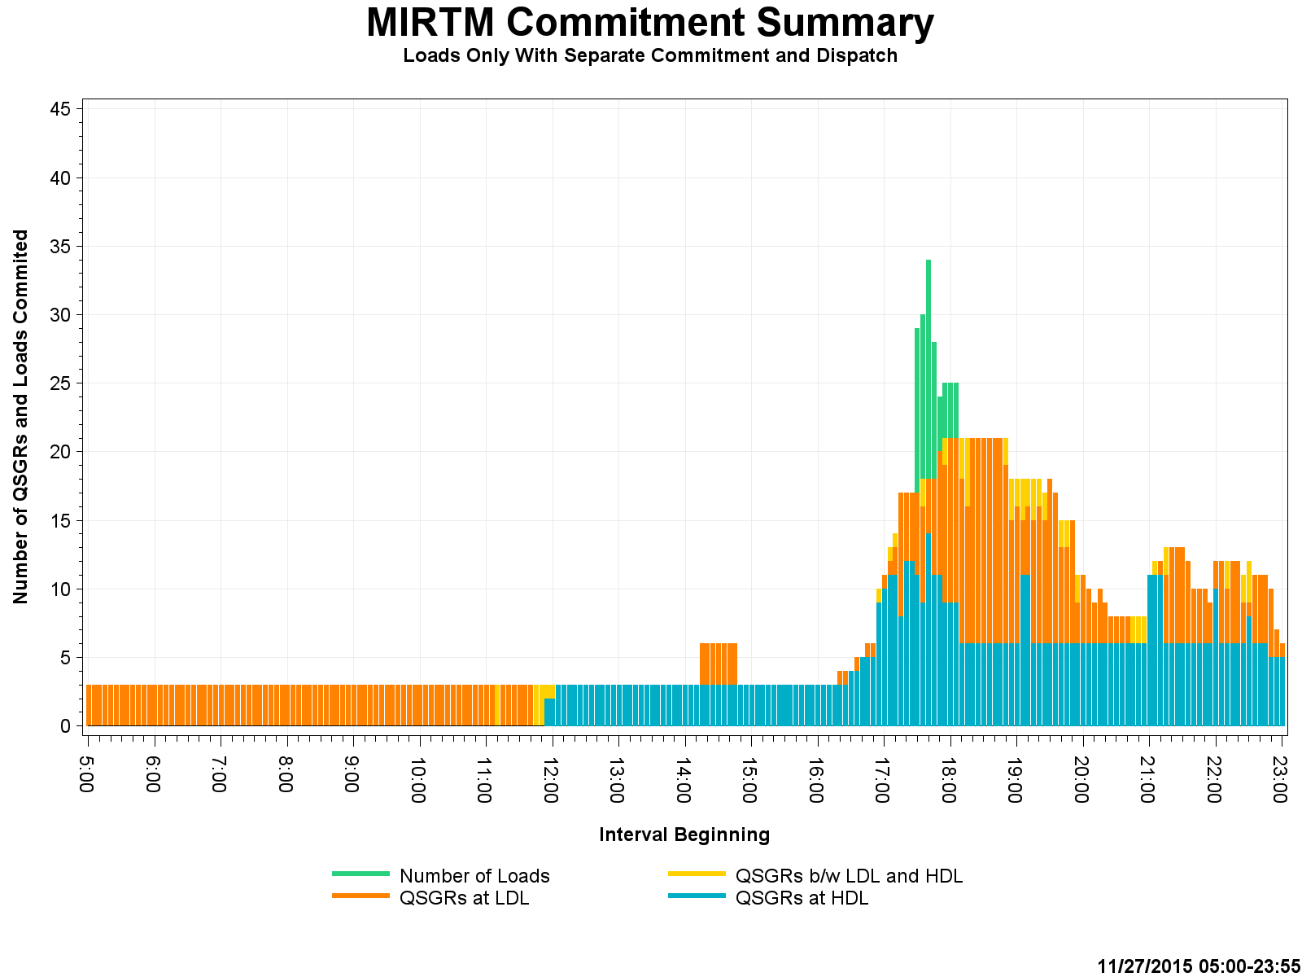
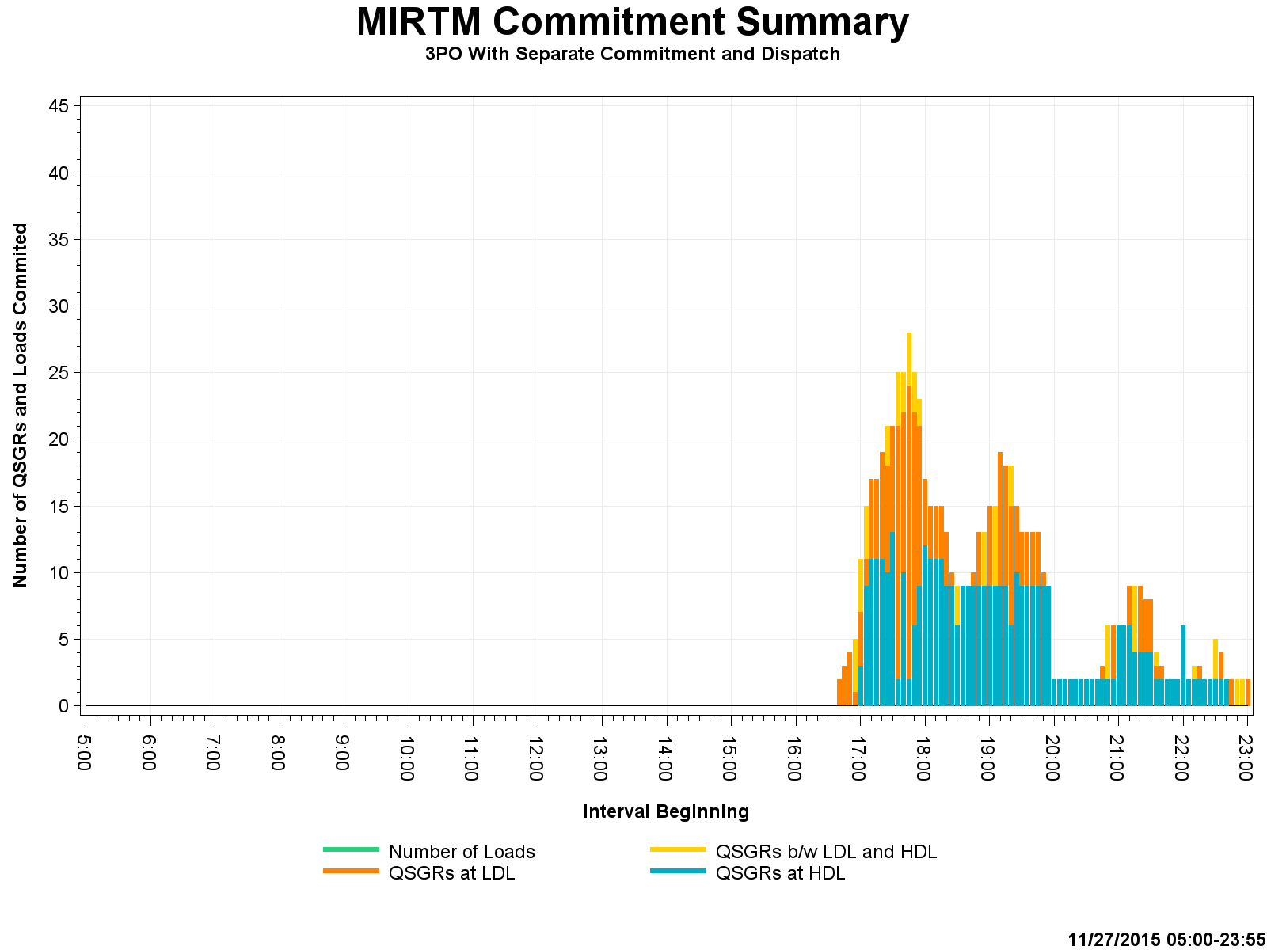
Study Day: Nov 27, 2015 – Commitment Summary

Slide 46
Study Day: March 27, 2016
3/27/2016 – ERCOT (Low wind, units shutting down, low dispatchable capacity)

Slide 47
Study Day: March 27, 2016

Slide 48
Study Day: March 27, 2016
One interval @ 20:10 there was a price spike of $9k due to load forecast under forecasting a load in future interval. When that interval became the binding interval, 2 units shutdown resulting in GTBD being higher and no time to commit more resources due to ramp constraints. Blocky load will not get committed unless we see increase in price in intervals 3 and beyond (depends on notification time).

Slide 49
Study Day: March 27, 2016

Slide 50
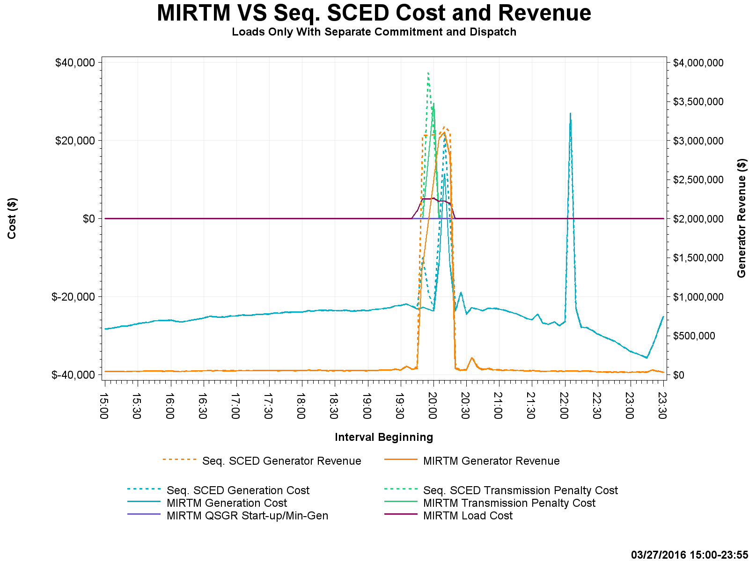
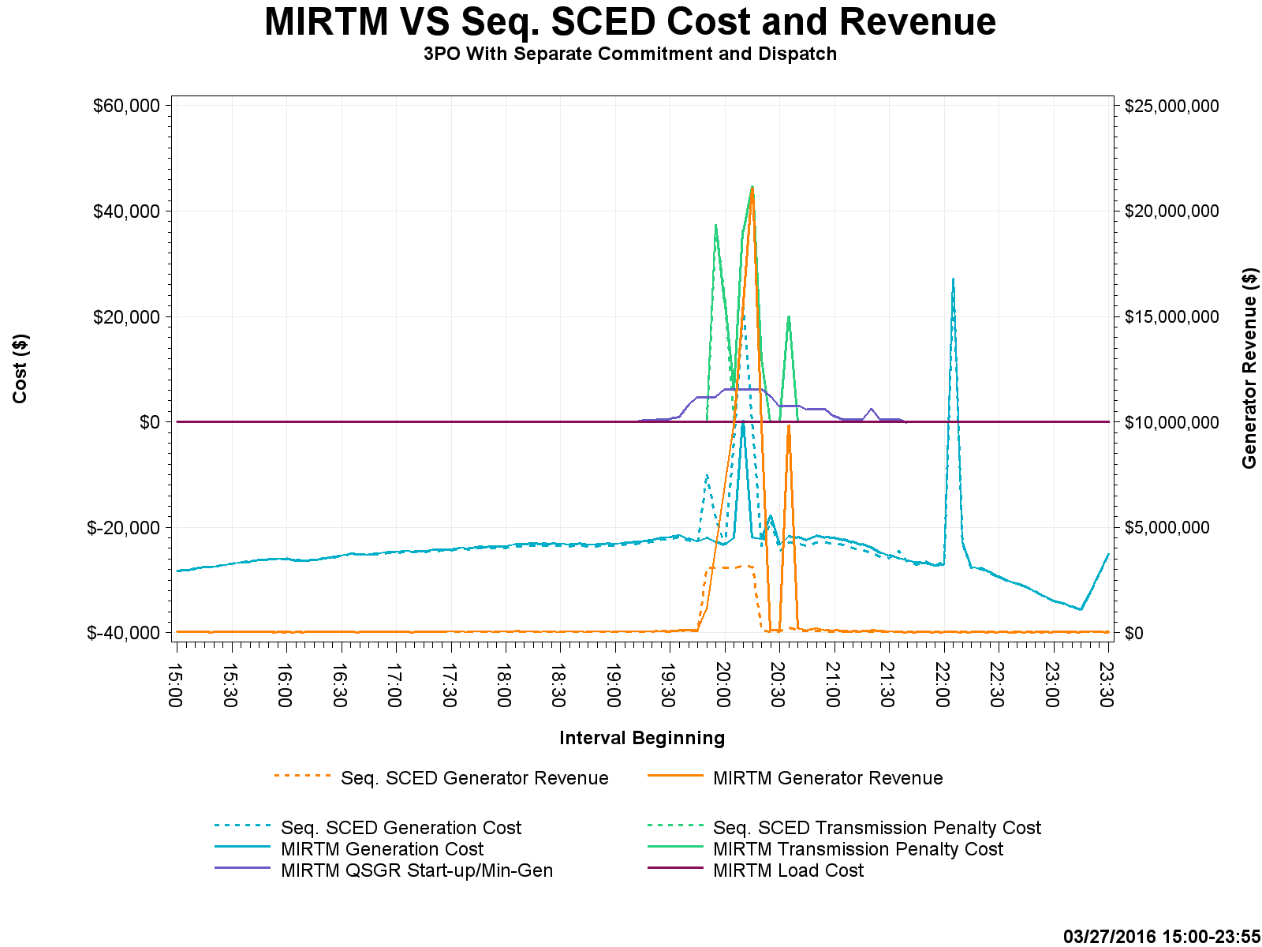
Study Day: March 27, 2016 – Cost and Revenue
$4M
$25M

Slide 51
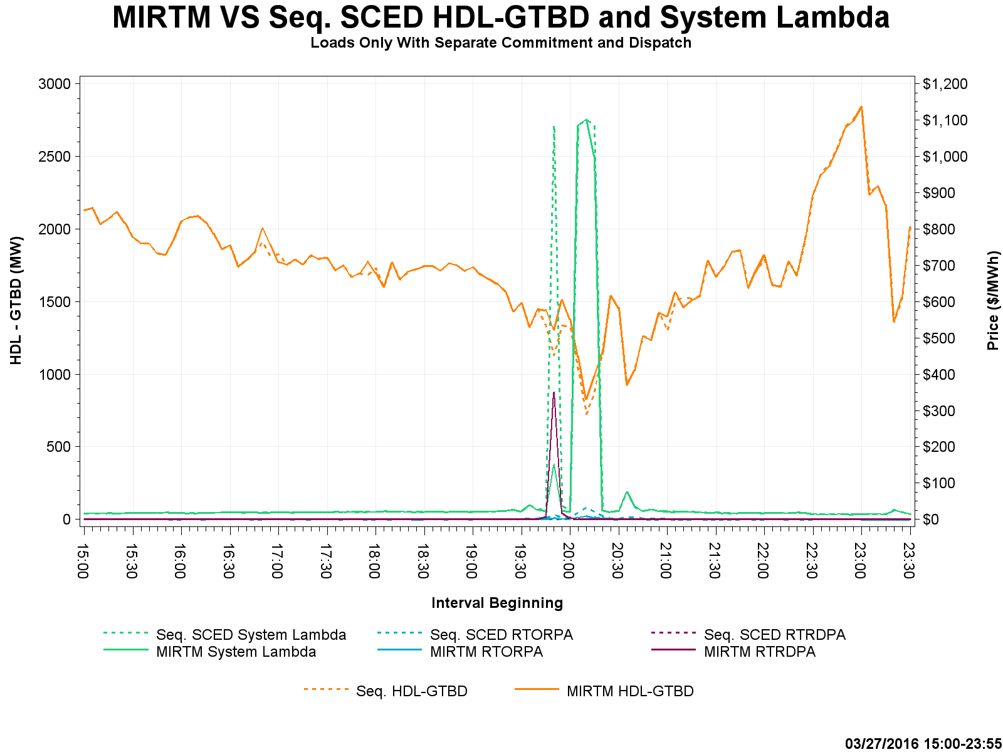
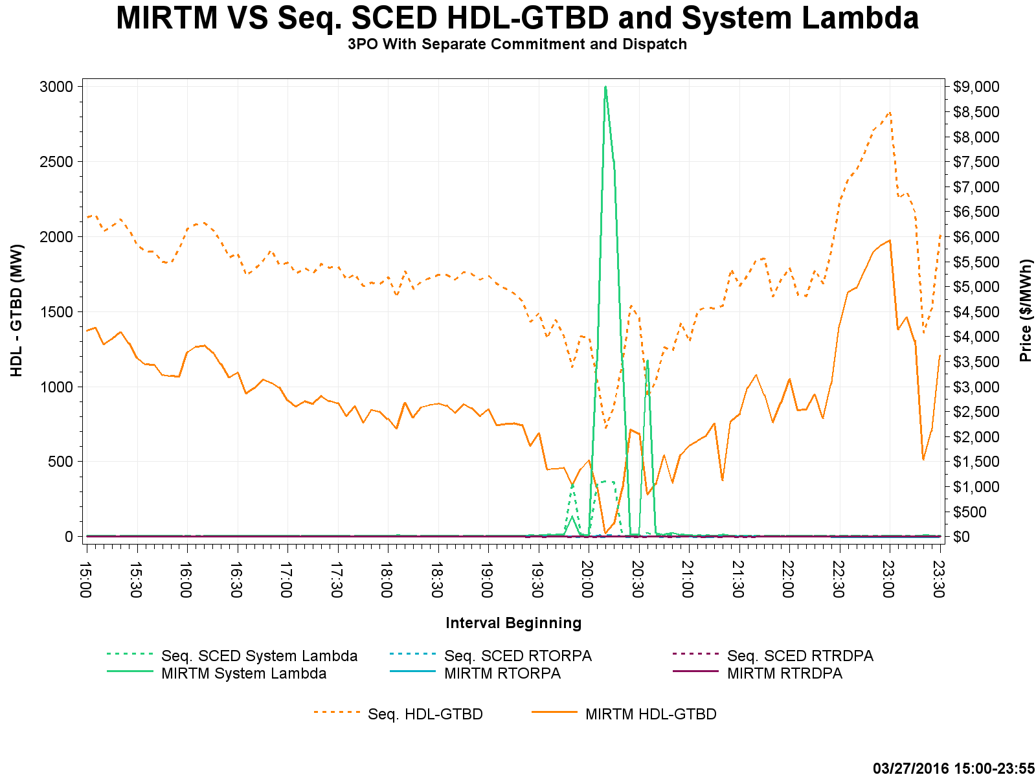
Study Day: March 27, 2016 – HDL-GTBD, SL
$1k
$9k

Slide 52
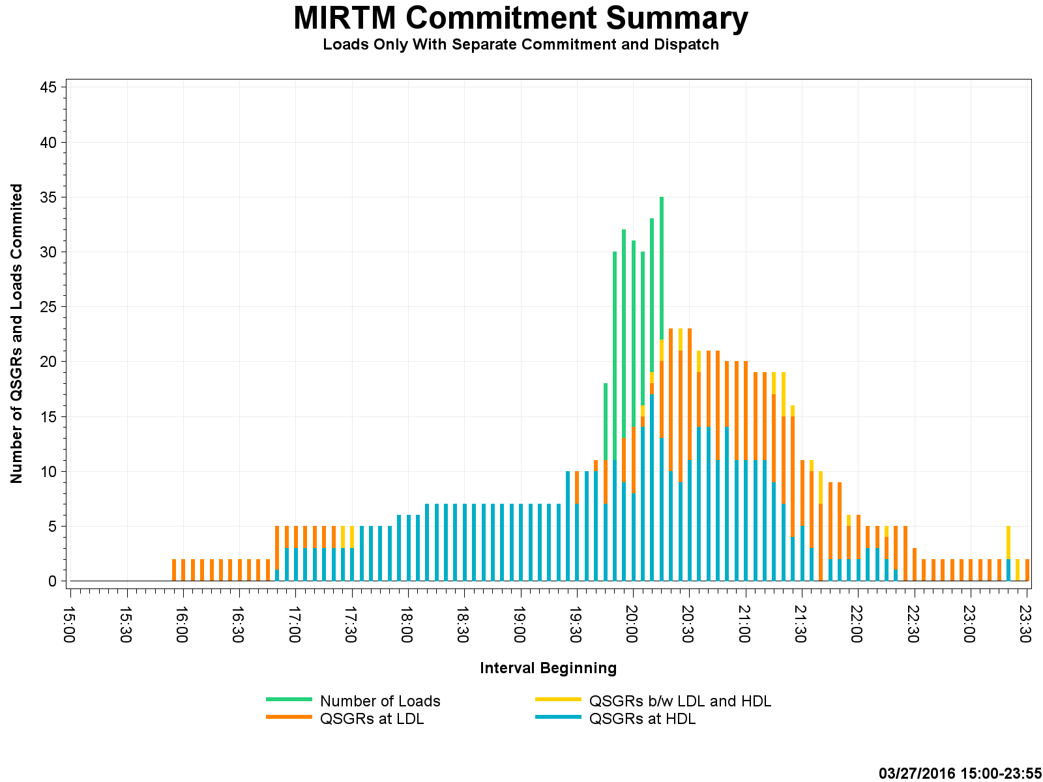
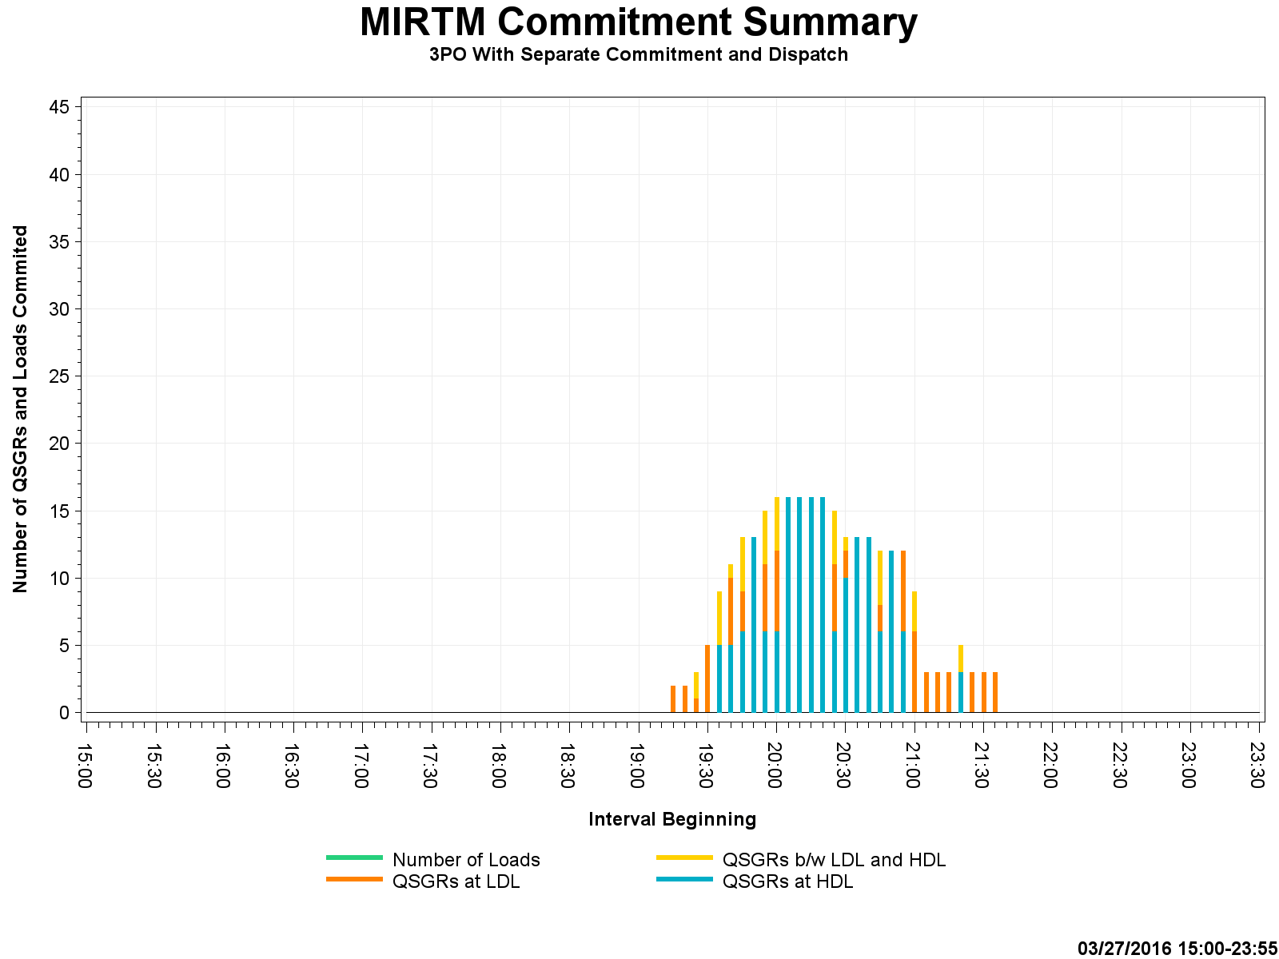
Study Day: March 27, 2016 – Commitment Summary

Slide 53
Study Day: July 25, 2016
7/25/2016 – ERCOT (Low wind, low dispatchable capacity)

Slide 54
Study Day: July 25, 2016

Slide 55
Study Day: July 25, 2016

Slide 56
Study Day: July 25, 2016

Slide 57
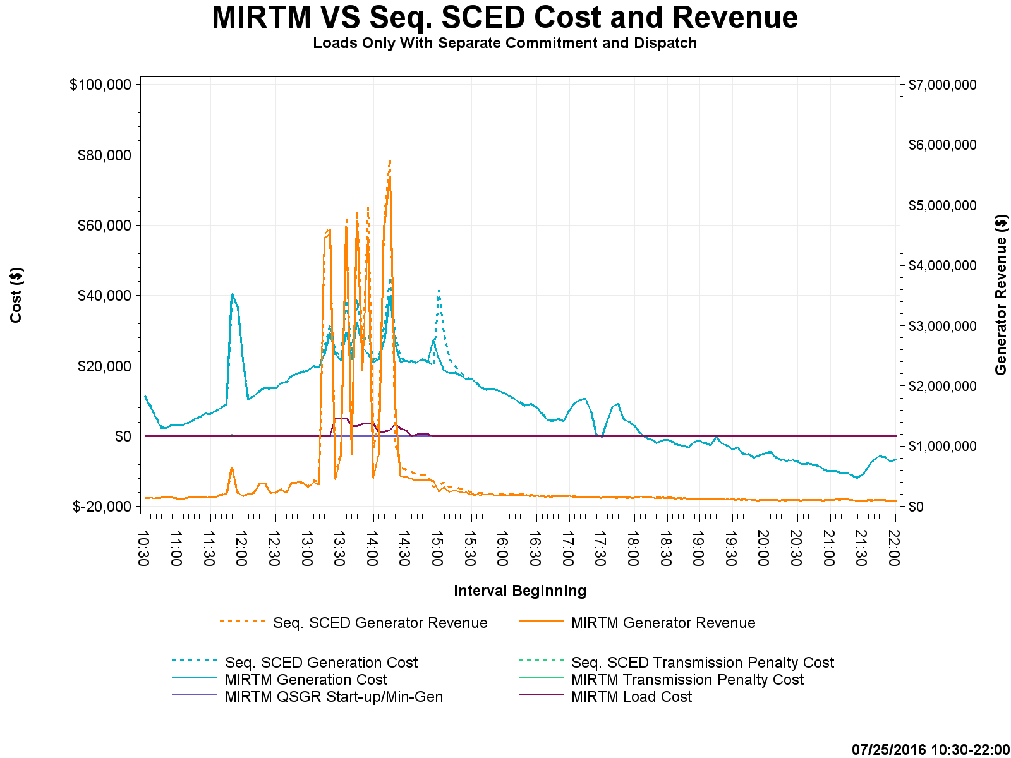
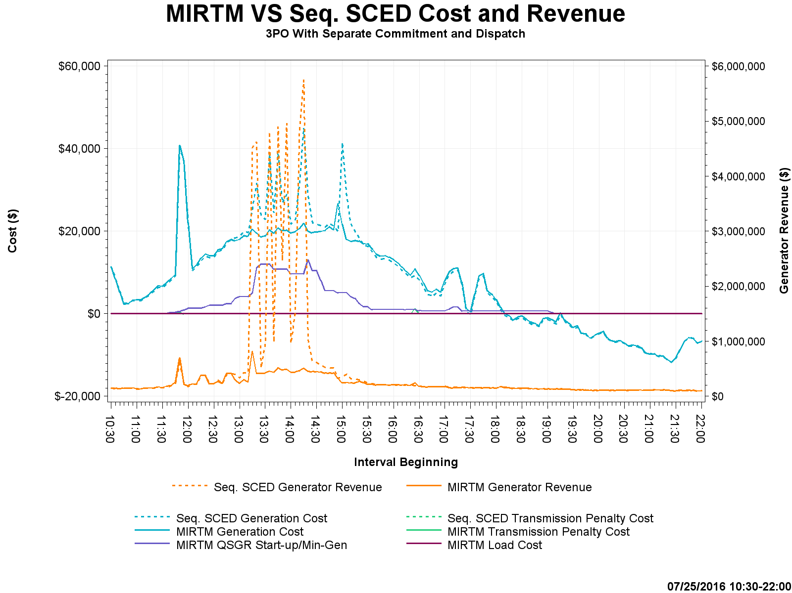
Study Day: July 25, 2016 – Cost and Revenue

Slide 58
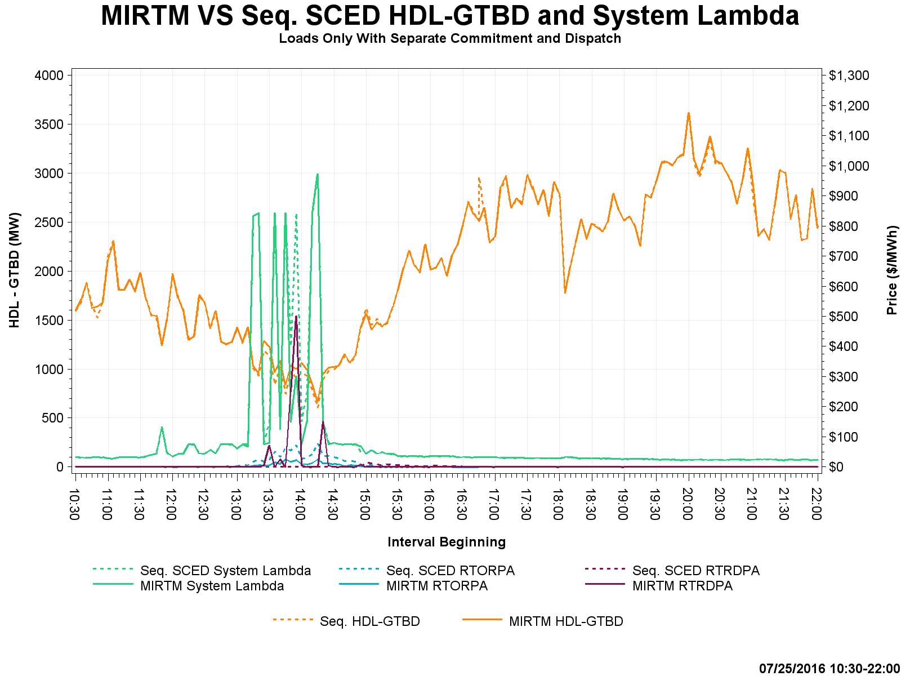
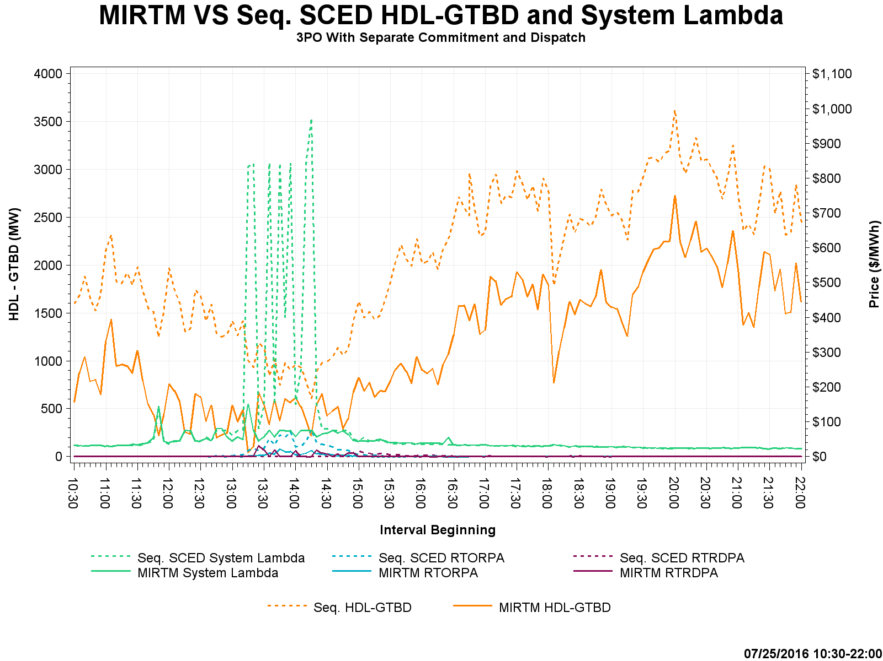
Study Day: July 25, 2016 – HDL-GTBD, SL

Slide 59
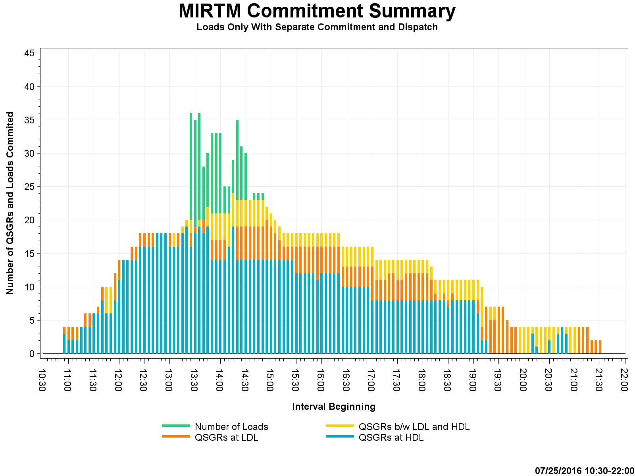
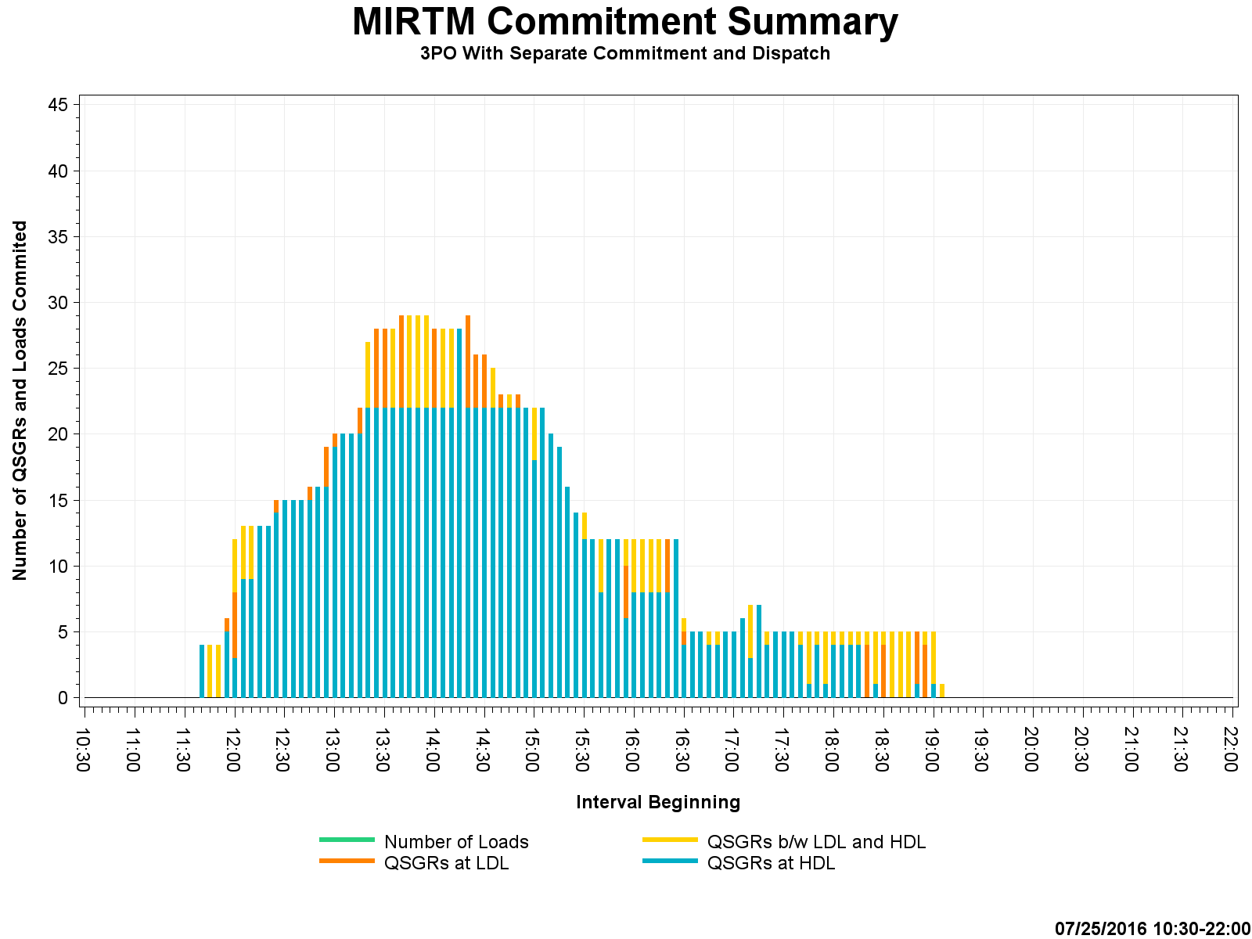
Study Day: July 25, 2016 – Commitment Summary

Slide 60
Questions and Next Steps
We would like to concentrate on these study days going forward.
Based on today’s discussion we can bring more details on specific events.
Changes in assumptions?

Slide 61
Appendix A. Additional Scenario Graphs

Slide 62
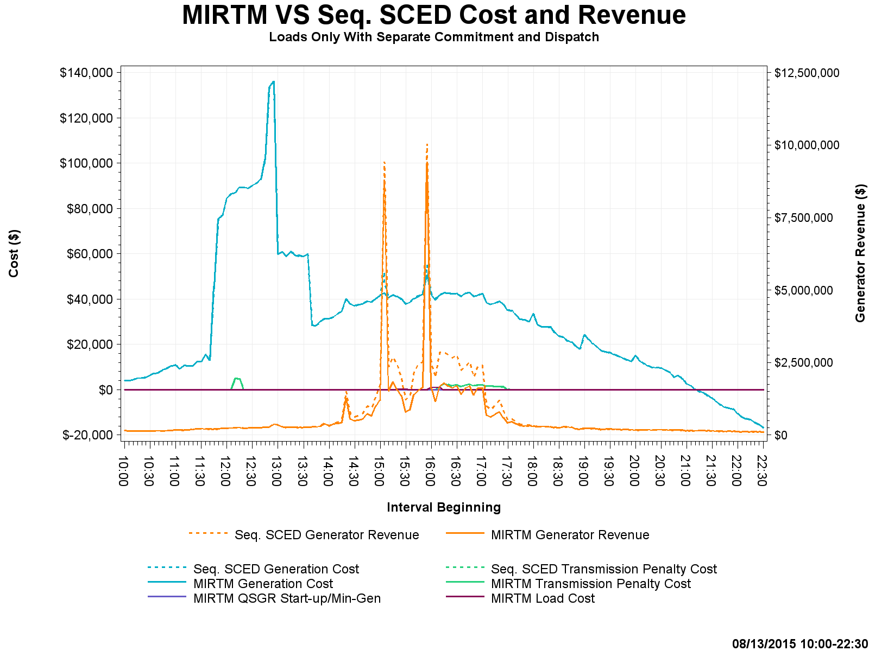
Study Day: August 13, 2015 MIRTM Load only

Slide 63
Study Day: August 13, 2015 MIRTM Load only

Slide 64
Study Day: August 13, 2015 MIRTM Load only

Slide 65
Study Day: August 13, 2015 MIRTM Prod EOC

Slide 66
Study Day: August 13, 2015 MIRTM Prod EOC

Slide 67
Study Day: August 13, 2015 MIRTM Prod EOC

Slide 68
Study Day: August 13, 2015 MIRTM 3PO

Slide 69
Study Day: August 13, 2015 MIRTM 3PO

Slide 70
Study Day: August 13, 2015 MIRTM 3PO

Slide 71
Study Day: August 13, 2015 MIRTM SPO

Slide 72
Study Day: August 13, 2015 MIRTM SPO

Slide 73
Study Day: August 13, 2015 MIRTM SPO

Slide 74
Study Day: July 1, 2015 – MIRTM Load Only

Slide 75
Study Day: July 1, 2015 – MIRTM Load Only

Slide 76
Study Day: July 1, 2015 – MIRTM Load Only

Slide 77
Study Day: July 1, 2015 – MIRTM 3PO

Slide 78
Study Day: July 1, 2015 – MIRTM 3PO

Slide 79
Study Day: July 1, 2015 – MIRTM 3PO

Slide 80
Study Day: August 11, 2015 – MIRTM Load only

Slide 81
Study Day: August 11, 2015 – MIRTM Load only

Slide 82
Study Day: August 11, 2015 – MIRTM Load only

Slide 83
Study Day: August 11, 2015– MIRTM 3PO

Slide 84
Study Day: August 11, 2015– MIRTM 3PO

Slide 85
Study Day: August 11, 2015– MIRTM 3PO

Slide 86
Study Day: Nov 11, 2015 – MIRTM Load only

Slide 87
Study Day: Nov 11, 2015– MIRTM Load only

Slide 88
Study Day: Nov 11, 2015 – MIRTM Load only

Slide 89
Study Day: Nov 11, 2015 – MIRTM 3PO

Slide 90
Study Day: Nov 11, 2015 – MIRTM 3PO

Slide 91
Study Day: Nov 11, 2015 – MIRTM 3PO

Slide 92
Study Day: Nov 27, 2015 – MIRTM Load only

Slide 93
Study Day: Nov 27, 2015– MIRTM Load only

Slide 94
Study Day: Nov 27, 2015 – MIRTM Load only

Slide 95
Study Day: Nov 27, 2015 – MIRTM 3PO

Slide 96
Study Day: Nov 27, 2015 – MIRTM 3PO

Slide 97
Study Day: Nov 27, 2015 – MIRTM 3PO

Slide 98
Study Day: March 27, 2016 – MIRTM Load only

Slide 99
Study Day: March 27, 2016 – MIRTM Load only

Slide 100
Study Day: March 27, 2016 – MIRTM Load only

Slide 101
Study Day: March 27, 2016 – MIRTM 3PO

Slide 102
Study Day: March 27, 2016 – MIRTM 3PO

Slide 103
Study Day: March 27, 2016 – MIRTM 3PO

Slide 104
Study Day: July 25, 2016 – MIRTM Load only

Slide 105
Study Day: July 25, 2016 – MIRTM Load only

Slide 106
Study Day: July 25, 2016 – MIRTM Load only

Slide 107
Study Day: July 25, 2016 – MIRTM 3PO

Slide 108
Study Day: July 25, 2016 – MIRTM 3PO

Slide 109
Study Day: July 25, 2016 – MIRTM 3PO

Slide 110
Appendix B. Example MIRTM Study Run

Slide 111
Example MIRTM Study Run
System with the following conditions:
Initial load is 50,000 MW
Assume demand (GTBD) forecast is correct
Generation Mix:
50,001 MW of dispatchable generation priced at $50/MWh
100 MW Fast Start Resource:
Single Part Offer with all MWs at $200/MWh
LSL=0, HSL=100
Minimum Run Time = 15 minutes
Notification Time = 5 minutes
When a Generation Resource is committed for a future interval, the MW output remains zero till its first committed interval. At the end of the first committed interval, the MW output of the Generation Resource is the desired Base Point. Thus, this fast start resource will be fully at its Base Point in 10 minutes with a notification time of 5 minutes.

Slide 112
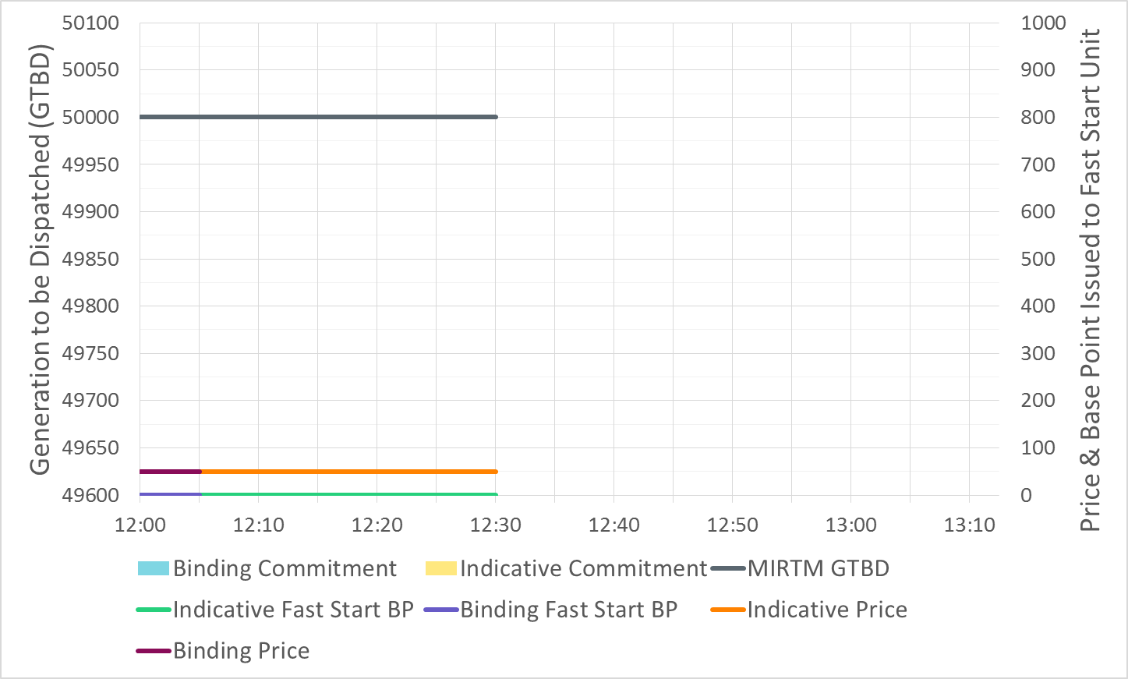
Example MIRTM Study Run

Slide 113
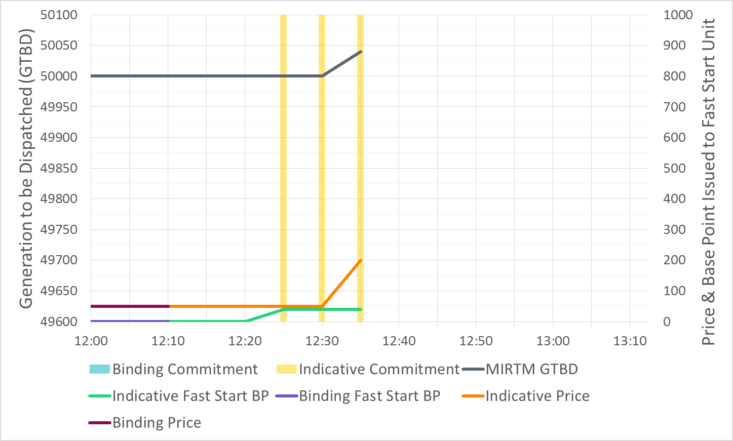
Example MIRTM Study Run

Slide 114
Example MIRTM Study Run

Slide 115
Example MIRTM Study Run

Slide 116
Example MIRTM Study Run

Slide 117
Example MIRTM Study Run

Slide 118
Example MIRTM Study Run

Slide 119
Example MIRTM Study Run

Slide 120
Example MIRTM Study Run

Slide 121
Example MIRTM Study Run

Slide 122
Example MIRTM Study Run

Slide 123
Example MIRTM Study Run

Slide 124
Example MIRTM Study Run

Slide 125
Example MIRTM Study Run

