Slide 1
CDR Modification Proposal
For the Supply Analysis Working Group Meeting, 8/15/2016

Slide 2
New CDR Worksheet
Create new CDR worksheet focused only on reporting classes of planned resources that have met interconnection process milestones; for example, Total Planned Resource capacity for which:
A Commissioning Plan has been submitted
Interconnection facility Financial Security posted and Notice-to-Proceed given by the TSP
An Interconnection Agreement has been signed
ERCOT has approved the Full Interconnect Study
Full Interconnect Study has been requested
Include CDR-eligible resource line item for comparison purposes

Slide 3
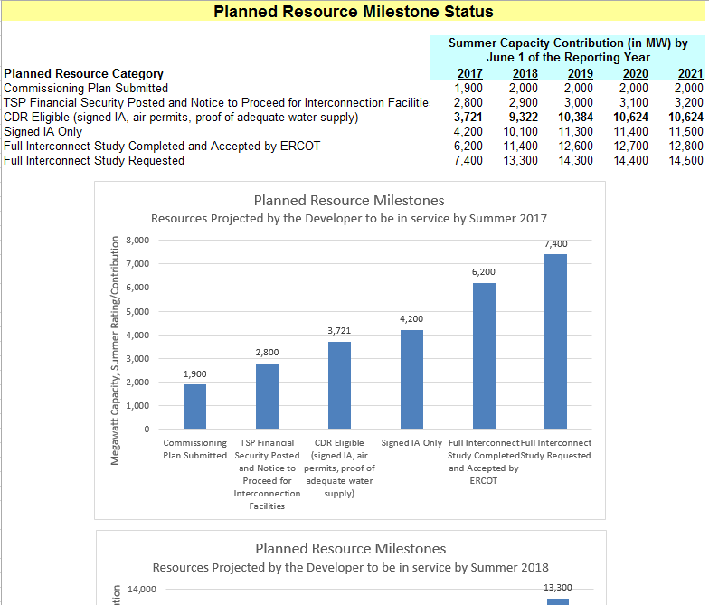
CDR Mock-up

Slide 4
Rationale
Addresses NPRR759
Addresses TIEC’s resource reporting “symmetry” concern
Separate worksheet avoids complicating the Summary worksheets with additional line items
Provides “scenario” data without explicitly reporting alternative planning reserve margins
Avoids sending mixed messages regarding the planning reserve situation
An NPRR is not required to implement, so NPRR759 can be cancelled

Slide 5
Other Considerations
SAWG would review and propose modifications to the resource categories as part of it’s periodic CDR review cycle; WMS can approve the list
Other “scenario” line items or report links can be added if deemed useful
If an NPRR is desired, then language would be broadly worded to allow ERCOT and Market Participant flexibility to modify reported data based on prevailing needs

