Slide 1
Multi-Interval Real-Time Market Update to SAWG
August 15, 2016

Slide 2
Refresher on the MIRTM Process
MIRTM six 5-minute intervals (30 minutes total) with separate commitment and dispatch
RT Market Execution: Depicts the start and end times of the clearing process and the length of symbol is indicative of maximum time allowed to clear market
Interval where the LMPs, MW awards (energy, AS) and Commitment Instructions are ALL binding commitment instructions
Intervals where ONLY Commitment Instructions are binding and the LMPs and MW awards (energy, AS) are indicative
8:40 8:45 8:50 8:55 9:00 9:05 9:10 9:15 9:20 9:25 9:30 9:35
Analysis window of rolling 30 minutes
Dispatch Run & Pricing run
Binding commitments for ALL intervals
1st Interval Binding Base Point & Binding LMPs
Dispatch Run & Pricing Run
Sequence of Multi-Interval RT Markets
Note: The introduction of the Binding Dispatch/Base Point run while eliminating make-Whole payments to Generation Resources due to binding ramp constraints, can however, lead to missed commitments or too early decommitments/recalls. The assumption is that the benefits of eliminating this category of make-whole payments outweighs the disadvantages of missed commitments or too early decommitments/recalls.

Slide 3
Overview of Recent Activity
Implement Dispatch module
Implement Pricing module
Developed Three part offers (TPO) based on average Verifiable Costs and unit HSL
Developed Single part offers (SPO) from TPO allocating start costs over min up time
Allowed for Wartsila units to have zero start time and zero min off time (allows fast ramping resources to meet demand in same interval)
Studied the following dates:7/1/2015, 8/11/2015, 8/13/2015, 11/11/2015

Slide 4
Today’s Agenda
Refresher on study inputs
For study day 8/13/2015 review and compare all of the Separate Commitment and Dispatch MIRTM runs listed on the next slide
For remaining three study days
  7/1/2015 – Luminant request (Volatile wind, little congestion, low system lambda)
  8/11/2015 - Luminant request (Little congestion, low dispatchable capacity)
  11/11/2015 - ERCOT (New STLF over forecasts load)
  Compare two runs:
    Separate Commitment and Dispatch (3PO) (fast responding resources and load)
    Separate Commitment and Dispatch (LOAD) (fast responding resources modeled as production i.e. not committable by MIRTM)

Slide 5
Study Runs
For the 8/13 run we will step incrementally through the progression of studies as follows:
Production SCED
Sequential SCED
MIRTM with Separate Commitment and Dispatch:
  Loads only with QSGR not committable to mimic production (LOAD)
  QSGRs have Production offers with single part offers (SPO Prod. SCED EOCs)
  QSGRs have three-part offer based on average Verifiable Costs (3PO)
  QSGRs have single-part offer based on average Verifiable Costs (SPO)
  Note: we could come back at a later date with a comparison between MIRTM Combined Commitment and Dispatch and MIRTM Separate Commitment and Dispatch. It was too much data to show in one session.

Slide 6
Study Process
Determine the study period based on the day of interest and run a sequential SCED for the entire study period using the Energy Offers from actual Real Time SCED runs.
Sequential SCED considered the “baseline” that simulates all resources following base points while the GTBD mimics the production case.
Run MIRTM Separate Commitment and Dispatch with different offer structures (SPO Prod. SCED EOCs, 3PO, SPO) as inputs while the GTBD mimics the production case.
Use new STLF and Wind Persistence to “look ahead” 30 minutes to determine if commitments needed

Slide 7
Study Process
Calculate Production Costs: Four Components
  Generation Costs: Integrate Step 2 EOC from LSL to BP + Power Balance Violation
  Transmission Penalty Cost: Violated MW * Shadow Price
  QSGR Startup/Mingen Cost: Startup and Minimum Energy Costs
  Blocky Load Cost: Bid Price * Commit MW
Calculate Make Whole
  QSGR Make whole across entire study period
    Prod. SCED & Seq. SCED: Emergency Operations QSGR payments (Per 6.6.9 (3))
    MIRTM: Max(0,QSGR Revenue - QSGR Verifiable Cost)
  Blocky Load Make whole across entire study period
    MIRTM: Max(0,[Binding LMP * Commit MW] - [Bid Price * Commit MW])
Notes:
QSGR revenue:
(Binding LMP + ORDC Online Price Adder + Pricing Run Price Adder) * Binding Base Point of Committable QSGR Unit List
QSGR Verifiable cost:
QSGR Verifiable Cost Above LSL - Integrate Input EOC or Verifiable Cost EOC (if no QSGRs in MIRTM) from LSL to BP of Committable QSGR Unit List
plus
QSGR Startup/Mingen Cost of Committable QSGR Unit List - Startup and Minimum Generation Costs of Committable QSGR Unit List

Slide 8
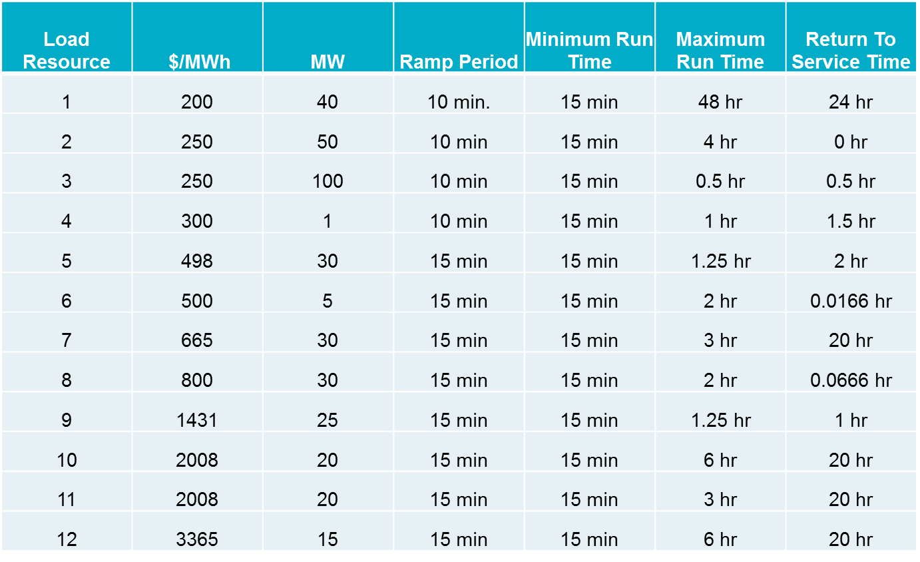
Simulation Assumptions – Blocky Load Resources
Offers were received for 12 Blocky Loads from DSWG
A total of 366 MW split between the load zones (each zone has 12 resources)

Slide 9
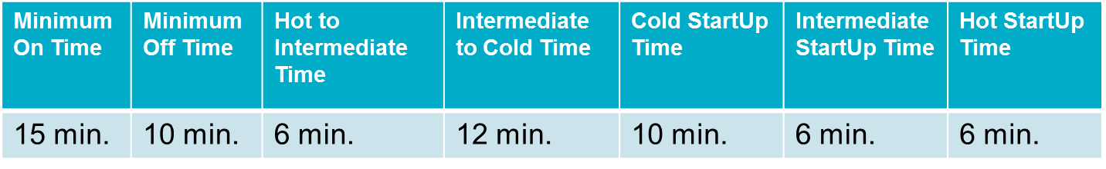
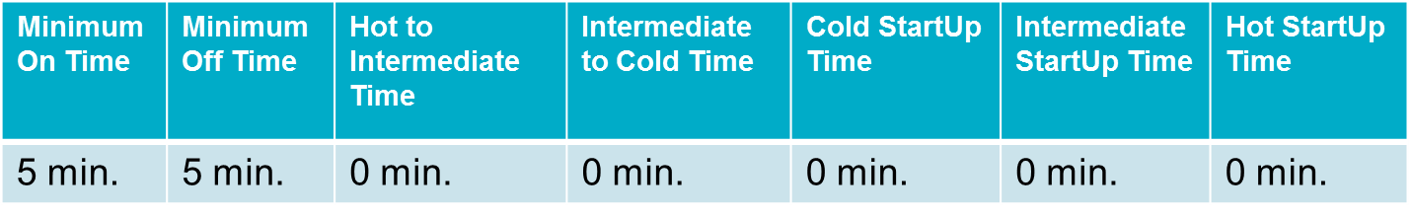
Simulation Assumptions – Fast Generation Resource Temporal Constraints
All Resources that are Quick Start qualified are considered “fast responding resources”. If the Resource was “OUT” or “ONTEST” during the study period they are not considered as “committable” Gas Turbines (36 units)
Reciprocating Engines (3 units)
Wartsilas (4 units)
Minimum On Time | Minimum Off Time | Hot to Intermediate Time | Intermediate to Cold Time | Cold StartUp Time | Intermediate StartUp Time | Hot StartUp Time
0 min. | 0 min. | 0 min. | 0 min. | 0 min. | 0 min. | 0 min.

Slide 10
Simulation Assumptions – Fast Responding Resources
Four average Verifiable Costs groups were identified.
Each Fast Responding Resources is assigned a group cost based on HRL/LSL
The Single Part offer is structured in order to recover Start Up and Minimum Energy cost over the Minimum On time
Minimum EOC is $75 if Resource had Non-Spin responsibility during study period
Res Type | HRL (MW) | LRL (MW) | Seasonal LSL (MW) | Startup Cost ($) | Min-Energy Price ($/MWh) | Min EOC ($/MWh) | Max EOC ($/MWh) | Single Part Cost ($/MWh)
SCLE90 | 54.0 | 10.0 | 13.0 | 4,322.05 | 52.39 | 30.86 | 33.91 | 1,287.26
SCLE90 | 60.0 | 0.0 | 12.0 | 3,448.99 | 48.85 | 28.47 | 31.05 | 1,198.51
SCLE90 | 95.0 | 0.0 | 41.0 | 6,058.75 | 56.12 | 40.35 | 41.88 | 647.21
DSL | 8.9 | 6.0 | 6.0 | 962.21 | 39.93 | 34.84 | 39.79 | 1,964.34

Slide 11
Other Assumptions – Days Analyzed
  The Capacity from all Fast Responding Resources is considered online in MIRTM study runs; this has the impact of changing the ORDC calculation slightly; however, the resource capacity is only shifted from offline to online.
  The Block Load Resources are considered “new” Resources which increases the RTOLCAP and shifts the curve to the right by 366MW.
  Keep this in mind when comparing the ORDC price adder revenues across the Production SCED, Sequential SCED, and MIRTM study runs.
  The Reliability Deployment Price Adder in MIRTM treats the deployment by ERCOT as a “deployment event” therefore MIRTM may find a RTDP when Production and Sequential SCED did not.

Slide 12
Study Day: August 13, 2015

Slide 13
Study Day: August 13, 2015
Increase in prices due to offer assumptions (see slide 10)

Slide 14
Study Day: August 13, 2015
Zero Make Whole

Slide 15
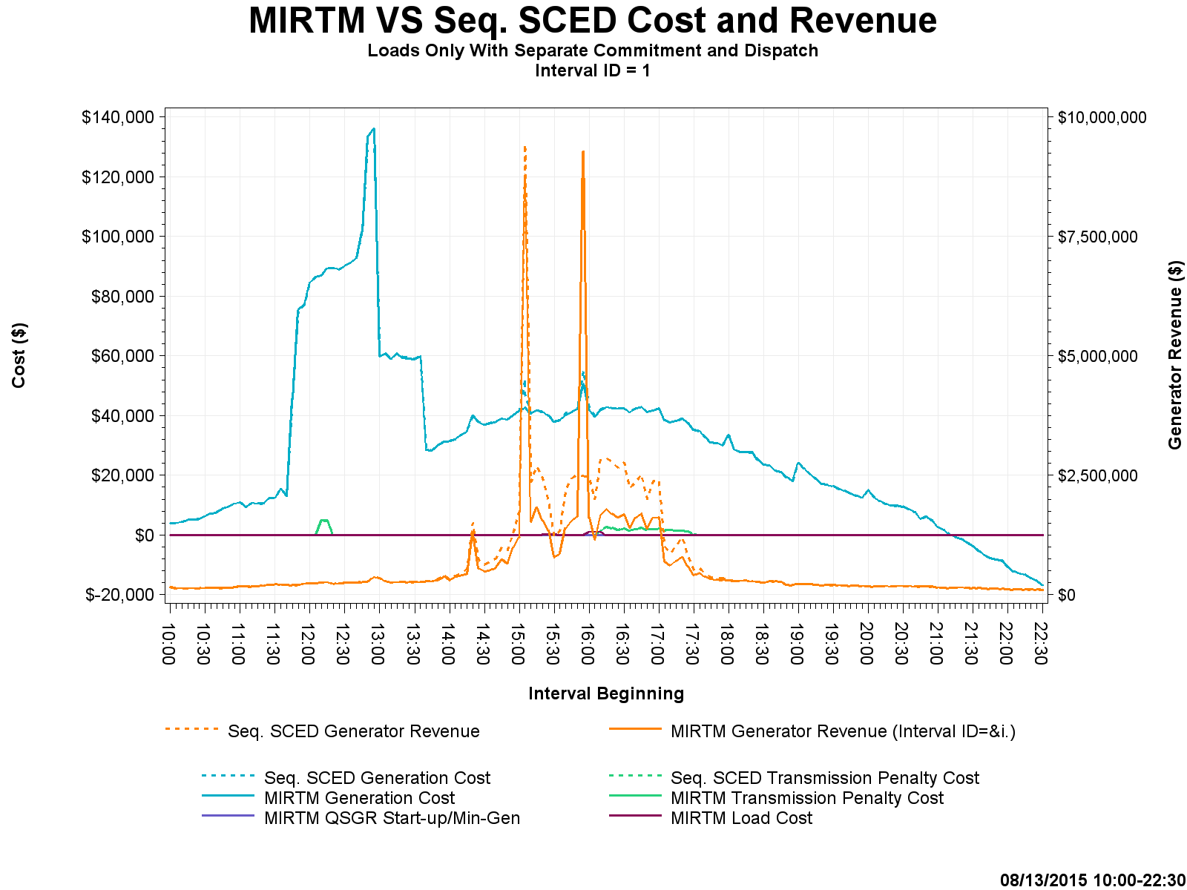
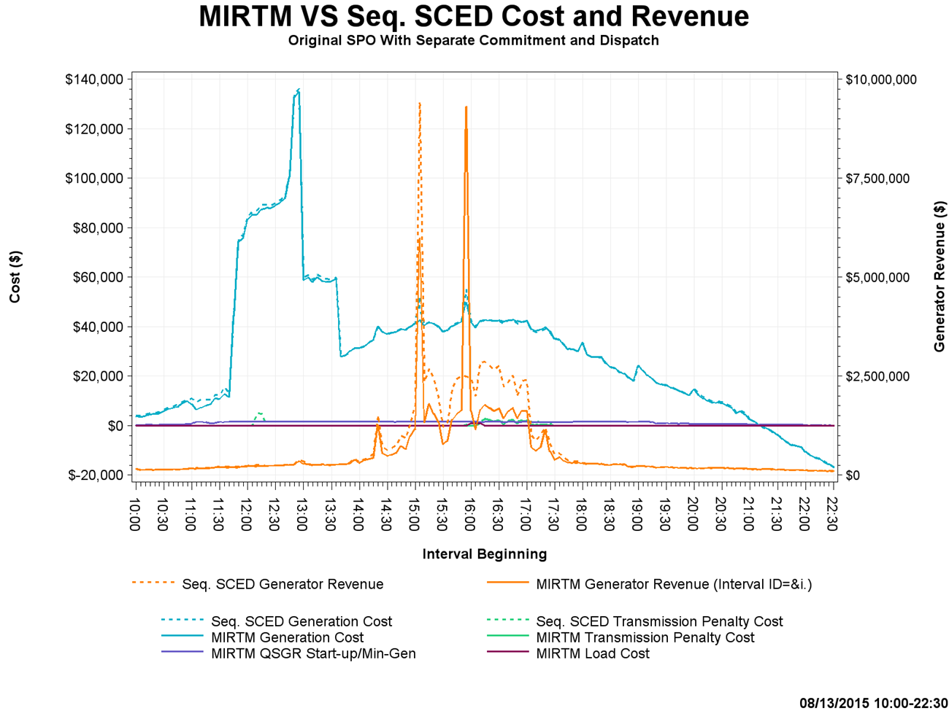
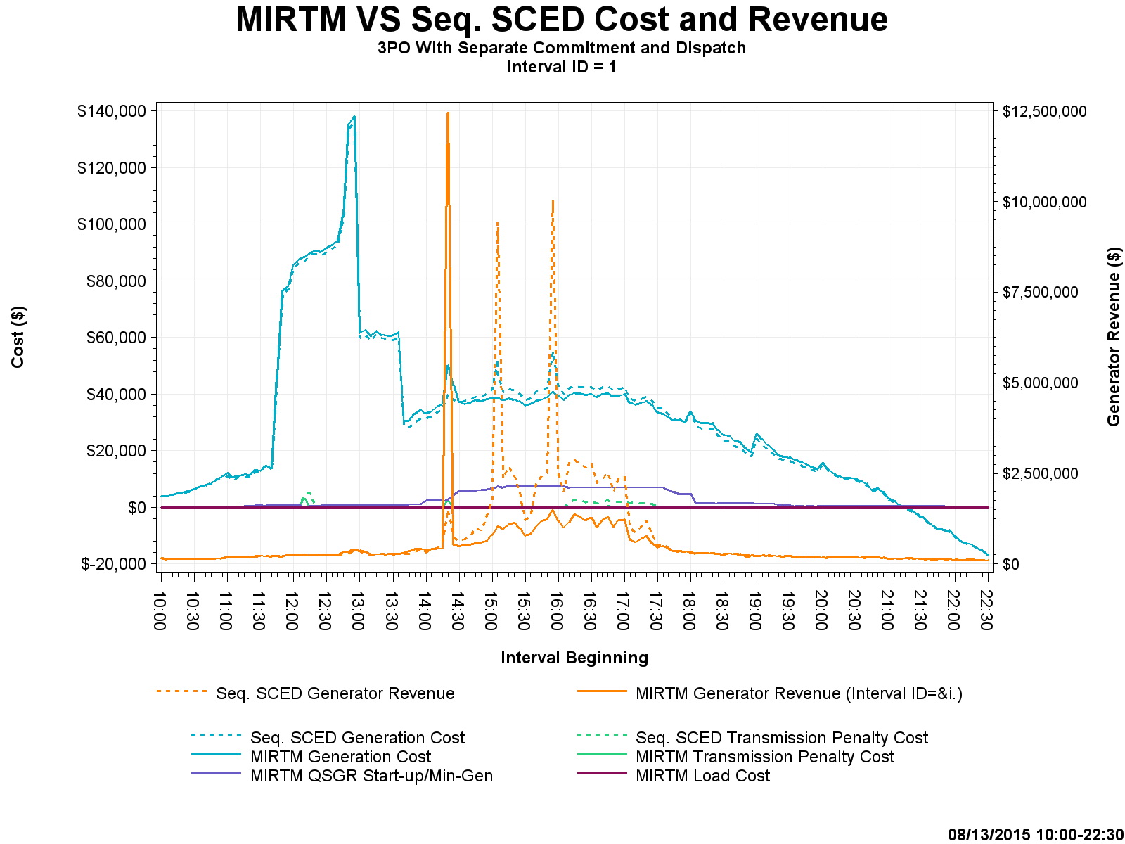
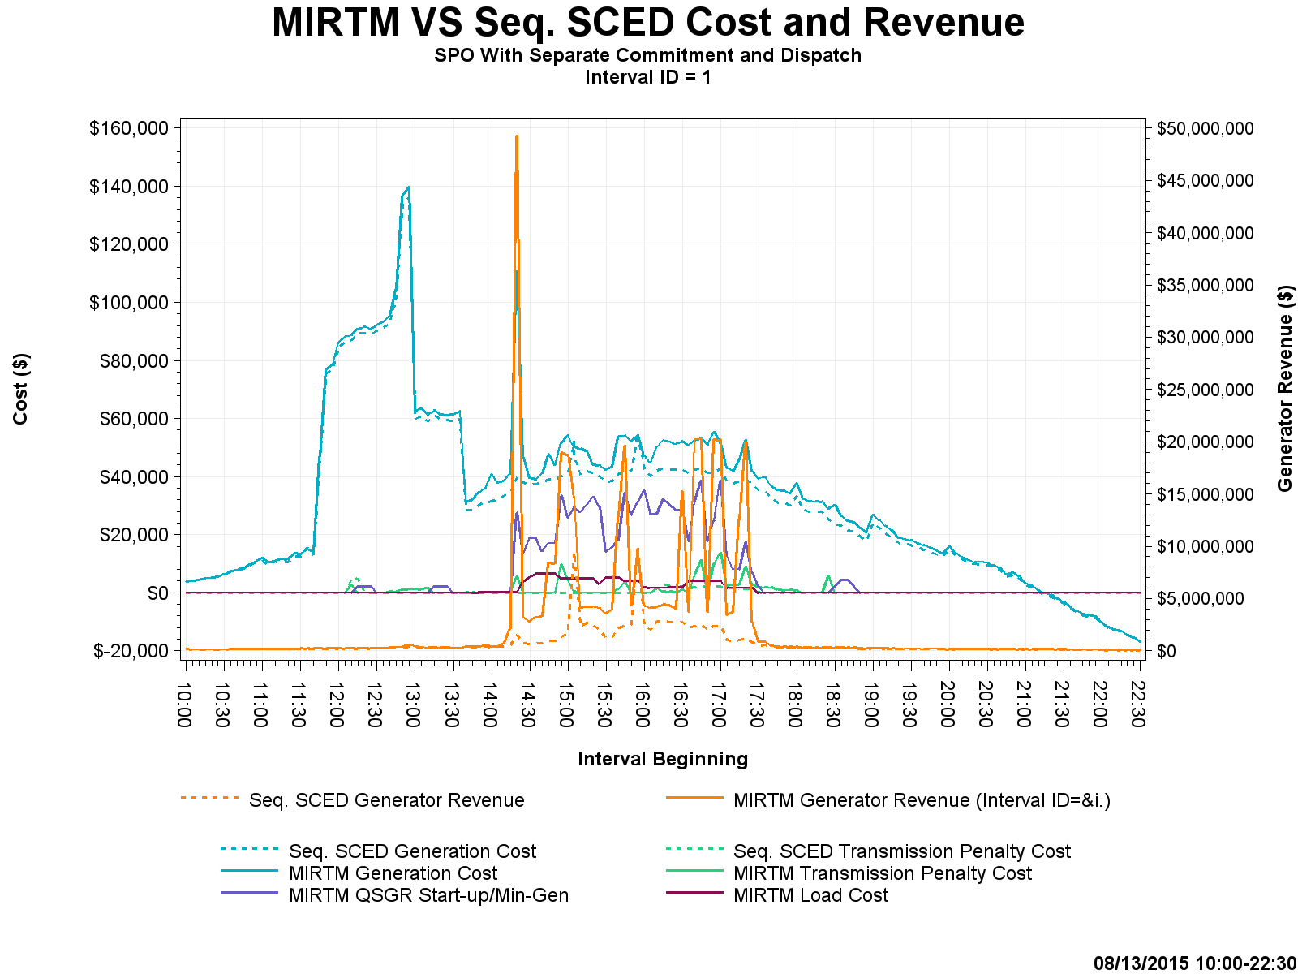
Study Day: August 13, 2015 Cost and Revenue

Slide 16
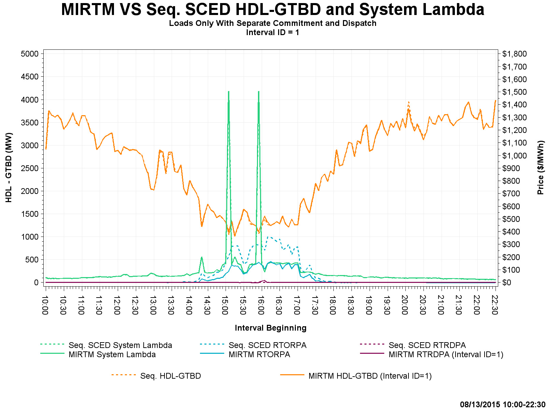
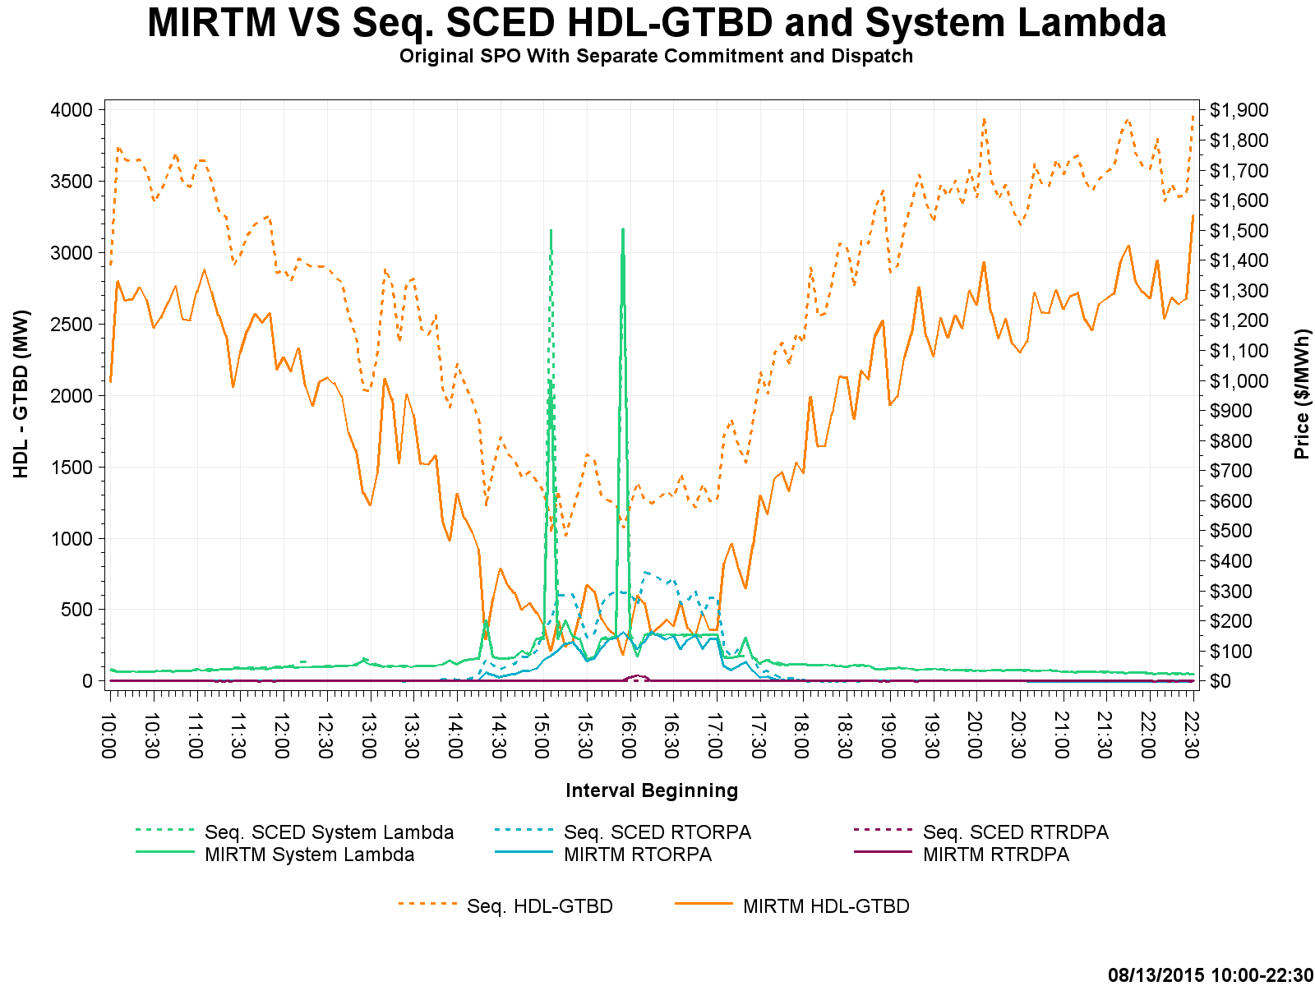
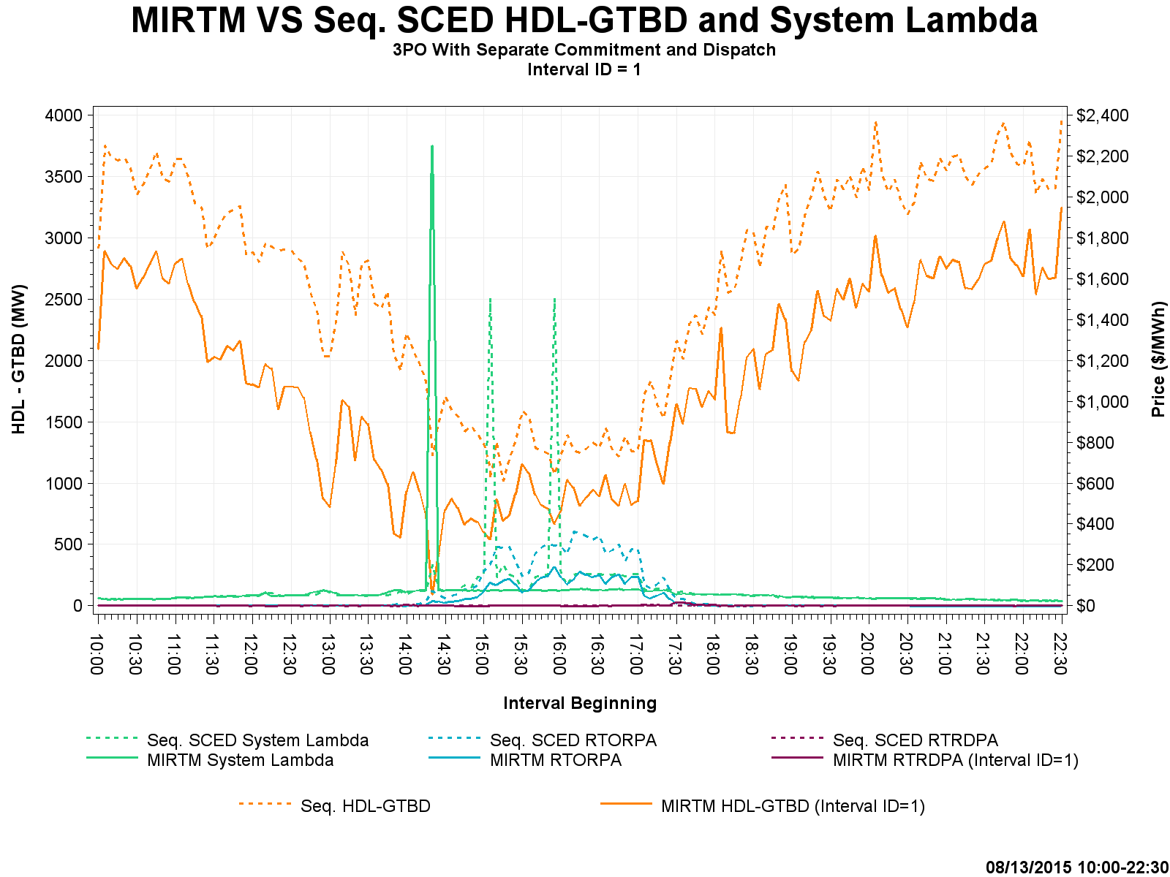
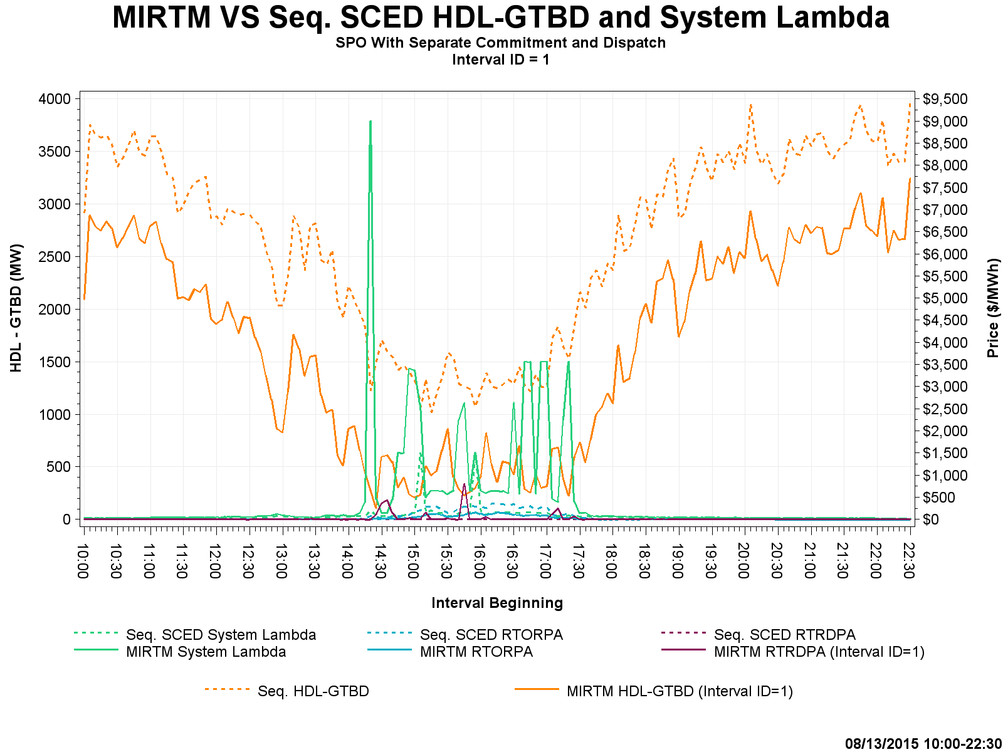
Study Day: August 13, 2015 HDL-GTBD, SL

Slide 17
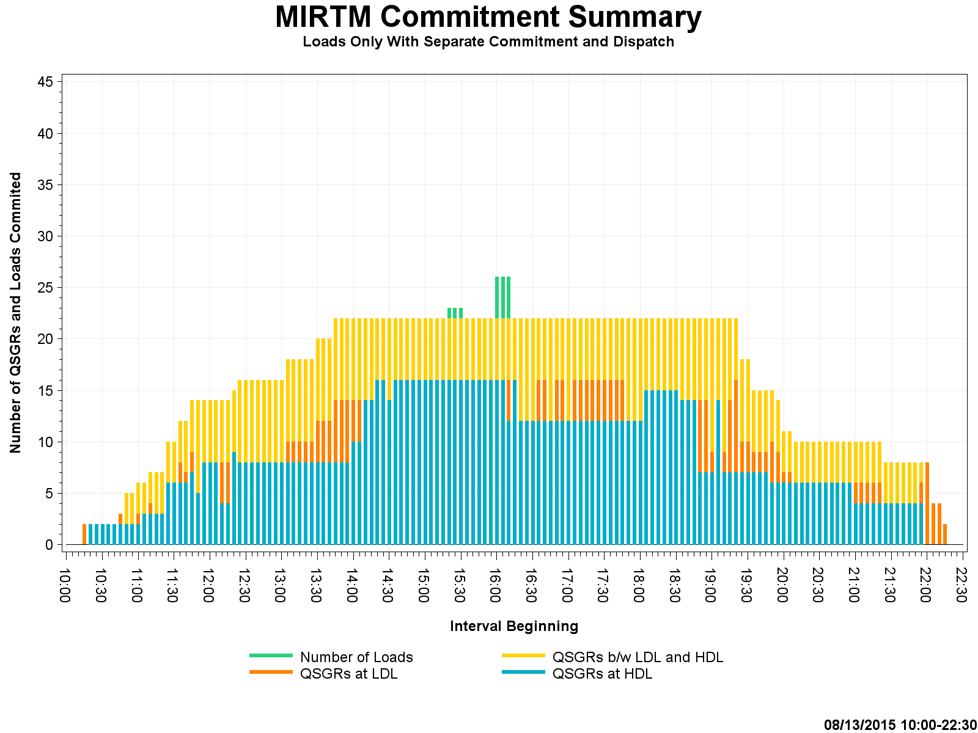
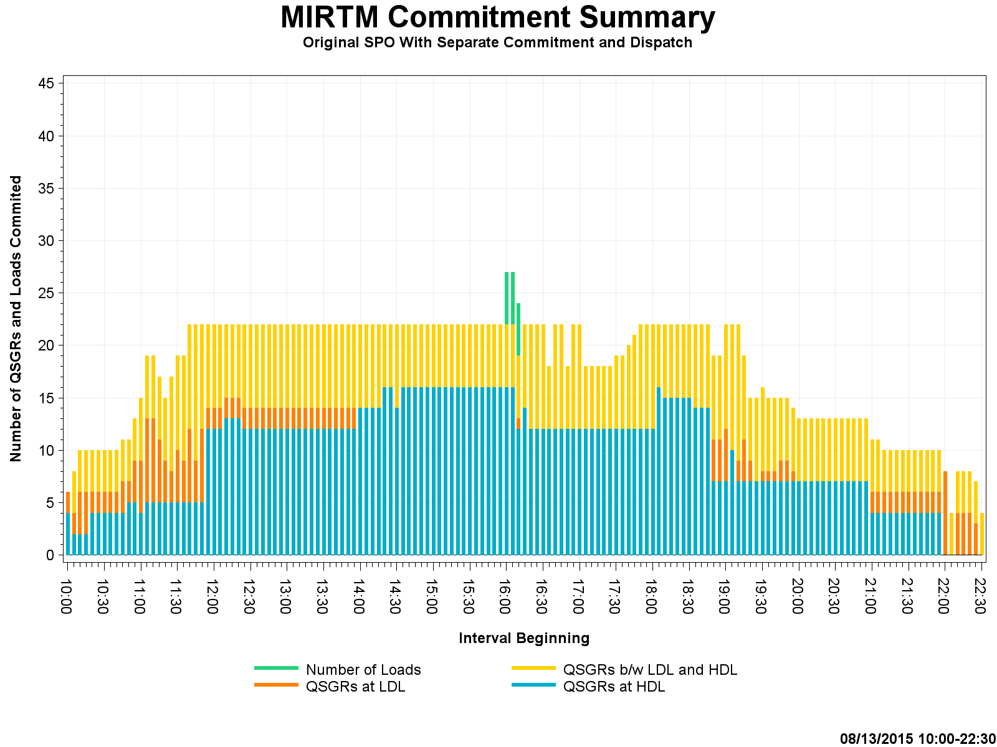
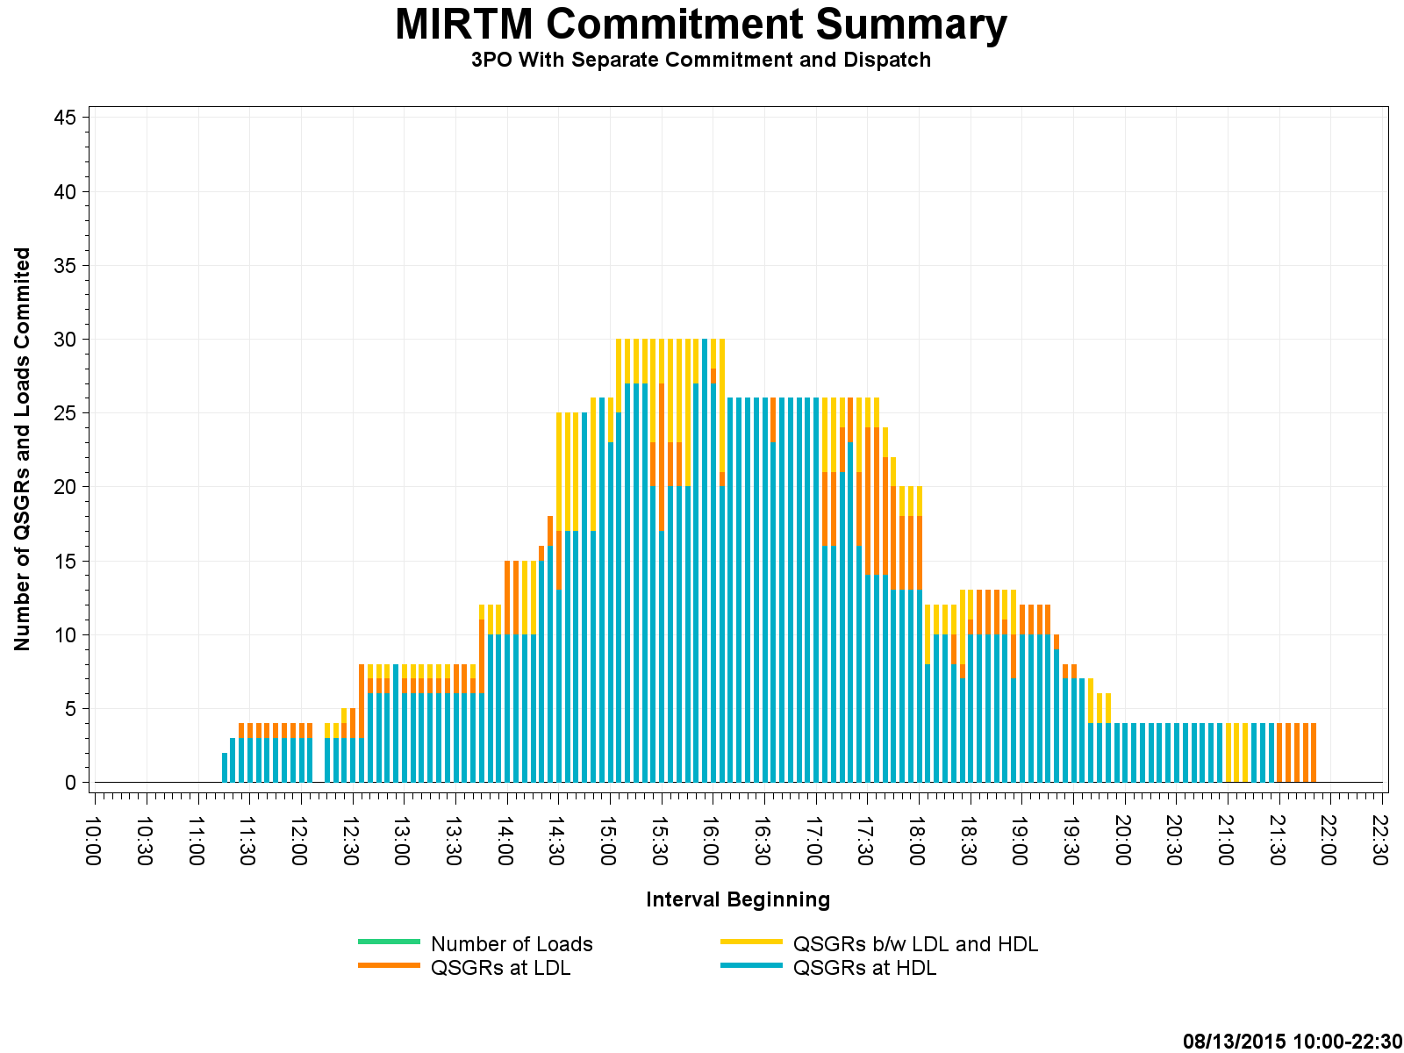
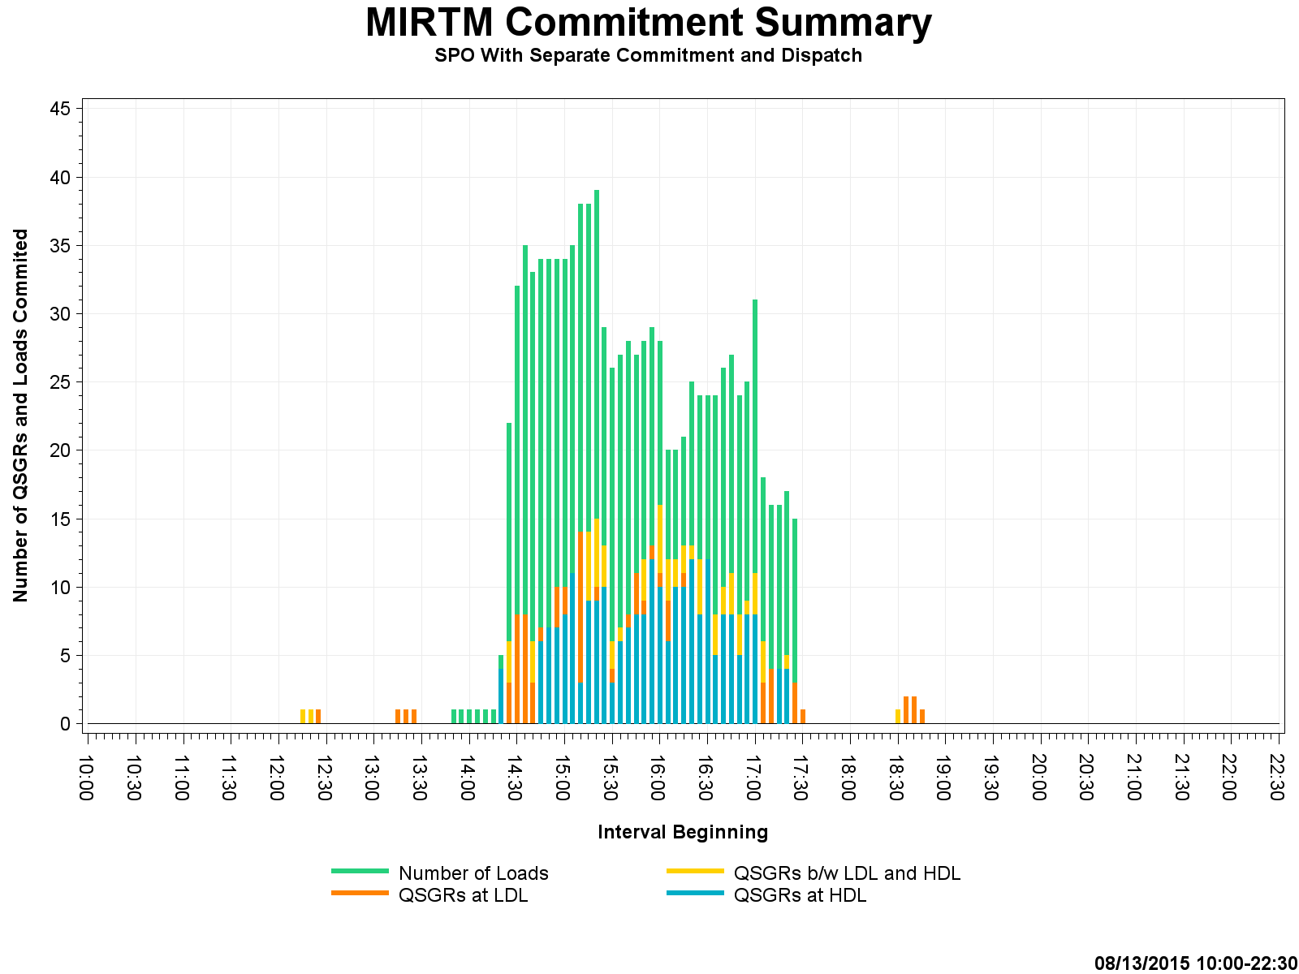
Study Day: August 13, 2015 Commitment Summary

Slide 18
Study Day: July 1, 2015
  7/1/2015 – Luminant request (Volatile wind, little congestion, low system lambda)

Slide 19
Study Day: July 01, 2015

Slide 20
Study Day: July 01, 2015

Slide 21
Study Day: July 01, 2015
Zero Make Whole

Slide 22
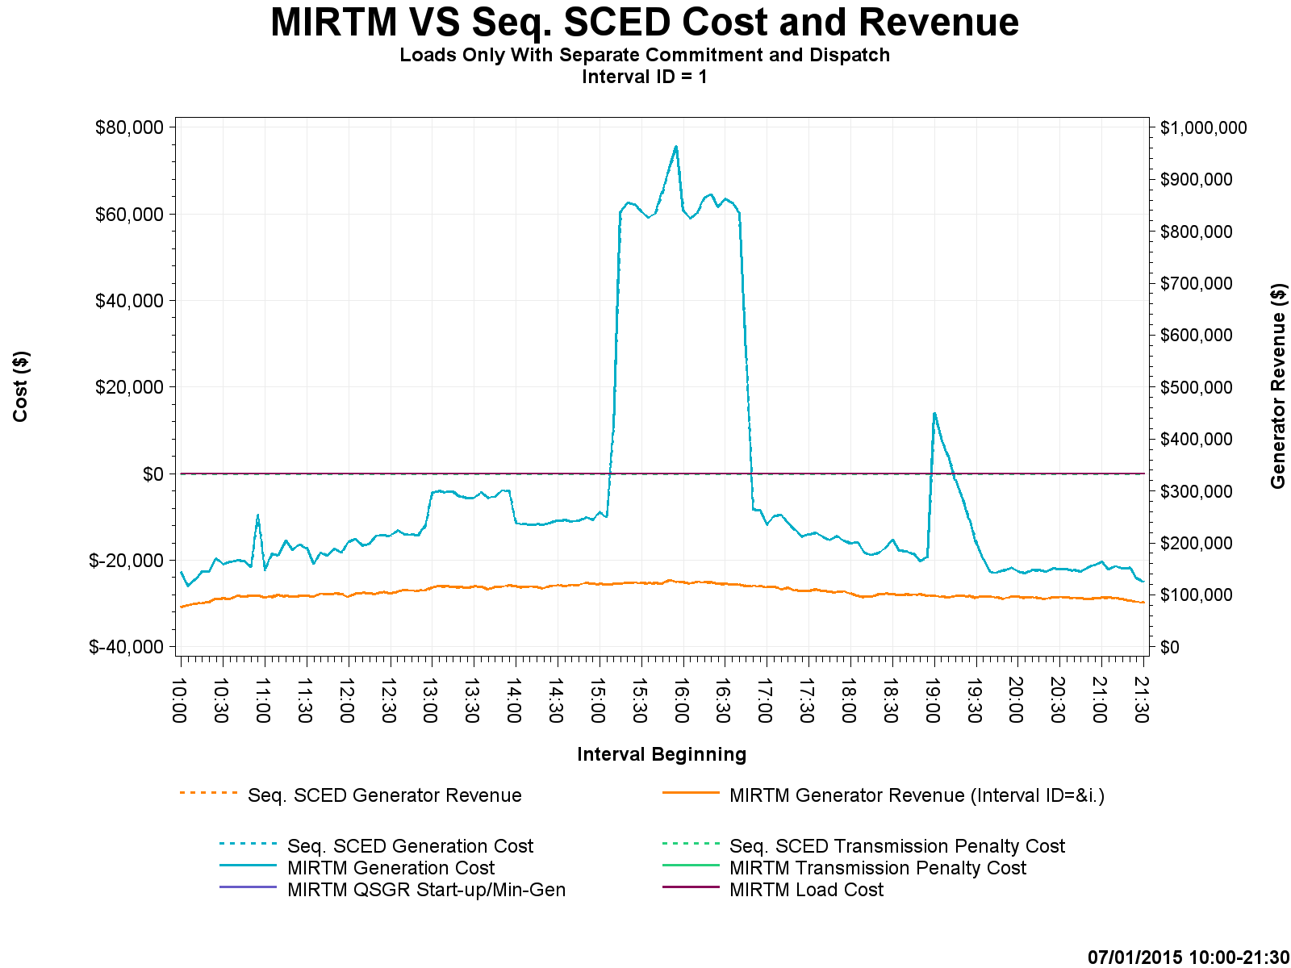
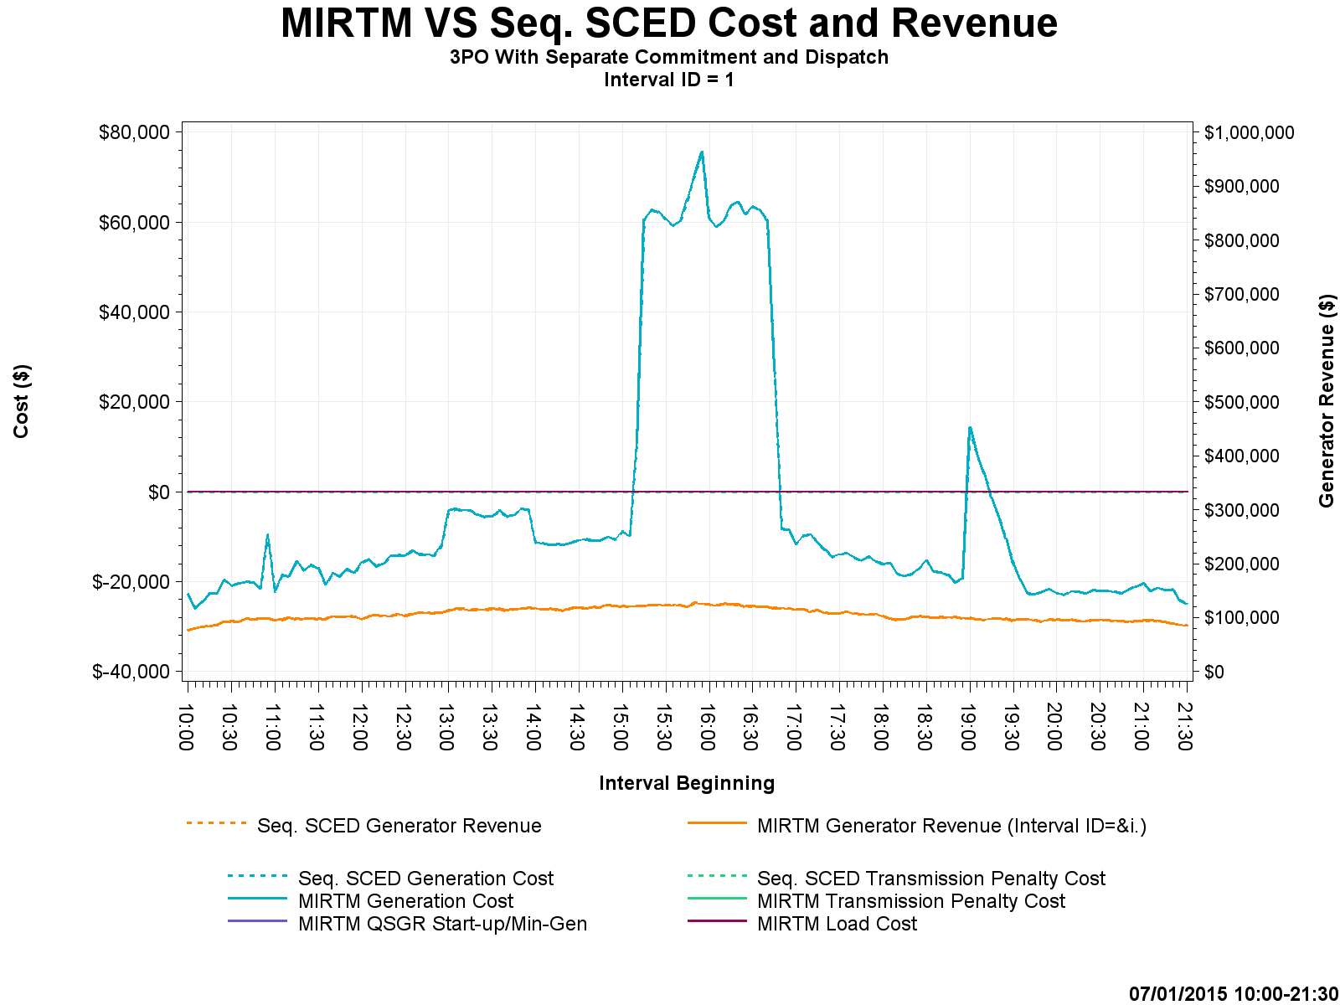
Study Day: July 1, 2015 – Cost and Revenue

Slide 23
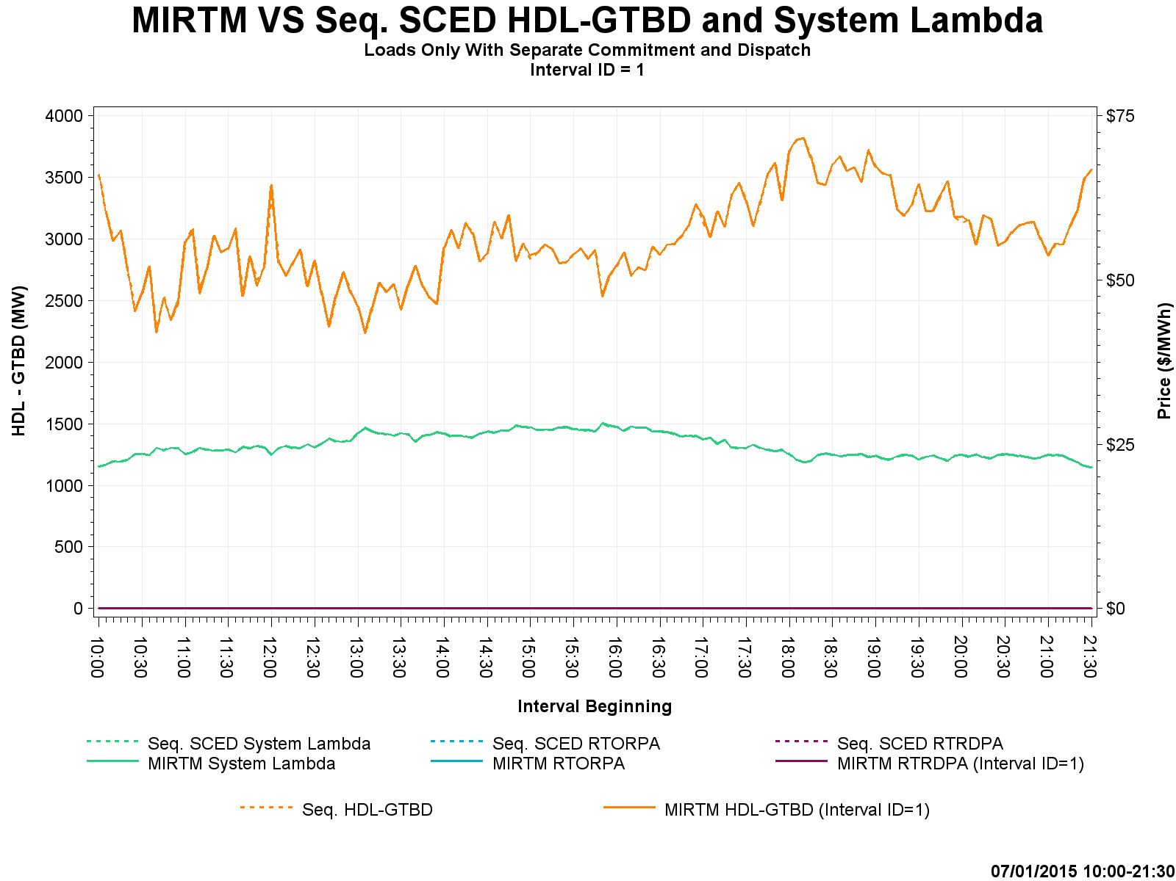
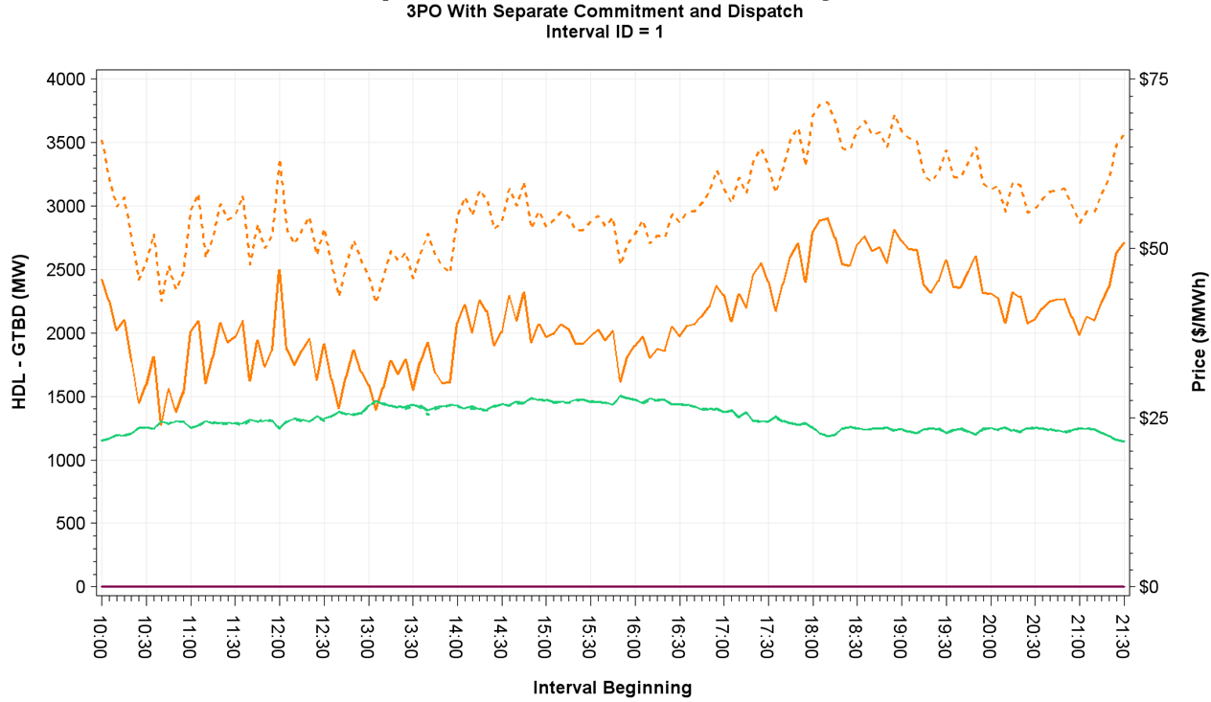

Study Day: July 1, 2015 – HDL-GTBD, SL

Slide 24
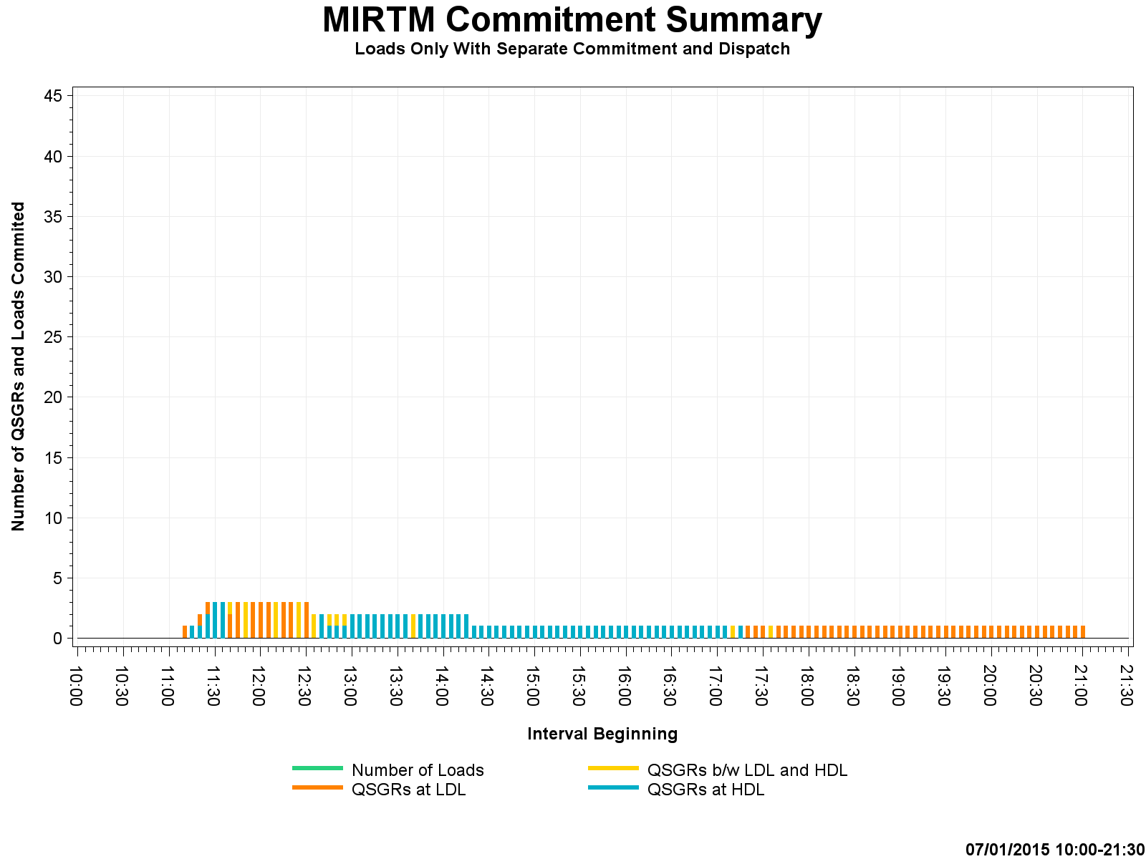
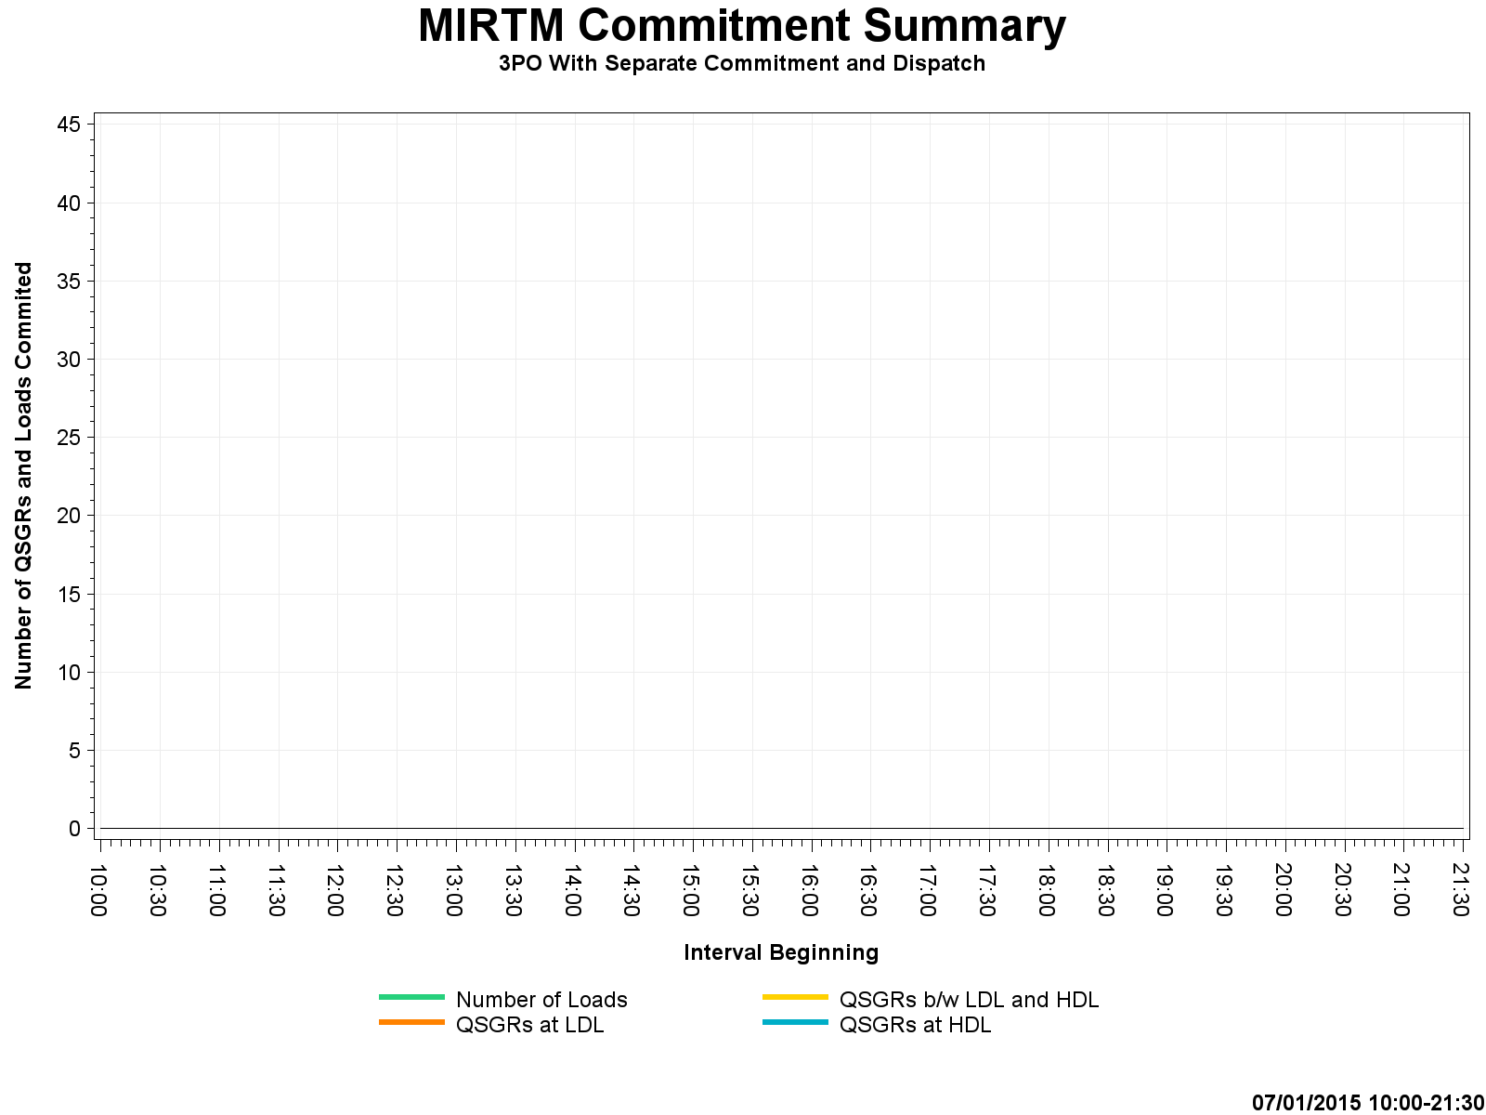
Study Day: July 1, 2015 – Commitment Summary
Zero Commitments

Slide 25
Study Day: August 11, 2015
  8/11/2015 - Luminant request (Little congestion, low dispatchable capacity)

Slide 26
Study Day: August 11, 2015

Slide 27
Study Day: August 11, 2015

Slide 28
Study Day: August 11, 2015

Slide 29
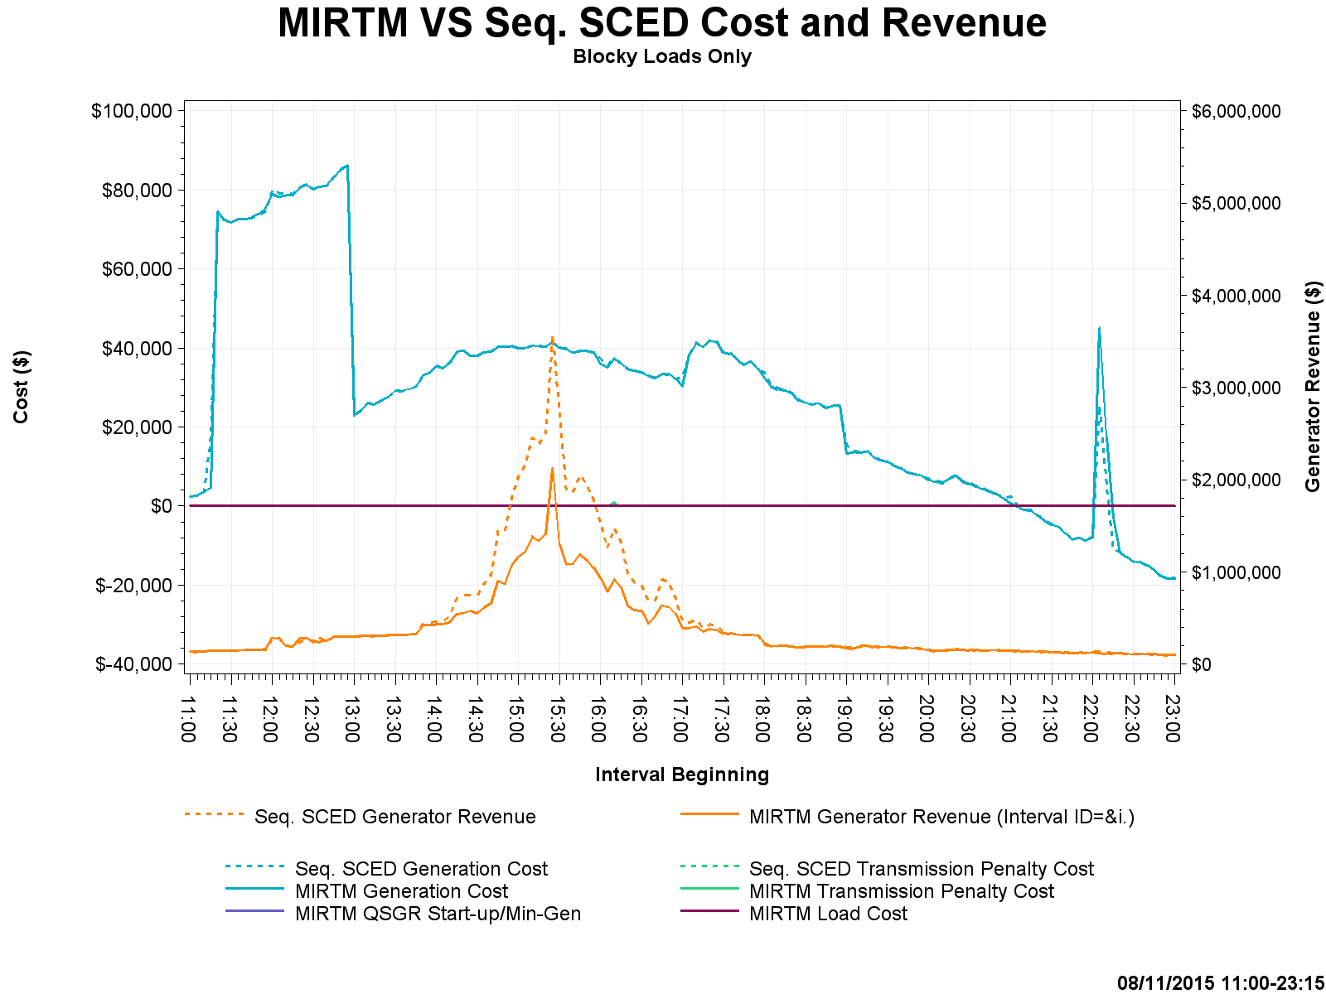
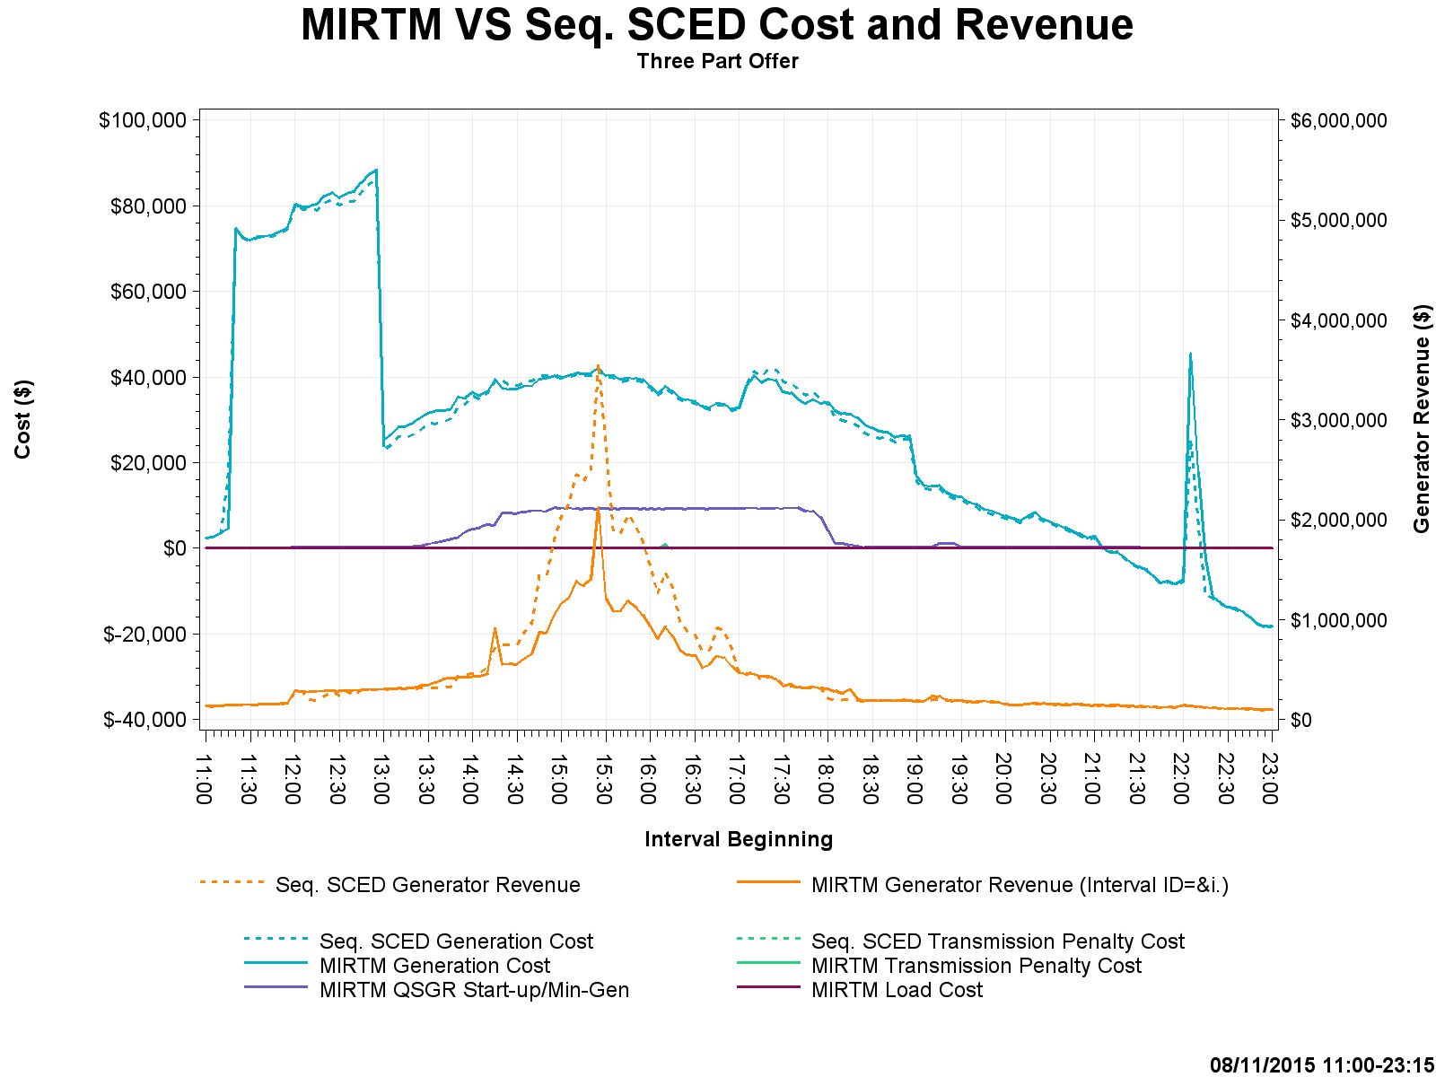
Study Day: August 11, 2015 – Cost and Revenue

Slide 30
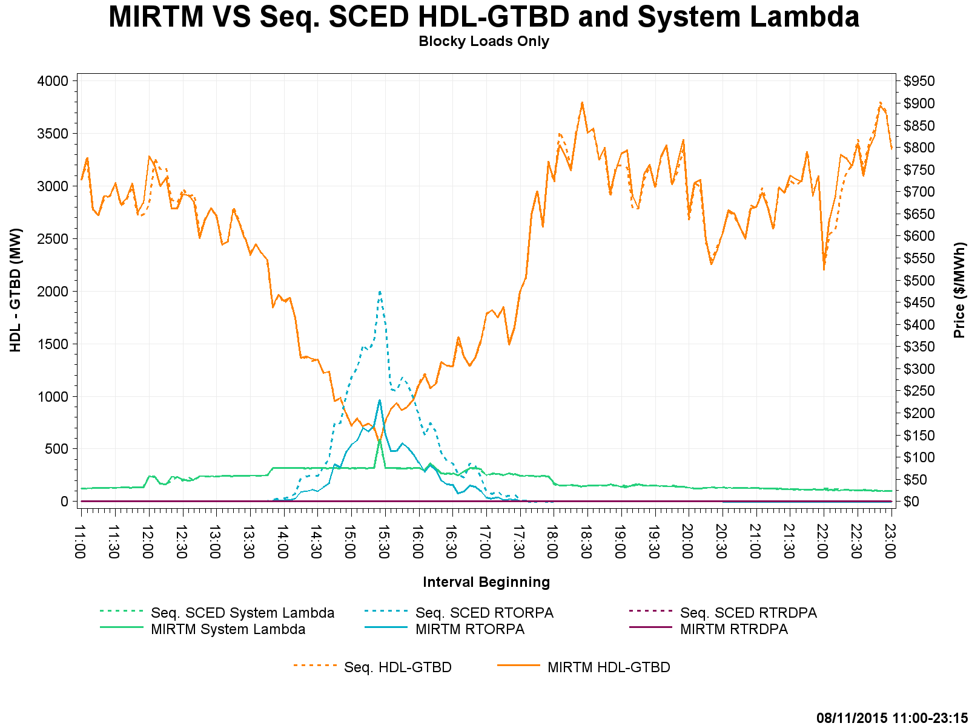
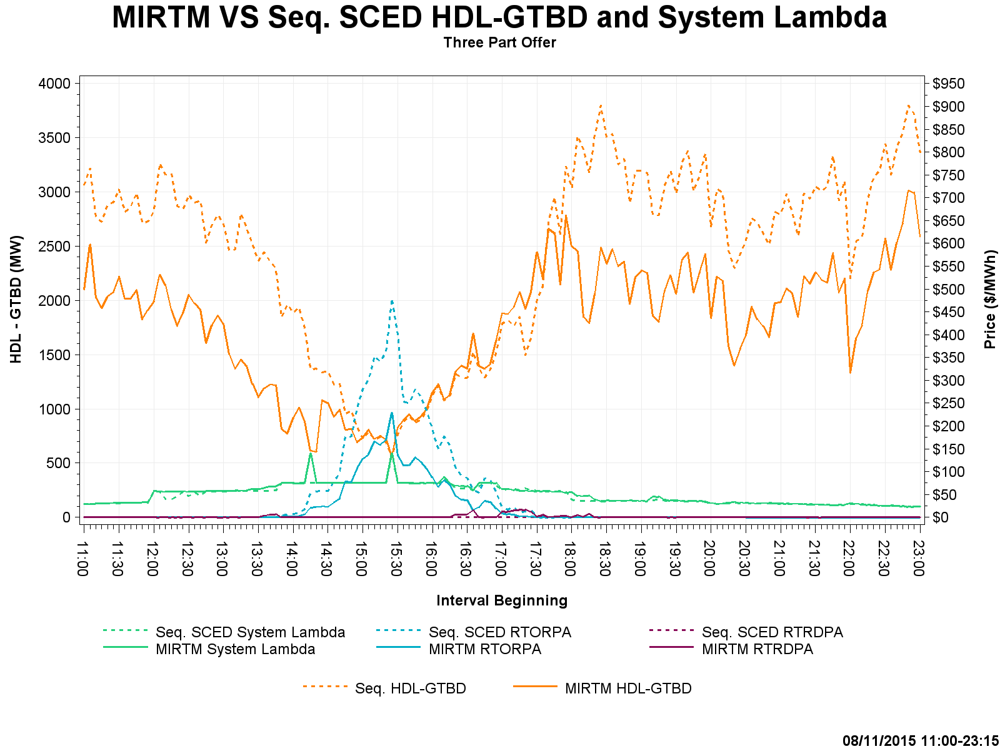
Study Day: August 11, 2015 – HDL-GTBD, SL

Slide 31
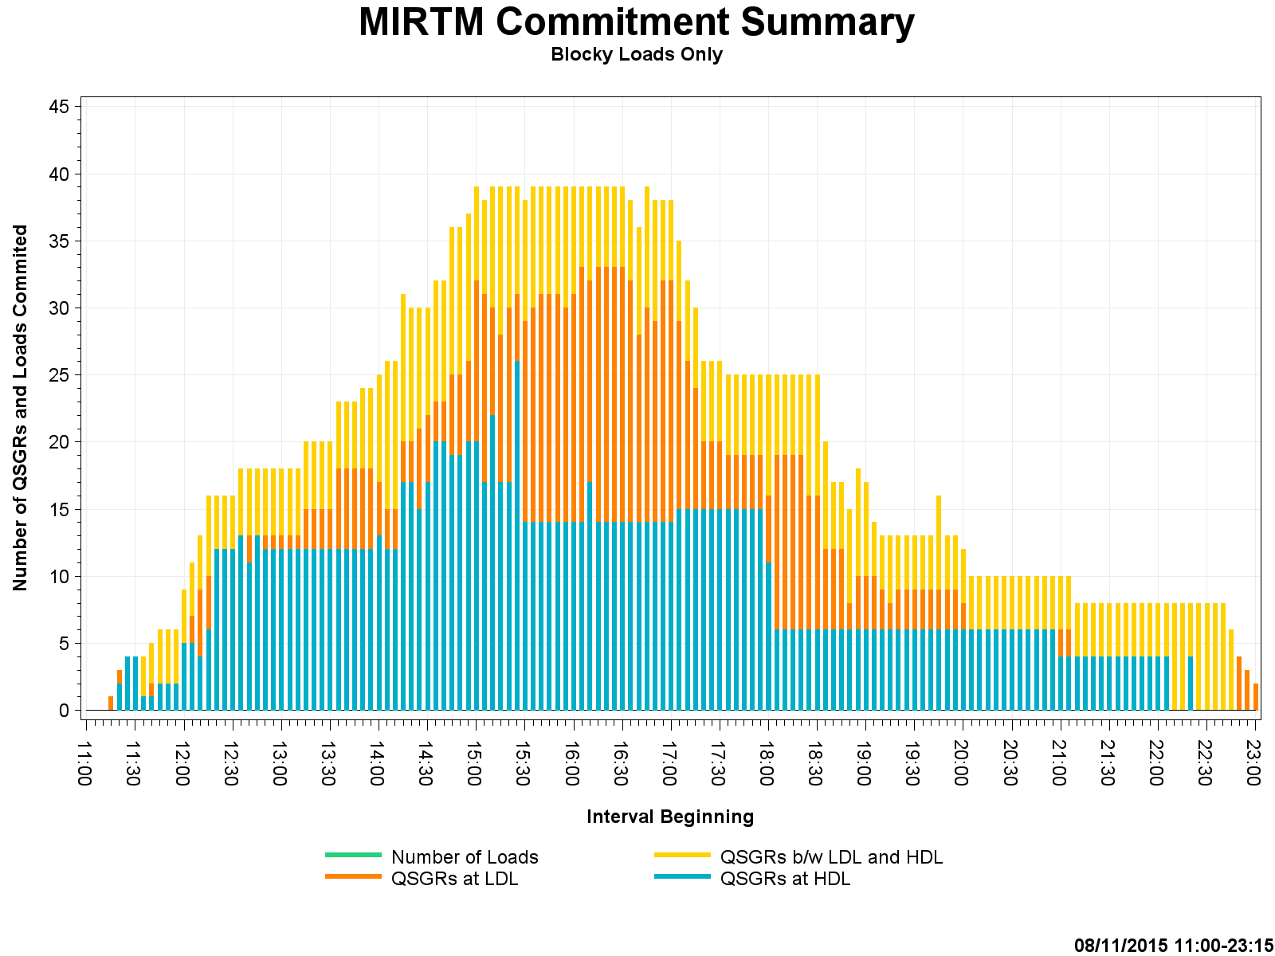
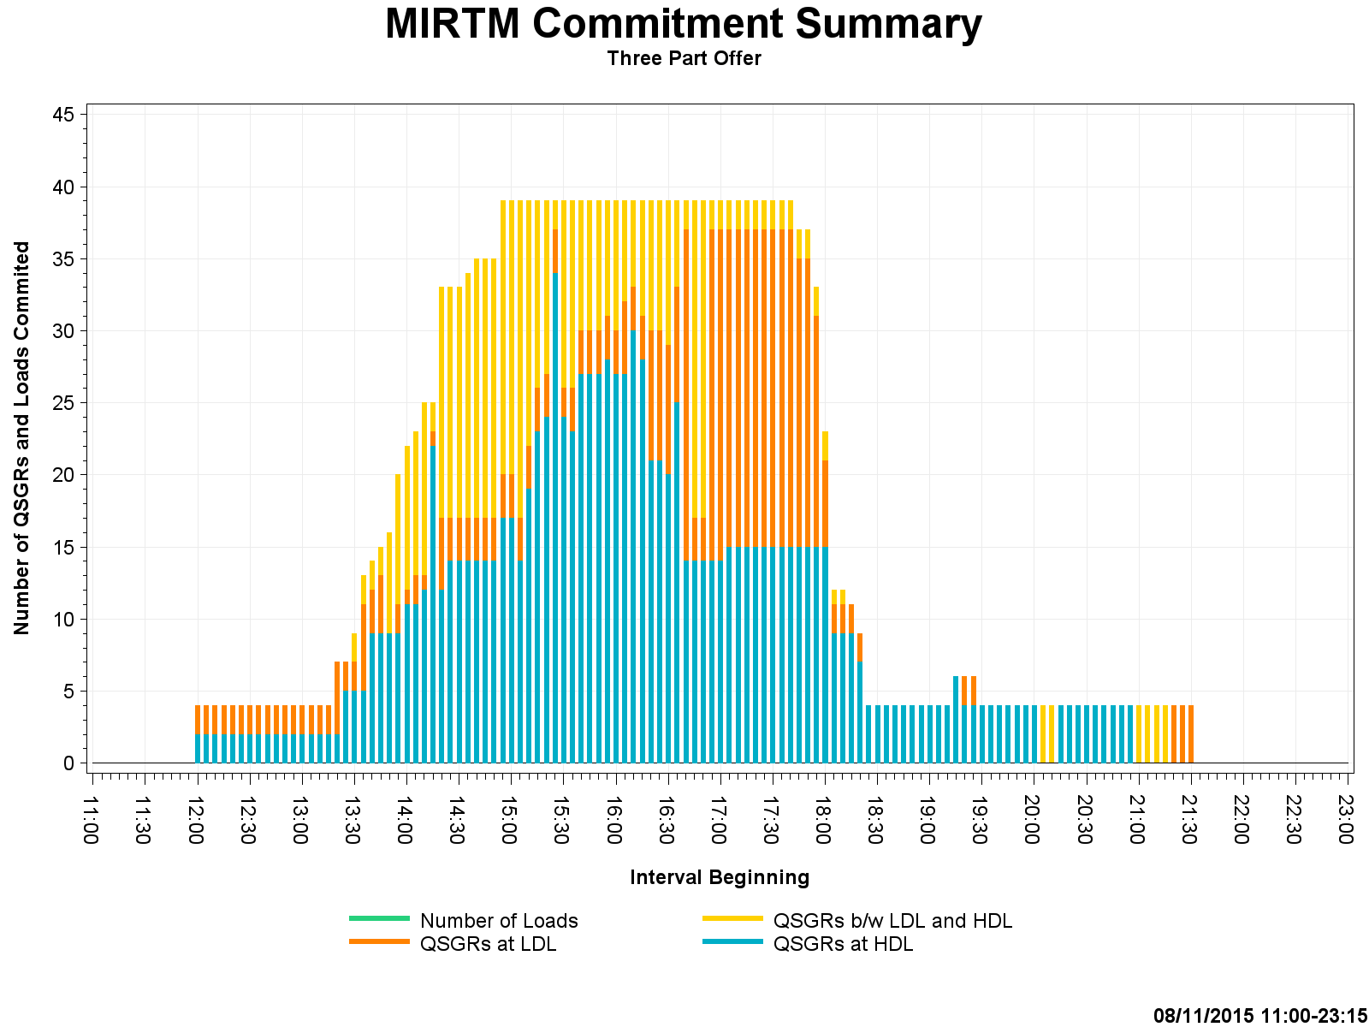
Study Day: August 11, 2015 – Commitment Summary

Slide 32
Study Day: Nov 11, 2015
  11/11/2015 - ERCOT (New STLF over forecasts load)

Slide 33
Study Day: Nov 11, 2015

Slide 34
Study Day: Nov 11, 2015

Slide 35
Study Day: Nov 11, 2015

Slide 36
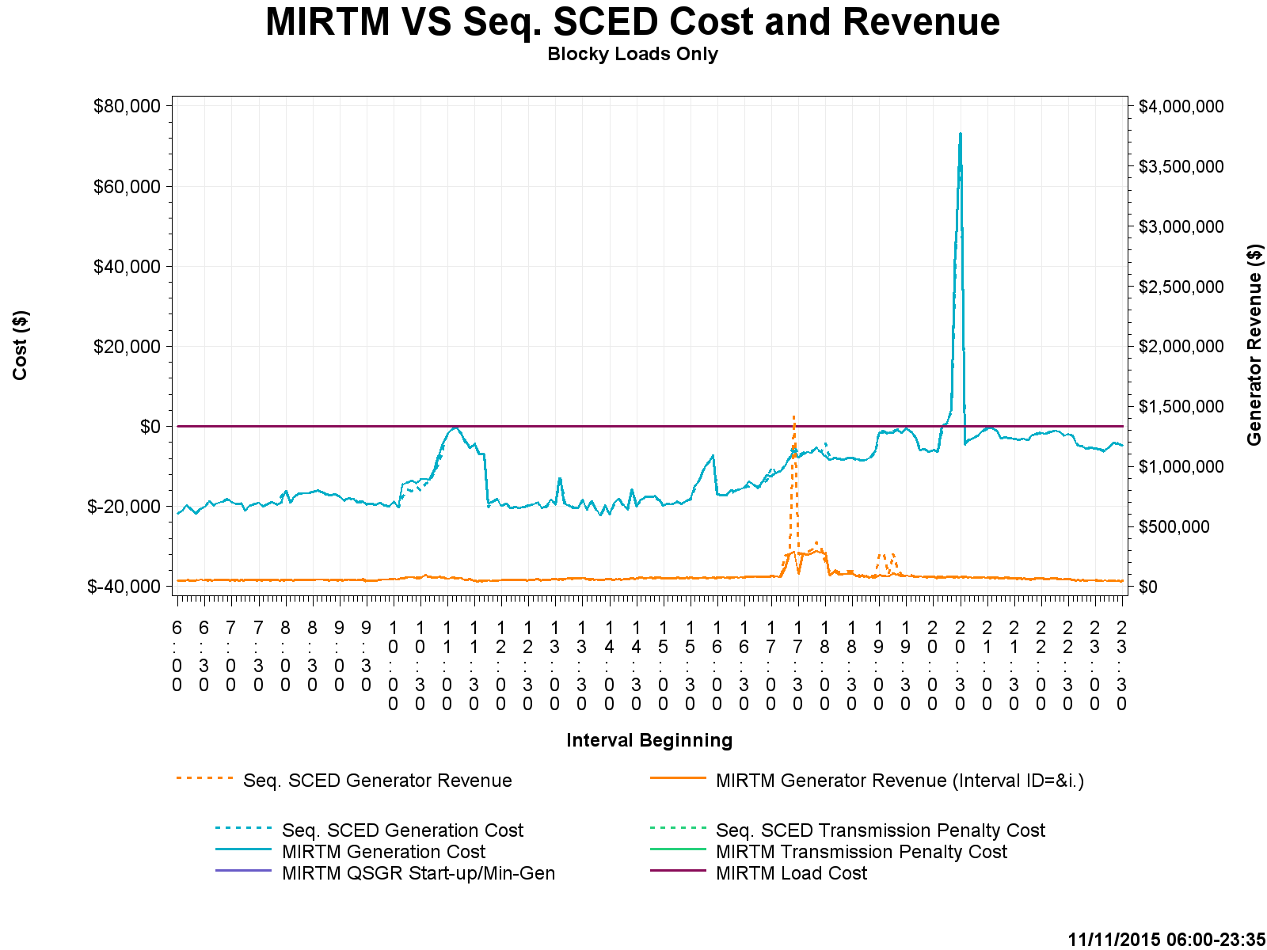
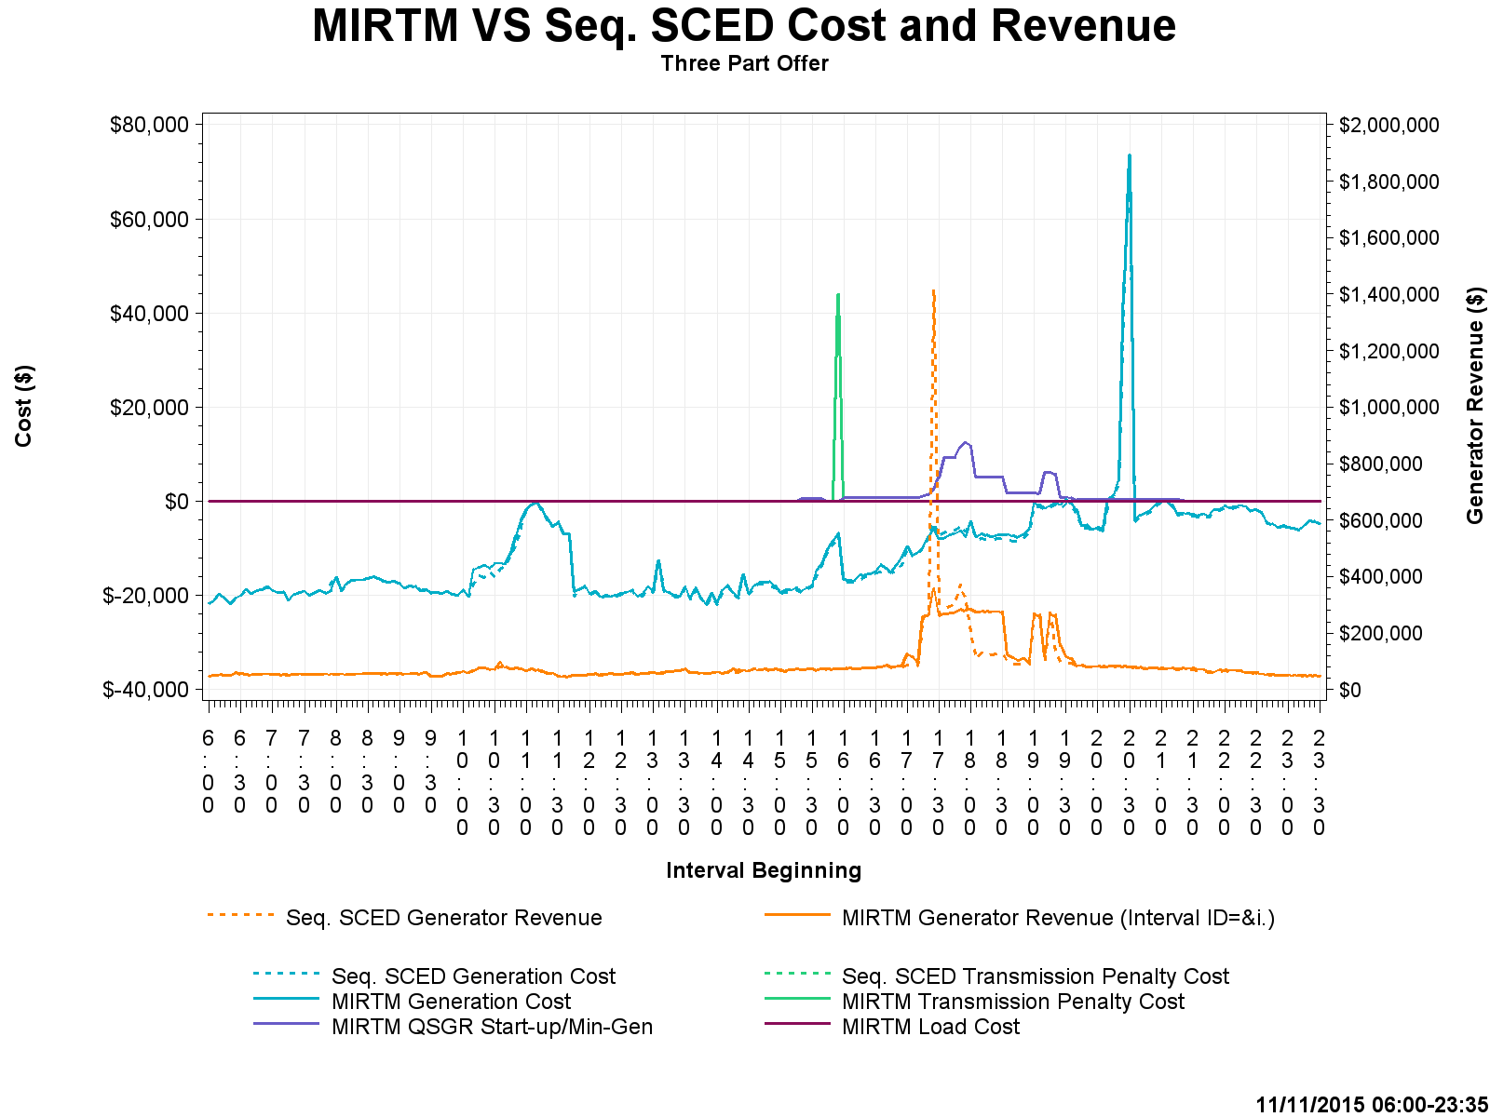
Study Day: Nov 11, 2015 – Cost and Revenue

Slide 37
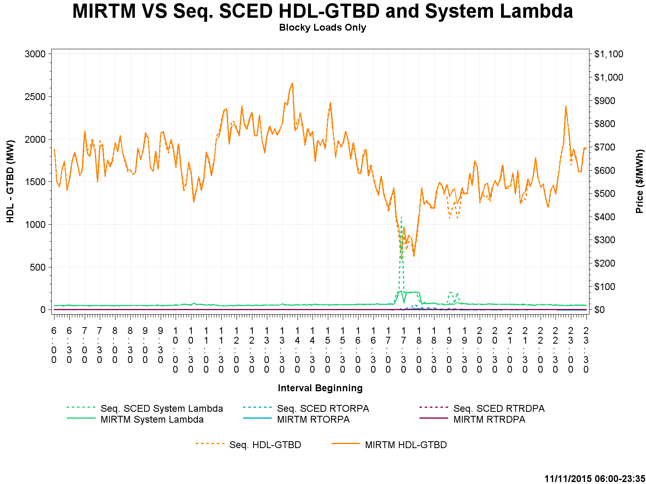
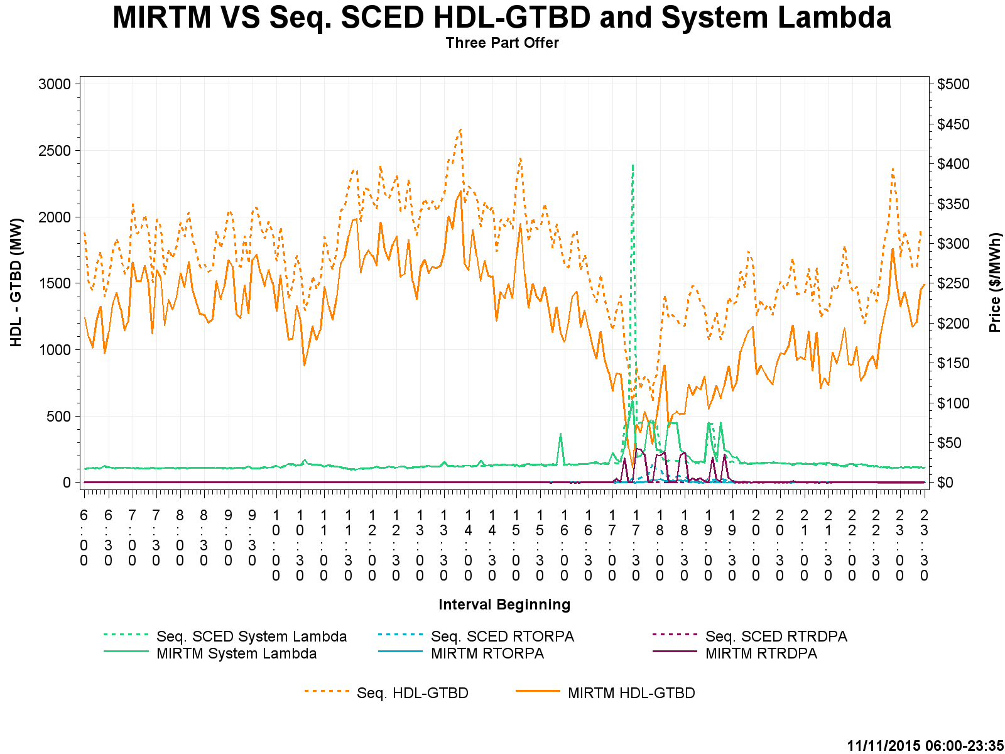
Study Day: Nov 11, 2015– HDL-GTBD, SL

Slide 38
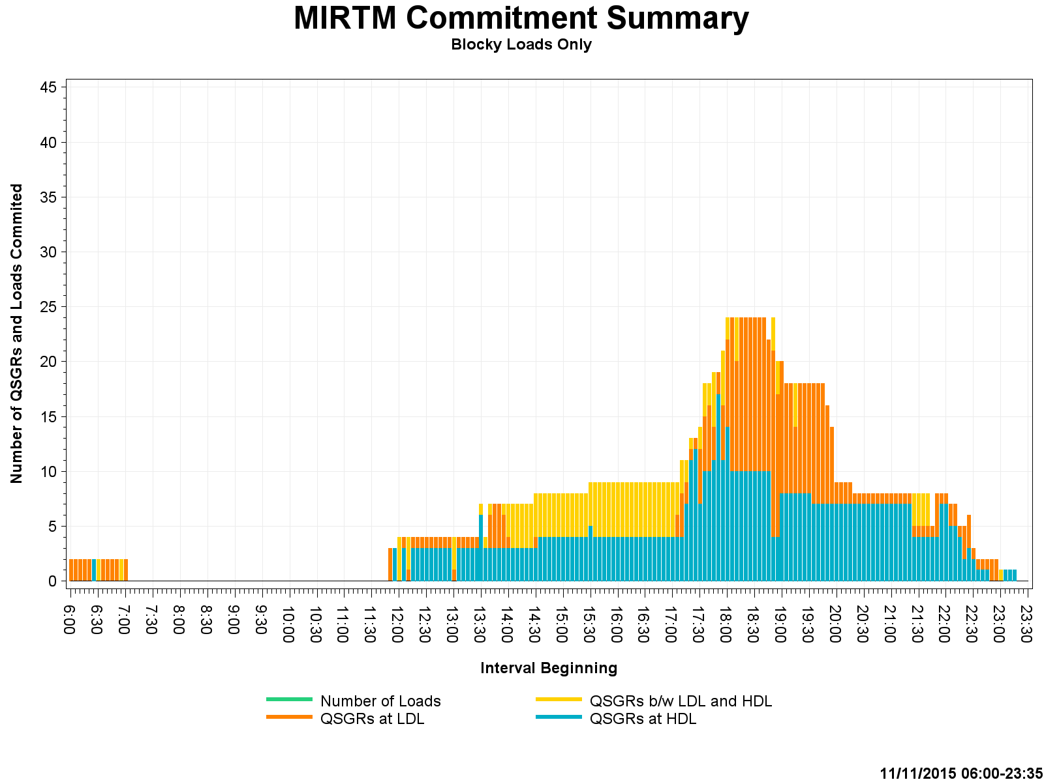
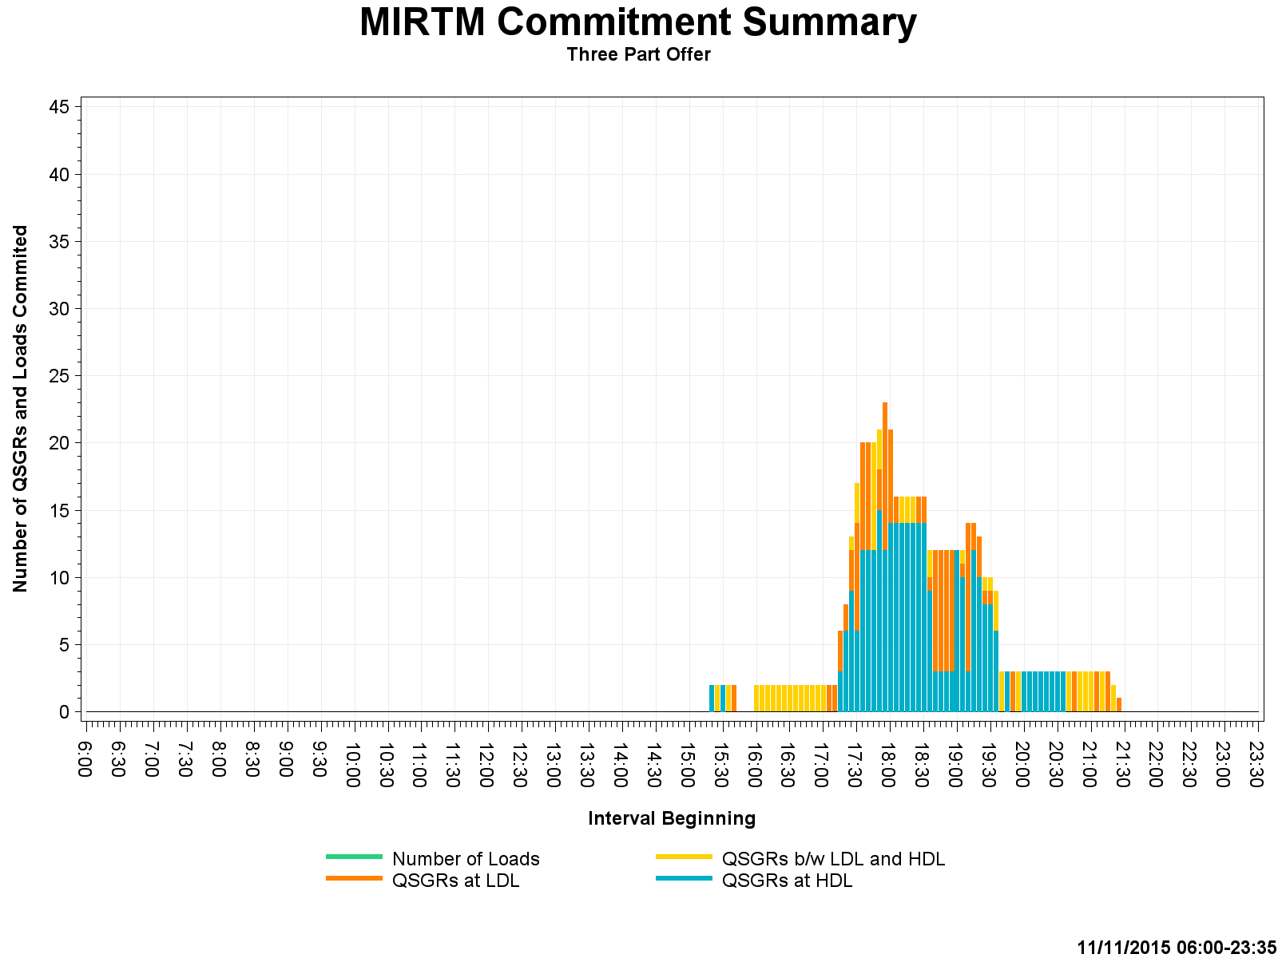
Study Day: Nov 11, 2015 – Commitment Summary

Slide 39
Appendix

Slide 40
Study Day: August 13, 2015 MIRTM Load only

Slide 41
Study Day: August 13, 2015 MIRTM Load only

Slide 42
Study Day: August 13, 2015 MIRTM Load only

Slide 43
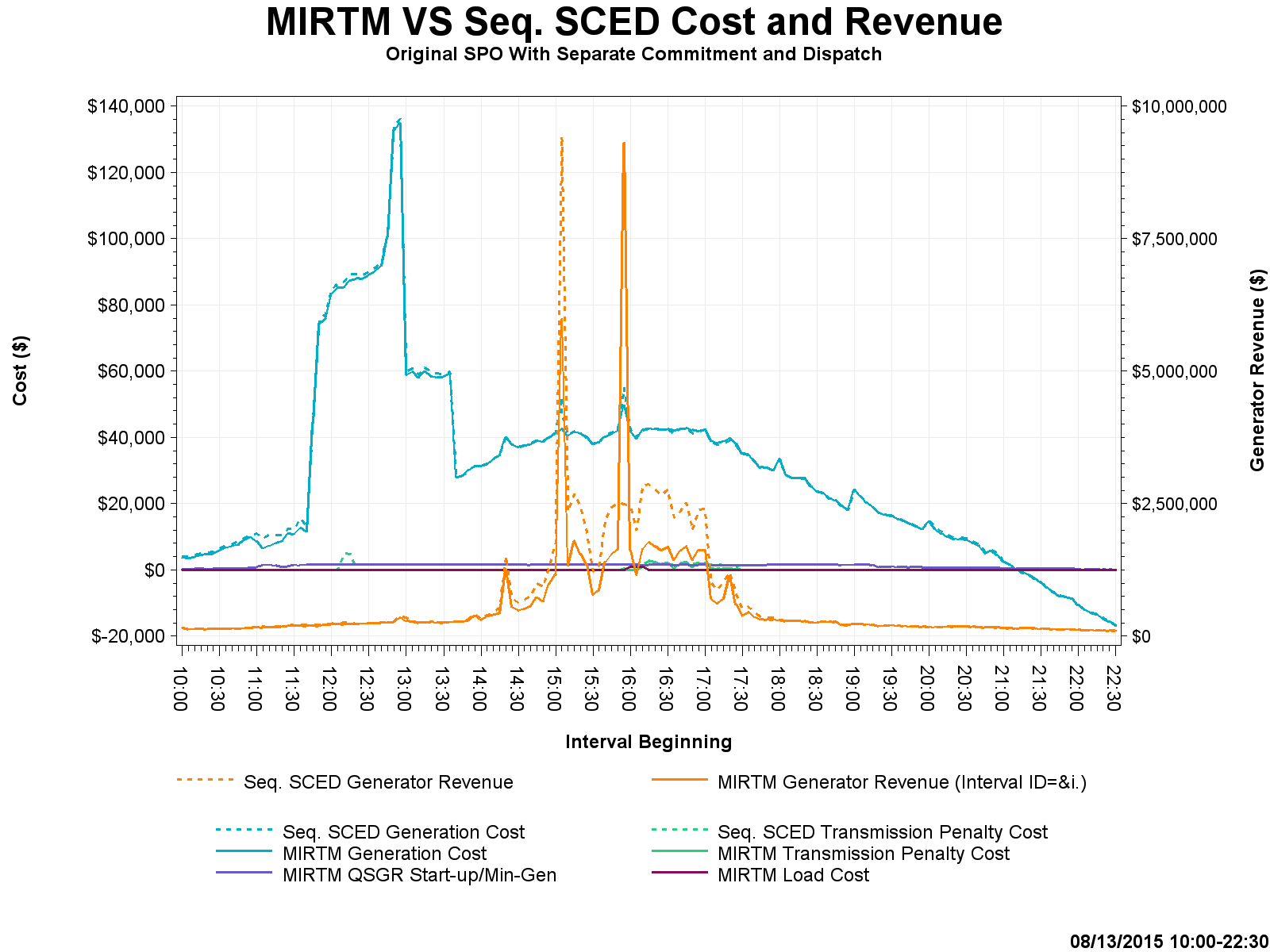
Study Day: August 13, 2015 MIRTM Prod EOC

Slide 44
Study Day: August 13, 2015 MIRTM Prod EOC

Slide 45
Study Day: August 13, 2015 MIRTM Prod EOC

Slide 46
Study Day: August 13, 2015 MIRTM 3PO

Slide 47
Study Day: August 13, 2015 MIRTM 3PO

Slide 48
Study Day: August 13, 2015 MIRTM 3PO

Slide 49
Study Day: August 13, 2015 MIRTM SPO

Slide 50
Study Day: August 13, 2015 MIRTM SPO

Slide 51
Study Day: August 13, 2015 MIRTM SPO

Slide 52
Study Day: July 1, 2015 – MIRTM Load Only

Slide 53
Study Day: July 1, 2015 – MIRTM Load Only

Slide 54
Study Day: July 1, 2015 – MIRTM Load Only

Slide 55
Study Day: July 1, 2015 – MIRTM 3PO

Slide 56
Study Day: July 1, 2015 – MIRTM 3PO

Slide 57
Study Day: July 1, 2015 – MIRTM 3PO

Slide 58
Study Day: August 11, 2015 – MIRTM Load only

Slide 59
Study Day: August 11, 2015 – MIRTM Load only

Slide 60
Study Day: August 11, 2015 – MIRTM Load only

Slide 61
Study Day: August 11, 2015– MIRTM 3PO

Slide 62
Study Day: August 11, 2015– MIRTM 3PO

Slide 63
Study Day: August 11, 2015– MIRTM 3PO

Slide 64
Study Day: Nov 11, 2015 – MIRTM Load only

Slide 65
Study Day: Nov 11, 2015– MIRTM Load only

Slide 66
Study Day: Nov 11, 2015 – MIRTM Load only

Slide 67
Study Day: Nov 11, 2015 – MIRTM 3PO

Slide 68
Study Day: Nov 11, 2015 – MIRTM 3PO

Slide 69
Study Day: Nov 11, 2015 – MIRTM 3PO

Slide 70
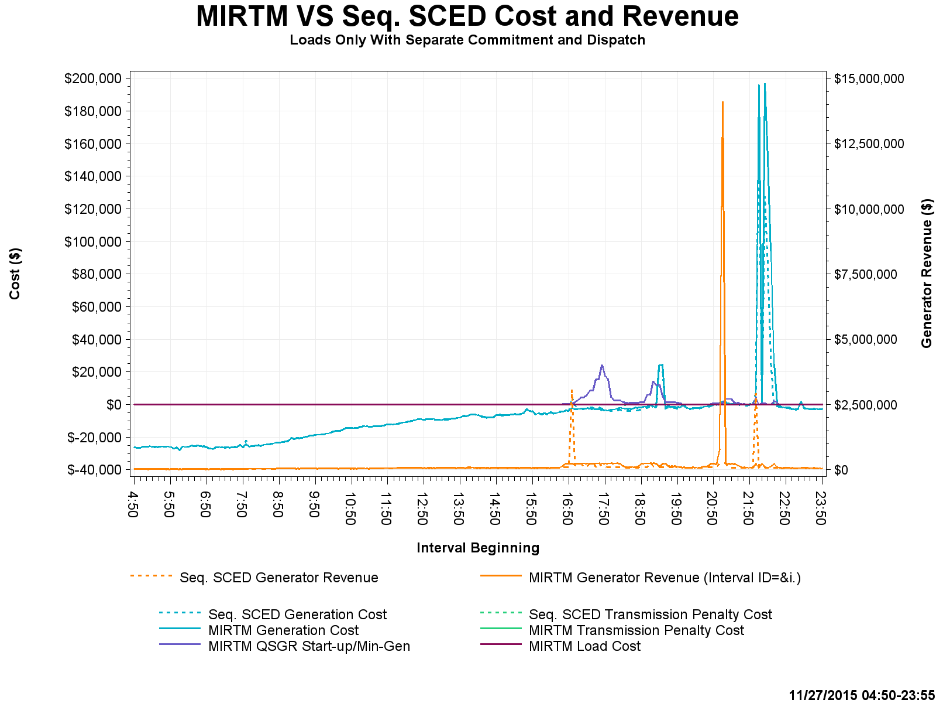
Study Day: Nov 27, 2015 – MIRTM Load only

Slide 71
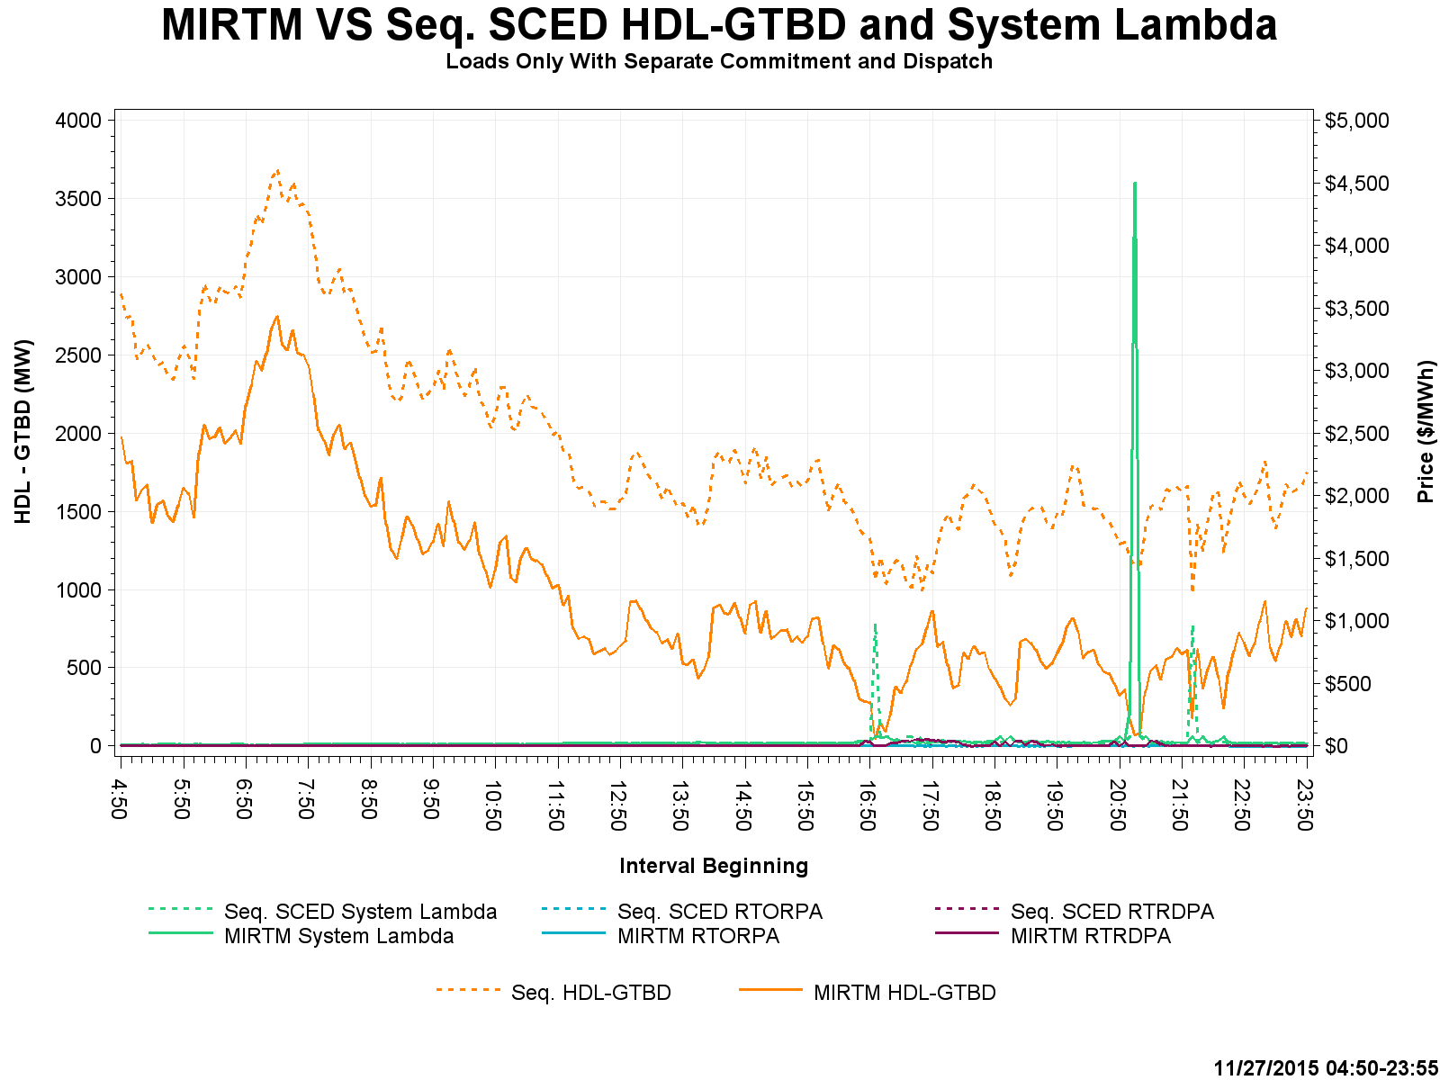
Study Day: Nov 27, 2015– MIRTM Load only

Slide 72
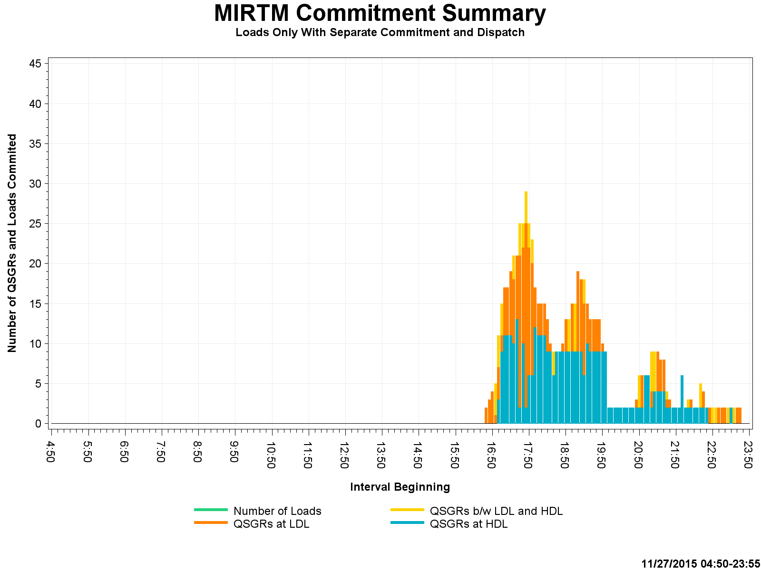
Study Day: Nov 27, 2015 – MIRTM Load only

Slide 73
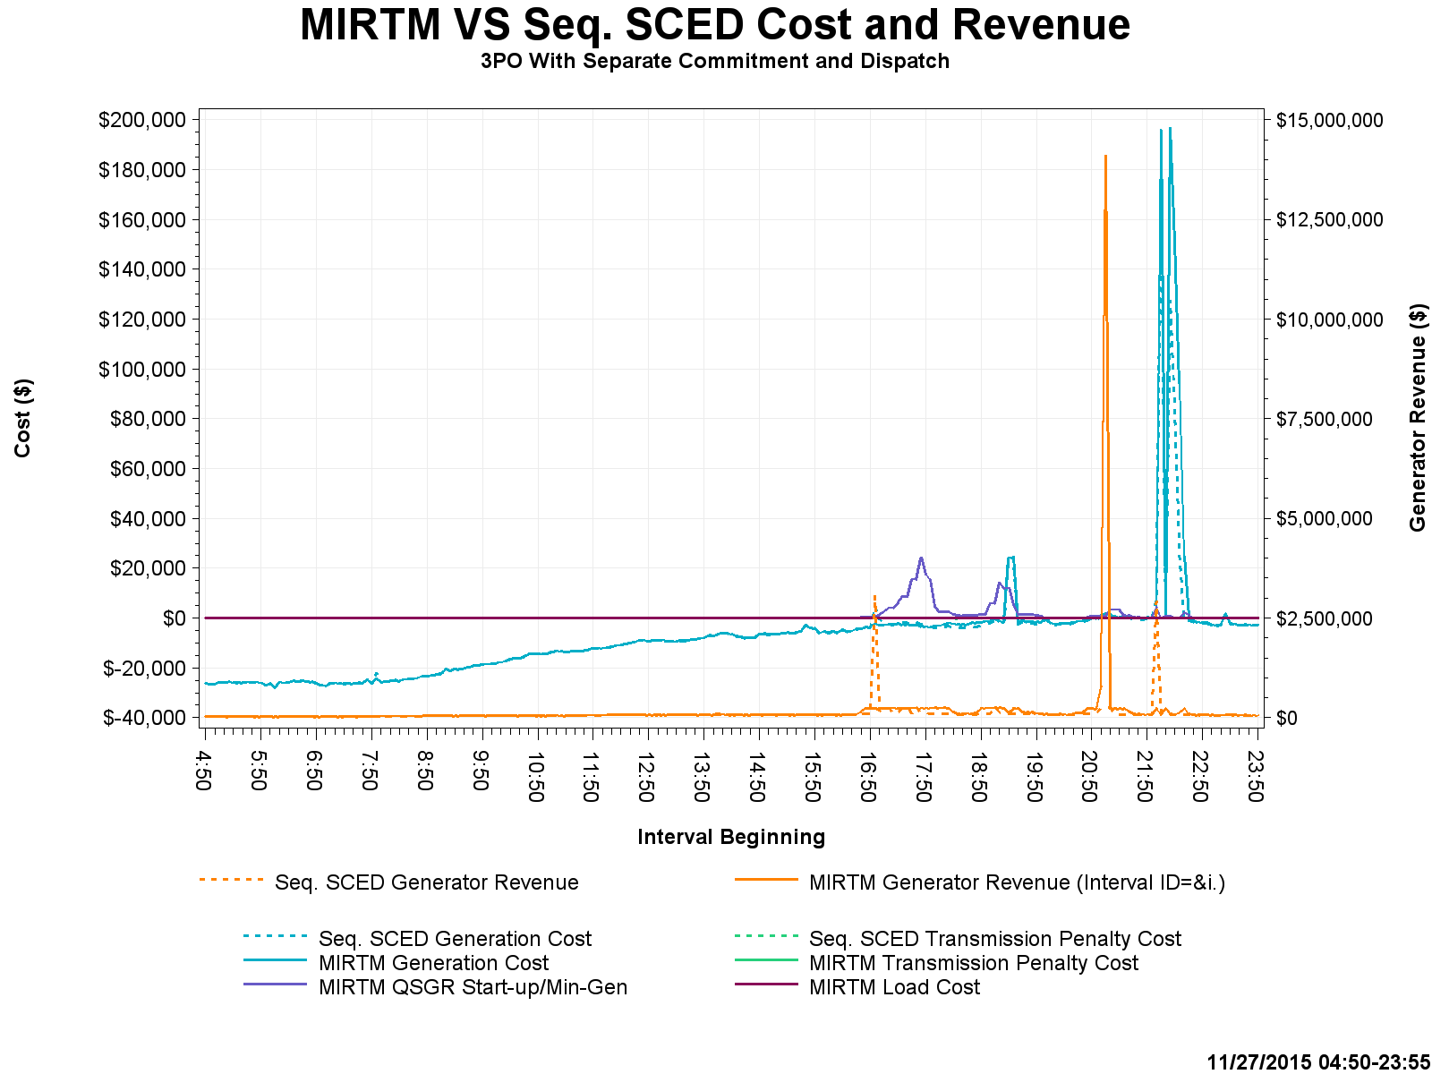
Study Day: Nov 27, 2015 – MIRTM 3PO

Slide 74
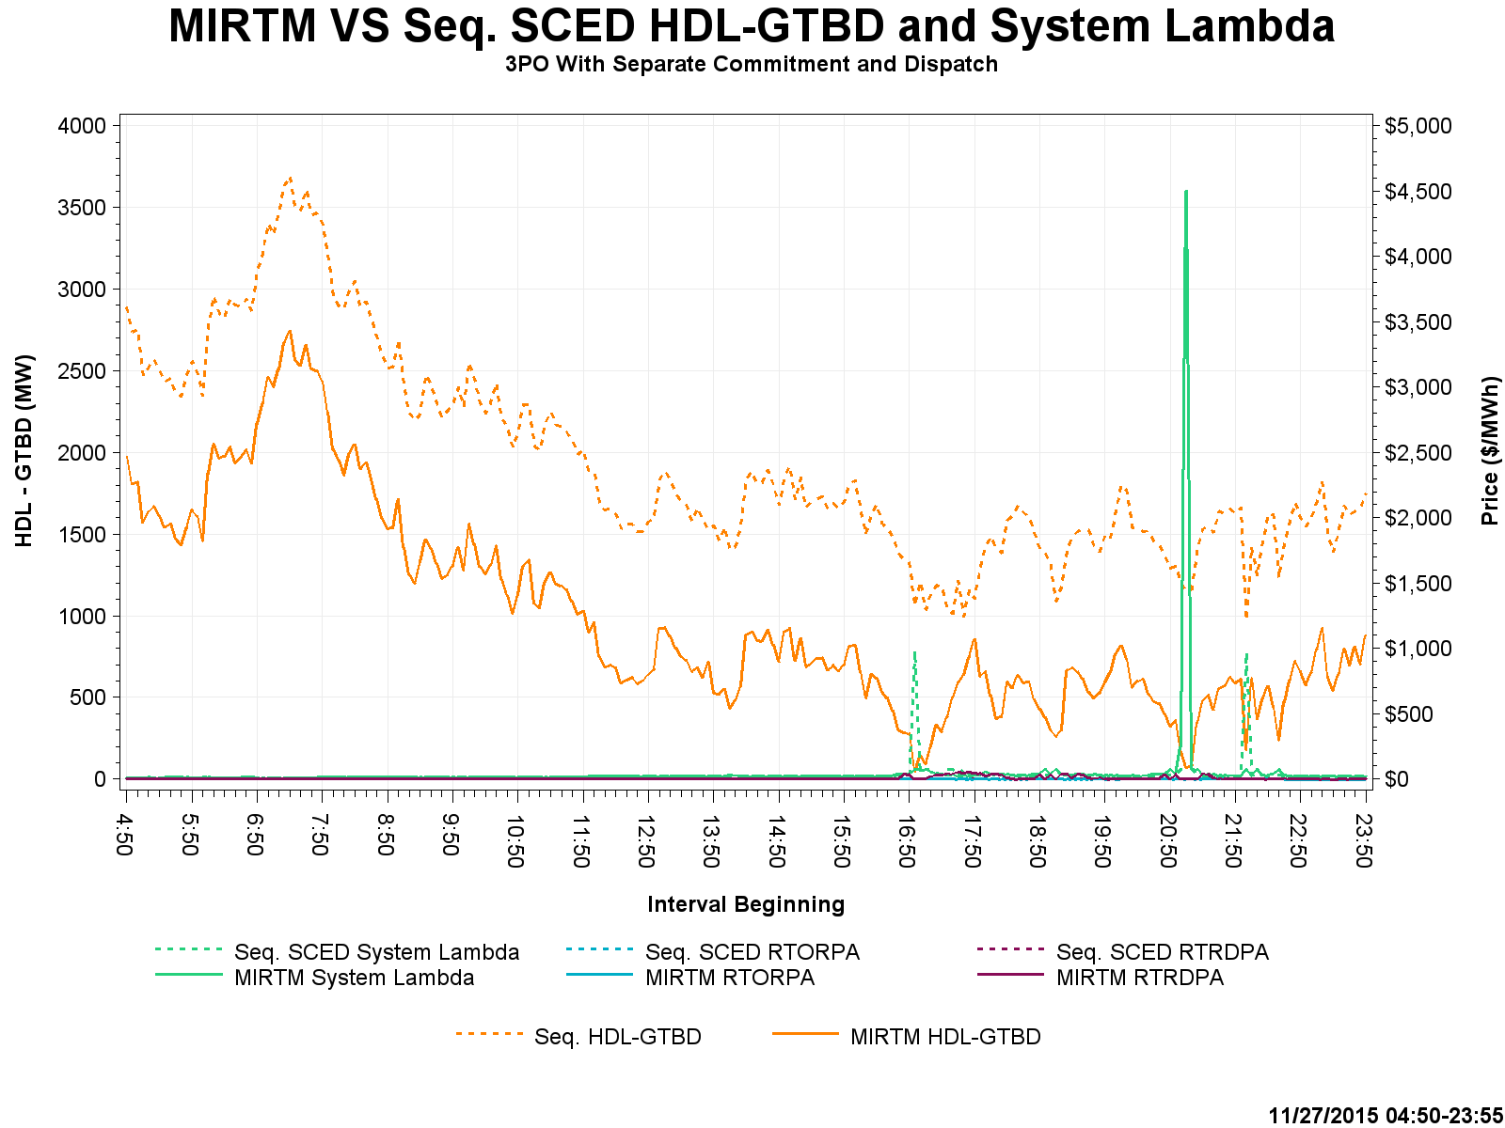
Study Day: Nov 27, 2015 – MIRTM 3PO

Slide 75
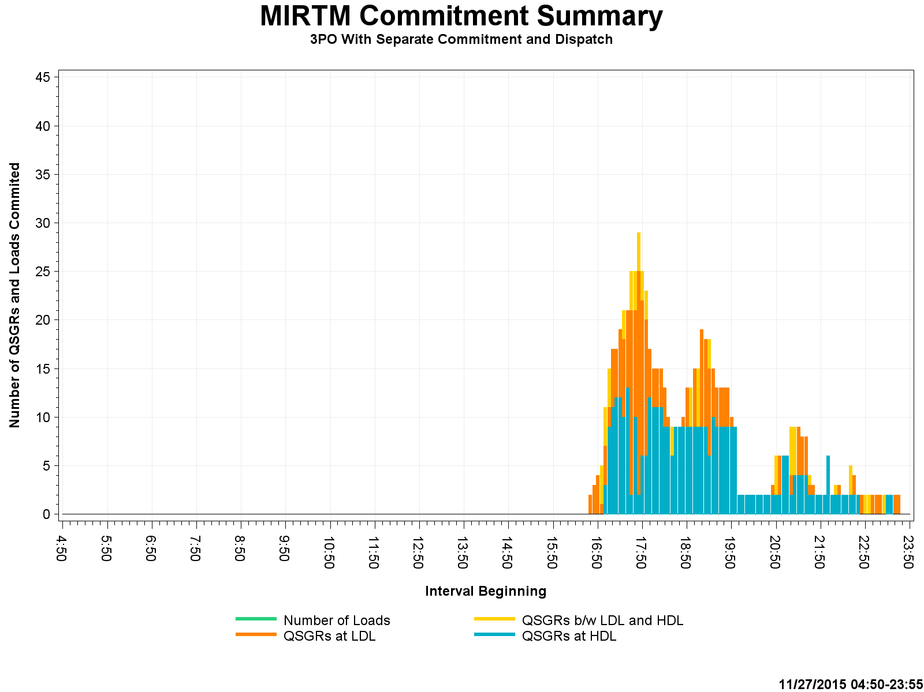
Study Day: Nov 27, 2015 – MIRTM 3PO

