Slide 1
MDWG Update to COPS
August 10, 2016

Slide 2
NOGRR084 – Daily Grid Ops Report
NOGRR084 is back on track
It will remain as a NOGRR
Data elements will be reviewed with OWG and MDWG
Impact Analysis is in progress
New NOGRR:
“ERCOT shall post to the MIS Public Area, a summary level report of each Operating Day’s operational information. The report includes, but is not limited to, information related to Load, weather, generation, Renewables, Outages, unit commitments, and Ancillary Services. An initial report shall be posted each Operating Day for the previous Operating Day. An updated report may be posted within two Business Days following the Operating Day if additional information related to specific a system event is needed.” (Emphasis added)

Slide 3
Reports to be Automated
CEER 2/3
Currently in planning
CSA Report for CRs | Information needed by CRs to audit their CSA's ownership. | CEER2 | ITCM 12748 | YES -Automate existing market report: CSA Report for CRs
Retail Performance Measures | Compliance tracking against ERCOT Retail Protocols | CEER2 | ITCM 12749 | This is executed exclusively from DataTrak which is not replicated in an EIS accessible way.
Customer Billing Contact Information & ESIID Counts by Rep | Provides compliance with CBCI that includes ESIID counts | CEER2 | ITCM 12750 | This is available exclusively to the PUC via a monthly official filing from legal.
IAG RMS Report | Trending data on Inadvertent Gain issues | CEER2 | ITCM 12744 | This is a tracking report between Siebel and MarkeTrak. MarkeTrak isn't replicated. It is also posted only to the site page for RMS meetings.
ESIIDs Excercising Option | ESIIDs that have exercised provider option to not be affiliated with the AREP | CEER2 |  | Not reasonable to automate
Monthly Transaction Summary | Month-end Retail Transaction Volumes | CEER2 |  | YES
QSEs in ERCOT Region | List of QSEs in ERCOT Region | CEER3 | ITCM 12949 | Begin working with Business first week in August.

Slide 4
Open Issues
Load Forecast Distribution Factor Report
Change to event-driven schedule, rather than hourly
NPRR754 – Approved by Board
ERCOT to provide release schedule
Zero/Null Data in 60-day SCED GRD Report
Replaces zero values with nulls above top of curves
Scheduled for Release 4 in August

Slide 5
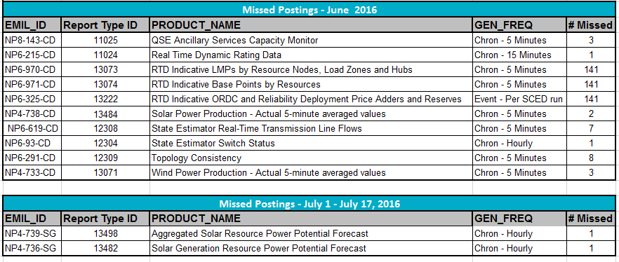
Market Data Transparency SLA
Missed Postings list
Report is now part of MDWG monthly postings
Posted to Transparency page and MDWG
Cumulative list
Market Reports and Extracts

Slide 6
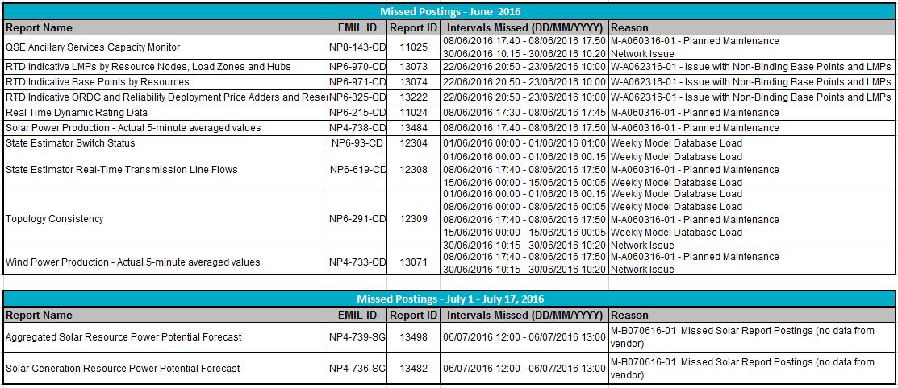
Missed Postings – Details

Slide 7
Digital Certificates
Windows 10/Active X Development
Active X will be retired
Workaround will remain in place until updated application is ready
Development is underway
SSL Certificate Upgrade
ERCOT Intermediate and Root certificates were changed about a year ago.
New standard SHA and applies to MIS API, Notifications, Production Web Services, MarkeTrak and Get Report/Get List functionality
MOTE was be upgraded on July 6, 2016 and used for testing
Production will be upgraded August 2, 2016
Market Call was held on July 22, 2016 describing the change and steps the Market needs to take for the upgrade
Published new SSL Root Certificates ERCOT.com

Slide 8
MIS Changes Visibility
Final review of Problem Statement
Document will be presented to ERCOT management
Posted to MDWG listserv
Available on MDWG meeting page
MDWG requested that ERCOT data strategy leadership join us to discuss data strategy

Slide 9
EWS Modification
Brian Brandaw and Julie Thomas will socialize information with other stakeholder groups
Presented to COPS
Presented to CSWG
CSWG wanted to be sure that extracts were included in scope
Other groups will be scheduled

Slide 10
Upcoming Changes
R4
Correction for zeroes instead of null values in 60-day SCED GRD report
Changes in several link names
Change to disclaimer language on Indicative LMP display
R5
MIS Link changes

Slide 11
Next MDWG Meeting
Tuesday, August 30, 2016
9:30 AM – noon
WebEx Only
September meeting moved to Monday, September 19, 2016
1:30 PM – 4 PM
WebEx Only

