Slide 1
Project Update and Summary of
Project Priority List (PPL) Activity
August 11, 2016

Slide 2
Project Update Agenda
Project Portfolio Update p. 3-7
  Recent/Upcoming Project Highlights
  2016 Release Targets
  2016 Project Spending Forecast
  Revision Request Funding Placeholder Status
  TAC Referral: Tracking Funds for Upgrade Revision Requests
  Priority/Rank Options for Revision Requests with Impacts
Appendix
  Project Portfolio Gantt Chart p. 8-15
Location of Project Priority List (PPL): http://www.ercot.com/services/projects/index

Slide 3
Recent / Upcoming Project Highlights
2016 July Retail Release – Weekend of 7/23/2016 Complete
  RMGRR126 – Add’l ERCOT Validations for Customer Billing Contact Information File
  RMGRR137 – Timeline and Completion Process for Correcting CBCI Files
2016 August Release – Week of 8/30/2016 In Flight
  NPRR662 – Proxy Energy Offer Curves
  NPRR712 – Clarification of RUC Process
2016 September Release – Week of 9/26/2016 In Flight
  NPRR219 – TSPs Must Submit Outages for Resource Owned Equipment and Clarification of Changes in Status of Transmission Element Postings
  SCR783 – Outage Scheduler Enhancements -- Groups 2 and 3, Group Outage, Usability and Filtering Enhancements
  NOGRR050 – Resolution of Reporting Issues Related to NPRR219
Note: Projected Go-Live dates are subject to change.
Please watch for market notices as the effective dates approach.

Slide 4
2016 Release Targets – Board Approved NPRRs / SCRs / xGRRs
February 2/2 – 2/4 | April 4/12 – 4/14 | June 6/21 – 6/23 | August 8/30 – 9/1 | September 9/26 – 9/30 | December 12/6 – 12/8
NPRR588 NPRR615 NPRR686(b) | NPRR419 NPRR728 COPMGRR040 | NPRR515 NPRR617 NPRR700 NPRR719 NPRR742 VMCRR008 EMS Upgrade | NPRR662 NPRR712 NOGRR143 RMGRR126 RMGRR137 | NPRR219 SCR783 NOGRR050 NOGRR143 NMMS Upgrade NPRR495 NPRR736 | NPRR573 NPRR714 NPRR754 NOGRR147 SCR787 SCR788 RMGRR127 SCR786
3 | 3 | 6 | 4 | 6 | 7
E
E
E
E
E
E
E
E
E
H
NS
P
P
NS
E
E
9/22
5/1
6/16
7/23 – 7/24
12/10 – 12/11
11/1 – 11/3
EMS Upgrade “Chill”
2016 TBD Items (and point at which they became “TBD”)
2014 | 2015 | February 2016 | June 2016 | August 2016
NOGRR084, NPRR664 | None | SCR781 H | NPRR754, NPRR758, SCR790 | TBD
Go-live dates can differ from Protocol effective dates – Please refer to market notices for more details
APPENDIX
Red Text: New additions and target release changes
Strike-Through Text: Previous target release changes
(a), (b), etc. indicates multiple phases
In-Flight Items Planned for 2017 Delivery
CMM bundle (Planning): NPRR439, NPRR519, NPRR620, NPRR683, NPRR702, NPRR741, NPRR743
CRR Upgrade (Planning): SCR777
Release targets are subject to change
NPRR686(b) – Solar portion
Items Originally Targeted for 2016 Now Planned for 2017 Delivery
RRGRRs 003, 006, 007 (2017-R1 target)
NPRR272 (2017-R1 target)
NPRR714 (2017-R3 target)
Project Status Codes: NS = Not Started, I = Initiation, P = Planning, E = Execution, H = On Hold

Slide 5
2016 Project Spending Forecast
2016 PPL Budget = $22.5M
“Potential Demand” represents internal ERCOT projects that have not been fully approved

Slide 6
Revision Request Funding Placeholder Status
In 2016 and 2017, ERCOT forecasted $4.0M for Revision Request work
Yearly Revision Request Spending Forecast Summary
Project Status | 2016 | 2017
YTD Actuals | $1.51M | –
Approved – In-Flight / Complete | $2.33M | $0.57M
Approved – On Hold | $0.03M | $0.40M
Approved – Not Started | $0.37M | $1.38M
Remaining Funding | $1.27M | $1.65M
Total Allocation | $4.00M | $4.00M
As of 6/30/2016
Each year, an additional $400k is held in reserve in the event the $4M allocation is insufficient

Slide 7
Prioritization of Upgrade Revision Requests
PRS and TAC have discussed the fact that SCR789 – Update NMMS Topology Processor to PSSE 34 Capability is an upgrade project that should have market awareness but may not be appropriate for tracking against the market’s target project budget allocation
  At TAC, ERCOT suggested that ideas could be brought to PRS for further discussion
Options
  When ERCOT and PRS agree that a Revision Request is not an enhancement it is excluded from market spending metric
  No change – these situations don’t come up very frequently
Request PRS members consider these options and bring forward any other alternatives for a detailed discussion in September

Slide 8
Priority / Rank Options for Revision Requests with Impacts
Options for…
Revision Request | Description | Priority | Rank | Comments
NPRR755 | Data Agent-Only QSE Registration [ERCOT] | 2016 | 1559 | Closely aligns with NPRR519 – try to include in the CMM project since it is still in Planning
NPRR760 | Calculation of Exposure Variables For Days With No Activity [DC Energy] | 2016 | 1558 | Consistent with items in the in-flight CMM project bundle – try to include in the CMM project since it is still in Planning
NPRR778 | Modifications to Date Change and Cancellation Evaluation Window [Texas SET Working Group] | 2016 | 1700 | Add to end of 2016 PPL – target late 2016 start as current in-flight Retail projects go live
NPRR782 | Settlement of Infeasible Ancillary Services Due to Transmission Constraints [ERCOT] | 2016 | 1730 | Settlements team hopes to get this project started before the end of 2016
NPRR785 | Synchronizing WGR and PVGR COPs with Short Term Wind and PhotoVoltaic Forecasts [ERCOT] | 2016 | 1740 | Provides significant benefit to Grid Operations – target 2016 start
RMGRR134 | Allow AMS Data Submittal Process for TDSP-Read Non-Modeled Generators [ERCOT] | 2017 | 1810 | Multiple projects impacting resources needed for this RMGRR make it a 2017 project candidate

Slide 9
Appendix
  7/31/2016 Project Gantt
    In-flight items sorted by Project End Date
    “On Hold” projects listed separately
    “Not Started” items sorted by Project Start Date

Slide 10
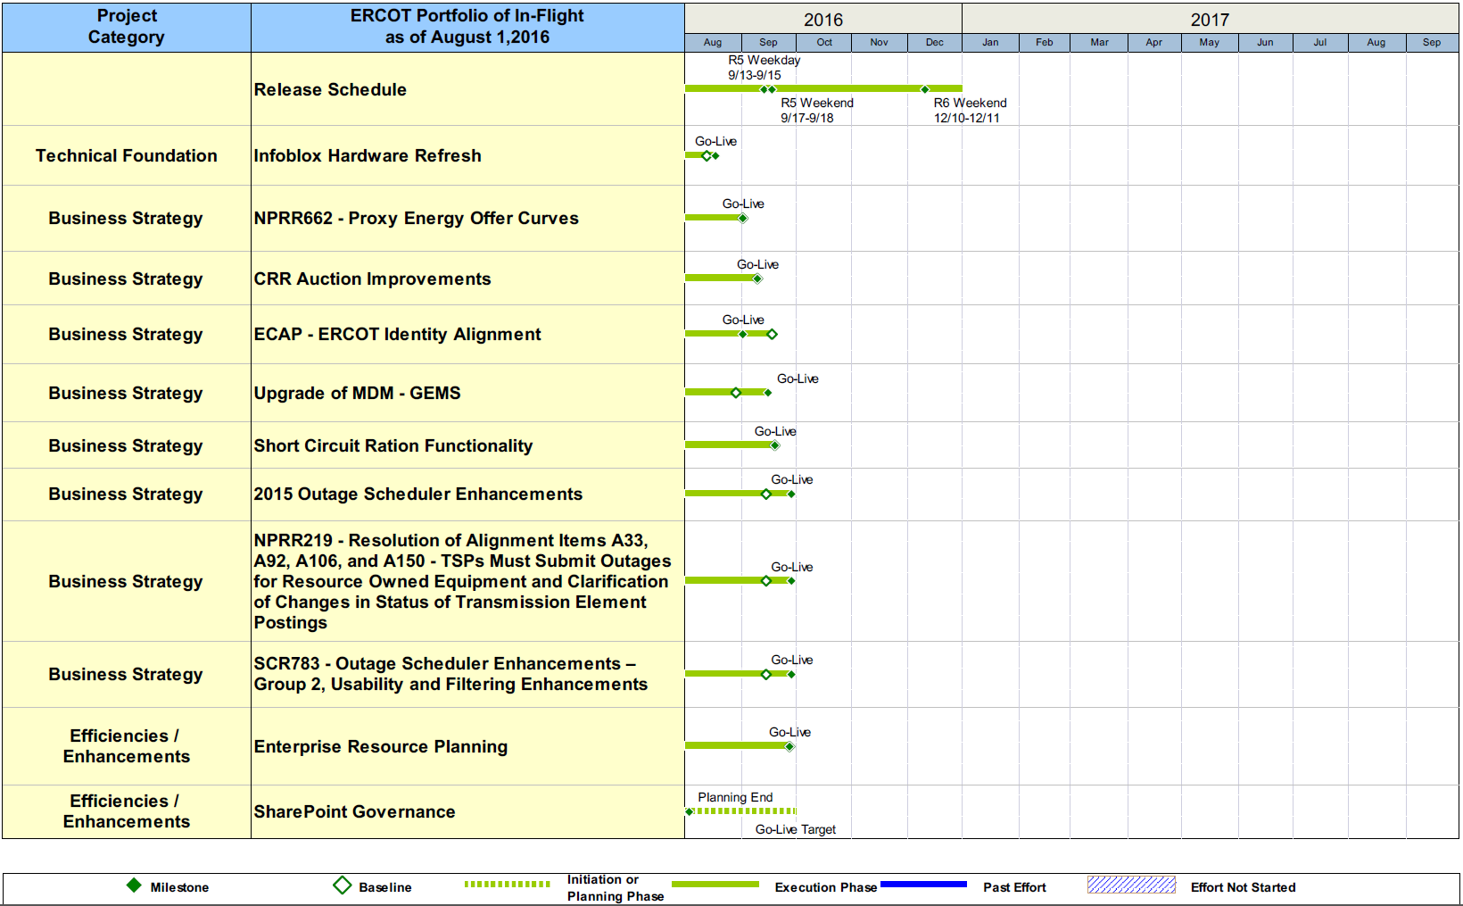
Project Portfolio Status – as of 7/31/2016

Slide 11
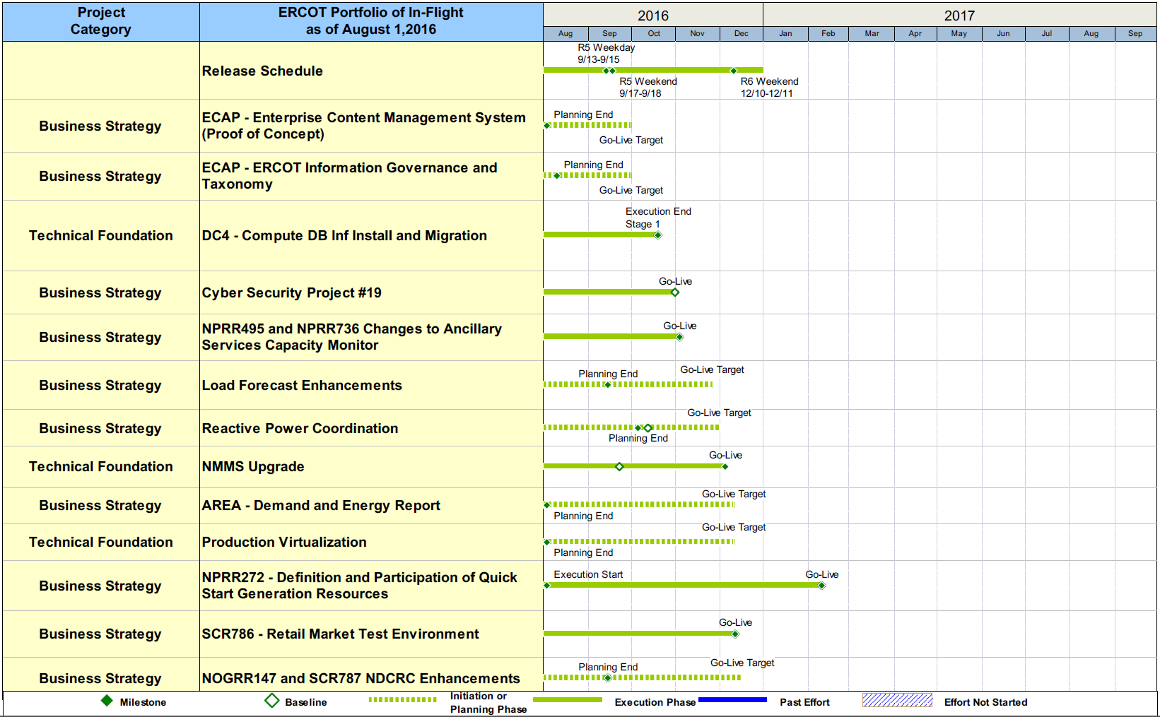
Project Portfolio Status – as of 7/31/2016

Slide 12
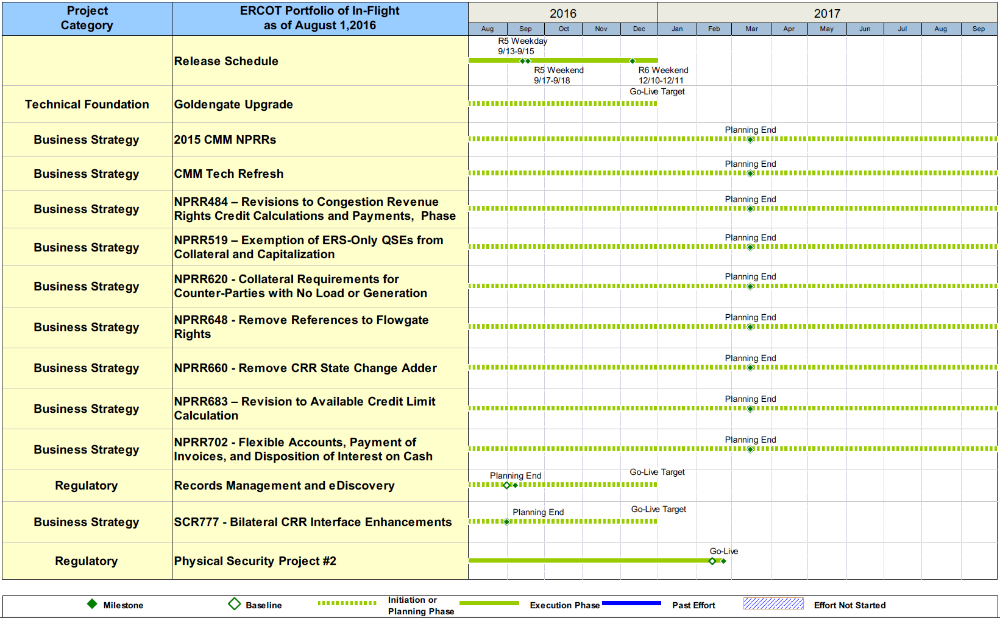
Project Portfolio Status – as of 7/31/2016

Slide 13
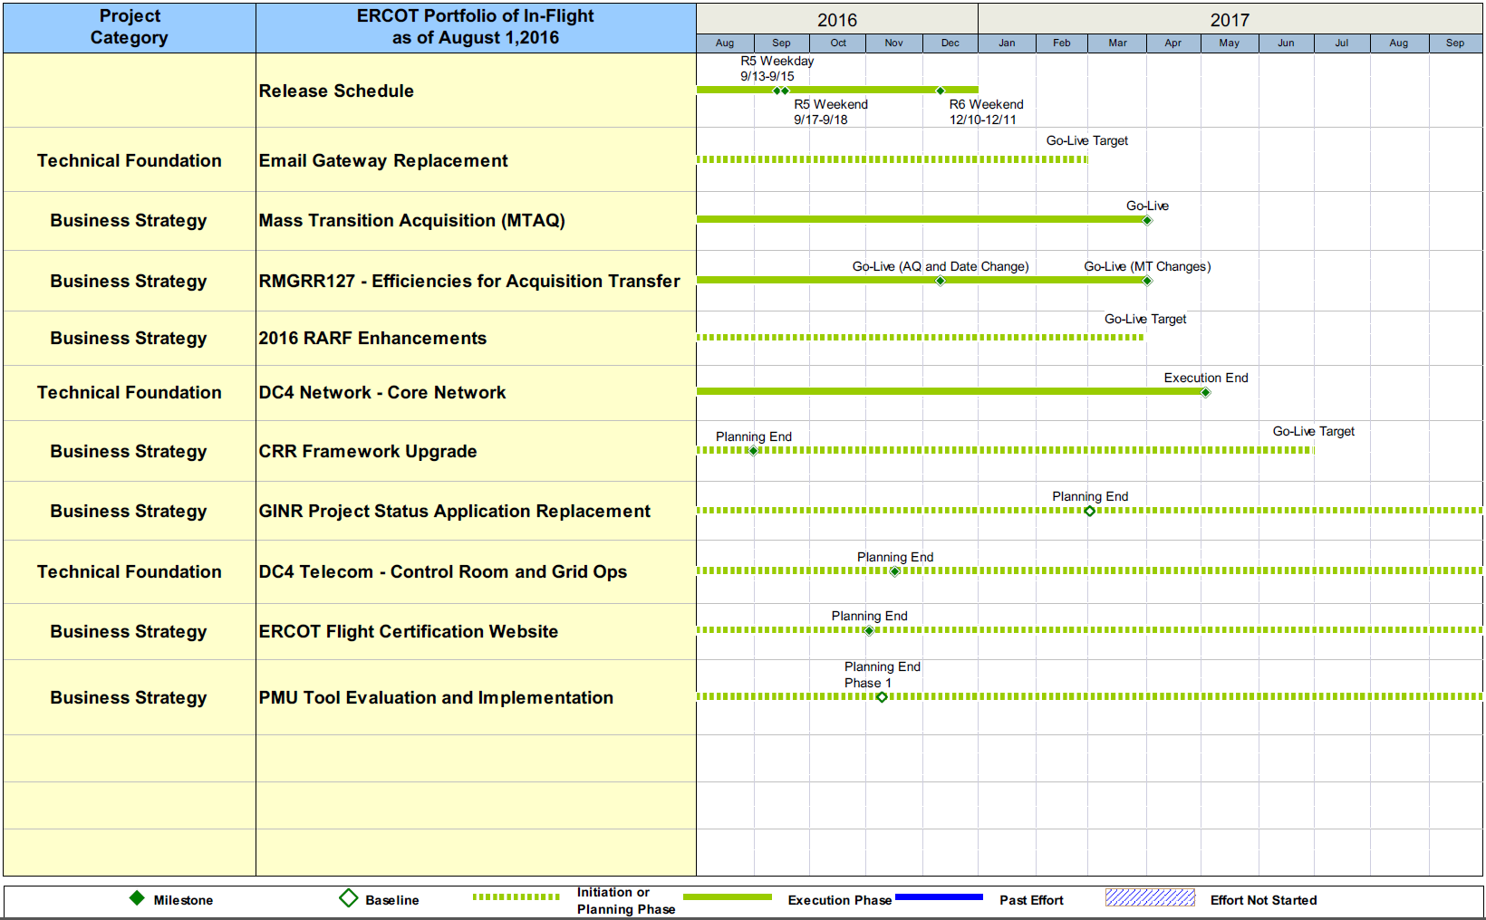
Project Portfolio Status – as of 7/31/2016

Slide 14
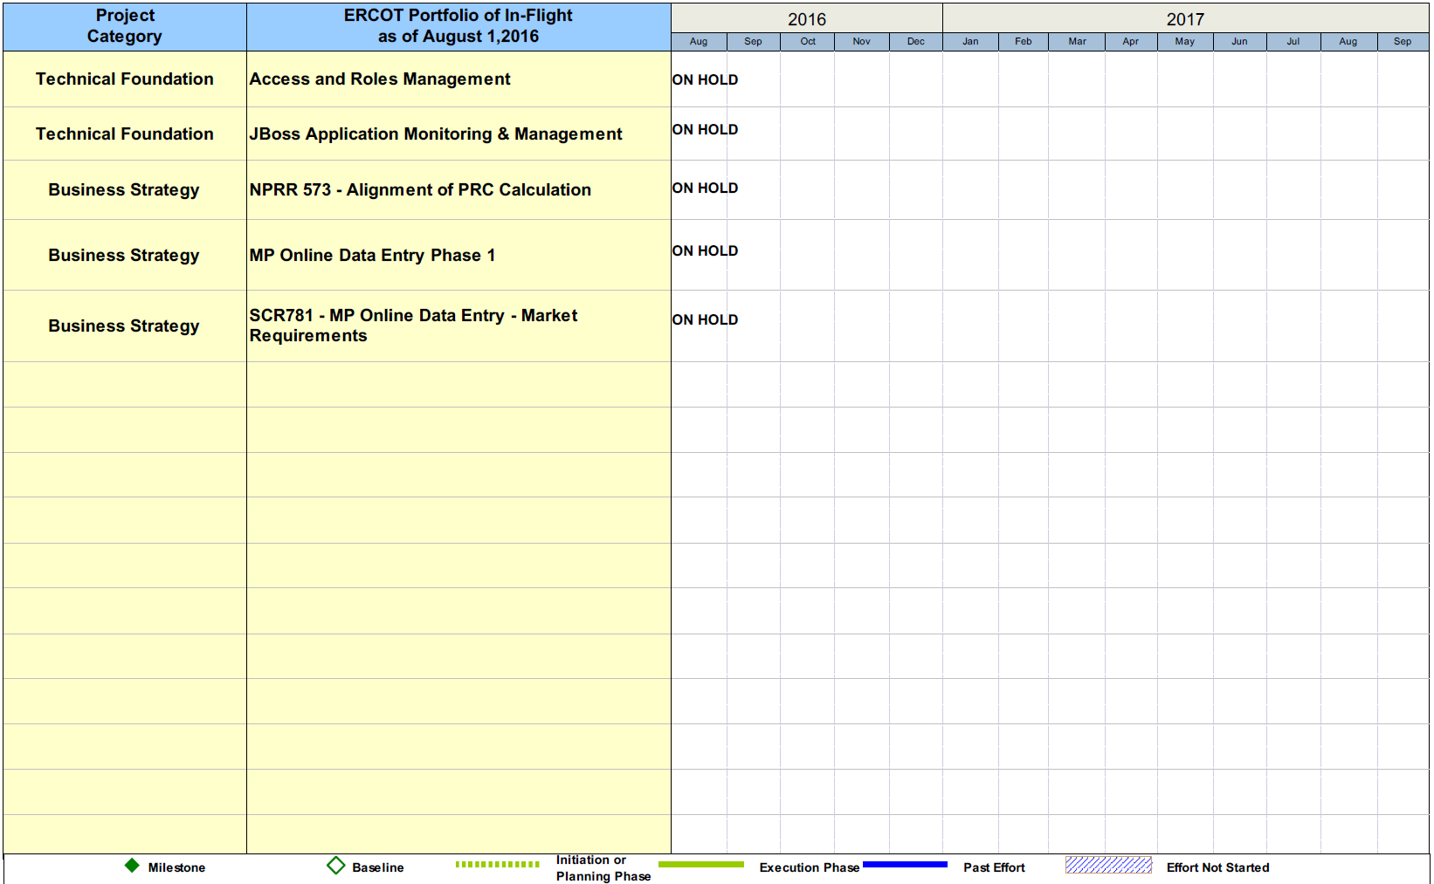
Project Portfolio Status – as of 7/31/2016

Slide 15
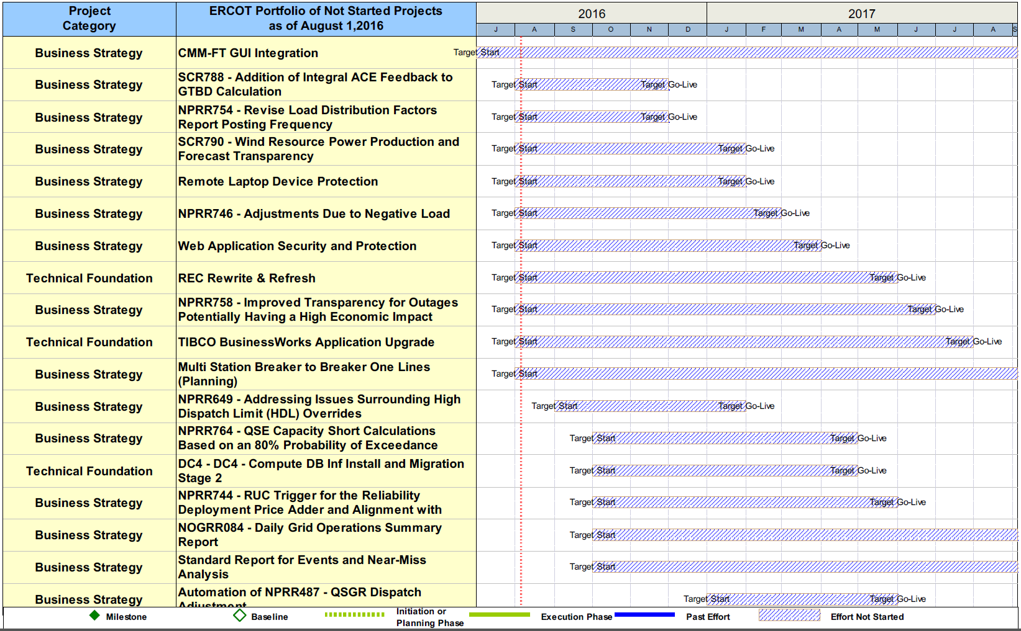
Project Portfolio Status – as of 7/31/2016

Slide 16
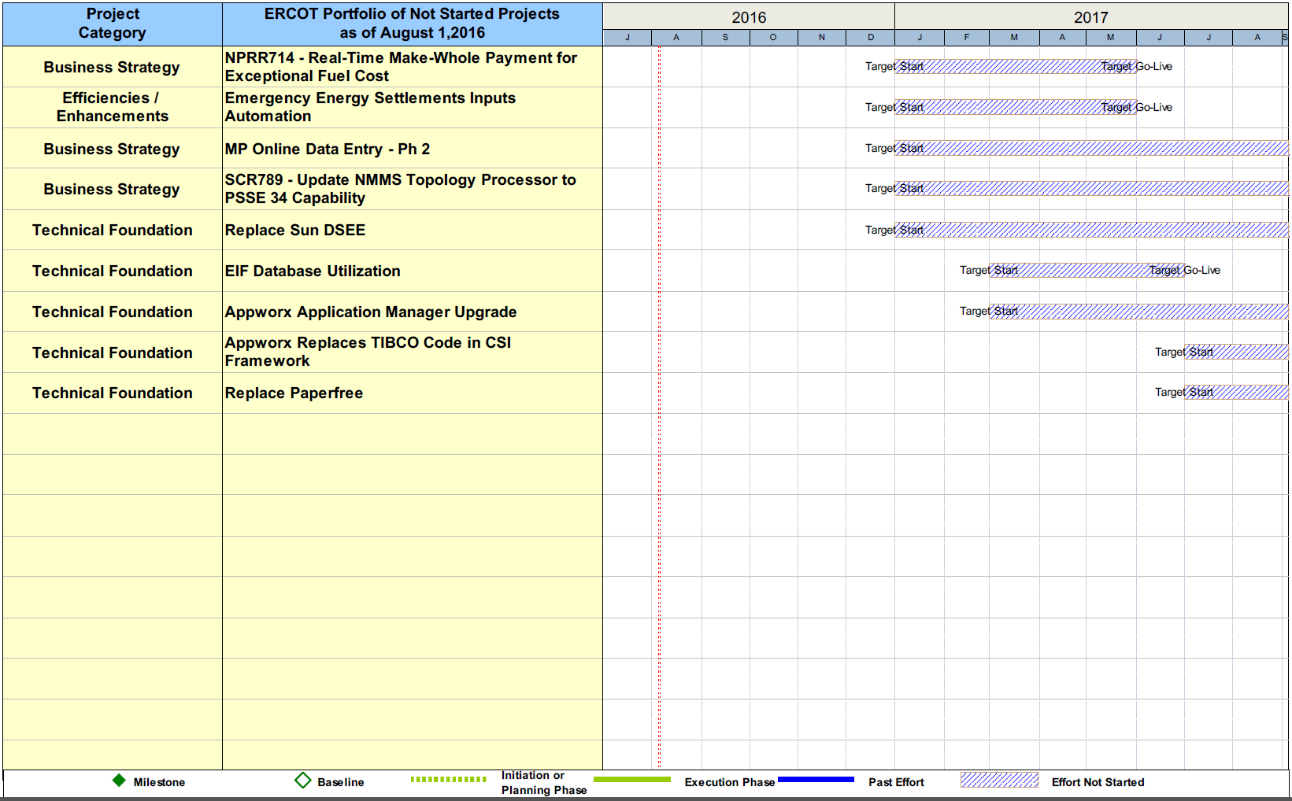
Project Portfolio Status – as of 7/31/2016

