Slide 1
PDCWG Report to ROS
Chair: Percy Galliguez, Brazos Electric Power Cooperative, Inc.
Vice Chair: Stewart Rake, Luminant
ROS
August 4th, 2016

Slide 2
Report Overview & Notes
Report Overview
  Meeting Minutes
  BAL-001-TRE-1 FMEs & IMFR
    4 FMEs in the month of July
    BAL-001-TRE-1 Unit Performance Report now includes Solar resources.
  Frequency Control Report

Slide 3
Meeting Minutes
PDCWG Meeting 7/13/16
  Regulation & Frequency Control Reports
  GREDP Performance Analysis
  MOD-026-1 & MOD-027-1 Discussion
  Reviewed 2 FME’s
    06/06/2016 16:21:42
      Loss of 517 MW
      820 MW/0.1HZ Response
    06/19/2016 18:14:33
      Loss of 669 MW
      857 MW/0.1HZ Response

Slide 4
Frequency Measurable Events Performance
July 2016

Slide 5
Frequency Measurable Events
There were 4 FMEs in July.
  7/10/2016 18:54:24
    Loss of 1,376 MW
    Interconnection Frequency Response: 1,678 MW/0.1 Hz
    6 of 44 Generation Resources had less than 75% of their expected Initial Primary Frequency Response.
    6 of 44 Generation Resources had less than 75% of their expected Sustained Primary Frequency Response.
  7/13/2016 13:30:02
    Loss of 722 MW
    Interconnection Frequency Response: 976 MW/0.1 Hz
    10 of 49 Generation Resources had less than 75% of their expected Initial Primary Frequency Response.
    10 of 49 Generation Resources had less than 75% of their expected Sustained Primary Frequency Response.

Slide 6
Frequency Measurable Events
  7/14/2016 15:50:53
    Loss of 581 MW
    Interconnection Frequency Response: 764 MW/0.1 Hz
    5 of 42 Generation Resources had less than 75% of their expected Initial Primary Frequency Response.
    4 of 42 Generation Resources had less than 75% of their expected Sustained Primary Frequency Response.
  7/21/2016 14:53:26
    Loss of 703 MW
    Interconnection Frequency Response: 651 MW/0.1 Hz
    13 of 50 Generation Resources had less than 75% of their expected Initial Primary Frequency Response.
    19 of 50 Generation Resources had less than 75% of their expected Sustained Primary Frequency Response.

Slide 7
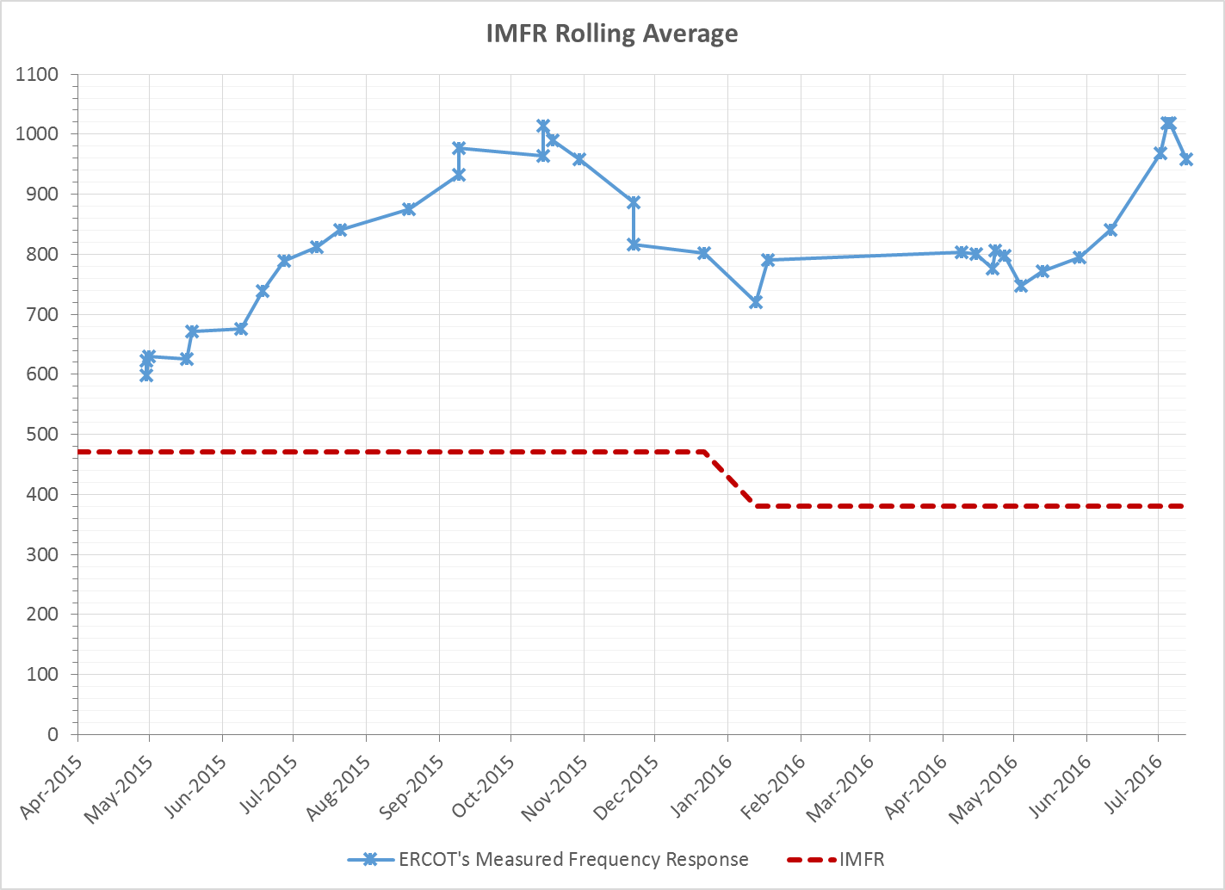
Interconnection Minimum Frequency Response (IMFR) Performance
IMFR Performance currently 957.82 MW/0.1Hz

Slide 8
Frequency Control Report
January 2016

Slide 9
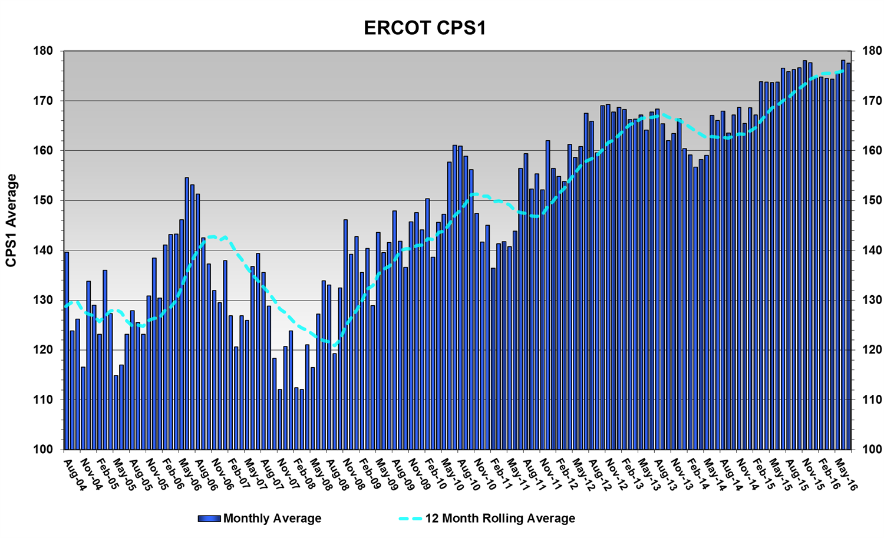
CPS1 Performance
CPS1 12 Month Rolling Average = 176.18%

Slide 10
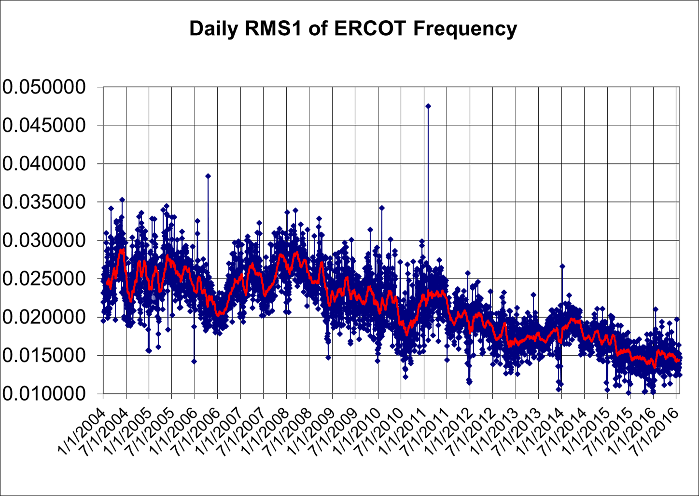
RMS1 Performance of ERCOT Frequency

Slide 11
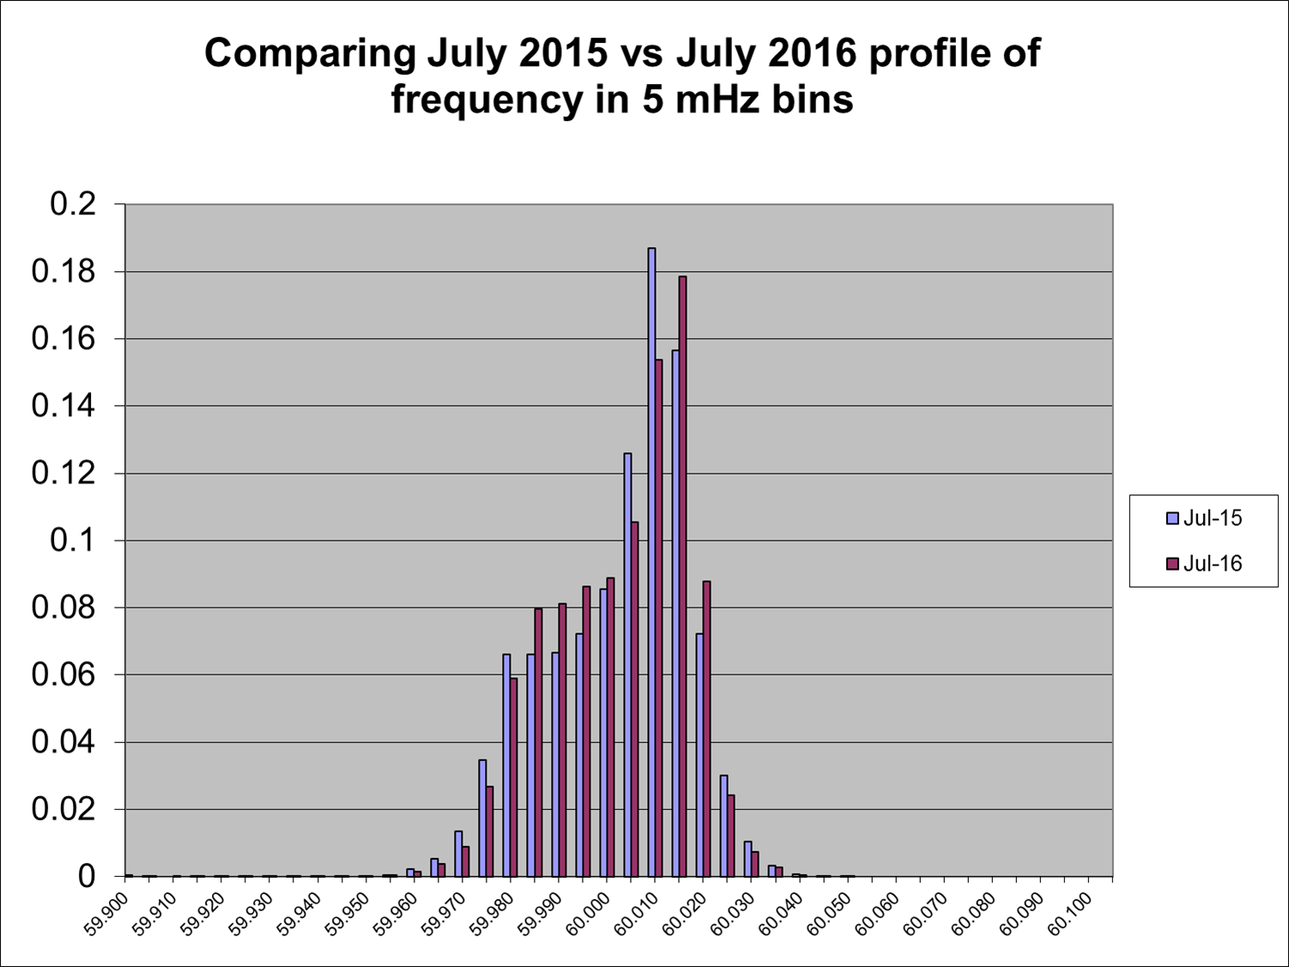
Frequency Profile Analysis
Year | Low Side (<60Hz) | High Side (>60Hz)
2015 | 173.82 | 178.47
2016 | 174.69 | 181.12
Year | Mean | Standard Deviation
2015 | 60.000032 | 0.015826
2016 | 60.00004 | 0.015525

Slide 12
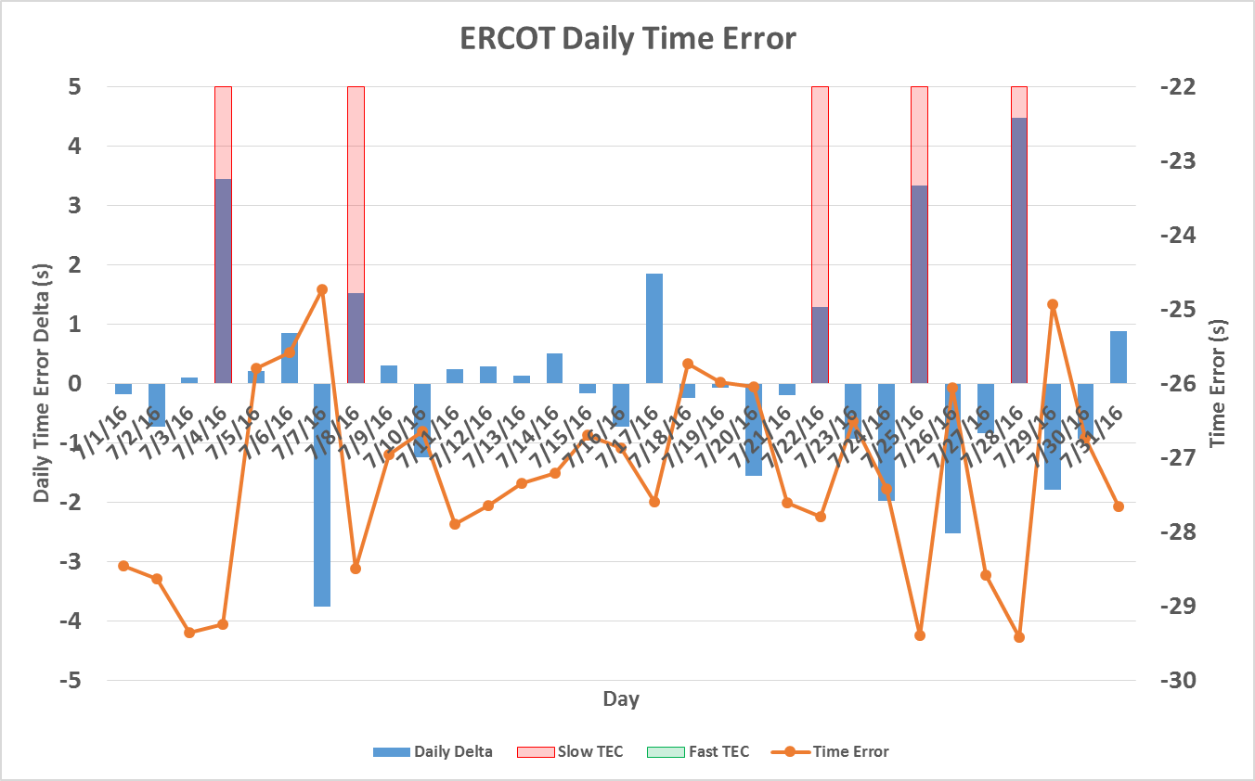
Time Error Corrections
There were 5 Time Error Corrections (TEC) in July.

Slide 13
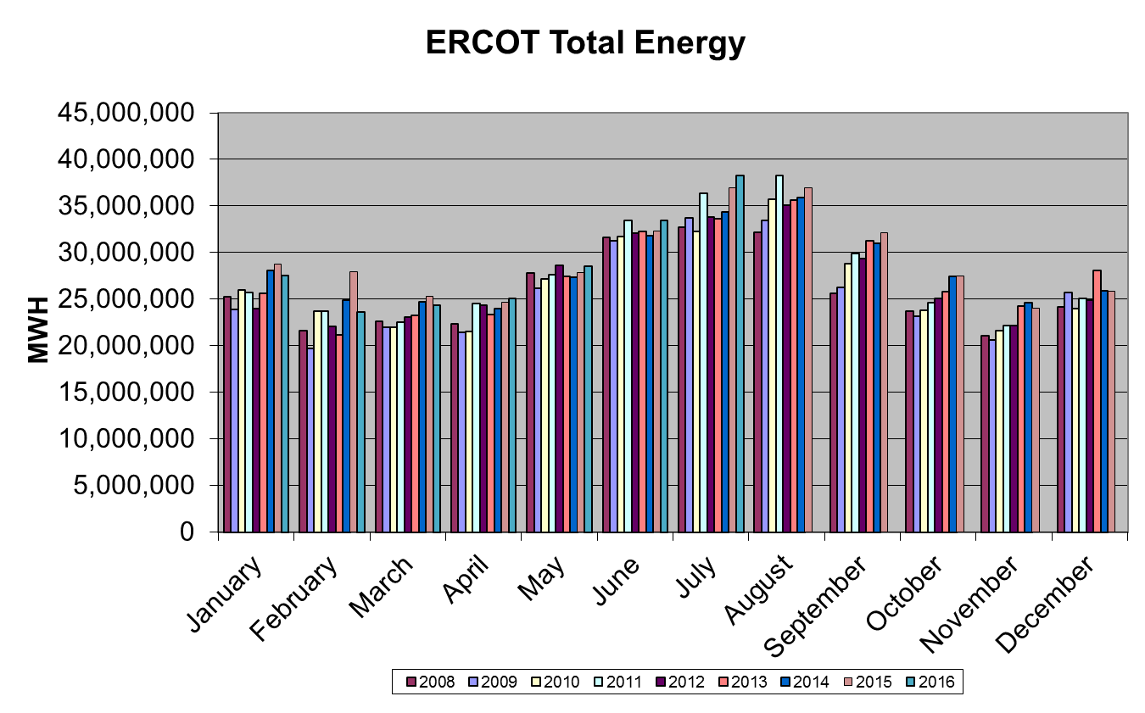
Wind Generation Performance

Slide 14
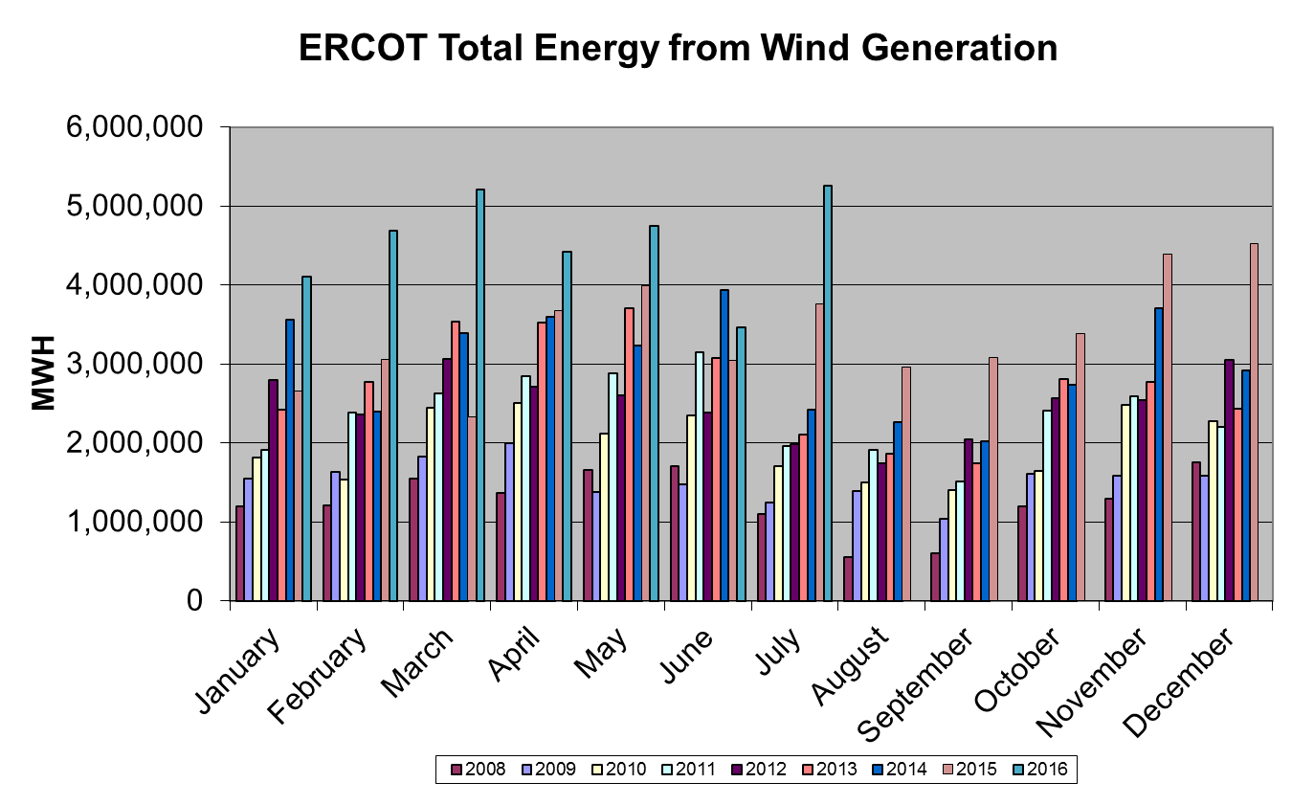
Wind Generation Performance

Slide 15
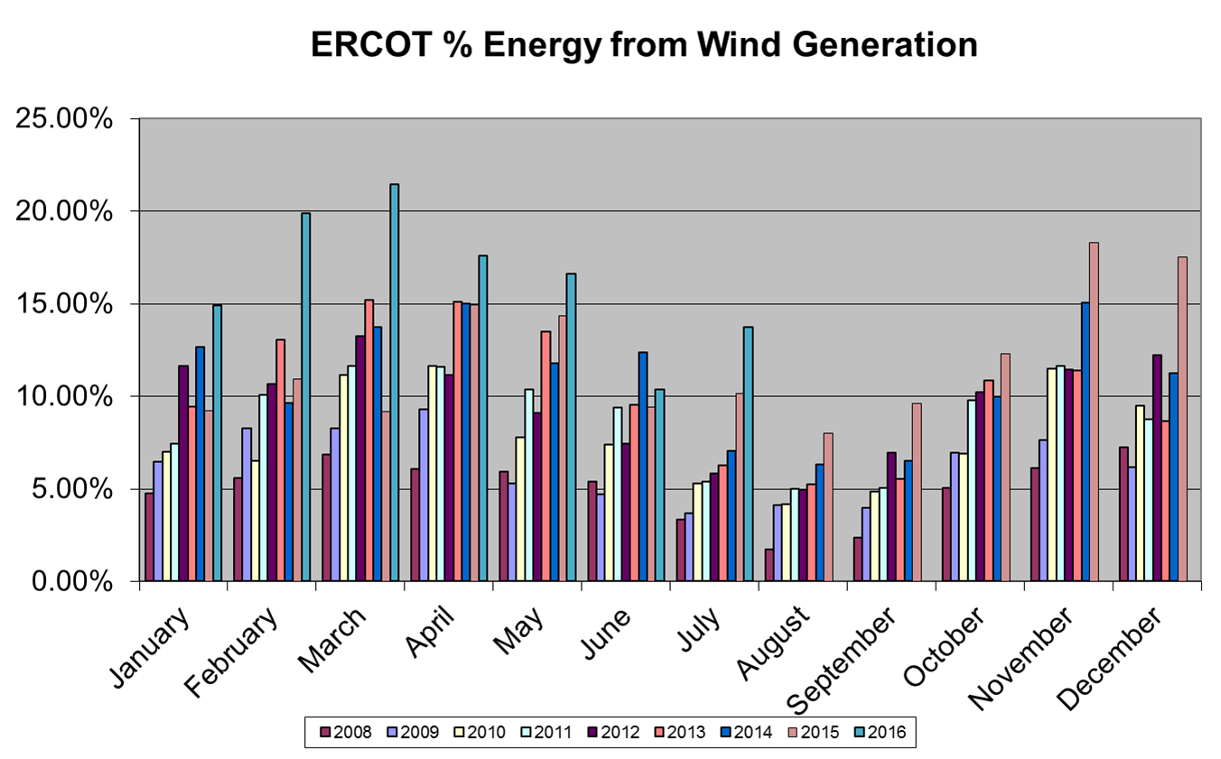
Wind Generation Performance

Slide 16
Questions?

