Slide 1
ERCOT 90th
percentile load forecast
Calvin Opheim
Manager, Load Forecasting & Analysis
PLWG
July 20, 2016

Slide 2
Outline of Today’s Presentation
Process for creating ERCOT’s 90th percentile forecast
Model accuracy - looking back at the 2015 summer peak
Comparison of SSWG and ERCOT 90th percentile forecasts
2017 summer peak forecast comparison
Questions

Slide 3
ERCOT’s
90th Percentile Forecast

Slide 4
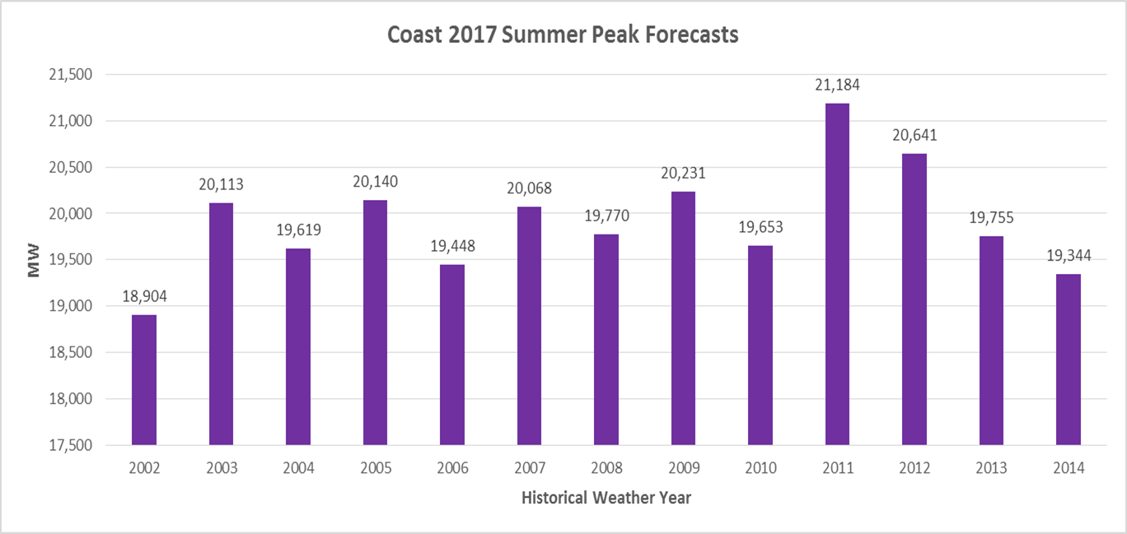
90th Percentile (90/10) Forecast
Performed at the Weather Zone Level
Historical weather from calendar years 2002 – 2014 is used as input into each hourly weather zone forecast model

Slide 5
90th Percentile (90/10) Forecast
Performed at the Weather Zone Level
Forecasted values are sorted from high to low for each year
The sorted values are used to calculate the 90th percentile (and average) by rank
Example:
Below are the top 5 peak values for Coast for 2017

Slide 6
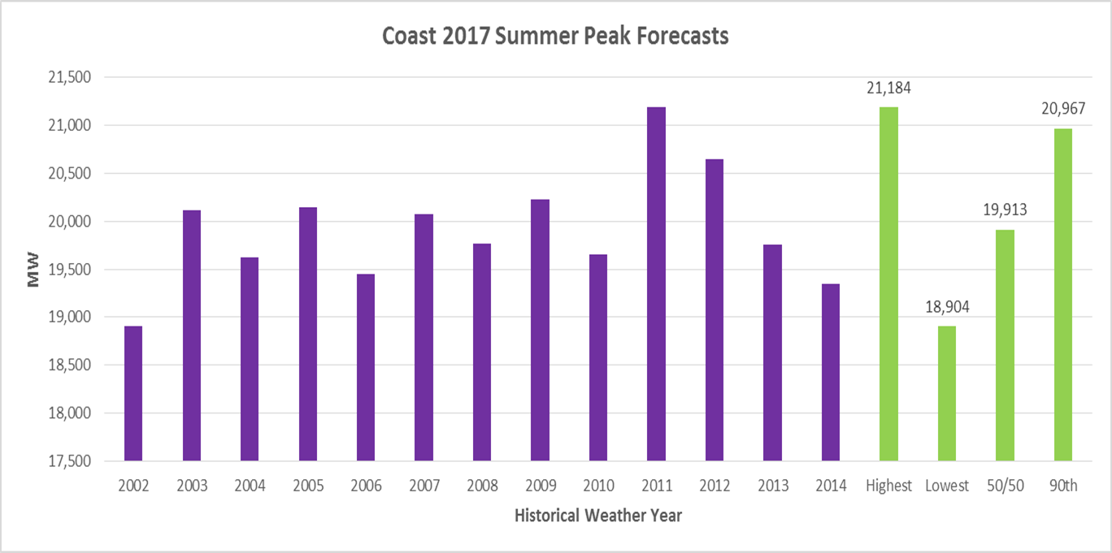
90th Percentile (90/10) Forecast
Performed at the Weather Zone Level

Slide 7
90th Percentile (90/10) Forecast
Performed at the Weather Zone Level
This process is completed for every weather zone, for each forecasted year (2016 – 2025)
ERCOT (90/10) Forecast
After the weather zone (90/10) hourly load forecasts are completed, the results are mapped into a representative historical calendar by rank
The 2003 calendar was selected (as has been our convention in the past)

Slide 8
Model Accuracy
2015 Summer Peak

Slide 9
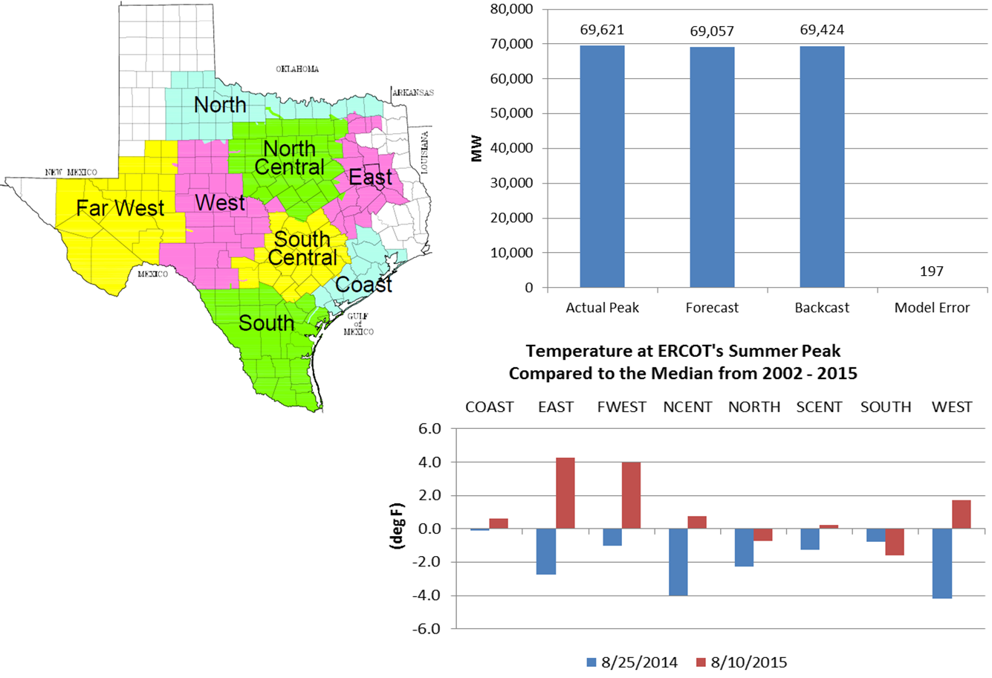
Weather Zones

Slide 10
Comparison of SSWG and ERCOT’s 90th percentile forecasts

Slide 11
Load definitions
ERCOT’s load forecast is based on transmission adjusted load values
Does not include PUN load
Only includes load that ERCOT serves
SSWG’s load forecasts are calculated at the distribution level
Includes PUN load

Slide 12
Caution
The charts that follow show ERCOT’s load forecast values (and actual load values) adjusted by removing transmission losses and adding PUN load.
This is not the typical way that ERCOT reports its load forecast or its actual load.
The listed values will not agree with ERCOT’s published official load forecast documentation.

Slide 13
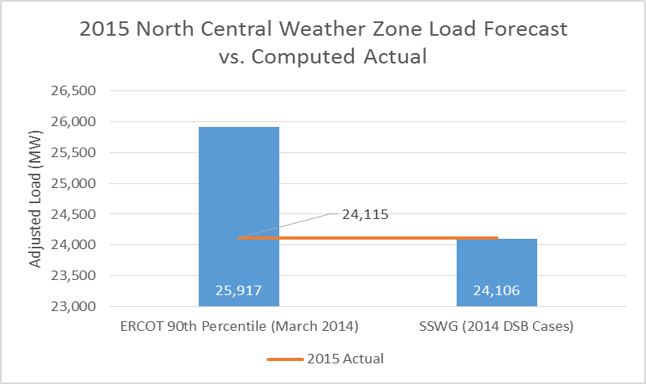
90th Percentile (90/10) Forecast

Slide 14
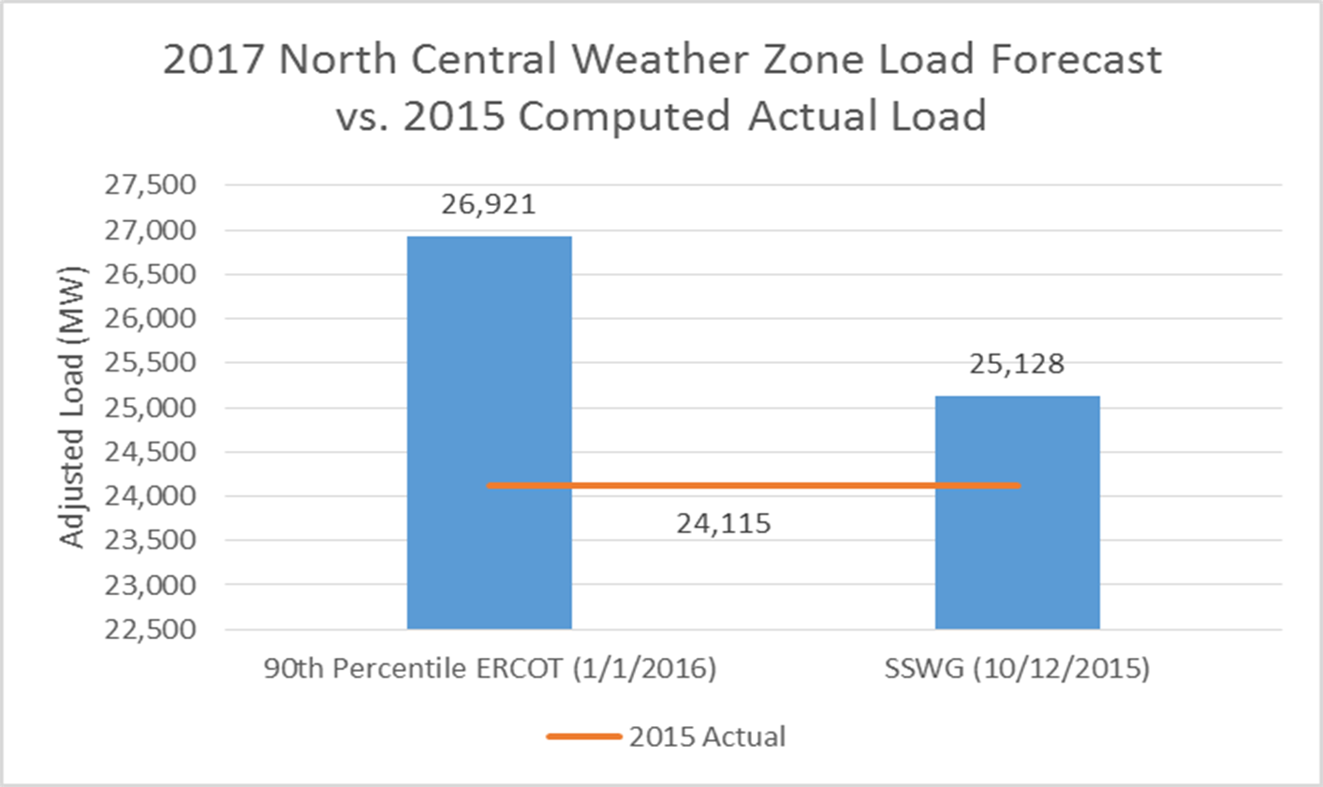
90th Percentile (90/10) Forecast

Slide 15
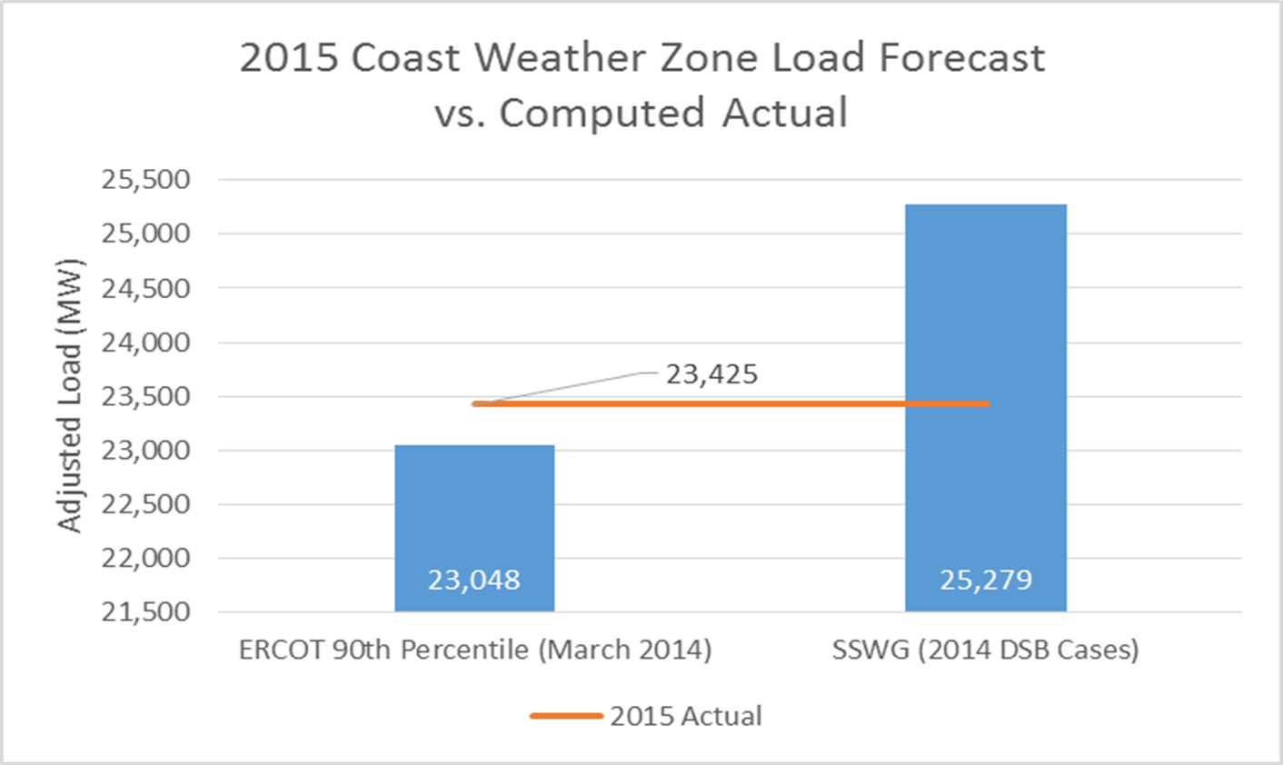
90th Percentile (90/10) Forecast

Slide 16
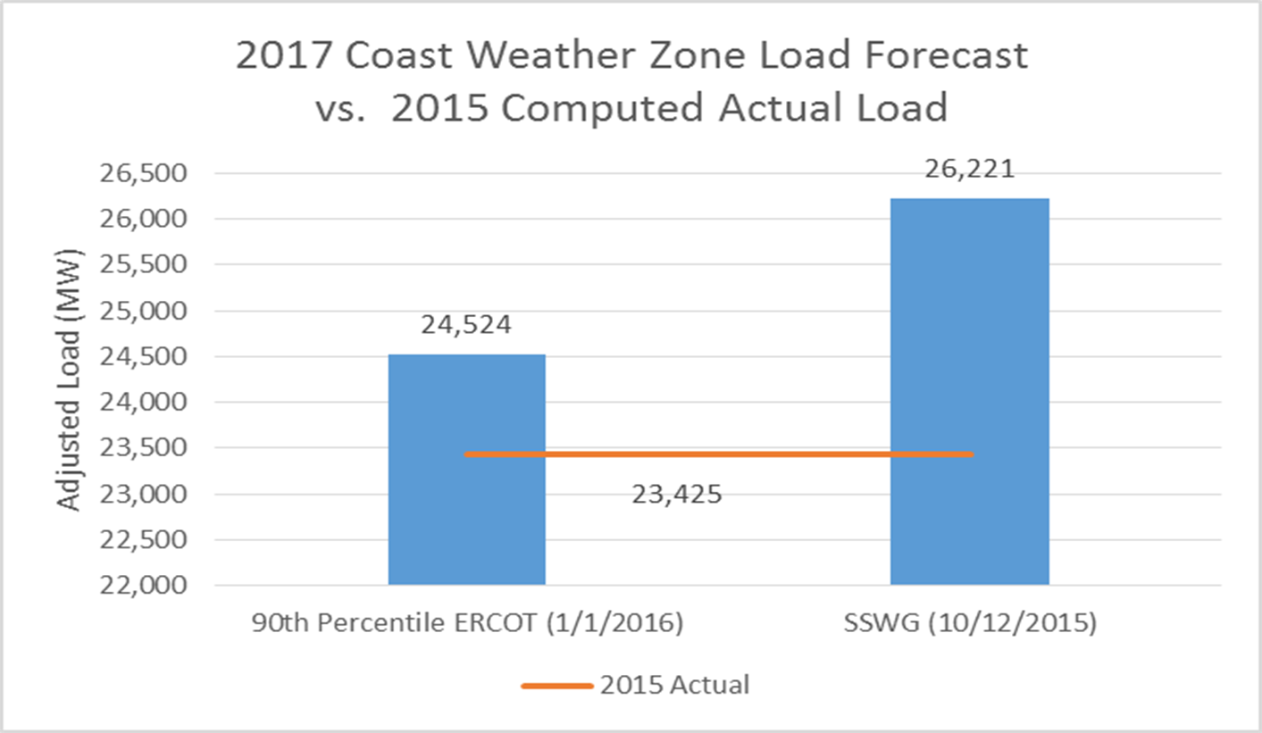
90th Percentile (90/10) Forecast

Slide 17
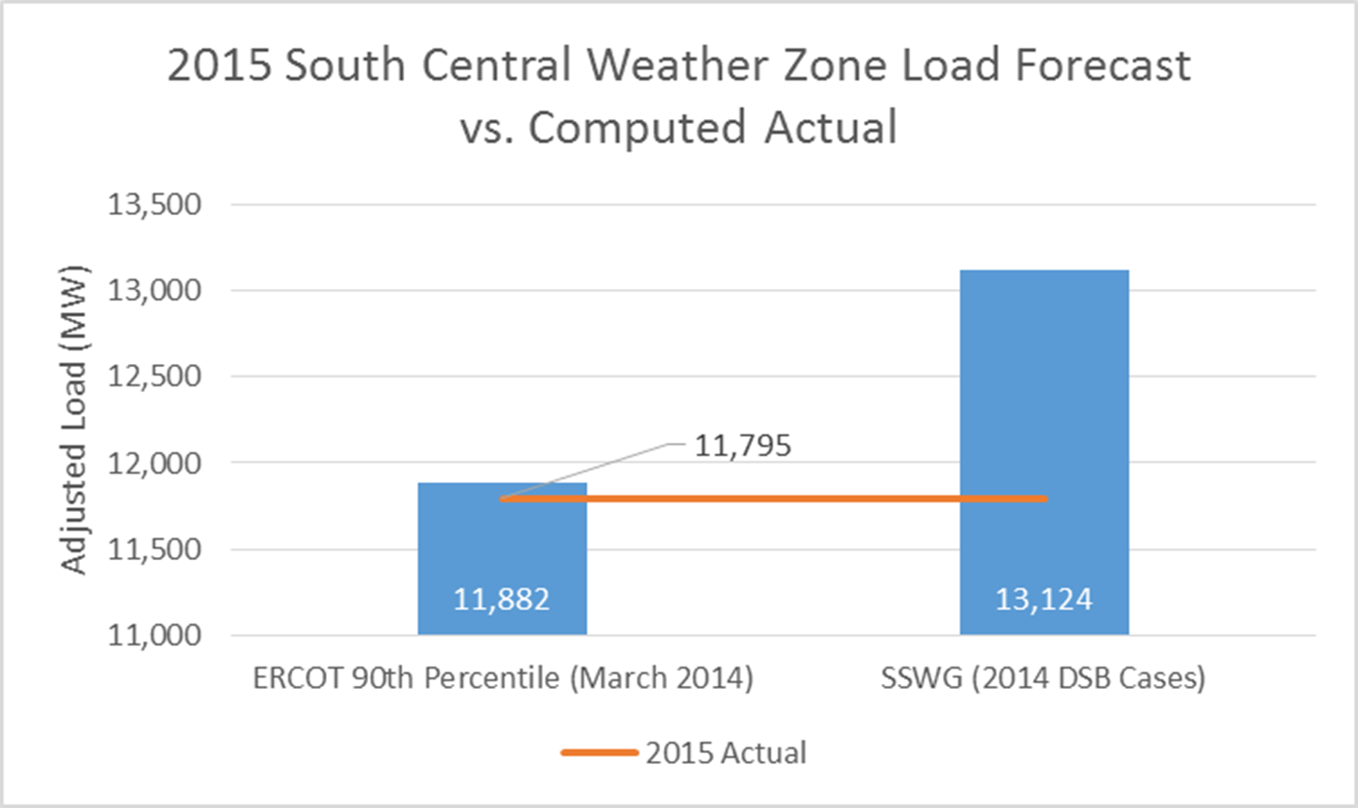
90th Percentile (90/10) Forecast

Slide 18
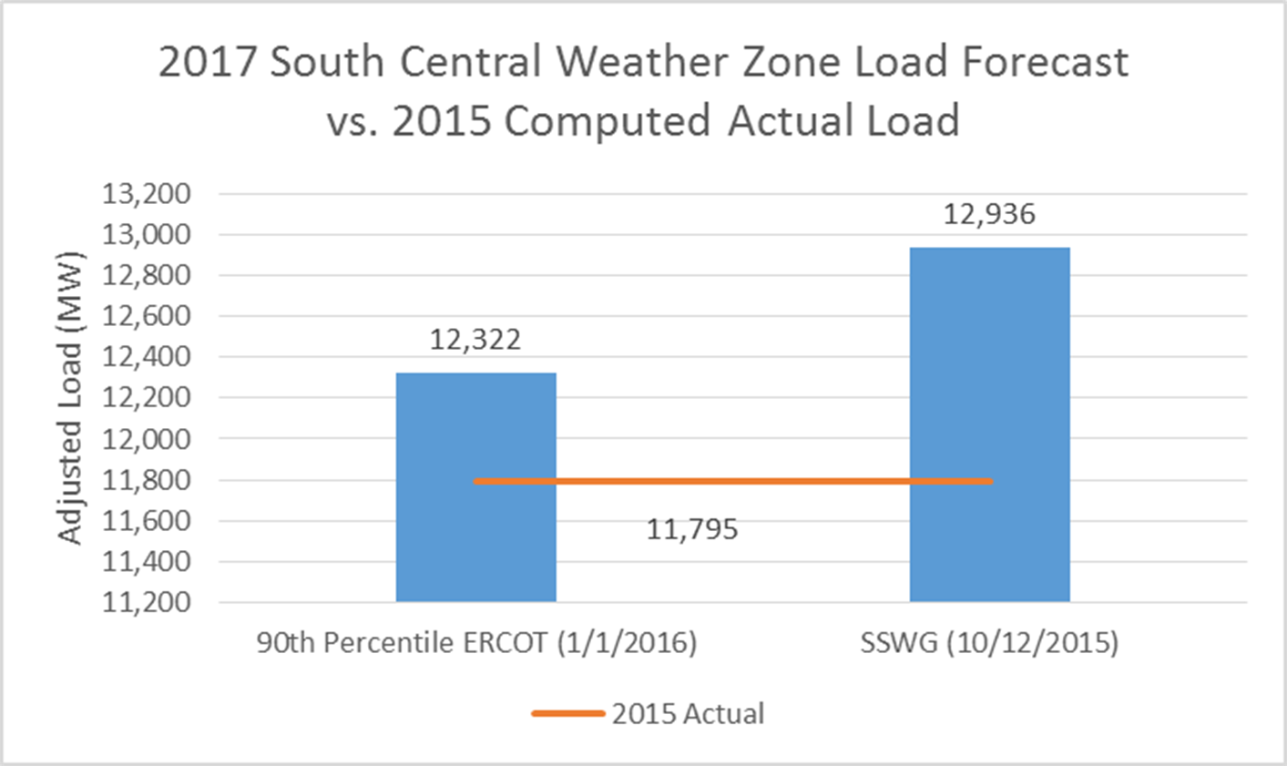
90th Percentile (90/10) Forecast

Slide 19
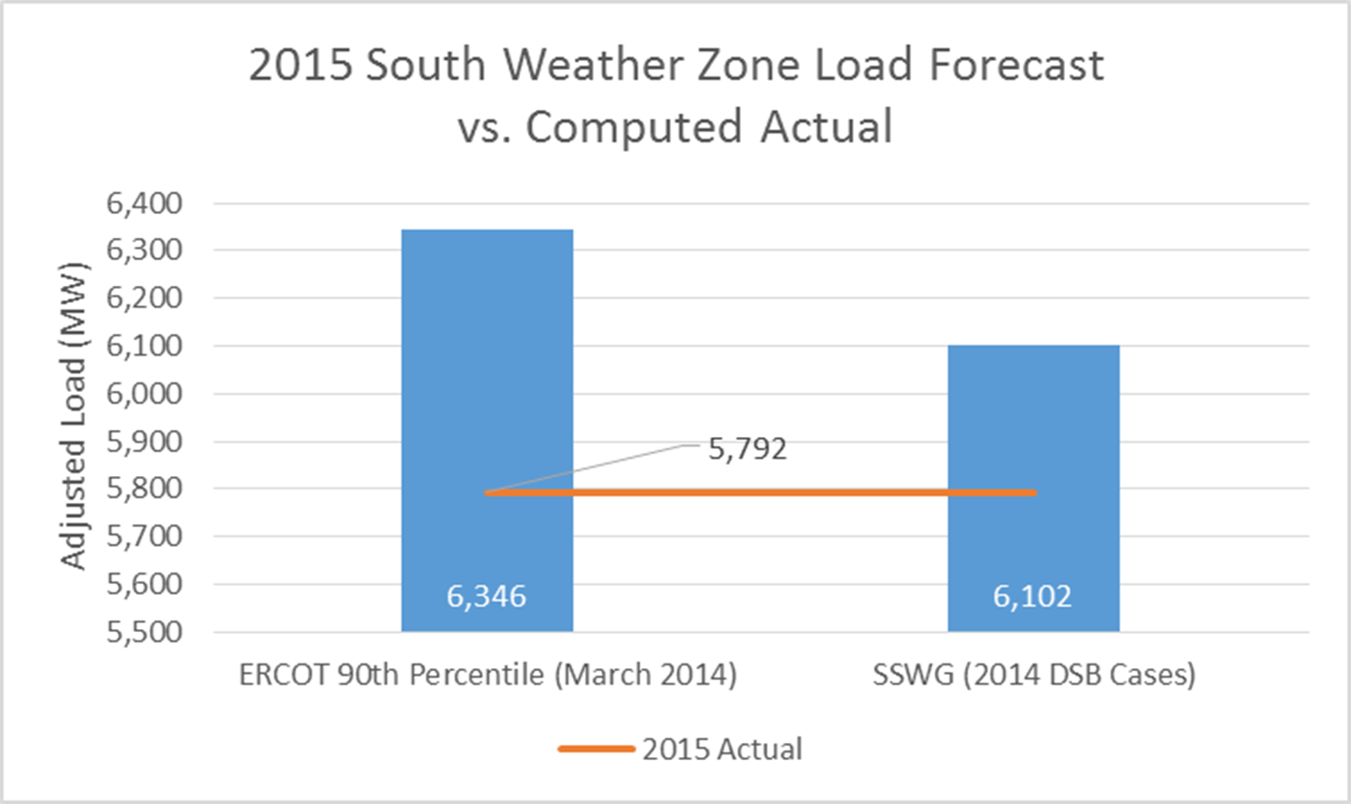
90th Percentile (90/10) Forecast

Slide 20
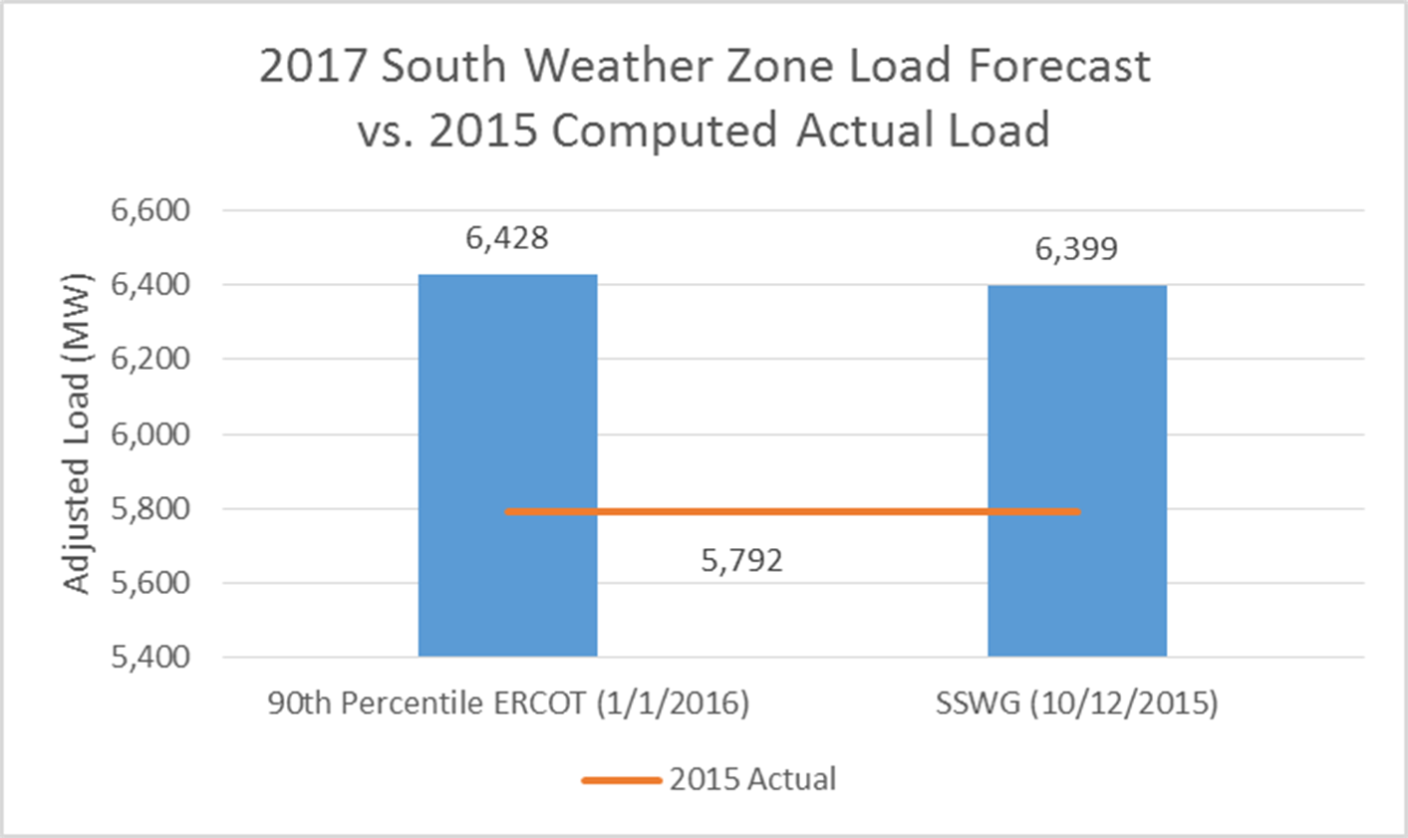
90th Percentile (90/10) Forecast

Slide 21
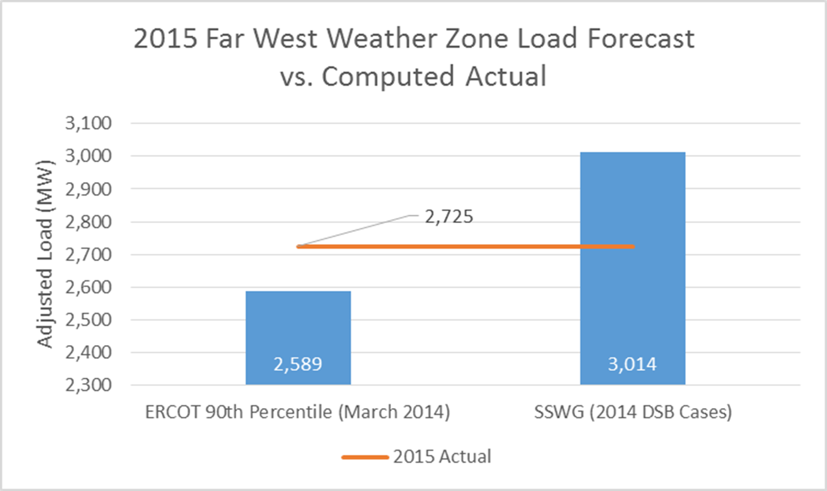
90th Percentile (90/10) Forecast

Slide 22
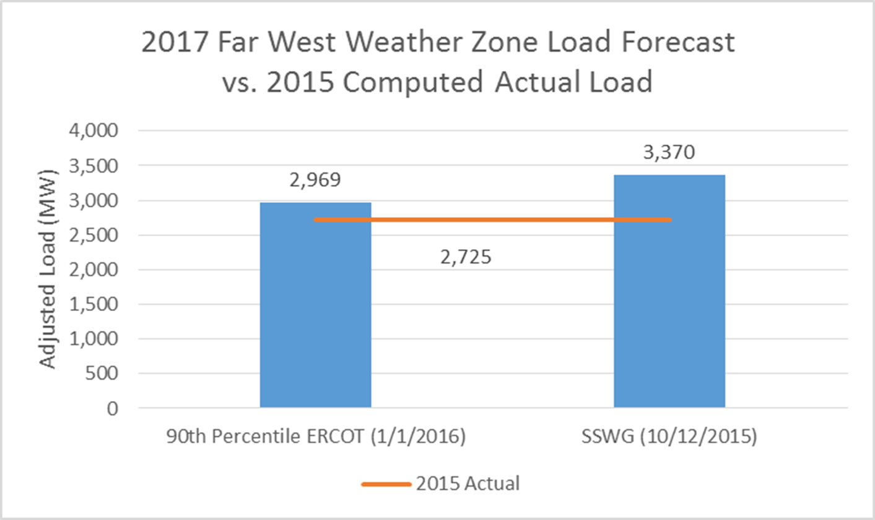
90th Percentile (90/10) Forecast

Slide 23
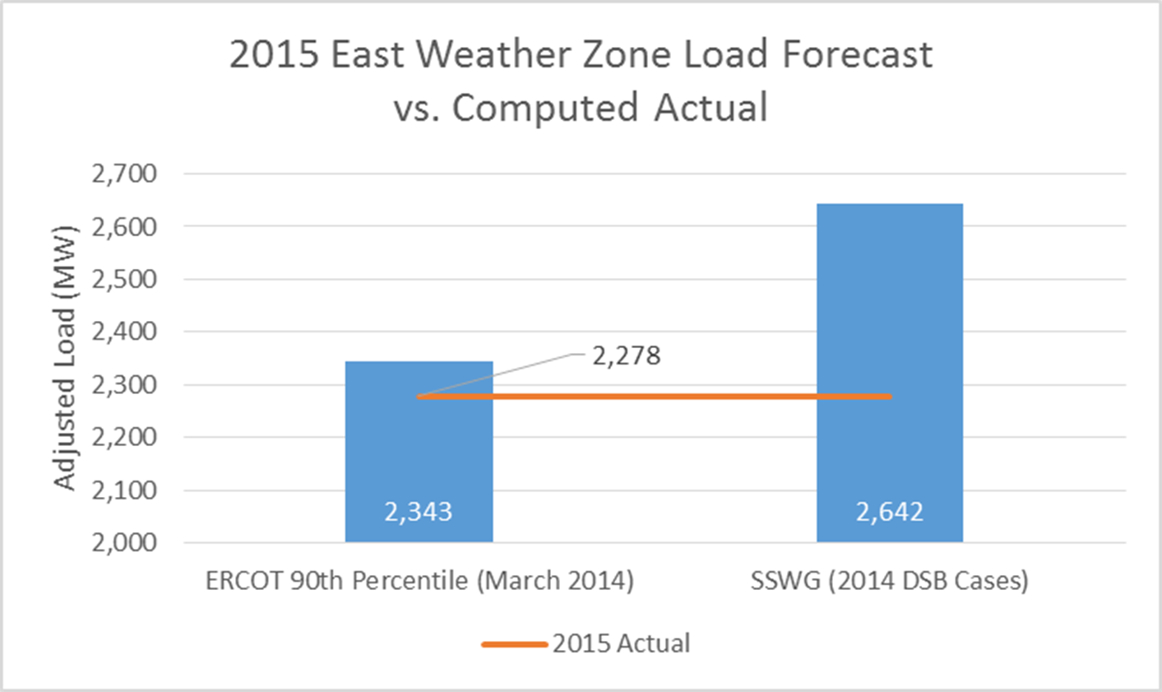
90th Percentile (90/10) Forecast

Slide 24
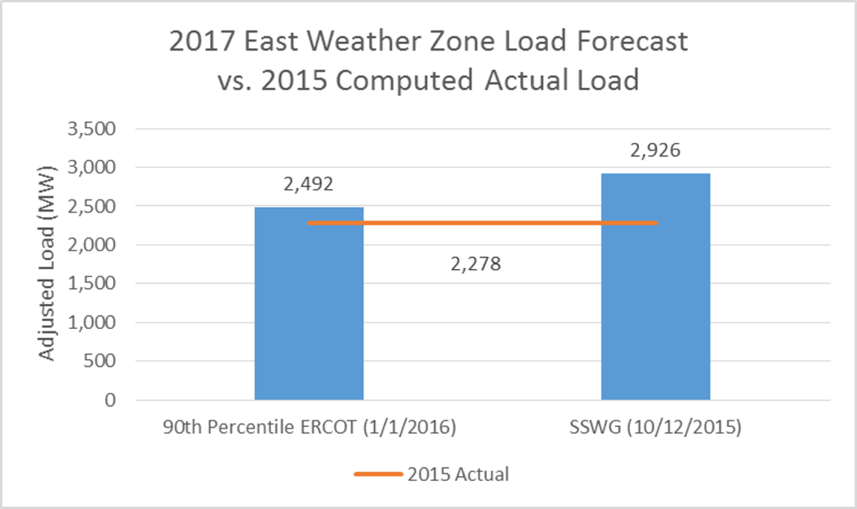
90th Percentile (90/10) Forecast

Slide 25
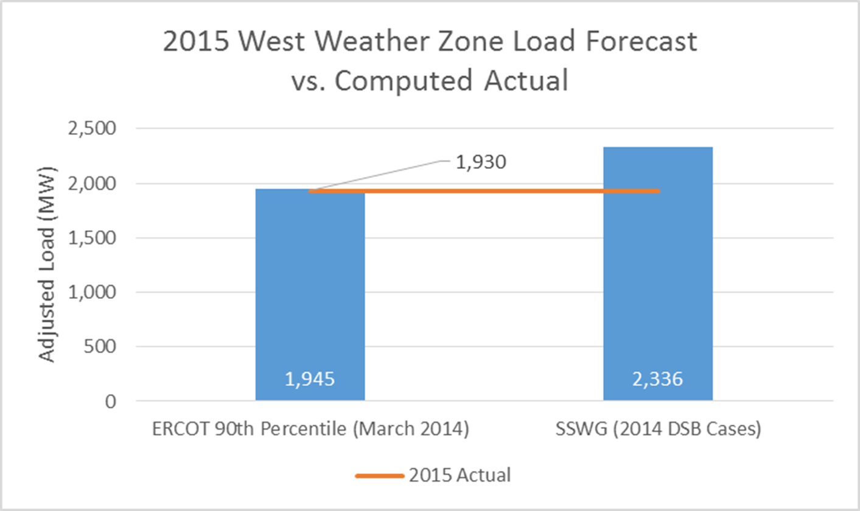
90th Percentile (90/10) Forecast

Slide 26
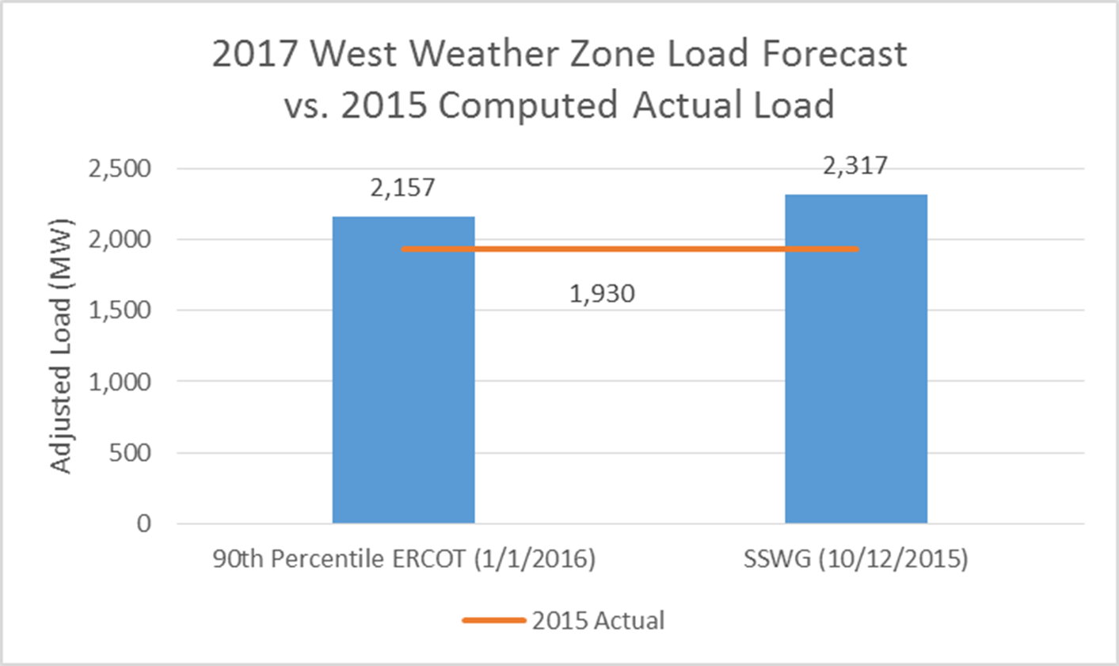
90th Percentile (90/10) Forecast

Slide 27
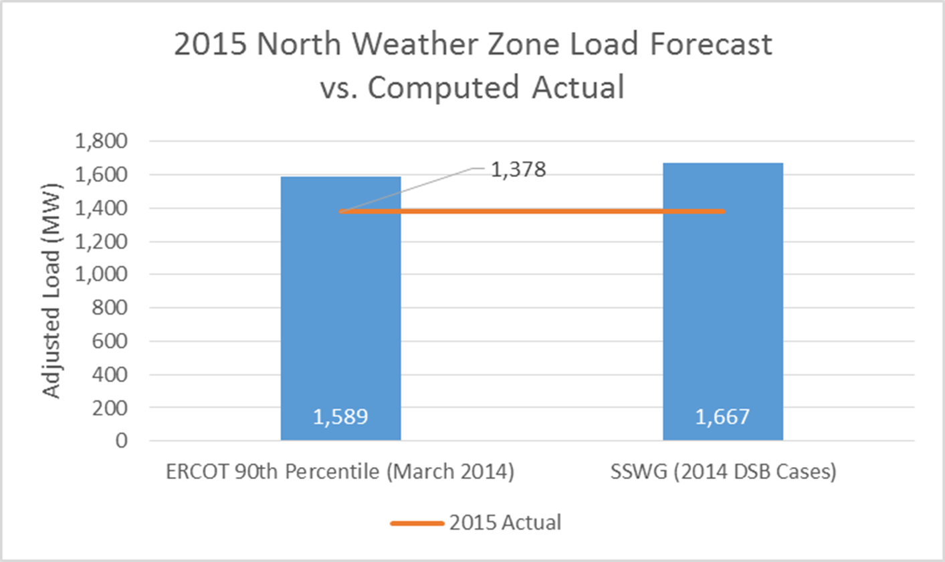
90th Percentile (90/10) Forecast

Slide 28
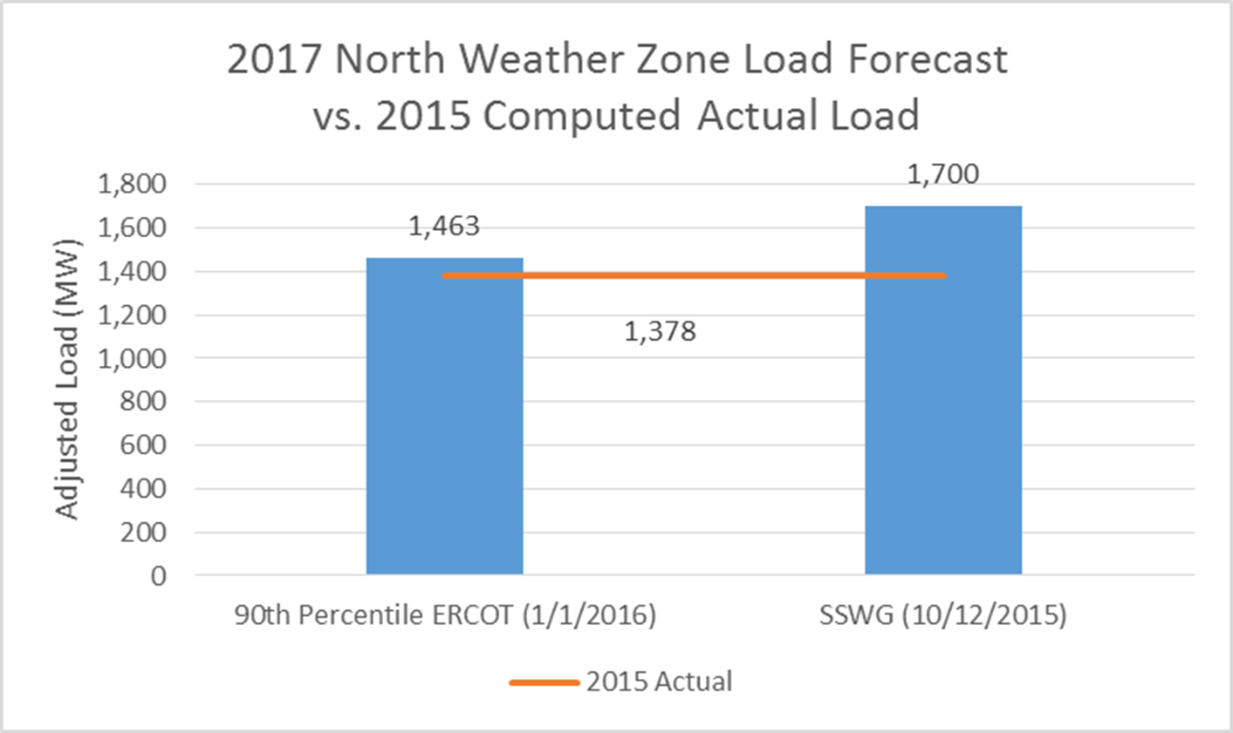
90th Percentile (90/10) Forecast

Slide 29
Questions

Slide 30
Appendix
2015 Weather Data

Slide 31
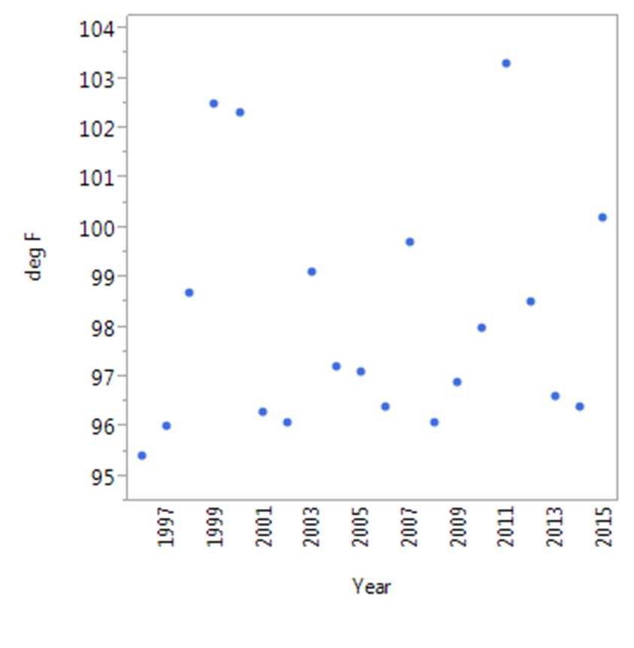
Coast – High Temperature in August

Slide 32
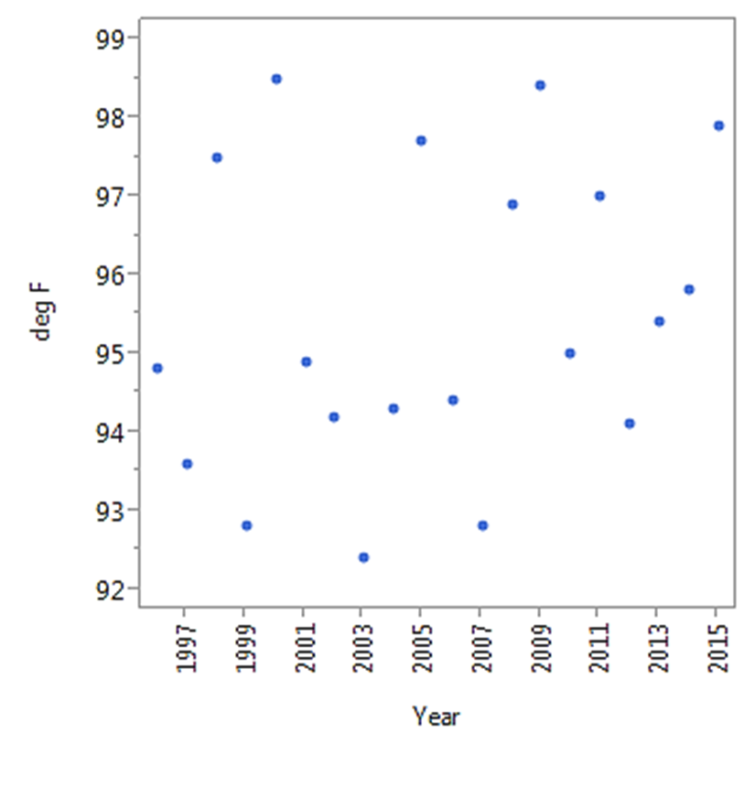
Coast – High Temperature in July

Slide 33
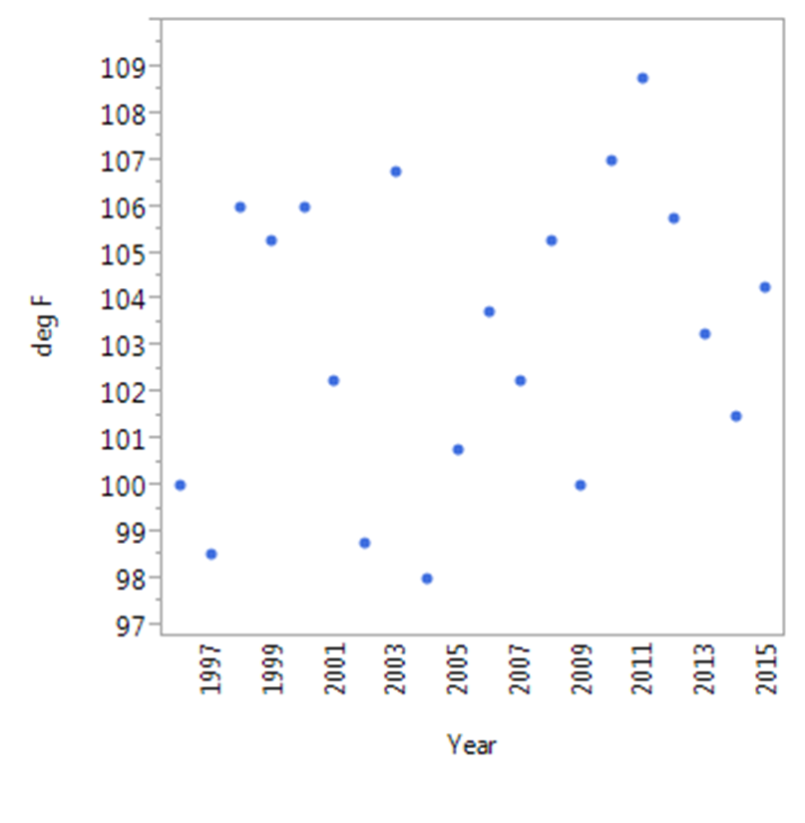
Ncent – High Temperature in August

Slide 34
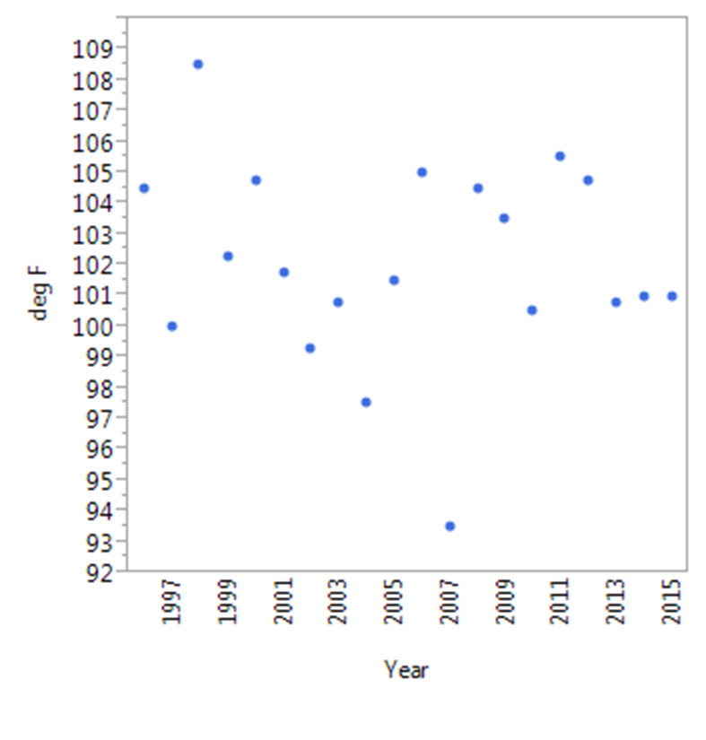
Ncent – High Temperature in July

Slide 35
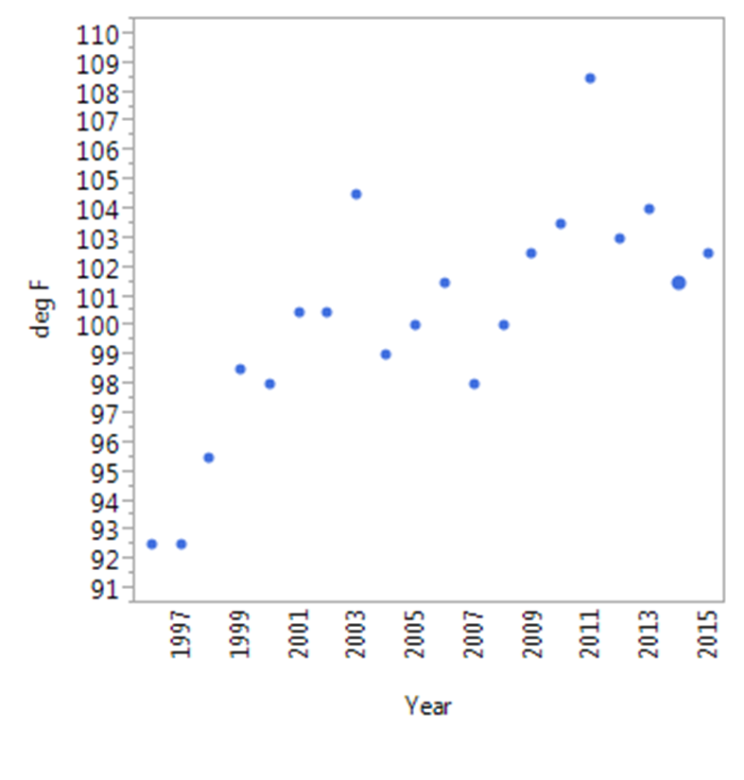
Scent – High Temperature in August

Slide 36
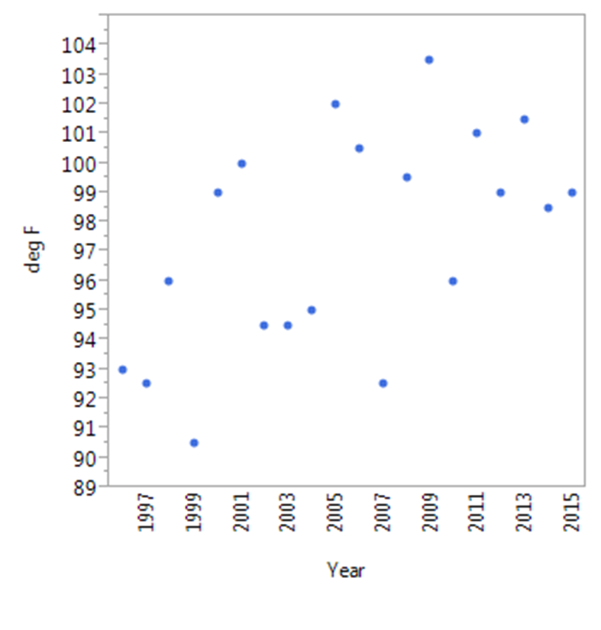
Scent – High Temperature in July

Slide 37
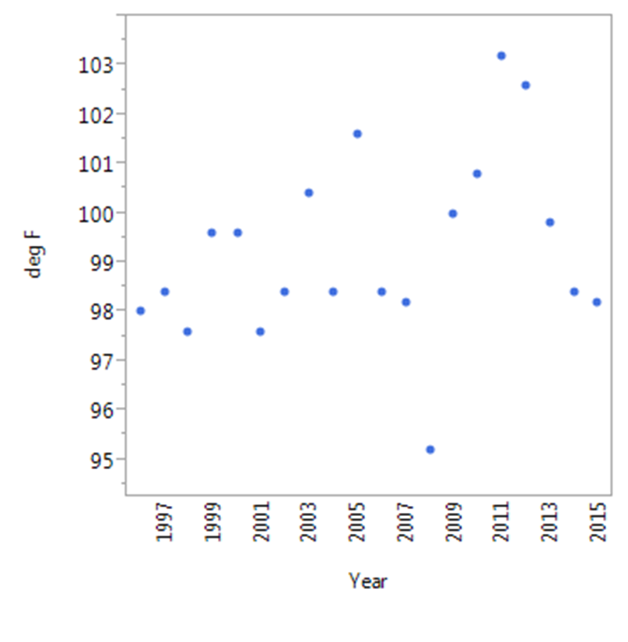
South – High Temperature in August

Slide 38
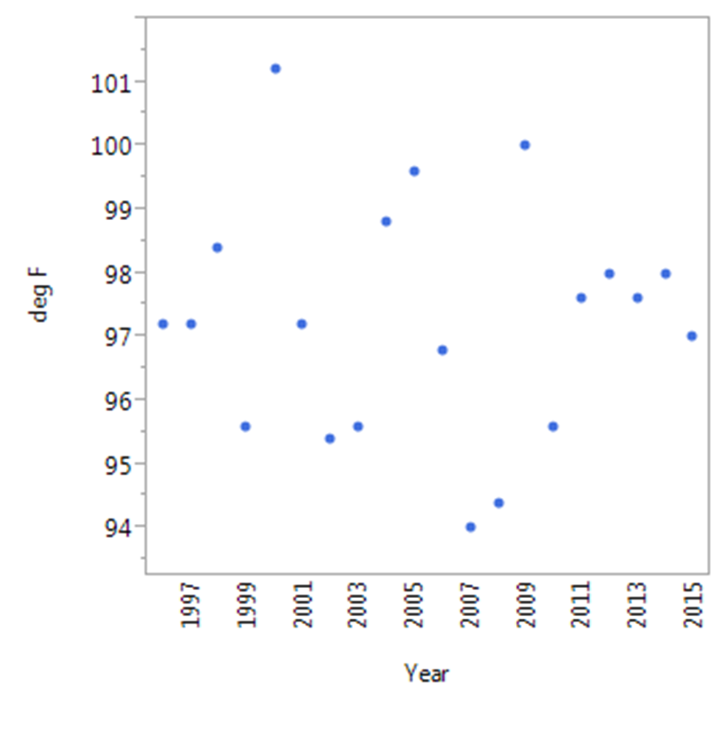
South – High Temperature in July

Slide 39
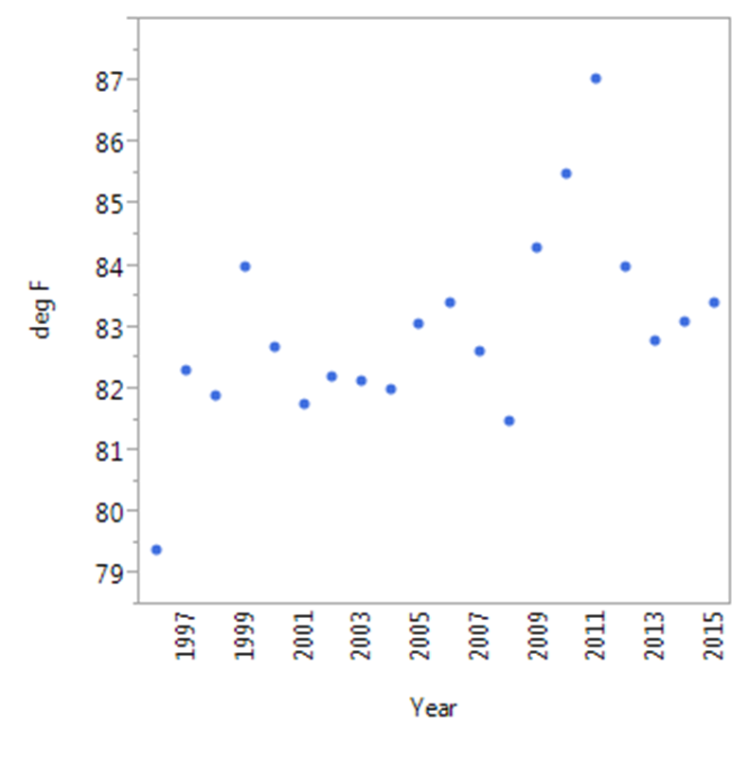
Coast – Median Temperature in August

Slide 40
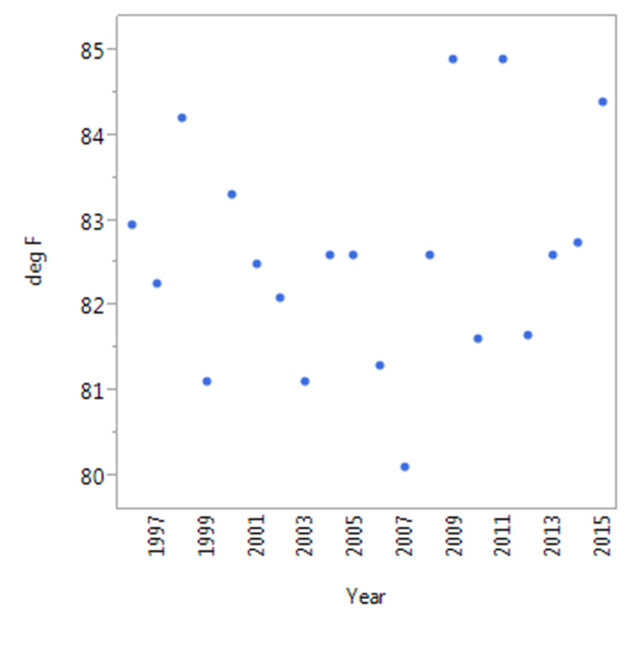
Coast – Median Temperature in July

Slide 41
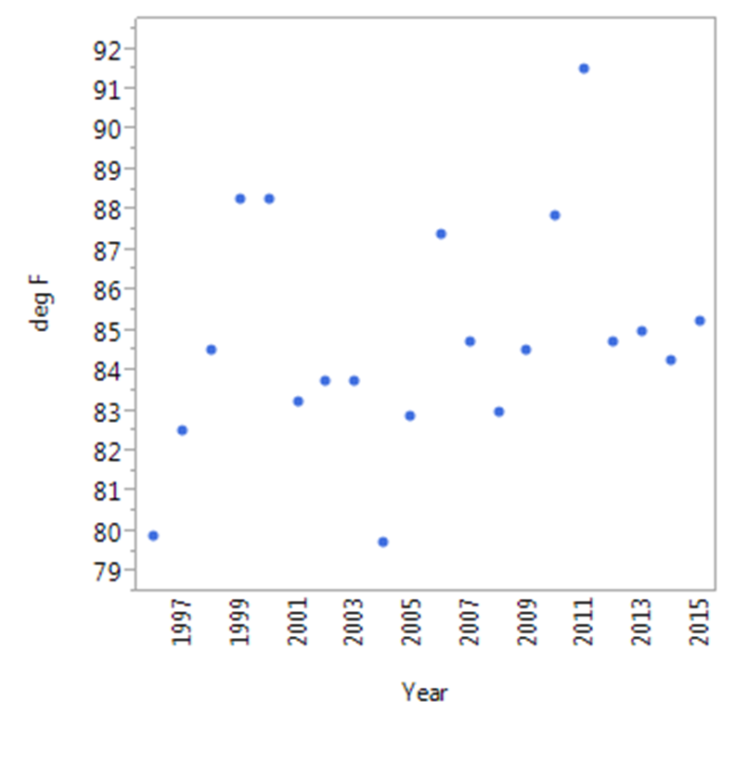
Ncent – Median Temperature in August

Slide 42
Ncent – Median Temperature in July

Slide 43
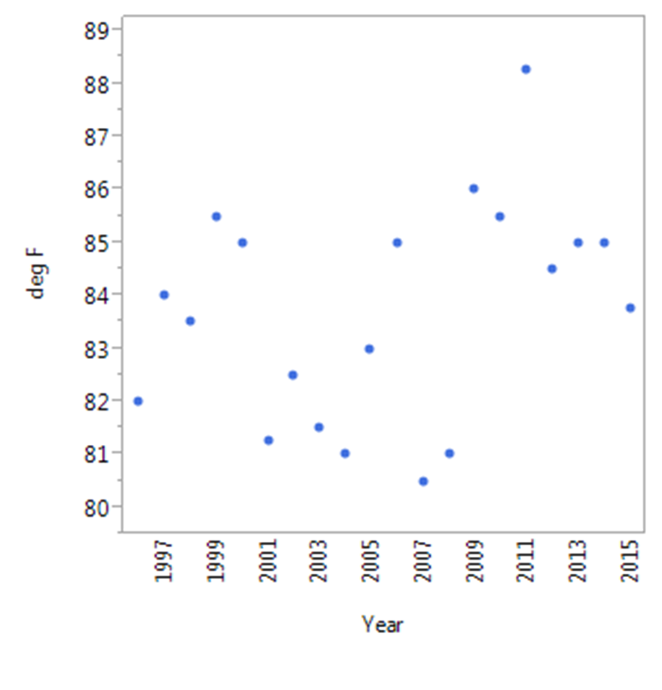
Scent – Median Temperature in August

Slide 44
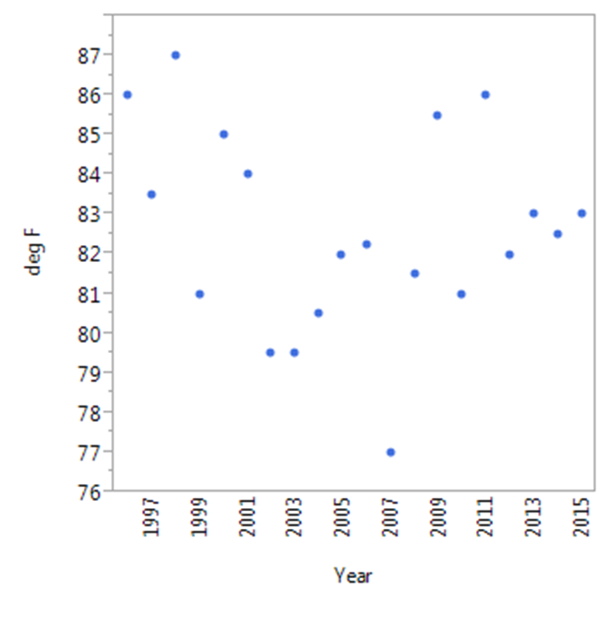
Scent – Median Temperature in July

Slide 45
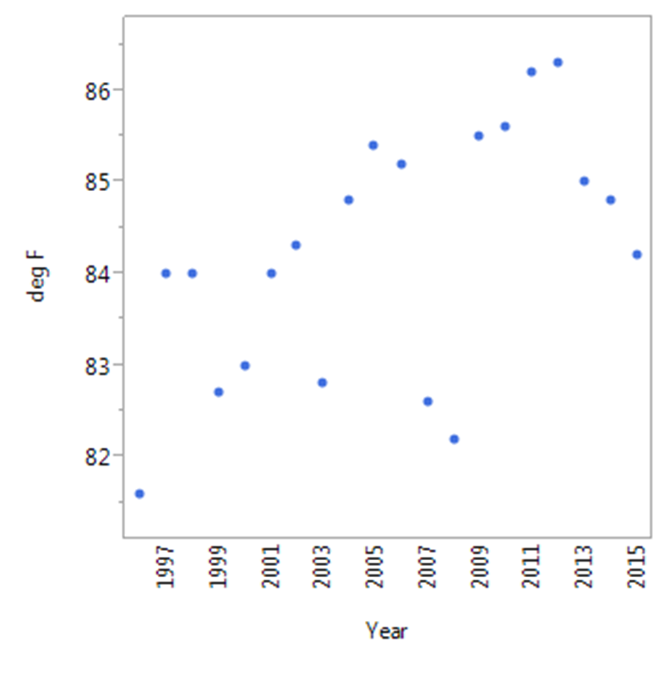
South – Median Temperature in August

Slide 46
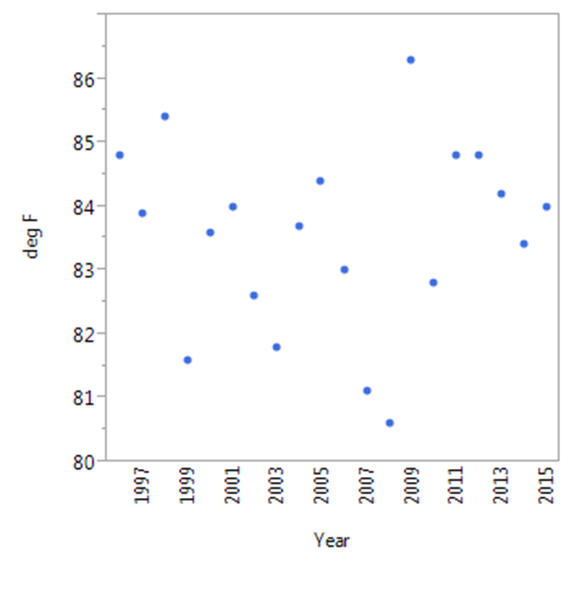
South – Median Temperature in August

