Slide 1
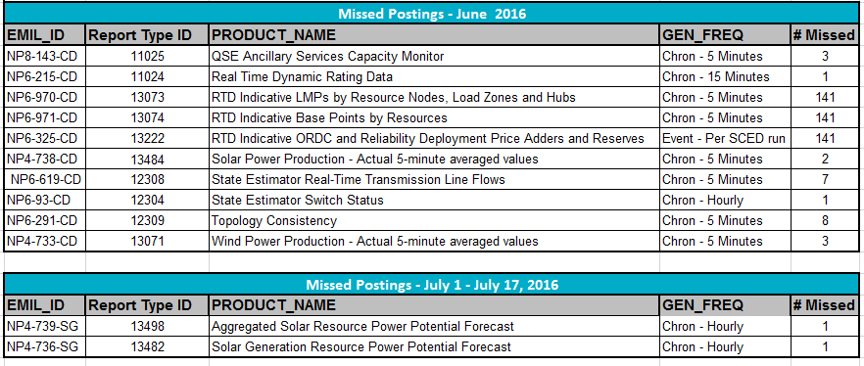
Missed Postings June 2016 through July 17, 2016: Summary

Slide 2
Missed Postings June 2016 through July 17, 2016: Detail

