Slide 1
Settlement Update
Blake Holt
ERCOT
7/25/2016

Slide 2
Agenda
NPRR662
Future Projects

Slide 3
NPRR662- Proxy Energy Offer Curves
Addresses proxy energy offer curves for Resources that submit incomplete curves.
The Protocols currently create an offer at the System-Wide Offer Cap (SWCAP) for certain energy without an associated Energy Offer Curve. This has the effect of withholding energy from Security-Constrained Economic Dispatch (SCED) until prices reach the cap, which can cause irregular pricing outcomes and may signal scarcity when scarcity conditions do not exist.
R4 Go-Live Date (8/30-9/1)

Slide 4
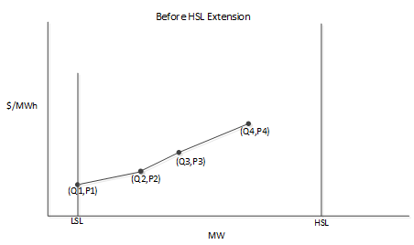
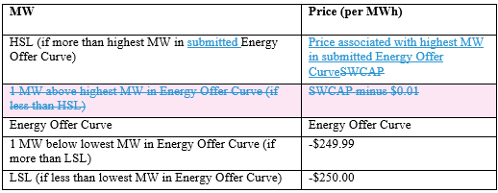
NPRR662- Proxy Energy Offer Curves
6.5.7.3 Security Constrained Economic Dispatch
4. (c) Non-IRRs without full-range Energy Offer Curves For each non-IRR for which its QSE has submitted an Energy Offer Curve that does not cover the full range of the Resource’s available capacity, ERCOT shall create a proxy Energy Offer Curve that extends the submitted Energy Offer Curve to use the entire available capacity of the Resource using the SWCAPabove the highest point on the Energy Offer Curve to the Resource’s HSL and the offer floor from the lowest point on the Energy Offer Curve to its LSL, using these points:
NPRR662 Revision
Scenario

Slide 5
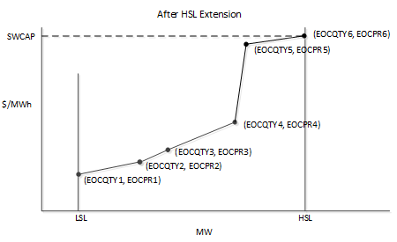
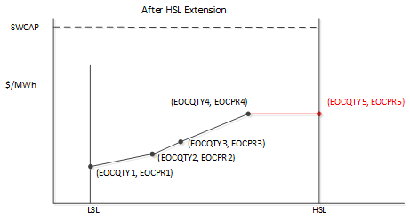
NPRR662- Proxy Energy Offer Curves
6.5.7.3 Security Constrained Economic Dispatch
4. (c) Non-IRRs without full-range Energy Offer Curves For each non-IRR for which its QSE has submitted an Energy Offer Curve that does not cover the full range of the Resource’s available capacity, ERCOT shall create a proxy Energy Offer Curve that extends the submitted Energy Offer Curve to use the entire available capacity of the Resource using the SWCAPabove the highest point on the Energy Offer Curve to the Resource’s HSL and the offer floor from the lowest point on the Energy Offer Curve to its LSL, using these points:
Current Implementation
NPRR662 Implementation

Slide 6
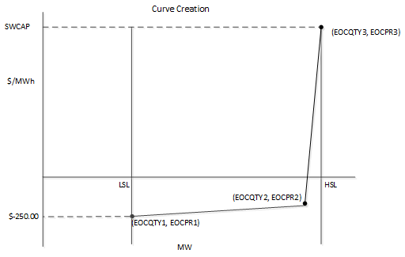
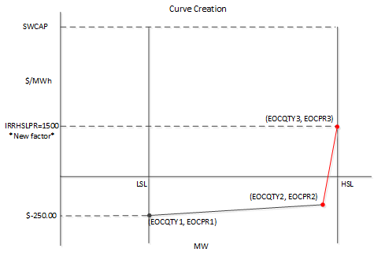
NPRR662- Proxy Energy Offer Curves
6.5.7.3 Security Constrained Economic Dispatch
4. (d) (i) For each IRR that has not submitted an Energy Offer Curve, ERCOT shall create a monotonically increasing proxy Energy Offer Curve as described below:
Current Implementation
NPRR662 Implementation

Slide 7
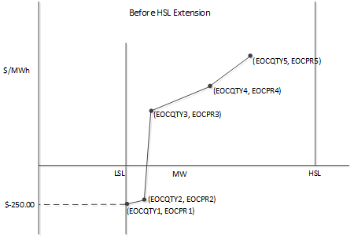
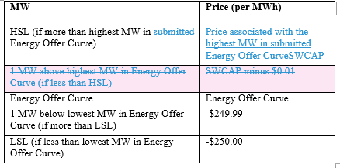
NPRR662- Proxy Energy Offer Curves
6.5.7.3 Security Constrained Economic Dispatch
4. (d) (ii) For each IRR for which its QSE has submitted an Energy Offer Curve that does not cover the full range of the IRR’s available capacity, ERCOT shall create a monotonically increasing proxy Energy Offer Curve as described below:
NPRR662 Revision
Scenario

Slide 8
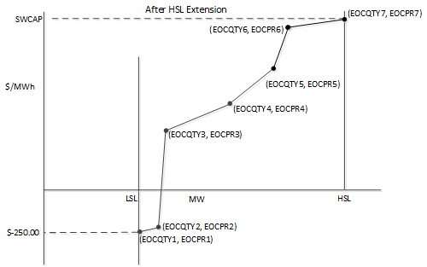
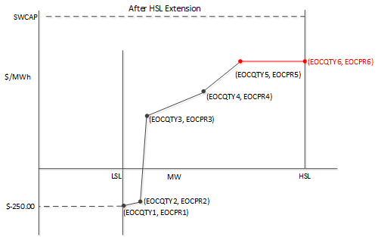
NPRR662- Proxy Energy Offer Curves
6.5.7.3 Security Constrained Economic Dispatch
4. (d) (ii) For each IRR for which its QSE has submitted an Energy Offer Curve that does not cover the full range of the IRR’s available capacity, ERCOT shall create a monotonically increasing proxy Energy Offer Curve as described below:
Current Implementation
NPRR662 Implementation

Slide 9
What’s on the horizon?
NPRR | Description | Release | Timeframe | Discussion
NPRR272 | Definition and Participation of QSGRs | R6 | DEC-2016 | NOV-2016

